Slide 1


CodeRefine:
The Future of Autonomous Code Review
Leveraging Llama 3.3 70B & Groq for Ultra-Fast Code Optimization
Team ZeroBugAuthority: A. Rishitha • Almisbah • Safura Minhaj
• S.Lakshmi Chandana • B.Navya
Notes:
1

Slide 2

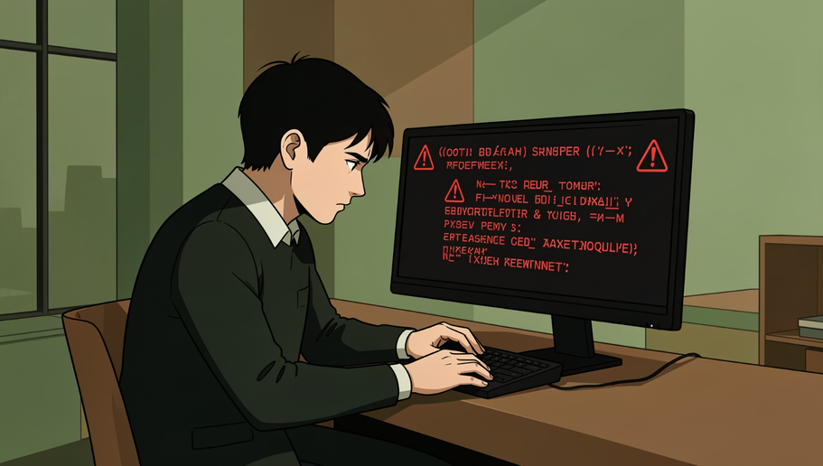
CRITICAL CHALLENGE
Glacial Review Cycles
The Developer's Bottleneck
Traditional code reviews take hours or days, blocking deployment pipelines and slowing innovation velocity.
Surface-Level Analysis
Static linters catch syntax errors but completely miss deep logical flaws, security vulnerabilities, and architectural issues.
Security Time Bombs
SQL injection attacks, hardcoded API secrets, and authentication bypasses slip through undetected into production.
Notes:
2

Slide 3


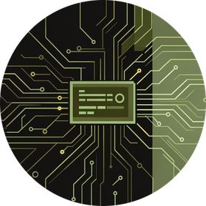

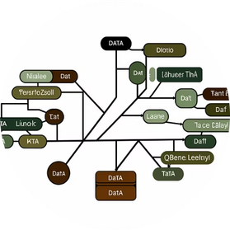
INNOVATION
The Solution: AI Code Guardian
Intent Recognition
Logic Rewriting Engine
Groq Ultra-Low Latency
Transparent AI Reasoning
AI agent decodes what developers meant to build, not just what they wrote, ensuring alignment with best practices.
Autonomous refactoring transforms problematic code into optimized, secure implementations without human intervention.
Millisecond-level feedback powered by Groq LPU infrastructure delivers instant insights during active development.
Thinking Logs expose AST analysis, security pattern detection, and optimization decision-making processes in real-time.
Notes:
3

Slide 4

Technical Architecture
SYSTEM DESIGN
Llama 3.3 70B
Deep semantic model brain
Interactive Diff Viewer
Code Analysis Architecture
Groq LPU Inference
Code comparison panels
High-speed model execution
Tailwind CSS Frontend
FastAPI Backend
Request handling & orchestration
Responsive UI styling
Our system leverages cutting-edge AI infrastructure for seamless code analysis. The Llama 3.3 70B model provides deep semantic understanding, while Groq's LPU delivers unprecedented inference speeds. FastAPI handles efficient request routing, and our Tailwind-powered frontend presents actionable insights through an intuitive diff viewer interface.
Notes:
4

Slide 5
Demo Highlights & Innovation
Before: Vulnerable Code
After: AI-Optimized
// SQL Injection Risk
query = "SELECT * FROM users
WHERE id=" + userId;
// Hardcoded Secret
apiKey = "sk_live_abc123";
// O(n²) Algorithm
for(i=0; i<n; i++)
for(j=0; j<n; j++)
sum += arr[i][j];
// Parameterized Query
query = db.prepare(
"SELECT * FROM users
WHERE id=?", [userId]);
// Environment Variable
apiKey = process.env.API_KEY;
// O(n) Optimized
sum = arr.flat()
.reduce((a,b) => a+b, 0);
OWASP Top 10 Detection
Auto-Rewrite Engine
Performance Profiling
GitHub PR Integration
Identifies injection flaws, broken authentication, XSS, and all critical security vulnerabilities instantly.
Generates production-ready secure alternatives with complete diff tracking and rollback capability.
Detects algorithmic complexity issues and suggests optimized implementations for scalability.
Automated comments on pull requests with inline suggestions and security scoring metrics.
Notes:
5

Slide 6
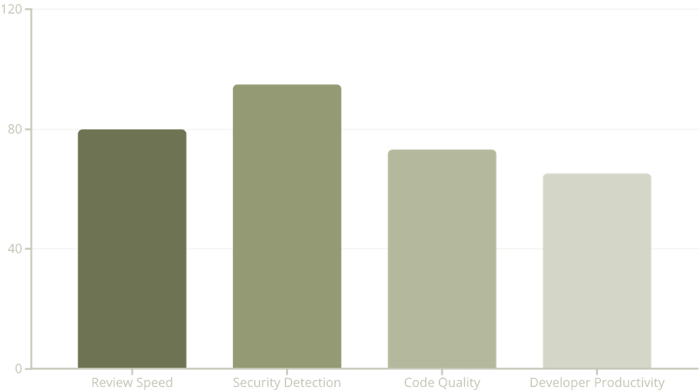




Impact & Measurable Benefits
80% Faster Reviews
From hours to minutes—instant feedback loops accelerate deployment cycles and reduce context-switching overhead.
Security Reliability
Comprehensive vulnerability scanning eliminates entire classes of exploits before they reach production environments.
Scalable Architecture
Cleaner, optimized code handles exponential growth without infrastructure rewrites or performance degradation.
Developer Velocity
Teams ship features faster with confidence, spending time on innovation instead of manual security audits.
Notes:
6

Slide 7
The Future of Code Intelligence
Q1 2026: CI/CD Native
Q3 2026: Intelligent Co-Pilot
Seamless integration with Jenkins, GitHub Actions, and GitLab pipelines for automated gate-keeping.
Predictive coding assistance that writes secure, optimized code alongside developers in real-time.
1
2
3
Q2 2026: Repository Analysis
Multi-file dependency tracking, cross-module vulnerability detection, and architectural pattern recognition.
"Making bugs a thing of the past, one commit at a time"
Notes:
7

Slide 8
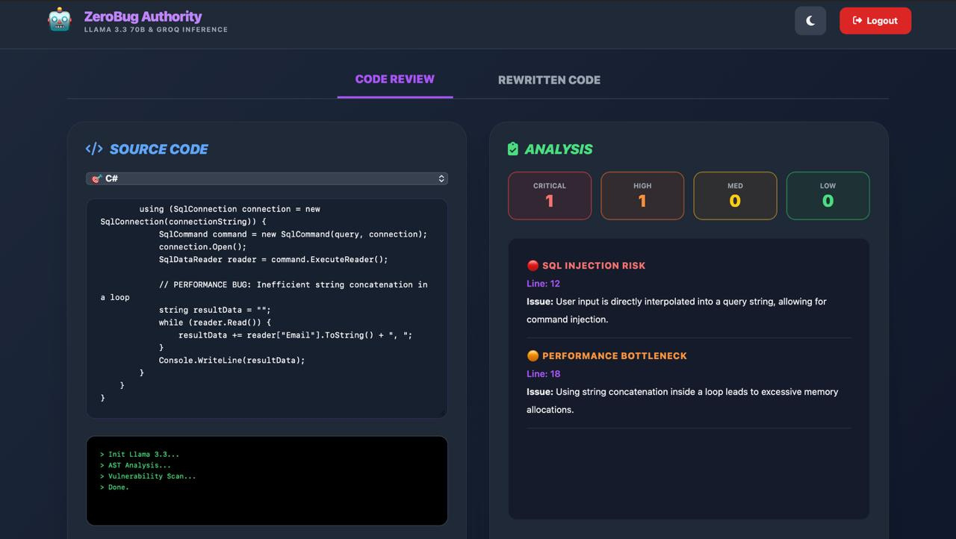
Notes:
7

Slide 9
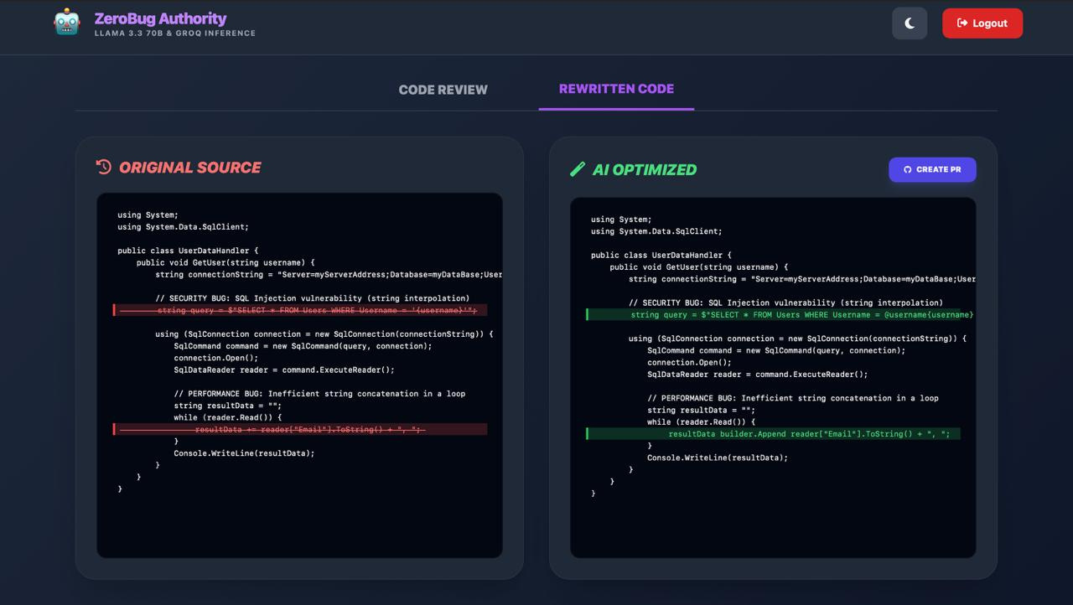
OUTPUT
Notes:
7

Slide 10
Thank you! 🚀
Team: ZeroBugAuthority
Notes:
7

