Slide 1
Chapter 10
Component-Level Design
Slide Set to accompany
Software Engineering: A Practitioner’s Approach, 8/e
by Roger S. Pressman and Bruce R. Maxim
Slides copyright © 1996, 2001, 2005, 2009, 2014 by Roger S. Pressman
For non-profit educational use only
May be reproduced ONLY for student use at the university level when used in conjunction with Software Engineering: A Practitioner's Approach, 8/e. Any other reproduction or use is prohibited without the express written permission of the author.
All copyright information MUST appear if these slides are posted on a website for student use.

Slide 2
What is a Component?
OMG Unified Modeling Language Specification [OMG01] defines a component as
  “… a modular, deployable, and replaceable part of a system that encapsulates implementation and exposes a set of interfaces.””
OO view: a component contains a set of collaborating classes
Conventional view: a component contains processing logic, the internal data structures that are required to implement the processing logic, and an interface that enables the component to be invoked and data to be passed to it.

Slide 3
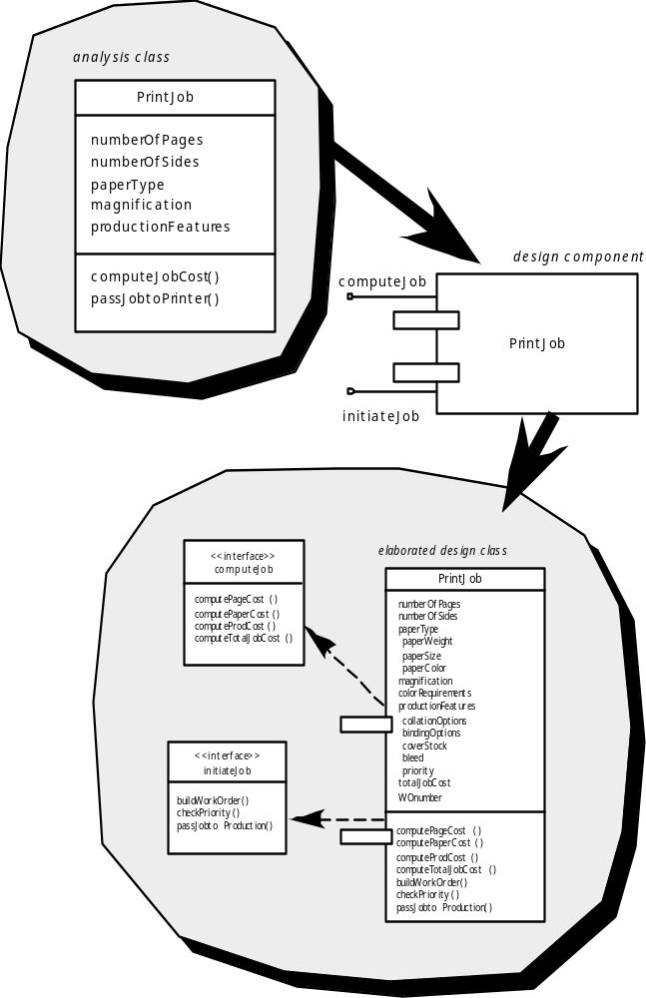
OO Component

Slide 4
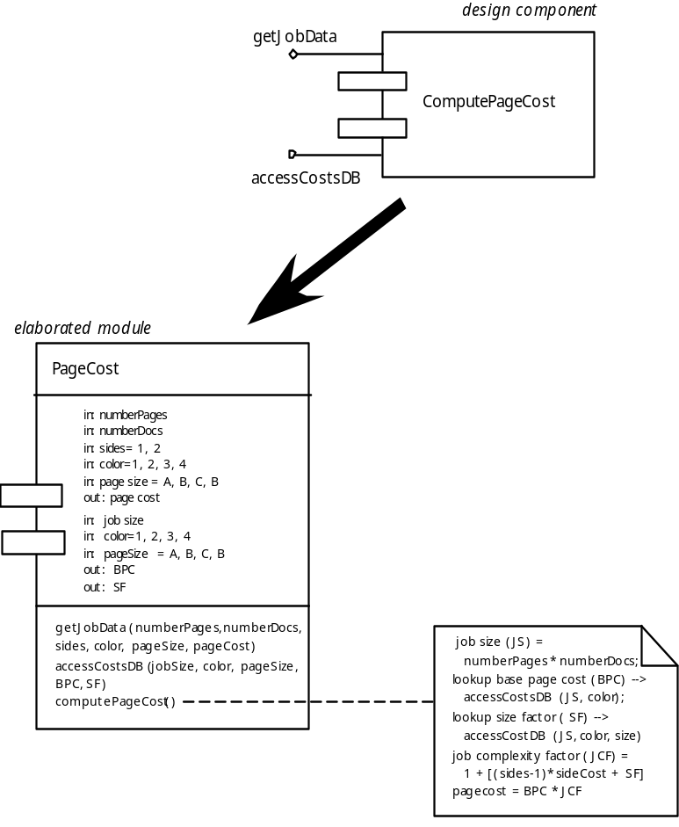
Conventional Component

Slide 5
Design Guidelines
Components
  Naming conventions should be established for components that are specified as part of the architectural model and then refined and elaborated as part of the component-level model
Interfaces
  Interfaces provide important information about communication and collaboration
Dependencies and Inheritance
  it is a good idea to model dependencies from left to right and inheritance from bottom (derived classes) to top (base classes).

Slide 6
Cohesion
Conventional view:
  the “single-mindedness” of a module
OO view:
  cohesion implies that a component or class encapsulates only attributes and operations that are closely related to one another and to the class or component itself
Levels of cohesion
  Functional
  Layer
  Communicational
  Sequential
  Procedural
  Temporal
  utility

Slide 7
Coupling
Conventional view:
  The degree to which a component is connected to other components and to the external world
OO view:
  a qualitative measure of the degree to which classes are connected to one another
Level of coupling
  Content
  Common
  Control
  Stamp
  Data
  Routine call
  Type use
  Inclusion or import
  External

Slide 8
Component Design for WebApps
WebApp component is
  (1) a well-defined cohesive function that manipulates content or provides computational or data processing for an end-user, or
  (2) a cohesive package of content and functionality that provides end-user with some required capability.
Therefore, component-level design for WebApps often incorporates elements of content design and functional design.

Slide 9
Content Design for WebApps
focuses on content objects and the manner in which they may be packaged for presentation to a WebApp end-user
consider a Web-based video surveillance capability within SafeHomeAssured.com
  potential content components can be defined for the video surveillance capability:
    (1) the content objects that represent the space layout (the floor plan) with additional icons representing the location of sensors and video cameras;
    (2) the collection of thumbnail video captures (each an separate data object), and
    (3) the streaming video window for a specific camera.
  Each of these components can be separately named and manipulated as a package.

Slide 10
Functional Design for WebApps
Modern Web applications deliver increasingly sophisticated processing functions that:
  (1) perform localized processing to generate content and navigation capability in a dynamic fashion;
  (2) provide computation or data processing capability that is appropriate for the WebApp’s business domain;
  (3) provide sophisticated database query and access, or
  (4) establish data interfaces with external corporate systems.
To achieve these (and many other) capabilities, you will design and construct WebApp functional components that are identical in form to software components for conventional software.

Slide 11
Designing Conventional Components
The design of processing logic is governed by the basic principles of algorithm design and structured programming
The design of data structures is defined by the data model developed for the system
The design of interfaces is governed by the collaborations that a component must effect

Slide 12
Algorithm Design
the closest design activity to coding
the approach:
  review the design description for the component
  use stepwise refinement to develop algorithm
  use structured programming to implement procedural logic
  use ‘formal methods’ to prove logic

Slide 13
Stepwise Refinement
open
walk to door;
reach for knob;
open door;
repeat until door opens
turn knob clockwise;
walk through;
if knob doesn't turn, then
close door.
take key out;
find correct key;
insert in lock;
endif
pull/push door
move out of way;
end repeat

Slide 14
Algorithm Design Model
represents the algorithm at a level of detail that can be reviewed for quality
options:
  graphical (e.g. flowchart, box diagram)
  pseudocode (e.g., PDL) ... choice of many
  programming language
  decision table

Slide 15
Structured Programming
uses a limited set of logical constructs:
sequence
conditional
— if-then-else, select-case
loops
— do-while, repeat until
leads to more readable, testable code
can be used in conjunction with ‘proof of correctness’
important for achieving high quality,
but not enough

Slide 16
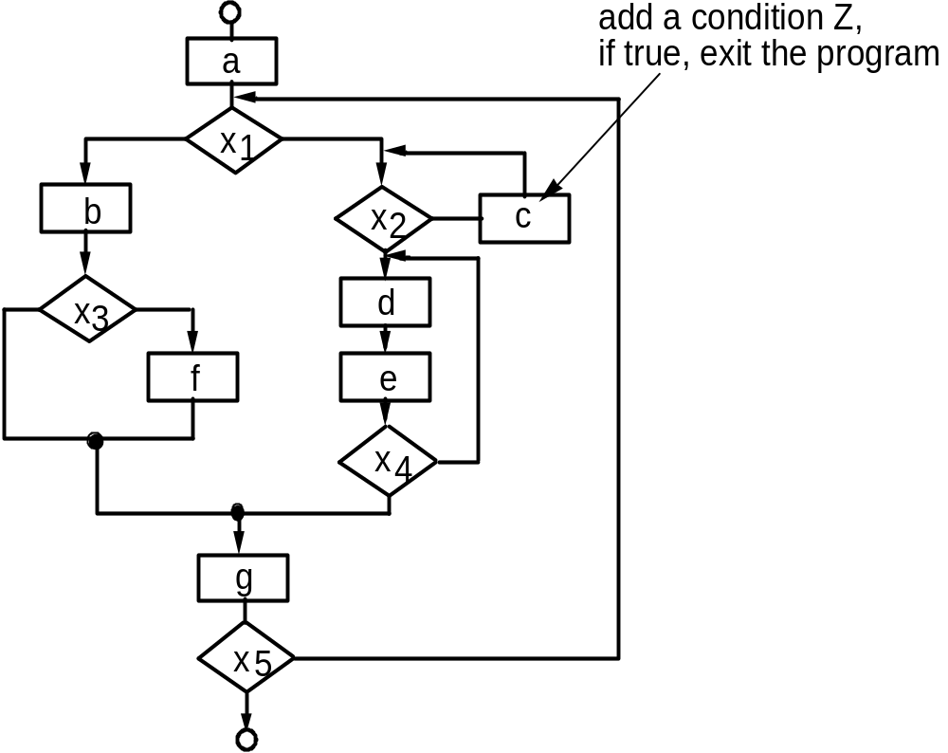
A Structured Procedural Design

Slide 17
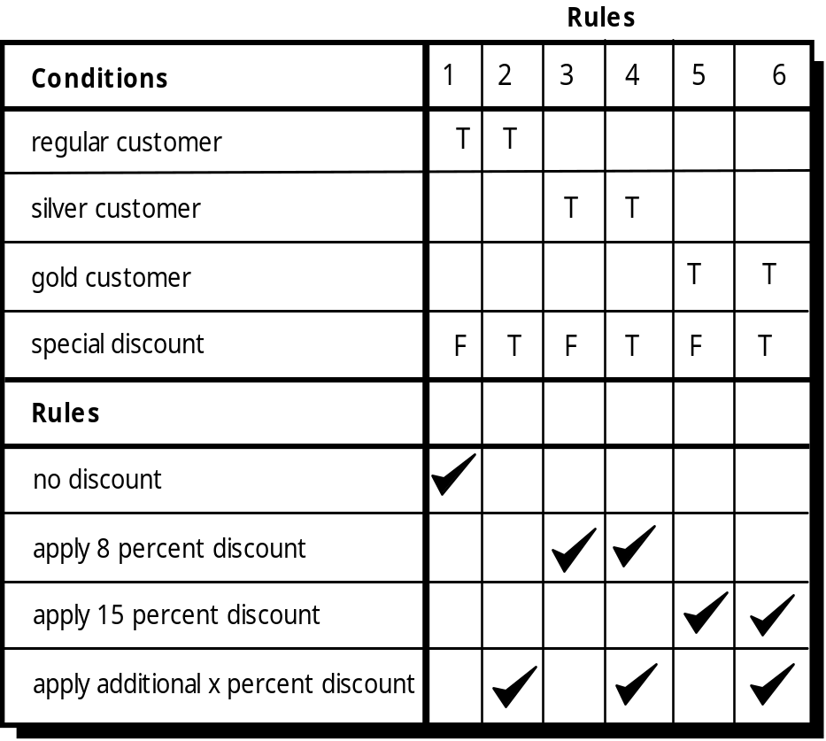
Decision Table

Slide 18
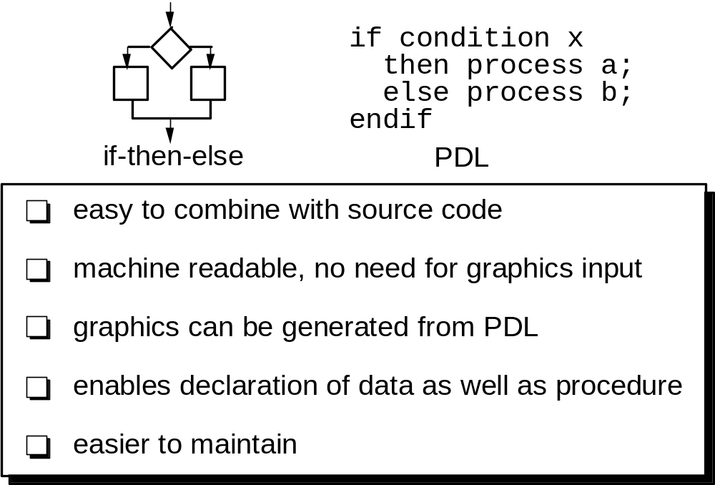
Program Design Language (PDL)

Slide 19
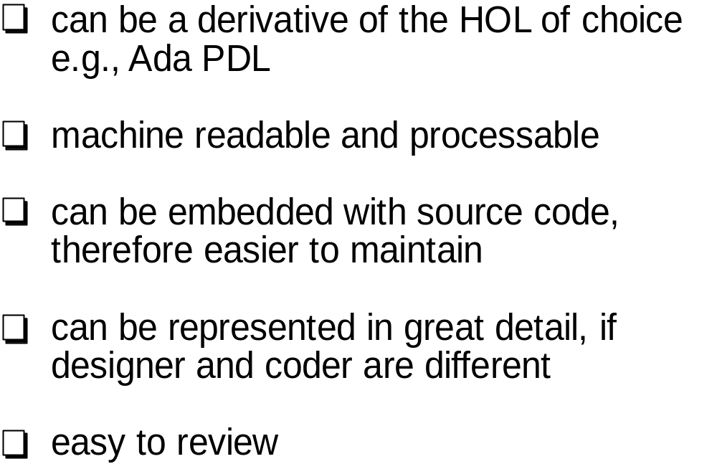
Why Design Language?
Higher Order Language (HOL)

Slide 20
Component-Based Development
When faced with the possibility of reuse, the software team asks:
  Are commercial off-the-shelf (COTS) components available to implement the requirement?
  Are internally-developed reusable components available to implement the requirement?
  Are the interfaces for available components compatible within the architecture of the system to be built?

Slide 21
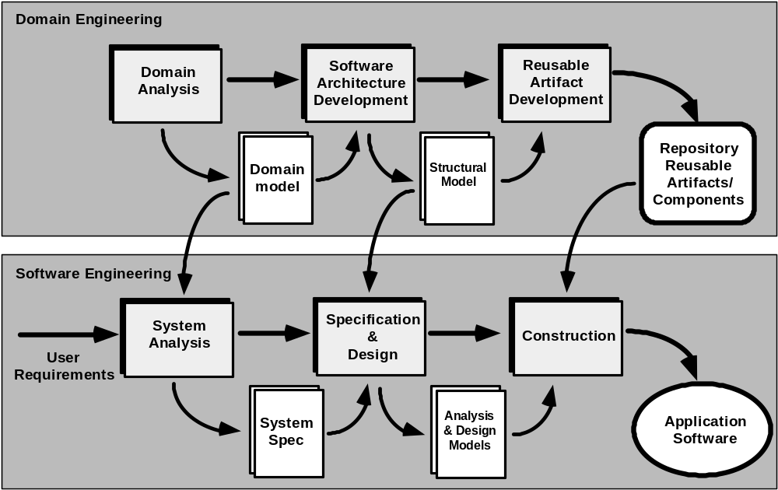
The CBSE Process

Slide 22
Domain Engineering
1. Define the domain to be investigated.
2. Categorize the items extracted from the domain.
3. Collect a representative sample of applications in the domain.
4. Analyze each application in the sample.
5. Develop an analysis model for the objects.

Slide 23
Component-Based SE
a library of components must be available
components should have a consistent structure
a standard should exist, e.g.,
  OMG/CORBA
  Microsoft COM
  Sun JavaBeans

Slide 24
CBSE Activities
Component qualification
Component adaptation
Component composition
Component update

Slide 25
Qualification
Before a component can be used, you must consider:
• application programming interface (API)
• development and integration tools required by the component
• run-time requirements including resource usage (e.g., memory or storage), timing or speed, and network protocol
• service requirements including operating system interfaces and support from other components
• security features including access controls and authentication protocol
• embedded design assumptions including the use of specific numerical or non-numerical algorithms
• exception handling

Slide 26
Adaptation
The implication of “easy integration” is:
(1) that consistent methods of resource management have been implemented for all components in the library;
(2) that common activities such as data management exist for all components, and
(3) that interfaces within the architecture and with the external environment have been implemented in a consistent manner.

Slide 27
Composition
An infrastructure must be established to bind components together
Architectural ingredients for composition include:
  Data exchange model
  Automation
  Structured storage
  Underlying object model

Slide 28
OMG/ CORBA
The Object Management Group has published a common object request broker architecture (OMG/CORBA).
An object request broker (ORB) provides services that enable reusable components (objects) to communicate with other components, regardless of their location within a system.
Integration of CORBA components (without modification) within a system is assured if an interface definition language (IDL) interface is created for every component.
Objects within the client application request one or more services from the ORB server. Requests are made via an IDL or dynamically at run time.
An interface repository contains all necessary information about the service’s request and response formats.

Slide 29
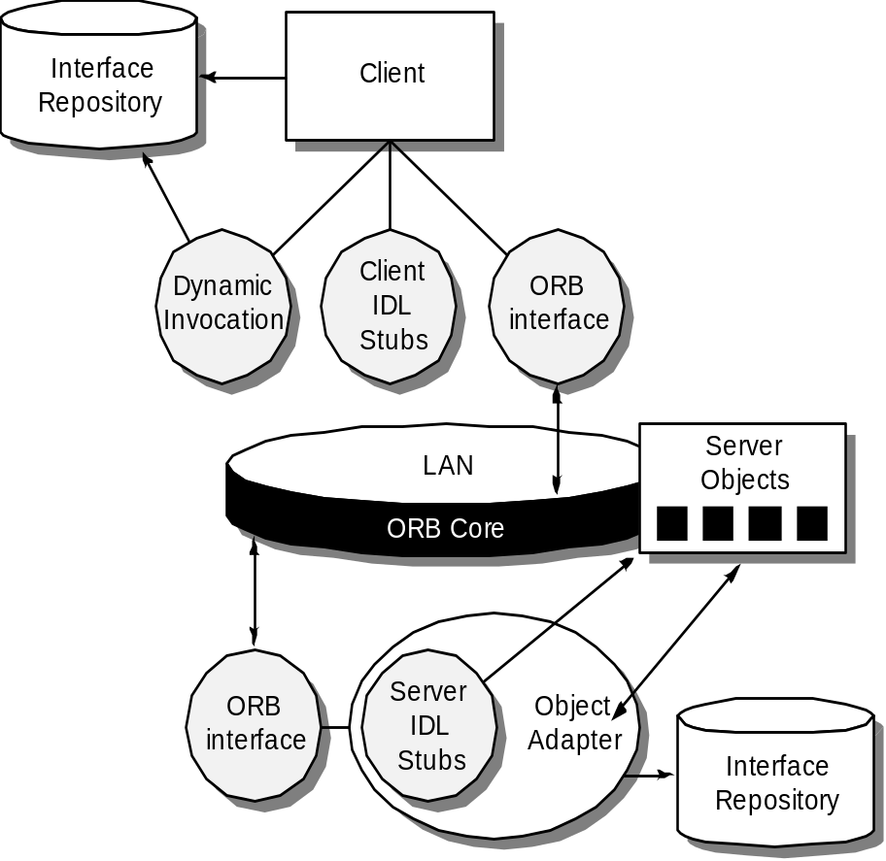
ORB Architecture

Slide 30
Microsoft COM
The component object model (COM) provides a specification for using components produced by various vendors within a single application running under the Windows operating system.
COM encompasses two elements:
  COM interfaces (implemented as COM objects)
  a set of mechanisms for registering and passing messages between COM interfaces.

Slide 31
Sun JavaBeans
The JavaBeans component system is a portable, platform independent CBSE infrastructure developed using the Java programming language.
The JavaBeans component system encompasses a set of tools, called the Bean Development Kit (BDK), that allows developers to
  analyze how existing Beans (components) work
  customize their behavior and appearance
  establish mechanisms for coordination and communication
  develop custom Beans for use in a specific application
  test and evaluate Bean behavior.

Slide 32
The Reuse Environment
A component database capable of storing software components and the classification information necessary to retrieve them.
A library management system that provides access to the database.
A software component retrieval system (e.g., an object request broker) that enables a client application to retrieve components and services from the library server.
CBSE tools that support the integration of reused components into a new design or implementation.

