Slide 1
Chapter 6
Requirements Modeling: Scenarios, Information, and Analysis Classes
Slide Set to accompany
Software Engineering: A Practitioner’s Approach, 8/e
by Roger S. Pressman and Bruce R. Maxim
Slides copyright © 1996, 2001, 2005, 2009, 2014 by Roger S. Pressman
For non-profit educational use only
May be reproduced ONLY for student use at the university level when used in conjunction with Software Engineering: A Practitioner's Approach, 8/e. Any other reproduction or use is prohibited without the express written permission of the author.
All copyright information MUST appear if these slides are posted on a website for student use.

Slide 2
Requirements Analysis
Requirements analysis
  specifies software’s operational characteristics
  indicates software's interface with other system elements
  establishes constraints that software must meet
Requirements analysis allows the software engineer (called an analyst or modeler in this role) to:
  elaborate on basic requirements established during earlier requirement engineering tasks
  build models that depict user scenarios, functional activities, problem classes and their relationships, system and class behavior, and the flow of data as it is transformed.

Slide 3
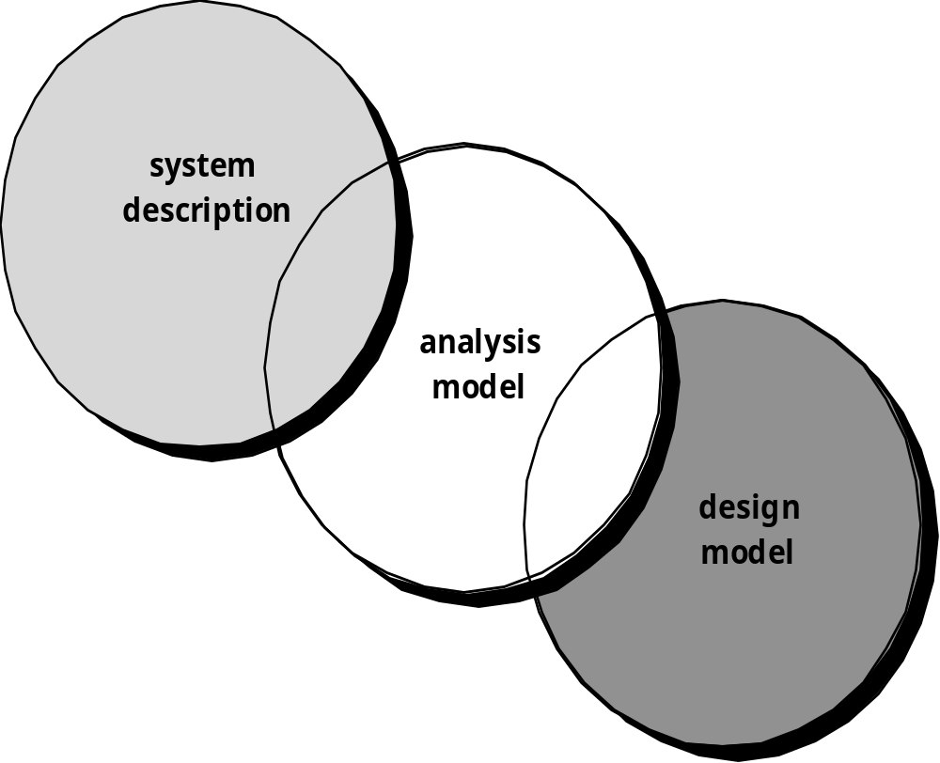
A Bridge

Slide 4
Rules of Thumb
The model should focus on requirements that are visible within the problem or business domain. The level of abstraction should be relatively high.
Each element of the analysis model should add to an overall understanding of software requirements and provide insight into the information domain, function and behavior of the system.
Delay consideration of infrastructure and other non-functional models until design.
Minimize coupling throughout the system.
Be certain that the analysis model provides value to all stakeholders.
Keep the model as simple as it can be.
Note: Functional requirements define specific behavior or functions, while non-functional requirement is a requirement that specifies criteria that can be used to judge the operation of a system, rather than specific behaviors.

Slide 5
Domain Analysis
Define the domain to be investigated.
Collect a representative sample of applications in the domain.
Analyze each application in the sample.
Develop an analysis model for the objects.

Slide 6
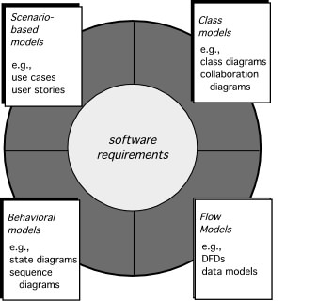
Elements of Requirements Analysis

Slide 7
Scenario-Based Modeling
“[Use-cases] are simply an aid to defining what exists outside the system (actors) and what should be performed by the system (use-cases).” Ivar Jacobson
  (1) What should we write about?
  (2) How much should we write about it?
  (3) How detailed should we make our description?
  (4) How should we organize the description?

Slide 8
What to Write About?
Quality Function Deployment (QFD) is a structured approach to defining customer needs or requirements and translating them into specific plans to produce products to meet those needs.
Inception and elicitation—provide you with the information you’ll need to begin writing use cases.
Requirements gathering meetings, QFD, and other requirements engineering mechanisms are used to
  identify stakeholders
  define the scope of the problem
  specify overall operational goals
  establish priorities
  outline all known functional requirements, and
  describe the things (objects) that will be manipulated by the system.
To begin developing a set of use cases, list the functions or activities performed by a specific actor.

Slide 9
How Much to Write About?
As further conversations with the stakeholders progress, the requirements gathering team develops use cases for each of the functions noted.
In general, use cases are written first in an informal narrative fashion.
If more formality is required, the same use case is rewritten using a structured format similar to the one proposed.

Slide 10
Use-Cases
a scenario that describes a “thread of usage” for a system
actors represent roles people or devices play as the system functions
users can play a number of different roles for a given scenario

Slide 11
Building an ERD
Level 1—model all data objects (entities) and their “connections” to one another
Level 2—model all entities and relationships
Level 3—model all entities, relationships, and the attributes that provide further depth

Slide 12
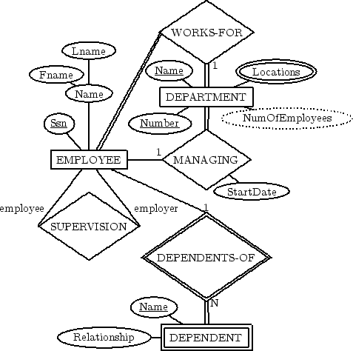
The ERD: An Example
(1,1)

Slide 13
Class-Based Modeling
Class-based modeling represents:
  objects that the system will manipulate
  operations (also called methods or services) that will be applied to the objects to effect the manipulation
  relationships (some hierarchical) between the objects
  collaborations that occur between the classes that are defined.
The elements of a class-based model include classes and objects, attributes, operations, CRC (class responsibility colloborator) models, collaboration diagrams and packages.

Slide 14
CRC Models
Class-responsibility-collaborator (CRC) modeling [Wir90] provides a simple means for identifying and organizing the classes that are relevant to system or product requirements. Ambler [Amb95] describes CRC modeling in the following way:
  A CRC model is really a collection of standard index cards that represent classes. The cards are divided into three sections. Along the top of the card you write the name of the class. In the body of the card you list the class responsibilities on the left and the collaborators on the right.

Slide 15
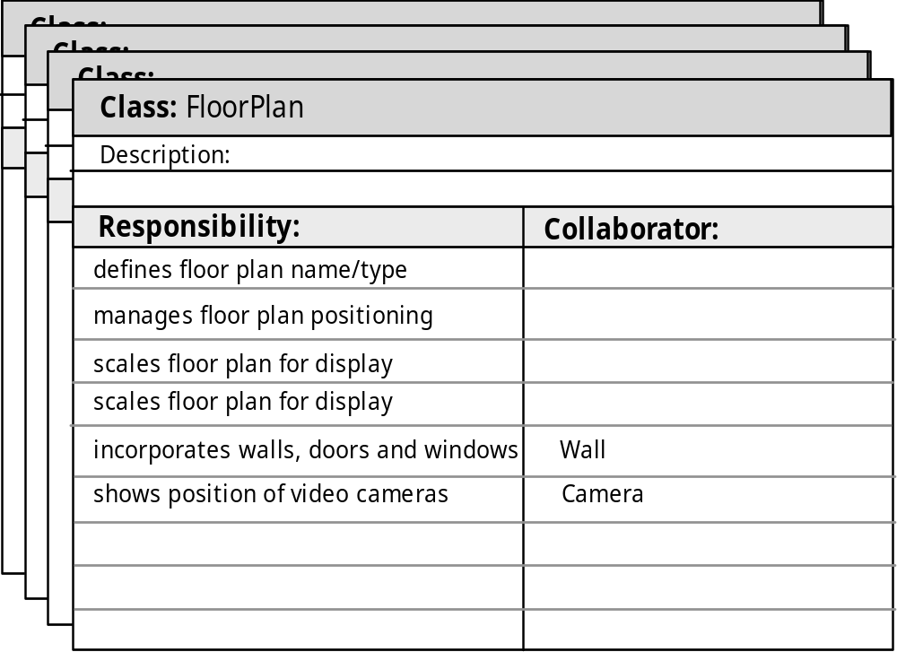
CRC Modeling

