Slide 1
Use Case Diagrams

Slide 2
Use Cases
What is a Use Case
  A formal way of representing how a business system interacts with its environment
  Illustrates the activities that are performed by the users of the system
  A scenario-based technique in the UML
  A sequence of actions a system performs that yields a valuable result for a particular actor.

Slide 3
Use Case Analysis
What is an Actor?
  A user or outside system that interacts with the system being designed in order to obtain some value from that interaction
Use Cases describe scenarios that describe the interaction between users of the system (the actor) and the system itself.

Slide 4
Use Cases
Use case diagrams describe what a system does from the standpoint of an external observer. The emphasis is on what a system does rather than how.
Use case diagrams are closely connected to scenarios. A scenario is an example of what happens when someone interacts with the system.

Slide 5
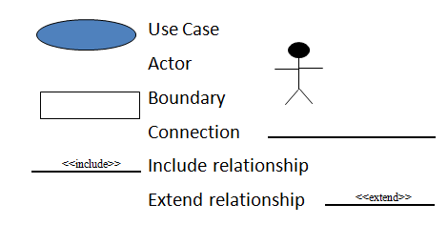
UML Use Case Diagram Symbols

Slide 6
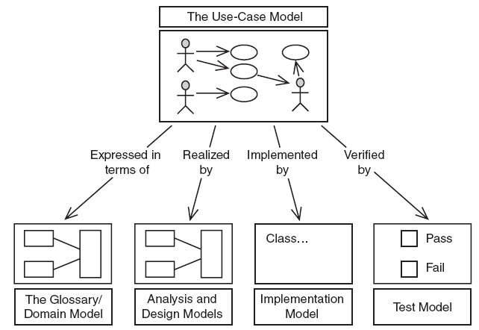
Usages of a Use Case Model
Notes:
Object-Oriented Analysis - Instructor Notes
Module 2 – Modeling System Behavior with Use Cases

Slide 7
Use Cases (Example)
Here is a scenario for a medical clinic.
A patient calls the clinic to make an appointment for a yearly checkup. The receptionist finds the nearest empty time slot in the appointment book and schedules the appointment for that time slot. "
We want to write a use case for this scenario.
Remember: A use case is a summary of scenarios for a single task or goal.

Slide 8
Use Cases
Step 1 Identify the actors
As we read the scenario, define those people or systems that are going to interact with the scenario.
A patient calls the clinic to make an appointment for a yearly checkup. The receptionist finds the nearest empty time slot in the appointment book and schedules the appointment for that time slot. "

Slide 9
Actors
An Actor is outside or external the system.
It can be a:
  Human
  Peripheral device (hardware)
  External system or subsystem
  Time or time-based event
Represented by stick figure

Slide 10
Use Cases
A use case is a summary of scenarios for a single task or goal.
An actor is who or what initiates the events involved in the task of the use case. Actors are simply roles that people or objects play.
So as we read our scenario, what or who is the actor????

Slide 11

Use Cases
A patient calls the clinic to make an appointment for a yearly checkup. The receptionist finds the nearest empty time slot in the appointment book and schedules the appointment for that time slot. "
The actor is a Patient.

Slide 12
Use Cases
The use case is a summary of scenarios for a single task or goal.
So What is the Use Case????
The Use Case is Make Appointment.
It is a use case for the medical clinic.

Slide 13

Use Cases
The picture below is a Make Appointment use case for the medical clinic.
The actor is a Patient. The connection between actor and use case is a communication association (or communication for short).
Actors are stick figures. Use cases are ovals. Communications are lines that link actors to use cases.
Actors are stick figures. Use cases are ovals. Communications are lines that link actors to use cases.
Actors are stick figures. Use cases are ovals. Communications are lines that link actors to use cases.

Slide 14
Use Case Components
The use case has three components.
The use case task referred to as the use case that represents a feature needed in a software system.
The actor(s) who trigger the use case to activate.
The communication line to show how the actors communicate with the use case.

Slide 15
Use Case Diagram - Use Case
A major process performed by the system that benefits an actor(s) in some way
Models a dialogue between an actor and the system
Represents the functionality provided by the system
Notes:
Use Case
Represent the user functionality (not system functionality)

Slide 16
Use Case
Each use case in a use case diagram describes one and only one function in which users interact with the system
  May contain several “paths” that a user can take while interacting with the system
  Each path is referred to as a scenario

Slide 17
Use Case
Labelled using a descriptive verb-noun phrase
Represented by an oval
Make
Appointment

Slide 18
Use Case - Actor
Labelled using a descriptive noun or phrase
Represented by a stick character

Slide 19
Use Case - Relationships
Relationships
  Represent communication between actor and use case
  Depicted by line or double-headed arrow line
  Also called association relationship
Make
Appointment
Notes:
Use Case Relationship
Association relationship
May exist between actor and a use case
Often referred to as a communicate association
Navigable in both directions (actor to use case and use case to actor)
Some use just a line
Others use a double-headed arrowhead
Navigable in only one direction (actor to use case OR use case to actor)
Use a arrowhead where arrowhead denotes the direction of communication
Navigation direction of an association represents who is initiating the communication
Multiplicity
Not consistency shown on all use-case diagrams (Some do; some don’t)

Slide 20
Use Case - Relationships
Boundary
  A boundary rectangle is placed around the perimeter of the system to show how the actors communicate with the system.
Make
Appointment

Slide 21
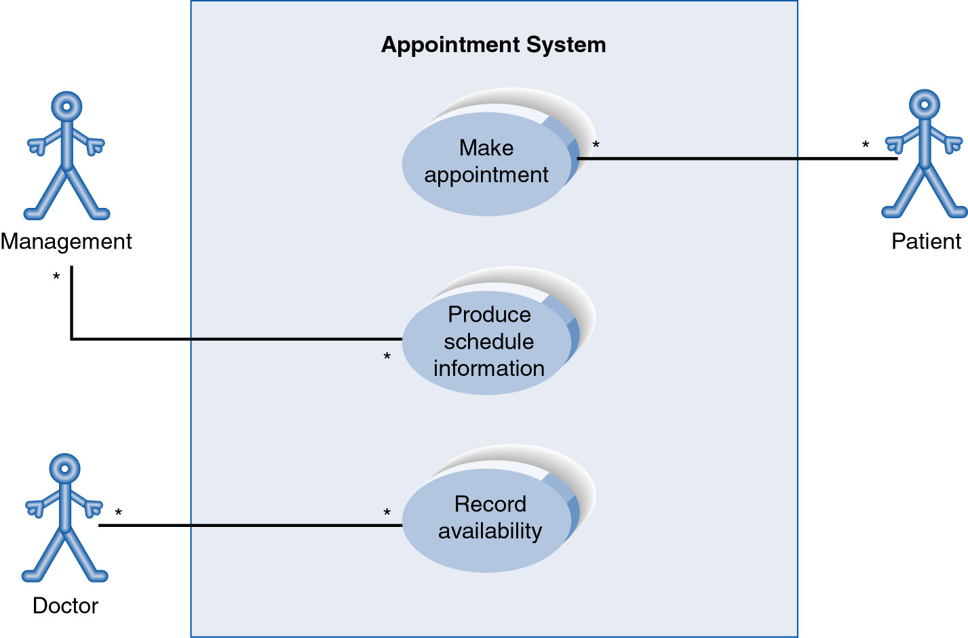
Use-Case Diagram
A use case diagram is a collection of actors, use cases, and their communications.

Slide 22
Use Case Diagram
Other Types of Relationships for Use Cases
  Generalization
  Include
  Extend
Notes:
Inheritance

Slide 23
Components of Use Case Diagram
Generalization Relationship
  Represented by a line and a hollow arrow
    From child to parent
Child use case
Parent use case

Slide 24
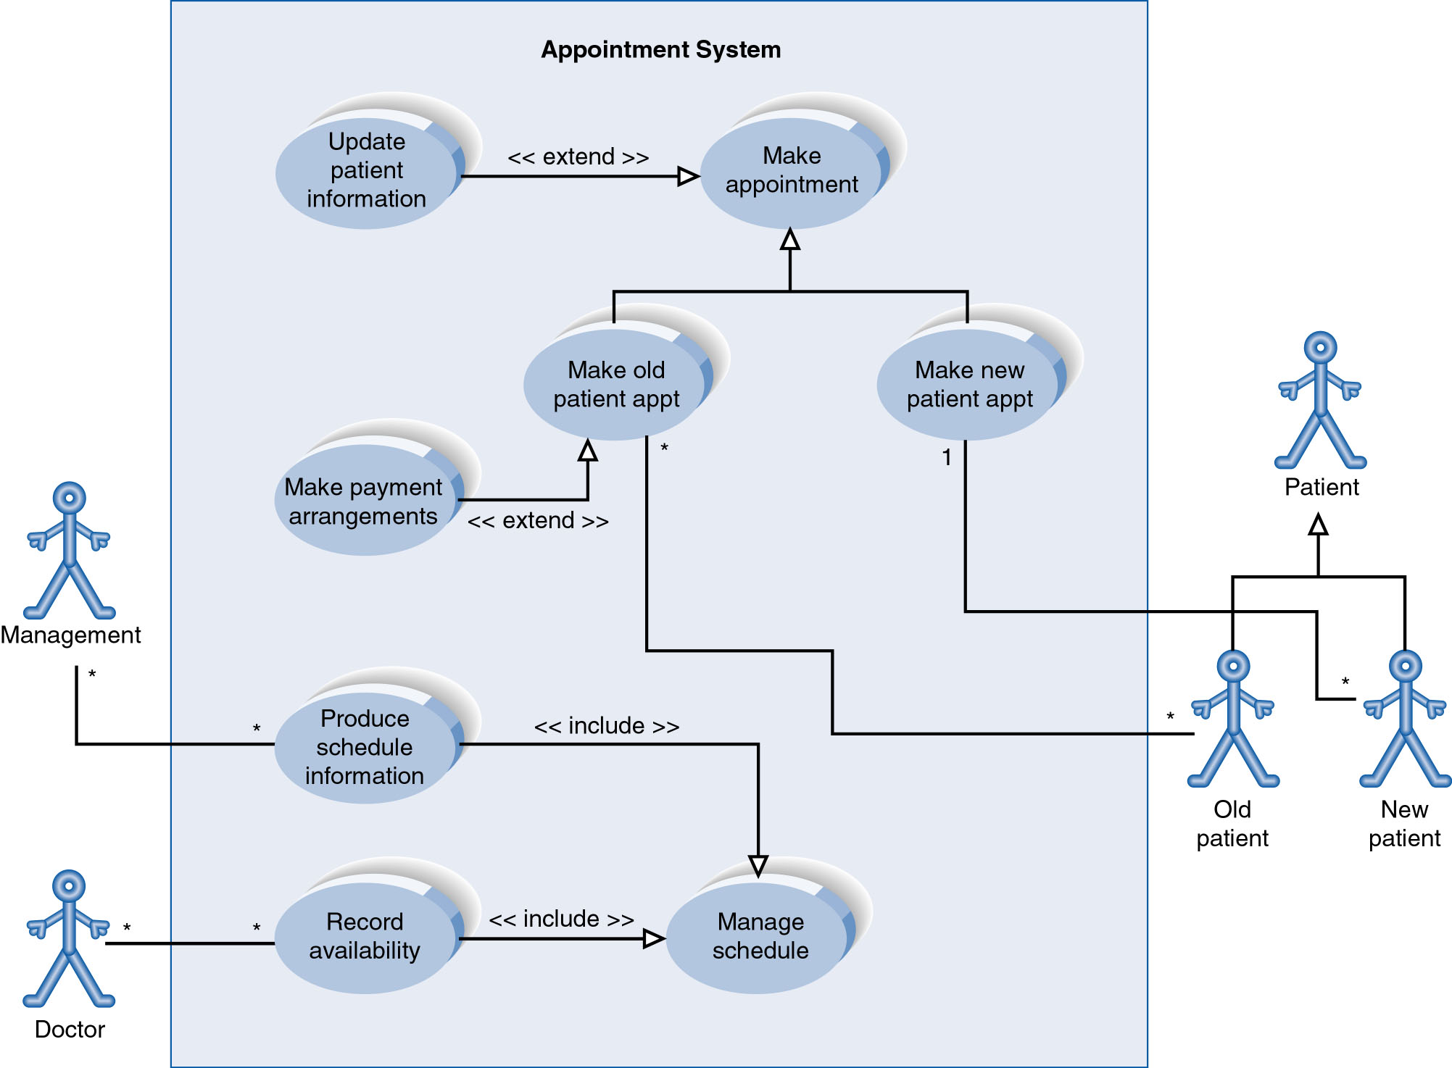
Example of Relationships

Slide 25
Use Case Diagram
Include Relationship
  Represents the inclusion of the functionality of one use case within another
  Arrow is drawn from the base use case to the used use case
  Write << include >> above arrowhead line

Slide 26
Use Case Diagram
Extend relationship
  Represents the extension of the use case to include optional functionality
  Arrow is drawn from the extension use case to the base use case
  Write << extend >> above arrowhead line
Notes:
Use Case Relationship
Extend relationship
Used to show optional behavior (behavior that is run only under certain circumstances)
Depicted by arrowhead with word “<<extend>>” above it
An extend relationship indicates that one use case is a variation of another.
This is often used when much of the same code may be in both only one extends the functionality somewhat.
A typical example is a add record to the database and modify that record.
So an add student is similar to a modify student so I may reuse some of the code.
Extend notation is a dotted line, labeled <<extend>>, and with an arrow toward the base case.
The extension point, which determines when the extended case is appropriate, is written inside the base case.

Slide 27
Use Case Relationships
Pro:
  Reduces redundancy in use cases
  Reduces complexity within a use case
Con
  May introduce complexity to use case diagram

Slide 28
Use-Case Diagrams (POST): Example-2
POST: Point of Sale Terminal
Store
Buy Item
Refund a Purchased Item
Customer
Adapted from Larman “Applying UML and Patterns”

Slide 29
Use-Case Diagrams (POST): Example-2 (Continue)
POST: Point of Sale Terminal
Use Case
POST
System Boundary
Buy Item
Log In
Cashier
Customer
Refund a Purchased Item
Adapted from Larman “Applying UML and Patterns”

Slide 30
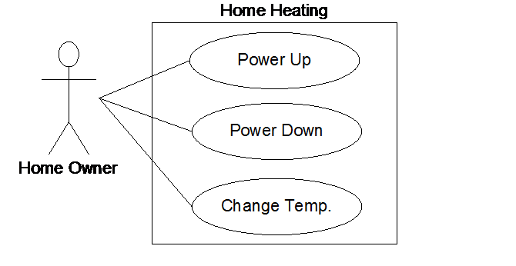
Home Heating Use-Case Diagram (Example-3)
05-Use-Cases

Slide 31
Home Heating Use-Cases (Example-3)
Use case: Power Up
Actors: Home Owner (initiator)
Type: Primary and essential
Description: The Home Owner turns the power on. Each room
is temperature checked. If a room is below the
the desired temperature the valve for the room is
opened, the water pump started. If the water temp falls below threshold, the fuel valve is
opened, and the burner ignited.
If the temperature in all rooms is above the desired
temperature, no actions are taken.
05-Use-Cases

Slide 32
Modified Home Heating (Example-3)
Home Heating
Power Up
Temp. High
«includes»
«includes»
Power Down
Adjust Temp
Home Owner
«includes»
«includes»
Change Temp.
Temp. Low
05-Use-Cases

