Slide 1
Chapter 7
Requirements Modeling: Flow, Behavior, Patterns, and WebApps
Slide Set to accompany
Software Engineering: A Practitioner’s Approach, 8/e
by Roger S. Pressman and Bruce R. Maxim
Slides copyright © 1996, 2001, 2005, 2009, 2014 by Roger S. Pressman
For non-profit educational use only
May be reproduced ONLY for student use at the university level when used in conjunction with Software Engineering: A Practitioner's Approach, 8/e. Any other reproduction or use is prohibited without the express written permission of the author.
All copyright information MUST appear if these slides are posted on a website for student use.

Slide 2
Requirements Modeling Strategies
One view of requirements modeling, called structured analysis, considers data and the processes that transform the data as separate entities.
  Data objects are modeled in a way that defines their attributes and relationships.
  Processes that manipulate data objects are modeled in a manner that shows how they transform data as data objects flow through the system.
A second approach to analysis modeled, called object-oriented analysis, focuses on
  the definition of classes and
  the manner in which they collaborate with one another to effect customer requirements.

Slide 3
Flow-Oriented Modeling
Represents how data objects are transformed at they move through the system
data flow diagram (DFD) is the diagrammatic form that is used
Considered by many to be an “old school” approach, but continues to provide a view of the system that is unique—it should be used to supplement other analysis model elements

Slide 4
The Flow Model
Every computer-based system is an
information transform ....
computer
based
system
input
output

Slide 5
Flow Modeling Notation
external entity
process
data flow
data store

Slide 6
External Entity
A producer or consumer of data
Examples: a person, a device, a sensor
Another example: computer-based
system
Data must always originate somewhere
and must always be sent to something

Slide 7
Process
A data transformer (changes input
to output)
Examples: compute taxes, determine area,
format report, display graph
Data must always be processed in some
way to achieve system function

Slide 8
Data Flow
Data flows through a system, beginning
as input and transformed into output.
base
compute
triangle
area
area
height

Slide 9
Data Stores
Data is often stored for later use.
sensor #
sensor #, type,
location, age
look-up
sensor
data
report required
type,
location, age
sensor number
sensor data

Slide 10
Data Flow Diagramming: Guidelines
all icons must be labeled with meaningful names
the DFD evolves through a number of levels of detail
always begin with a context level diagram (also called level 0)
always show external entities at level 0
always label data flow arrows
do not represent procedural logic

Slide 11
Constructing a DFD—I
review user scenarios and/or the data model to isolate data objects and use a grammatical parse to determine “operations”
determine external entities (producers and consumers of data)
create a level 0 DFD

Slide 12
Level 0 DFD Example
processing
request
user
requested
video
signal
digital
video
processor
monitor
video
source
NTSC
video signal

Slide 13
Constructing a DFD—II
write a narrative describing the transform
parse to determine next level transforms
“balance” the flow to maintain data flow continuity
develop a level 1 DFD
use a 1:5 (approx.) expansion ratio

Slide 14
The Data Flow Hierarchy
a
b
x
P
y
level 0
a
c
p2
f
p1
p4
b
d
p5
p3
e
g
level 1

Slide 15
Flow Modeling Notes
each bubble is refined until it does just one thing
the expansion ratio decreases as the number of levels increase
most systems require between 3 and 7 levels for an adequate flow model
a single data flow item (arrow) may be expanded as levels increase (data dictionary provides information)

Slide 16
DFDs: A Look Ahead
analysis model
Maps into
design model

Slide 17
Control Flow Modeling
Represents “events” and the processes that manage events
An “event” is a Boolean condition that can be ascertained (determined / established)

Slide 18
Requirements Modeling for WebApps
Content Analysis. The full spectrum of content to be provided by the WebApp is identified, including text, graphics and images, video, and audio data. Data modeling can be used to identify and describe each of the data objects.
Interaction Analysis. The manner in which the user interacts with the WebApp is described in detail. Use-cases can be developed to provide detailed descriptions of this interaction.
Functional Analysis. The usage scenarios (use-cases) created as part of interaction analysis define the operations that will be applied to WebApp content and imply other processing functions. All operations and functions are described in detail.
Configuration Analysis. The environment and infrastructure in which the WebApp resides are described in detail.

Slide 19
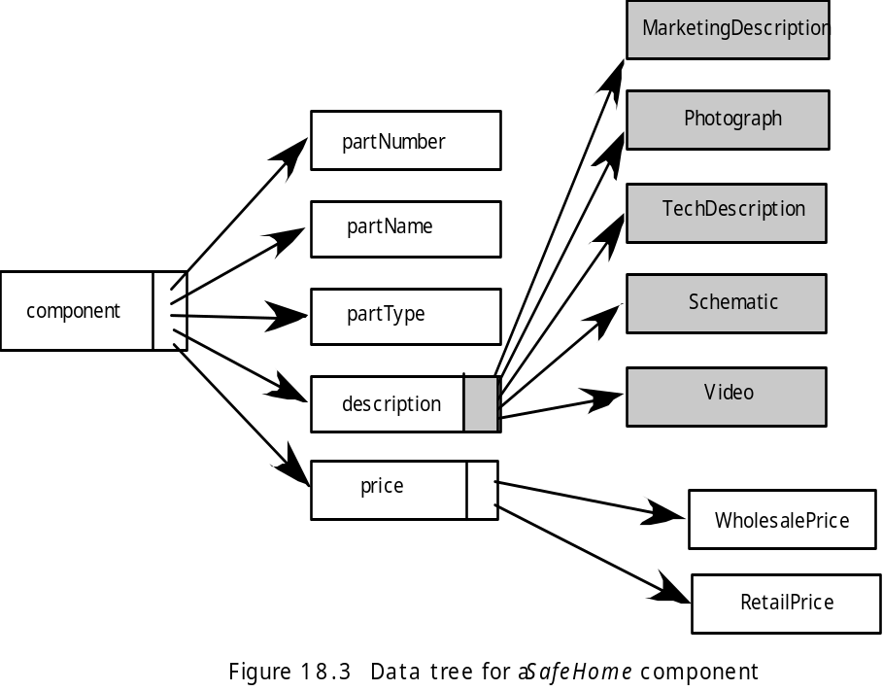
Data Tree

Slide 20
The Interaction Model
Composed of four elements:
  use-cases
  sequence diagrams
  state diagrams
  a user interface prototype
Each of these is an important UML notation and is described in Appendix I (of textbook)

