Slide 1
Data Flow Diagrams
Compiled by
Prof. Tariq Rahim Soomro, Ph.D.

Slide 2
Where do they fit in?
Life Cycle Phases
Planning
Feasibility Study
Analysis
Design
Code and Unit test
Analysis (What do we do?)
  Fact finding
    investigate business process and the current system
  modelling the current and required systems
  deliverables -
    requirements specification
    logical models of the required system (e.g. DFD)

Slide 3
Data Flow Diagrams (DFD)
DFDs describe the flow of data or information into and out of a system
  what does the system do to the data?
A DFD is a graphic representation of the flow of data or information through a system
3
Notes:
3
BCS - GP1

Slide 4
4 Main Elements
external entity - people or organisations that send data into the system or receive data from the system
process - models what happens to the data i.e. transforms incoming data into outgoing data
data store - represents permanent data that is used by the system
data flow - models the actual flow of the data between the other elements

Slide 5
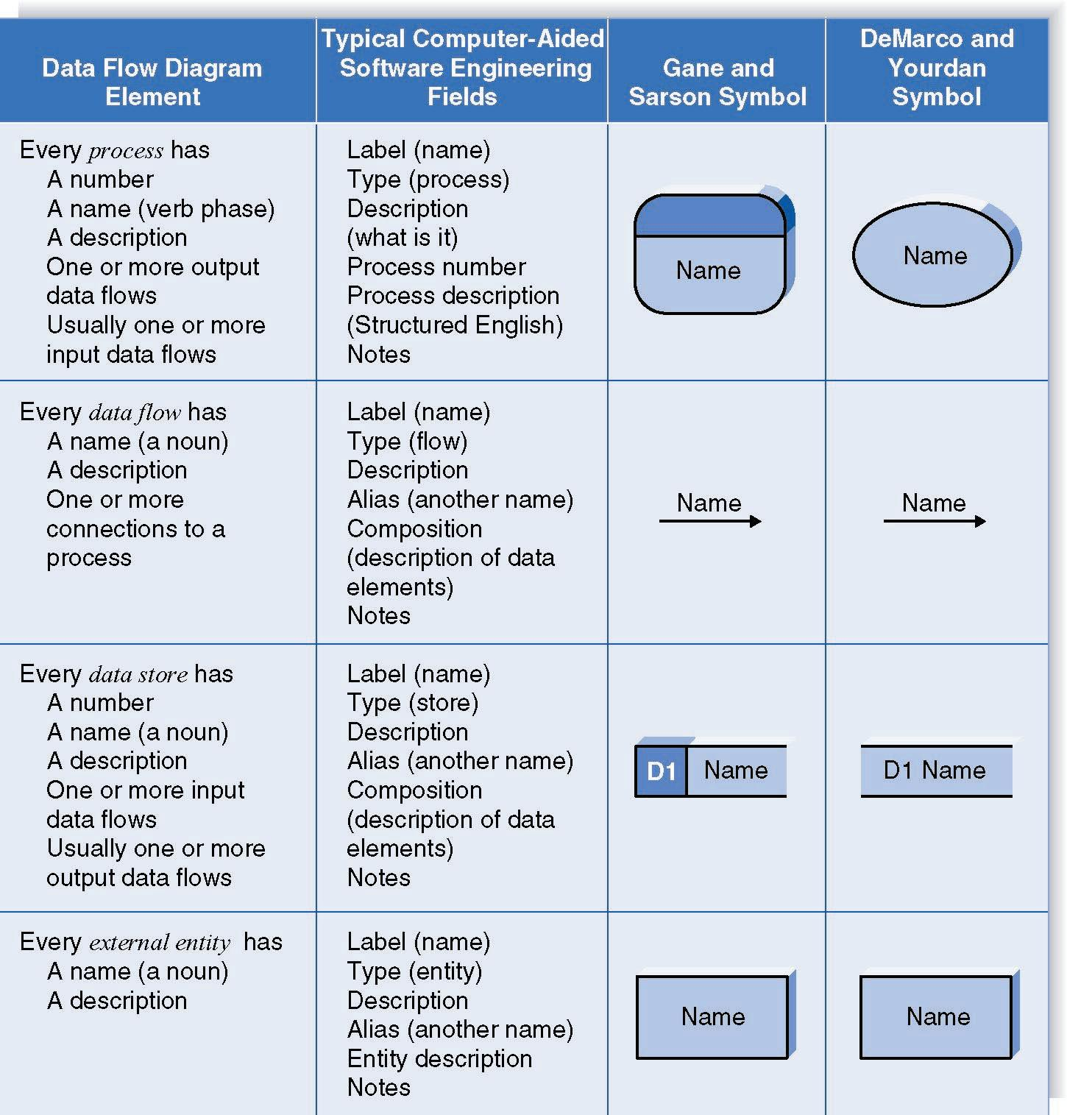
Notation

Slide 6
Levelled DFDs
Even a small system could have many processes and data flows and DFD could be large and messy
  use levelled DFDs - view system at different levels of detail
  one overview and many progressively greater detailed views
4
Notes:
4
BCS - GP1

Slide 7
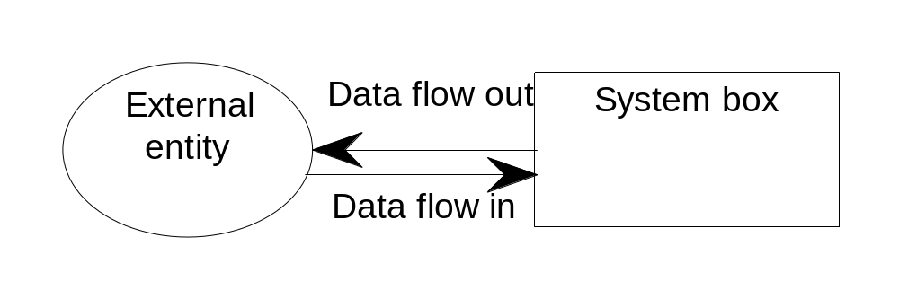
Level 0 - Context Diagram
models system as one process box which represents scope of the system
identifies external entities and related inputs and outputs
Additional notation - system box

Slide 8
Level 1 - overview diagram
gives overview of full system
identifies major processes and data flows between them
identifies data stores that are used by the major processes
boundary of level 1 is the context diagram

Slide 9
Level 2 - detailed diagram
level 1 process is expanded into more detail
each process in level 1 is decomposed to show its constituent processes
boundary of level 2 is the level 1 process

Slide 10
Rules for DFDs
Numbering
Labelling
Balancing
5
Notes:
5
BCS - GP1

Slide 11
Numbering
On level 1 processes are numbered 1,2,3…
On level 2 processes are numbered x.1, x.2, x.3… where x is the number of the parent level 1 process
Number is used to uniquely identify process not to represent any order of processing
Data store numbers usually D1, D2, D3...

Slide 12
Labelling
Process label - short description of what the process does, e.g. Price order
Data flow label - noun representing the data flowing through it e.g. Customer payment
Data store label - describes the type of data stored
Make labels as meaningful as possible

Slide 13
Balancing and data stores
Balancing
  any data flows entering or leaving a parent level must by equivalent to those on the child level
Data stores
  data stores that are local to a process need not be included until the process is expanded

Slide 14
Order System
Example
Order
System
New customer
Customer
Order
Picking Slip
Warehouse
Invoice
Order
Ship Statement
Notes:
Context diagram

Slide 15
Order System
New info
1
Add
Customer
New customer
D Customer 1 Master
Packing slip
Warehouse
3
Warehouse
Picking
Slip
Produced
2
Process
Customer
Order
Customer
Cust Info
Order
Order
Picked
Pending Order
Backorder
Proc Info
4
Shipping
Prepare
D Back 3 Order
D Inventory 2 Master
Ship statement
Customer
Ship N/A
D Customer 1 Master
Shipping B/O info
5
Customer
Bill
Produce
Cust Bill
Bill N/A
Bill Info
Notes:
This shows the DFD for the order entry including processing, data stores, entities and data flow.

Slide 16
Order System
2.1
Verify
Customer
Customer
D Customer 1 Master
Order
Need to establish
Valid
2.2
Verify
Item
Customer
D Inventory 2 Master
Order
Update
Notify
2.4
Update
Commit
Valid Item
2.3
Check
Available
Avail
D Shipping 4 Taxes
Tax
2.5
Create
Order
Back Order
Ord
D Inventory 2 Master
D Back 3 Order
Pending Order
Notes:
This slide shows a break down of 2 - Process Customer Order from the previous slide.

Slide 17
Another Example
Al Burns is the professor for the class. He manually creates a spreadsheet with all the student information based on a course roster he gets from Campus Connect. He also creates a list of assignments, a description for each assignment, and a grading key for each one.
Students complete the assignment and give them to Al Burns. Al Burns collects the assignments and gives them to Ms. Grader for grading. Ms. Grader grades the assignments based on a key provided by Al Burns, and assigns a score (grade) from 0 to 5. She then records the scores for the students on the spreadsheet.
Grades are reported back to students via a course web page created from the spreadsheet.
Assignment: Draw a context diagram and level 1 diagram for the Grading System.

Slide 18
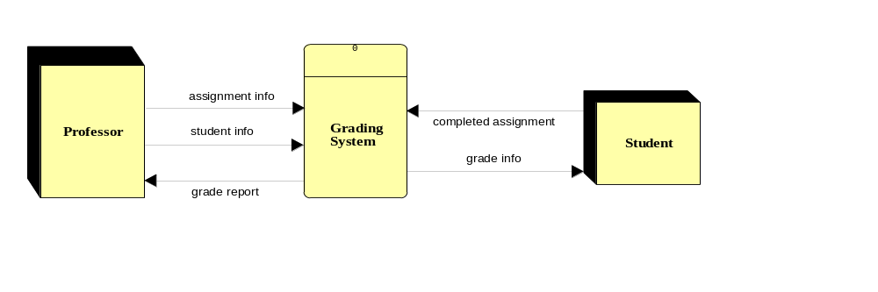
Grading System DFD Context

Slide 19
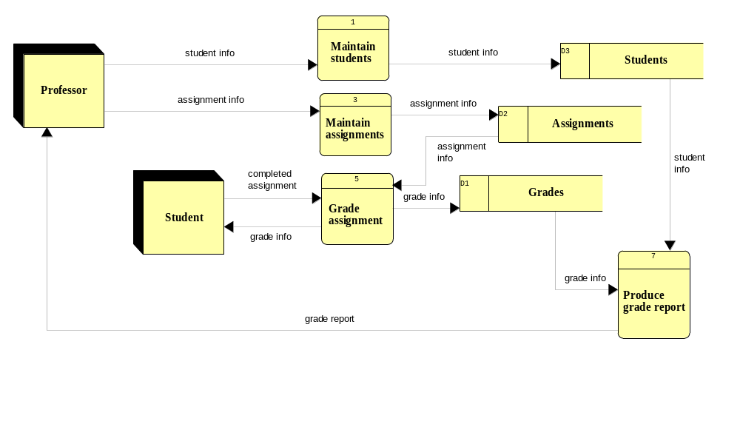
Grading System DFD Level 0

