Slide 1
CSE 4128 Image Processing and Computer Vision Laboratory Week 2: Segmentation(Edge Detection)
Dr. Sk. Md. Masudul Ahsan
Professor
Dept. of CSE, KUET
Dipannita Biswas
Lecturer
Dept. of CSE, KUET

Slide 2
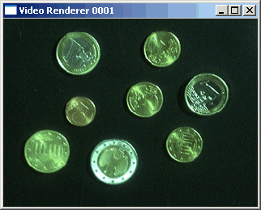

Segmentation
Segmentation subdivides an image into its constituent regions or objects.
Separating objects from the background and giving them individual labels(ID numbers)
Segmentation attempts to partition the pixels of an image into groups that strongly correlate with the objects in an image

Slide 3
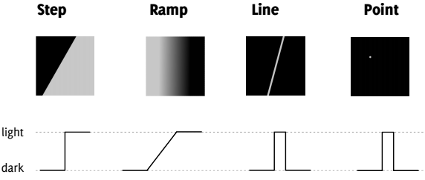
Edge Detection
It is most frequently used for segmenting images based on abrupt(local) changes in intensity. It centers around contour detection.
An edge is a set of connected pixels that lie on the boundary between two regions
Edge models

Slide 4
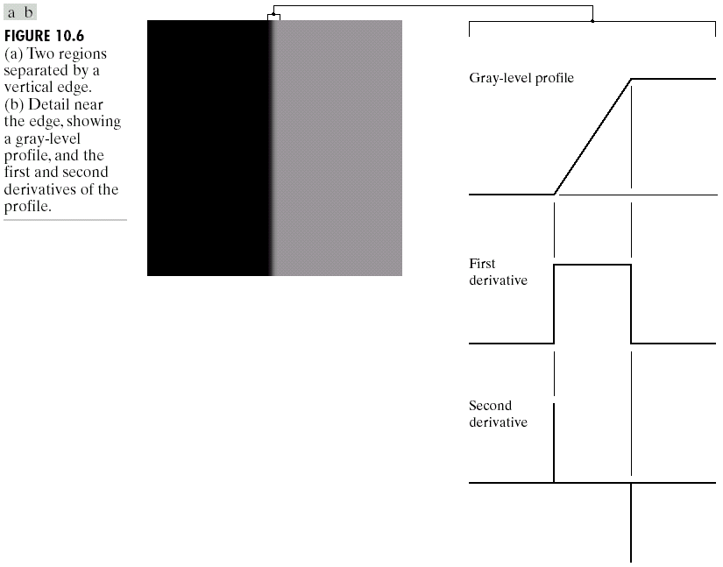
Edge and Derivatives
Derivatives are used to find discontinuities.
1st derivative tells us where an edge is.

Slide 5
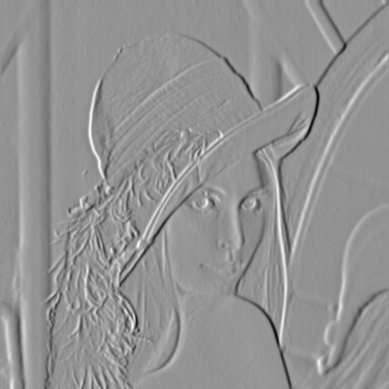
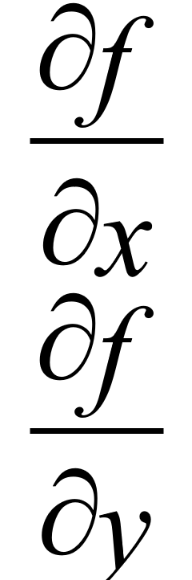
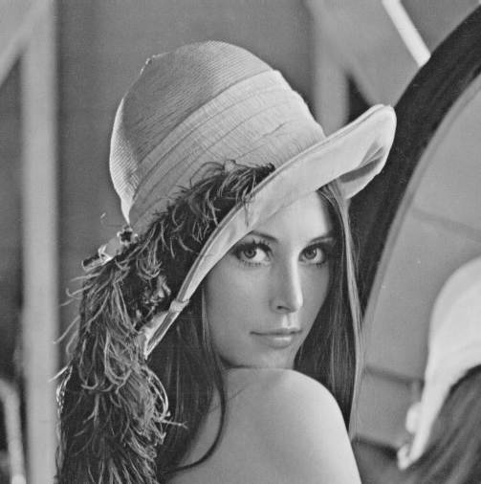
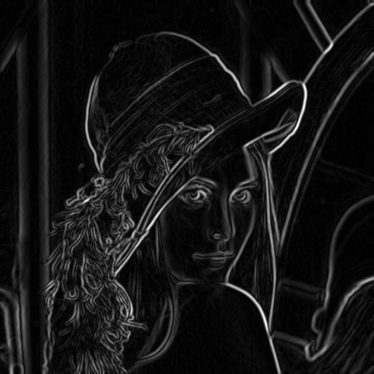
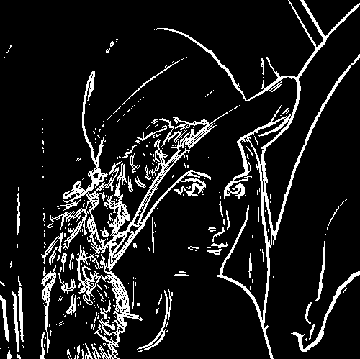
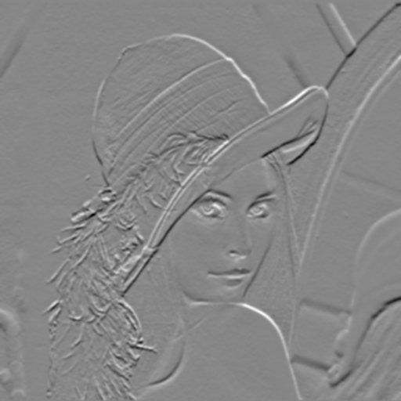

Segmentation with Edge Detection
Applying
Global thresholding
X-Derivative
Gradient Magnitude
Edge Detected
Y-Derivative

Slide 6
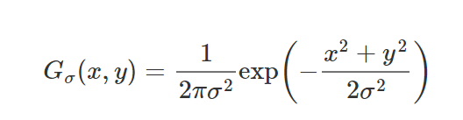
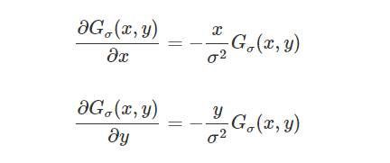
Gradient
A 2-dimensional continuous Gaussian filter (again μ=0) is defined as follows:
For the 2-dimensional Gaussian G_{σ}(x,y) the 1st order partial derivatives are:
The edge strength can be obtained from gradient magnitude:

Slide 7
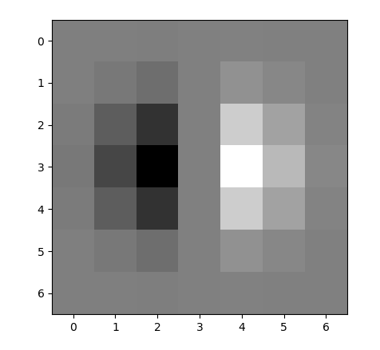
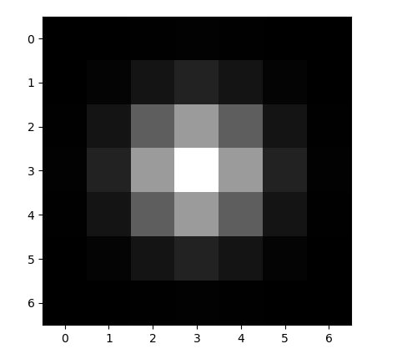
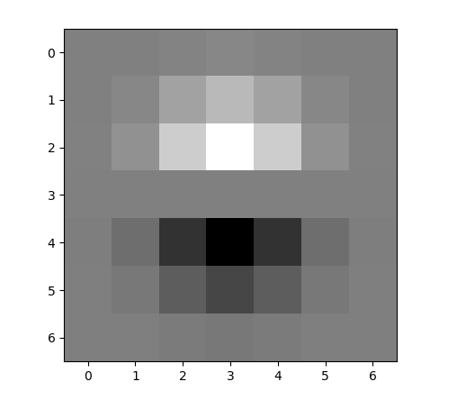
Gaussian filter & its Derivatives
x-direction
y-direction
7X7 kernel with sigma = 1

Slide 8
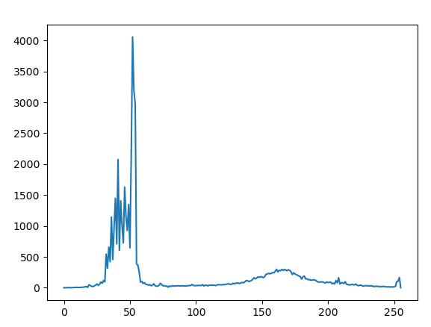
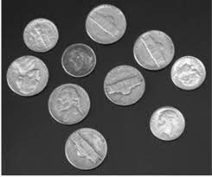

Thresholding
By selecting an adequate threshold value T, the gray level image can be converted to binary image.
Global Thresholding partitions the image histogram using a single global threshold T midway between the two gray value distributions
T = 110

Slide 9
Determine Global Threshold Automatically
The basic global threshold, T, is calculated by averaging as follows:
Select an initial estimate for T (typically the average grey level in the image)
Segment the image using T to produce two groups of pixels:
G₁ : pixels with grey levels >T
G₂ : pixels with grey levels ≤ T
Compute the average grey levels of pixels in G₁ to give μ₁ and G₂ to give μ₂
Compute a new threshold value:
Repeat steps 2 – 4 until the difference in T in successive iterations is less than a predefined limit T∞

Slide 10
Workflow
Create kernels for 1st order derivatives (x and y) for Gaussian filter.
Apply convolution on the image using the x and y derivative kernels.
Calculate the gradient magnitude.
Apply global thresholding on the gradient magnitude.
The resultant image shows the edges of the input image.

Slide 11



Output Results with different sigma value
sigma = 0.7 (kernel = 5X5)
sigma = 2 (kernel = 13X13)

Slide 12
Assignment
Apply Canny edge detection for detecting edges in images.
The steps involved in implementing the Canny edge detection algorithm:
Differential operators along x and y axis : the value of sigma will be user input.
Non-maximum Suppression finds peaks in the image gradient
Hysteresis thresholding locates edge strings

Slide 13
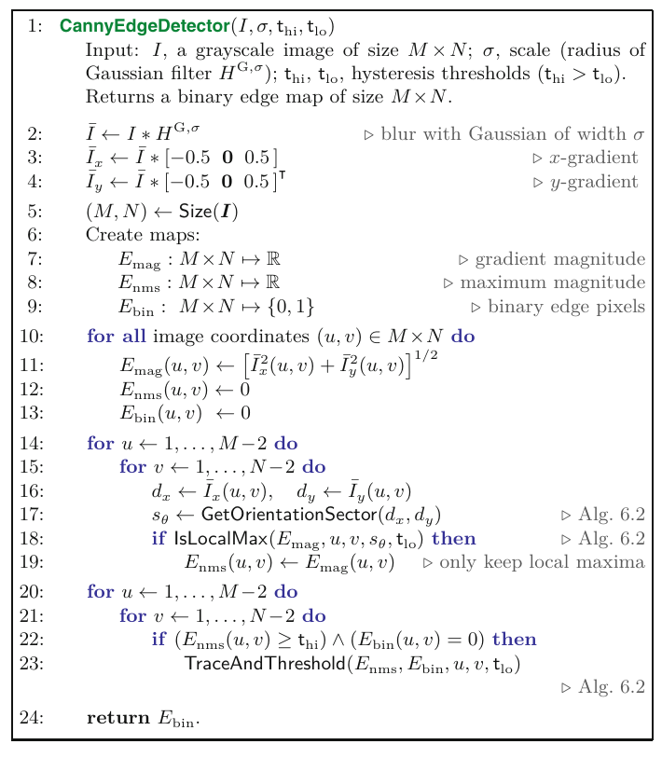
Algorithm

Slide 14

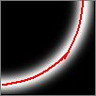
Non-maximum suppression
At q, we have a maximum if the value is larger than those at both p and at r. Interpolate to get these values.

Slide 15
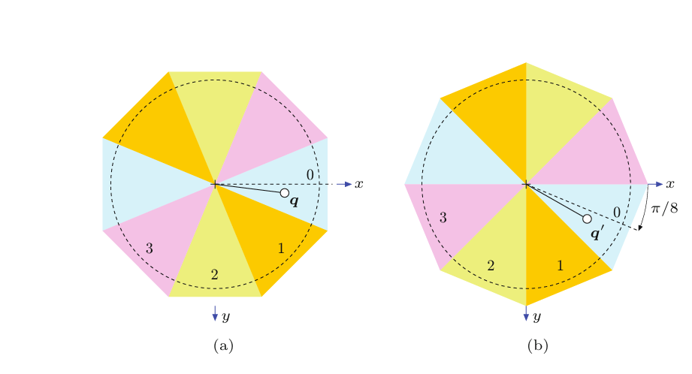
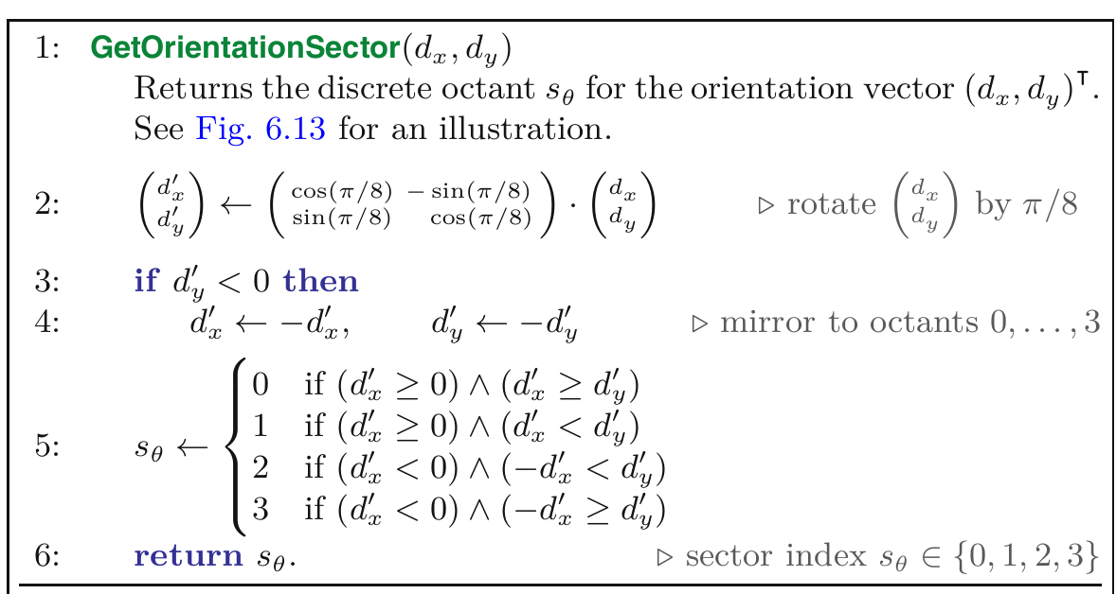
Algorithm

Slide 16
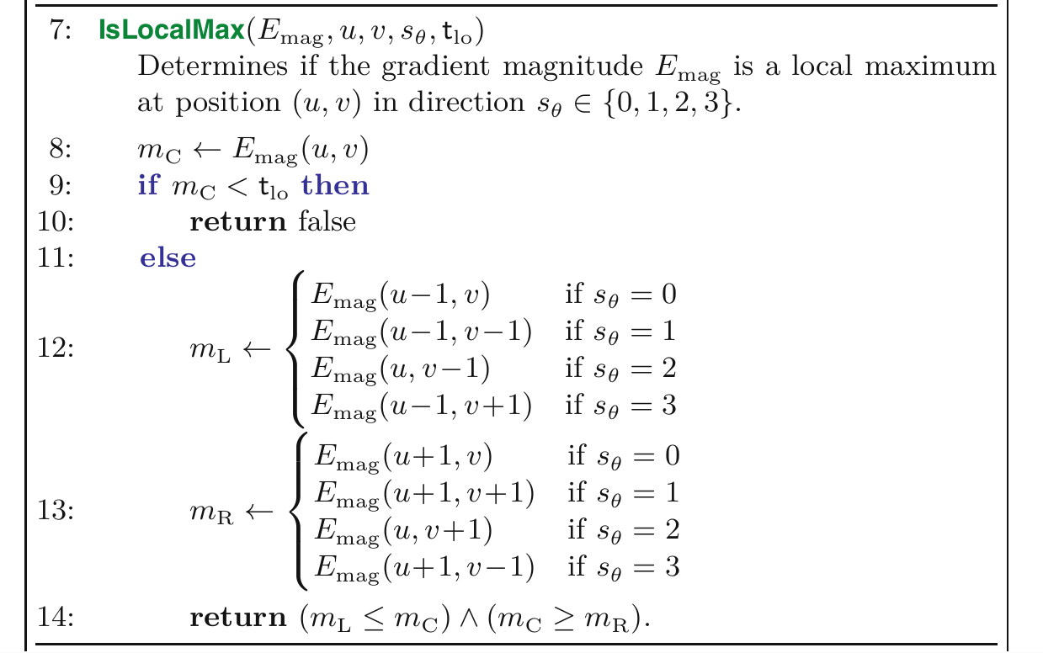
Algorithm

Slide 17
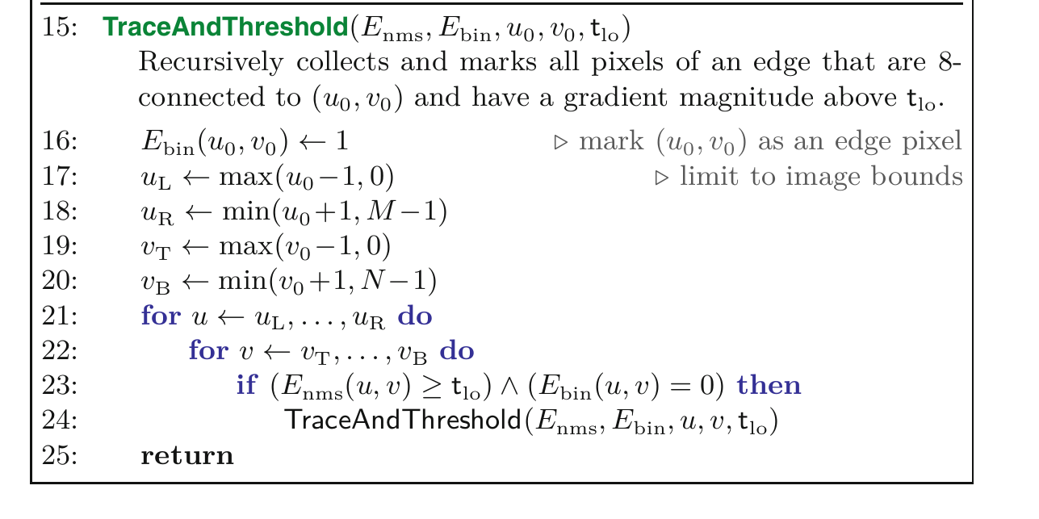
Algorithm
Reference: “Digital Image
Processing - An Algorithmic Introduction Using Java”
Second Edition, by Wilhelm Burger
Mark J. Burge

Slide 18
Hysteresis Threshold
Threshold at low/high levels to get weak/strong edge pixels
Do connected components, starting from strong edge pixels
Canny uses hysteresis threshold to fill up the narrow gap along the edge.
Uses two threshold - high threshold T_h and low threshold T_l.
Pixels with gray values greater than T_h is set as the initial edge pixels
Pixels are set as background if their values are lower than T_l.

