Slide 1
Capstone Project
Safwan Asghar Abbas

Slide 2
Overview
Problem Statement & KPIs
Building Web Crawlers
Apache Kafka
Ingesting into & Extracting from Data Lake
Data Labelling
User Interface
Recommendations

Slide 3
Problem Statement & KPIs

Slide 4
Problem Statement
Create a module that ingests data in real time into the raw-zone of Data Lake
Extract terms related to diseases and prescription
The system should forward the news relevant to a patients’ medical condition

Slide 5
KPIs
Data gathering from sources
Streaming Process into raw zone
Extracting ICD10 codes
Extracting NDC
Building a user interface to present data

Slide 6
Timeline
Include the steps leading up to the completion of this project
Storing the unstructured data in NoSQL Database (MongoDB)
Presenting the data to user via dynamic website
Ingesting in to the raw zone of Data Lake
Applying pre-trained model for text mining
Extracting the data, cleaning it & labeling
Using Kafka for streaming the data
Scraping the articles

Slide 7
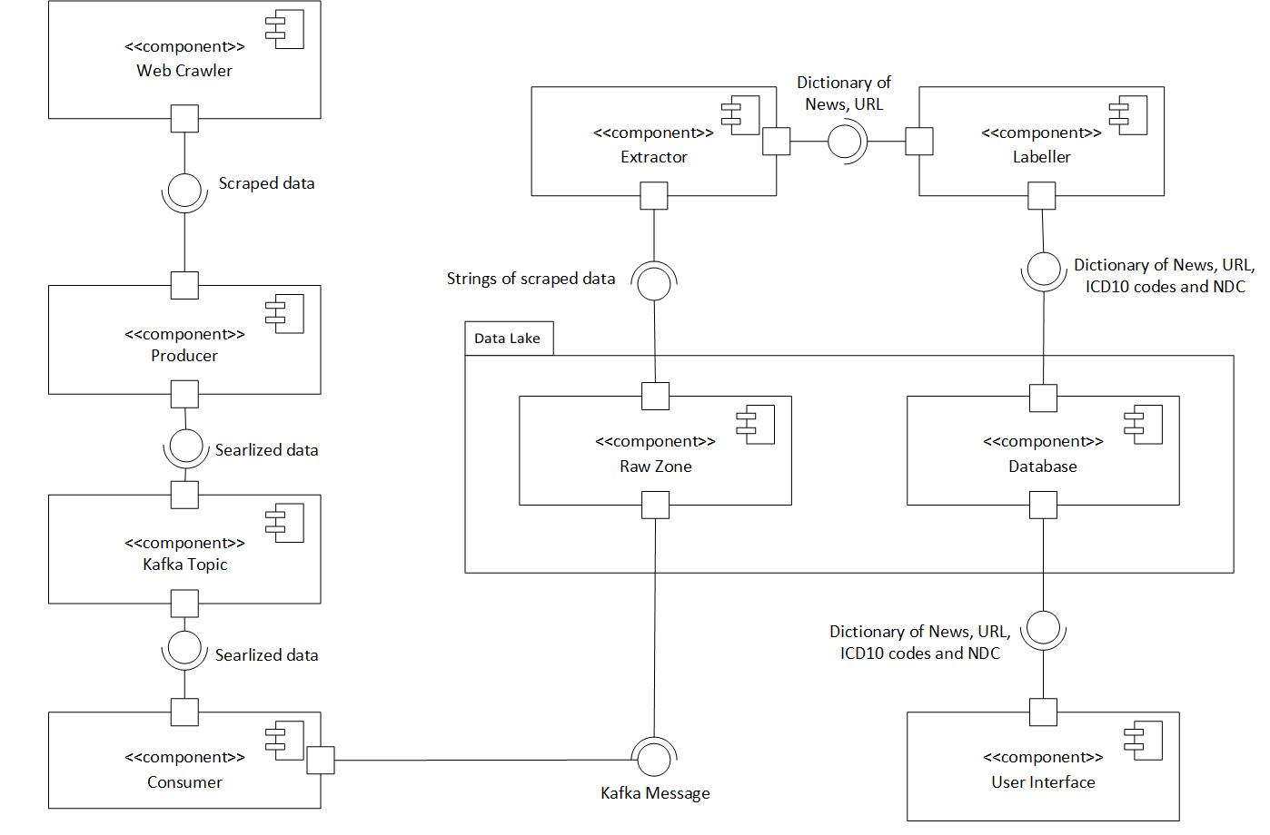
Architecture

Slide 8
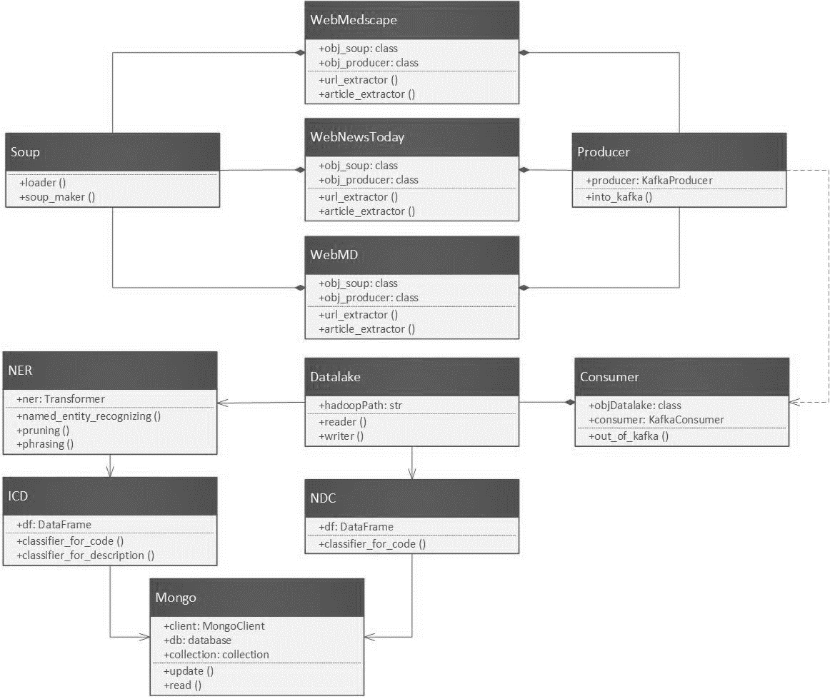
Class Diagram

Slide 9
Building Web Crawlers

Slide 10

Web Scraping
Static Web Scraping
Fetches web pages from the server without the help of a browser
Ignores JavaScript
Dynamic Web Scraping
Data which gets rendered on clicking JavaScript links
Automating the button clicks by accessing Chrome browser driver
The combination of Beautiful Soup and Selenium will do the job of dynamic scraping

Slide 11
Website for Scraping
Multiprocessing - broken to smaller routines that run independently
CDC - https://www.cdc.gov/ / https://www.cdc.gov/media/
Medscape - https://www.medscape.com/
1 process
Around 2000 scraped articles
Medical News Today - https://www.medicalnewstoday.com/
3 processes
Around 270 scraped articles
FDA - https://www.fda.gov/food / https://www.fda.gov/drugs / https://www.fda.gov/medical-devices
Kaiser Health News - https://khn.org/
WebMD - https://www.webmd.com/
2 processes
Around 650 scraped articles
Fierce - https://www.fiercehealthcare.com/

Slide 12
Apache Kafka

Slide 13
Components
Kafka Broker
Kafka Topic
Kafka Producer
Kafka Consumer
Kafka Manager
Apache Kafka
Input
(Data)
Kafka Topic
Output
(Apps)
Kafka Producer
Kafka Consumer
Zookeeper

Slide 14
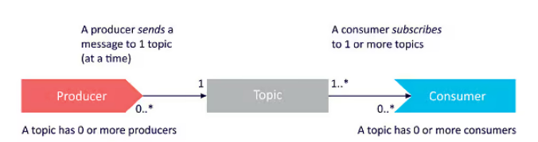
Kafka Architecture
Kafka Broker
Server running in a Kafka cluster
Kafka Topics
Channel through which data is streamed
Topics are divided into partitions
Kafka Producer
A data source that publishes messages to Kafka topics
Kafka Consumer
Read messages from the topics to which they subscribe

Slide 15
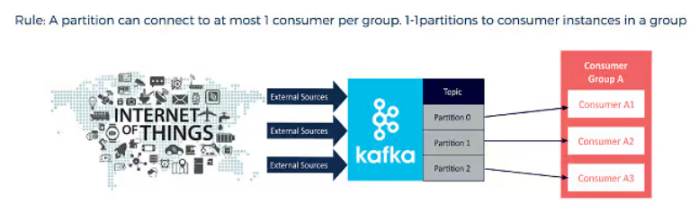
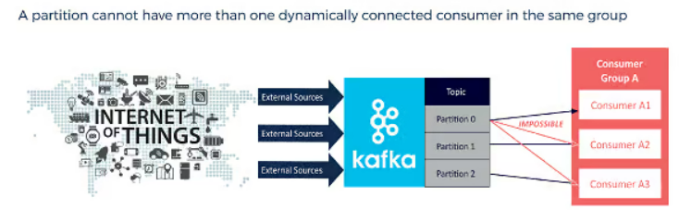
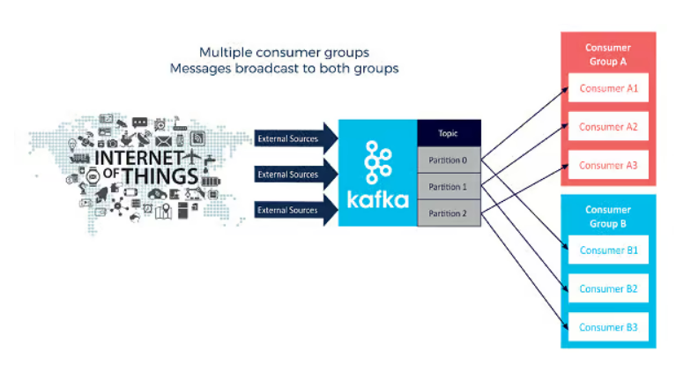
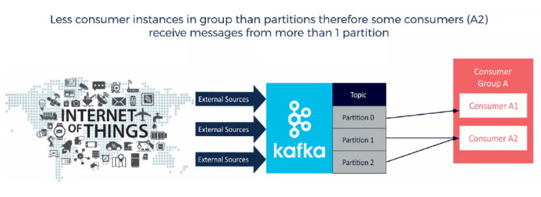
Component Relationship

Slide 16
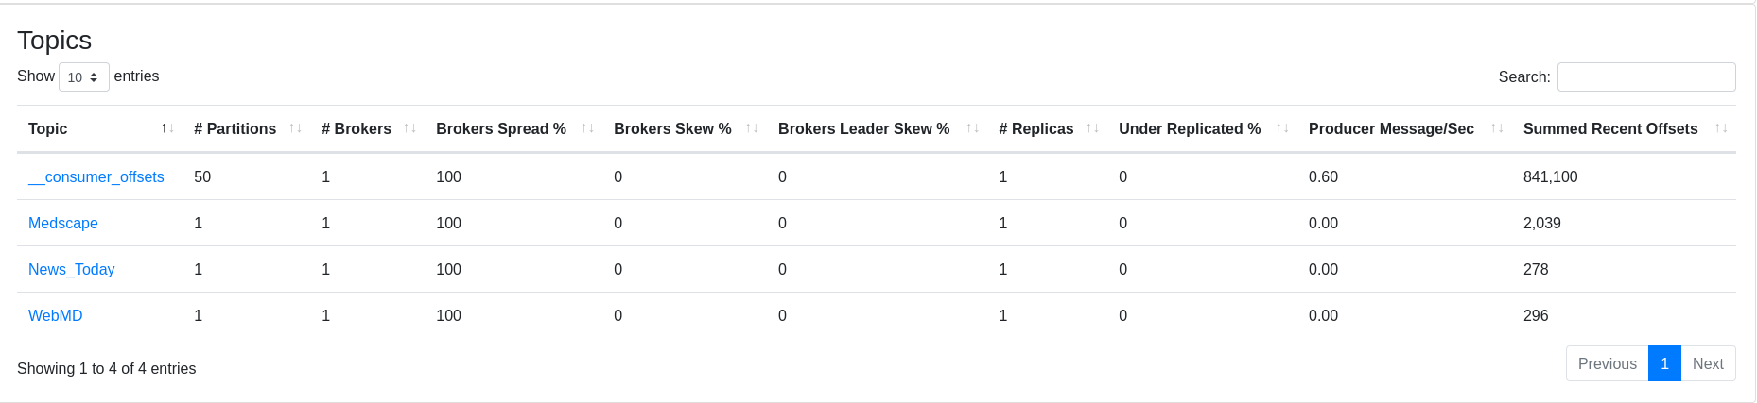
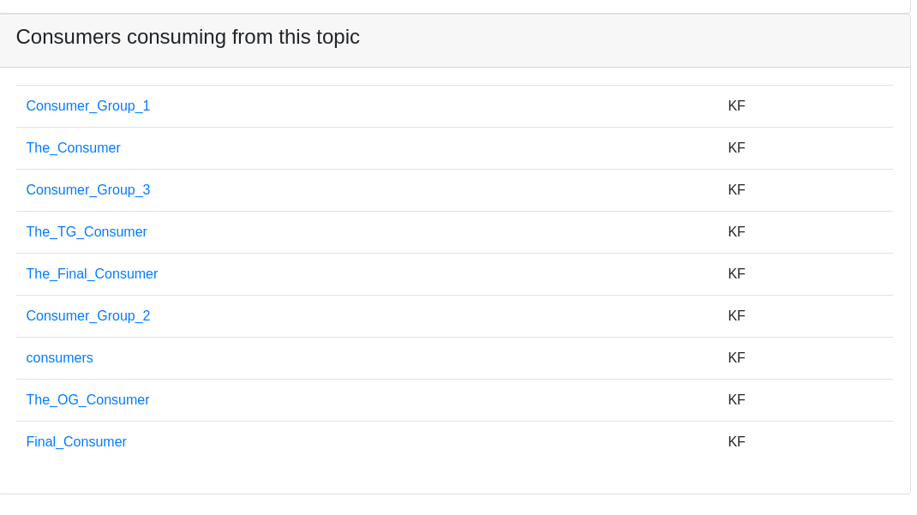
Kafka Manager

Slide 17
Ingesting into & Extraction from Data Lake

Slide 18
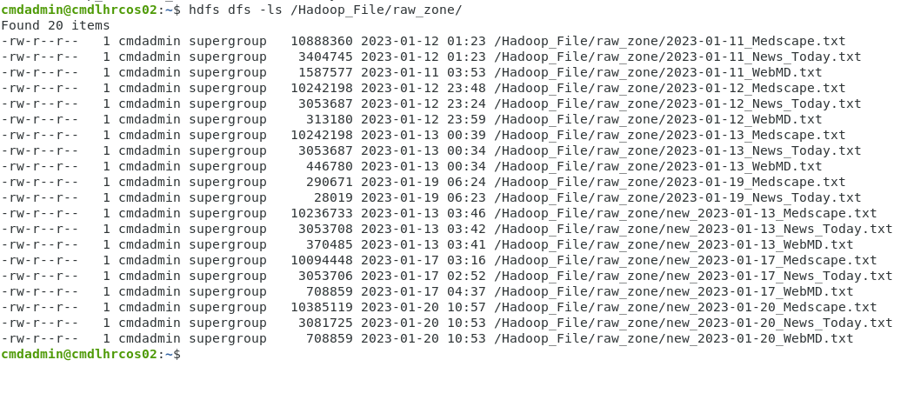
Ingesting Data
Kafka Streaming
Kafka Producer → Kafka Topic (Downstream)
Kafka Topic → Kafka Consumer (Upstream)
Serialization process
Data stored in text file

Slide 19

Extracting Data
Available libraries for connecting to Data Lake
snakebite
hdfs
pywebhdfs
Snakebite
Popular library developed by Spotify
Provides a python HDFS client
Communicates directly with the Name Node

Slide 20
Data Labelling

Slide 21
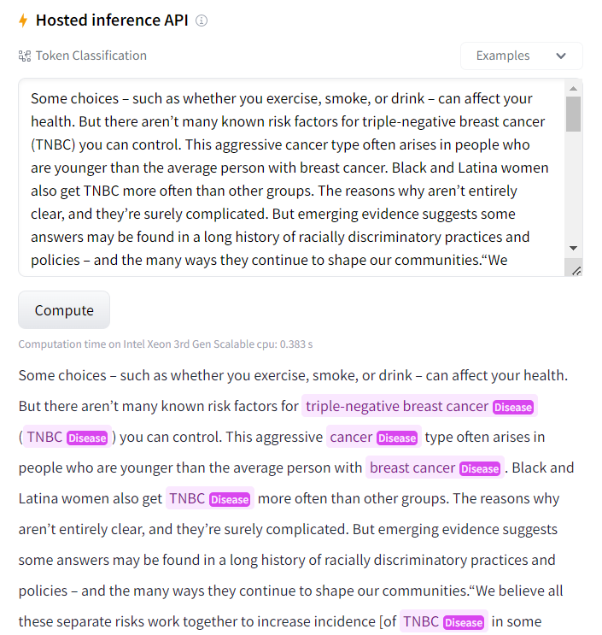
Pre-trained Models from Hugging Face
NER – Named Entity Recognition
Locating named entities mentioned in unstructured text such as organizations, locations, medical codes etc.
Extracting disease names from text
Bio NLP - raynardj/ner-disease-ncbi-bionlp-bc5cdr-pubmed
Sci Bert - mobashgr/NCBI-disease-WLT-256-SciBERT-13INS
Extracting medicine name from text
No open source model was found

Slide 22
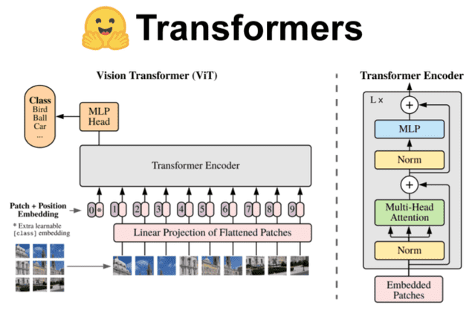
Limitations
Models required knowledge of deep learning
Lack of data to train own models

Slide 23

RegEx
Regular Expression
String searching algorithm
Matched the medicine name against provided library

Slide 24
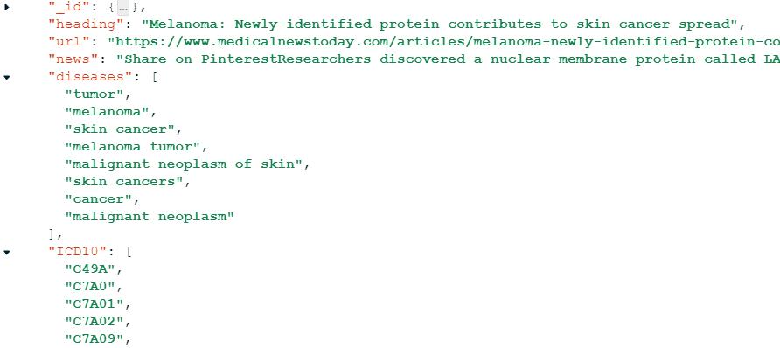
NDC & ICD10 Codes
Diagnostic codes & Prescription codes provided by Database Team (Farhan Saeed & Salman Aziz)
Diagnostic Codes - 71704
Prescription Codes - 150649
String Matching to extract codes

Slide 25
User Interface

Slide 26
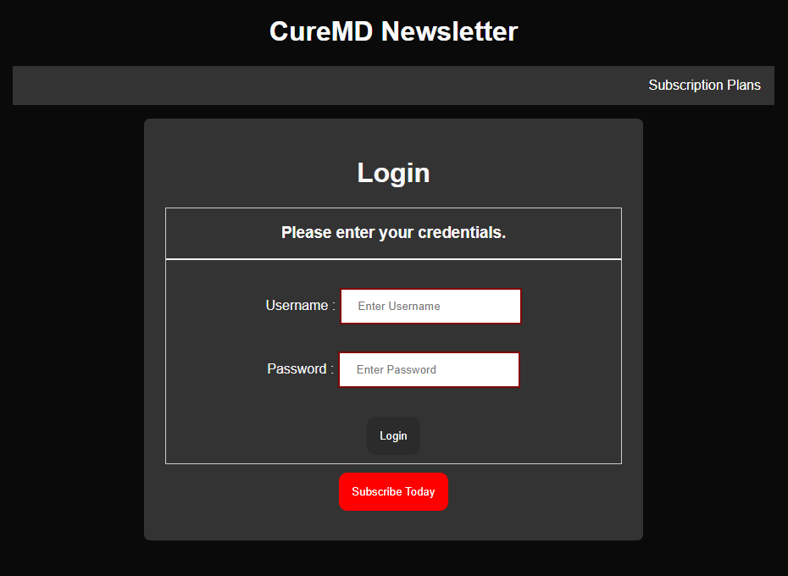
Framework
Available frameworks:
Django
Flask
Flask was selected as it is:
Lightweight web framework
Used to build simpler web applications
Simple and flexible
Dynamic website with user login
Search option for user to find relevant news articles

Slide 27
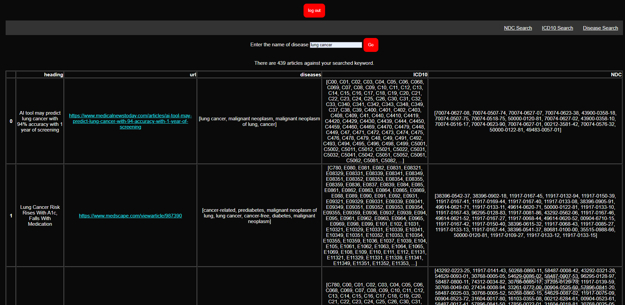
Results

Slide 28
Recommendations
System should forward the news relevant to a patients’ medical condition
Instead of string matching, model should be trained to extract more accurate results

Slide 29
Thank You!

