Slide 1
PORTLAND CHAPTER
JANUARY 27, 2014
SAF GOVERNANCE

Slide 2
SAF Constitution
Article II. Sec. 1, Mission:
The mission of SAF is to advance the science, education, technology, and practice of forestry; to enhance the competency of its members; and
to use the knowledge, skills, and conservation
ethic of the profession to ensure the continued health and use of forest ecosystems and the present and future availability of forest resources to benefit society

Slide 3
SAF Governance
Chapters
  Local
  Student
State Societies
  Divisions
  Chapters
National
  Council
  House of Society Delegates
  National Office Staff – CEO/EVP

Slide 4
House Of Society Delegates (HSD)
Tie between members, through their delegates, to Council and National Office Staff
Delegates include:
  State Society Chair and Alternates
  National Student Congress Chair and Vice Chair
  HSD Chair and Vice Chair
HSD Purpose:
  Partnership with Council and Staff on Forestry issues
  Channel of Communication
  Forum for exchange of ideas and discussion

Slide 5
SAF Constitution (cont.)
Article V, Sec. 5, Council:
The Society shall be governed by a Council comprising the president, vice-president, immediate past-president, and 11 elected members
Council provides leadership and direction to the Society of American Foresters to ensure the achievement of its mission
  “to advance the science, technology, education, and practice of professional forestry in America and to use the knowledge and skills of the profession to benefit society.”
Council is responsible to SAF members for :
  fiduciary matters,
  explicit governing policies,
  vision and ends-oriented thinking and planning, operations oversight,
  and for assurance of the Executive Vice-President’s (CEO/EVP) performance

Slide 6
New SAF Leaders for 2014
  Officers:
  Dave Walters – President
  Bob Alverts – Vice-President
  Joann Cox – Immediate Past-President
  Louise Murgia – Interim CEO/EVP
  Council Members:
  Ed Shepard– District 2
  Gary Vander Wyst– District 5
  Judd Edeburn– District 8
  Don Grebner – District 11
  Anne Heissenbuttel – HSD Chair

Slide 7
Other Council Members for 2014
  Council Members:
  John Walkowiak – District 1
  Jay Lopez – District 3
  Johnny Hodges – District 4
  Andy Hayes – District 6
  Kim Steiner – District 7
  Greg Hoss – District 9
  Dave Lewis – District 10
  Forest Science & Tech Board Chair:
  Kurt Gottschalk
  Forest Policy Chair:
  Dennis Becker
  Student Rep:
  - Thomas Roland

Slide 8
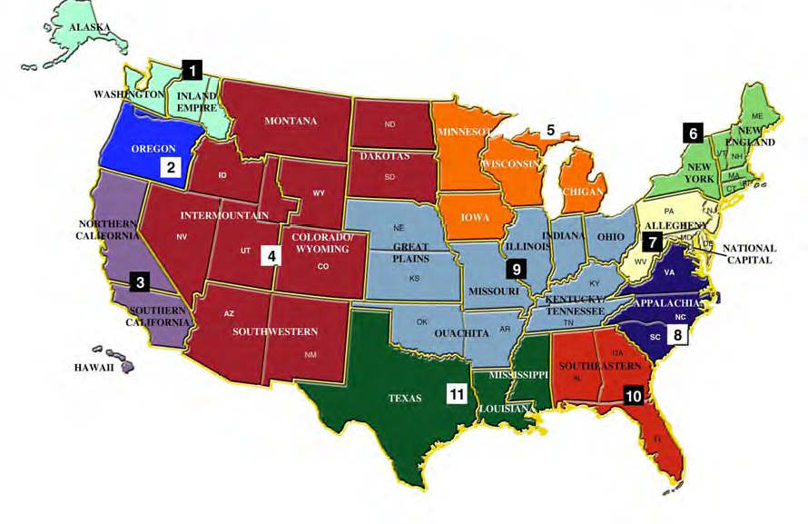
SAF Council District Map

Slide 9
Council Committees
Executive Committee
Strategic Planning
Finance & Investment (Audit)
Diversity (special relationship)

Slide 10
SAF National Committees
Accreditation Committee
Certification Review Board
Committee on Forest Policy
Communications Committee
Cultural Diversity Committee
Educational Policy Review Committee
Ethics Committee
Forest Science and Technology Board
Forest Tech School Accreditation
House of Society Delegates
Leadership Development
National Convention Program Committee
National Nominating Committee
Professional Recognition Committee
RNRF Coordinating Committee
World Forestry

Slide 11
Key Priorities for 2014
Synergize with Staff
Grow and Broaden the membership
  Enlarge the pie…increase the colors
Hire an Excellent EVP & facilitate transition
Insure an excellent Convention with CIF/IUFRO
Close the Sale of Wild Acres property
Draft, Communicate & Pass the new Articles of Incorporation, Bylaws and Operating Manual

Slide 12
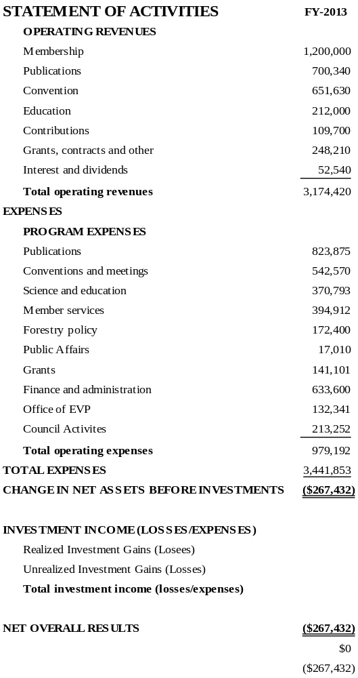
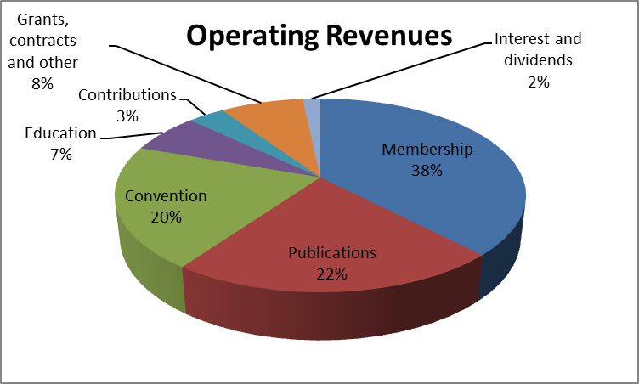
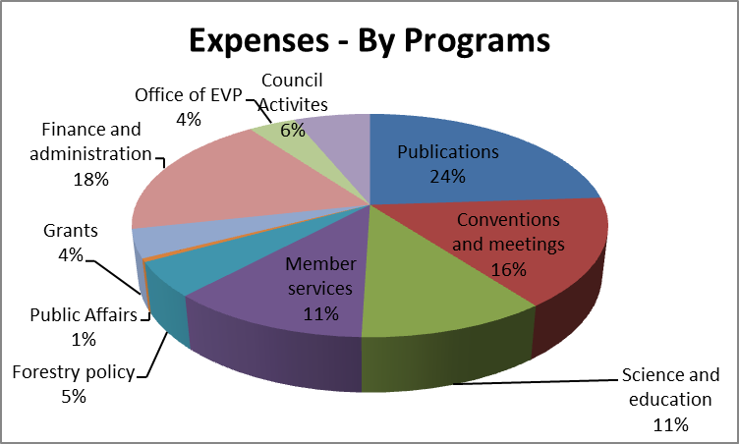
2013 Budget Distribution

Slide 13
Key Priorities for 2014 (cont)
Work of forest policies related to federal land management policies and wildland fires in the west
Develop coalitions to highlight SAF involvement:
  50th Anniv. of Wilderness Act
  70th Anniv. of Smokey Bear
  90th Anniv. of Clark-McNary Act
Complete and implement new accreditation program for NR/EM
Work with NAUFRP to establish committed faculty advisors in each forestry school to instill importance of SAF membership to students and young professionals

Slide 14
2014 Convention with CIF/UIFRO
Dates: Oct. 8-11
Location: Salt Lake City, UT
Theme: Remodeling the Forest Science – Management Partnership
Presentation Abstracts due: March 9
go to: www.xcdsystem.com/saf
- Posters due: Sept 1
Registration Info available at: www.safconvention.org

Slide 15
For More Information Contact:
Ed Shepard
(971) 832-3945
sssstr1@comcast.net

