Slide 1
Welcome to the Society of American Foresters
We’re changing SAF and now is a time for your involvement! Do not be asleep at the wheel. We want to increase the relevance of SAF while maintaining our core beliefs, traditions and purpose. To do so we need your ideas, support and active participation.” - Dave Walters, President, January 2014

Slide 2
Our Mission Stands Firm
The mission of SAF is to advance the science, education, technology, and practice of forestry; to enhance the competency of its members; to establish professional excellence; and to use the knowledge, skills, and conservation ethic of the profession to ensure the continued health and use of forest ecosystems and the present and future availability of forest resources to benefit society.
SAF Constitution: Article II. Sec. 1

Slide 3
SAF’s Core Values are Sound
Forests are a fundamental source of global health and human welfare
Forests must be sustained through simultaneously meeting environmental, economic, and community aspirations and needs
Forest resource professionals are dedicated to sound forest management and conservation
Forest resource professionals serve landowners and society by providing sound knowledge and professional management skills

Slide 4
Society of American Foresters Thriving forests. Essential resources. Strong communities.
We challenge land-owners, decision-makers and society at large to make choices about our forests based on professional knowledge, leading-edge thinking and a century of practical experience.
We seek viable pathways forward, balancing diverse demands on our natural resources.
We set the standard in forest management, bringing science, best practice and the best people together to actively shape the future of the profession.
‘For the greatest good. For the greatest number. For the long run.’
Society of American Foresters
Evolving Forest Management since 1900

Slide 5
What have we learned?
We are in the business of advancing forest science & education, and improving the practice of forest management.
We seek continuous improvement.
Our credibility and ability to demonstrate the value of being an SAF member is everything.
We must “grow the pie.”

Slide 6
Changes already made by Council
Committed funds to improve website and databases
Provided membership information on website
Implemented tiered dues structure
Established Founders Circle
Implemented ForestEd.org website
Established pathway for SAF Technicians to become Certified Foresters (CF)
Passed resolution to govern SAF under DC Nonprofit Corporation Act of 2010
Approved balanced budget for 2014

Slide 7
Changes made by Staff
Co-Hosted “The State and Future of US Forestry and the Forest Industry Conference”
Published Introduction to Consulting Forestry
Submitted amicus brief and hosted seminar on Capitol Hill concerning Forest Roads
Maintained an SAF Carbon Accounting Response Team
Created Certified Urban Forester credential
California Urban Forest Council partnership
Added Implications Statements to JoF articles

Slide 8
Six Key Actions for 2014
1. Hire, welcome & mentor new Chief Executive Officer (CEO).
2. Complete the sale of headquarters property & develop investment strategy for proceeds
3. Increase SAF Membership
4. SUNY ESF will one of 1st schools to undergo an accreditation review under the new Natural Resources/Ecosystem Management (NREM) standard for their Natural Resources Management degree program
5. Host an outstanding national convention with CIF/IUFRO colleagues in Salt Lake City.
6. Ratify updated Articles of Incorporation & Bylaws

Slide 9
Other SAF Priorities for 2014
Develop new relationships and coalitions
Continue strong SAF policy program on key issues (e.g., federal appropriations; wildland fire; forest roads; etc.)
Improve SAF member services and operational efficiency (regional models)
Improve SAF governance structure & program effectiveness
Engage House of Society Delegates (HSD) more effectively
Support SAF committees to improve and grow SAF
Increase revenue from CF program activities, publications, Founders Circle, etc.
Complete investment policy/procedures
Manage endowment funds from property sale and consider appropriate investments for a portion of these funds (additional staff, architectural study on headquarters building and deferred maintenance needs)
Recognize outstanding accomplishment and excellence

Slide 10
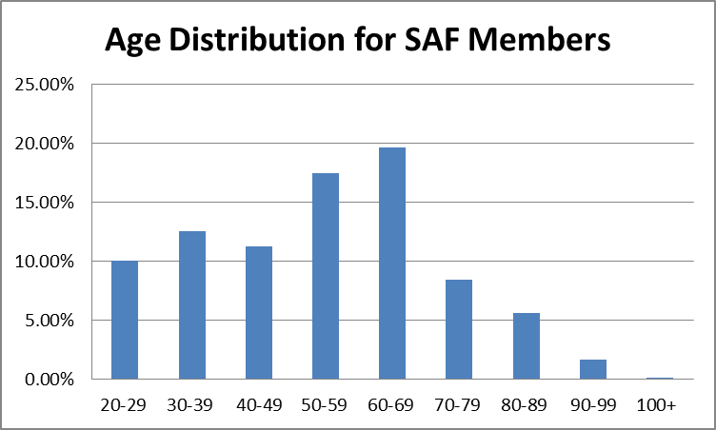
Challenges Ahead: Member Demographics

Slide 11
Membership Goal
Currently 33% of members are <50 years of age
We must:
recruit and retain more young members
increase 20-30-40 age classes
recruit natural resource professionals
retain student members after graduation
find strong and engaged faculty advisors
put young members to work in SAF

Slide 12
Funding Goal
Dues accounts for nearly 40% SAF revenue.
National conventions 20%
Publications 20%
Goal to reduce revenue from dues to <20% and replace this revenue from new sources.

Slide 13
SAF Needs You
Demonstrate your passion for the profession as we reach out to others to “grow the pie.”
Engage and encourage young professionals.
Develop coalitions with other groups and organizations.

Slide 14
SAF Needs You
Public agency employees – Recapture their passion
Industry foresters - Deliver value
University professors - Recapture their commitment to SAF
Consulting foresters – Deliver value
Students - They are our life blood
Urban foresters - Provide value, seek their involvement
Natural resource professionals - Welcome and engage

Slide 15
You Need SAF
SAF is an organization that includes professionals across the broad field of forestry and natural resource science, education and management – a broad and inclusive field
SAF publications and science and policy information keeps members abreast of current science and key issues
SAF has proven capacity to influence public policy
SAF provides superb capacity for networking
SAF helps individuals learn new competencies and develop personal leadership skills and a sense of community
SAF provides young members access to some of the profession’s key executives and leaders

Slide 16
Call to Action
We need you, and with your support, we will continue to be a strong professional organization that is based on the science, education and practice of forestry.
There is a place for you in SAF – get involved
We are committed to continuous improvement.
We need your ideas and your help as we take bold steps to move forward together. Let’s have some fun and get moving!

Slide 17
For More Information Contact:
Bob Alverts
1-503-639-0405
Balverts@teleport.com

