Slide 1
CONTINUING FORESTRY EDUCATION
Oregon society of american forsters
& washington state society of american foresters leADERSHIP CONFERENCE
SILVER FALLS STATE PARK
JANUARY 16 - 17, 2009

Slide 2
ORGANIZATIONAL CHART
Certification Review Board
(overall administration of program)
National SAF Office
(provides management of program)
Continuing Education Committee
(conducts audits of coordinators & providers)
CFE Coordinators
(state officer responsible for processing applications & assigning CFE credits)

Slide 3
Local Providers
(chapter officer, industry contacts, agency personnel who wish to conduct an educational program for foresters and offer CFE credits)

Slide 4
The Process
The CFE Application Process
From the OSAF/WSSAF website download the application, fill in all information requested, and email it to your state CFE Coordinator
Apply at least 1 week before the event; this allows for “advertising time” on the SAF Events Calendar
CFE Coordinator will review application, assign CFE credits, enter event on SAF Events Calendar, and send provider 3 pdf documents to be used for the event.

Slide 5
Continuing forestry education
Provider Application Form
Provider Information:
Provider (Company) Name: Website address: _____________
Contact Name: Phone: E-mail:_____________________________
Activity:
Title:
Knowledge/skills: (What knowledge/skills are attendees intended to take away from this program?)
Location: ___________________________________________ City: State: Oregon
Target Audience:
___ Foresters ___ Landowners ___ Loggers
___ Natural Resource Professionals ___ Forestry Technicians ___ Others ________________
This program is a:
___ Workshop/Seminar ___ SAF meeting ___ Field Trip ___ Videoconference
___ Conference ___ Lecture ___ Self study
Program duration:
___ Single day event w/o field trip ___ Multi day event w/o field trip ___ Event repeated more than once
___ Single day event w/ field trip ___ Multi day event w/ field trip
Options:
___ No options ___ Field trip(s) optional ___ Other options
Agenda: given complete agenda including all items below – use additional sheet if necessary
Date(s) of the event Start/end time for each session Start/end time for each break Presentation title Speaker’s name(s) and credential(s) Field Trips – Travel time; and time at each location/stop A complete description of content covered in each presentation
Return this email to: micksrs@yahoo.com

Slide 6
Event Provider will use the pdf documents to advertise the event, conduct the sign-in process for those who wish CFE credits, and process and hand out CFE Participation Certificates to those same members.

Slide 7
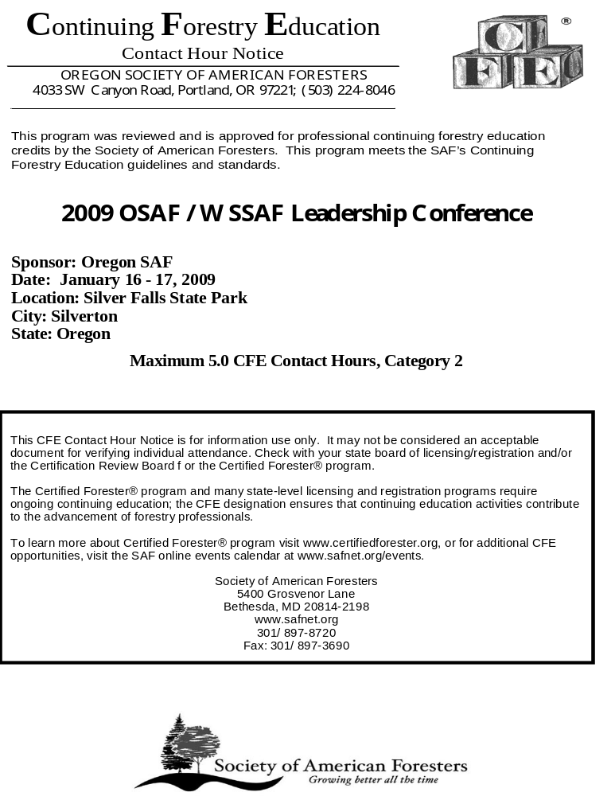

Slide 8
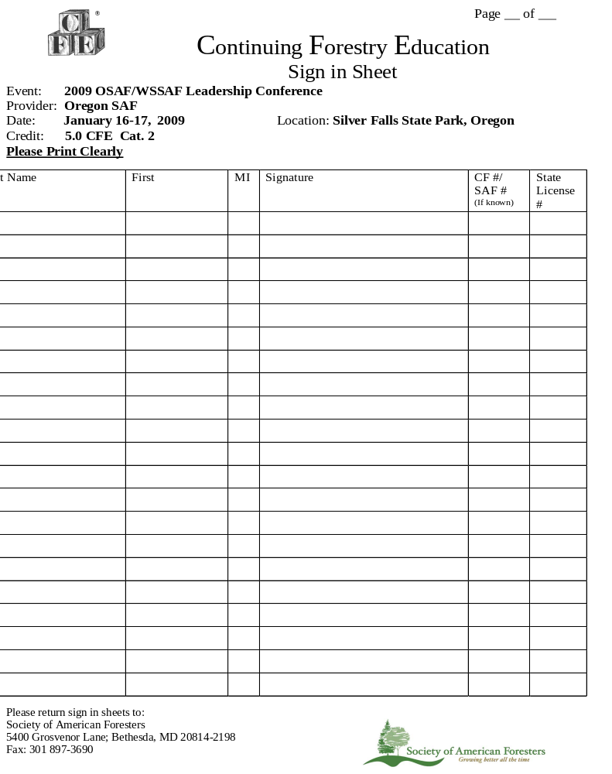

Slide 9
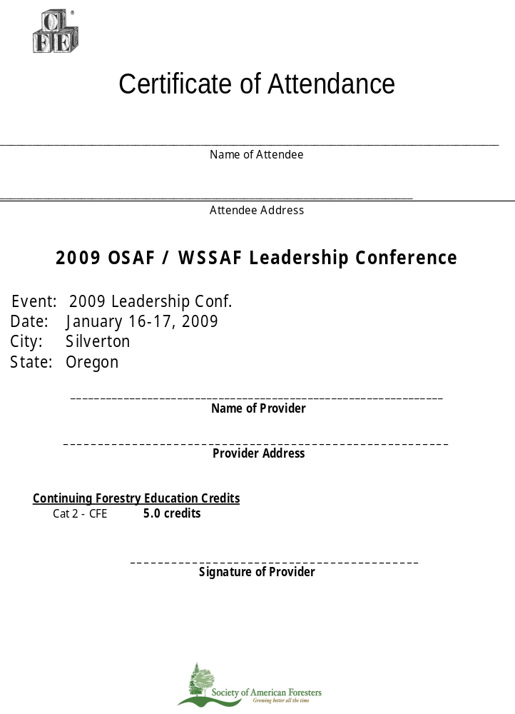

Slide 10
The CRB categorizes continuing education activities into the following three types:
Live Programs – educational workshops, seminars, conferences, lectures, live videoconference, field trips, or phone broadcasts.
Subscription Self-Study – credit awarded through quizzes contained within professional periodicals.
Online Self-Study – educational programs with quizzes or a system that can track attendance on the Internet.

Slide 11
Category 1 – Core Education
Category 1 activities are the core requirement for the Certified Forester program and many state boards of licensure.
All Category 1 activities MUST satisfy ALL of the following conditions:
(1) It is an organized program of learning conducted in a setting physically suitable to continuing forestry education objectives.
(2) Speakers must be qualified to address their topics and be considered experts in their presentation subject by virtue of special education, training, and/or experience.

Slide 12
(3) The subject matter must directly relate to the approved content area for the appropriate credential. Individual presentations within a workshop or conference may qualify while others do not.
(4) The program content must be of a technical level and nature such that it supplements and builds upon the knowledge necessary to ensure professional competency. Training sessions targeted specifically for landowners do NOT meet this criterion.
(5) The program content cannot be:
specific to protocols of an individual organization, company, or agency;
about organization-specific procedures and operations;
employee training in organization-specific practices/policies.

Slide 13
Category 1-CF
Program content must be directly related to the Topics / Knowledge content areas defined for the four Certified Forester Domains:
Resource Assessment:
Understanding soil properties and processes specific to forested areas
Understanding photo interpretation and remote sensing
Understanding how to use GIS and GPS in data collection and maintenance
Understanding the interactions between forest ecological factors and ecosystem services
Understanding forest measurements, land surveying concepts, inventory and sampling techniques, and new technology

Slide 14
Identifying impacts from forest insects and diseases
Identifying basic aquatic and terrestrial flora & fauna
Understanding how climate, fire, pollution, genetics, insects, diseases, invasive species affect forest health and productivity
Understanding how to access and evaluate current economic and market conditions

Slide 15
Stakeholder Analysis & Relations:
Communications including conflict resolution, mediation, how to conduct effective stakeholder surveys and meetings, and techniques
Understanding how polices, federal, state, and local laws and regulations directly govern the practice of forestry, including voluntary standards and guidelines
Understanding changing forest landowner demographics and identifying stakeholders
Understanding how social, cultural, political, legal, educational, economic and institutional histories influence the practice of forestry

Slide 16
Management Planning:
Understanding hydrology, water quality, and watershed functions and management and constraints
Understanding the relationship between forest management and wildlife, fisheries, range, or wetlands management
Understanding how tax policies impact forest management
Understanding of silvicultural principles and techniques to achieve objectives
Developing management plans with specific objectives including forest products, recreation, non-timber products, wildlife

Slide 17
Developing a fire risk assessment and understanding of suppression techniques,
Understanding fire weather and prescribed fire methods
Understanding how to use GIS in land management planning
Analyzing economic, environmental, and social consequences of forest resource management strategies and decisions
Analyzing inventory data and projecting future forest, stand and tree conditions
Understanding basic real estate and legal records such as land records, deeds, and land surveys

Slide 18
Execution of Management Plan:
Developing harvesting plans including road maintenance, roadbed stabilization, timber appraisal, and logging costs
Understanding methods to achieve silvicultural objectives
Understanding contract law and interpreting contract specifications
Recognizing and determining the impact and severity caused by catastrophic agents and corrective methods such as rehabilitation or salvage harvesting

Slide 19
Understanding harvesting systems, techniques, and methods and how economic impacts effect harvesting schedules
Understanding reforestation methods and measuring success rates
Understanding control methods and pesticide application technologies for forest insects and diseases and vegetation management
Understanding professional ethics
Understanding how cost share programs impact the management plan

Slide 20
Category 2 – Related Education
Category 2 activities directly benefit professionals, but do not meet the requirements for Category 1.
Category 2 activities MUST satisfy ALL of the following conditions:
(1) It is an organized program of learning conducted in a setting physically suitable to continuing forestry education objectives.
(2) Speakers must be qualified to address their topics and be considered experts in their presentation subject by virtue of special education, training, and/or experience.

Slide 21
(3) The program content must be of a technical level and nature such that it supplements and builds upon the knowledge necessary to ensure professional competency and performance.
(4) The program content cannot be:
specific to protocols of an individual organization, company, or agency
about organization-specific procedures and operations
employee training in organization-specific practices/policies

Slide 22
Examples:
Computer science
OSHA or similar Personnel mgt.
Business/Marketing skills
First Aid/Logging safety
Logging/Pesticide equipment maintenance
General agriculture, wildlife, fisheries, and ornithology (when not related to forest management)

Slide 23
Category 3 – Profession Development and Volunteer Activities:
Category 3 activities must satisfy ALL the following conditions:
Professional activities undertaken outside of normal job responsibilities
The subject matter qualifies under category 1, such as presentations in a classroom, field, or lab setting; writing and publishing of forestry or forestry-related subject matter; or, service to the profession through volunteer work
Requests for category 3 CFE credit must be sent directly to the national office staff.

Slide 24
Credit Hour Determination
The following activities do not qualify for credit:
Introductory, welcome, and closing remarks
Opening ceremonies/award presentations
Exhibits & poster sessions (except when presenter speaks)
Coffee, meal breaks, and banquet/social events
Cultural performances, entertainment, or recreational activities
Business meetings or committee meetings of volunteer organizations, state credentialing boards, companies, and agencies
Transportation time to a specific site, loading and unloading, and dislocation to a point of interest
Work experience or on-the-job training

Slide 25
Definition of Credit Hours
One CFE Credit Hour (1.0) = 60 minutes of interaction between learner and instructor or learner and materials which have been prepared for learning.
½ CFE Credit Hour (0.5) = 30 minutes of interaction between learner and instructor or learner and materials which have been prepared for learning.
Programs shorter than 30 minutes in entirety are not eligible for credit.

Slide 26
Provider Responsibilities
Attendance Documentation
Providers are responsible for producing and distributing certificates of attendance/completion to attendees for any activity including live, online, and subscription programs offering CFE credit. Certificates must include the following information:
Provider: Name and complete contact information
Title/Name of the program
Date and location (city and state) of the program
Name of the attendee to whom the hours are awarded
The number of hours awarded – broken down when appropriate

Slide 27
The number of hours awarded must be broken down by day for multi-day events. Hours awarded may be broken down in a logical way to fit the event format. For example, if a daylong meeting has an indoor presentation in the morning and a field trip in the afternoon, the hours can be broken down to reflect the number of credits for the morning presentation and the number of credits for the afternoon field trip.
Names of attendees will preferably be pre-printed on the certificates to help ensure the security of the forms. Certificates of attendance may be made available at the conclusion of the event or may be mailed to people after the event. Certificates of attendance/completion should never be sent to the SAF but should always be given or sent to the attendee. Unused certificates should be destroyed.

Slide 28
Attendance Verification
Providers must ensure that the hours awarded to each participant represent the actual hours that the person attended an event or activity. This can be completed by one of the following:
(1) Registration records – Registration records should clearly indicate those individuals that registered for a single day, entire event, optional events, or were no-shows.
(2) Sign in sheets – Sign in sheets should be easily accessible for attendees. Sign-in sheets can also be used to track attendance at concurrent sessions and optional events.

Slide 29
After the Event:
No later than three weeks after conclusion of an event, providers must submit the following information to the SAF National Office:
Final Agenda AND
Sign in Sheets OR Registration Records
The SAF National Office will retain the past three-years of agendas and attendance verifications.
If a provider fails to submit the above information, the CRB reserves the right to immediately remove CFE credit in its entirety.

Slide 30
Confidentiality
Attendance records will be available to the Certification Review Board and state boards of licensure upon request for validating continuing forestry education requirements within a specific credentialing program. It will also be used during the audit process of CFE coordinators and national office staff.
The information will not be used for any other purpose or distributed to a third party other than the state boards of licensure without the consent of the provider.

