Slide 1

SAF- Who are We?
Presented by:
Shaun Harkins, C.F.
Membership Co-Chair- OSAF
May 17, 2007

Slide 2
SAF- Background
Background
Gifford Pinchot and six other pioneer foresters founded the Society of American Foresters (SAF) in 1900. The Society, with about 15,000 members, is the national organization representing the forestry profession in the United States and includes public and private practitioners, researchers, administrators, educators and forestry students. It is also the accreditation authority for professional forestry education in the United States.
SAF members subscribe to a code of ethics, the foundation for their professional behavior in relations with the land, the public, their employees (including clients), and with each other. Stewardship of the land is the cornerstone of the forestry profession. As such, SAF members advocate and practice land management consistent with ecologically sound principals.
The society publishes the Journal of Forestry, Forest Science, Southern Journal of Applied Forestry, Northern Journal of Applied Forestry, Western Journal of Applied Forestry, and Proceedings for the national convention.

Slide 3
SAF Mission Statement
Mission
The mission of the Society of American Foresters is to advance the science, education, technology and practice of forestry; to enhance the competency of its members; to establish standards of professional excellence; and to use the knowledge, skills and conservation ethic of the profession to ensure the continued health and use of forest ecosystems and the present and future availability of forest resources to benefit society.

Slide 4
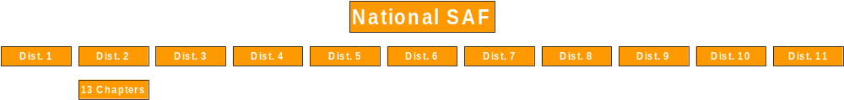
SAF- Organizational Chart

Slide 5
National SAF

Slide 6
Demographics
By Member Type
By Years in Membership
By Age
By Gender
By Ethnic Group
By Employer
By Salary
By Position

Slide 7
By Member Type
Professional Member | 10043 | 65.68%
Professional Member-Fellow | 356 | 2.33%
Professional Retired Member | 1897 | 12.41%
Professional Retired Fellow | 461 | 3.02%
Lifetime-Member | 3 | 0.02%
Lifetime-Fellow | 1 | 0.01%
Conditional Professional Member | 73 | 0.48%
Technician Member | 506 | 3.31%
Associate Member | 182 | 1.19%
Professional Student | 1084 | 7.09%
Conditional Professional Student | 162 | 1.06%
Technician Student | 287 | 1.88%
Associate Student | 5 | 0.03%
International Member | 69 | 0.45%
International Student | 2 | 0.01%
Corresponding Member | 116 | 0.76%
Honorary Member | 43 | 0.28%

Slide 8
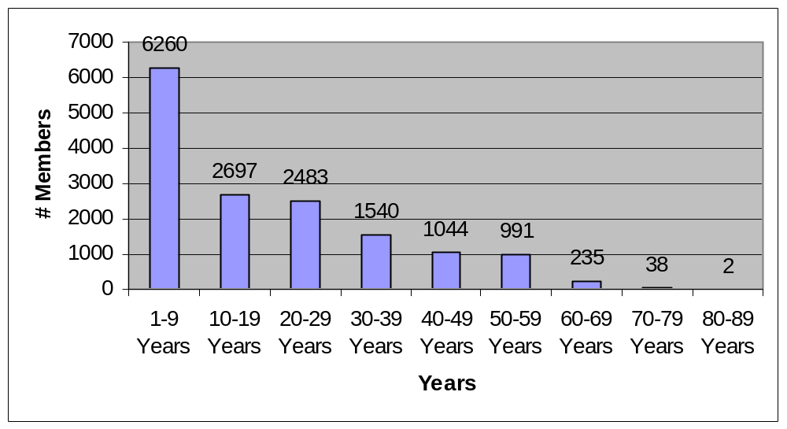
By Years in SAF

Slide 9
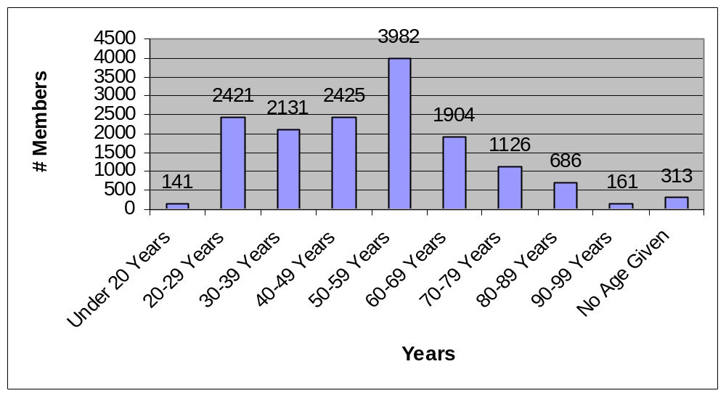
By Age

Slide 10
By Gender
Female 1961 12.83 %
Male 13329 87.17 %

Slide 11
By Ethnic Group
American Indian/Alaska Native | 77 | 0.50%
Asian | 150 | 0.98%
Black/African American | 72 | 0.47%
Hispanic/Latino | 145 | 0.95%
Other | 62 | 0.41%
Prefer not to say | 315 | 2.06%
White/Caucasian | 14469 | 94.63%

Slide 12
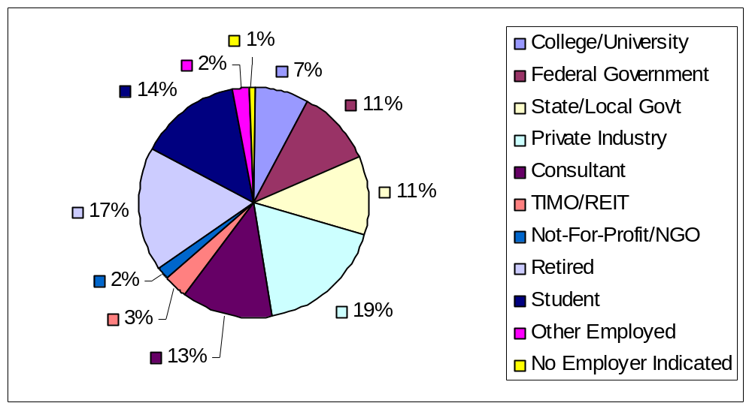
By Employer

Slide 13
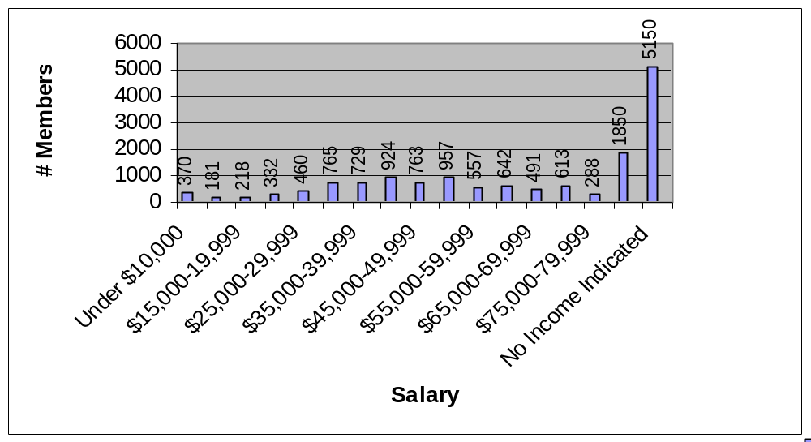
By Salary

Slide 14
By Position
Owner | 251 | 1.64%
Retired | 2616 | 17.11%
Student | 320 | 2.09%
Management/Administration | 3711 | 24.27%
Staff Specialist | 1314 | 8.59%
Field Forestry | 2553 | 16.70%

Slide 15

2007 SAF Membership Campaign
Status Report as of April 30th
The Goal
To increase your state society’s membership on December 31, 2007 by one more member as compared to membership on December 31, 2006.

Slide 16
2007 SAF Membership Campaign
 |  |  |  |  | Purge Figures
DISTRICT | # members on 04/30/07 | 2007 Goal |  | # of Members Not YetRenewed for 2007 | 2006 | 2005 | 2004
District 1 ( WA, AK) | 1,091 | 1,085 |  | 105 | 100 | 99 | 125
District 2 (OR) | 1,029 | 1,011 |  | 72 | 67 | 56 | 75
District 3 (CA, HI) | 887 | 881 |  | 123 | 96 | 108 | 153
District 4 (ID, MT, CO, WY, ND, SD) | 1,462 | 1,452 |  | 187 | 149 | 146 | 145
District 5 (MN, WI, MI, IA) | 1,420 | 1,390 |  | 149 | 172 | 163 | 174
District 6 (New England, NY) | 1,552 | 1,521 |  | 155 | 156 | 139 | 183
District 7 (Allegheny, National Capitol) | 1,372 | 1,351 |  | 134 | 119 | 134 | 144
District 8 (Appalachian) | 1,721 | 1,684 |  | 218 | 152 | 168 | 175
District 9 (MO, IL, OH, IN, KY, TN) | 1,584 | 1,536 |  | 192 | 165 | 184 | 216
District 10 (Southeastern) | 1,421 | 1,388 |  | 166 | 164 | 141 | 175
District 11 (MS, TX, LA) | 1,214 | 1,202 |  | 180 | 143 | 148 | 154
Affiliated w/no SS | 650 | 622 |  | 89 | 81 | 69 | 106

Slide 17
Oregon SAF

Slide 18
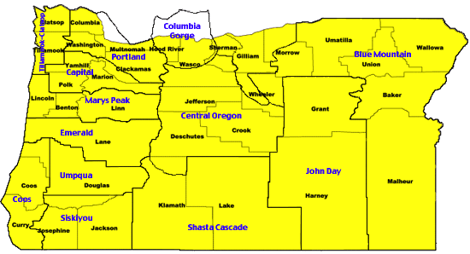
OSAF Chapters

Slide 19
By Member Type
Professional Member | 629 | 61.37%
Professional Member-Fellow | 34 | 3.32%
Professional Retired Member | 201 | 19.61%
Professional Retired Fellow | 38 | 3.71%
Lifetime-Member | 1 | 0.10%
Conditional Professional Member | 4 | 0.39%
Technician Member | 23 | 2.24%
Associate Member | 19 | 1.85%
Professional Student | 62 | 6.05%
Conditional Professional Student | 3 | 0.29%
Technician Student | 5 | 0.49%
Corresponding Member | 6 | 0.59%

Slide 20
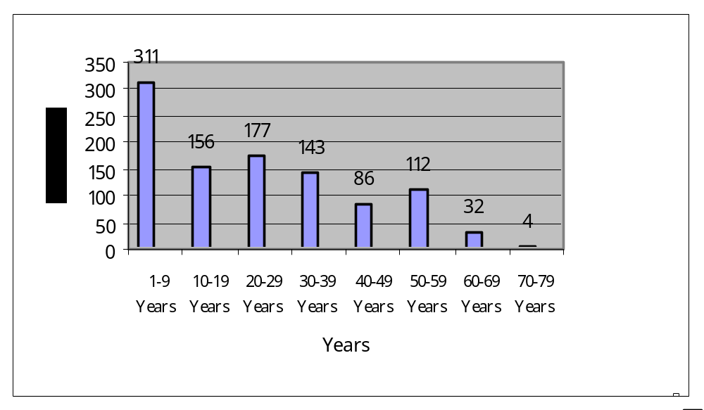
By Years in SAF

Slide 21
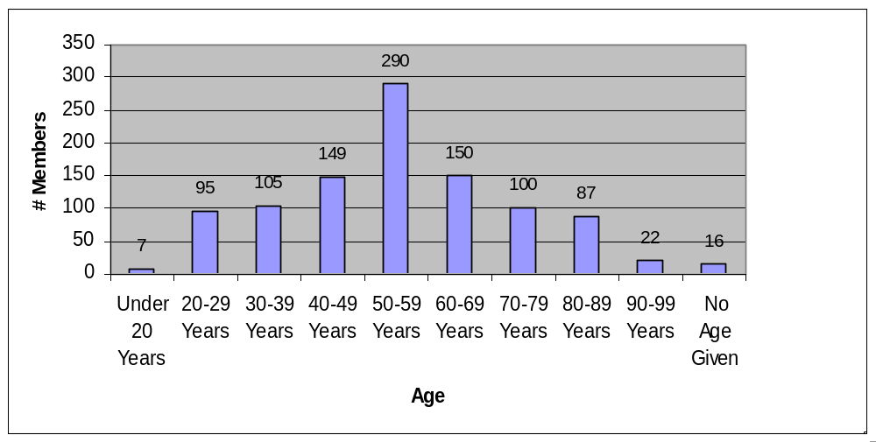
By Age

Slide 22
By Gender
Female 133 12.98 %
Male 892 87.02 %

Slide 23
By Ethnic Group
American Indian/Alaska Native | 6 | 0.59%
Asian | 8 | 0.78%
Black/African American | 3 | 0.29%
Hispanic/Latino | 11 | 1.07%
Other | 3 | 0.29%
Prefer not to say | 15 | 1.46%
White/Caucasian | 979 | 95.51%

Slide 24
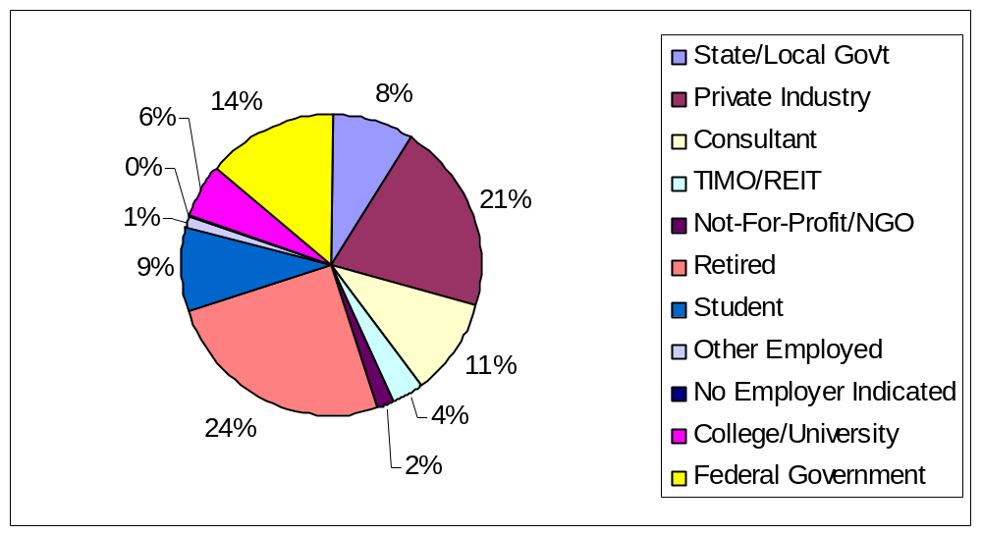
By Employer

Slide 25
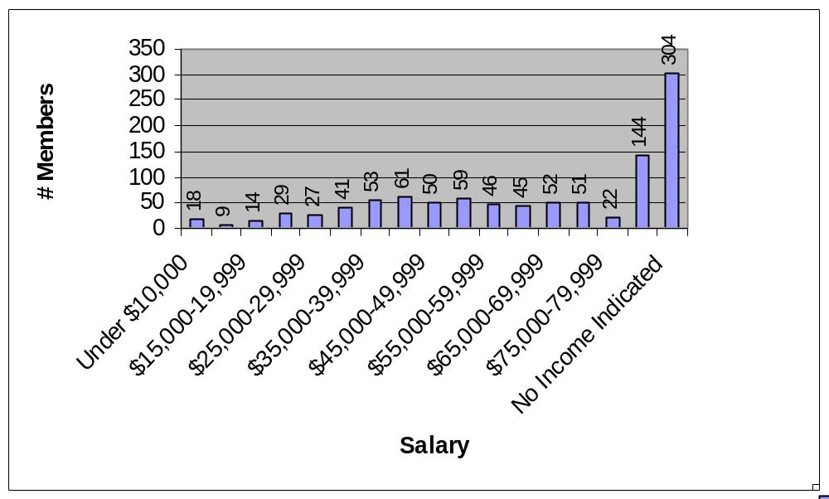
By Salary

Slide 26
By Position
Resource Manager | 1 | 0.10%
Owner | 19 | 1.85%
Retired | 258 | 25.17%
Student | 20 | 1.95%
Management/Administration | 263 | 25.66%
Staff Specialist | 93 | 9.07%
Field Forestry | 150 | 14.63%
Researcher/Educator | 84 | 8.20%
Other | 51 | 4.98%
No Position Indicated | 86 | 8.39%

Slide 27
Thank You
Shaun Harkins, C.F.
Plum Creek
Membership Co-Chair- OSAF
541-267-1855
shaun.harkins@plumcreek.com

