Slide 1
COMPUTER NETWORKS PROJECT
AI-Based Network
Traffic Prediction
Using Long Short-Term Memory (LSTM) Neural Networks
Deep Learning • Time-Series Forecasting • Telecommunications • Quality of Service

Slide 2
Problem Statement & Objectives
THE PROBLEM
PROJECT OBJECTIVES
Networks suffer from two extremes:
❌ Under-provisioning
Dropped packets, high latency, poor user experience
❌ Over-provisioning
Wasted energy, excessive operational costs
Root cause: No ability to forecast future bandwidth demand from historical logs.
01
Generate & analyze a realistic temporal network traffic dataset
02
Design a deep learning LSTM forecasting architecture
03
Evaluate model accuracy using regression metrics (MAE & RMSE)
04
Demonstrate AI's advantage over traditional statistical methods

Slide 3
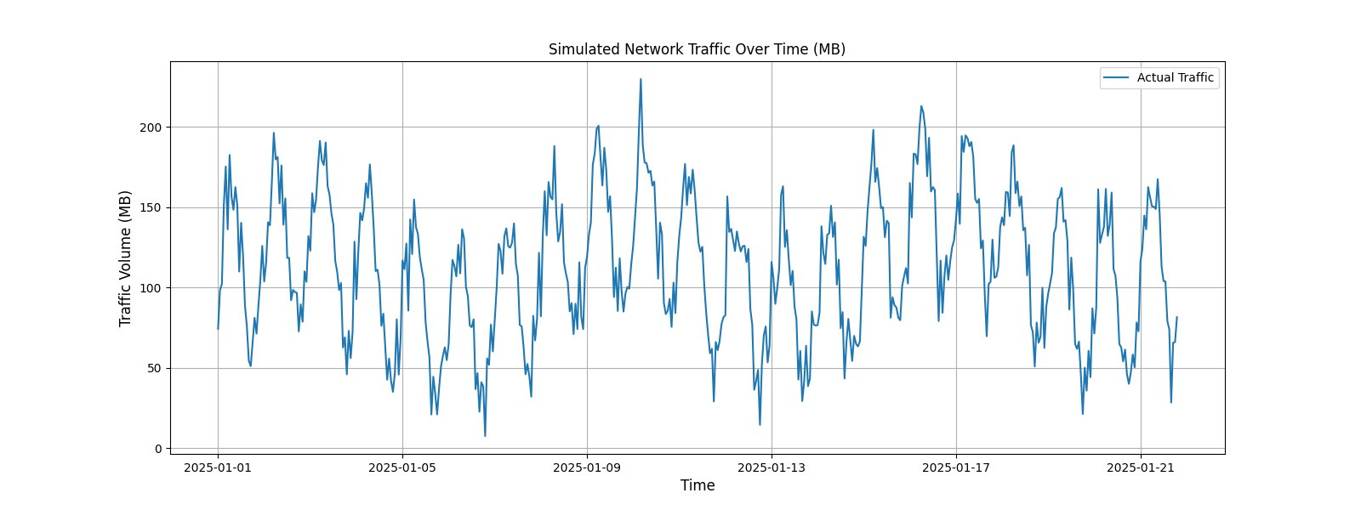
Dataset
Synthetic time-series data mimicking real-world ISP network traffic
2,500
~104
1
3
Hourly Records
Days of Data
Feature: Traffic (MB)
Signal Components

Slide 4
Methodology
1
Data Generation
2
Preprocessing
3
Model Selection
Synthetic hourly traffic with upward trend, daily (24h) & weekly (168h) seasonality + Gaussian noise
MinMax Normalization [0,1] + Sequence structuring: X = [t₁…t₄₈] → y = t₄₉
Two-layer LSTM with Dropout(0.2) regularization — handles both short & long-term temporal dependencies
4
Training
5
Testing & Inference
80/20 train-test split · Adam optimizer · MSE loss · 15 Epochs · Batch size 32
Predictions on unseen data with inverse MinMax transformation to evaluate real-world MB values

Slide 5
LSTM Architecture
INPUT LAYER
LSTM LAYER 1
DROPOUT 20%
LSTM LAYER 2
DROPOUT 20%
DENSE OUTPUT
Rolling window
48-hour sequence
50 units
return_sequences=True
Prevents overfitting
Randomly freezes neurons
50 units
return_sequences=False
Second regularization
pass
1 unit
Next-hour traffic (MB)
Why LSTM?
Optimizer
Loss Function
Handles both short-term (last hour) and long-term (same time last week) traffic dependencies via forget/input/output gates
Adam (Adaptive Moment Estimation) — combines AdaGrad + RMSProp for fast, stable convergence
Mean Squared Error (MSE) — penalizes larger prediction errors more heavily, ideal for traffic spikes

Slide 6
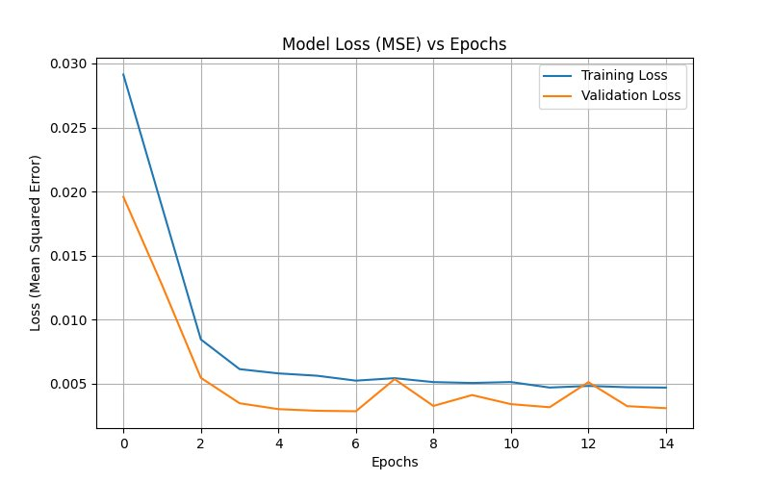
Model Training Results
Rapid Convergence
Training loss dropped sharply from 0.029 to ~0.005 within just 3 epochs
No Overfitting
Validation loss closely tracks training loss — Dropout regularization working effectively
Stable at Epoch 7+
Both curves plateau and remain flat, indicating the model has learned the underlying traffic pattern
Config: 15 Epochs • Batch 32 • 80/20 Split • 10% Validation

Slide 7
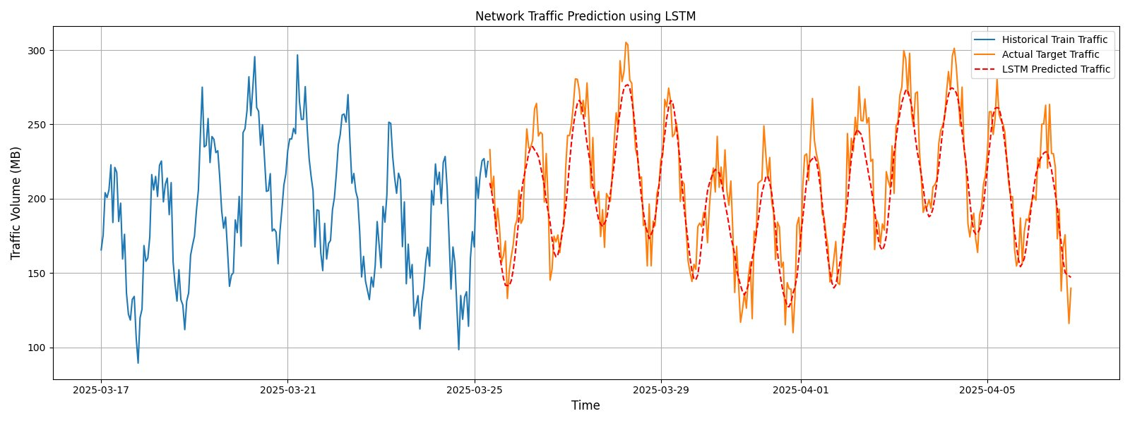
Prediction Results
MAE
RMSE
Pattern Tracking
14.74 MB
18.28 MB
✔ Excellent
Avg hourly deviation
Penalizes spike errors
Seasonality & trend captured

Slide 8
Why AI Outperforms Traditional Methods
Criterion | ARIMA | SVR | LSTM (This Project)
Non-linear Data | ✗ Weak | Partial | ✔ Strong
Auto Feature Extraction | ✗ Manual | ✗ Manual | ✔ Automatic
Long-Term Memory | ✗ No | ✗ No | ✔ Cell State
Scales with Big Data | ✗ Slow | Moderate | ✔ GPU-Ready
Seasonal Recognition | Partial | Partial | ✔ Daily + Weekly
LSTM's gated cell structure retains both short-term spikes and long-term seasonal patterns — eliminating the need for manual feature engineering required by classical approaches.

Slide 9
Real-World Applications
NETWORK MANAGEMENT
SECURITY
SUSTAINABILITY
Smart Networks (SDN/NFV)
Cybersecurity & Anomaly Detection
Energy Optimization
Predictions enable dynamic instantiation of virtual network machines exactly where and when traffic surges, maximizing network elasticity and uptime.
An AI-predicted 'normal' traffic baseline allows sudden deviations — such as DDoS attacks — to trigger security alerts before routers are overwhelmed.
Base stations and server racks enter sleep mode during confidently predicted low-traffic periods, significantly reducing carbon footprint and operational costs.

Slide 10
Future Scope
01
Multivariate Forecasting
Incorporate external signals — weather patterns, public event calendars, CPU server metrics — as additional input features to improve prediction accuracy.
02
Real-Time Streaming Integration
Connect to Apache Kafka to ingest live data from network switches and feed predictions directly to SDN controllers for autonomous traffic management.
03
Federated Learning
Train models locally on decentralized edge routers, preserving client privacy while still enabling network-wide intelligence — critical for compliance with data protection laws.

Slide 11
Conclusion
LSTM successfully modeled complex daily and weekly network traffic seasonality without manual feature engineering.
Model achieved MAE of 14.74 MB and RMSE of 18.28 MB on unseen data, demonstrating reliable real-world accuracy.
Rapid convergence in training (3 epochs) with no overfitting confirms that the Dropout regularization strategy was effective.
Deep Learning provides a scalable, automated, and intelligent approach to network management — far surpassing traditional ARIMA and SVR baselines.
AI-Based Network Traffic Prediction using LSTM • Deep Learning for Telecommunications

