Slide 1
Big Data Analytics
Getting to Know Data & Exploratory Data Analysis
EDA: Purpose & Benefits
Size, Dimension, and Resolution of Data Types of Attributes
Statistical EDA
Measures of Central Tendencies and Spread Bivariate EDA: Correlation, Contingency Table
Graphical EDA
Types of Diagrams
Imdad ullah Khan
Getting to know Data & EDA

Slide 2
Exploratory Data Analysis (EDA): Purpose and Benefits
EDA: Initial investigation of data using summary statistics and diagrams
Objectives of EDA are to
understand data (what it is, where it comes from, what does it represent, kind of values, specific characteristics of data)
find out if there are missing values? (how to deal with them!) spot anomalies (are there outliers?)
discover patterns (how does the data look like?)
understand relationships between features (measure similarity, distance and relationship type)
check our assumptions visually describe the data
Getting to know Data & EDA

Slide 3
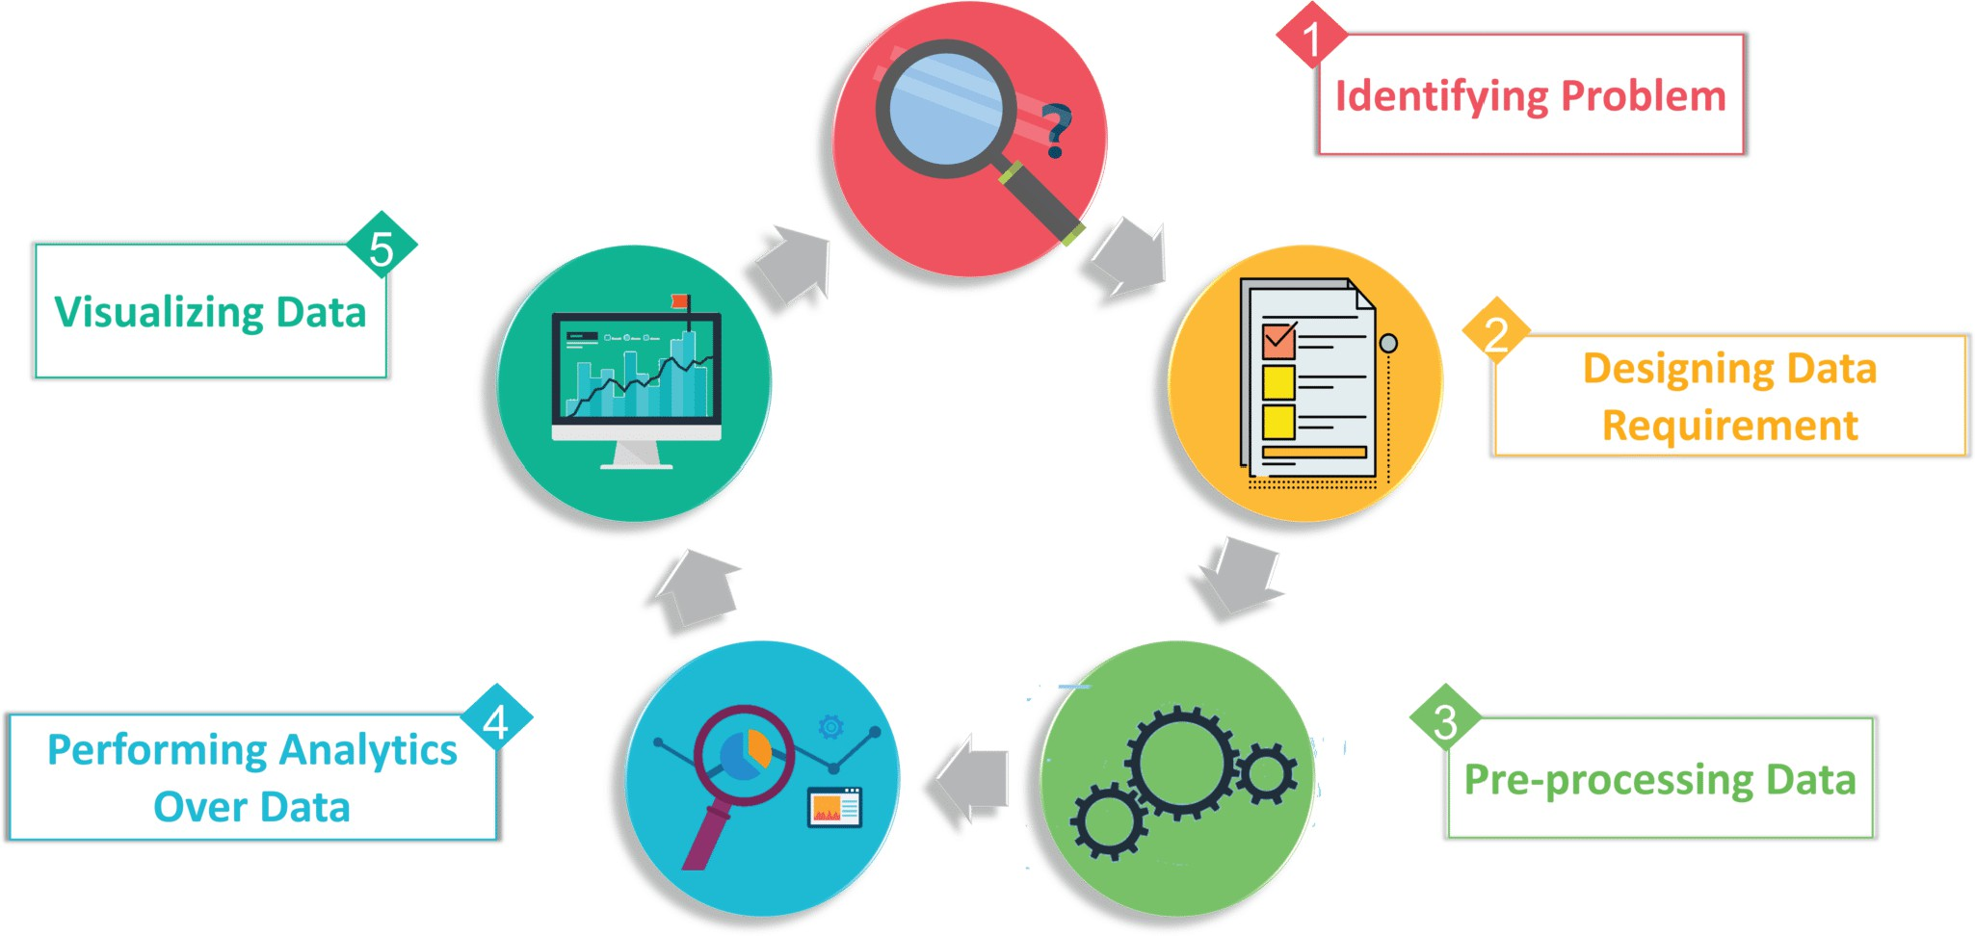
EDA: Purpose and Benefits
Preliminary exploration and inspection of data is essential for analysis
It guides preprocessing steps
It gives a clear picture of data sizes, which helps in selecting the right data structures, tools and even modeling strategies
Could help reduce data sizes (dimensions or records)
Getting to know Data & EDA

Slide 4
Data object and Attribute
Data object
represents an entity in the data set
also called data item, point, instance, example, sample, row, observation
e.g. a patient, movie, student, customer, product, book, tweet described by a set of attributes
Attribute
is a data field, representing a feature/characteristic of data objects also called variable, feature, dimension, column, coordinate, field
e.g. reaction to a test, genre/director, course, address, price/category, author, publisher, word
Getting to know Data & EDA

Slide 5
Size and dimensions of data
Size of Data refers to number of data objects
Dimension of Data refers to number of attributes
Sparsity in Data
If most of the feature values are missing, then the data is called sparse
Missing values could be represented as NaN, blank, -, 0 This could be a problem for many statistical methods
For efficient computation, can use libraries for sparse data
e.g. sparse matrix multiplication, sparse storage schemes
Getting to know Data & EDA

Slide 6
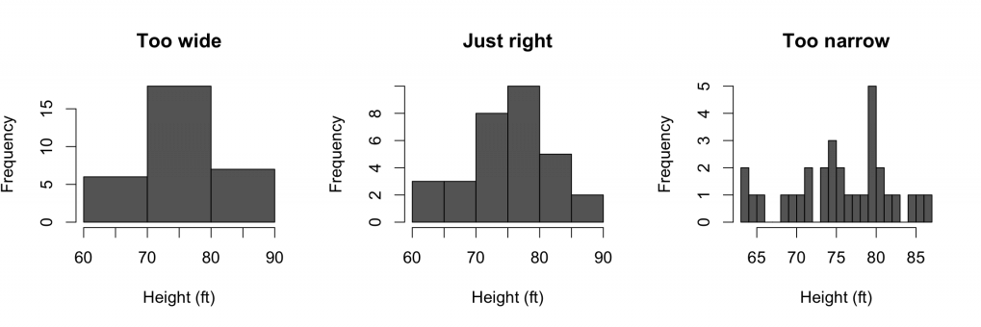
Resolution of Data
Different resolution reveal different patterns
If resolution is too fine, a pattern may be buried in noise If the resolution is too coarse pattern may disappear
See number of bins in histograms below
Getting to know Data & EDA

Slide 7
Types of Data
Types of data based on number of attributes
Univariate Data Bivariate Data Multivariate Data
Getting to know Data & EDA

Slide 8
Types of Data
Univariate: Consists of only one feature per observation. Analysis deals with only one quantity that changes
Heights (cm)
164
167.3
170
174.2
178
180
186
What is the average height?
How much the values deviate form the average height?
Getting to know Data & EDA

Slide 9
Types of Data
Bivariate: Involves two different features per observation
Analysis of this type of data deals with comparisons, relationships, causes and explanations
Temperature ( C) | Ice Cream Sales
20 | 2000
25 | 2500
35 | 5000
43 | 7800
Are the temperature and ice cream sales related/dependent? As temperature increases, sales also increases
Getting to know Data & EDA

Slide 10
Types of Data
Multivariate: Objects are described by more than 2 features
To see if one or more of them are predictive of a certain outcome
The predictive variables are independent variables and the outcome is the dependent variable
Roll Num | CS100 | SS101 | MT200 | MGMT240 | Major
19100115 | A | B | B | C | CS
19100120 | B | A | B | C | PHY
19100122 | B | B | C | A | CS
19100126 | C | A | C | A | EE
19100127 | B | A | C | C | CS
19100133 | C | B | A | B | PHY
19100135 | C | C | A | C | Maths
Getting to know Data & EDA

Slide 11
Types of Attributes
Getting to know Data & EDA

Slide 12
Types of Attributes
Roll Num | Gender | Grade | Age | Major
19100115 | Male | B | 23 | CS
19100120 | Male | A | 22 | PHY
19100122 | Female | B | 21 | CS
19100126 | Male | C | 19 | EE
19100127 | Female | A | 21 | CS
19100133 | Female | B | 20 | PHY
19100135 | Male | C | 22 | Maths
Nominal/Categorical Attributes Ordinal Attributes
Numeric Attributes
Getting to know Data & EDA

Slide 13
Types of Attributes: Nominal/Categorical
Possible values are symbols, labels or names of things, categories
gender, major, state, color
Describe a feature qualitatively and values have no order
Not quantitative, arithmetic operations can’t be performed on them male − female = ?? green + blue = ??
Can code by numbers (numeric symbols) e.g. postal codes, roll numb frequency of values and the most frequent value
Can compute
middle value
average value of an attribute
Binary Attribute: - special case of nominal true/false, Pass/Fail, 0/1 Symmetric: Both symbols carry the same weight e.g. gender Asymmetric: Both symbols are not equally important, e.g. Pass/Fail
Getting to know Data & EDA

Slide 14
Types of Attributes: Ordinal Attributes
Possible values have meaningful order
Grades : A,B,C,D
Serving Sizes : Small, Medium, Large Ratings : poor, average, excellent
No quantified difference between two levels
A is higher/better than B but
Cannot quantify how much higher is A than B, or
if the difference between A and B the same as the difference between B and C
Can be obtained by discretizing numeric quantities (data reduction)
frequency of values and the most frequent value middle value
average value of an attribute
Can compute
Getting to know Data & EDA

Slide 15
Types of Attributes: Numeric Attributes
Quantitative and measurable
can quantify the difference between two values
temperature, age, number of courses, height, years of experience
frequency of values and the most frequent value
Can compute
middle value
average value of an attribute
Discrete Numeric Attributes
values come from a finite or countably infinite sets
Continuous Numeric Attributes
values are real (continuous)
Interval-Scaled: No point 0, ratios have no meaning
e.g. Temperature in Celsius. 30◦ is not double as hot as 15◦
Ratio-Scaled: Well-Defined point 0, ratios are meaningful
e.g. Temperature in Kelvin. 30◦ is double as hot as 15◦
Getting to know Data & EDA

Slide 16
Statistical EDA
Getting to know Data & EDA

Slide 17
Statistical Description of Data
Estimates that give an overall picture of data
Summary statistics are numbers that summarize properties of data Typical values of variables (features/attributes)
Spread and distribution of values Dependencies and correlations among variables
Getting to know Data & EDA

Slide 18
Measures of Central Tendencies
These measures describe the location of data
location of concentration or middle of data
Data is “distributed” around this “center” Computed for each attribute
Three common types of locations
Mode Mean Median
These measures do not give information regarding
extreme values in data distribution or spread of the data
Getting to know Data & EDA

Slide 19
Frequency
Nominal and Ordinal attributes are generally described with frequencies
The frequency of a value is the number of times the value occurs in the dataset
Some time we use fraction or percentage of time the value appears
Probability mass function
Getting to know Data & EDA

Slide 20
Measures of Central Tendencies: Mode
For location of nominal and ordinal attributes one can use the most frequent value
Mode is the most frequent element Can have more than one modes
unimodal (one mode in data)
multi-modal (bimodal, trimodal): more than one modes in data
Not the same as the Majority element (a value with frequency more than 50%)
Getting to know Data & EDA

Slide 21
Measures of Central Tendencies: Mean
For a dataset X = {x₁, x₂, · · · , x_{n}}
(Arithmetic) Mean is the average of the data set
▷ This definition readily extend to higher dimensional data
Σ
x₁ + x₂ + . . . + x_{n}
n
n
x_{i}
x =
=
i=1
n
Weighted Mean
Σ
n
w_{i}x_{i}
x = Σ
i=1
n
w
i =1
i
Harmonic Mean
n
x =
Σ
n 1
i =1 x_{i}
Geometric Mean
n
^{!1}/n
Y
x =
x_{i}
i =1
Getting to know Data & EDA

Slide 22
Other Types of Mean
Arithmetic mean is sensitive to outliers ▷ unstable statistic Just one very high/low value (think ±∞) makes mean very high/low
2.5 2.5 3 3.5 3.5 3.5 3.5 4 4 4 4.5 4.5 4.5 5 5 5.5 5.5 6 98 99
5
99
Mean = 13.57
Trimmed Mean: Ignore k% of values at both extremes to compute mean
2.5 2.5 3 3.5 3.5 3.5 3.5 4 4 4 4.5 4.5 4.5 5 5 5.5 5.5 6 98 99
5
99
Mean = 4.34
Getting to know Data & EDA

Slide 23
Measures of Central Tendencies: Median
Median is the middle value of a dataset
Odd/even number of values
Median is less sensitive to outliers as compared to mean
Median is good for asymmetric distributions and where data has outliers
5
Median = 4.25 Mean = 13.57
99
Various possible definitions for median of higher dimensional data Mean together with variance (see below) has nice properties
Getting to know Data & EDA
23 / 64

Slide 24
Measures of Spread
Location measures do not tell anything about extremes or spread (how extreme are the extremes)
Measures of spread describe distribution of data
Max Min
Range := max - min
Midrange := average of min and max
Inter-Quartile Range := 3rd quartile - 1st quartile Low Spread Mid-spread High Spread Variance and Standard Deviation
Getting to know Data & EDA

Slide 25
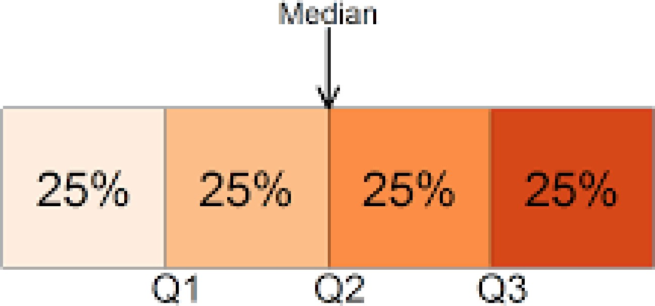
Quantile
Quantiles are points taken at regular interval so as data is divided into roughly equal sized consecutive subsets
The i th q-quantile is a data point x such that ∼ ^{i}/q fraction of points are less than x and ∼ ^{(q−i )}/q fraction of points are greater than x
Median is the first 2-quantile
3rd quartile := 3rd 4-quantile := 75 percentile
Getting to know Data & EDA

Slide 26
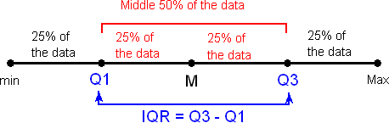
Measures of Spread
Getting to know Data & EDA

Slide 27
Five-Number Summary
Five-number summary (elementary EDA of numeric univariate data)
Min
˛
maximum
(100th percentile)
1st /lower quartile
˛
^{upper quartile} (75th percentile)
interquartile range
x`
data range
x`
median (50th percentile)
Median
2nd /upper quartile
Max
¸
lower quartile (25th percentile)
¸
minimum
(0th percentile)
0
Getting to know Data & EDA

Slide 28
EDA: Measures of Spread
Variance: Measures the deviation in values relative to mean
Σ
n
(x_{i} − x )²
σ
2 ₌ i=1
n
Varaince is mean squared deviation from mean
Squared to avoid cancellation of +ve and −ve deviation
Mean deviation could be 0 for data with significant spread mean and average distance from mean of both
{−5, −10, 5, 10} and {−100, −50, 50, 100} are 0 and 0
▷ There is significantly more spread in the latter data
Σ_{n}
Mean Absolute Deviation: MAD :=
i =1
n
|x_{i} −x|
Variance is easy to compute and has useful mathematical properties
Getting to know Data & EDA

Slide 29
Measures of Spread
Standard Deviation
Variance has different unit than that of original data
Standard deviation also measures deviation in values relative to mean Standard deviation is the square root of variance
r
Σ
n
(x_{i} − x )²
σ =
i=1
n
Standard deviation restores the measure to the original unit of data
Getting to know Data & EDA

Slide 30
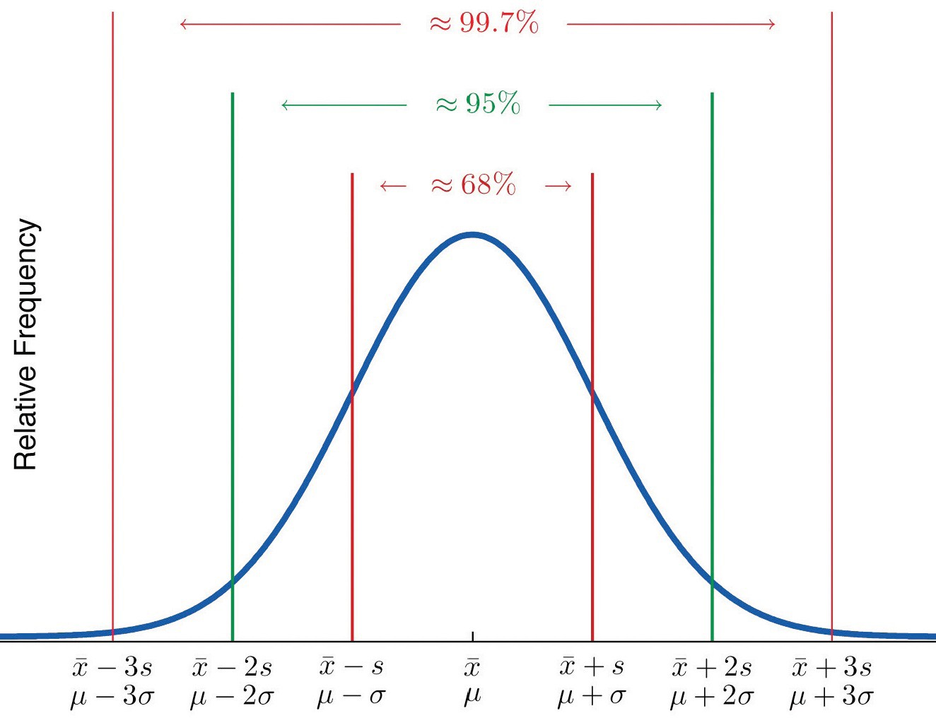
Normal Distribution (Bell-Curve)
For normal distribution, there are guarantees that certain number of values must fall within k st-dev from the mean
At least ∼ 68% must lie within k = 1 st-dev (x ± 1σ) At least ∼ 95% must lie within k = 2 st-dev (x ± 2σ) At least ∼ 99.7% must lie within k = 3 st-dev (x ± 3σ)
Getting to know Data & EDA

Slide 31
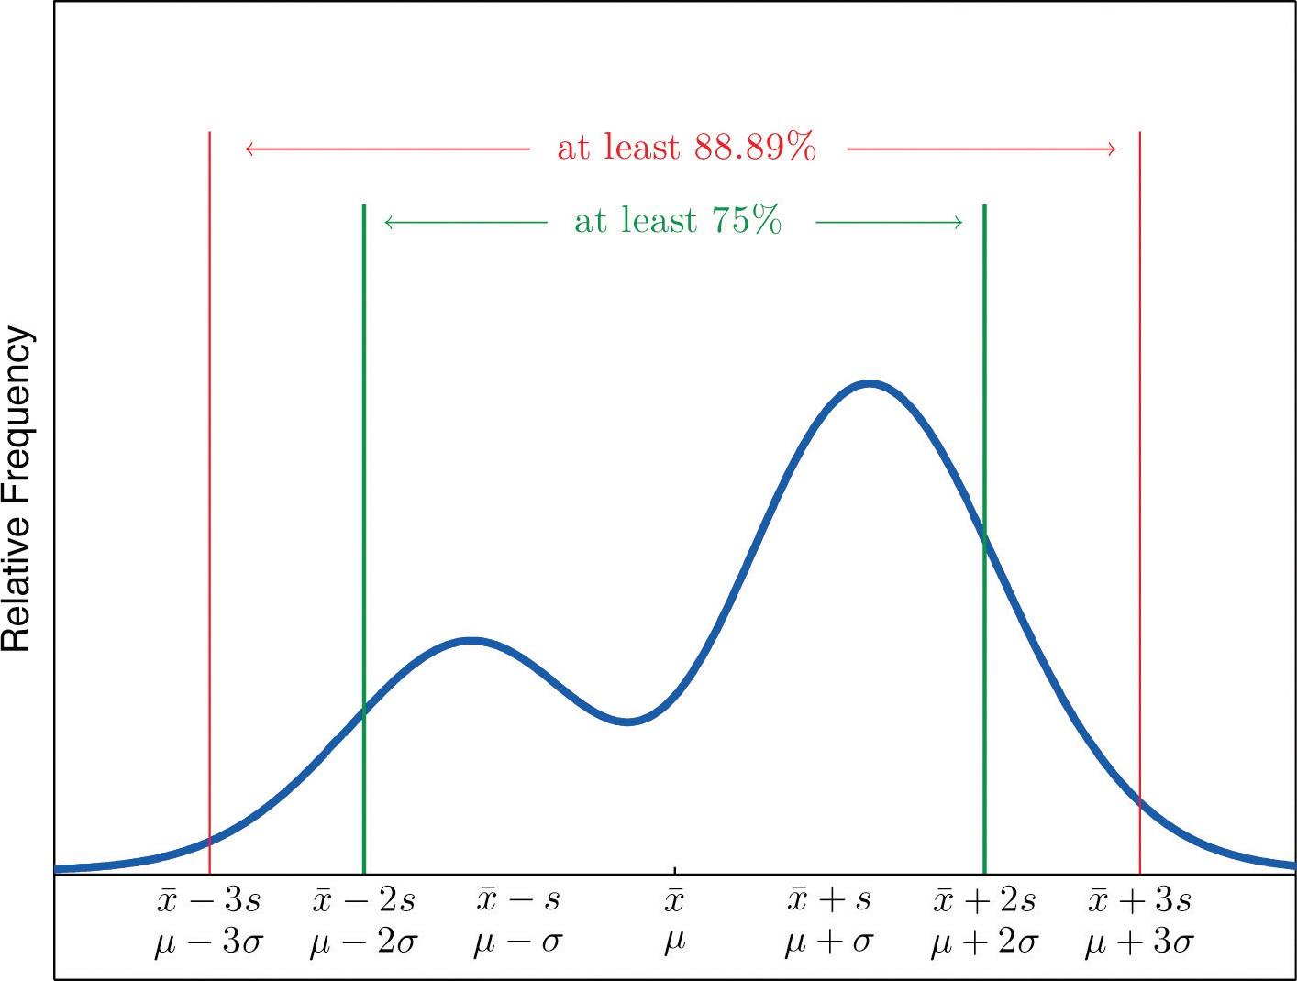
EDA: Three-Sigma Rule - The Empirical Rule
For any distribution of data, there are guarantees that certain number of values must fall with k st-dev from the mean
At least ∼ 75% must lie within k = 2 st-dev (x ± 2σ) At least ∼ 89% must lie within k = 3 st-dev (x ± 3σ) At least ∼ 93% must lie within k = 4 st-dev (x ± 4σ)
Getting to know Data & EDA

Slide 32
Bivariate Measures
Used for bivariate data or pairs of attributes, more detail later
Nominal or Ordinal Attributes
Contingency Table
χ² statistics
Numeric Attributes
Covariance Correlation Correlation Matrix
Getting to know Data & EDA

Slide 33
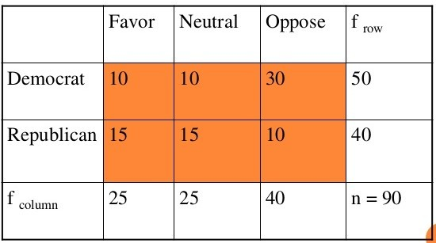
Contingency Table
Contingency table summarizes data with two nominal or ordinal features Used to determine whether the variable pair is correlated (χ²-Test)
(nominal) A and B taking values in {a₁, a₂, . . . , a_{p} } and {b₁, b₂, . . . , b_{q} }
f_{ij} : frequency of joint occurrence of (a_{i} , b_{j} )
▷ observed frequency of the joint event (A = a_{i} , B = b_{j} )
Contingency Table:
 | a₁ | a₂ | . . . | a_{p}
b₁
b₂
. |  |  | fij
b_{q}
C =
Getting to know Data & EDA

Slide 34
χ²-test for two attributes A and B
χ²-statistic: A “correlation” between two nominal attributes A and B
taking values in {a₁, a₂, . . . , a_{p} } and {b₁, b₂, . . . , b_{q} }
f_{ij} : frequency of joint occurrence of (a_{i} , b_{j} )
▷ observed frequency of the joint event (A = a_{i} , B = b_{j} )
The expected frequency, e_{ij} of the joint event (A = a_{i} , B = b_{j} ), under independence assumption
Σ_{q}
Estimating probability, P = Pr {A = a } =
^{f}ij
, N = pq
a i
j=1
N
i
e_{ij} = P_{ai} · P_{bj} · N
The χ² value (Pearson’s χ²-statistics) is
p q 2
Σ Σ (f − e )
ij ij
i =1 j=1
eij
Large χ² values indicates variables are related
Getting to know Data & EDA

Slide 35
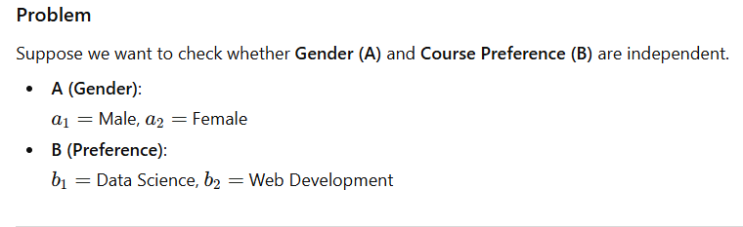
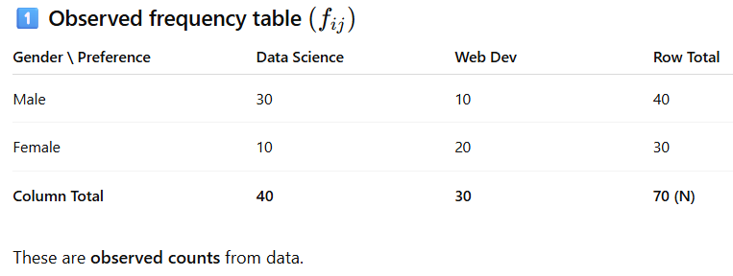

Slide 36
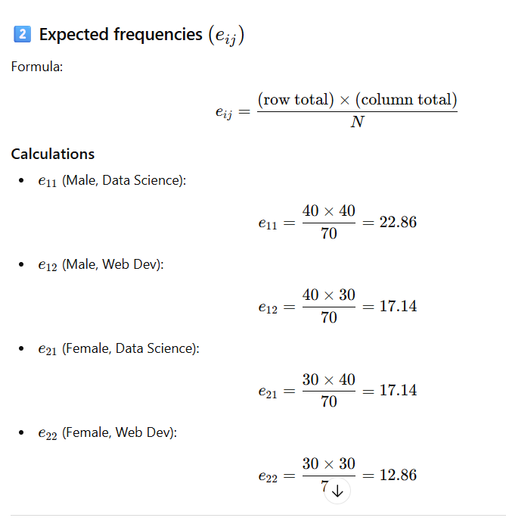

Slide 37
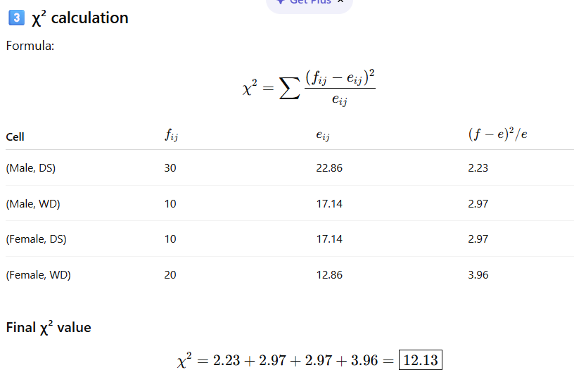

Slide 38
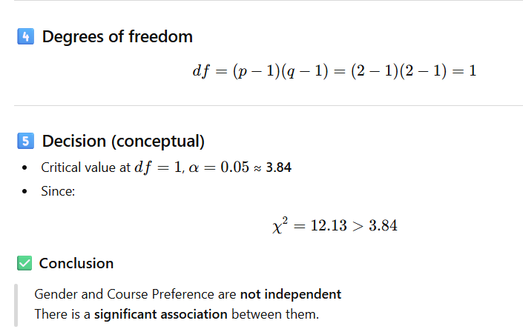

Slide 39
Covariance and Correlation
Covariance and correlation are helpful in understanding the dependency/relationship between two numeric variables
Covariance between two variables x = {x₁, x₂, · · · , x_{n}} and
y = {y₁, y₂, · · · , y_{n}} with means x and y , resp. is defined as
Σ
n
(x_{i} − x)(y_{i} − y)
cov(x, y) =
i=1
n
▷ Covariance reveals the “proportionality” between variables
Note when x_{i} and y_{i} both are greater or smaller than their respective means, (x_{i} − x)(y_{i} − y) is positive and vice-versa
cov(x, y) < 0 =⇒ inverse proportionality cov(x, y) > 0 =⇒ direct proportionality cov(x, y) = 0 =⇒ no linear relation
Getting to know Data & EDA

Slide 40
Covariance and Correlation
Some properties of covariance that readily follow from definition
cov(x, y) = cov(y, x)
cov(x, x) = var(x, x)
If x and y are independent, then cov(x, y) = 0 For constant a and b
cov(x, a) = 0
cov(ax, by) = ab cov(x, y)
cov(x + a, y + b) = cov(x, y)
cov(x, y + z) = cov(x, y) + cov(x, z)
Getting to know Data & EDA

Slide 41
Covariance and Correlation
Correlation
Covariance depends on magnitude and scale of variable x and y
Correlation quantifies how strongly two variables are linearly related
cov(x, y)
r_{xy} = corr (x, y) =
σ .σ
x y
−1 ≤ corr (x, y) ≤ 1
It is not affected by changes in scale of variables x and y
corr (x, y) = −1 =⇒ perfect negative linear association corr (x, y) = 1 =⇒ perfect positive linear association corr (x, y) = 0 =⇒ no linear association
Getting to know Data & EDA

Slide 42
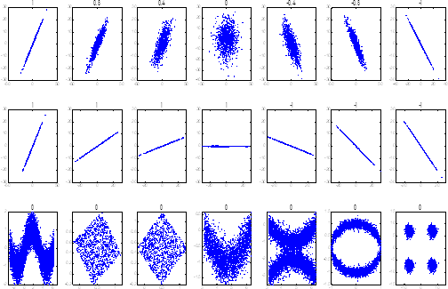
Correlation
1 0.8 0.4 0 −.4 −.8 −1
1
1
1
1
−1
−1
−1
0
0
0
0
0
0
0
Figure: x and y -axis represent variables - their correlations is on the top
Getting to know Data & EDA

Slide 43
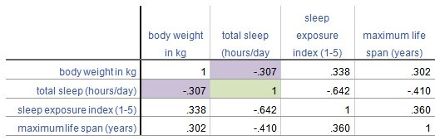
Correlation matrix
For multi-variate numeric data correlation matrix is
A table of pairwise correlation coefficients between variables Each cell shows the correlation between two variables
Used to summarize data, as an input into a more advanced analysis, and as a diagnostic for advanced analyses
Also used to remove redundant variables
Getting to know Data & EDA

Slide 44
Graphical EDA
Getting to know Data & EDA

Slide 45
Diagrammatic Representations of Data
Easy to understand: Numbers do not tell all the story. Diagrammatic representation of data makes it easier to understand
Simplified Presentation: Large volumes of complex data can be represented in a simplified and intelligible diagram
Reveals hidden facts: Diagrams help in bringing out the facts and relationships between data not noticeable in raw/tabular form
Easy to compare: Diagrams make it easier to compare data
Getting to know Data & EDA

Slide 46
Visualizing Data for Insight
Purpose of Graphical EDA: To reveal underlying structures, detect outliers and anomalies, and understand patterns within the data through visual methods.
Simplifies complex quantitative information. Facilitates faster comprehension and decision-making. Helps in spotting trends, patterns, and outliers.
Common Tools: Histograms, Box plots, Scatter plots, etc.
Getting to know Data & EDA

Slide 47
Types of Diagrams
We will briefly discuss and use the following types of diagrams
▷ More on importance of visualization later
Bar Charts Histogram Box Plot Scatter Plot Heat map Line Graph
Parallel Axis Plot Word-Cloud
▷ and also overlapping histogram
▷ and also side-by-side box-plots
▷ and scatter plot matrix
Getting to know Data & EDA

Slide 48
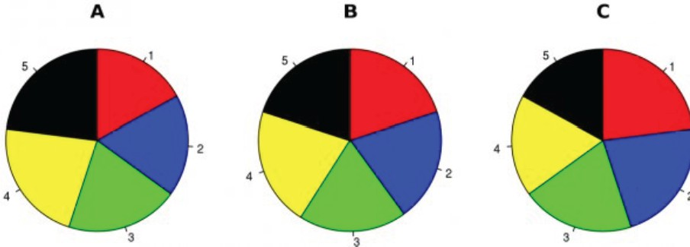
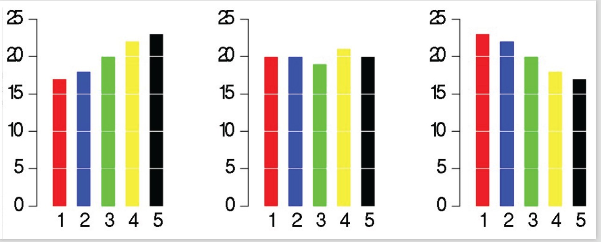
Bar charts
Generally used for a nominal and ordinal variables
Different bars (usually colored/shaded differently) for distinct values (levels, categories, symbols) of the variable
Height of bar represent frequencies of each symbol (value)
Can reveal variables that have no or limited information e.g. constants Note that we can use pie charts for the same purpose too
Humans perceive difference in lengths better than in angles
Getting to know Data & EDA

Slide 49
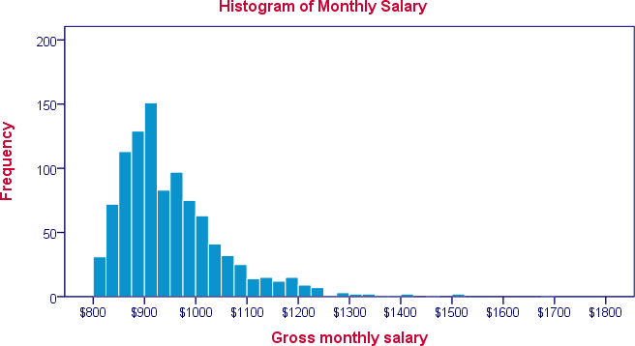
Histograms
Represent distribution of data in a numeric/continuous variable (estimates probability distribution of a numeric variable)
Group values by a series of intervals (bins - usually consecutive non-overlapping subintervals covering range of data)
Plot the number of values falling in each bin (represented by the height of the bar)
Normalized histogram shows proportion of values in each bin
Getting to know Data & EDA

Slide 50
Histograms
A histogram with appropriate number/length of bins reveals
Where is the data located Where/what are the extremes What is the distribution of the data How the data is spread out
If the distribution is symmetric or have skew (left or right) Whether the data is unimodal, bimodal or more
Can also detect outliers in the data if any
Getting to know Data & EDA

Slide 51
Histograms
Number and sizes of bins are important considerations Bins do not have to be of equal sizes
For unequal bin sizes height of the bar is not the frequency of values in the bin, it is the frequency density
Area of the bar is proportional to the frequency Number of items per unit of the variable of x -axis
Too many bins in histogram gives too much unnecessary details (shows too much noise)
Too few bins give almost nothing, obscure the underlying patterns
Getting to know Data & EDA

Slide 52
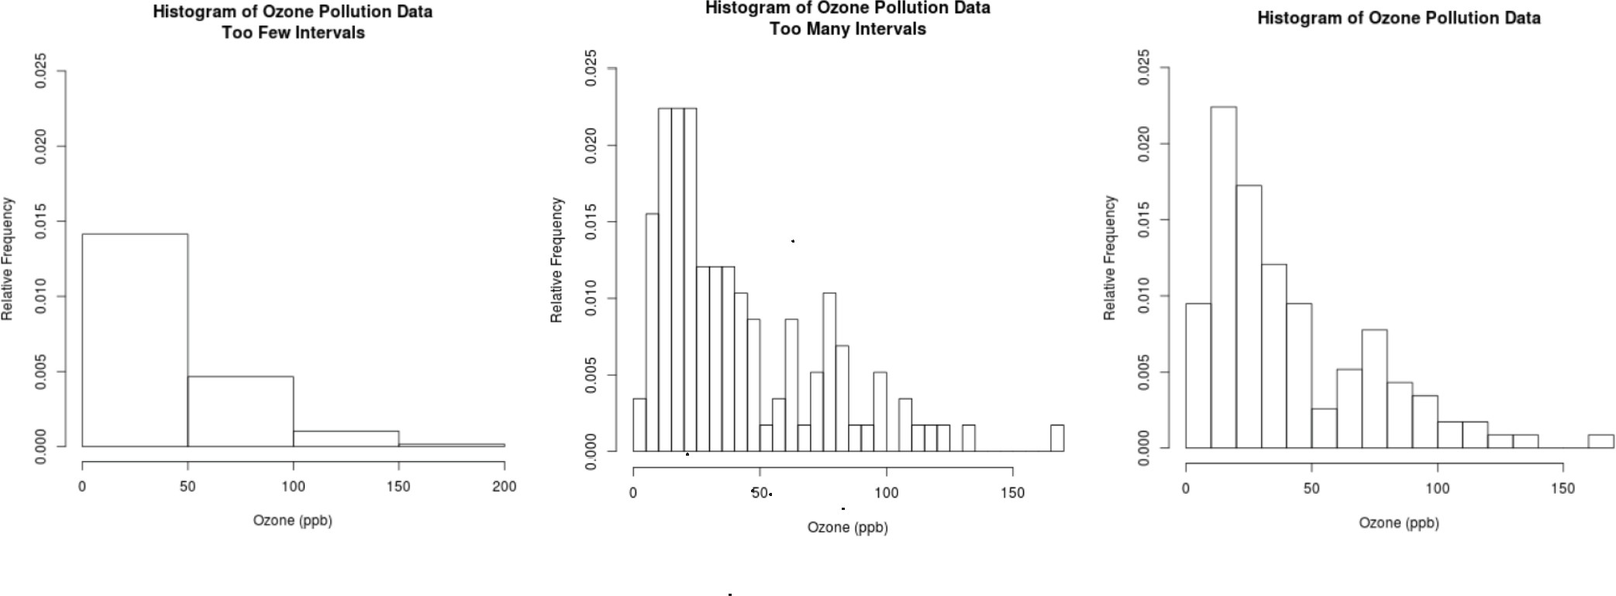
Histograms
Getting to know Data & EDA

Slide 53
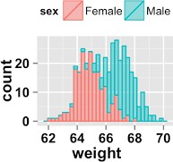
Overlapping Histograms
Useful in observing distribution of values with respect to a nominal variable
Getting to know Data & EDA

Slide 54
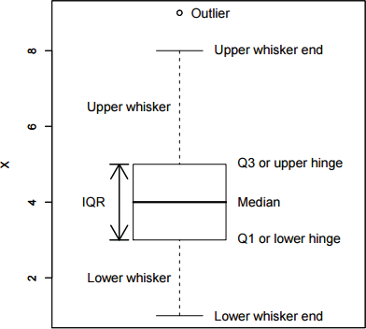
Box Plots
Another way of displaying the distribution of data (somewhat) Box-Plots or Box and Whisker diagrams
Getting to know Data & EDA

Slide 55
Box Plots
Box-Plots or Box and Whisker diagrams
Top and bottom lines of the box are 3rd and 1st quartiles of data Length of the box is the inter-quartile range (midspread)
The line in the middle of the box is median of data
The top whisker denotes the largest value in the data that is within
1.5 times midspread (Q3 × 1.5 · IQR)
Similarly the bottom whisker
Anything above and below the whiskers are considered outliers
Relative location of median within the box tells us about data distribution
We find out at what end are the outliers if any
Getting to know Data & EDA

Slide 56
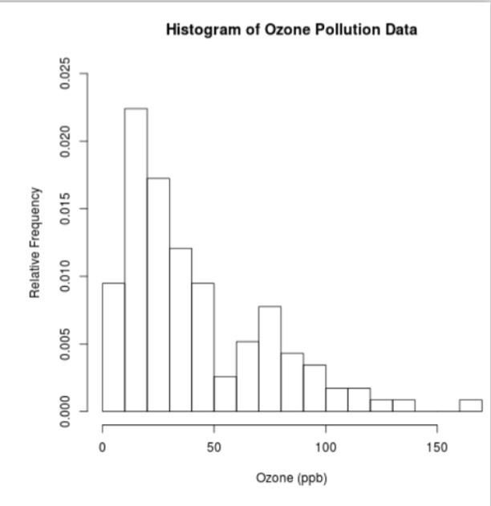
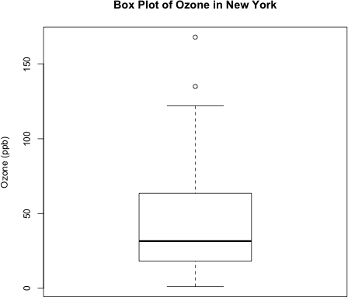
Box Plots
Can get some idea of skew by observing the shorter whisker
Various norms for whiskers (sometime) top whisker is 90th percentile
Uni-modality and multi-modality type information is generally not clear from box plots
Getting to know Data & EDA

Slide 57
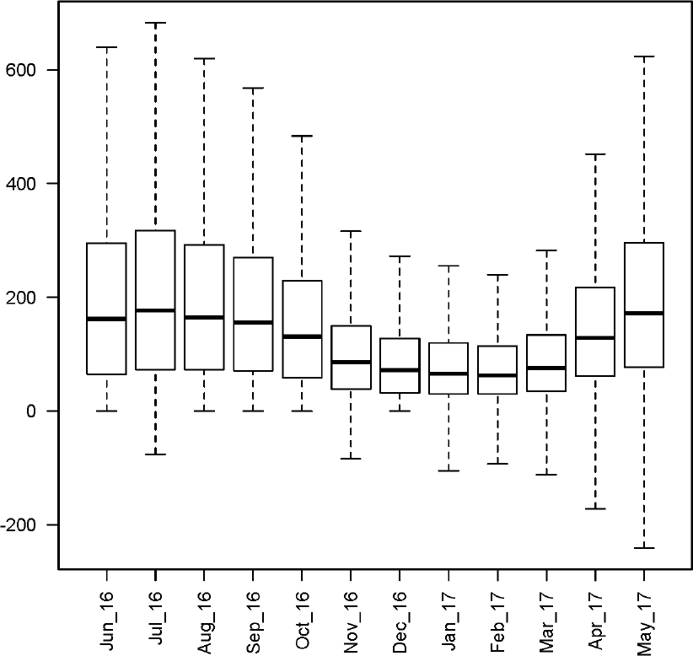
Side-by-side Box Plots
Extremely useful for comparisons of two or more variables.
To compare numeric variables, we draw their box-plots in parallel
Getting to know Data & EDA

Slide 58
Side-by-side Box Plots
Side by side groupwise box plots are extremely useful Groups are based on values of a categorical variable
It reveals whether a factor (the categorical variable) is important It addresses whether the location of data differ between groups
To some extent it also reveals whether distribution and variation differ between groups
Overlapping histograms are more suitable for the latter question, unless there is too much overlap
Getting to know Data & EDA

Slide 59
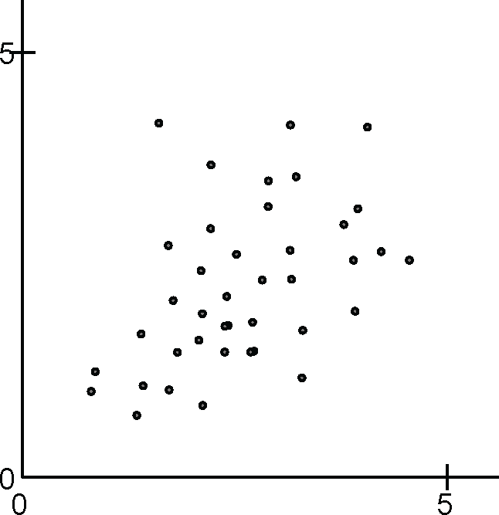
Scatter Plot
Scatter Plot is the best to visualize two dimensional numeric data
This directly represent the two dimensional observations as points in R². Plot one variable on x -axis and other on y -axis
Getting to know Data & EDA

Slide 60
Scatter Plot
Scatter Plot is the best to visualize two dimensional numeric data
This directly represent the two dimensional observations as points in R². Plot one variable on x -axis and other on y -axis
It shows how the two variables are related to each other
▷ reveals correlations between the variables
If one or both variables are highly skewed, then scatter plots are hard to examine, as bulk of the data is concentrated in a small part of plot
For this we should use some kind of transformation, explained later on one or both the variables
log-scaled plots can also be used in such cases
Getting to know Data & EDA

Slide 61
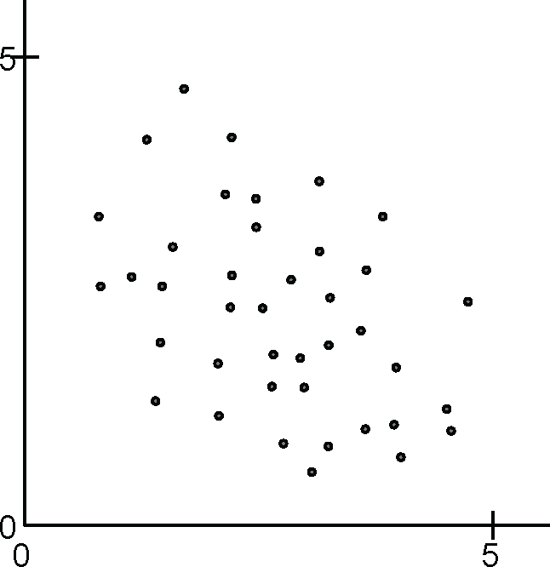
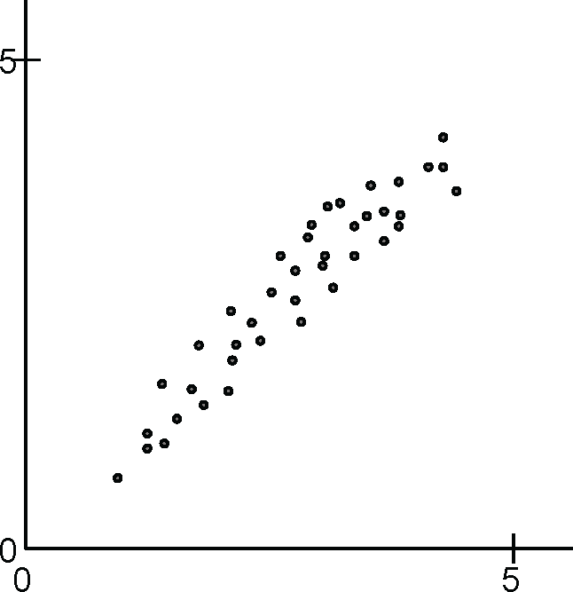
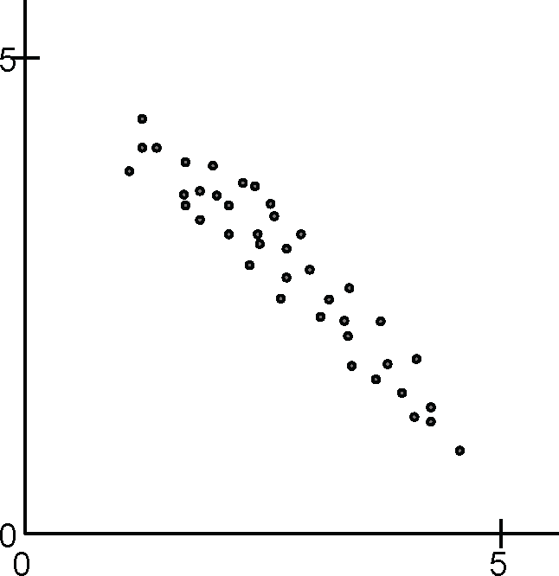
Scatter Plot
Getting to know Data & EDA

Slide 62
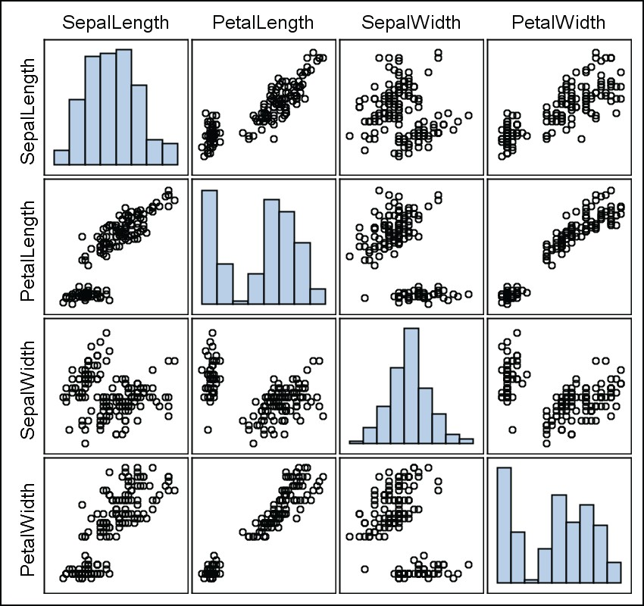
Scatter Plot Matrix
Pairwise scatter plots, pairwise correlations and individual histograms or density plots
Summarize the relationships of all pairs of numerical attributes
Getting to know Data & EDA

Slide 63
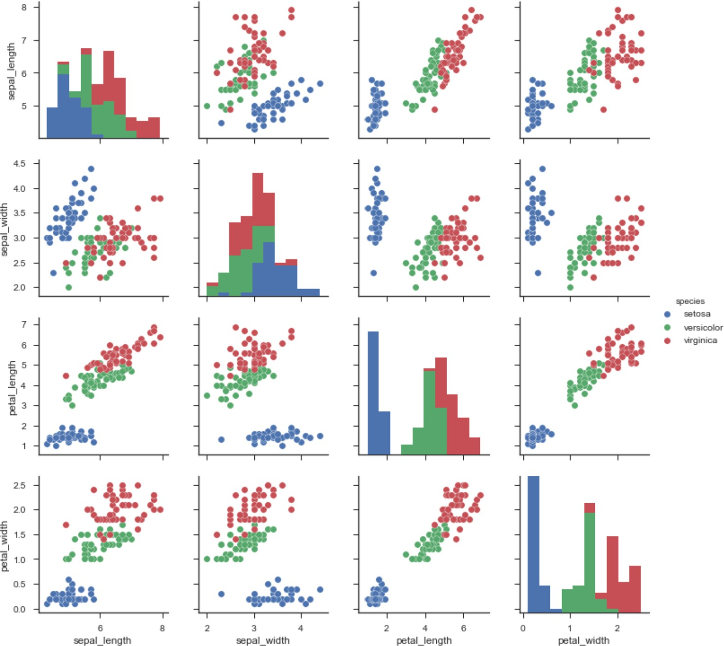
Scatter Plot Matrix
Scatter plot (matrix) can be combined with information in a nominal attribute encoded through color or marker shape
Getting to know Data & EDA

Slide 64
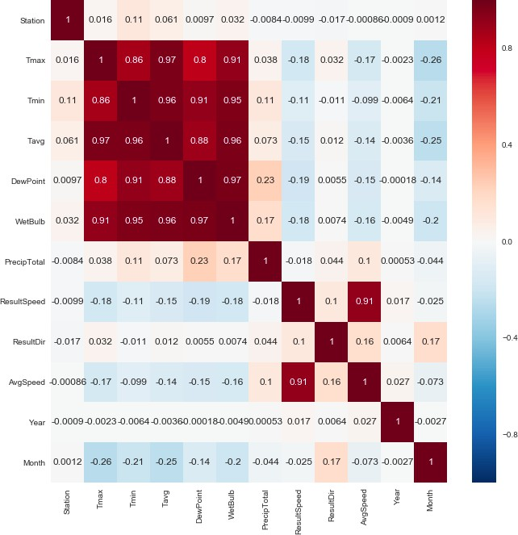
Presents pairwise relationship between attributes of multivariate data
Heat Map
Getting to know Data & EDA

Slide 65
Heat Map
Presents pairwise relationship between attributes of multivariate data Provides a numerical value of the correlation between each variable
Also provides an easy to understand visual representation of those numbers (colors shades)
Darker red showing high correlation
Dark blue showing none or negative correlation Can be used to visualize any matrix
Getting to know Data & EDA

Slide 66
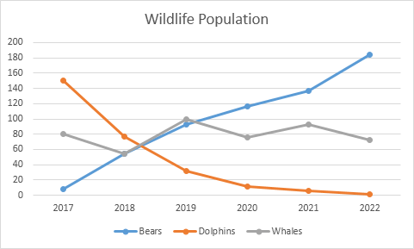
Line graphs
Line graphs are used for time series e.g. player’s yearly average, student’s semester gpa or hourly energy consumption
Two or more time series can be compared in different colors or markers (legend should be provided)
Getting to know Data & EDA

Slide 67
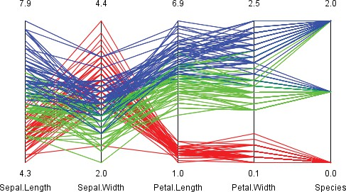
Parallel Axis Plot
Getting to know Data & EDA

Slide 68

Word-Cloud
Very useful in text analytics
A word cloud shows words used in a text corpus (collection of documents) with size of words proportional to their importance (e.g. tf-idf)
Quite clear that the word cloud on left is for a collection of articles about US politics, political news, while that on the right seems a corpus of astronomy/astrophysics
Getting to know Data & EDA

