Slide 1
Data Science

Slide 2
Thank you to Dr. Imadullah Khan(LUMS) for Slides

Slide 3

Introduction
What is Data Science?
The process of extracting knowledgeable insights from data using scientific methods and tools.
https://www.ontotext.com/wp-content/uploads/2016/06/Semantic-Information-Extraction.png

Slide 4
Introduction
Components of Data Science
There are four major components of data science:
  Data Strategy
  Data Engineering
  Data Modeling & Analysis
  Data Visualization & Operationalization

Slide 5
Introduction
Data Engineering
End to end data management is called data engineering:
  Understanding data sources (Formats, Types)
  Data Pipelines, Cleansing, Transformation, Enrichment
  Data Retention Management
  Data Marts
  Data Analysis & Visualization

Slide 6
Introduction
Data Modeling & Analysis
Data science is combination of various statistical models and software development techniques.

Slide 7
Introduction
Data Visualization & Operationalization
The graphical representation of data and information in the form of tables, charts, graphs & dashboards.
  Financial Reporting
  Operational Reports
  Historical Reports
  Forecasting & Planning

Slide 8
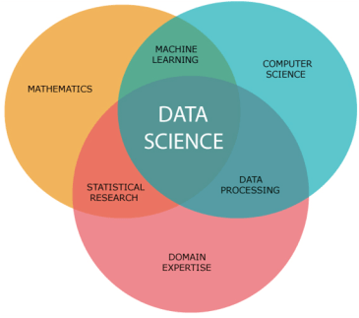
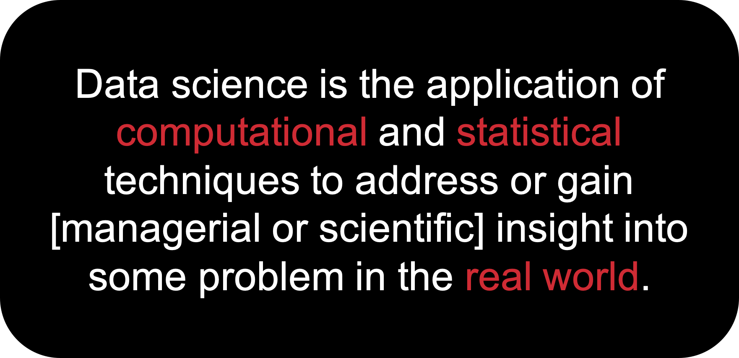

WHAT IS DATA SCIENCE?
Data science is an interdisciplinary field focused on discovering patterns and describing relationships using data.

Slide 9
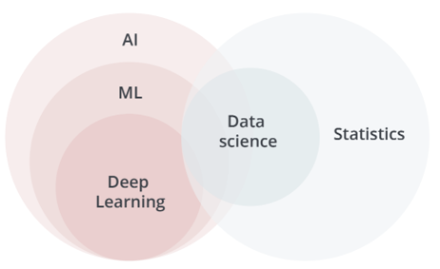
AI: any technique that enables computers to mimic human intelligence, e.g., using decision trees, rules, logic, ML
ML: a subset of AI that uses statistical techniques that enable machines to use experience to improve at tasks
Deep Learning: a subset of ML that uses vast amounts of data and multilayer neural nets to enable a machine to train itself to perform tasks
Statistics: science of collecting and analyzing numerical data, either to describe properties of a dataset or to make inferences based on a subset of data
Data Science: an applied branch of statistics that uses computer science techniques to manage, analyze, visualize and discover patterns in data

Slide 10
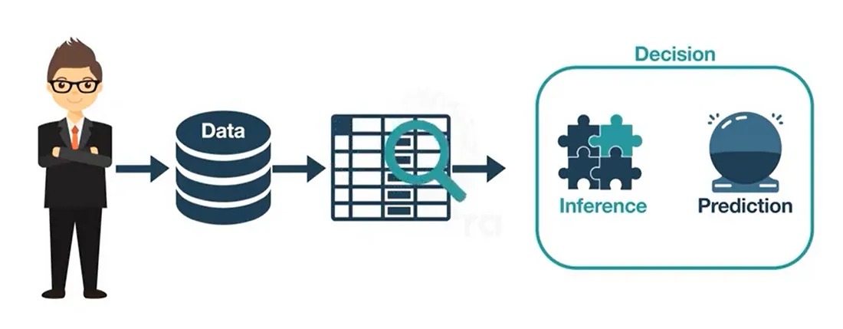
WHAT IS THIS COURSE ABOUT?
This semester we will learn to take raw data and turn it into insights about the world or predictions about the future.

Slide 11
Big Data Analytics
Big Data
Big Data Generation and Growth What is Big Data
Importance of Big Data Analytics Industries benefiting from Data Analytics
Sources of Data (people, machines, organizations) Aspects of Bigness (The 5 V’s of big data)
Types of Data (table, text, multimedia, stream, sequence, graphs) The Analytics Process (preprocessing, analytics, visualization)
Big Data Analytics: Introduction

Slide 12
Big Data Generation and Growth
Data has been generated at an exploding rate in recent years
Organizations collect trillions of bytes of information about their customers, suppliers, and operations every day
Large pools of data is being captured, communicated, aggregated, stored, and analyzed by businesses, academia, and governments
Individuals with smartphones on social network sites are continuously fueling the exponential growth of multimedia data
Big Data Analytics: Introduction

Slide 13

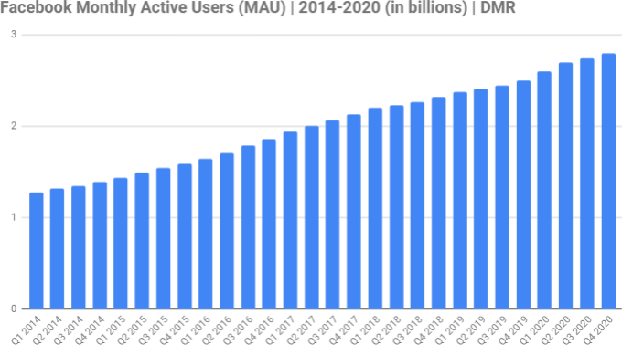
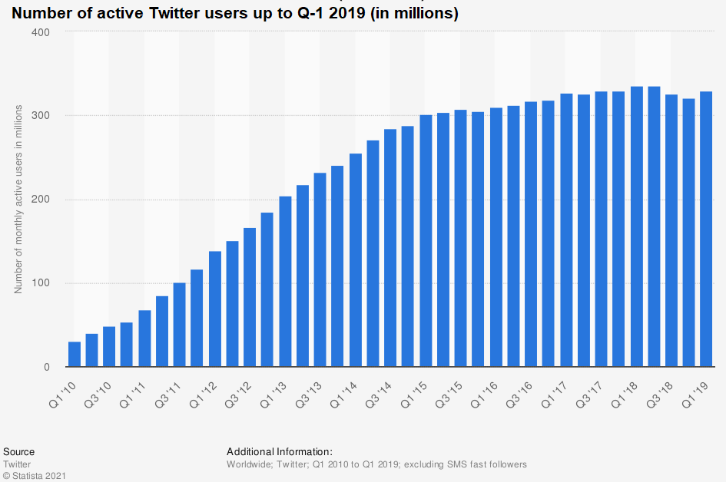
Big Data Generation and Growth
expandedramblings.com
Big Data Analytics: Introduction

Slide 14
Big Data Generation and Growth
Where data comes from?
Internet users generate about 2.5 quintillion bytes of data each day¹ In 2018, internet users spent 2.8 million years online²
Social media accounts for 33% of the total time spent online ²
In 2019, there were 2.3 billion active Facebook users Twitter users send nearly half a million tweets every minute¹
By 2020, every person will generate 1.7 megabytes in just a second¹ By 2020, there will be 40 trillion gigabytes of data (40 zettabytes)³ 90% of all data has been created in the last two years ⁴
Domo report (a company with data analytic platform for businesses)
Global Web Index report (a company with big data analytic platform) ³EMC (Dell EMC provides big data solutions)
⁴IBM
Big Data Analytics: Introduction

Slide 15
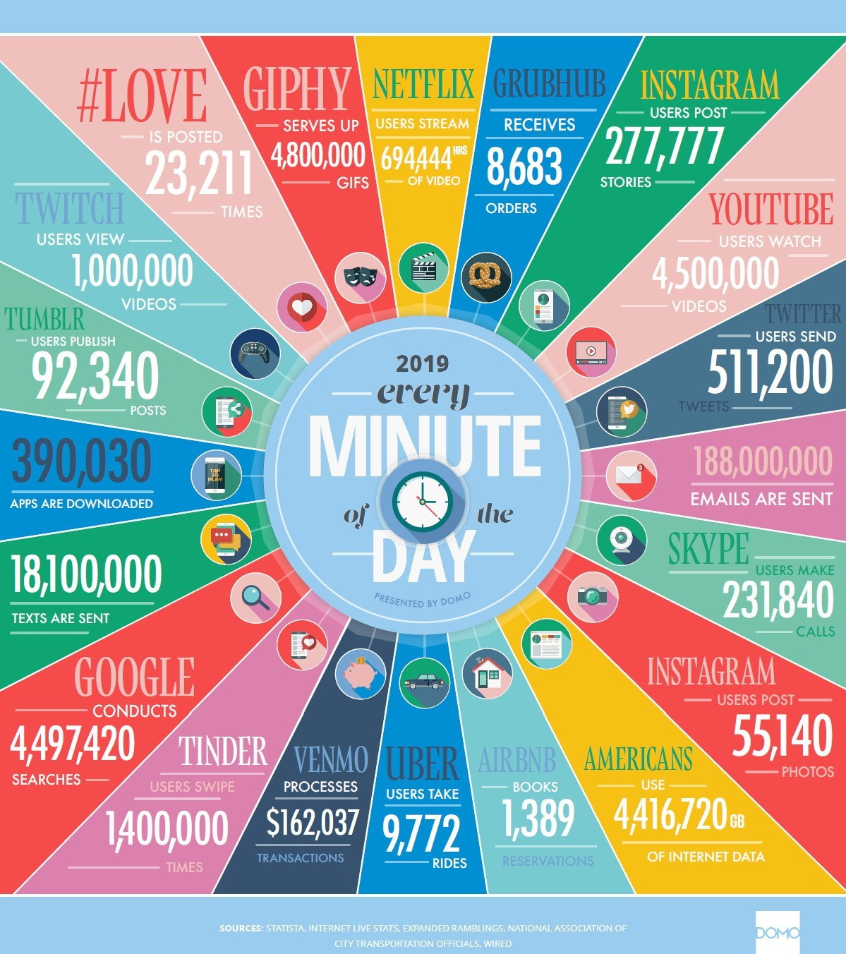
Big Data Generation and Growth
Big Data Analytics: Introduction

Slide 16
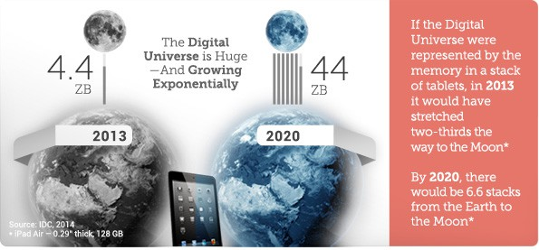
Big Data Generation and Growth
90% of all data has been created in the last two years ⁵
⁵IBM
Big Data Analytics: Introduction

Slide 17
What is Big Data
“Big data”: datasets whose size is beyond the ability of typical database software tools to capture, store, manage, and analyze
As technology advances over time, the size of datasets that qualify as big data will also increase
The definition varies by sector, depending on the kinds of available software tools and sizes of datasets in a particular industry
With those caveats, big data in many sectors today will range from a few dozen terabytes to multiple petabytes (thousands of terabytes)
Big Data Analytics: Introduction

Slide 18
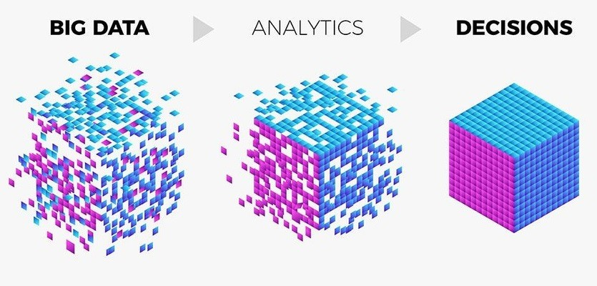
Data Analytics
Data: Set of values of qualitative or quantitative variables
Information: Meaningful or organized data
Data Analytics: The process of examining data in order to draw and communicate useful conclusions about the information it contains
Source: https://enablecomp.com/
Big Data Analytics: Introduction

Slide 19
Big Data Analytics: Market
Big Data Analytics: Introduction

Slide 20
Data Analytics: Then and Now
Data Analytics has been around for years
Even in 1950’s, businesses were using basic analytics (manual examination) on data (essentially numbers in a spreadsheet) to uncover insights and trends
New tools and technologies bring speed and efficiency in techniques
Today, businesses analyze data and can identify insights for immediate decisions
The ability to work faster and stay agile gives organizations a competitive edge they did not have before
Big Data Analytics: Introduction

Slide 21
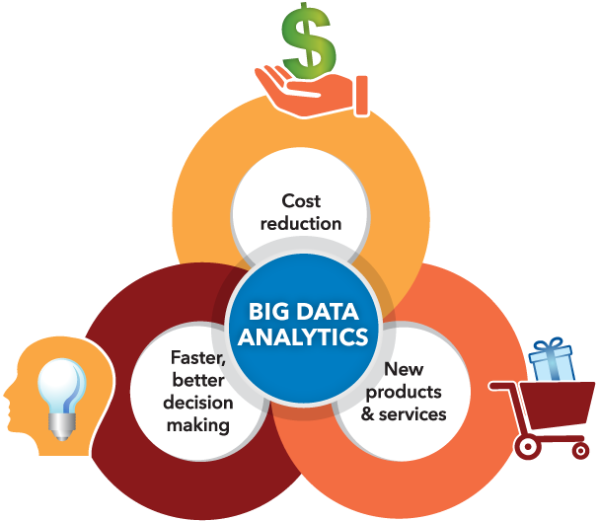
Why is Big Data Analytics Important
Organizations analyze data
to identify new opportunities
to gain insights that lead to smarter business decisions to identify methods for more efficient operations
to maximize larger revenues and higher profits to keeps customers satisfied
Top three factors businesses got the most value in
Cost reduction
Faster, better decision making New products and services
Big Data Analytics: Introduction

Slide 22
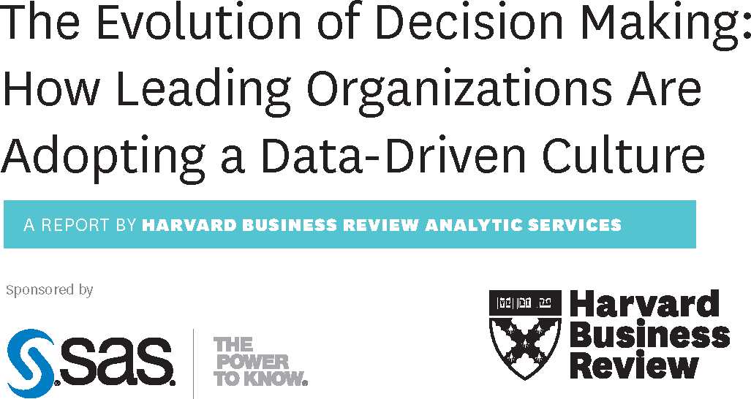
Why enterprises use Big Data Analytics
Companies are using big data analytics for all types of decisions
Big Data Analytics: Introduction

Slide 23
What enterprises use Big Data Analytics for
Competitor Analysis
Online traffic to websites and related social media
Market Analysis
Trends and market segment analysis
Productivity Enhancement
Analyze employees tracking data
Cost Cutting
Reduce energy bills, optimize routes, predict demands, process efficiency and automation⁶
Targeted Marketing
Analyze purchasing history and target the right people for a product
Improved Customer Relations
Analyze customer feedback and make adjustments
⁶Forbes (01/08/2016) Big Data Analytics’ Potential to Revolutionize Manufacturing Is Within Reach
Big Data Analytics: Introduction

Slide 24
Industries Benefiting from Big Data Analytics
Retail: Advertising, Targeted marketing, recommendation system, customer loyalty, inventory management, demand prediction
Banking and Financial: Customer loyalty and churn, fraud detection, risk assessment
Brands: 66% brands use data analytics for product and service launch, appropriate timings
Logistics and Transportation: Fleet management, maintenance needs, drivers risk assessment, real time tracking
Health Care: Efficiency in healthcare operations, predictive analytics, outbreak prediction, immunization strategy
Government & Utility Companies: Surveys & census, development planning, health, education, energy supply & demand management
Big Data Analytics: Introduction

Slide 25
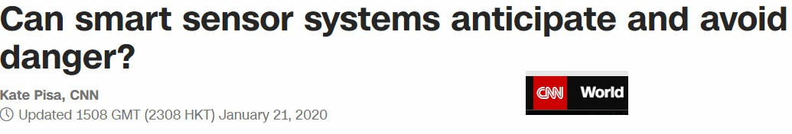
Industries Benefiting from Big Data Analytics
Big Data Analytics: Introduction

Slide 26

Industries Benefiting from Big Data Analytics
Big Data Analytics: Introduction

Slide 27
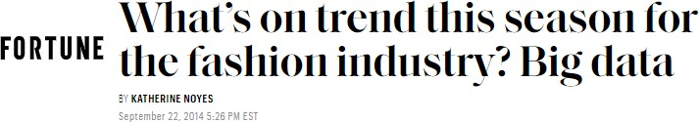
Industries Benefiting from Big Data Analytics
Big Data Analytics: Introduction

Slide 28

Industries Benefiting from Big Data Analytics
Big Data Analytics: Introduction

Slide 29
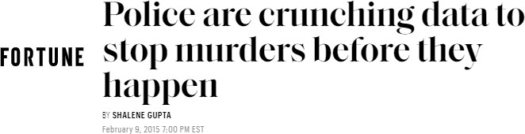
Industries Benefiting from Big Data Analytics
Big Data Analytics: Introduction

Slide 30

Industries Benefiting from Big Data Analytics
Big Data Analytics: Introduction

Slide 31
Big Data Analytics - Market
12% - the rate of increase for big data and business analytics use from 2018 to 2019 ⁷
$189.1 billion – projected worldwide revenues for big data and business analytics solutions for 2019 ⁷
$274.3 billion – projected worldwide revenues for big data and business analytics solutions by 2022 ⁷
13.2% - projected compound annual growth rate (CAGR) of big data and business analytics within the five-year period, 2018-2022 ⁷
⁷ International Data Corporation (IDC) - Big data analytics company
Big Data Analytics: Introduction

Slide 32
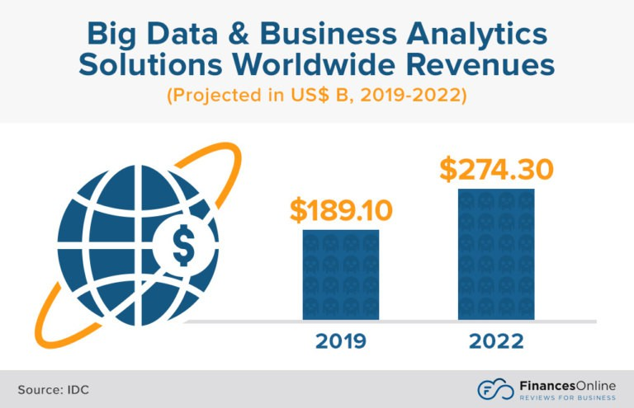
Big Data Analytics - Market
Big Data Analytics: Introduction

Slide 33
Sources of Big Data
Big Data Analytics: Introduction

Slide 34
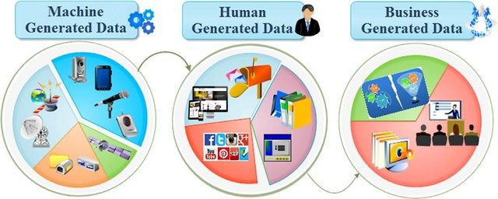
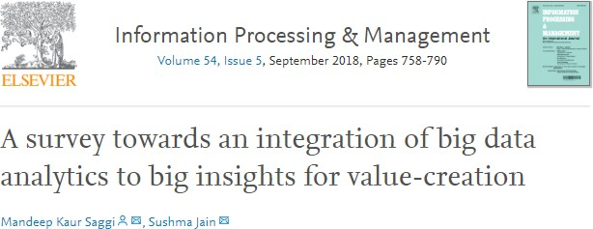
Sources of Big Data
Big Data Analytics: Introduction

Slide 35
Sources: Machine Generated Data
Biggest source of big data
Temperature sensors, GPS navigator, Satellite imagery, Apps, Increasing number of smart devices, IoT
A 12 hours flight produces 84TB of data, sensors, temperature, pressure, accelerometer, turbulence
Smart City, Smart Transportation
Think about the volume of video data collected at Lahore Safe City Authority Control Room
Generally, such data is unstructured
Big Data Analytics: Introduction

Slide 36

Sources: People Generated Data
Blogs, social network posts, keywords search, photo sharing, pictures, emails, ratings and reviews
Daily facebook data 30+ PB > All US Academic libraries (2 PB)
Companies use 12PB/day Twitter data for sentiment analysis around their products
Could be used for disaster management, e.g. to identify and measure affected areas and channel resources
Typically unstructured, or at best semi-structured such as emails, where the header has somewhat of a structure, except in few cases such as filling up a survey form
Generally more text: 500 million tweets per day
Big Data Analytics: Introduction

Slide 37
Sources: Organization Generated Data
LUMS Students Data, ESPN Cricinfo, TCS shipment tracking data
Governments open data, Stock Records, Banks, e-Commerce Medical Records
Optimize routs and optimal scheduling can save 50m by reducing each drivers route by one mile
Combine Walmart sales data with Twitter sentiment analyses or events to launch a new product
Estimate demands Fraud Detection
Highly Structured Data
Big Data Analytics: Introduction

Slide 38
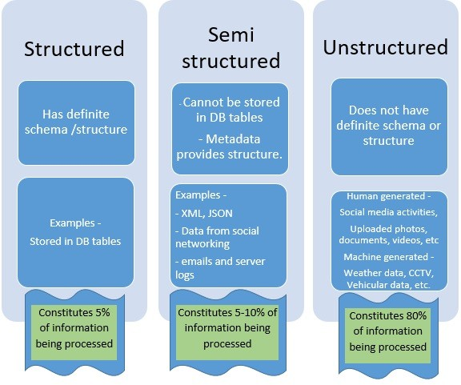
Categories of Data
Big Data Analytics: Introduction

Slide 39
The 5 V’s of Data
Big Data Analytics: Introduction

Slide 40
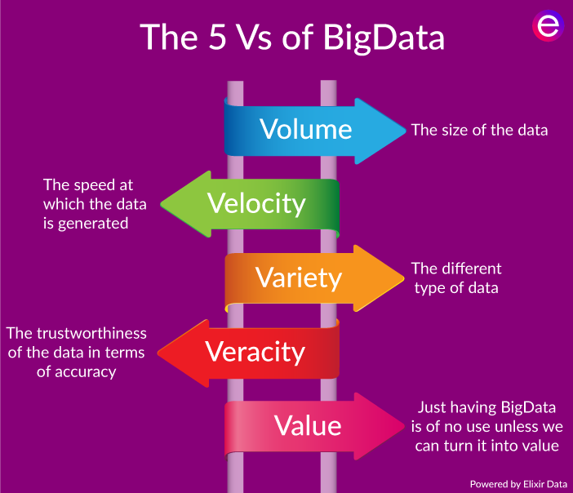
Aspects of Big: The 5 V’s
Volume
Velocity
Variety
Veracity
Value
Big Data Analytics: Introduction

Slide 41
Aspects of Big: The 5 V’s – Volume
Volume: size, scale, dimensionality,
204m emails/minute, if an email is 100KB, see the volume
Challenges: Acquisition, Storage, Retrieval, Processing Time Large dimensional data has more information, it is a blessing
It is a also a big curse, dealing with large dimensions is a core topic in this course
Big Data Analytics: Introduction

Slide 42
Aspects of Big: The 5 V’s – Velocity
Velocity: Speed of data is very high
Number of emails, twitter messages, photos, videos etc. per second
Late decisions implies missed opportunities
Real time processing vs Batch Processing (end of the day)
Big Data Analytics: Introduction

Slide 43
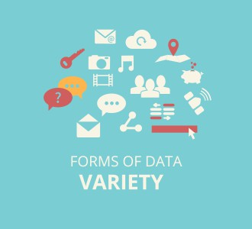
Aspects of Big: The 5 V’s – Variety
Variety: Structural variety, different formats, models
Source: https://openautomationsoftware.com/
Medium variety, audio, text, video, DBMS, files, traffic logs, XML, code Online vs Offline,
Real time vs Intermittent data (another way data varies) Challenges: requirement of analytics, Semantic, how to interpret
Big Data Analytics: Introduction

Slide 44
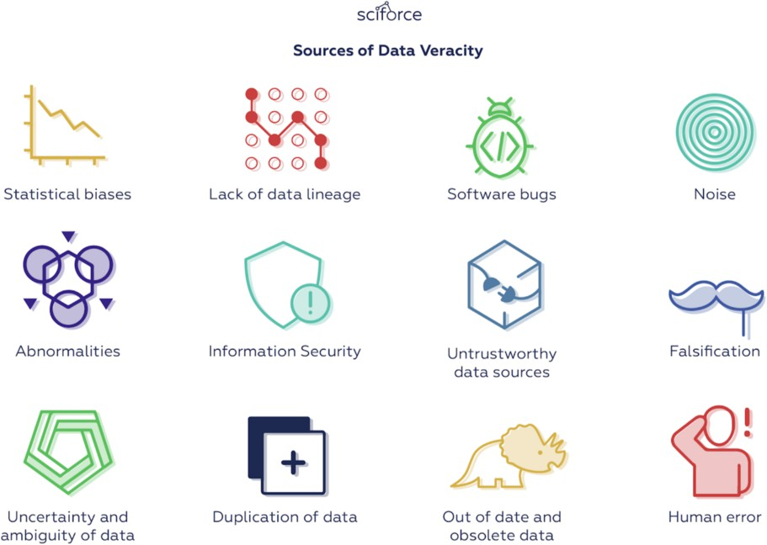
Aspects of Big: The 5 V’s – Veracity
Veracity: Quality of data
Data could have many issues (biases, anomalies, inconsistent measurements and units, incomplete and duplicate records)
Volatility in data, updated/outdated, changing trends/sentiments Trustworthiness and reliability of sources and generation/processing Fake news, rumours, fake likes, fake followers
Source: https://datafloq.com/
Big Data Analytics: Introduction

Slide 45
Aspects of Big: The 5 V’s – Value
Value: Data can be turned into big value
Data having no value is of no good to the company Should be able to meet strategic objectives
Should amplify other technology innovations
Big Data Analytics: Introduction

Slide 46
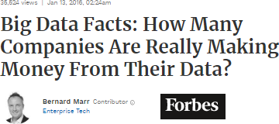
5 Vs of Big Data: Value
The Economist Intelligence Unit report on surveying 476 executives
60% feel that data is generating revenue within their organizations 83% say it is making existing services and products more profitable
63% executives based in Asia said they are routinely generating value from data
In the US, the figure was 58% and in Europe, 56%
Big Data Analytics: Introduction

Slide 47
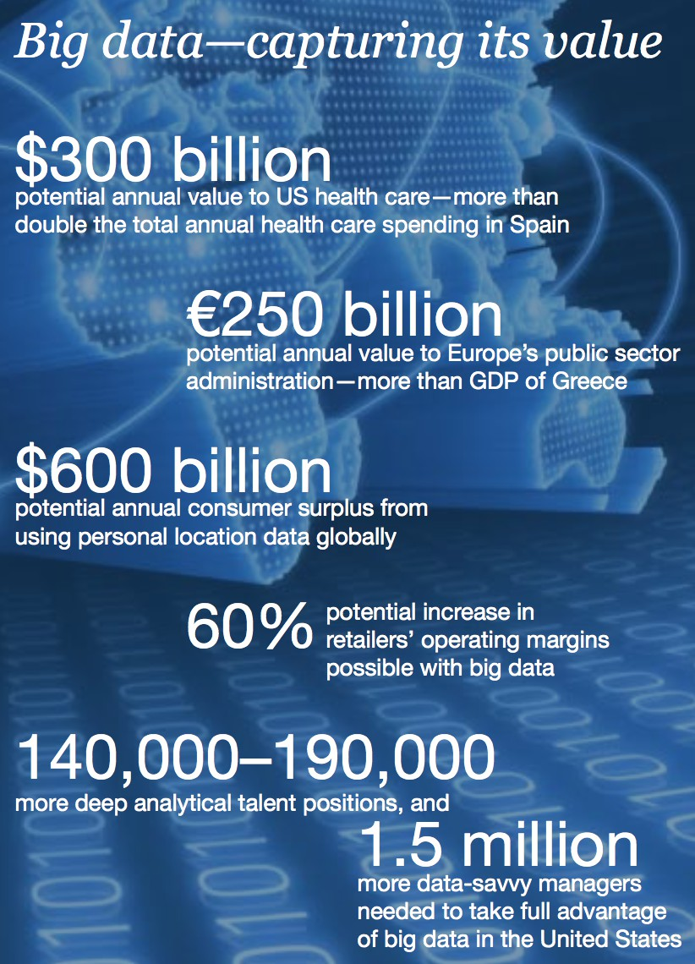
5 Vs of Big Data: Value
McKinsey Global Institute (May 2011)
Big Data - The Next Frontier of Innovation,
Competition and Productivity
Big Data Analytics: Introduction

Slide 48
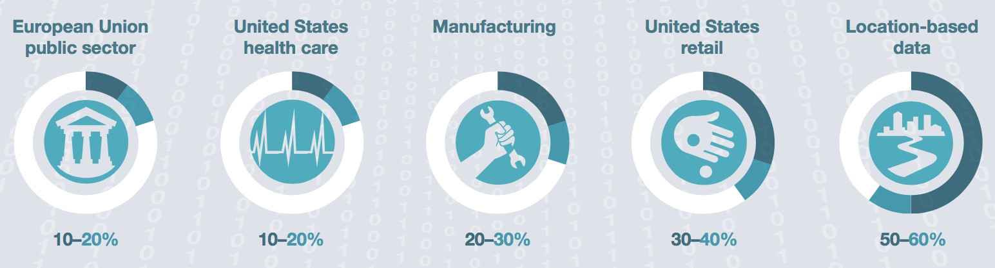
5 Vs of Big Data: Value
Big Data Analytics: Introduction

Slide 49
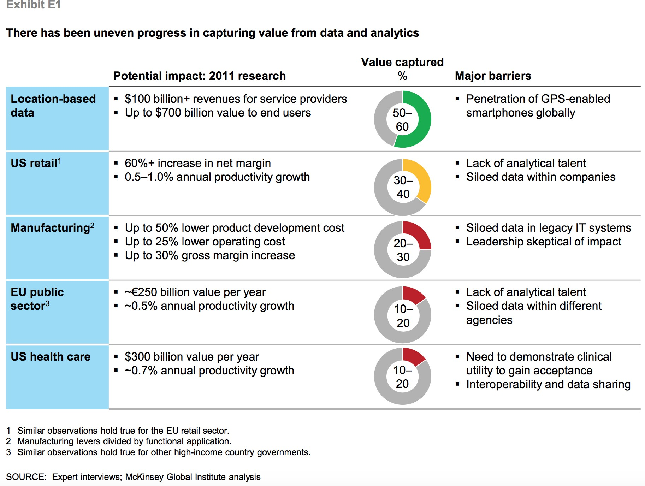
5 Vs of Big Data: Value
Big Data Analytics: Introduction

Slide 50
Types of Data
Big Data Analytics: Introduction

Slide 51
Types of Data
Relational Data
Text Data Multimedia Data Time Series Data Sequential Data Streams
Graphs and Homogeneous Networks Graphs and Heterogeneous Networks
Big Data Analytics: Introduction

Slide 52

Types of Data: Text
blogs, webpages, tweets, documents, emails
High dimensionality, vocabulary, information retrieval, natural language processing
Latest search engine for Walmart.com uses text analysis, machine learning and even synonym mining to produce relevant search results. Wal-Mart says adding semantic search has improved online shoppers completing a purchase by 10% to 15%. ”In Wal-Mart terms, that is billions of dollars,”
Big Data Analytics: Introduction

Slide 53



Types of Data: Multimedia
image, audio, video
‘Fast food and video’ company is training cameras on drive-through lanes to determine what to display on its digital menu board. When the lines are longer, the menu features products that can be served up quickly; when the lines are shorter, the menu features
higher-margin items that take longer to prepare
Big Data Analytics: Introduction

Slide 54
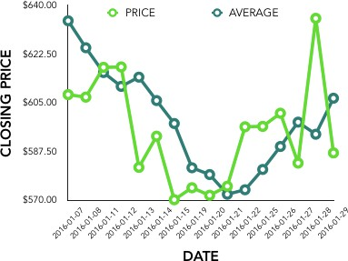
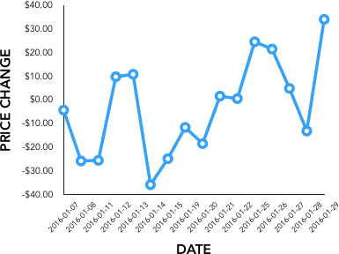
Types of Data: Time Series
Sequence of data points at equally spaced time intervals
Sensor data, Stock market data, Forex rates, Temporal tracking (GPS), Smart Meters Data (AMI)
Understanding the underlying forces and structure of observed data and fit a model to forecast, monitor or control
Economic Forecasting, Sales Forecasting, Stock Market Analysis, Yield Projections, Process and Quality Control, Inventory Studies,
Workload Projections, Census Analysis
market momentum
Application of Time Series Analysis in Financial Economics by @Statswork https://link.medium.com/n3FJPzhIadb
Big Data Analytics: Introduction

Slide 55
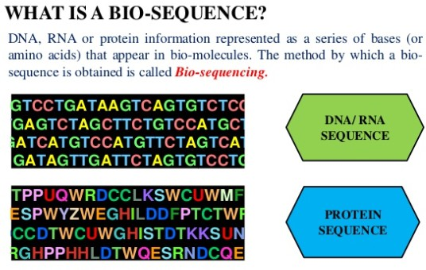
Types of Data: Sequential Data
Bio-sequences
Discretized music and audio data Text
Source: Sijo Asokan (slideshare.net)
Big Data Analytics: Introduction

Slide 56
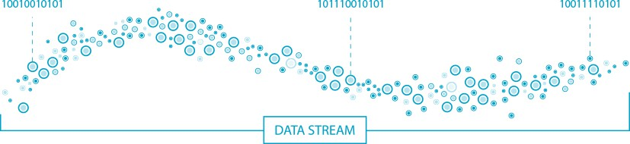
Types of Data: Streams
Real time data
Single pass algorithms/online algorithms Irreversible decisions
Small memory algorithms
Big Data Analytics: Introduction

Slide 57
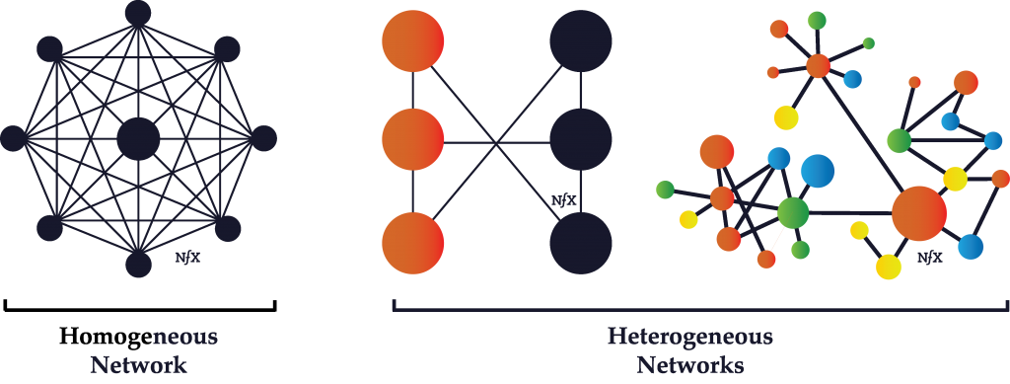
Types of Data: Graphs/Homogeneous Networks
G = (V , E ), data items represented as graphs Could have similarity on edges
Could have weights on vertices, edges or both
Facebook, webgraph, twitter, co-authorship graphs (bibliometric), citation networks
Big Data Analytics: Introduction

Slide 58
Types of Data: Heterogeneous Networks
Nodes represent different entities Authors and conferences
Big Data Analytics: Introduction

Slide 59
Data Analytics: Process and Tasks
Big Data Analytics: Introduction

Slide 60
The Analytics Process
Business Objective
Why we are seeking data analytics in the first place?
How can we reduce production costs without sacrificing quality? What are some ways to increase sales with our current resources? Do customers view our brand in a favorable way?
Data Collection
What data is needed and available?
Identify sources of data and relevance of data
Are there enough instances, are all relevant features there? Identify datasets, acquire and retrieve
Sources RDBMS, .txt, webservices (soup), RSS, tweets Experiments, synthetic data generation, Survey
Big Data Analytics: Introduction

Slide 61
The Analytics Process
Data Preparation
Make the data ready for analytics
Exploratory Data Analysis Describe, Summarize, Visualize
Pre-process: Improve data quality, clean data, transformation, standardization, normalization
Data Analysis
Apply analytical techniques
Supervised and unsupervised learning, Graph analytics
Report and Deployment
Communicate results and findings, and apply conclusions to gain benefit
Big Data Analytics: Introduction

Slide 62
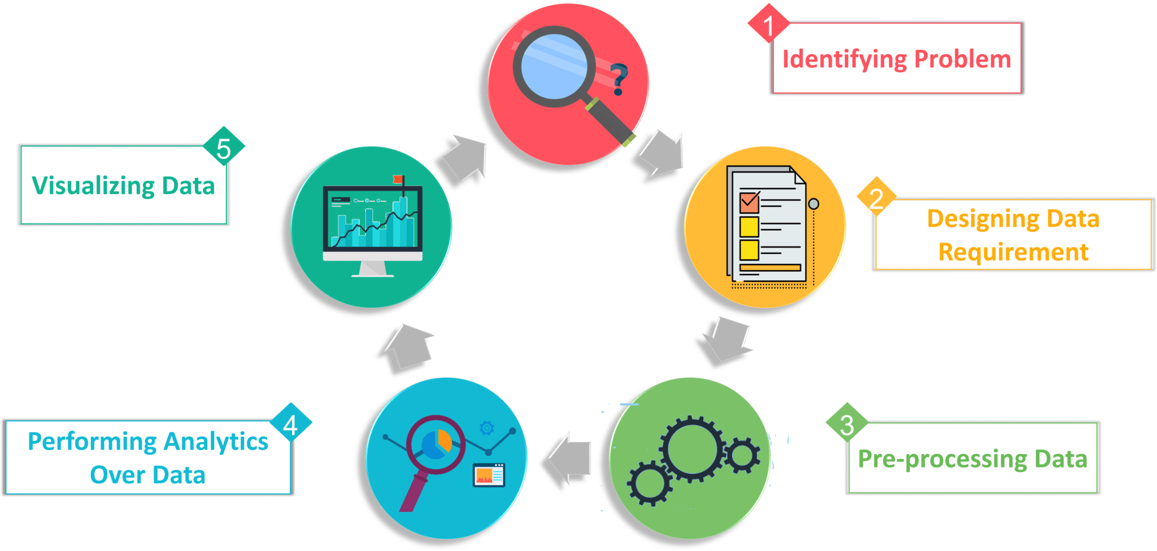
The Analytics Process
Big Data Analytics: Introduction

Slide 63
Data Analytics Tasks and Methods
Data Analytics is the process
to discover patterns in data to find relationships in data
to (automatically) extract knowledge from data
to summarize data in ways that are understandable and useful
Discovering knowledge form data often requires learning
Big Data Analytics: Introduction

Slide 64
Data Analytics Tasks and Methods
Descriptive Analytics
Uncover patterns, correlations, trends & trajectories describing data Explanatory in nature
Require post-processing to validate and explain the results Clustering/grouping the data or Detecting outliers (anomalies) in data
Predictive Analytics
Predict value of a attribute based on values of other attributes Predicted attribute: Target/dependent/response variable
Attributes used to predict: Predictor/explanatory/independent variables Classification: nominal target attribute (class labels)
Regression: numeric target attribute
Big Data Analytics: Introduction

Slide 65
Data Analytics Taks
Clustering: Partition data into meaningful groups
Outlier Detection: Detect points that are unusual (unlike others) Classification: Assign (predefined) class labels to each object Regression: Find a function that models (continuous) target variable
Association Analysis: Find patterns in data that describe relationships
Recommendation: Predict an unknown rating based on known ratings
Community Detection: Find (overlapping) communities of nodes in networks
Centrality and Important nodes: Find important (or evaluate importance of) nodes in networks
Big Data Analytics: Introduction

Slide 66
Machine Learning for Data Analytics
Supervised Learning
For some data items the correct results (values of the target variable) are given (ground truth)
We want to learn a model that generalizes i.e. the model is able to perform accurately on new/unseen/unlabeled data items
Classification, where the target is a categorical attribute Regression, where the target is a continuous attribute
Test Data
Training Data
Predict Target Variable Values
Model
Known Labels
Big Data Analytics: Introduction

Slide 67
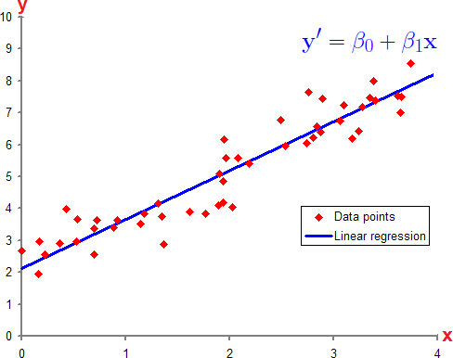
Machine Learning for Data Analytics
Binary Classification
Multi-Class Classification
Regression
x2
x2
x1
x1
Big Data Analytics: Introduction

Slide 68
Machine Learning for Data Analytics
Unsupervised Learning
No correct output is provided
Learning and analytics is done using statistical properties of data
Clustering Outlier detection
Modeling the density of data Dimensionality reduction
Big Data Analytics: Introduction

Slide 69
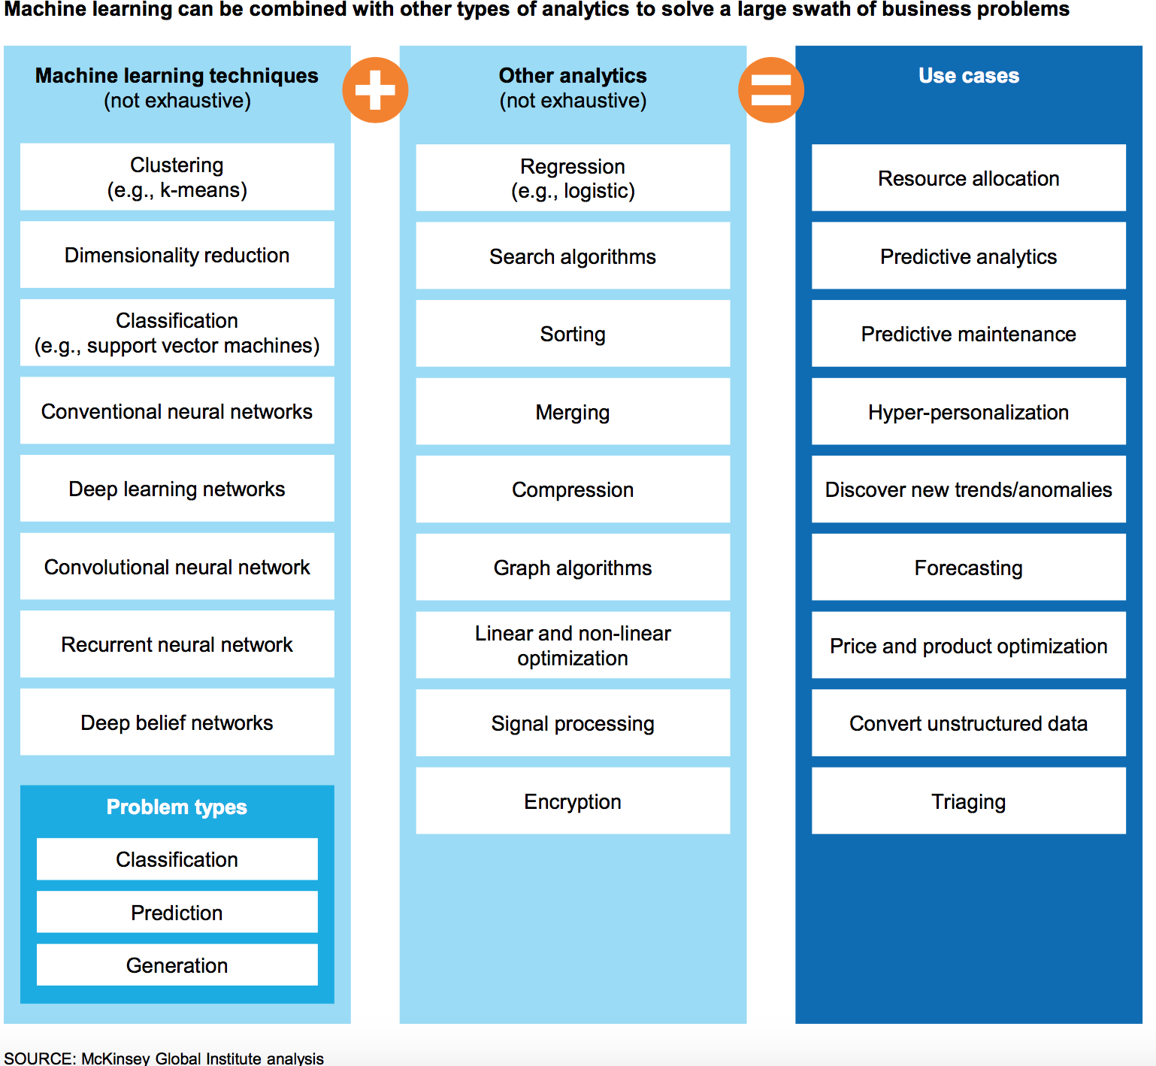
Data Analytics Tasks and Methods
Big Data Analytics: Introduction

