Slide 1
Advanced Classification techniques
David Kauchak CS 159 – Spring 2023

Slide 2
Admin
Assignment 7
Next Monday: project proposal presentations
informal
1 minute
See the final project handout for details
Hack week QA session from OpenAI engineer (Friday @ 12:30pm)
https://5chack.com/#hack-week

Slide 3
Schedule for the rest of the semester

Slide 4
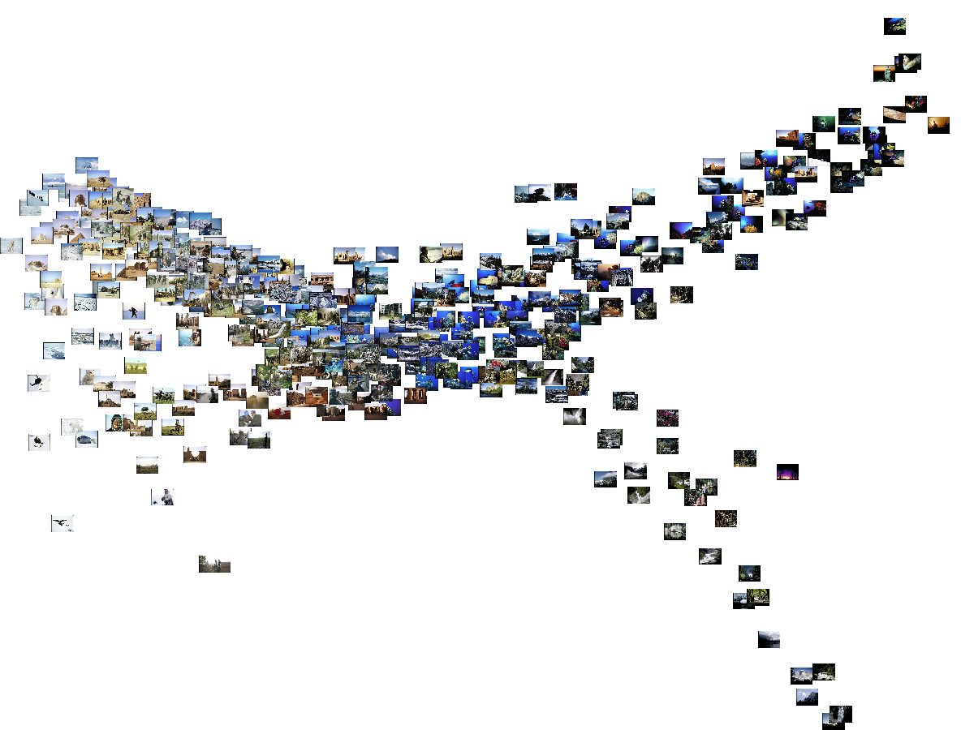
Machine Learning: A Geometric View

Slide 5
Apples vs. Bananas
Weight | Color | Label
4 | Red | Apple
5 | Yellow | Apple
6 | Yellow | Banana
3 | Red | Apple
7 | Yellow | Banana
8 | Yellow | Banana
6 | Yellow | Apple
Can we visualize this data?

Slide 6
Apples vs. Bananas
Turn features into numerical values
Weight | Color | Label
4 | 0 | Apple
5 | 1 | Apple
6 | 1 | Banana
3 | 0 | Apple
7 | 1 | Banana
8 | 1 | Banana
6 | 1 | Apple
1
A
B
B
B
A
Color
0
A
A
0
Weight
10
We can view examples as points in an n-dimensional space where n is the number of features called the feature space

Slide 7
Examples in a feature space
feature₂
label 1
label 2
label 3
feature₁

Slide 8
Test example: what class?
feature₂
label 1
label 2
label 3
feature₁

Slide 9
Test example: what class?
feature₂
label 1
label 2
closest to red
label 3
feature₁

Slide 10
Another classification algorithm?
To classify an example d:
Label d with the label of the closest example to d in the training set

Slide 11
What about this example?
feature₂
label 1
label 2
label 3
feature₁

Slide 12
What about this example?
feature₂
label 1
label 2
closest to red, but…
label 3
feature₁

Slide 13
What about this example?
feature₂
label 1
Most of the next closest are blue
label 2
label 3
feature₁

Slide 14
k-Nearest Neighbor (k-NN)
To classify an example d:
Find k nearest neighbors of d
Choose as the label the majority label within the k nearest neighbors

Slide 15
k-Nearest Neighbor (k-NN)
To classify an example d:
Find k nearest neighbors of d
Choose as the label the majority label within the k nearest neighbors
How do we measure “nearest”?

Slide 16
Euclidean distance
Euclidean distance! (or L1 or cosine or …)
(b₁, b₂,…,b_{n})
(a₁, a₂, …, a_{n)}

Slide 17
Decision boundaries
The decision boundaries are places in the features space where the classification of a point/example changes
label 1
label 2
label 3
Where are the decision boundaries for k-NN?

Slide 18
k-NN decision boundaries
label 1
label 2
label 3
k-NN gives locally defined decision boundaries between classes

Slide 19
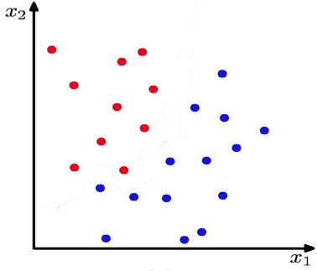
K Nearest Neighbour (k-NN) Classifier
K = 1
What is the decision boundary for k-NN for this one?

Slide 20
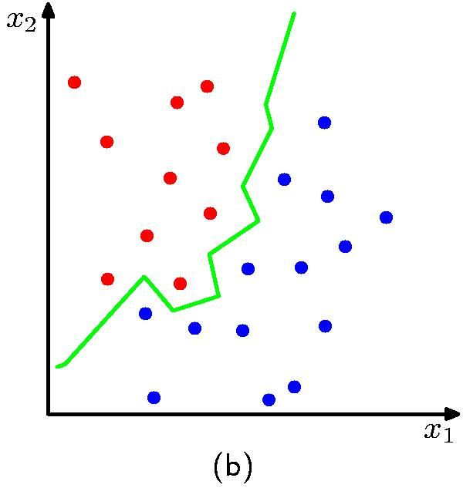
K Nearest Neighbour (kNN) Classifier
K = 1

Slide 21
Machine learning models
Some machine learning approaches make strong assumptions about the data
If the assumptions are true this can often lead to better performance
If the assumptions aren’t true, they can fail miserably
Other approaches don’t make many assumptions about the data
This can allow us to learn from more varied data
But, they are more prone to overfitting (biasing too much to the training data)
and generally require more training data

Slide 22
What is the data generating distribution?

Slide 23
What is the data generating distribution?

Slide 24
What is the data generating distribution?

Slide 25
What is the data generating distribution?

Slide 26
What is the data generating distribution?

Slide 27
What is the data generating distribution?

Slide 28
Actual model

Slide 29
Model assumptions
If you don’t have strong assumptions about the model, it can take you a longer to learn
Assume now that our model of the blue class is two circles

Slide 30
What is the data generating distribution?

Slide 31
What is the data generating distribution?

Slide 32
What is the data generating distribution?

Slide 33
What is the data generating distribution?

Slide 34
What is the data generating distribution?

Slide 35
Actual model

Slide 36
What is the data generating distribution?
Knowing the model beforehand can drastically improve the learning and the number of examples required

Slide 37
What is the data generating distribution?

Slide 38
Make sure your assumption is correct, though!

Slide 39
Machine learning models
What were the model assumptions (if any) that k-NN and NB made about the data?
Are there training data sets that could never be learned correctly by these algorithms?

Slide 40
k-NN model
K = 1

Slide 41
Linear models
A strong assumption is linear separability:
in 2 dimensions, you can separate labels/classes by a line
in higher dimensions, need hyperplanes
A linear model is a model that assumes the data is linearly separable

Slide 42
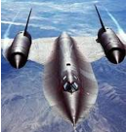
Hyperplanes
A hyperplane is line/plane in a high dimensional space
What defines a line?
What defines a hyperplane?

Slide 43
Defining a line
Any pair of values (w₁,w₂) defines a line through the origin:
f₂
f₁

Slide 44
Defining a line
Any pair of values (w₁,w₂) defines a line through the origin:
f₂
f₁
What does this line look like?

Slide 45
Defining a line
Any pair of values (w₁,w₂) defines a line through the origin:
f₂
-2
-1
0
1
2
1
0.5
0
-0.5
-1
f₁

Slide 46
Defining a line
Any pair of values (w₁,w₂) defines a line through the origin:
f₂
-2
-1
0
1
2
1
0.5
0
-0.5
-1
f₁

Slide 47
Defining a line
Any pair of values (w₁,w₂) defines a line through the origin:
f₂
(1,2)
w=(1,2)
f₁
We can also view it as the line perpendicular to the weight vector

Slide 48
Classifying with a line
Mathematically, how can we classify points based on a line?
f₂
BLUE
(1,1)
f₁
RED
(1,-1)
w=(1,2)

Slide 49
Classifying with a line
Mathematically, how can we classify points based on a line?
f₂
BLUE
(1,1):
(1,1)
(1,-1):
f₁
RED
(1,-1)
w=(1,2)
The sign indicates which side of the line

Slide 50
Defining a line
Any pair of values (w₁,w₂) defines a line through the origin:
f₂
f₁
How do we move the line off of the origin?

Slide 51
Defining a line
Any pair of values (w₁,w₂) defines a line through the origin:
f₂
-2
-1
0
1
2
f₁

Slide 52
Defining a line
Any pair of values (w₁,w₂) defines a line through the origin:
f₂
Now intersects at -1
-2
-1
0
1
2
0.5
0
-0.5
-1
-1.5
f₁

Slide 53
Linear models
A linear model in n-dimensional space (i.e. n features) is define by n+1 weights:
In two dimensions, a line:
In three dimensions, a plane:
In n-dimensions, a hyperplane
(where b = -a)

Slide 54
Classifying with a linear model
We can classify with a linear model by checking the sign:
Positive example
f₁, f₂, …, f_{m}
classifier
Negative example

Slide 55
Learning a linear model
Geometrically, we know what a linear model represents
Given a linear model (i.e. a set of weights and b) we can classify examples
learn
Training
Data
How do we learn a linear model?
(data with labels)

Slide 56
Which hyperplane would you choose?

Slide 57
Large margin classifiers
margin
margin
Choose the line where the distance to the nearest point(s) is as large as possible

Slide 58
Large margin classifiers
margin
margin
The margin of a classifier is the distance to the closest points of either class
Large margin classifiers attempt to maximize this

Slide 59
Large margin classifier setup
Select the hyperplane with the largest margin where the points are classified correctly!
Setup as a constrained optimization problem:
subject to:
what does this say?
y_{i}: label for example i, either 1 (positive) or -1 (negative)
x_{i}: our feature vector for example i
Notes:
That each example is classified correctly!

Slide 60
Measuring the margin
How do we calculate the margin?

Slide 61
Support vectors
For any separating hyperplane, there exist some set of “closest points”
These are called the support vectors
Notes:
- they are vectors (i.e. points) and they support/define the line

Slide 62
Measuring the margin
The margin is the distance to the support vectors, i.e. the “closest points”, on either side of the hyperplane

Slide 63
Support vector machine problem
Posed as a quadratic optimization problem
Maximize/minimize a quadratic function
Subject to a set of linear constraints
Many, many variants of solving this problem
One of the most successful classification approaches

Slide 64


Support vector machines
One of the most successful (if not the most successful) classification approach:
decision tree
Support vector machine
k nearest neighbor
Naïve Bayes

Slide 65
Soft Margin Classification
subject to:
What about this problem?

Slide 66
Soft Margin Classification
subject to:
We’d like to learn something like this, but our constraints won’t allow it ☹

Slide 67
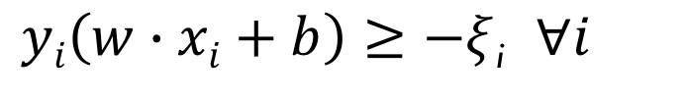
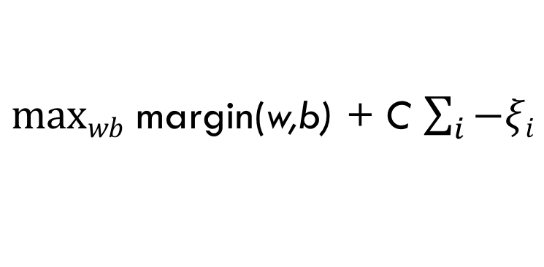
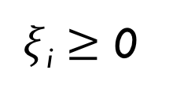
Slack variables
subject to:
$maxwb$ margin(w,b) + C $\sum_{i}{−ξi}$
slack variables (one for each example)
subject to:
$yi\left(w∙xi+b\right)≥−ξ$_{i} $∀i$
$ξ$_{i} $≥$ 0
What effect does this have?

Slide 68
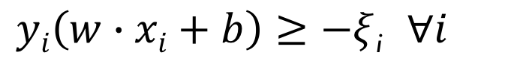
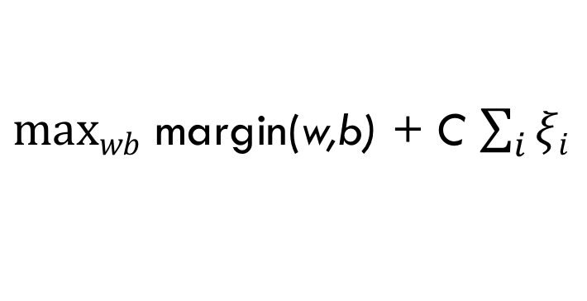
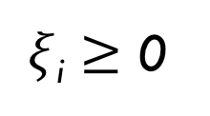
Slack variables
$maxwb$ margin(w,b) + C $\sum_{i}{ξi}$
subject to:
$yi\left(w∙xi+b\right)≥−ξ$_{i} $∀i$
$ξ$_{i} $≥$ 0
slack penalties

Slide 69
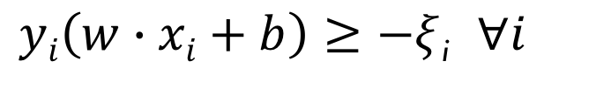
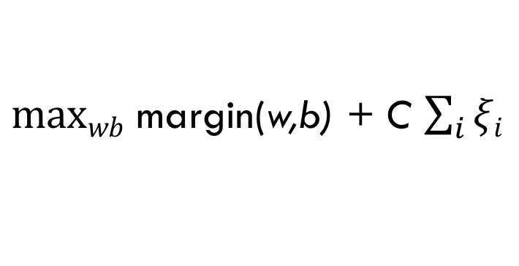
Slack variables
trade-off between margin maximization and penalization
margin
penalized by how far from “correct”
$maxwb$ margin(w,b) + C $\sum_{i}{ξi}$
subject to:
allowed to make a mistake
$yi\left(w∙xi+b\right)≥−ξ$_{i} $∀i$
$ξ$_{i} $≥$ 0

Slide 70
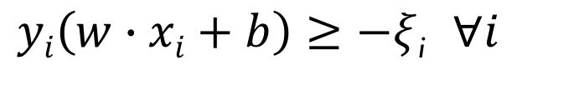
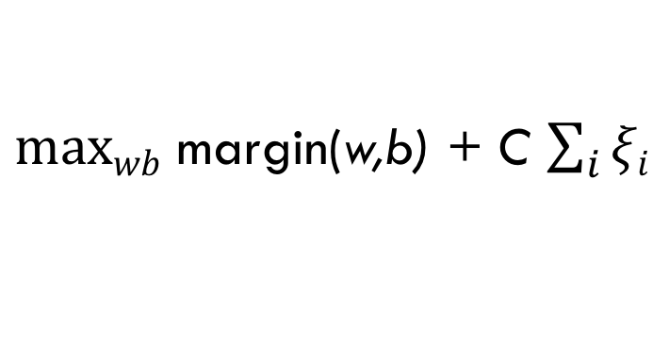
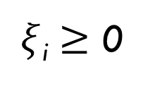
Soft margin SVM
$maxwb$ margin(w,b) + C $\sum_{i}{ξi}$
subject to:
$yi\left(w∙xi+b\right)≥−ξ$_{i} $∀i$
$ξ$_{i} $≥$ 0
Still a quadratic optimization problem!

Slide 71
Other successful classifiers in NLP
Perceptron algorithm
Linear classifier
Trains “online”
Fast and easy to implement
Often used for tuning parameters (not necessarily for classifying)
Logistic regression classifier (aka Maximum entropy classifier)
Probabilistic classifier
Doesn’t have the NB constraints
Performs very well
More computationally intensive to train than NB

