Slide 1
Gradient Boosting-Classifier
Dr. Muhammad safyan

Slide 2

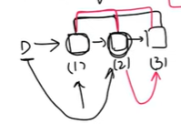
Adding models in a stage wise fashion:
Additive modeling
Target is LBLV
But : B*(1/v)

Slide 3
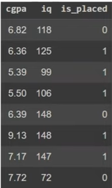


In boosting each model is weak learner: HB/LV
We add/combine them to make HB+HB+HB= LBLV
First one are simple mode
Two and Three are Decision Tree.

Slide 4


Simple Model
In case of classification we take log-odds instead of Mean
→ F0(x)

Slide 5
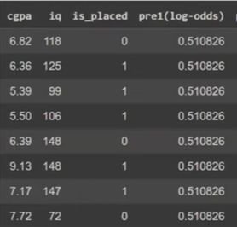
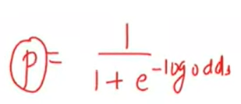
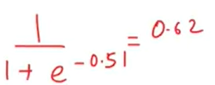
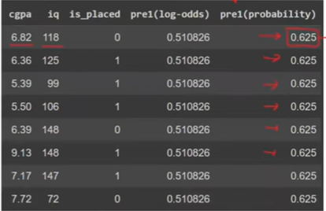
Convert log-odds into probabilities:

Slide 6
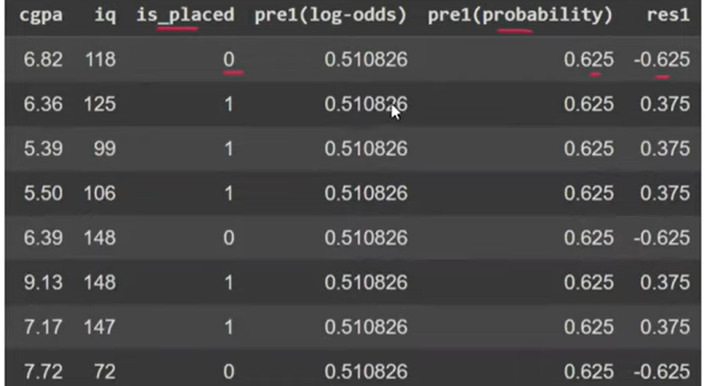
Calculate the error of model-1
Pseudo-Residual=y – y^

Slide 7

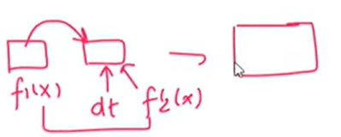
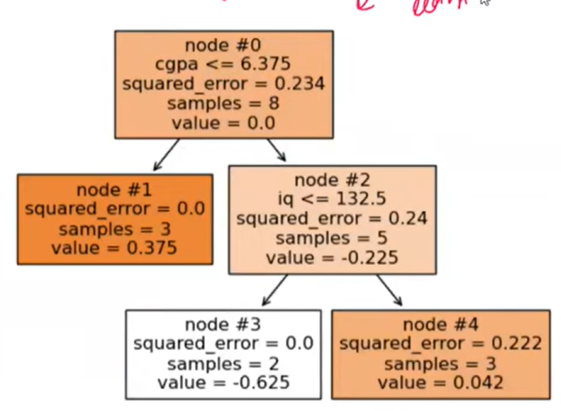

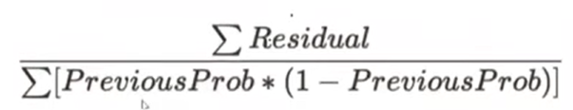
Model-2
Output will be:
In regression leaf-value was or probability/answer we can not add this probability with log-odds of model-1.
We need to convert our model-2 probability into log-odds.
For this covert each leaf node value to log-odds with following formulas

Slide 8
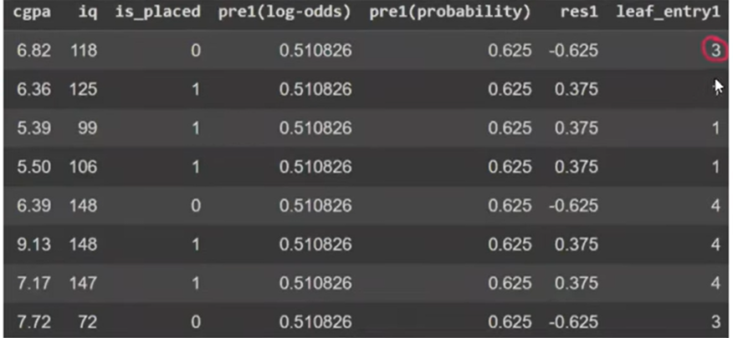
To implement this formula you should know , how many points falls in each node. E.g in node 2, there are three points.
We also need to know, which are those three points.

Slide 9
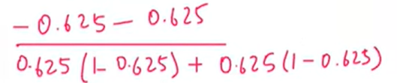
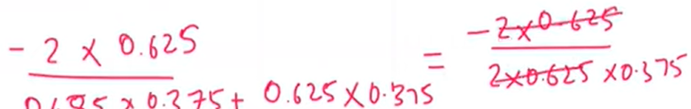


Here we will know how to calculate the log-odds for leaf number 3.
From table we can see only point 1 and last fall in to node 3.
Calculate log-odds for these points

Slide 10
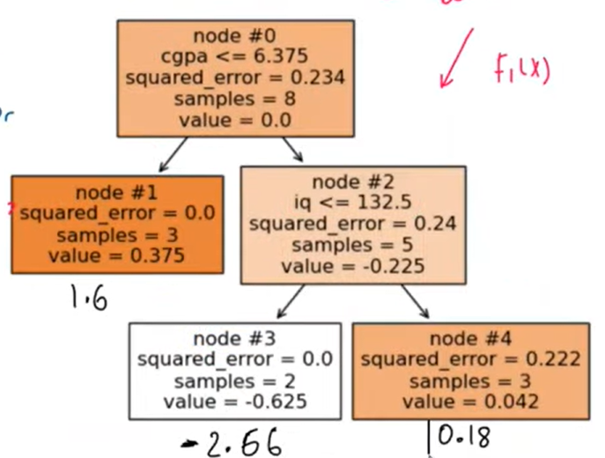
For the rest of three nodes

Slide 11

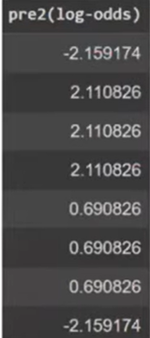
Now add log-odds of the f0(x) and f1(x)

Slide 12
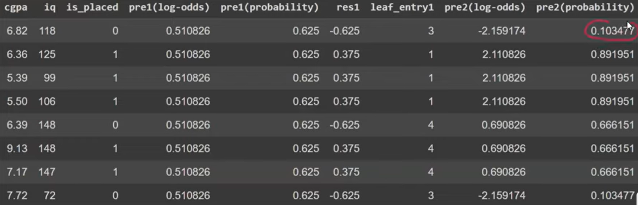
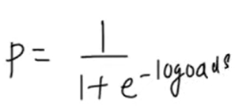
Now we again convert log-odds into probabilities to calculate the residuals:
Using the same formula

Slide 13

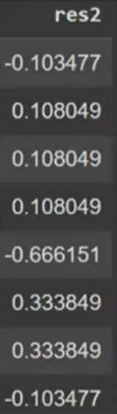
Now calculate the residual for model-2 →
Residual is reducing with model-2.
Us can use learning rate in it to control the reduction.

Slide 14
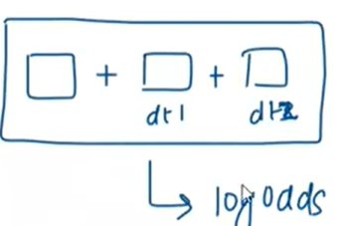
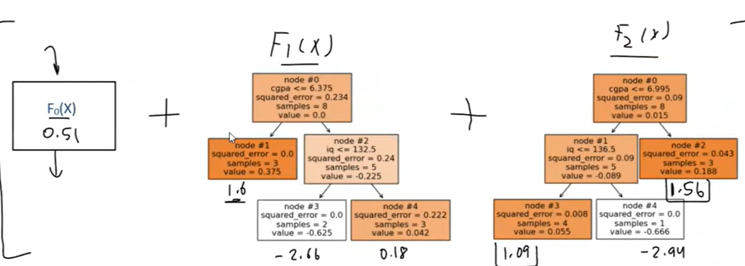
Model-3

Slide 15
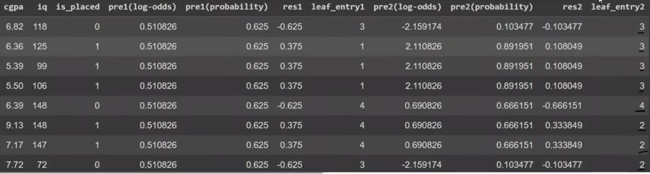

Slide 16
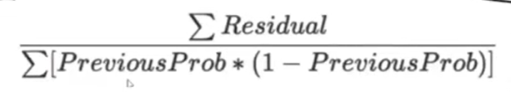
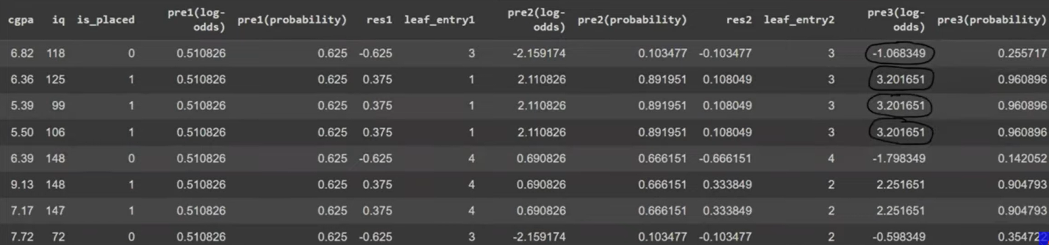

Slide 17
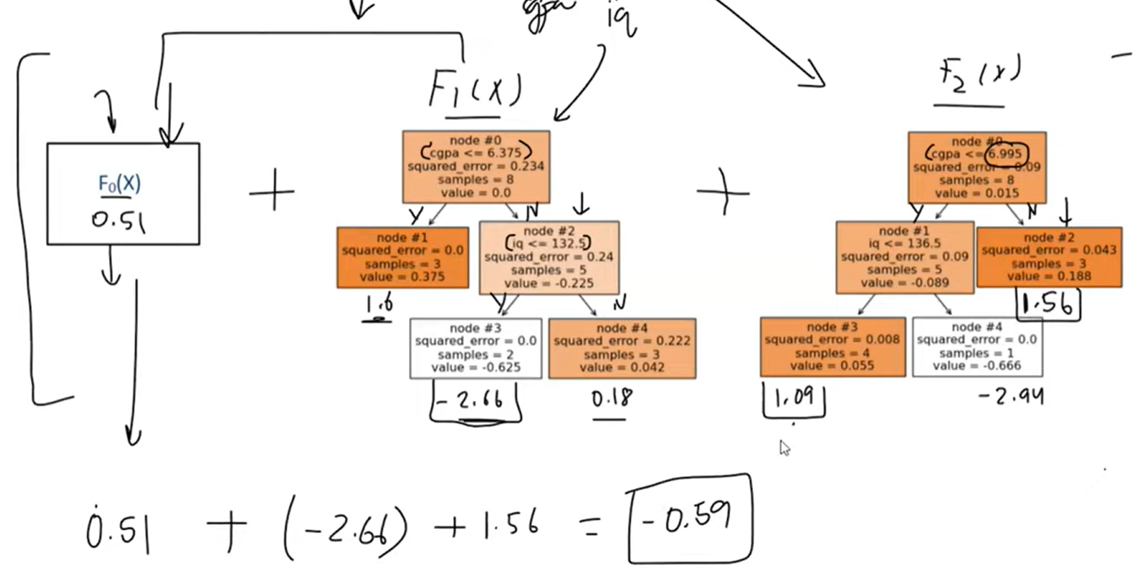
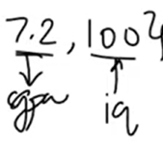

Slide 18
