Slide 1

Model representation
Linear regression with one variable
Machine Learning
Notes:
How the model look like
E,g

Slide 2
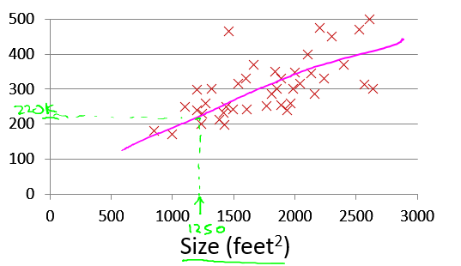

Housing Prices
(Portland, OR)
Price
(in 1000s of dollars)
Size (feet²)
Supervised Learning
Given the “right answer” for each example in the data.
Regression Problem
Predict real-valued output
Notes:
Some house size and their associated price
Let size =1250 the you can know the price of the house ,
This is superivised example, supervisor learning give the right answer for the some given example.
While regression is used to predict the real value
Supervise learning has data set
E.g data of the houses

Slide 3
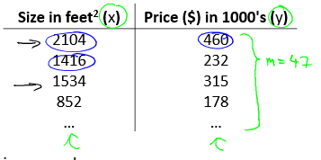
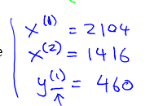

Training set of
housing prices
(Portland, OR)
Size in feet² (x) | Price ($) in 1000's (y)
2104 | 460
1416 | 232
1534 | 315
852 | 178
… | …
Notation:
m = Number of training examples
x’s = “input” variable / features
y’s = “output” variable / “target” variable
Notes:
Use to predict the house prices
M is no to examples/data
X input
Y is output
We can represent it as
(X,y) one training example
Or
(X^{(i)}, y^{(i)}) represent i^{th} training example.
Supervisor learning works like this
We have a train set which is fed into learning algorithm, which open a function h, which is b y convention said to be hypothesis.
Which will take the size of the house as input and output the estimated price of the house.
So h is function that map the x to y
Why it is hypothesis , it was written in early days , may ben you thing it is not a greate name, but now it is fixed.

Slide 4
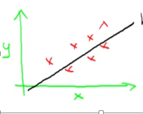

Notes:
How to represent h
Next we are going to represent h
hΘ (x)= Θ0+Θ1x
or
h(x)
This is linear function , some time we represent non linear function through this hypothesis
This is one simple function, we will go to more complex linear function
Above model is call linear regression, with uni variable(x) or another name is univariate.

Slide 5
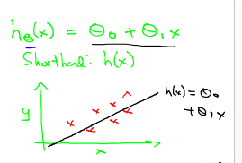

Training Set
How do we represent h ?
Learning Algorithm
Size of house
h
Estimated price
Linear regression with one variable.
Univariate linear regression.
Notes:
How to represent h
Next we are going to represent h
hΘ (x)= Θ0+Θ1x
or
h(x)

Slide 6
Cost function
Linear regression with one variable
Machine Learning

Slide 7
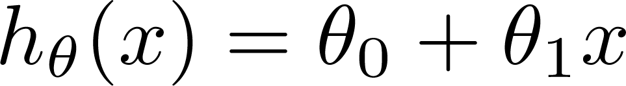

Training Set
Size in feet² (x) | Price ($) in 1000's (y)
2104 | 460
1416 | 232
1534 | 315
852 | 178
… | …
Hypothesis:
‘s: Parameters
How to choose ‘s ?
Notes:
Cost Function.
This lecture descrble the cost function, which describle the how to fit the line best fit the data.
In linear regression we have data
Describe the training set and hypothesis.
Θ are also called parameters, lect ure is about how to choose the parameter values.
How we choose Θ, is which comes on good fit on data.

Slide 8

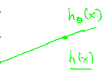
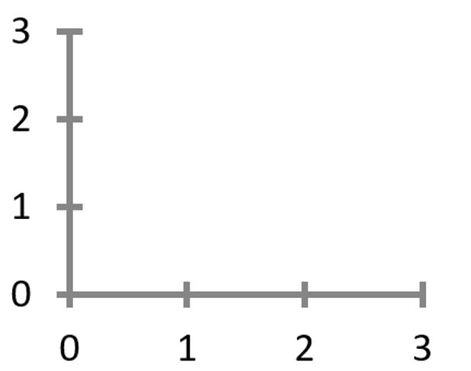

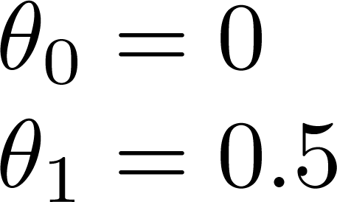
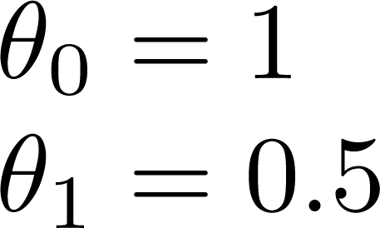
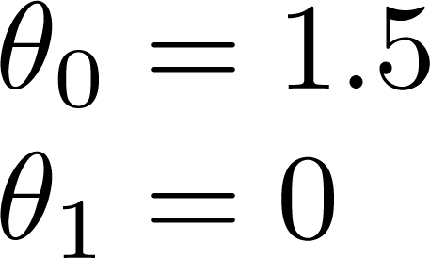

Slide 9
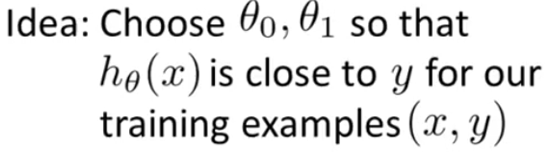
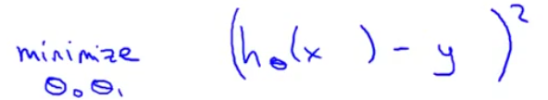
Regression is minimization problem

Slide 10

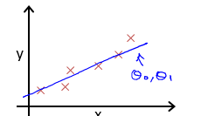



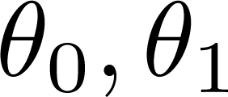

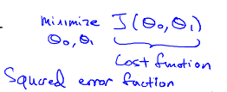

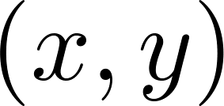
y
x
Idea: Choose so that is close to for our training examples
Notes:
Htheta is predicted value when the value of xi is minus the actual price
M is size of training set size.
1/m is to take the average of the error , why its saqure and divided by 2 I dnot know yet.
We write the cost function as
Some time it is called squared error function.
There are other cost function as well but squared error function is commonly used for regression problem.

Slide 11
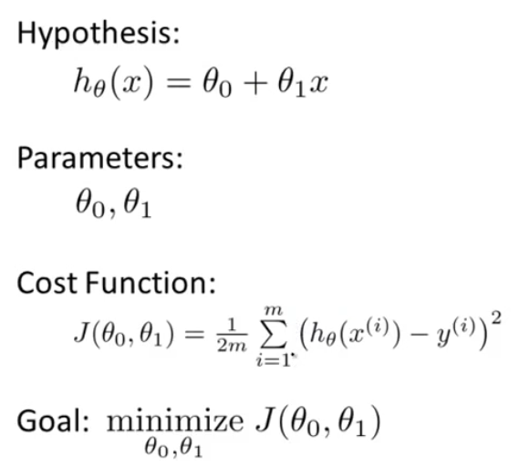
Notes:
Summary of the lecture
Goal is optimization of cost function
Is simplified way when Theta0 is 0 can be written as

Slide 12
Cost function intuition I
Linear regression with one variable
Machine Learning

Slide 13
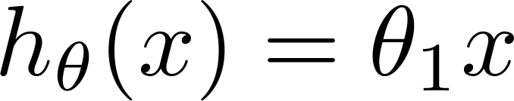

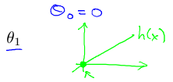

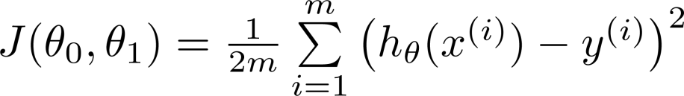
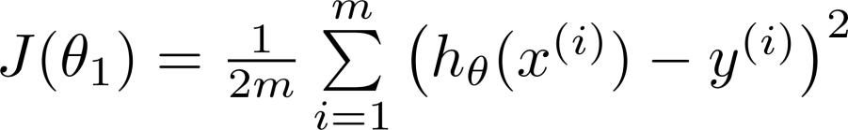

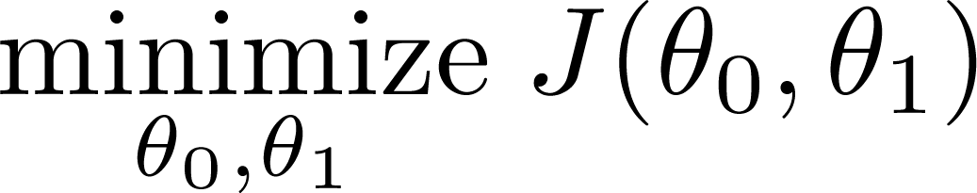
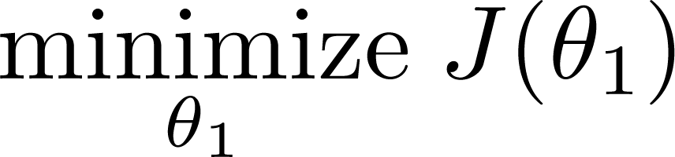
Simplified
Hypothesis:
Parameters:
Cost Function:
Goal:

Slide 14








(for fixed , this is a function of x)
(function of the parameter )
y
x
Notes:
Two key function needs to understand one is hypothesis function and other is cost function.
hypothesis htheata(x) is a function of x in which theta s fixed lets say it 1 or 2 such as size of the house
While cost function j(theta) is functions of parameter which control the slop.
Lets plot the hypothesis , there are three point , horizontal is x size of thouse , while theta1=1 temporarily
Then j(theata) is cost function with j(theta1)
Simplyfy term 0+0+0
The xi=yi
Now plot the right side, where theat1 will be on horizontal side,
If we take j(theata)=j(1)=0 then explin red cross on 1.
If theta is is .5
==========================
Now we are able to concretely measure the accuracy of our predictor function against the correct results we have so that
we can predict new results we don't have.
If we try to think of it in visual terms, our training data set is scattered on the x-y plane. We are trying to make straight line
(dened by ) which passes through this scattered set of data. Our objective is to get the best possible line. The best
possible line will be such so that the average squared vertical distances of the scattered points from the line will be the
least. In the best case, the line should pass through all the points of our training data set. In such a case the value of
J(θ0,θ1)
(x)h
θ
will be 0.

Slide 15

(for fixed , this is a function of x)
(function of the parameter )
y
x
Notes:
If theta is .5 then line will be look like this left and j(0.5) will be sum of square of line is the difference of y and x
And the it will be on right side “there”,
Now what about if theta1=0. then h(x) will be flat line

Slide 16
(for fixed , this is a function of x)
(function of the parameter )
y
x
Notes:
If theta is .5 then line will be look like this left and j(0.5) will be sum of square of line is the difference of y and x
And the it will be on right side “there”,
Now what about if theta1=0. then h(x) will be flat line measuring the like look a left

Slide 17
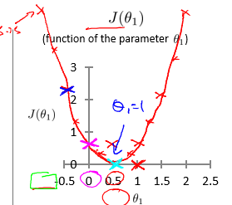
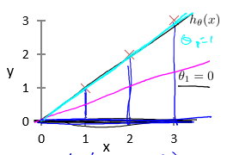


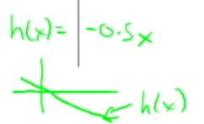

(for fixed , this is a function of x)
(function of the parameter )
y
x
Notes:
If theta is .5 then line will be look like this left and j(0.5) will be sum of square of line is the difference of y and x
And the it will be on right side “there”,
Now what about if theta1=0. then h(x) will be flat line measuring the like look a left
For the different value of theta1 can be computed like below and function will be likely this right
For different value of theta1 produces a different hypothesis/straight line
For different value of theata1 we can derive different j(theta).
Objective of the optimization is to find the value of theta having minimum J(theta).
Figure above having minimum j(theta) with value 1 of theta. Best line will be at theat value 1.

Slide 18
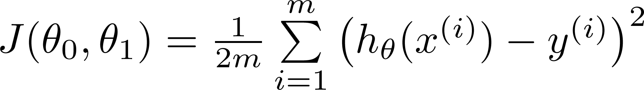
Hypothesis:
Parameters:
Cost Function:
Goal:
Notes:
Summary of the previous:

Slide 19
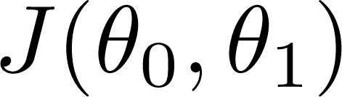



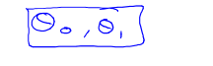
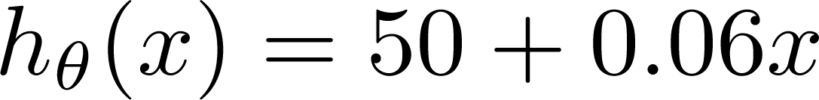
(for fixed , this is a function of x)
(function of the parameters )
Price ($)
in 1000’s
Size in feet² (x)
Notes:
Here my housing prices .
Lets make some hypothesis, let theta0=50 and theata1=.06
Uptil now we have discus only one parameter , now we have two paramters. Then hypothesis will be……….
And plot is more complicated
so plot may of bowl shape function.

Slide 20
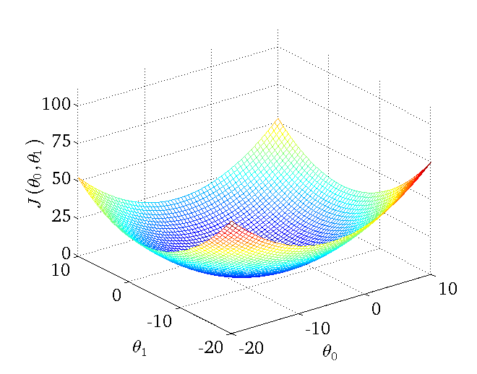
Notes:
Depending upon the cost function , your plot may be look 3 d surface plot. this bowl shaped.
Where the xais are label theta 0 and theta 1.
With different value of t0 and t1, we have different value of cost function. Hight of the point on surface.
for the rest of the topic we are not going to discus 3-d surface , there may be more the 2 dimension, which is not possible
To show them visually

Slide 21
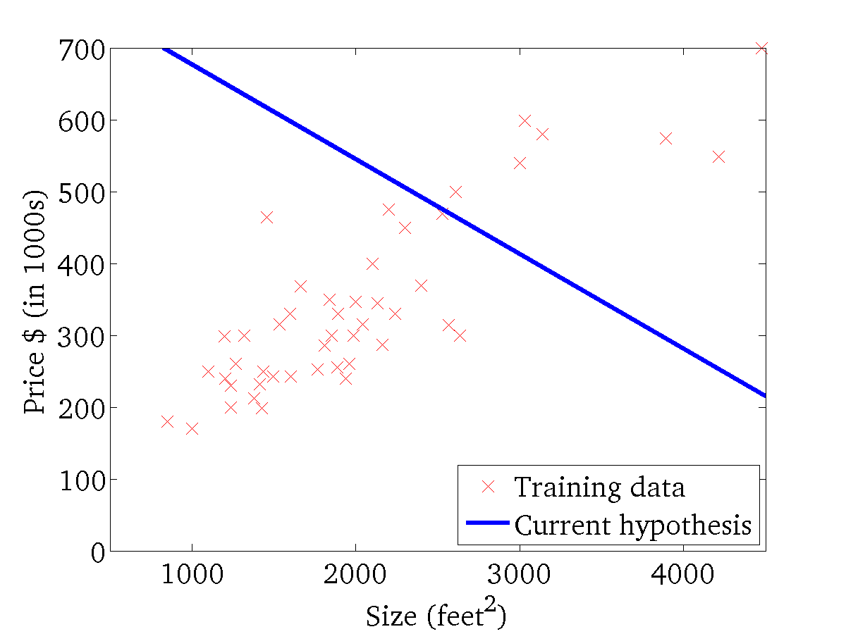
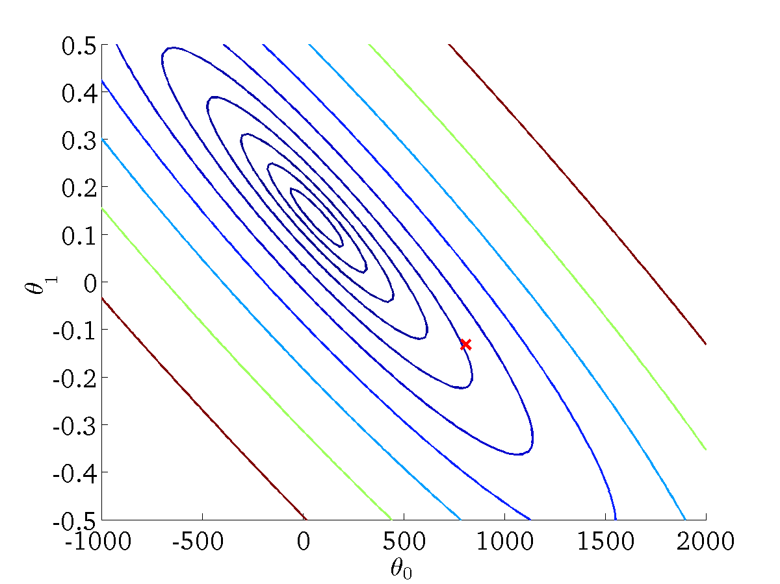
(for fixed , this is a function of x)
(function of the parameters )
Notes:
Instead we represent the high dimension class with counter plot/figure to show the surface.
What
We have to convert our bowl function into sequential segements of same sizes.
Cut with z-axsis,
Same size line will drawn
Line are called contour line.curve or level curve.
We may more than on minima ,
We have some lines on our x-axis

Slide 22
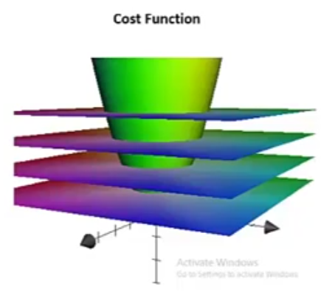
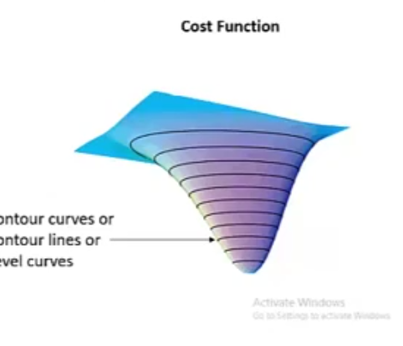

Slide 23
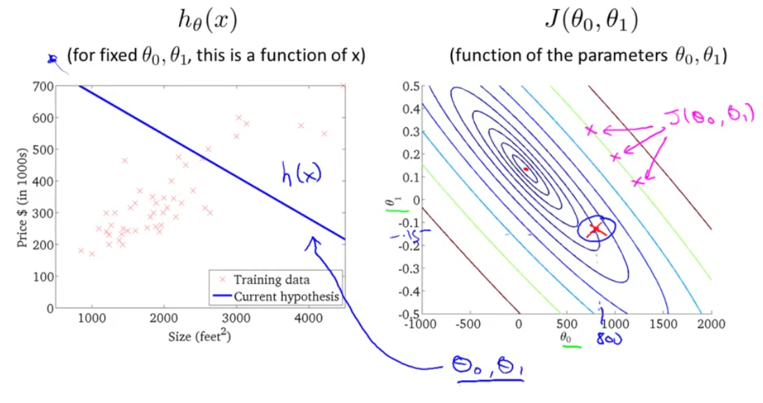

Slide 24
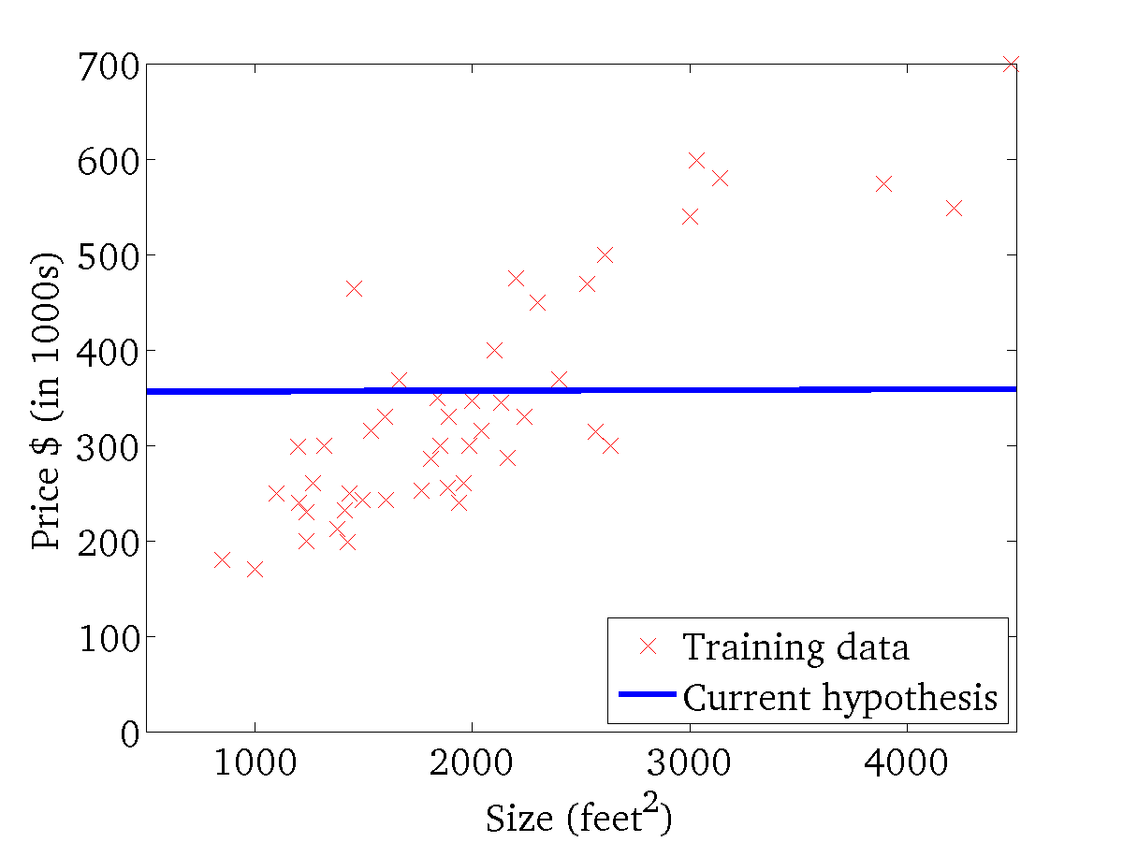
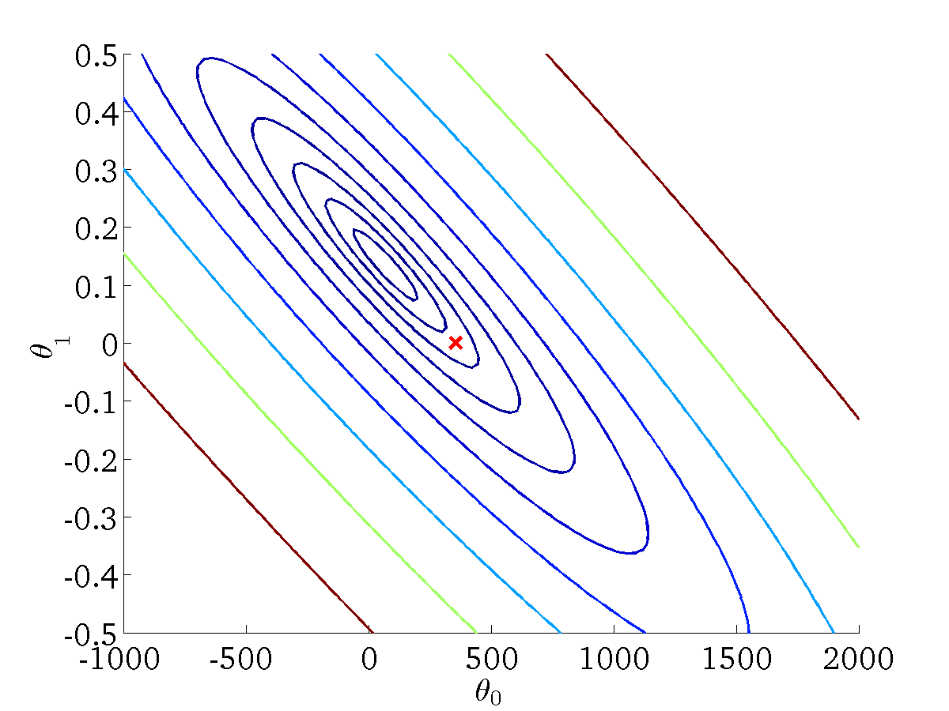
(for fixed , this is a function of x)
(function of the parameters )

Slide 25
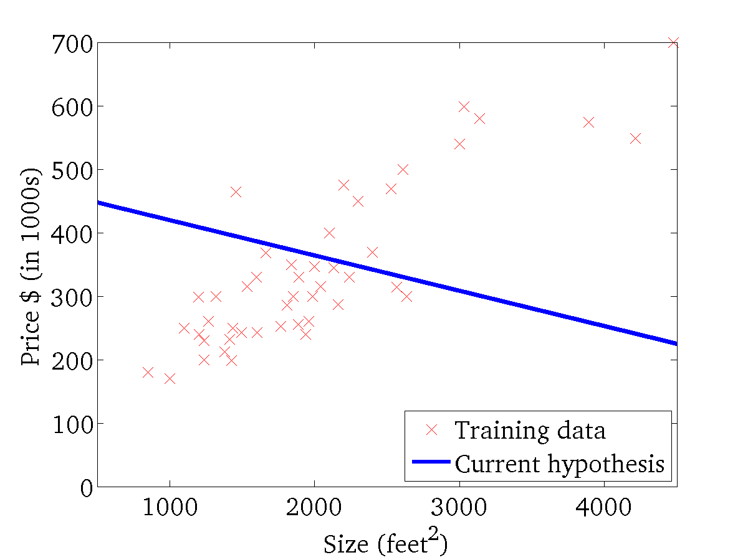

(for fixed , this is a function of x)
(function of the parameters )

Slide 26
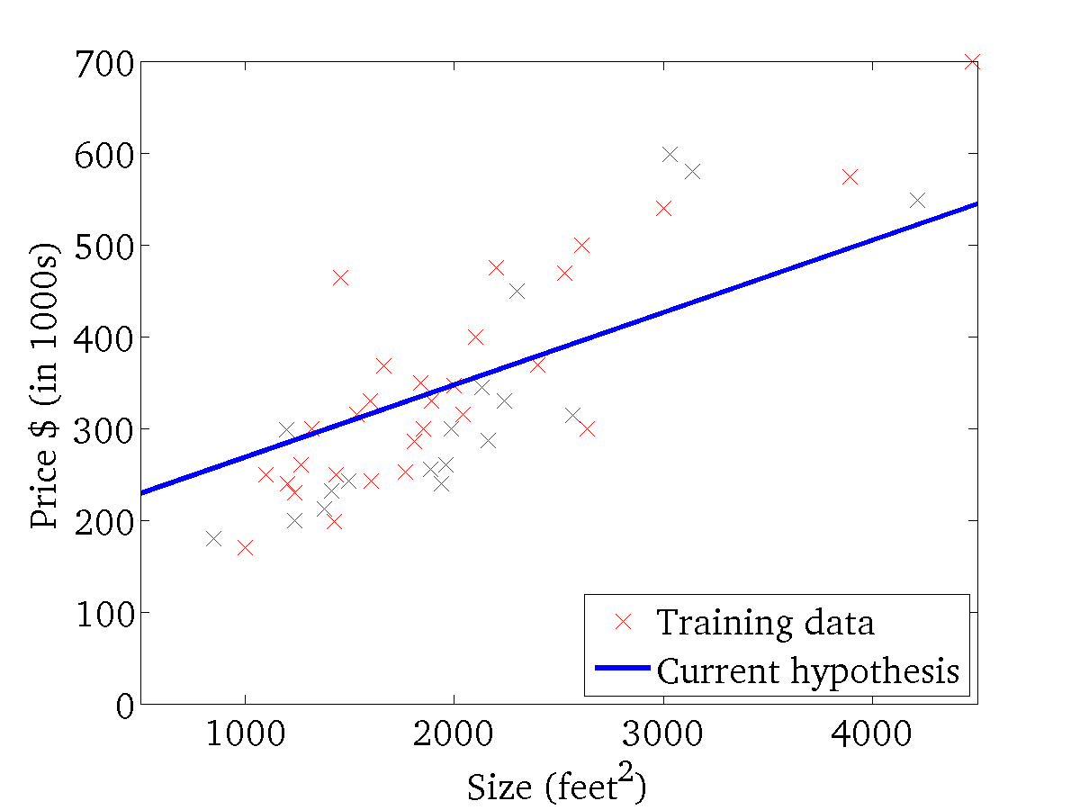
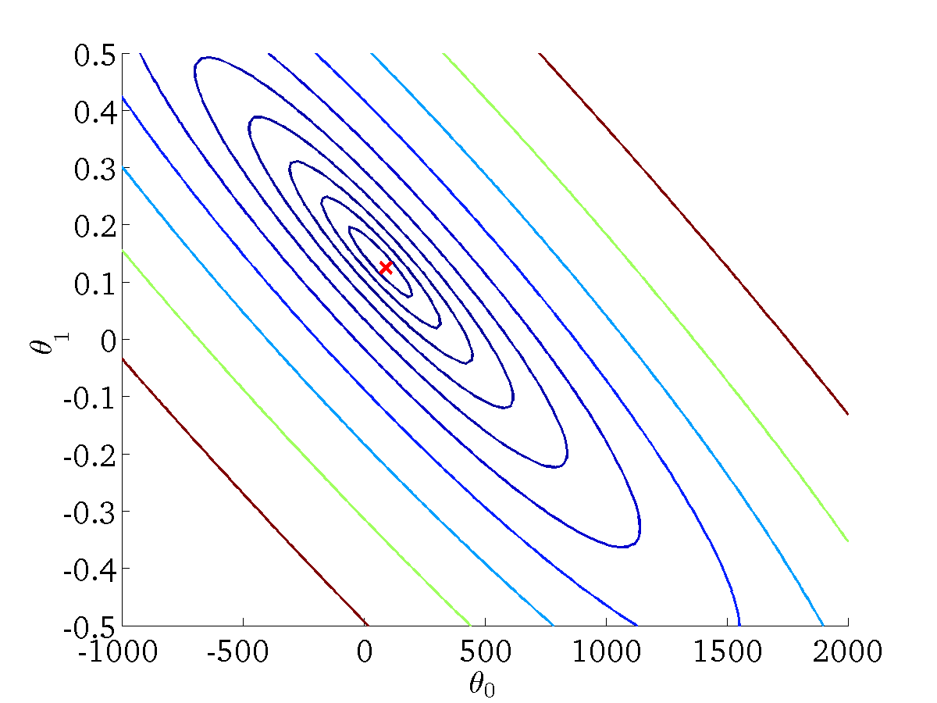
(for fixed , this is a function of x)
(function of the parameters )

Slide 27
Gradient descent
Linear regression with one variable
Machine Learning
Notes:
Dradient descendent is an algorithm used to find the minimum cost function, it is more general algo not only use for regression, it is used
In many other technques as well.
Use to minimize cost function
First we see gradient desendent arbitrarily and then for specifically for linear regression.
It is also used to minimize other thing , not only the cost function of linear regression

Slide 28
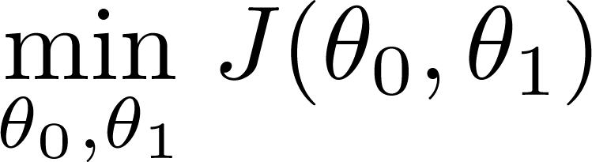
Have some function
Want
Outline:
Start with some
Keep changing to reduce until we hopefully end up at a minimum
Notes:
Here are only two parameter It can be generalize, on next slides,
Initialized t0 and t1
Changes t0 and t1 a little bit to reduce j(t0, t1) to hope well reach at minimum.

Slide 29
Have some function
Want
Outline:
Start with some
Keep changing to reduce until we hopefully end up at a minimum

Slide 30
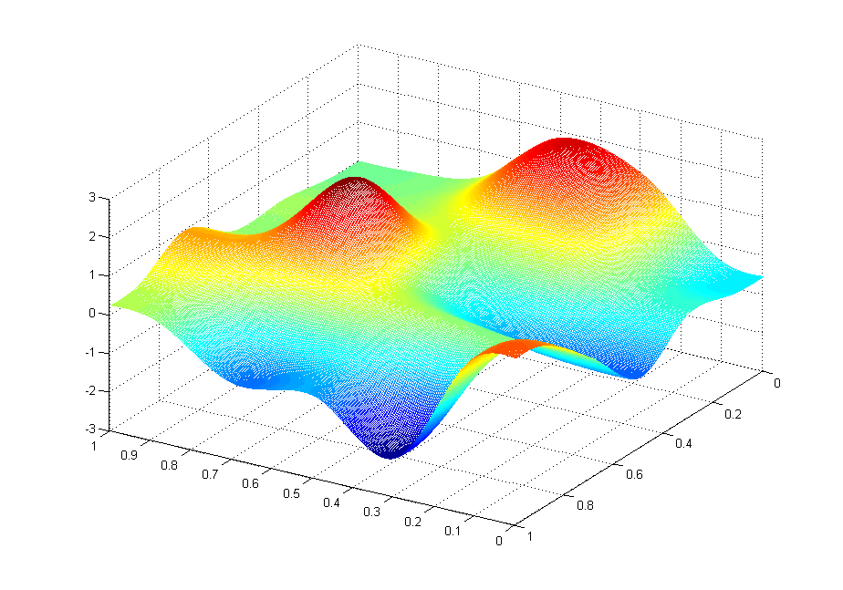
J(θ₀,θ₁)
θ₁
θ₀

Slide 31
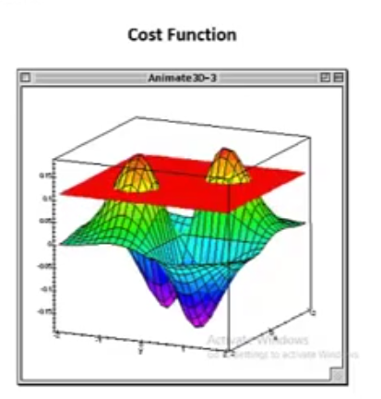
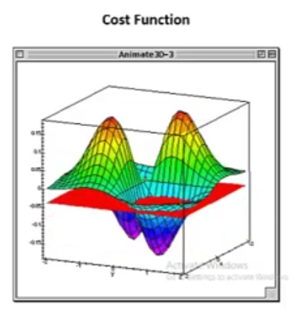
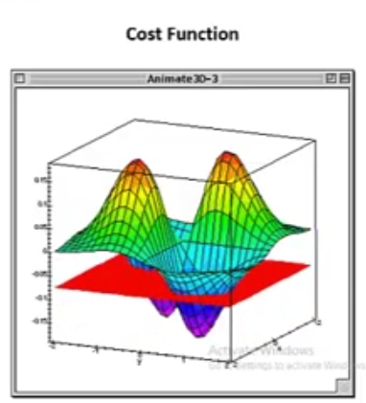
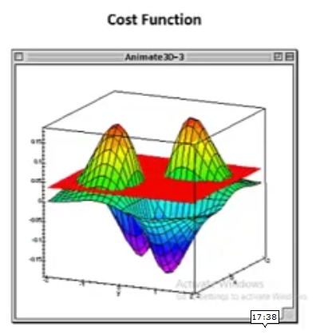

Slide 32
J(θ₀,θ₁)
θ₁
θ₀

Slide 33
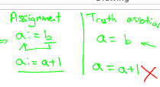
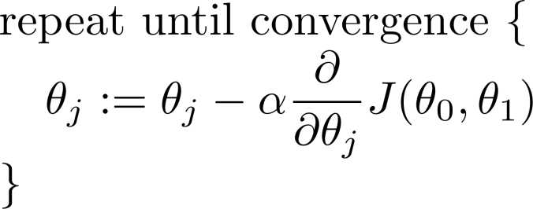



Gradient descent algorithm
Learning Rate
Correct: Simultaneous update
Incorrect:
Notes:
Alpha mean how bigger step we take

Slide 34
Gradient descent algorithm
Correct: Simultaneous update
Incorrect:

Slide 35
Gradient descent intuition
Linear regression with one variable
Machine Learning

Slide 36


Gradient descent algorithm
Notes:
Alpha rate depict the how big step is taken to learn minimum optima.
Below written is discussed earler of one parameter

Slide 37




Notes:
Draw tangent to point just touching the line , find the slop of the function, i.e hight divided by horizontal
Above slop is positive , move the point to left.
This gives glimps what the derivative term is doing?

Slide 38

If α is too small, gradient descent can be slow.
If α is too large, gradient descent can overshoot the minimum. It may fail to converge, or even diverge.
Notes:
What happen If alpha is too small or too large

Slide 39


at local optima
Current value of
Notes:
At local optima derivative term/slop will be zero. (At local optima)

Slide 40
Gradient descent can converge to a local minimum, even with the learning rate α fixed.
As we approach a local minimum, gradient descent will automatically take smaller steps. So, no need to decrease α over time.
Notes:
Why GD reaches to local minimum, while alpha is constant

Slide 41
Gradient descent for linear regression
Linear regression with one variable
Machine Learning
Notes:
Map GD on linear Regression

Slide 42


Gradient descent algorithm
Linear Regression Model

Slide 43




Slide 44


Gradient descent algorithm
update
and
simultaneously

Slide 45
J(θ₀,θ₁)
θ₁
θ₀

Slide 46
J(θ₀,θ₁)
θ₁
θ₀

Slide 48


(for fixed , this is a function of x)
(function of the parameters )

Slide 49

(for fixed , this is a function of x)
(function of the parameters )

Slide 50


(for fixed , this is a function of x)
(function of the parameters )

Slide 51


(for fixed , this is a function of x)
(function of the parameters )

Slide 52

(for fixed , this is a function of x)
(function of the parameters )

Slide 53

(for fixed , this is a function of x)
(function of the parameters )

Slide 54


(for fixed , this is a function of x)
(function of the parameters )

Slide 55

(for fixed , this is a function of x)
(function of the parameters )

Slide 56


(for fixed , this is a function of x)
(function of the parameters )

Slide 57
“Batch” Gradient Descent
“Batch”: Each step of gradient descent uses all the training examples.

Slide 58

Notes:
There aer couple of extension of these ideas

Slide 59



Slide 60

Notes:
You need a very baic of linear algebra for mL

Slide 61


