Slide 1
Decision Tree Regression
Dr. Muhammad safyan

Slide 2
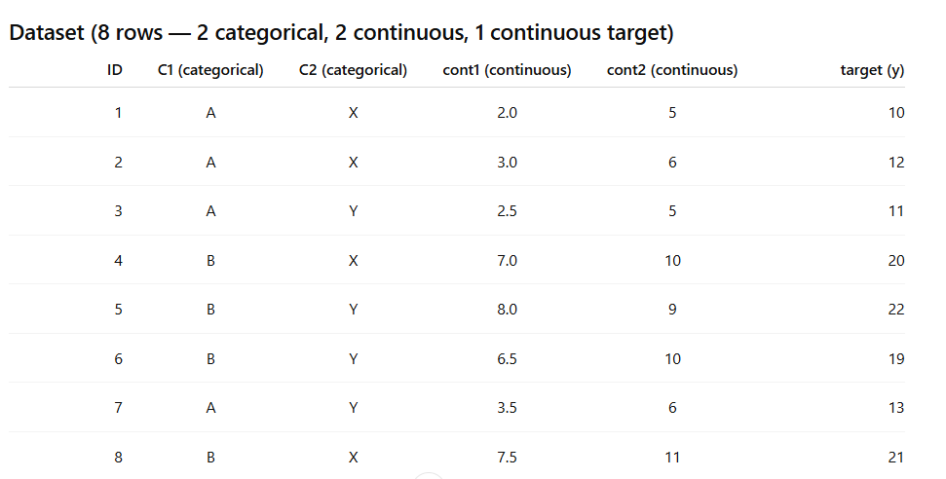

Slide 3
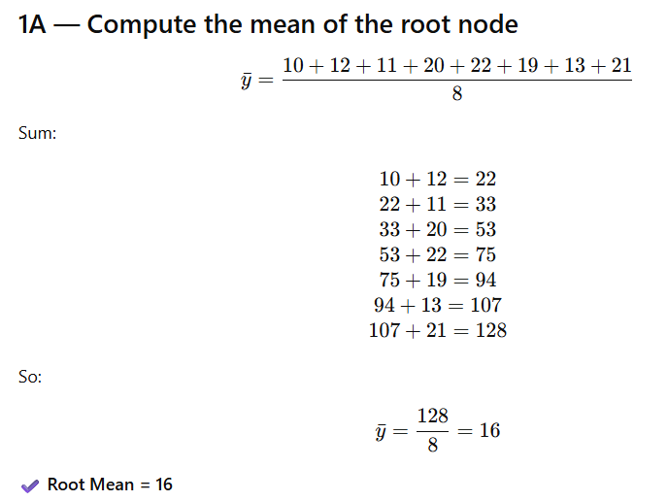
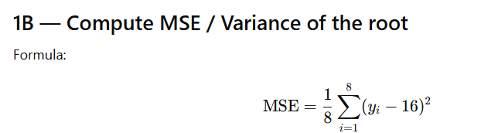
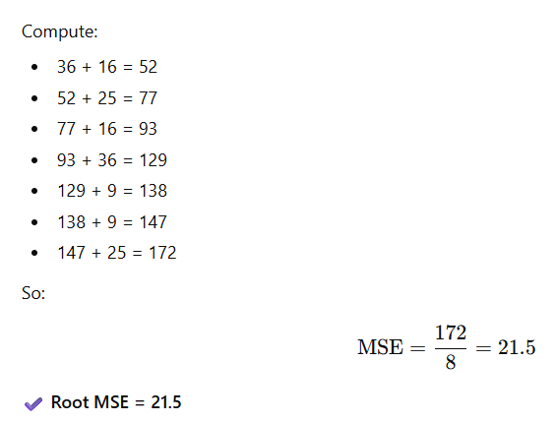

Slide 4

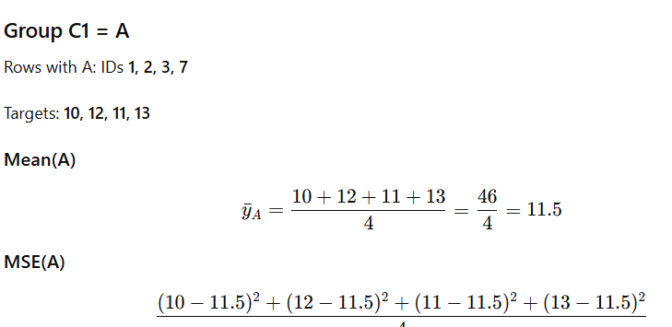
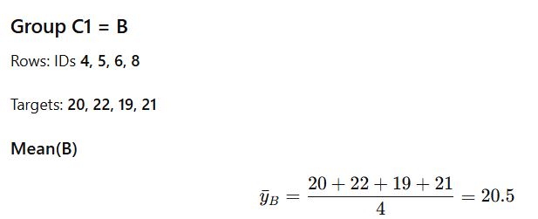


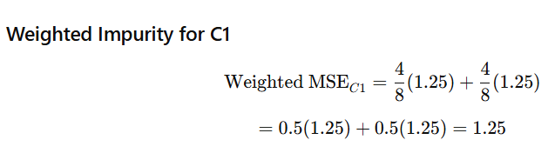

Slide 5

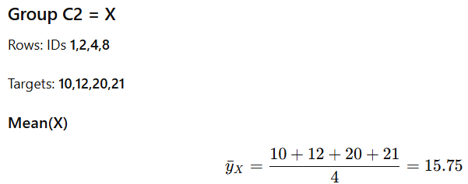
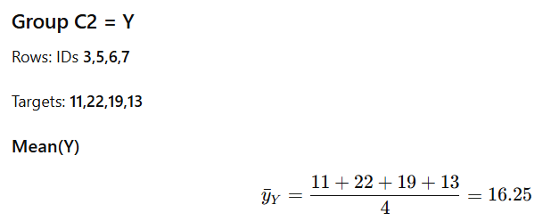


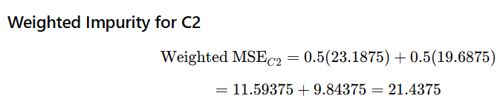

Slide 6


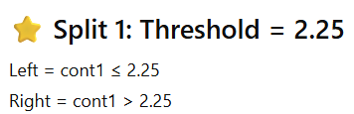

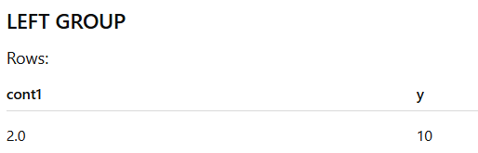





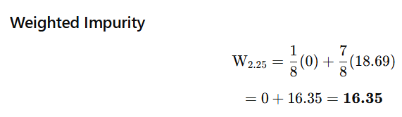

Slide 7
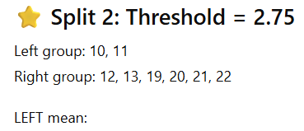
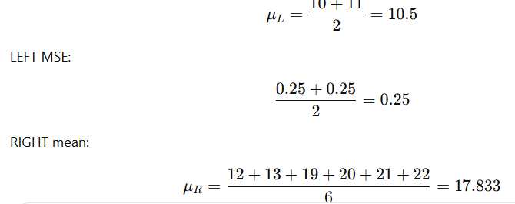
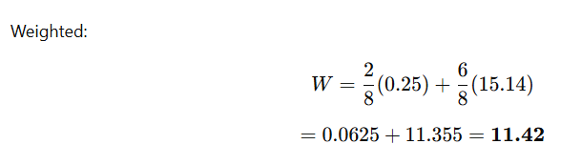


Slide 8
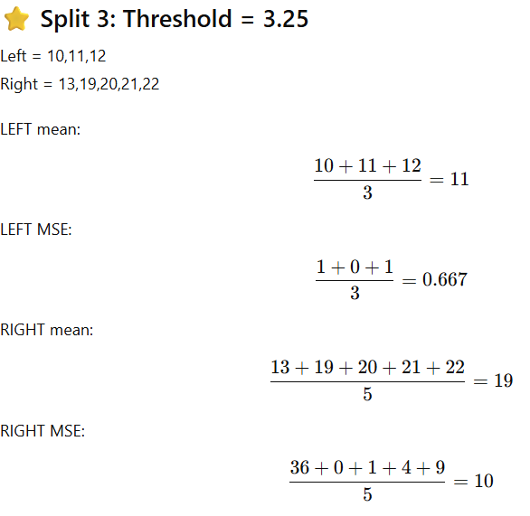
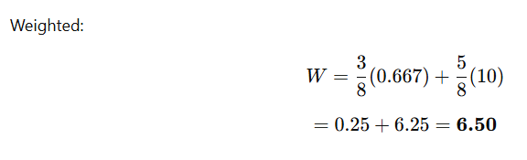

Slide 9
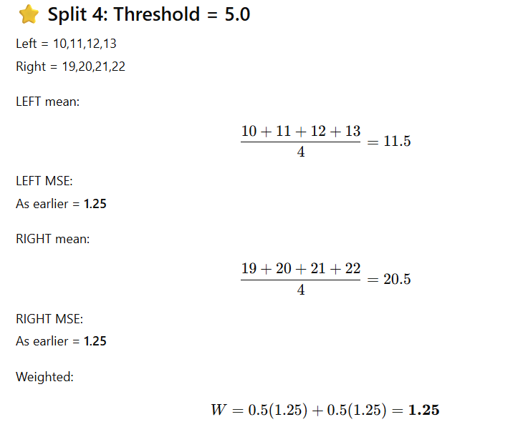

Slide 10
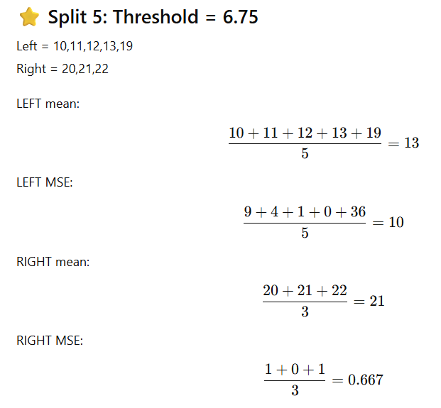
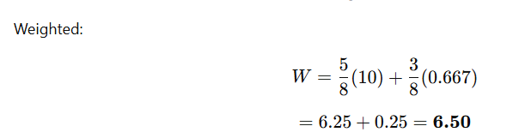

Slide 11
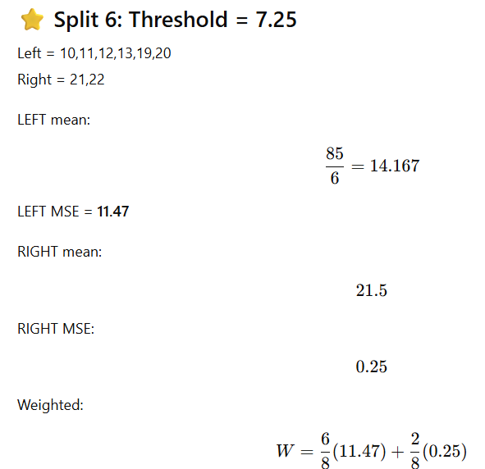
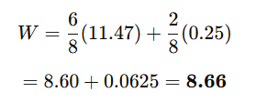

Slide 12
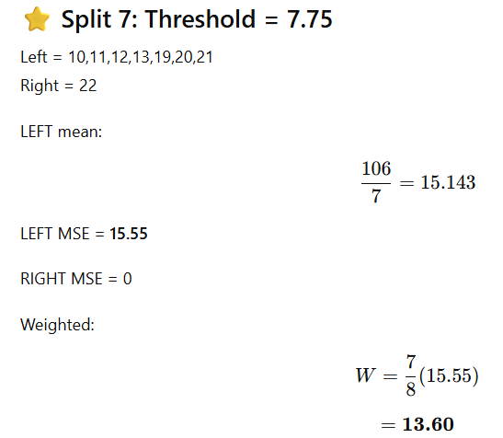

Slide 13
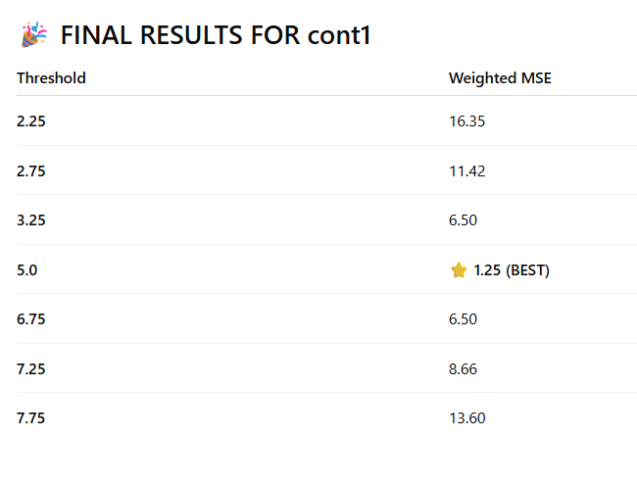

Slide 14
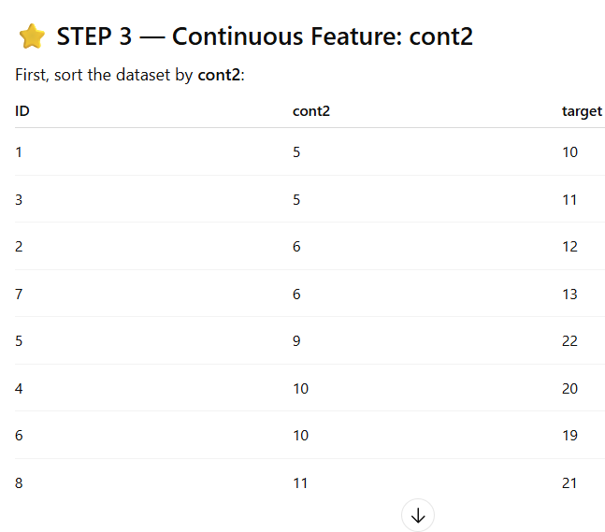
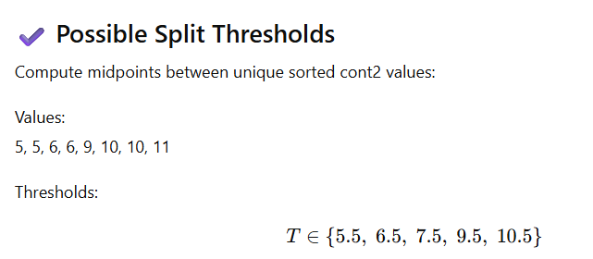

Slide 15
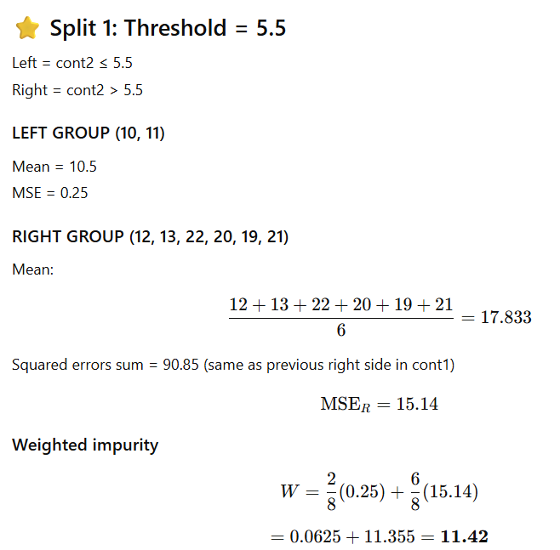

Slide 16
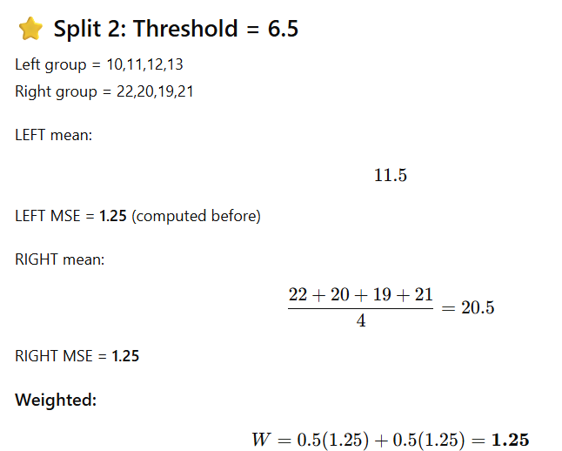

Slide 17
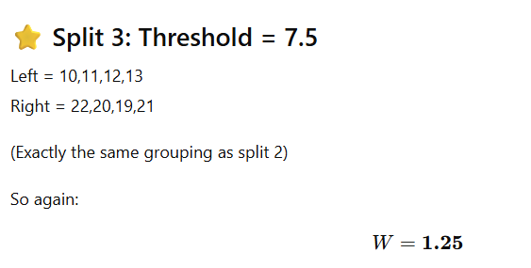

Slide 18
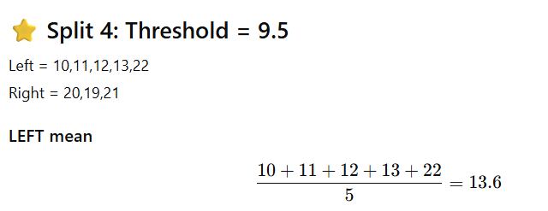


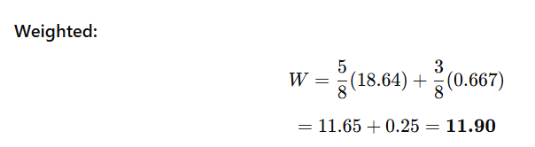

Slide 19
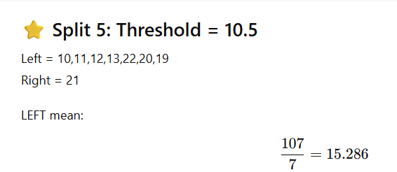
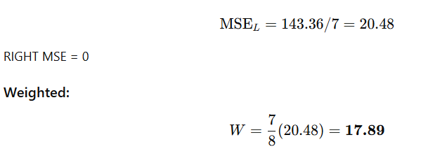

Slide 20
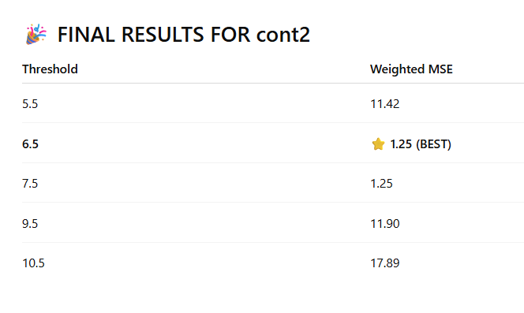
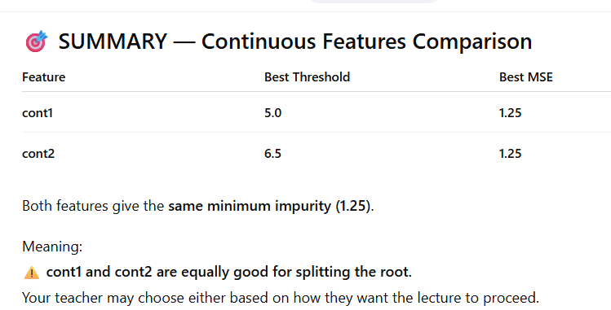

Slide 21
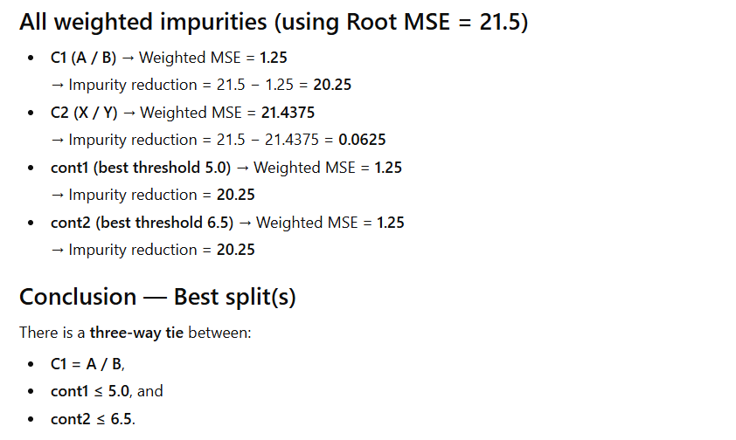
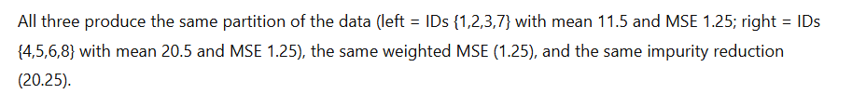

Slide 22
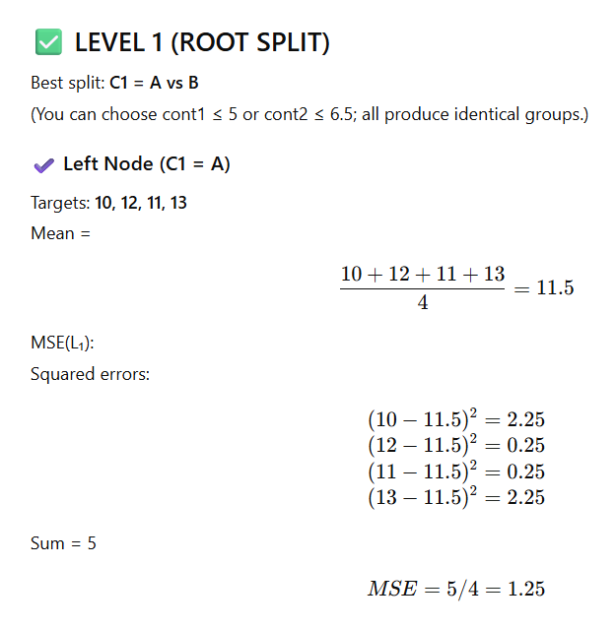
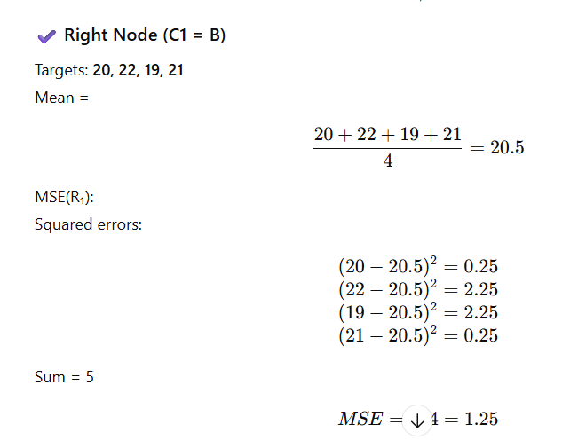
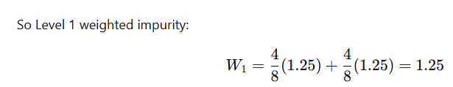

Slide 23
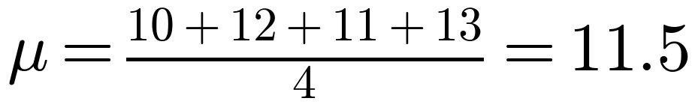
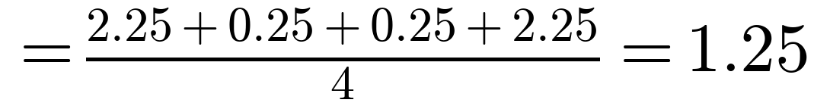
LEVEL 2 — Left Node (C1 = A)
Level 2 · Left node (C1 = A)
ID | C1 | C2 | cont1 | cont2 | target (y)
1 | A | X | 2.0 | 5 | 10
2 | A | X | 3.0 | 6 | 12
3 | A | Y | 2.5 | 5 | 11
7 | A | Y | 3.5 | 6 | 13
Candidates to evaluate
C1: every row has C1 = A, so it cannot split this node
C2: X vs Y
cont1: midpoint thresholds
cont2: midpoint thresholds
Node mean and MSE (the parent impurity)

Slide 24
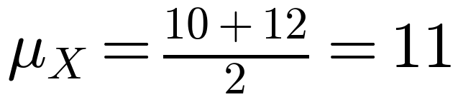
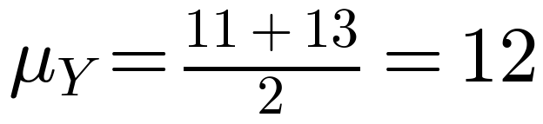
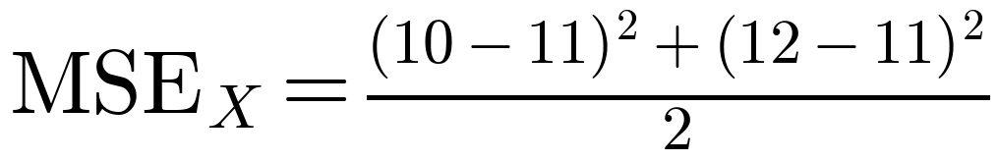
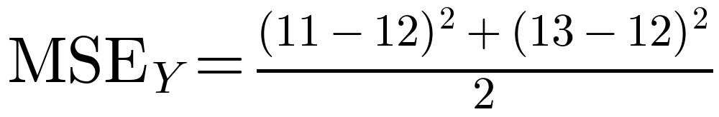
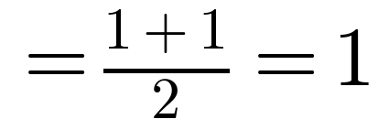
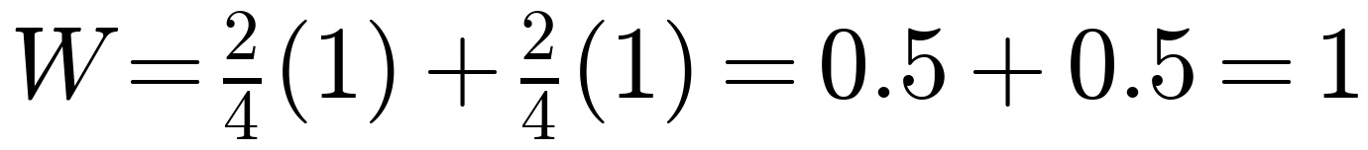
STEP 1 — Evaluate categorical feature C2
Level 2 · Left node (C1 = A)
Group C2 = X
Group C2 = Y
IDs 1, 2 | targets: 10, 12
IDs 3, 7 | targets: 11, 13
Mean
Mean
MSE
MSE
Weighted MSE

Slide 25
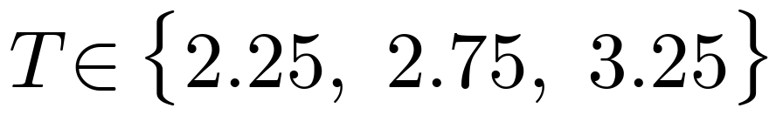
STEP 2 — Continuous Feature: cont1
Level 2 · Left node (C1 = A)
ID | cont1 | target (y)
1 | 2 | 10
3 | 2.5 | 11
2 | 3 | 12
7 | 3.5 | 13
Possible split thresholds
Sorted values: 2.0, 2.5, 3.0, 3.5
Unique values: 2.0, 2.5, 3.0, 3.5
Midpoints between neighbouring unique values:
(2.0 + 2.5) / 2 = 2.25
(2.5 + 3.0) / 2 = 2.75
(3.0 + 3.5) / 2 = 3.25

Slide 26





cont1 — Split 1: Threshold = 2.25
Level 2 · Left node (C1 = A)
LEFT: cont1 ≤ 2.25
RIGHT: cont1 > 2.25
IDs 1 | targets: 10
IDs 2, 3, 7 | targets: 12, 11, 13
Mean
Mean
MSE
MSE
Weighted MSE

Slide 27





cont1 — Split 2: Threshold = 2.75
Level 2 · Left node (C1 = A)
LEFT: cont1 ≤ 2.75
RIGHT: cont1 > 2.75
IDs 1, 3 | targets: 10, 11
IDs 2, 7 | targets: 12, 13
Mean
Mean
MSE
MSE
Weighted MSE

Slide 28





cont1 — Split 3: Threshold = 3.25
Level 2 · Left node (C1 = A)
LEFT: cont1 ≤ 3.25
RIGHT: cont1 > 3.25
IDs 1, 2, 3 | targets: 10, 12, 11
IDs 7 | targets: 13
Mean
Mean
MSE
MSE
Weighted MSE

Slide 29
FINAL RESULTS FOR cont1
Level 2 · Left node (C1 = A)
Threshold | Weighted MSE | Impurity reduction (1.25 − W)
2.25 | 0.5 | 0.75
2.75 | 0.25 (BEST) | 1
3.25 | 0.5 | 0.75

Slide 30

STEP 3 — Continuous Feature: cont2
Level 2 · Left node (C1 = A)
ID | cont2 | target (y)
1 | 5 | 10
3 | 5 | 11
2 | 6 | 12
7 | 6 | 13
Possible split thresholds
Sorted values: 5, 5, 6, 6
Unique values: 5, 6
Midpoints between neighbouring unique values:
(5 + 6) / 2 = 5.5

Slide 31
cont2 — Split 1: Threshold = 5.5
Level 2 · Left node (C1 = A)
LEFT: cont2 ≤ 5.5
RIGHT: cont2 > 5.5
IDs 1, 3 | targets: 10, 11
IDs 2, 7 | targets: 12, 13
Mean
Mean
MSE
MSE
Weighted MSE

Slide 32
SUMMARY — Left Node (C1 = A)
Level 2 · Left node (C1 = A)
Feature | Best split | Weighted MSE | Impurity reduction (1.25 − W)
C2 | X vs Y | 1 | 0.25
cont1 | ≤ 2.75 | 0.25 | 1
cont2 | ≤ 5.5 | 0.25 | 1
Decision: split on cont1 ≤ 2.75
cont1 ≤ 2.75 and cont2 ≤ 5.5 create the same partition (tie), so we keep cont1.
Left child: IDs 1, 3 → mean 10.5, MSE 0.25. Right child: IDs 2, 7 → mean 12.5, MSE 0.25.

Slide 33


LEVEL 2 — Right Node (C1 = B)
Level 2 · Right node (C1 = B)
ID | C1 | C2 | cont1 | cont2 | target (y)
4 | B | X | 7.0 | 10 | 20
5 | B | Y | 8.0 | 9 | 22
6 | B | Y | 6.5 | 10 | 19
8 | B | X | 7.5 | 11 | 21
Candidates to evaluate
C1: every row has C1 = B, so it cannot split this node
C2: X vs Y
cont1: midpoint thresholds
cont2: midpoint thresholds
Node mean and MSE (the parent impurity)

Slide 34





STEP 1 — Evaluate categorical feature C2
Level 2 · Right node (C1 = B)
Group C2 = X
Group C2 = Y
IDs 4, 8 | targets: 20, 21
IDs 5, 6 | targets: 22, 19
Mean
Mean
MSE
MSE
Weighted MSE

Slide 35

STEP 2 — Continuous Feature: cont1
Level 2 · Right node (C1 = B)
ID | cont1 | target (y)
6 | 6.5 | 19
4 | 7 | 20
8 | 7.5 | 21
5 | 8 | 22
Possible split thresholds
Sorted values: 6.5, 7.0, 7.5, 8.0
Unique values: 6.5, 7.0, 7.5, 8.0
Midpoints between neighbouring unique values:
(6.5 + 7.0) / 2 = 6.75
(7.0 + 7.5) / 2 = 7.25
(7.5 + 8.0) / 2 = 7.75

Slide 36




cont1 — Split 1: Threshold = 6.75
Level 2 · Right node (C1 = B)
LEFT: cont1 ≤ 6.75
RIGHT: cont1 > 6.75
IDs 6 | targets: 19
IDs 4, 5, 8 | targets: 20, 22, 21
Mean
Mean
MSE
MSE
Weighted MSE

Slide 37




cont1 — Split 2: Threshold = 7.25
Level 2 · Right node (C1 = B)
LEFT: cont1 ≤ 7.25
RIGHT: cont1 > 7.25
IDs 4, 6 | targets: 20, 19
IDs 5, 8 | targets: 22, 21
Mean
Mean
MSE
MSE
Weighted MSE

Slide 38




cont1 — Split 3: Threshold = 7.75
Level 2 · Right node (C1 = B)
LEFT: cont1 ≤ 7.75
RIGHT: cont1 > 7.75
IDs 4, 6, 8 | targets: 20, 19, 21
IDs 5 | targets: 22
Mean
Mean
MSE
MSE
Weighted MSE

Slide 39
FINAL RESULTS FOR cont1
Level 2 · Right node (C1 = B)
Threshold | Weighted MSE | Impurity reduction (1.25 − W)
6.75 | 0.5 | 0.75
7.25 | 0.25 (BEST) | 1
7.75 | 0.5 | 0.75

Slide 40

STEP 3 — Continuous Feature: cont2
Level 2 · Right node (C1 = B)
ID | cont2 | target (y)
5 | 9 | 22
4 | 10 | 20
6 | 10 | 19
8 | 11 | 21
Possible split thresholds
Sorted values: 9, 10, 10, 11
Unique values: 9, 10, 11
Midpoints between neighbouring unique values:
(9 + 10) / 2 = 9.5
(10 + 11) / 2 = 10.5

Slide 41




cont2 — Split 1: Threshold = 9.5
Level 2 · Right node (C1 = B)
LEFT: cont2 ≤ 9.5
RIGHT: cont2 > 9.5
IDs 5 | targets: 22
IDs 4, 6, 8 | targets: 20, 19, 21
Mean
Mean
MSE
MSE
Weighted MSE

Slide 42




cont2 — Split 2: Threshold = 10.5
Level 2 · Right node (C1 = B)
LEFT: cont2 ≤ 10.5
RIGHT: cont2 > 10.5
IDs 4, 5, 6 | targets: 20, 22, 19
IDs 8 | targets: 21
Mean
Mean
MSE
MSE
Weighted MSE

Slide 43
FINAL RESULTS FOR cont2
Level 2 · Right node (C1 = B)
Threshold | Weighted MSE | Impurity reduction (1.25 − W)
9.5 | 0.5 (BEST) | 0.75
10.5 | 1.167 | 0.083

Slide 44
SUMMARY — Right Node (C1 = B)
Level 2 · Right node (C1 = B)
Feature | Best split | Weighted MSE | Impurity reduction (1.25 − W)
C2 | X vs Y | 1.25 | 0
cont1 | ≤ 7.25 | 0.25 | 1
cont2 | ≤ 9.5 | 0.5 | 0.75
Decision: split on cont1 ≤ 7.25 (a unique winner, no tie)
Weighted MSE 0.25 beats every other candidate (next best is 0.50).
Left child: IDs 4, 6 → mean 19.5, MSE 0.25. Right child: IDs 5, 8 → mean 21.5, MSE 0.25.

Slide 45
FINAL REGRESSION TREE (max depth = 2)
C1 = A ?
n = 8 | MSE = 21.5
Yes
No
cont1 ≤ 2.75 ?
n = 4 | MSE = 1.25
cont1 ≤ 7.25 ?
n = 4 | MSE = 1.25
Yes
No
Yes
No
ŷ = 10.5
IDs 1, 3
n = 2 | MSE = 0.25
ŷ = 12.5
IDs 2, 7
n = 2 | MSE = 0.25
ŷ = 19.5
IDs 4, 6
n = 2 | MSE = 0.25
ŷ = 21.5
IDs 5, 8
n = 2 | MSE = 0.25

Slide 46
FINAL MODEL — Predictions and Fit
ID | Actual y | Path to leaf | ŷ | (y − ŷ)²
1 | 10 | C1 = A, cont1 ≤ 2.75 | 10.5 | 0.25
3 | 11 | C1 = A, cont1 ≤ 2.75 | 10.5 | 0.25
2 | 12 | C1 = A, cont1 > 2.75 | 12.5 | 0.25
7 | 13 | C1 = A, cont1 > 2.75 | 12.5 | 0.25
6 | 19 | C1 = B, cont1 ≤ 7.25 | 19.5 | 0.25
4 | 20 | C1 = B, cont1 ≤ 7.25 | 19.5 | 0.25
8 | 21 | C1 = B, cont1 > 7.25 | 21.5 | 0.25
5 | 22 | C1 = B, cont1 > 7.25 | 21.5 | 0.25
Training MSE = 0.25
Σ(y − ŷ)² = 8 × 0.25 = 2.0, then 2.0 ÷ 8
R² = 1 − 2 / 172 = 0.988
172 = total sum of squares at the root (8 × 21.5)
MSE: 21.5 → 1.25 → 0.25
root → after level 1 → after level 2

Slide 47
STOPPING RULE AND TAKEAWAYS
1
Stopping rule used: max depth = 2
The tree has 4 leaves, and each leaf predicts the mean of its training targets.
2
Why stop here
Each leaf has 2 rows. One more split would give pure leaves (MSE = 0), but that only memorises the training data (overfitting).
3
Usual controls in practice
max_depth, min_samples_split, min_samples_leaf and a minimum impurity decrease.
4
Example prediction
New row with C1 = B, cont1 = 7.2: C1 = A? No, then cont1 ≤ 7.25? Yes, so ŷ = 19.5.

