Slide 1

Machine Learning

Slide 2
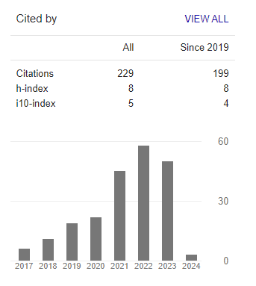
About the Instructor
Dr. Muhammad Safyan
PhD(2018) – AI & Knowledge Graph (Activity Recognition)
Research Output
Number of publications -28
Google Scholar:
Notes:
Widely accepted definition.
Perforamnce is qunatitaive(Scalar , or vector) lets .8 , you get more experience E . You improve your performance let say .85, it mean you learn.
Experience is some thing gain by some entity and you can can direct that entity how to learn. This entity may be any algorithm, robot, software agent.
If b

Slide 3
About the Course
About the Course
Machine Learning
Pre-requsite and background
Applications
Applied Side
Course Outline
Teaching Method
Assignment
Research Focus
Term Paper discussion

Slide 4
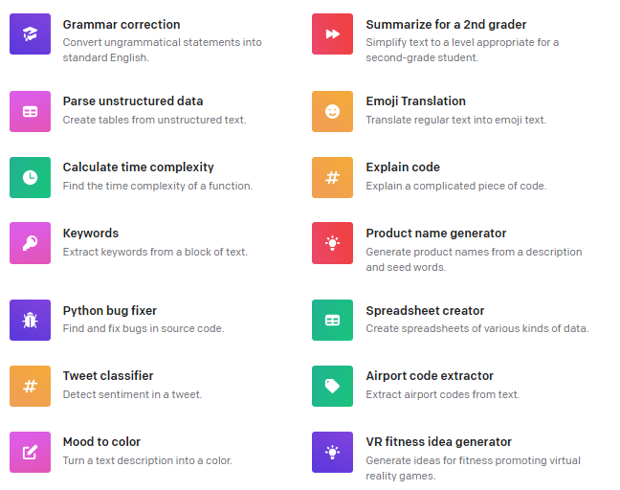
Potential Applications- OpenAI API
Prompt Engineering
https://platform.openai.com/examples

Slide 5
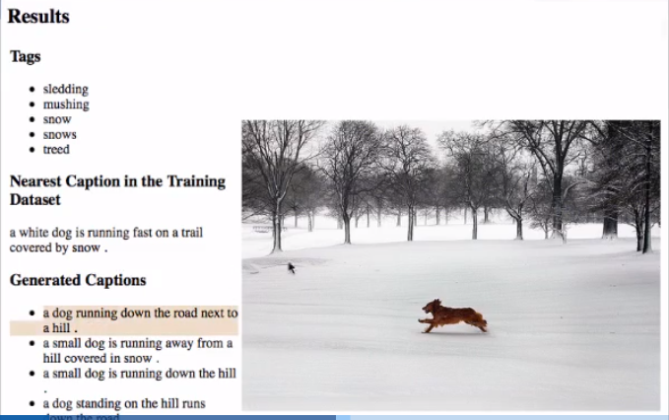
Image Tagging
Notes:
Widely accepted definition.
Perforamnce is qunatitaive(Scalar , or vector) lets .8 , you get more experience E . You improve your performance let say .85, it mean you learn.
Experience is some thing gain by some entity and you can can direct that entity how to learn. This entity may be any algorithm, robot, software agent.
If b

Slide 6
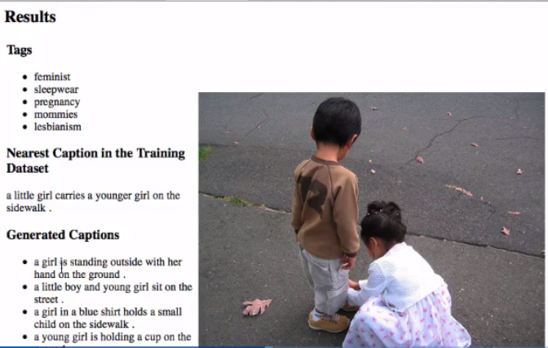
Image Tagging
Notes:
Widely accepted definition.
Perforamnce is qunatitaive(Scalar , or vector) lets .8 , you get more experience E . You improve your performance let say .85, it mean you learn.
Experience is some thing gain by some entity and you can can direct that entity how to learn. This entity may be any algorithm, robot, software agent.
If b

Slide 7
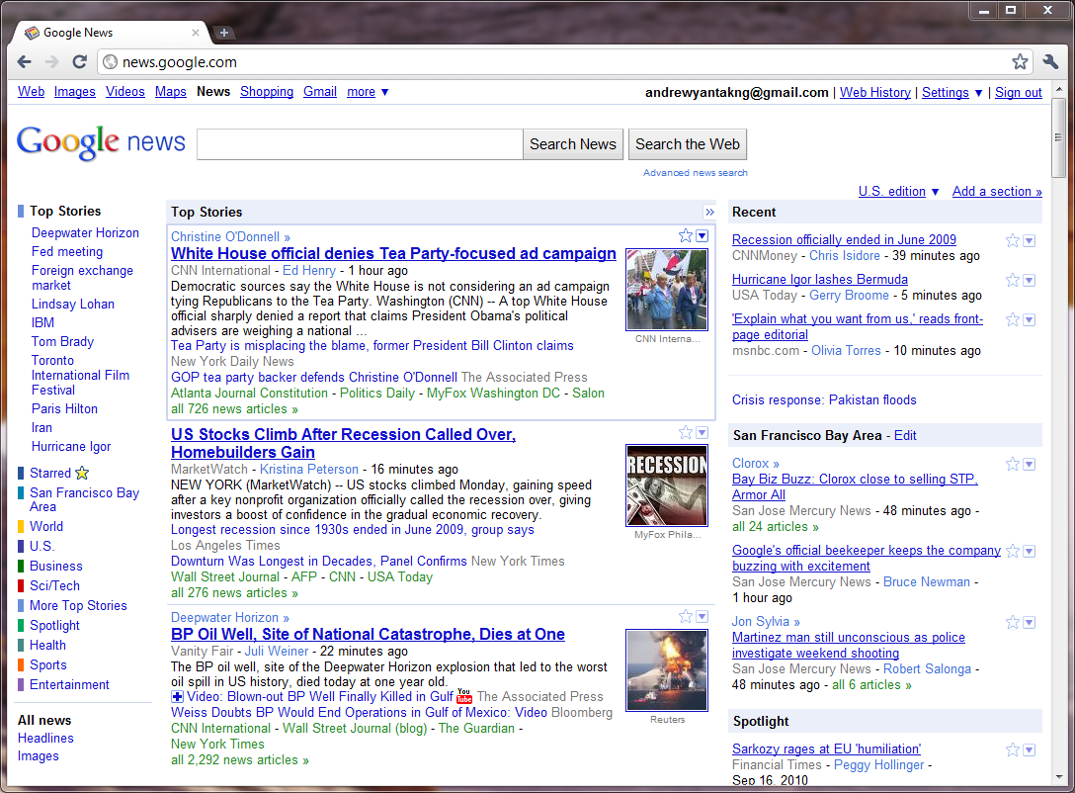
News Clustering

Slide 8
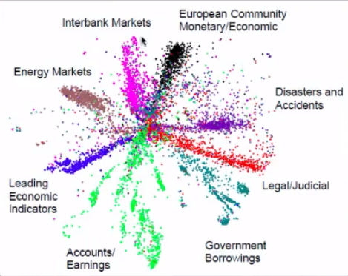
Market Segmentation
Notes:
Widely accepted definition.
Perforamnce is qunatitaive(Scalar , or vector) lets .8 , you get more experience E . You improve your performance let say .85, it mean you learn.
Experience is some thing gain by some entity and you can can direct that entity how to learn. This entity may be any algorithm, robot, software agent.
If b

Slide 9
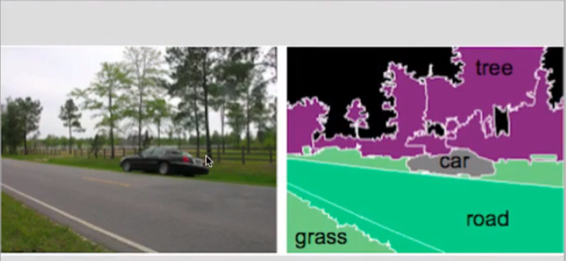
Image Detection and Localization
Notes:
Widely accepted definition.
Perforamnce is qunatitaive(Scalar , or vector) lets .8 , you get more experience E . You improve your performance let say .85, it mean you learn.
Experience is some thing gain by some entity and you can can direct that entity how to learn. This entity may be any algorithm, robot, software agent.
If b

Slide 10
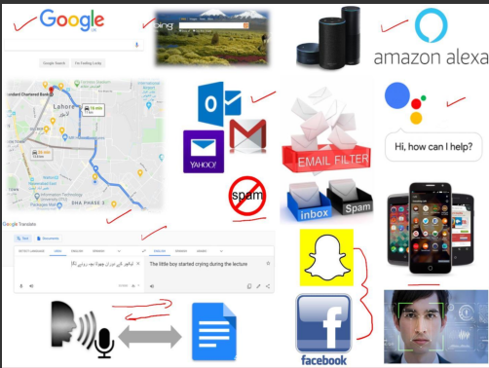
Daily used Applications
Notes:
Widely accepted definition.
Perforamnce is qunatitaive(Scalar , or vector) lets .8 , you get more experience E . You improve your performance let say .85, it mean you learn.
Experience is some thing gain by some entity and you can can direct that entity how to learn. This entity may be any algorithm, robot, software agent.
If b

Slide 11
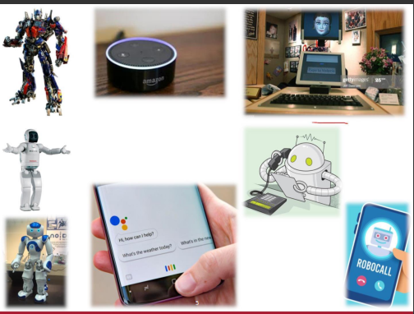
Daily used Applications

Slide 12
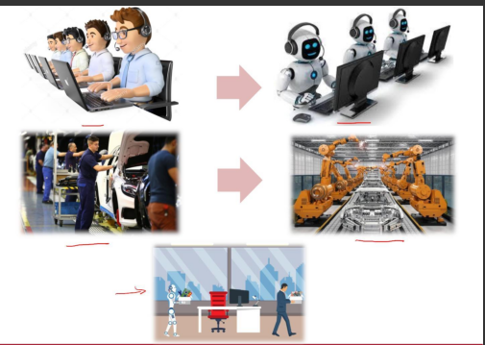
Daily used Applications

Slide 13
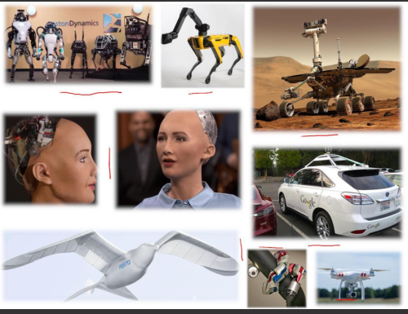
Applications

Slide 14
Historical Background
Early Foundations (1940s - 1950s):
Warren McCulloch and Walter Pitts: first neural networks, artificial neurons inspired by biological brains
AI Winter (1970s - 1980s):
faced significant challenges and a period known as the "AI Winter”
lack of funding and limited practical success
Reemergence (1990s):
resurgence in the 1990s, driven by advances in computing power and algorithmic improvements.
Decision trees, support vector machines
Rise of Deep Learning (2000s - Present):
deep neural networks, particularly deep convolutional neural networks (CNNs) for image recognition.
better optimization algorithms
availability of large datasets, like ImageNet,
increased computing power (GPUs)

Slide 15
Historical Background
Deep Learning's Dominance (2010s - Present):
dominant approach for mage and speech recognition, natural language processing, and reinforcement learning
recurrent neural networks (RNNs), long short-term memory networks (LSTMs), and Transformers
Frameworks like TensorFlow and PyTorch
Applications and Real-World Impact:
healthcare (diagnosis and drug discovery), autonomous vehicles, finance (algorithmic trading), and more.
Natural language processing models like GPT-3 and BERT
Future Directions (Beyond 2021):
evolve, with ongoing research into improving the efficiency, robustness, and generalization capabilities of deep learning models.
Exploring quantum computing's potential for machine learning and addressing ethical AI issues will be critical in the coming years.

Slide 16
Machine Learning Guru’s
Geoffrey Hinton: | affiliated with Google Brain as a Chief Scientific Advisor and a Professor Emeritus at the University of Toronto. Godfather of Deep Learning," Geoffrey Hinton made significant contributions to neural networks, backpropagation, and deep learning architectures, including Boltzmann Machines and the development of convolutional neural networks (CNNs).
Yann LeCun: | renowned for his work in convolutional neural networks (CNNs) and is a pioneer in the field of computer vision. He's also known for his contributions to the development of the backpropagation algorithm. Yann LeCun was a Chief AI Scientist at Facebook AI and a Professor at New York University (NYU).
Andrew Ng: | Professor at Stanford University and the co-founder of deeplearning.ai, an online learning platform. Andrew Ng is a co-founder of Google Brain and is known for his work on online education, including the creation of the popular machine learning course on Coursera. He has made significant contributions to the field of deep learning.

Slide 17
Machine Learning Guru’s
Fei-Fei Li: | is known for her work in computer vision and co-authored the ImageNet dataset, which played a pivotal role in the development of deep learning for image
Richard Sutton: | Richard Sutton is a prominent figure in reinforcement learning. His work includes the development of the temporal difference learning algorithm and his
Ian Goodfellow: | Ian Goodfellow is the author of the widely used textbook "Deep Learning." He's known for his work on generative adversarial networks (GANs) and has made significant contributions to deep learning research.

Slide 18
Programming Languages
Python:
most popular programming language for machine learning and deep learning due to its extensive libraries (NumPy, SciPy, pandas) and the availability of frameworks like TensorFlow and PyTorch.
R:
R often used in statistical modeling and data analysis. It has a rich ecosystem of packages for machine learning
Julia:
an emerging programming language known for its speed and is increasingly being used in scientific computing and machine learning.

Slide 19
Programming Languages
JavaScript:
JavaScript is used for implementing machine learning models in web applications and browser-based AI.
MATLAB:
MATLAB is used in academic and research settings for machine learning and signal processing applications.

Slide 20
Frameworks/API’s for Machine Learning
TensorFlow:
Developed by Google, TensorFlow is one of the most widely used deep learning frameworks. It offers a high level of flexibility and supports both CPU and GPU computations.
PyTorch:
PyTorch, developed by Facebook's AI Research lab (FAIR), is known for its dynamic computational graph and is favored by researchers for its ease of use and flexibility.
Keras:
Keras is a high-level neural networks API that can run on top of TensorFlow, Theano, or Microsoft Cognitive Toolkit (CNTK). It's known for its user-friendly interface.
Scikit-learn:
Scikit-learn is a popular machine learning library for Python, providing tools for classical machine learning algorithms and data preprocessing.

Slide 21
Frameworks/API’s for Machine Learning
Caffe:
Caffe is a deep learning framework developed by the Berkeley Vision and Learning Center. It's known for its speed and efficiency in image classification tasks.
MXNet:
MXNet is an open-source deep learning framework known for its scalability and support for multiple programming languages, including Python and Julia.
Theano:
Although its development has slowed down, Theano was influential in the early days of deep learning and served as a precursor to other frameworks.
Caffe2:
Developed by Facebook, Caffe2 was designed for mobile and large-scale distributed training and has been integrated into PyTorch as part of the PyTorch 1.0 release.

Slide 22
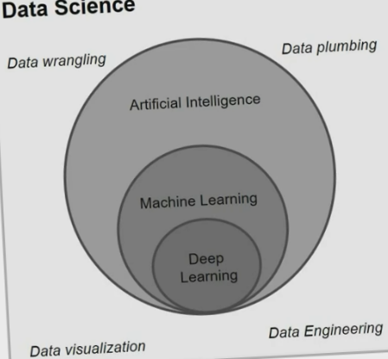
Demystifying DS,AI, ML and DL
Notes:
Widely accepted definition.
Perforamnce is qunatitaive(Scalar , or vector) lets .8 , you get more experience E . You improve your performance let say .85, it mean you learn.
Experience is some thing gain by some entity and you can can direct that entity how to learn. This entity may be any algorithm, robot, software agent.
If b
Deep learning liberaries: Theano, panda, keras, scikt-Learn,pandas

Slide 23
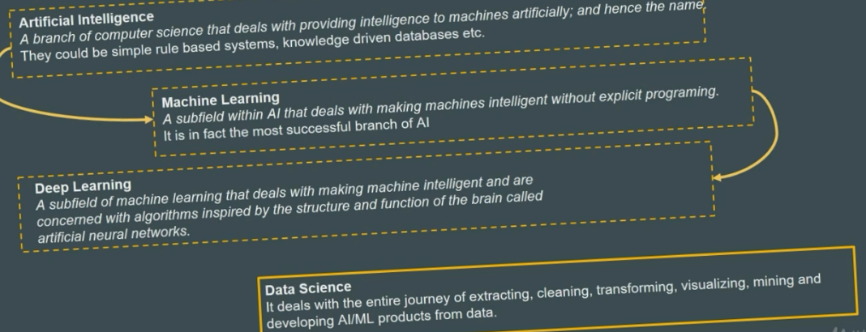

Slide 24
Machine Learning Definition
Philosophical learning of meaning
Tom Michel Definition ML as
A computer is said to be Learn from experience E with respect to some task T and some performance measure P, if its performance on T, as measured by P, improve with Experience E.

Slide 25
Notation
Variable
Random Variable
Vector
Notes:
Standard notations
You know the latin symbole after ABC like sigma, gemma,
e.g. number 2 and put in a variable x
In ml x is a constant which has some value but we dnt know
An other thing opposite to it
X belongs to real number
Random variable
Like a variable in language we know the chance what chance of the value.
White board length and width 10* 5
Y belong to R square
Length and witdht and grayscale shade
10,5, 0.8

Slide 26
Machine Learning Models
Supervised Learning
Like Teach , Supervisor
Human knows the ground truth
Regression
Classification
Unsupervised Learning
Clustering
Auto-encoder
Dimensionality Reduction
Reinforcement Learning
Notes:
Three types of learning
Like a teacher , supervisiosr , you tell him

Slide 27
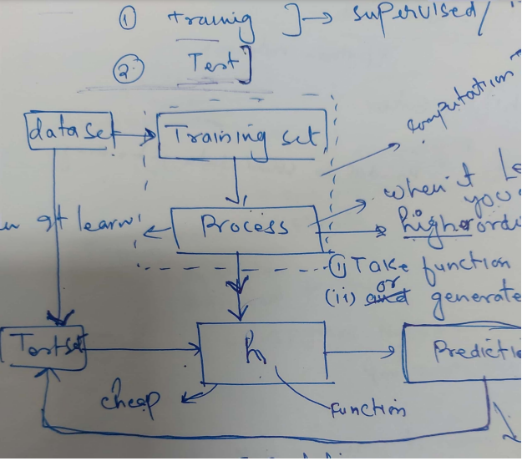
ML Model
Notes:
Three types of learning
Like a teacher , supervisiosr , you tell him

Slide 28
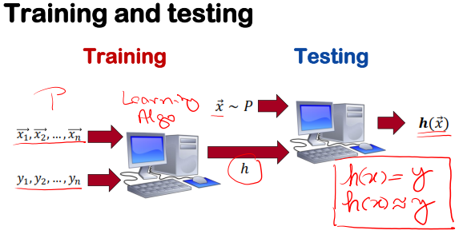
Machine Learning Models
Notes:
Three types of learning
Like a teacher , supervisiosr , you tell him

Slide 29
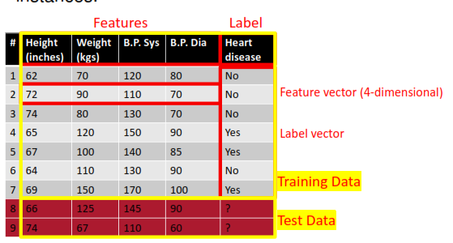
ML Model
Notes:
Three types of learning
Like a teacher , supervisiosr , you tell him

Slide 30
Machine Learning Models
Rules Vs. Learning
Supervised Learning
DATA(features, Labels, Train, Test, Diemension)
Feature Space
Label Space
Hypothesis space
Notes:
Three types of learning
Like a teacher , supervisiosr , you tell him

Slide 31
Model Evaluation
Loss functions
Calculate the average error of h in predicting 𝑦.
Smaller is better
0 loss: No error
100% loss: Could not even get one instance right
50% loss: Your h is as informative as a coin toss
Notes:
Three types of learning
Like a teacher , supervisiosr , you tell him

Slide 32
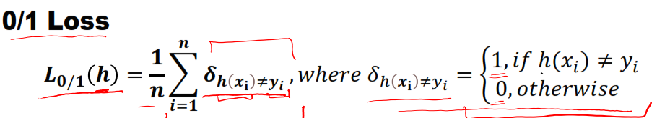
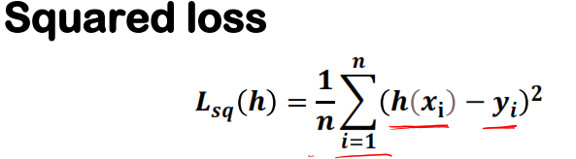
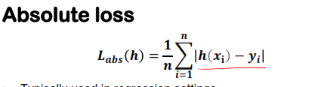
Model Evaluation
Notes:
Three types of learning
Like a teacher , supervisiosr , you tell him

Slide 33
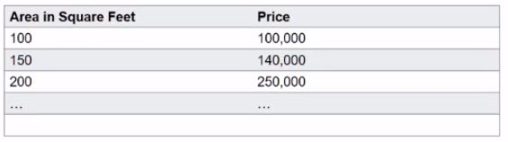
Linear Regression
Example:
Notation:
x’s = “input” variable / features
m = Number of training examples
y’s = “output” variable / “target” variable
Notes:
Three types of learning
Like a teacher , supervisiosr , you tell him

Slide 34
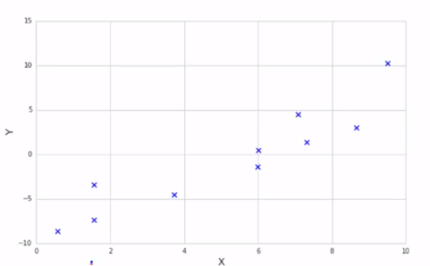
Plot/Shape-up Data
Example:
Notes:
Three types of learning
Like a teacher , supervisiosr , you tell him

