Slide 1
Object Oriented Programming
Instructor Name:
Lecture-13

Slide 2
Today’s Lecture
Association
Aggregation vs Composition
2

Slide 3
Association
What is Association?
Interaction of different objects in OO model (or in problem domain) is known as association.
In Object-oriented programming, one object is related to other to use functionality and service provided by that object. This relationship between two objects is known as the association
There are two main types of association which re further subdivide as
Class Association
Object Association
3

Slide 4
Class Association
Class Association
Class Association is implemented in terms of Inheritance.
Inheritance implements generalization/specialization relationship between objects.
Inheritance is considered class association.
In case of public inheritance it is “IS-A” relationship.
This relationship ensures that public members of base class are available to derived class in case of public inheritance.
4

Slide 5
Object Association
Object Association
It is the interaction of stand alone objects of one class with other objects of anther class.
It can be of following types
Simple Association
Composition
Aggregation
5

Slide 6
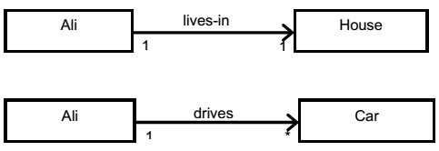

Object Association
Simple Association
The two interacting objects have no intrinsic relationship with other object.
It is the weakest link between objects.
It is a reference by which one object can interact with some other object.
6

Slide 7
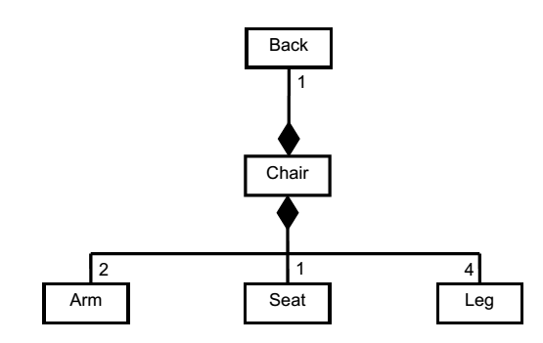
Object Association
Composition
An object may be composed of other smaller objects, the relationship between the “part” objects and the “whole” object is known as Composition
Composition is represented by a line with a filled-diamond head towards the composer object
7

Slide 8
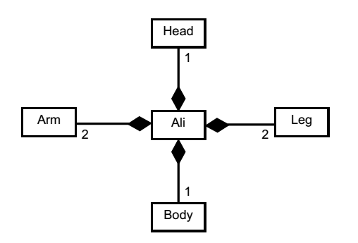
Object Association
Composition
Composition is stronger relationship:
Composition is a stronger relationship, because Composed object becomes a part of the composer
Composed object can’t exist independently
8

Slide 9
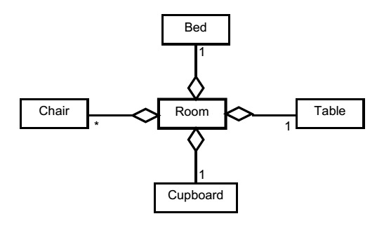
Object Association
Aggregation
An object may contain a collection (aggregate) of other objects, the relationship between the container and the contained object is called aggregation.
Aggregation is represented by a line with unfilled-diamond head towards the container
9

Slide 10
Object Association
Aggregation
Aggregation is weaker relationship, because
Aggregate object is not a part of the container
Aggregate object can exist independently
Example I
Furniture is not an intrinsic part of room
Furniture can be shifted to another room, and so can exist independent of a particular room
10

Slide 11
Object Association
Class Composition – Case Study
A class can have references to objects of other classes as members. This is called composition and is sometimes referred to as a has-a relationship.
An AlarmClock object needs to know the current time and the time when it’s supposed to sound its alarm, so it’s reasonable to include two references to Time objects in an AlarmClock object.
11

Slide 12
Composition
Class Composition – Case Study
Three Classes Date, Employee and Employee Test
Class Date – declares instance variable month, day and year of type int to represent a data.
A constructor is written that receives three parameters and after validation with the help of utility methods assign values to respective instance variables.
Three utility methods (checkDay(),checMonth(),checkYear()) , are written that validate the input before assigning to any instance variable
Class Date Code
12

Slide 13
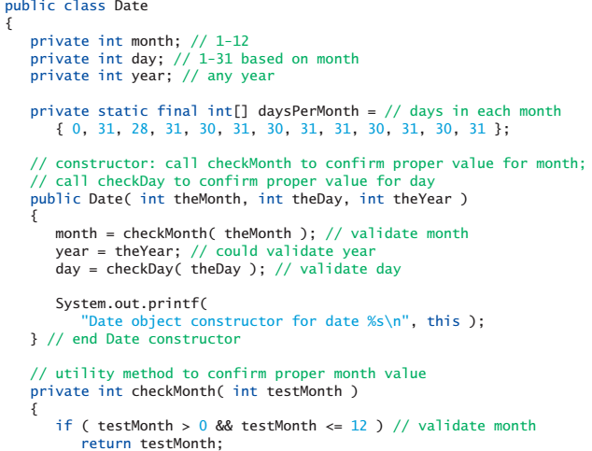
Composition
Class Composition – Case Study
13

Slide 14
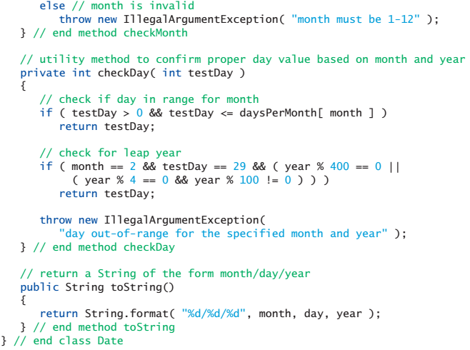
Composition
Class Composition – Case Study
14

Slide 15
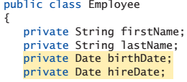
Composition
Class Composition – Case Study
Class Employee – declares instance variable firstName, lastName, birthdate, hireDate.
The first two instance variable are reference to String object while the last two are reference to Date object.
(shows a class can have instance variable of other class as we have already discussed in the clock example Lecture: Modularization and Abstraction)
A constructor is written that receives four parameters and values are assigned to the respectived reference objects
Class Employee Code
15

Slide 16
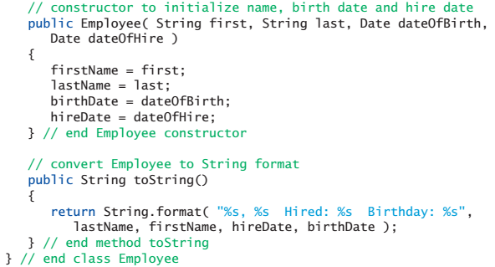
Composition
Class Composition – Case Study
Composing object in the container class
16

Slide 17
Composition
Class Composition – Case Study
Class EmployeeTest – creates two date objects to represent employee date of Birth and Hire date.
Note Carefully the use of toString() Method.
17

Slide 18
Composition
Class Composition – Case Study
public class EmployeeTest
{
public static void main( String[] args )
{
Employee employee = new Employee( "Bob","Blue", new Date(7,24,1989), new Date(3, 12, 2010 ));
System.out.println( employee );
} // end main
}// end class EmployeeTest
18

Slide 19
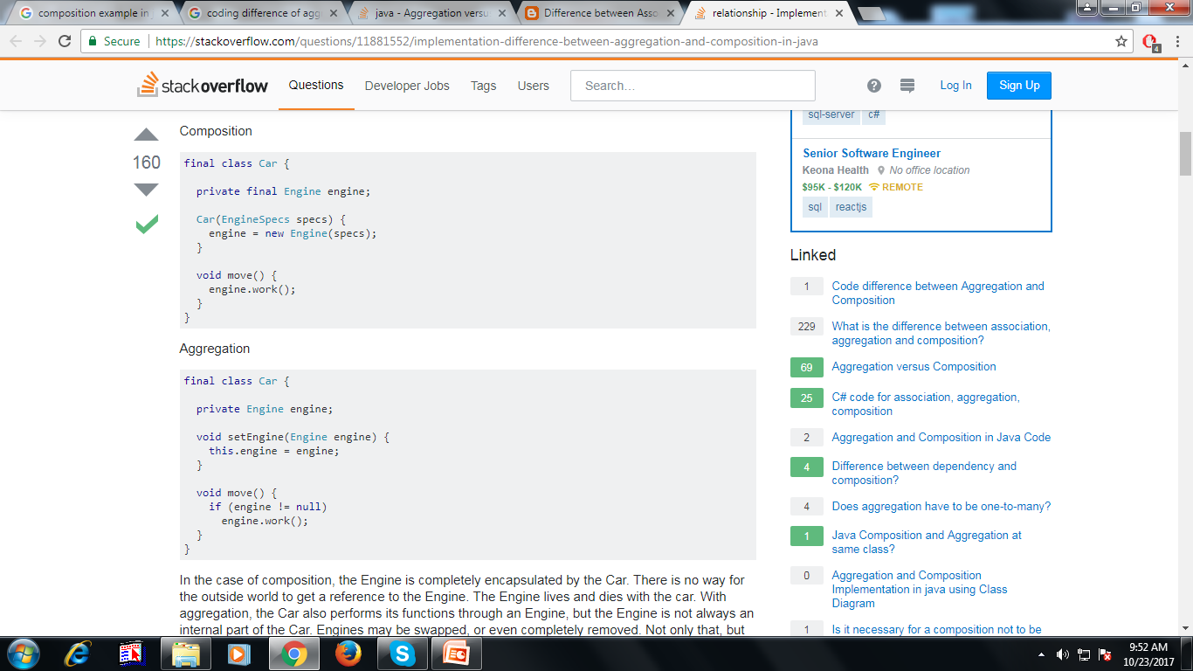

Slide 20
Composition
Class Aggregation – Case Study
When Use Aggregation
Code reuse is also best achieved by aggregation when there is no is-a relationship.
Inheritance should be used only if the relationship is-a is maintained throughout the lifetime of the objects involved; otherwise, aggregation is the best choice
Next Discussed Code is borrowed from JavaPoint.com
20

Slide 21
Composition
Class Aggregation – Case Study
public class Address {
String city,state,country;
public Address(String city, String state, String country) {
this.city = city;
this.state = state;
this.country = country;
}
}
21

Slide 22
Composition
Class Aggregation – Case Study
public class Emp {
int id;
String name;
Address address;
public Emp(int id, String name,Address address) {
this.id = id;
this.name = name;
this.address=address;
}
void display(){
System.out.println(id+" "+name);
System.out.println(address.city+" "+address.state+" "+address.country);
}
}
22

Slide 23
Composition
Class Aggregation – Case Study
public class EmpTest{
public static void main(String[] args) {
Address address1=new Address("ABC","UP","Pak");
Address address2=new Address("XYZ","UP","Pak");
Emp e=new Emp(111,"Ali",address1);
Emp e2=new Emp(112,"Arnold",address2);
e.display();
e2.display();
}
}
23

Slide 24
Coupling
What is Coupling?
Coupling is the degree of interdependence between software modules;
a measure of how closely connected two routines or modules are;
the strength of the relationships between modules.
24

Slide 25
Coupling
What is Coupling?
Refer to Chapter Designing Classes, four exit variable are declared for south, east, west north and in the setExits method there is one if statement per exit and same is the case with goRoom and printLocation.
What if we need to add more exit variables to add new exits, we need to add more cases
Whenever a change is encountered there is always need of so many modifications
Solution : make use of hashMap that should cope with any number of exits, and does not need so many modifications
25

Slide 26
Coupling
Loose Coupling
When only the implementation of a class changes, other classes should not be affected
This would be a case of loose coupling.
What is the case in Designing Class Chapter? Tight Coupling
Before implementing hashMap, first decouple classes
Use of encapsulation in classes reduces coupling and thus leads to a better design.
26

Slide 27
Cohesion
Cohesive Method & Class
A cohesive method is responsible for one, and only one, well-defined task.
A cohesive class represents one well-defined entity.
The rule of cohesion of classes states that each class should represent one single, well-defined entity in the problem domain.
Advantages of Cohesion
Readability
Reuse
27

Slide 28



28

