Slide 1
Object Oriented Programming
Instructor Name:
Lecture-3

Slide 2
Today’s Lecture
Inheritance
Polymorphism
2

Slide 3
Inheritance
What is Inheritance?
In Object Oriented Programming, Inheritance enables new objects to take on properties of existing objects
Inheritance is a process by which objects of one class acquire the properties of another class.
In Inheritance concepts are arranged in a hierarchy
Concepts at the higher level are more general
Concepts at lower level are more specific (inherit properties of concepts at higher level)
3

Slide 4
Inheritance
What is Inheritance?
Higher Level (General Concepts)
Lower Level (Specific Concepts)
Vehicle
Wheeled vehicle
Boat
Car
Bicycle
2-door
4-door
4

Slide 5
Inheritance
More Definitions of Inheritance
A Parent – Child Relationship between classes is called inheritance.
Allows sharing of the behavior of the parent class to child class
Child class can add new behavior or override existing behavior of class.
Real world Example of Inheritance
A most recent form of Mobile Phone inherited from least recent models of mobile phone
Least recent mobile inherited from Ordinary dial up phone
Automatic Car inherited from Manual Car
Laptop Inherited from Desktop Computers
5

Slide 6
Inheritance
Inheritance Terms
Super Class
Super Class also referred as Base Class or Parent Class. These terms are used to describe the parent in the relationship, which shares its functionality.
Sub Class
Sub Class also referred as Derived Class or Child Class. These terms are used to describe the child in the relationship, which accepts /inherits functionality from parent.
NOTE: one Sub Class may be parent of another sub class.
6

Slide 7
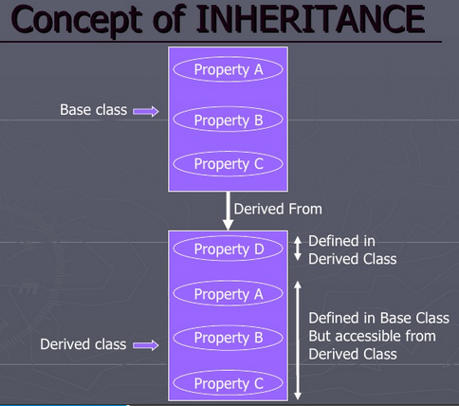
Inheritance
Inheritance Terms – Example
7

Slide 8
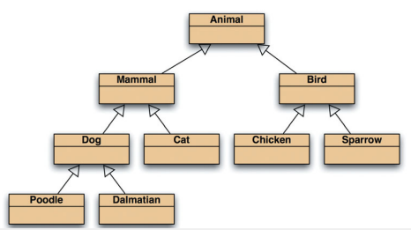
Inheritance
More on Inheritance
More than two sub classes can inherit from super class and a subclass in turn be a super class to other sub classes.
A instance (Object) of class Poodle has all the characteristics of a Poodle, a Dog, a Mammal and an Animal because a Poodle is a Dog which is a mammal and so on..
Inheritance hierarchy
8

Slide 9
Inheritance
Class Activity
Draw an Inheritance Hierarchy for the people in your place of study or work. For example if you are a University Student, then your University probably has students (first year students, Second year Students, Science Students, Social Science Students, Graduates Students, Undergraduate Students, ….), Professors, Administrative Officers, Clerical Staff and etc.
9

Slide 10
Inheritance
Relationship in Inheritance
There may be two kinds of relationship in Inheritance
“IS A KIND OF” relationship
“IS A” relationship
10

Slide 11

Relationship
“IS A KIND OF ” Relationship
Just consider a drawing. If you have to draw a point you need x and y values to draw a point
Now if you have to draw a circle you need x and y values plus radius to draw a circle
In Both cases we have two data elements x and y. While drawing a Point these elements describe the position of the point, in the case of Circle they describe the circle's center. Thus, x and y have the same meaning in both cases:
Knowing the properties of Point we can describe a circle as a point plus a radius and methods to access it. Thus, a circle is ``a-kind-of'' point
11

Slide 12

Relationship
“IS A” Relationship
The previous relationship is used at the class level to describe relationships between two similar classes.
If we create objects of two such classes we refer to their relationship as an ``is-a” relationship.
Since the class Circle is a kind of class Point, an instance of Circle, say acircle, is a point. Consequently, each circle behaves like a point.
For example, you can move points in x direction by altering the value of x. Similarly, you move circles in this direction by altering their x value.
12

Slide 13
“IS A” Relationship
Person
name
age
gender
eat
walk
Student
Teacher
Doctor
program
studyYear
designation
salary
designation
salary
study
heldExam
teach
takeExam
checkUp
prescribe
13

Slide 14
“IS A” Relationship
Shape
color
coord
draw
rotate
setColor
Triangle
Circle
radius
Line
angle
draw
computeArea
length
draw
computeArea
draw
14

Slide 15

Inheritance
Inheritance Scenario
Consider a collection of Birds which have different properties
Name
Color (some are of same name with different color)
They eat different things
They make different noises
Some make multiple kind of noise
15

Slide 16
Inheritance
Design Sketch
Key is to design a bird class hierarchy
Strategy
Design classes for objects
Identify characteristics classes have in common
Design super class to store common attributes
Design sub classes
16

Slide 17
Inheritance Hierarchy
Bird
call: ? color:? food:? movement:?
FlyingBird
call: ? color:? food:? movement:flew
WalkingBird
call: ? color:? food:? movement:walked
Parrot
call: Squawk color:? food: fruit
Owl
call:? color:? food:mice
Goose
call: honk color: gray food: bugs
Ostrich
call: neek-neek color: brown food: grass
TalkingParrot . . .
17

Slide 18
Levels of Inheritance
Inheritance Levels
Single Inheritance
Multilevel Inheritance
Multiple Inheritance
Hierarchical Inheritance
Hybrid Inheritance
18

Slide 19
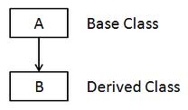
Levels of Inheritance
Single Inheritance
In this kind of inheritance have only one base class and one derived class
19

Slide 20
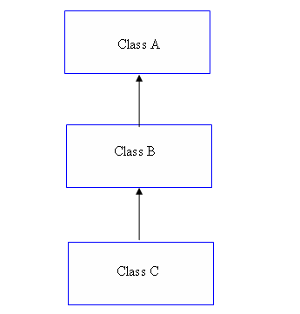
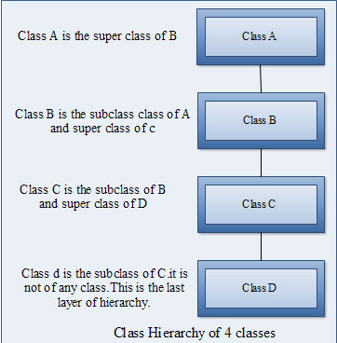
Levels of Inheritance
Multilevel Inheritance
In this kind of inheritance we have a chain of all classes and one base line. In this we must have to use three classes, there is one base class and more than one derived class.
20

Slide 21
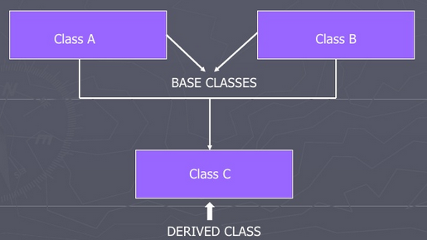
Levels of Inheritance
Multiple Inheritance
In this kind of inheritance we have more than one independent base classes and one derived class, connected with all base classes.
Multiple Inheritance is not supported in JAVA
21

Slide 22
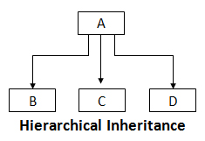
Levels of Inheritance
Hierarchical Inheritance
In this kind of inheritance we have more than one derived class connected with base classes.
This is just opposite of Multiple Inheritance
22

Slide 23
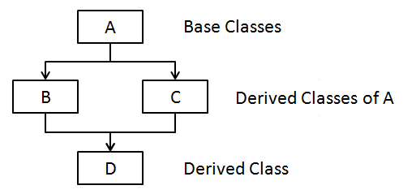
Levels of Inheritance
Hybrid Inheritance
This is combined form of Multiple and Hierarchical Inheritance
23

Slide 24
Advantages of Inheritance
Three main advantages
Reuse
Less Redundancy
Increased Maintainability
24

Slide 25
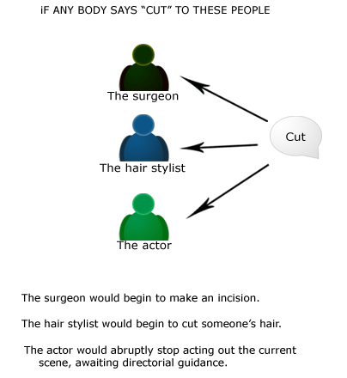
Polymorphism
What is Polymorphism?
25

Slide 26
Polymorphism
What is Polymorphism?
Polymorphism is the ability of an object to take on many forms.
Manipulate objects of various classes, and invoke different methods on an object without knowing the type of object
Any Java object that can pass more than one IS-A test is considered to be polymorphic.
In Java, all Java objects are polymorphic since any object will pass the IS-A test for their own type and for the class Object.
In general, polymorphism refers to existence of different forms of a single entity
For example, both Diamond and Coal are different forms of Carbon
26

Slide 27
Polymorphism
Polymorphism Example
Look at example
A Deer IS-A Animal
A Deer IS-A Vegetarian
A Deer IS-A Deer
A Deer IS-A Object
Since Deer inherits from Vegetarian, and Vegetarian inherits from Animal, then an object (say mydeer) of Deer is at all times Deer, a Vegetarian, and an Animal.
Animal
Vegetarian
Omnivorous
Deer
27

Slide 28
Polymorphism
Polymorphism in OO Model
In Object Oriented Model, Polymorphism means that different objects can behave in different ways for the same message
Consequently the sender of the message does not need to know exact class of the receiver
28

Slide 29
Polymorphism
Polymorphism Advantages
Message can be interpreted in different way depending upon the receiver class
draw
Shape
View
draw
Line
Circle
Triangle
draw
draw
draw
29

Slide 30
Polymorphism
Polymorphism Advantages
New classes can be added without changing the existing model.
In general Polymorphism powerful way to develop flexible and reusable systems
draw
Shape
View
draw
Square
Line
Circle
Triangle
draw
draw
draw
draw
30

Slide 31



31

