Slide 1
241-211. OOP (Java)
Semester 3
7. Good Class Design
Objectives
  introduce coupling, cohesion, responsibility-driven design, and refactoring

Slide 2
Topics
1. Why Class Design?
2. World of Zuul
3. Code Design Concepts
4. Code Duplication
5. Poor RDD
6. Ease of Modification
7. Implicit Coupling
continued

Slide 3
8. Code Size?
9. Refactoring Example
10. Enumerated Types
11. Using Enums in Zuul
12. Improved Zuul Class Diagrams
13. More Information

Slide 4
1. Why Class Design?
This part concentrates on how to create
well-designed classes
  getting code to work isn't enough
Benefits of good design:
  simplifies debugging, modification, maintenance
  increases the chances of reusing code

Slide 5
2. World of Zuul
We look at two versions of a simple adventure game called "World of Zuul" (Zuul for short).
Both versions have the same features, but the first is full of bad design choices, which I'll correct, leading to an improved second version.

Slide 6
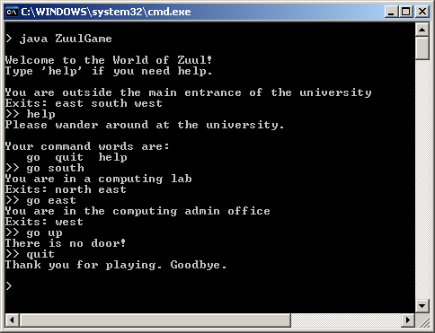
Zuul in Action
My input follows the
">>" zuul prompts.

Slide 7
Zuul Concepts
Zuul is quite basic:
  the user can move between a series of rooms, get help, and quit
A real adventure game would allow multiple users, include hidden treasure, secret passwords, death traps, and more.

Slide 8
Zuul Map
rooms
pub
outside
theatre
exits/
doors
lab
office
The user starts in the
"outside" room.
The exits are to the
North, South, East, and West

Slide 9
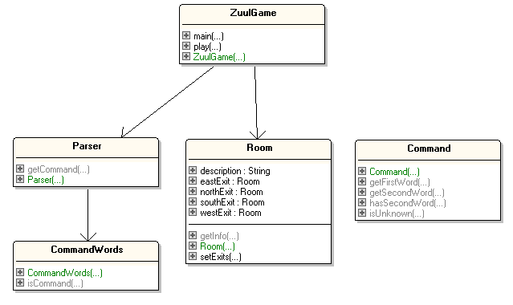
Zuul Class Diagrams
I can see some
problems
already!

Slide 10
Class Descriptions
ZuulGame
  creates the rooms, the parser, and starts the game. It evaluates and executes the commands that the parser returns.
Parser
  repeatedly reads a line from the terminal and interprets it as a two word command which it returns as a Command object
continued

Slide 11
CommandWords
  holds an array of all the command words in the game, which is used to recognise commands
    "go", "quit", "help"
Room
  represents a room in the game, connected to other rooms via exits. The exits are labelled "north", "east", "south", and "west".
continued

Slide 12
Command
  holds information about a user command, consisting of at most two strings
    e.g. "go" and "south"

Slide 13
3. Code Design Concepts
Coupling
Cohesion
Responsibility-driven Design (RDD)
Refactoring

Slide 14



3.1. Coupling
Coupling refers to the links between separate units (classes) in an application.
If two classes depend closely on
many details of each other, they
are tightly coupled. Usually bad.
Good design aims for
loose coupling. Good.

Slide 15
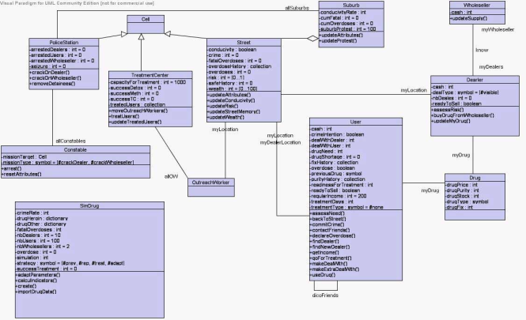
Loose Coupling
In class diagrams, loose
coupling means less
association lines
Loose coupling makes it possible to:
  understand one class without reading others
  change one class without affecting others
Loose coupling make debugging, maintenance, and modification easier.

Slide 16

3.2. Cohesion
Cohesion is the mapping of tasks to code units (e.g. to methods and classes).
We aim for high cohesion – good
  each task maps to a single code unit
    a method should do one operation
    a class should represent one entity/thing
continued

Slide 17
High cohesion makes it easier to:
  understand a class or method
  use descriptive names
  reuse classes or methods in other applications

Slide 18

3.3. Responsibility-driven Design (RDD)
Each class should be responsible for manipulating and protecting its
own data
  e.g. don't use public fields
RDD leads to low coupling, where code changes are localized
  i.e. they only affect the class/method that is being modified

Slide 19
3.4. Refactoring
Refactoring is a two-stage redesigning of classes/methods when an application needs modifying or extending.
Usually this leads to existing classes/methods being split up, and the addition of new classes/methods for the new features.
continued

Slide 20



Two Steps
1. Restructure the existing code, keeping the same functionality, with very simple new classes/methods.
  debug and test them
2. Add new functionality to the classes/methods created in step 1.
  debug and test again

Slide 21

3.5. Thinking Ahead
When designing a class, think
what changes are likely in the future
  aim to make those changes easier
Example:
  if the user interface is going to change (e.g. text-based → GUI) then make sure all the IO is carried out by one class

Slide 22

3.6. Other Factors
Coding style
  commenting, naming, layout
There's a big difference in the amount of work required to change poorly structured and well structured code.

Slide 23

4. Code Duplication
Code duplication means that a single design change requires code changes in many places
  makes maintenance harder
  e.g. printWelcome() and goDirection() in Room
continued

Slide 24
private void printWelcome()
{
System.out.println();
System.out.println("Welcome to the World of Zuul!");
System.out.println("Type 'help' if you need help.");
System.out.println();
System.out.println("You are " + currRoom.description);
System.out.print("Exits: ");
if (currRoom.northExit != null)
System.out.print("north ");
if (currRoom.eastExit != null)
System.out.print("east ");
if (currRoom.southExit != null)
System.out.print("south ");
if (currRoom.westExit != null)
System.out.print("west ");
System.out.println();
} // end of printWelcome()
continued

Slide 25
private void goDirection(Command command)
{
:
System.out.println("You are " + currRoom.getInfo());
System.out.print("Exits: ");
if (currRoom.northExit != null)
System.out.print("north ");
if (currRoom.eastExit != null)
System.out.print("east ");
if (currRoom.southExit != null)
System.out.print("south ");
if (currRoom.westExit != null)
System.out.print("west ");
System.out.println();
}
} // end of goDirection()
looks
familiar

Slide 26
5. Poor RDD
Room has a major design fault: public fields
  public String description;
  public Room northExit, southExit,
  eastExit, westExit;
The Room implementation is exposed.
Instead, use private fields and get methods
  e.g. getExit()
continued

Slide 27
Only Room should manage the room desciption, but since it's a public field, ZuulGame can use it directly:
  in ZuulGame.printWelcome():
    System.out.println("You are " +
    currRoom.description);
Make the description field private, and add a get method (getInfo()).

Slide 28

6. Ease of Modification
If adding a new, simple task to the design means a lot of extra coding, then it's an indication that the original design is not good.
e.g. add new directions "up" and "down" to the "go" command
continued

Slide 29
This requires changes in:
  Room setExits()
  ZuulGame createRooms()
  printWelcome()
  goDirection()
  room exits are manipulated in too many places

Slide 30
Why Limit the Exits?
The Room design limits the exits to be "north", "south", "east" and "west". Why?
The Room class should allow any number of exits, in any direction:
  use a HashMap to map a direction name (e.g. "up") to an adjacent Room object
continued

Slide 31
private HashMap<String, Room> adjRooms;
// maps directions to adjacent rooms
// in the Room constructor
adjRooms = new HashMap<String, Room>();
// no adjacent rooms initially
public void setAdjacentRoom(String dir,
Room neighbour)
{ adjRooms.put(dir, neighbour); }
continued

Slide 32
The limit of four directions in Room is visible outside the class because of Room.setExits() used by ZuulGame:
  Room outside = new Room("outside the main entrance");
  Room theatre = new Room("in a lecture theatre");
  Room pub = new Room("in the campus pub");
  Room lab = new Room("in a computing lab");
  Room office = new Room("in the admin office");
  // link the room exits
  outside.setExits(null, theatre, lab, pub);
  theatre.setExits(null, null, null, outside);
  pub.setExits(null, outside, null, null);
  lab.setExits(outside, office, null, null);
  office.setExits(null, null, null, lab);
continued

Slide 33
Recode the interface
  change setExits() to setAdjacentRoom(), which sets one exit, and then call it as many times as needed
  Room outside = new Room("outside the main entrance");
  Room theatre = new Room("in a lecture theatre");
  Room pub = new Room("in the campus pub");
  Room lab = new Room("in a computing lab");
  Room office = new Room("in the admin office");
  // link adjacent rooms
  outside.setAdjacentRoom("east", theatre);
  outside.setAdjacentRoom("south", lab);
  outside.setAdjacentRoom("west", pub);
  theatre.setAdjacentRoom("west", outside);
  pub.setAdjacentRoom("east", outside);
  lab.setAdjacentRoom("north", outside);
  :

Slide 34

7. Implicit Coupling
Coupling is when a class depends on data in another class
  e.g. ZuulGame uses Room.description
  easy to see and fix since fields should
  be private in a good design (see slide 7)
Implicit coupling are links that are harder to see
  e.g. ZuulGame assumes a Room has at most 4 exits when using setExits()

Slide 35
Example: Adding a new Command
The current commands:
  go, help, quit
Add "look" to examine a room without going into it.
Requires changes to:
  CommandWords
  ZuulGame: modify processCommand() and add a look() method
continued

Slide 36
in processCommand():
  String cmdWord = cmd.getFirstWord();
  if (cmdWord.equals("help"))
  printHelp();
  else if (cmdWord.equals("go"))
  goDirection(cmd);
  else if (cmdWord.equals("quit"))
  isFinished = tryQuit(cmd);
  else if (cmdWord.equals("look"))
  look();
  // else ignore any other words
continued

Slide 37
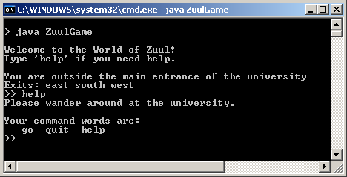
What about the output of "help":
The "help" command is implicitly coupled to CommandWords, which means that "help" should use it to list the commands.
continued

Slide 38
Current version of printHelp():
  private void printHelp()
  {
  System.out.println("Please wander around at
  the university.");
  System.out.println();
  System.out.println("Your command words are:");
  System.out.println(" go quit help");
  }
implicit coupling to
CommandWords

Slide 39

8. Code Size?
Common questions:
  how big should a class be?
  how big should a method be?
Answer in terms of method and class cohesion.
continued

Slide 40
A method is probably too long if it does more then one logical task.
A class is probably too complex if it represents more than one logical entity.
Note: these are guidelines.

Slide 41
Method Cohesion Example
public void play()
{
printWelcome();
Command cmd;
boolean isFinished = false;
while (!isFinished) {
cmd = parser.getCommand(); // get a command
isFinished = processCommand(cmd); // process it
}
System.out.println("Thank you for playing. Goodbye.");
} // end of play()

Slide 42
Class Cohesion Example
How should items be added to the rooms?
  an item has a description and weight
Bad approach:
  add description and weight fields to Room
Good approach:
  create an Item class, and add a "collection of Items" field to Room
  better readability, extensibility, reuseability

Slide 43
9. Refactoring Example
How can multiple players be added to the game?
  currently there is one player represented by the current room he/she is occupying
  private Room currRoom; // in ZuulGame
Based on RDD, players should be represented by objects of a new Player class.

Slide 44
Refactoring: Steps 1 and 2
1. Move currRoom to a new Player class. Test ZuulGame with one Player object.
2. Add the extra player fields to Player (e.g. items, strength). Test ZuulGame with one, two, several Player objects.

Slide 45
10. Enumerated Types
An enum type is a Java type made from a fixed set of constants.
Common examples:
  compass directions
  (NORTH, SOUTH, EAST, and WEST)
  the days of the week
  (SUNDAY → SATURDAY)

Slide 46
The bad C/C++ approach is to use "magic numbers" (e.g. 0, 1, 2, 3) instead of constants (e.g. NORTH , WEST)
Putting the constants into a Java enum type, improves readability, adds extra features, and allows more compile-time error checking by javac.

Slide 47
10.1. The Day Enum Type
public enum Day
{
SUNDAY, MONDAY, TUESDAY, WEDNESDAY,
THURSDAY, FRIDAY, SATURDAY
}

Slide 48
Using the Day Enum
public class UseDay
{
public static void main(String[] args)
{
for (Day d : Day.values())
System.out.println(d); // d printed as a String
System.out.println();
Day d1 = Day.SUNDAY;
Day d2 = Day.TUESDAY;
if ( d1.compareTo(d2) < 0)
System.out.println(d1 + " is earlier in week");
else
System.out.println(d2 + " is earlier in week");
} // end of UseDay()
} // end of UseDay class
enum constants

Slide 49
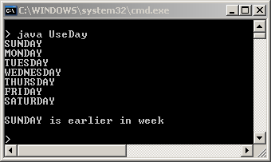
Execution

Slide 50
Notes
The enum type is a kind of Java class
  it inherits methods from the Enum class
    values(), compareTo(), etc.
  it's possible to add extra properties (fields) and methods to an enum type
    see the Flavour example

Slide 51
10.2. The Flavour Enum Type
public enum Flavour
{
// 3 flavours with calorie property
CHOCOLATE(100),
VANILLA(120),
STRAWBERRY(80);
private int calories;
private Flavour(int cals) // must be private
{ calories = cals; }
public int getCalories()
{ return calories; }
} // end of Flavour enum

Slide 52
Creating Enum Constants
The constructor for an enum type must be private.
The enum automatically creates the constants defined at its beginning
  you cannot invoke the enum constructor yourself

Slide 53
Using the Flavour Enum
public class UseFlavour
{
public static void main(String[] args)
{ System.out.println("Known flavours");
for (Flavour f : Flavour.values())
System.out.println(f + " with calories " + f.getCalories() );
System.out.println();
Flavour f1 = Flavour.CHOCOLATE;
Flavour f2 = Flavour.STRAWBERRY;
if (f1.getCalories() < f2.getCalories())
System.out.println(f1 + " is lighter");
else
System.out.println(f2 + " is lighter");
} // end of UseFlavour()
} // end of UseFlavour class

Slide 54
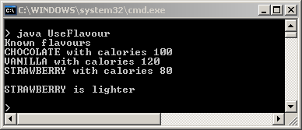
Execution

Slide 55
11. Using Enums in Zuul
Zuul should use an enum type for its command names
  change "go", "quit", "help" into a CommandOp enum type containing GO, QUIT, HELP
Extra benefits are to include a String property for the command names, and to add useful methods.

Slide 56
The CommandOp Enum Type
public enum CommandOp
{
// Command ops and their string versions
GO("go"), QUIT("quit"), HELP("help"), UNKNOWN("??");
private String cmdStr;
// stores a command op's string version
private CommandOp(String commandStr)
{ cmdStr = commandStr; }
public String toString()
{ return cmdStr; }
continued

Slide 57
// ------------ static methods -------------
public static CommandOp getOp(String cmdName)
// return the CommandOp associated with a command name
{
for (CommandOp cmdOp : CommandOp.values())
if (cmdName.equals( cmdOp.toString() ))
return cmdOp;
return CommandOp.UNKNOWN;
// more informative than returning null
} // end of getCommandOp()
continued

Slide 58
a new String-related class,
explained later
public static String listAll()
{
StringBuilder sb = new StringBuilder ();
for (CommandOp cmdOp : CommandOp.values())
if (cmdOp != CommandOp.UNKNOWN)
sb.append( cmdOp.toString() + " ");
return sb.toString();
} // end of listAll()
} // end of CommandOp class

Slide 59
What are Static Methods?
We've already met one use of static methods
  main() (and other functions) use static so they execute in the class
The static methods in CommandOp execute in the enum type
  this makes sense since they utilize all the enum constants

Slide 60
Uses of CommandOp
In the Parser class:
  // extract command and argument strings from the line
  String cmdStr = // get command as a string;
  String argStr = // get argument string;
  /* convert command and argument strings into
  a Command object */
  CommandOp cmdOp = CommandOp.getOp(cmdStr);
  Command cmd = new Command( cmdOp, argStr);
static method call

Slide 61
In ZuulGame:
  private void printHelp()
  {
  System.out.println("Please wander around the unive.");
  System.out.println();
  System.out.println("Understood commands are:");
  System.out.println( CommandOp.listAll() );
  } // end of printHelp()
static method call

Slide 62
private boolean processCommand(Command cmd)
/* Execute a command. Return true if the command
finishes the game, false otherwise. */
{
boolean isFinished = false;
CommandOp cmdOp = cmd.getCommandOp();
if (cmdOp == CommandOp.UNKNOWN) {
System.out.println("Sorry, I don't know what you mean.");
return false;
}
else if (cmdOp == CommandOp.HELP)
printHelp();
else if (cmdOp == CommandOp.GO)
goDirection(cmd);
else if (cmdOp == CommandOp.QUIT)
isFinished = tryQuit(cmd);
return isFinished;
} // end of processCommand()
enum constants

Slide 63
private void printWelcome()
{
System.out.println();
System.out.println("Welcome to the World of Zuul!");
System.out.println("Type '" + CommandOp.HELP.toString() +
"' if you need help.");
System.out.println();
System.out.println( currRoom.getInfo() );
} // end of printWelcome()

Slide 64
StringBuilder
A StringBuilder object is like a String, but can be modified
  its contents are changed in-place through calls such as append(), without the overhead of creating a new object (as happens with String)
The StringBuffer class is similar to StringBuilder but is slower since it can deal with Java threads.
StringBuilder sb = new StringBuilder("Andrew");
sb.append(" Davison");

Slide 65
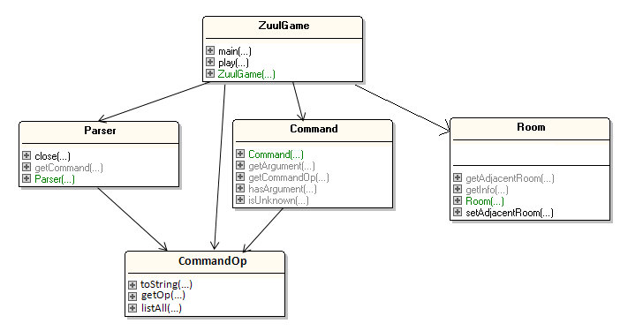
12. Improved Zuul Class Diagrams

Slide 66
Notes
The old CommandWords has been replaced by CommandOp.
CommandOp has simplified the code in ZuulGame, Command, and Parser
My UML tools cannot process enum types
  I had to draw the CommandOp box myself

Slide 67
13. More Information
A great book on coding style (for any language, not just Java):
  Code Complete
  Steve McConnell
  Microsoft Press, 2nd ed., 2004
  the first edition is in the CoE library

