Slide 1
Lecture Outline
Java Database Connectivity
1

Slide 2
Introduction
Java Database Connectivity (JDBC) provides a standard library for accessing databases.
The JDBC API contains number of interfaces and classes that are extensively helpful while communicating with a database.
java.sql package contains basic & most of the interfaces and classes.
2

Slide 3
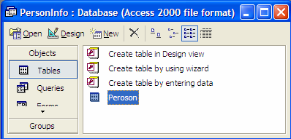
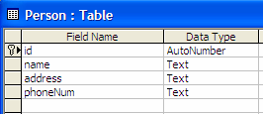
Connecting With Microsoft Access
Create Database
3

Slide 4
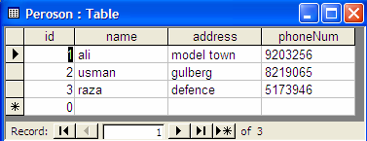
Adding Records
Add the following records into Person table as shown below.
Save the data base in some folder. (Your database will be saved as an .mdb file)
4

Slide 5
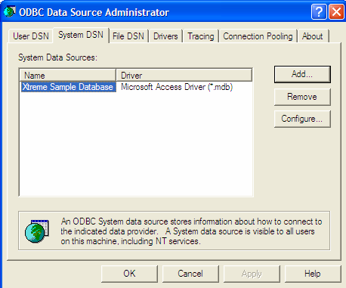
Setup System DSN
5

Slide 6
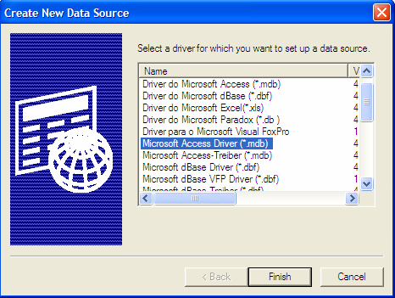
Adapter Classes
Press Add… button and choose Microsoft Access Driver (*.mdb) from Create New Data Source window and press Finish button as shown in diagram.
6

Slide 7
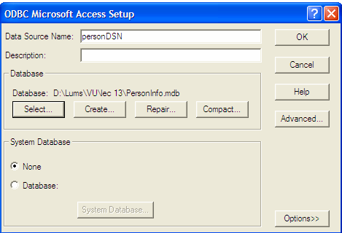
Adapter Classes
After that, ODBC Microsoft Access Setup window would be opened as shown in following diagram
Enter the Data Source Name personDSN and select the database by pressing Select button. The browsing window would be opened, select the desired folder that contains the database (The database .mdb file you have created in the first step) Press Ok button.
7

Slide 8
Basic Steps in Using JDBC
There are eight (8) basic steps that must be followed in order to successfully communicate with a database.
1-Import Required Package
Import the package java.sql.* that contains useful classes and interfaces to access & work with database.
import java.sql.*;
8

Slide 9
2-Load Driver
Need to load suitable driver for underlying database.
Different drivers & types for different databases are available.
For MS Access, load following driver available with j2se.
Class.forName(“sun.jdbc.odbc.JdbcOdbcDriver”);
For Oracle, load the following driver. You have to download it explicitly.
Class.forName(“oracle.jdbc.driver.OracleDriver”);
9

Slide 10
3-Define Connection URL
To get a connection, we need to specify the URL of a database (Actually we need to specify the address of the database which is in the form of URL)
As we are using Microsoft Access database and we have loaded a JDBC-ODBC driver.
Using JDBC-ODBC driver requires a DSN which we have created earlier and named it personDSN.
So the URL of the database will be String conURL = “jdbc:odbc:personDSN”;
10

Slide 11
4-Establish Connection With DataBase
Use DriverManager to get the connection object.
The URL of the database is passed to the getConnection method.
Connection con =DriverManager.getConnection(conURL);
If DataBase requires username & password, you can use the overloaded version of getConnection method as shown below:
String usr = “safyan”;
String pwd = “GCU”;
11

Slide 12
Introduction
Connection con = DriverManager.getConnection(conURL, usr, pwd);
12

Slide 13
5-Create Statement
A Statement object is obtained from a Connection object.
Statement stmt = con.createStatement( );
Once you have a statement, you can use it for various kinds of SQL queries.
13

Slide 14
6-Prepare and Execute a Query
The next step is to pass the SQL statements & to execute them.
Two methods are generally used for executing SQL queries. These are:
1-ExecuteQuery(sql) method
Used for SQL SELECT queries.
Returns the ResultSET object that contains the results of the query and can be used to access the query results.
String sql = “SELECT * from sometable”;
ResultSet rs = stmt.executeQuery(sql);
14

Slide 15
executeUpdate(sql) method
2-executeUpdate(sql) method
This method is used for executing an update statement like INSERT,UPDATE or DELETE
Returns an Integer value representing the number of rows updated
String sql = “INSERT INTO tablename ” +“(columnNames) Values (values)” ;
int count = stmt.executeUpdate(sql);
15

Slide 16
7-Process Results of the Query
The ResultSet provides various getXXX methods that takes a column index
or name and returns the data
The ResultSet maintains the data in the form tables (rows & columns)
First row has index 1, not 0.
The next method of ResultSet returns true or false depending upon
whether the next row is available (exist) or not and moves the cursor
16

Slide 17
Introduction
Always remember to call next() method at-least once
To retrieve the data of the column of the current row you need to use the various getters provided by the ResultSet.
For example, the following code snippet will iterate over the whole
ResultSet and illustrates the usage of getters methods
while ( rs.next() )
{
//by using column name
String name = rs.getString(“columnName”);
// or by using column index
String name = rs.getString(1);
}
17

Slide 18
Close the Connection
An opening connection is expensive, postpone this step if additional database operations are expected
con.close();
18

Slide 19
Different Types of Statements
Three types of Statement objects are available. These are;
1. Statement
The Statement objects are used for executing simple SQL statements.
PreparedStatement
The PrepaeredStatement are used for executing precompiled SQL
statements and passing in different parameters to it.
CallableStatement
- Theses are used for executing stored procedures.
- We are not covering this topic; See the Java tutorial on it if you are interested
in learning it.
19

Slide 20
Prepared Statements
What if we want to execute same query multiple times by only changing parameters.
PreparedStatement object differs from Statement object as that it is used to create a statement in standard form that is sent to database for compilation, before actually being used.
Each time you use it, you simply replace some of the marked parameters (?) using some setter methods.
20

Slide 21
Prepared Statements
We can create PreparedStatement object by using prepareStatement method of the connection class. The SQL query is passed to this method as an argument as shown below.
PreparedStatement pStmt = con.prepareStatement (“UPDATE tableName SET columnName = ? ” +“WHERE columnName = ? ” );
21

Slide 22
Close the Connection
If we want to replace first ? with String value, we use setString method and toreplace second ? with int value, we use setInt method. This is shown in the following code snippet.
pStmt.setString (1 , stringValue);
pStmt.setInt (2 , intValue)
Next, we can call executeUpdate (for INSERT, UPDATE or DELETE queries) or executeQuery (for simple SELECT query) method.
pStmt.executeUpdate();
22

Slide 23
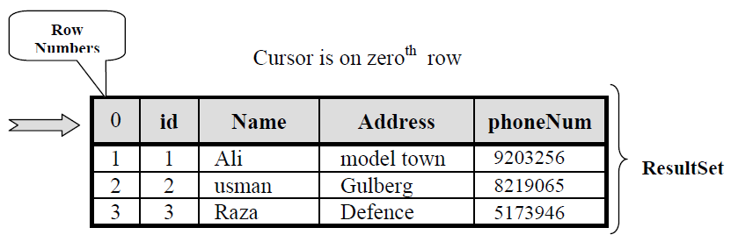
Result Set
A ResultSet contains the results of the SQL query
• Represented by a table with rows and columns
• Maintains a cursor pointing to its current row of data.
• Initially the cursor positioned before the row (0).
• First row has index 1
23

Slide 24
Close the Connection
A default ResultSet object is not updatable and has a cursor that moves forward only.
next( )
- Attempts to move to the next row in the ResultSet, if available
- The next() method returns true or false depending upon whether the next
row is available (exist) or not.
- Before retrieving any data from ResultSet, always remember to call next()at
least once because initially cursor is positioned before first row.
24

Slide 25
Close the Connection
To retrieve the data of the column of the current row you need to use the various
getters provided by the ResultSet
- These getters return the value from the column by specifying column name or
column index.
- For example, if the column name is “Name” and this column has index 3 in the
ResultSet object, then we can retrieve the values by using one of the
following methods:
String name = rs.getString(“Name”);
String name = rs.getString(3);
- These getter methods are also available for other types like getInt( ),
getDouble( ) etc. Consult the Java API documentation for more references.
25

Slide 26
Updatable and/or Scrollable ResultSet
String sql = “SELECT * FROM Person”;
PreparedStatement pStmt = con.prepareStatement(sql,
ResultSet.TYPE_SCROLL_INSENSITIVE,
ResultSet.CONCUR_UPDATABLE);
ResultSet rs = pStmt.executeQuery( );
26

Slide 27
Updatable and/or Scrollable ResultSet
previous( )
- Moves the cursor to the previous row in the ResultSet object, if available
- Returns true if cursor is on a valid row, false it is off the result set.
- Throws exception if result type is TYPE_FORWARD_ONLY
27

