Slide 1

GUI Components
Lecture-18

Slide 2
Lecture Outline
GUI Component:
JOPtion Pane
Displaying Text

Slide 3
Introduction
A graphical user interface (GUI) presents a user-friendly mechanism for interacting with an application.
A GUI (pronounced “GOO-ee”) gives an application a distinctive “look”and “feel.”
A GUI component is an object interact via mouse, keyboard or another form of input such and voice recognition.
You will learn many of java swing component from
Javax.swing
Notes:
The reason for this is simple.

Slide 4
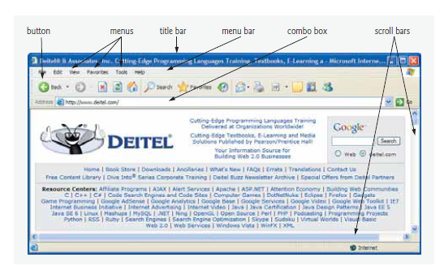
Introduction
As an example of a GUI, Fig. bellow contains an Internet Explorer web-browser window with some of its GUI components labeled. At the top is a title bar that contains the window’s title. Below that is a menu bar containing menus (File, Edit, View, etc.).
Notes:
The reason for this is simple.

Slide 5
Simple GUI-Based I/O with JOption Pane
Display text at the command window and obtain input from the command window.
Most applications you use on a daily basis use windows or dialog boxes (also called dialogs) to interact with the user.
For example, e-mail programs allow you to type and read messages in a window provided by the e-mail program.
Typically, dialog boxes are windows in which programs display important messages to the user or obtain information from the user.
Notes:
The reason for this is simple.

Slide 6
Simple GUI-Based I/O with JOption Pane
Java’s JOptionPane class (package javax.swing) provides
prepackaged dialog boxes for both input and output.
These dialogs are displayed by invoking static JOptionPane methods.
presents a simple addition application that uses two input dialogs to obtain integers from the user and a message dialog to display the sum of the integers the user enters.
Notes:
The reason for this is simple.

Slide 7
Simple GUI-Based I/O with JOption Pane
import javax.swing.JOptionPane;
public class Addition
{
public void add()
{
String fnum=JOptionPane.showInputDialog("Enter First Number");
String snum=JOptionPane.showInputDialog("Enter Second Number");
int num1=Integer.parseInt(fnum);
int num2=Integer.parseInt(snum);
int sum=num1+num2;
JOptionPane.showMessageDialog(null,"Sum="+sum, "sum of two integer", JOptionPane.PLAIN_MESSAGE);
}
}
Notes:
The reason for this is simple.

Slide 8
Simple GUI-Based I/O with JOption Pane
public class mainAdd
{
public static void main(String args[])
{
Addition a=new Addition();
a.add();
}
}
Notes:
The reason for this is simple.

Slide 9
Simple GUI-Based I/O with JOption Pane
public class mainAdd
{
public static void main(String args[])
{
Addition a=new Addition();
a.add();
}
}
Notes:
The reason for this is simple.

Slide 10
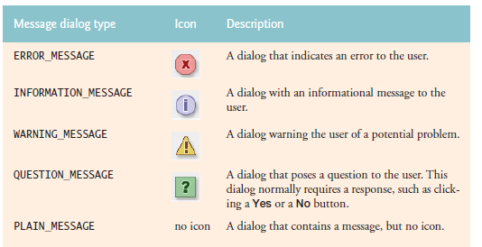
JOptionPane Message Dialog Constants
Notes:
The reason for this is simple.

Slide 11
1. GUI Principles
GUIs are built from components
buttons, menus, sliders, etc.
The positioning of GUI components in a window is done with layout managers
User actions are converted into events
button presses, menu selections, etc.
Events are processed by listeners.
11
Notes:
The reason for this is simple.

Slide 12
2. Background
GUI interfaces should be written with Swing GUI components
Swing includes buttons, text fields, scrolling windows, editor windows, tree displays, etc
I'll describe some of them
12
Notes:
The reason for this is simple.

Slide 13
2.1. Swing and AWT
In older Java programs, the AWT (Abstract Window Toolkit) GUI components are used
Swing has replaced AWT GUIs
never mix Swing and AWT components in a single program
Some parts of AWT are still used
e.g. its layout managers (see later)
continued
13
Notes:
The reason for this is simple.

Slide 14
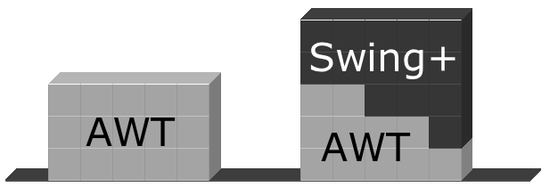
use Swing
14
Notes:
The reason for this is simple.

Slide 15
Lightweight and Heavyweight
Swing supports lightweight GUI components
they are drawn onto the screen in an area controlled by Java
the GUI is implemented completely within the JVM
advantage: the 'look' of GUI components can be controlled by Java
continued
15
Notes:
The reason for this is simple.

Slide 16

AWT supports heavyweight GUI components
each Java GUI component is actually a simple layer hiding the OSes GUI component
the OS component is called a peer component
e.g. on Windows, a Java button in AWT is implemented using a Windows' button
continued
16
Notes:
The reason for this is simple.

Slide 17
2.2. Disadvantages of AWT
Java does not have complete control over the AWT GUI components
some AWT GUIs do not work well because of problems with the underlying OS (e.g. file choosing in Windows)
The "look and feel" of Java GUIs in AWT vary between OSes.
17
Notes:
The reason for this is simple.

Slide 18
2.3. JFC
Swing is part of the Java Foundation Classes (JFC)
a collection of GUI-related classes to solve the problems with AWT
there are over 300 classes in JFC!!
JFC also includes:
pluggable "look and feel", an accessibility API, Java 2D, drag-and-drop, multiple undo's
18
Notes:
The reason for this is simple.

Slide 19
3. Three Steps to GUIs
There are three main steps to creating a GUI for a Java program:
1. Declare the GUI components;
2. Implement the listeners for the components;
3. Position the controls on the screen by using layout managers (and containers).
19
Notes:
The reason for this is simple.

Slide 20
2. Swing GUI Overview
The Swing GUI has six categories:
basic components
uneditable displays
interactive displays of highly formatted info
general-purpose containers
top-level containers
special-purpose containers
We will look at code
examples using the GUI
components listed in bold.
20
Notes:
The reason for this is simple.

Slide 21
2.1. Basic Components
Component Swing Class Name
button JButton, JCheckBox, JRadioButton
combo box JComboBox
list JList
menu JMenu, JMenuBar, JMenuItem
slider JSlider
text field JTextField, JPasswordField
21
Notes:
The reason for this is simple.

Slide 22
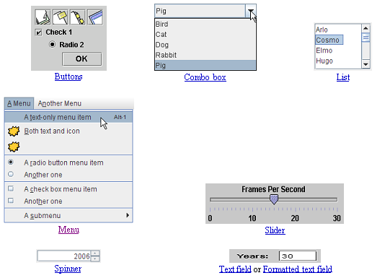
also known as
a pop-down list
These pictures are from the Java tutorial on Swing
22
Notes:
The reason for this is simple.

Slide 23
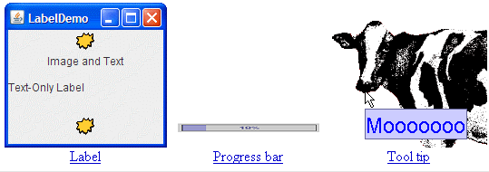
2.2. Uneditable Displays
Display Swing Class Name
label JLabel
Tooltip JToolTip
Progress bar JProgressBar
23
Notes:
The reason for this is simple.

Slide 24
2.3. Interactive Displays
Display Swing Class Name
table JTable
text JTextPane, JTextArea, JEditorPane
tree JColorChooser
file chooser JFileChooser
24
Notes:
The reason for this is simple.

Slide 25
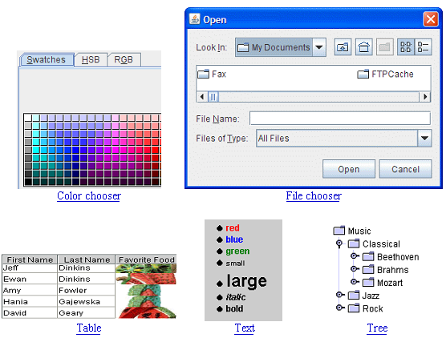
Notes:
The reason for this is simple.

Slide 26
2.4. General Purpose Containers
Container Swing Class Name
panel JPanel
scroll pane JScrollPane, JScrollBar
split pane JSplitPane
tabbed pane JTabbedPane
toolbar JToolbar
26
Notes:
The reason for this is simple.

Slide 27
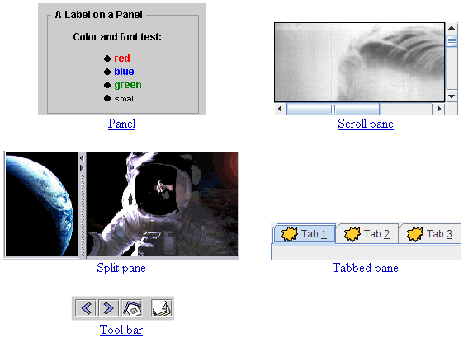
27
Notes:
The reason for this is simple.

Slide 28
2.5. Top-level Containers
Container Swing Class Name
frame JFrame
applet JApplet
dialog JOptionPane
28
Notes:
The reason for this is simple.

Slide 29
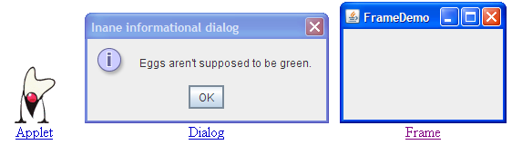
29
Notes:
The reason for this is simple.

Slide 30
2.6. Special-Purpose Containers
Container Swing Class Name
internal frame JInternalFrame
layered pane JLayeredPane
root pane JRootPane
indirectly used by top-level
containers to gain access to
the content pane and other
'layers' of a container
30
Notes:
The reason for this is simple.

Slide 31
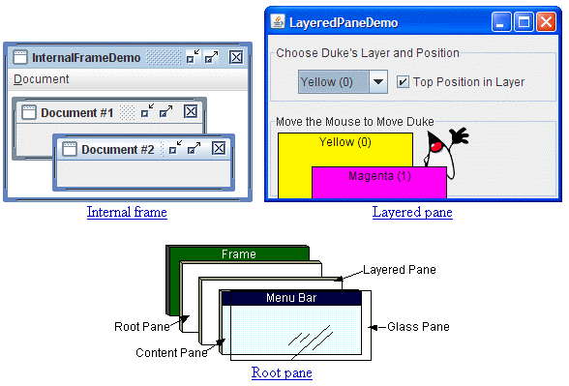
31
Notes:
The reason for this is simple.

Slide 32
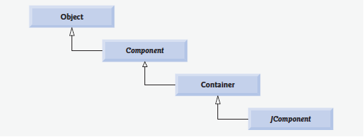
GUI Hierarchy
Notes:
The reason for this is simple.

Slide 33
GUI Hierarchy
Class Component (package java.awt) is a super class that declares the common features of GUI components in packge java.awt and javax.swing
Class Container (package java.awt) is a subclass of Component. Any object that is a Container can be used to organize other Components in a GUI. Because a Container is a Component.
you can attach Containers to other Containers to help organize a GUI.
Notes:
The reason for this is simple.

Slide 34
GUI Hierarchy
Class JComponent (package javax.swing) is a subclass of Container. JComponent is the superclass of all lightweight Swing components and declares their common attributes
Notes:
The reason for this is simple.

Slide 35
Displaying Text and Images in a Window
Most windows you will create are an instance of class JFrame or a subclass of Jframe.
JFrame provides the basic attributes and behaviors of a window.
title bar at the top of the window,
Buttons tominimize, maximize
and close the window.
Notes:
The reason for this is simple.

Slide 36
Steps in GUI Creation
The GUI is initialised in the class' constructor method.
Initialisation steps:
1. get the container for the frame
2. set the layout manager (FlowLayout)
3. declare the GUI components
4. add them to the container
5. register the components with event handlers
6. set window properties

Slide 37
Labeling GUI Components
A typical GUI consists of many components. In a large GUI, it can be difficult to identify the purpose of every component unless the GUI designer provides text instructions or information stating the purpose of each component. Such text is known as a label
Created with class JLabel—a subclass of JComponent. A JLabel displays a single line of readonly text, an image, or both text and an image.
Applications rarely change a label’s contents after creating it.
Notes:
The reason for this is simple.

Slide 38
Labeling GUI Components
import javax.swing.*;
import java.awt.*;
public class labelFrame extends JFrame
{
private JLabel label1;
private JLabel label2;
private JLabel label3;
public labelFrame()
{
super("My First Frame");
setLayout(new FlowLayout());
label1=new JLabel(“----label with text-----");
label1.setToolTipText("This is label1");
add(label1);
Notes:
The reason for this is simple.

Slide 39
Labeling GUI Components
Icon bug=new ImageIcon(getClass().getResource("D:/image.icon"));
bug,SwingConstants.LEFT);
label2=new JLabel("label with text and icon ", SwingConstants.LEFT);
label2.setToolTipText("this is label2");
add(label2);
Notes:
The reason for this is simple.

Slide 40
Labeling GUI Components
label3=new JLabel();
label3.setText("label with icon and text at bottom");
label3.setIcon(bug);
label3.setHorizontalTextPosition(SwingConstants.CENTER);
label3.setVerticalTextPosition(SwingConstants.BOTTOM);
label3.setToolTipText("this is label3");
add(label3);
}
}
Notes:
The reason for this is simple.

Slide 41
Labeling GUI Components
import java.awt.*;
import javax.swing.*;
public class LabelTest
{
public static void main(String[] args)
{
labelFrame frame=new labelFrame();
frame.setSize(260, 180);
frame.setVisible(true);
}
}
Notes:
The reason for this is simple.

