Slide 1

GUI Components
Lecture-19

Slide 2
Lecture Outline
GUI Components:
Text Field
Button
CheckBox

Slide 3
Text Fields
Write an e-mail in an e-mail application, clicking the Send button.
Tells the application to send the e-mail to the specified e-mail addresses.
GUIs are event driven
In GUI component, the interaction—known as an Event
Event drives the program to perform a task.
Notes:
The reason for this is simple.

Slide 4
Some Common Events
Clicking a button
typing in a text field
selecting an item from a menu
closing a window
moving the mouse
The code that performs a task in response to an event is called an event handler.
Overall process of responding to events is known as event handling.
Notes:
The reason for this is simple.

Slide 5
Text Field
Two new GUI components that can generate events.
JTextFields and JPasswordFields.
Class JTextField extends class JTextComponent
Provides many features common to Swing’s text-based components.
Class JPasswordField extends JTextField and adds several methods that are specific to processing passwords.
Each of these components is a single-line area
Jpassword hides the actual characters with an echo character, assuming that they represent a password that should remain known only to the user.
Notes:
The reason for this is simple.

Slide 6
TextField
When the user types text Field, then presses Enter, an event occurs.
Steps Required to Set Up Event Handling for a GUI Component.
Create a class that represents the event handler.
Implement an appropriate interface, known as an event-listener interface, in the class from Step 1.
Indicate that an object of the class from Steps 1 and 2 should be notified when the event occurs. This is known as registering the event handler.
Notes:
The reason for this is simple.

Slide 7
Using a Nested Class to Implement an Event Handler
All the classes discussed so far were so-called top-level classes
classes were not declared inside another class.
Java allows you to declare classes inside other classes—these are called nested classes.
Before an object of an inner class can be created, there must first be an object of the top-level class that contains the inner class.
Notes:
The reason for this is simple.

Slide 8
Overview of Swing Components
This is required because an inner-class object implicitly has a reference to an object of its top-level class.
There is also a special relationship between these objects—the inner-class object is allowed to directly access all the instance variables and methods of the outer class.
The event handling in this example is performed by an object of the private inner class TextFieldHandler.
This class is private because it will be used only to create event handlers for the text fields in top-level class TextFieldFrame.
Notes:
The reason for this is simple.

Slide 9
Overview of Swing Components
GUI components can generate a variety of events in response to user interactions.
Each event is represented by a class and can be processed only by the appropriate type of event handler.
When the userpresses Enter in text field the GUI component generates an ActionEvent.
Such an event is processed by an object that implements the interface ActionListener.
Notes:
The reason for this is simple.

Slide 10
Registering the Event Handler for Each Text Field
This object’s actionPerformed method will be called automatically when the user presses Enter in any of the GUI’s text fields.
before this can occur, the program must register this object as the event handler for each text field.
The application calls JTextField method addActionListener to register the event handler for each component.
This method receives as its argument an ActionListener object, which can be an object of any class that implements ActionListener.
Notes:
The reason for this is simple.

Slide 11
Registering the Event Handler for Each Text Field
The object handler is an ActionListener, because class TextFieldHandler implements ActionListener.
the object handler listens for events. Now, when the user presses Enter in any of these four textfields, method actionPerformed.
class TextFieldHandler is called to handle the event. If an event handler is not registered for a particular text field, the event that occurs when the user presses Enter in that text field is consumed—i.e., it is simply ignored by the application.
Notes:
A heavyweight component relies on native code for its visual representation so it is drawn by the underlying operating system. Heavyweight components are those defined in the java.awt package A lightweight component does not rely on native code - it is implemented entirely in Java. This means that a lightweight componet is entirely portable.

Slide 12
Common GUI Event Types and Listener Interfaces
presses Enter in a text field is stored in an ActionEvent object. Many different types of events can occur when the user interacts with a GUI.
The event-handling model described here is known as the delegation event model.
Notes:
The reason for this is simple.

Slide 13
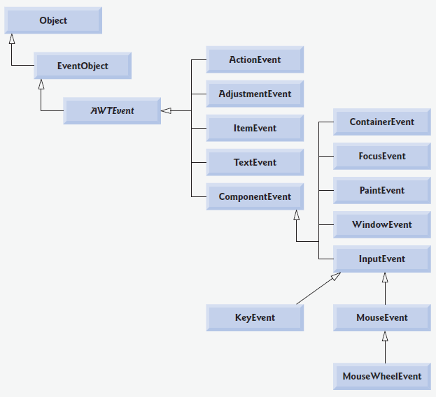
Notes:
The reason for this is simple.

Slide 14
For each event-object type, there is typically a corresponding event-listener interface.
An event listener for a GUI event is an object of a class that implements one or more ofthe event-listener interfaces from packages java.awt.event and javax.swing.event..
Notes:
The reason for this is simple.

Slide 15
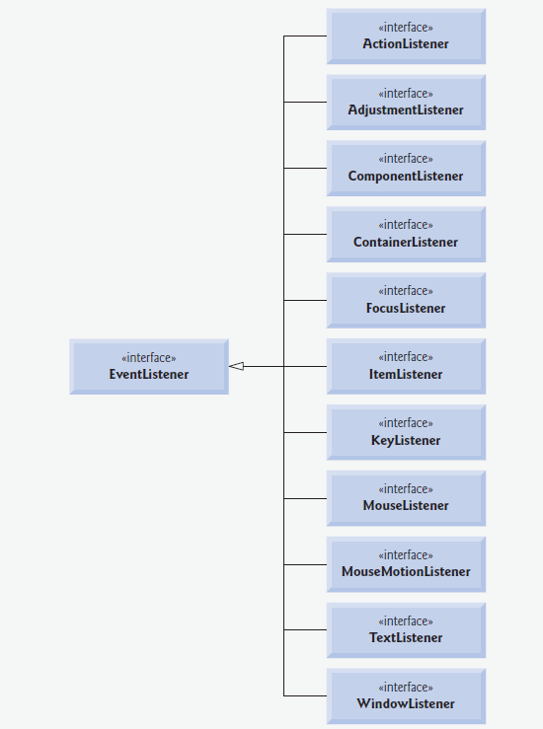
Notes:
The reason for this is simple.

Slide 16
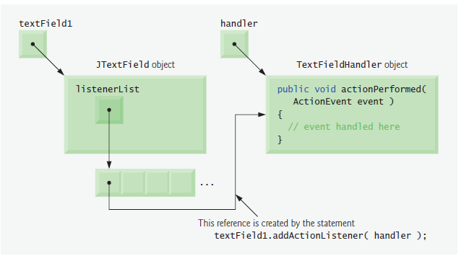
Notes:
The reason for this is simple.

Slide 17
JButton
A button is a component the user clicks to trigger a specific action. A Java application can use several types of buttons, including command buttons, checkboxes, toggle buttons and radio buttons.
All the button types are subclasses of AbstractButton (package javax.swing), which declares the common features of Swing buttons.
Notes:
A heavyweight component relies on native code for its visual representation so it is drawn by the underlying operating system. Heavyweight components are those defined in the java.awt package A lightweight component does not rely on native code - it is implemented entirely in Java. This means that a lightweight componet is entirely portable.

Slide 18
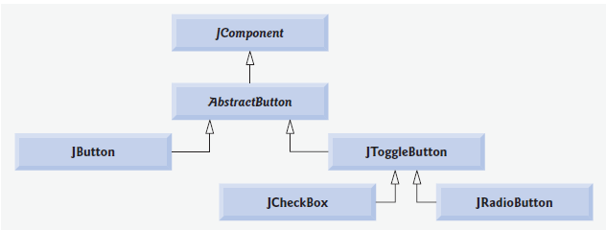
JButton
Notes:
A heavyweight component relies on native code for its visual representation so it is drawn by the underlying operating system. Heavyweight components are those defined in the java.awt package A lightweight component does not rely on native code - it is implemented entirely in Java. This means that a lightweight componet is entirely portable.

Slide 19
JButton
A button is a component the user clicks to trigger a specific action.
A Java application can use several types of buttons, including command buttons, checkboxes, toggle buttons and radio buttons.
Notes:
A heavyweight component relies on native code for its visual representation so it is drawn by the underlying operating system. Heavyweight components are those defined in the java.awt package A lightweight component does not rely on native code - it is implemented entirely in Java. This means that a lightweight componet is entirely portable.

Slide 20
When the user clicks a JCheckBox, an ItemEvent occurs. This event can be handled by an ItemListener object, which must implement method itemStateChanged.
lass CheckBoxHandler and register it with method addItemListener
isSelected to determine if the JCheckBox is selected

