Slide 2
Lecture 1
Introduction (Course Objective)
Marks Distribution
Structure Programming vs Object oriented programming
JVM (Java Virtual Machine) Architecture
Installation of JDK & IntelliJ Community Edition
What is Object Orientation?
What is an Object?
What is Object Oriented Programming?
What is Object Oriented Program?

Slide 3
Introduction (Course Objective)
The objective of this course is to introduce you to the fundamentals of Java programming, including its syntax, features, and the key concepts of Object-Oriented Programming (OOP). By the end, you'll be able to develop basic Java applications.
Software developers are realizing that adopting an object-oriented design and implementation approach significantly enhances productivity compared to earlier popular techniques like structured programming.
This shift allows for better code organization, flexibility, and reusability, leading to more efficient and manageable software development processes.

Slide 4
Marks Distribution (Theory)
Quiz 20%
Assignment & Class participation 10%
Mid Examination 20%
Final Examination 50%
Marks Distribution (Lab)
Attendance 5
Lab Tasks 5
Viva 10
Practical Exam 30
(Code + Logic + Compilation + Output)

Slide 5
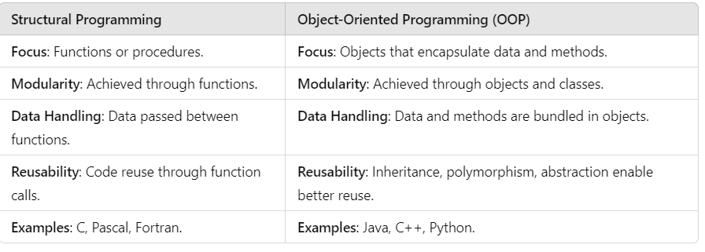
Structural Programming vs. Object Oriented programming

Slide 6
What is Java?
Java is a high-level, object-oriented programming language developed by Sun Microsystems in 1995.
It first internet based language became popular due to Its platform-independent capability→
meaning programs written in Java can run on any device with a Java Virtual Machine (JVM).
Java follows the principle of "write once, run anywhere" (WORA), making it popular for cross-platform applications.
It is known for its simplicity, security, and robustness, often used for web development, Android apps, and enterprise-level solutions. .

Slide 7
Java Virtual Machine (JVM)
A Java virtual machine (JVM) is an abstract computing machine that enables a computer to run a Java program.
Java is interpreter

Slide 8
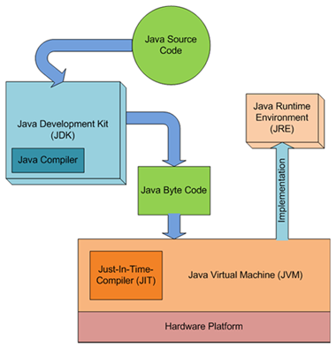
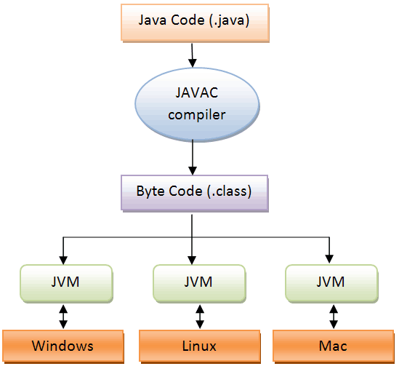

Slide 9
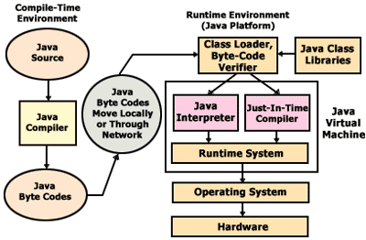

Slide 10
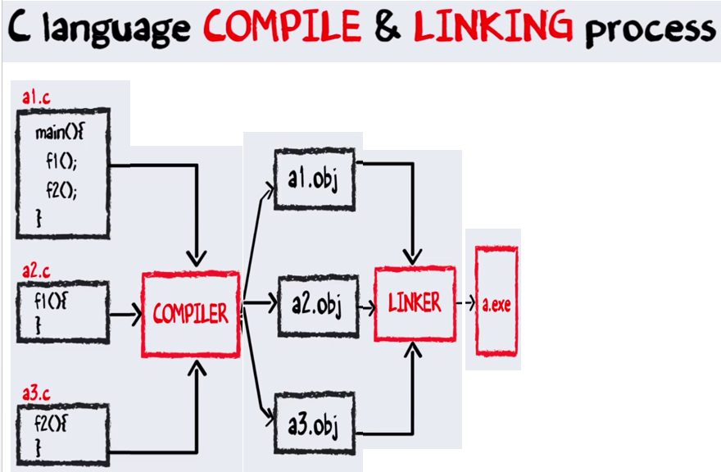

Slide 11
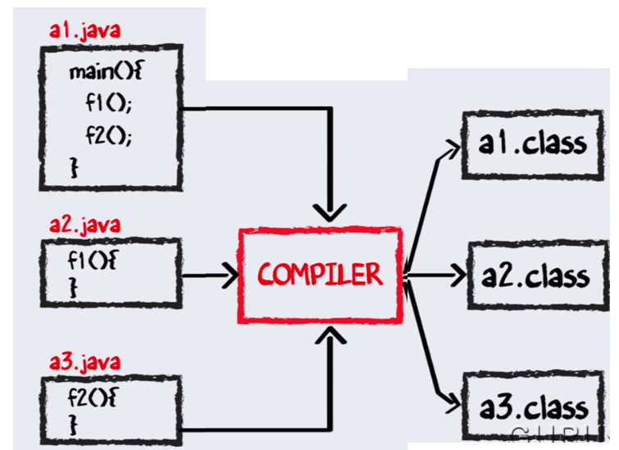

Slide 12
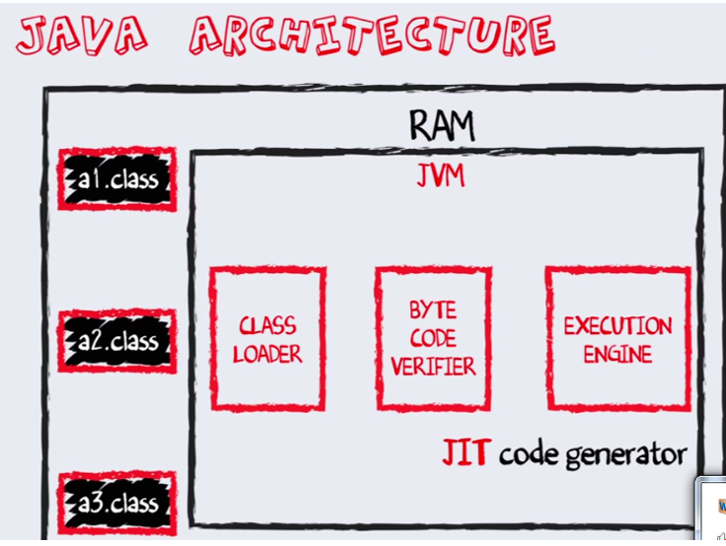

Slide 13
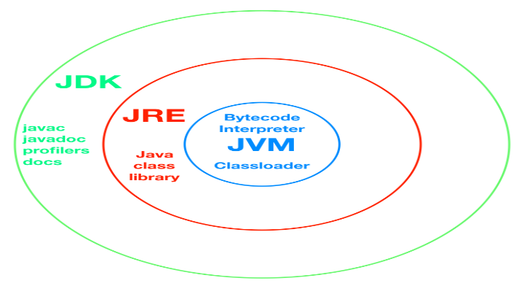
JVM (Java Virtual Machine) Architecture
JVM is a virtual machine that enables the execution of Java bytecode. The JVM acts as an interpreter between the Java programming language and the underlying hardware.

Slide 14
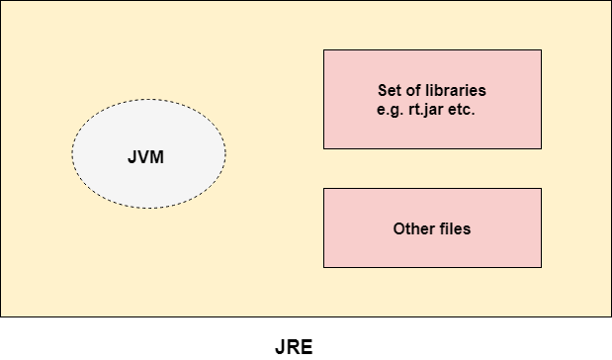
JRE(JAVA RUNTIME ENVIRONMENT)
The Java Runtime Environment is a set of software tools which are used for developing Java applications. It is used to provide the runtime environment. It is the implementation of JVM. It physically exists. It contains a set of libraries + other files that JVM uses at runtime.

Slide 15
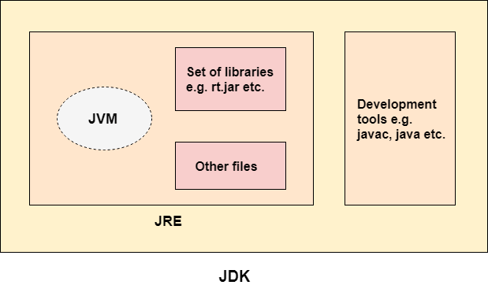
Java Development Kit (JDK)
The Java Development Kit (JDK) is a software development environment which is used to develop Java applications and applets. It physically exists. It contains JRE + development tools.
The JDK contains a private Java Virtual Machine (JVM) and a few other resources such as an interpreter/loader (java), a compiler (javac), an archiver (jar), a documentation generator (Javadoc), etc. to complete the development of a Java Application.

Slide 16
Steps to Install JDK and IntelliJ IDEA to Run Java Code
1. Install JDK:
Download JDK:
Visit the official Oracle website: Oracle JDK.
Choose the appropriate version and download it for your OS (Windows, macOS, or Linux).
Install JDK:
Run the downloaded installer.
Follow the installation wizard steps to complete the installation.
Set Environment Variables (Windows):
Right-click on This PC → Properties → Advanced System Settings → Environment Variables.
Under System Variables, find PATH, click Edit, and add the path to your JDK’s bin directory.
Verify JDK Installation:
Open a terminal or command prompt.
Type java -version and javac -version to ensure the JDK is correctly installed.

Slide 17
Steps to Install JDK and IntelliJ IDEA to Run Java Code
Download IntelliJ IDEA:
Go to the official JetBrains website: IntelliJ IDEA.
Download the Community Edition (free) for your operating system.
Install IntelliJ IDEA:
Run the installer and follow the on-screen instructions to install IntelliJ IDEA.
Launch IntelliJ IDEA:
Open IntelliJ IDEA after installation.

Slide 18
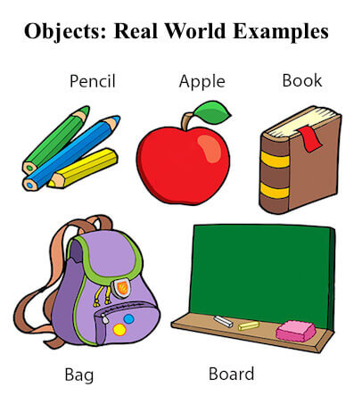
What is an Object?
An object has three characteristics:
An object is an instance of a class. It represents a real-world entity with attributes (properties or data) and methods (behaviors or functions). For example, a car object can have attributes like color, brand, and speed, and methods like start, stop, and accelerate.
State: represents the data (value) of an object.
Behavior: represents the behavior (functionality) of an object such as deposit, withdraw, etc.
Identity: An object identity is typically implemented via a unique ID. The value of the ID is not visible to the external user. However, it is used internally by the JVM to identify each object uniquely.

Slide 19
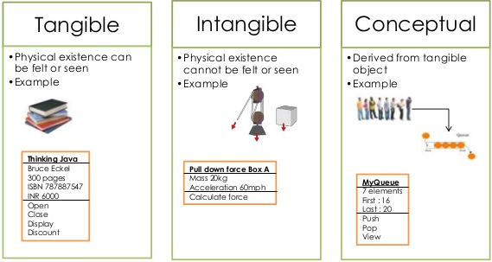
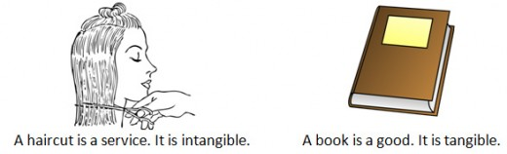
Object Orientation
Types of Objects
An object may be tangible or Intangible
19

Slide 20
What is Object Orientation?
Object Orientation is a programming paradigm where everything is modeled as objects. It is based on the concept of real-world entities, with each entity represented as an object that contains both data and behavior (methods). The main goal is to make software development more intuitive, reusable, and modular.
“Object" refers to a particular instance of a class.
whereas the object can be a combination of variables, functions, and data structures.

Slide 21
What is Object Orientation?
Object-oriented programming (OOP) is a programming language model organized around objects rather than "actions" and data rather than “logic”.
Object-oriented or object-orientation is a software engineering concept, in which concepts are represented as "objects“
It is a technique in which we visualize our programming problems in the form of objects and their interactions as happened in real life
OO Model consists of several interacting objects.

Slide 22
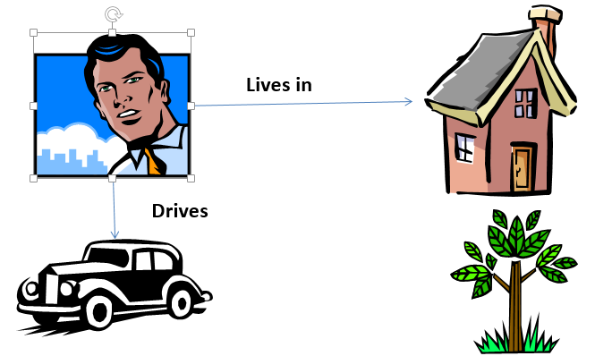

Slide 23
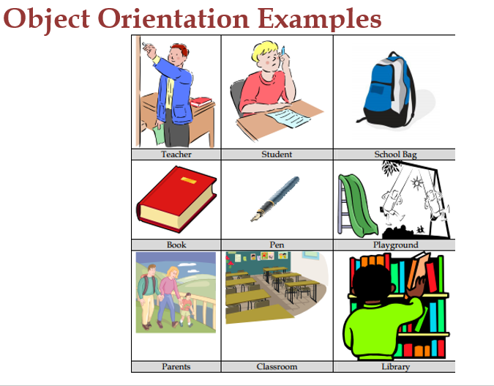

Slide 24
Object Oriented Model
What is a Model?
A model is abstraction of something.
Purpose is to understand the product before using it.
Example are Highway Map , Architectural Design and Mechanical models.
What is OO Model in Programming?
In the context of programming, Models are used to understand problem before start developing it.
Object Oriented Models can be developed by showing interaction among objects to understand a system implementation.
24

Slide 25
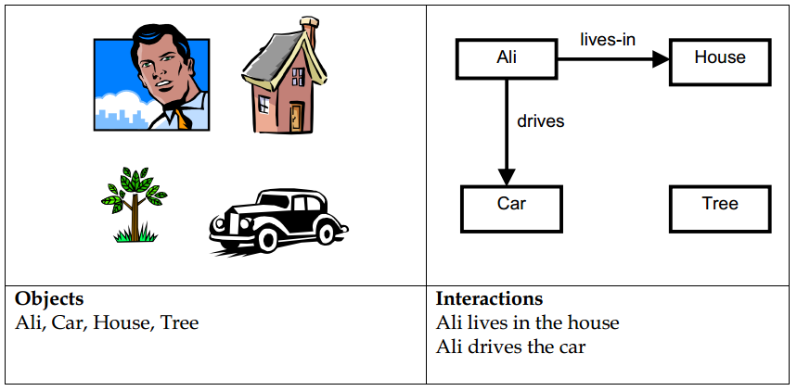
Object Oriented Model
Object Oriented Model Example 1
25

Slide 26
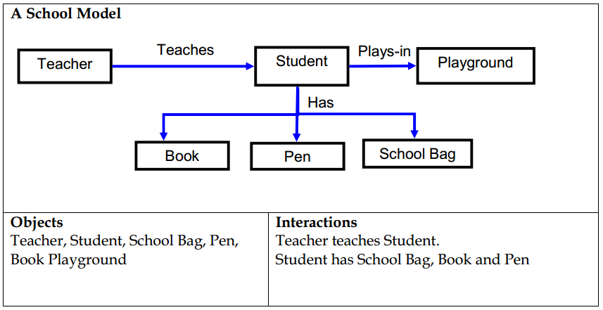
Object Oriented Model
Object Oriented Model Example 2
26

Slide 27
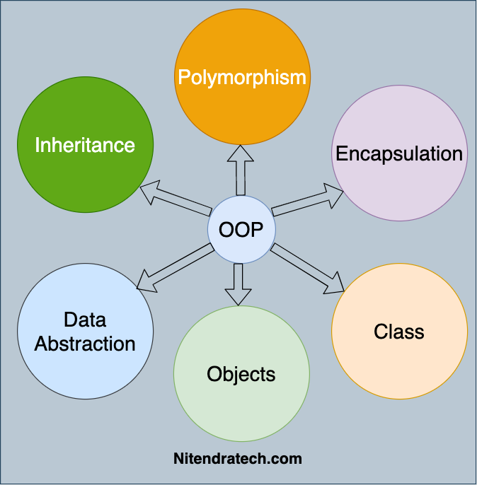
Object-Oriented Program
An object-oriented program is a software application that is structured around the concept of objects. These objects interact with one another to perform tasks, each having specific roles and behaviors as defined by their respective classes.

Slide 28
OOP Characteristics
Object-Oriented Programming (OOP) is a programming style where programs are designed using objects and their interactions. It emphasizes the four core principles:
Information hiding/ Encapsulation: Bundling data and methods into objects and restricting access to certain details.
Advantage : information hiding
Abstraction: Hiding complex details and exposing only necessary parts.
Inheritance: Creating new classes from existing ones to promote code reuse.
Polymorphism: Allowing objects to take on multiple forms, enabling flexibility in behavior.

Slide 29
Information hiding
Introduction
private information should only be accessible to the owner.
“Showing only those details to the outside world which are necessary for the outside world and hiding all other details from the outside world.”
Information is stored within the Object
Information within the object is not accessible to outside world
Information can only be manipulated by the object
29
Notes:
Real Life Examples of Information Hiding
Your name and other personal information is stored in your brain we can’t access this information directly. For getting this information we need to ask you about it and it will be up to you how much details you would like to share with us.
An email server may have account information of millions of people but it will share only our account information with us if we request it to send anyone else accounts information our request will be refused.
A phone SIM card may store several phone numbers but we can’t read the numbers directly from the SIM card rather phone-set reads this information for us and if the owner of this phone has not allowed others to see the numbers saved in this phone we will not be able to see those phone numbers using phone.

Slide 30
Information hiding
Information Hiding – Real Life Examples
A Person’s (Say Ali) name other information is stored in this brain and we can not access it directly
An Email server has millions of email address but it shares only our account information with us
A phone SIM card may store several phone numbers but we can not read numbers directly rather a phone set (a person’s own) will read this information for us
30

Slide 31
Encapsulation/information hiding
Information Hiding in OOP’s Perspective
In OOP an Object have state and behaviors that is hidden from outside world. So in OOP perspective information hiding is
“Hiding object detail (state & behavior) from the users”
Term “user” defined here means an “Object” of another class that is calling functions of this class using or it may be another program in which we are using this class.
31

Slide 32
Information hiding Advantage
Advantages of Information Hiding
Simplifies Object Oriented Model
In OOP Model we only have object and their interaction
Barrier against change propagation
Any change in the functionality doesn’t effect the OOP model
32

Slide 33
Information Hiding
Achieving Information Hiding
Information hiding can be achieved using
Encapsulation
Abstraction
33

Slide 34
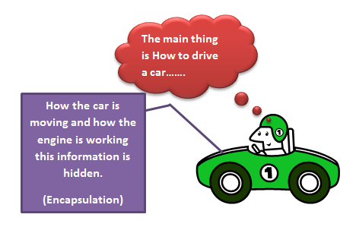
Encapsulation
Introduction
34

Slide 35
Encapsulation
What is Encapsulation?
Encapsulation means “All the characteristics of an object are hidden in the object itself”.
The wrapping up of data and function into a single unit is known as encapsulation.
Encapsulation hides the implementation details
Encapsulation and information hiding are the same concepts so they may be used as synonyms.
35

Slide 36
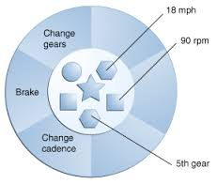
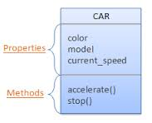
Encapsulation
Encapsulation and Object
Data and Behaviour are tightly coupled inside an object
Information structure and implementation details of its operations are hidden from outside world.
36

Slide 37
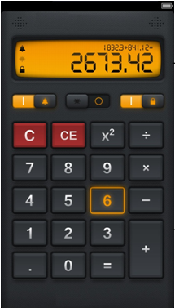

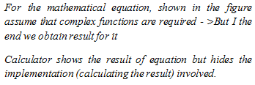
Encapsulation
Encapsulation Example
A Phone stores phone numbers in digital format and knows how to convert it into human-readable characters
We don’t know
How the data is stored
How it is converted to human-readable characters
37

Slide 38
Encapsulation
Advantages of Encapsulation
Followings are the advantages of Encapsulation
Simplicity and Clarity
Low Complexity
Better Understanding
Ensure Structural Changes remain Local
Encapsulation Allows adding some logic when accessing client’s data
For Example validation on modifying a property
38

Slide 39
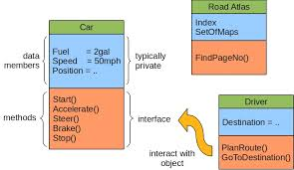
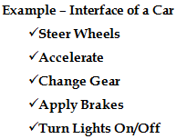
Interface
Object and Interface
Every Object has an Interface.
Interface is set of functions of an object that he wants to expose to other objects.
An object encapsulates data and behaviour. So how will an object interact with other objects?
Objects communicate through this interface.
39

Slide 40
Implementation
Object and Implementation
The behaviour of object requires implementation.
The actual implementation (coding) of the behaviour in any object oriented language is called implementation.
Implementation has two parts
Internal Data Structures to hold an object state that will be hidden from us
Functionality in the form of member functions to provide required behaviour
Example – Implementation of Gear Box
Data Structure
Mechanical structure of gear box
Functionality
Mechanism to change gear
40

Slide 41
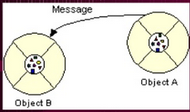
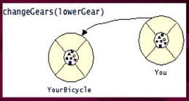
Messages
What is a message in OOP?
A message is a request for an object to perform one of its operations (methods)
All Communication between objects is done via messages
The number and kind of messages that can be sent to an object depends upon its interface
The object to which message is addressed (yourBicycle)
The name of the method to perform (changeGear)
Any parameter needed by the method (lowerGear)
41

Slide 42
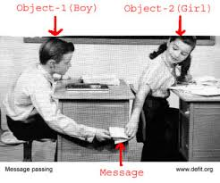
Messages
What is a message in OOP?
SHOULD WE INCLUDE THIS SLIDE ?
42

Slide 43

Abstraction
What is Abstraction?
Abstraction means ignoring irrelevant features, properties, or functions and emphasizing the relevant one
…relevant to the given project (with an eye to future reuse in similar projects)
Abstraction = managing complexities
43

Slide 44
Abstraction
What is Abstraction?
Abstraction is something we do everyday
Looking at an object , we see those things about it that have meanings to us.
We abstract the properties of the object, and keep only what we need.
Abstraction allows us to represent a complex reality in terms of simplified model
Abstraction highlights the properties of an entity that we are most interested in and hides the other
44

Slide 45
Abstraction
Abstraction Example
“Ali is PHD student and teaches BS students”
Here Object Ali has two perspective one is student perspective and other is teacher perspective.
Attributes
Student Perspective Teacher Perspective
Name Employee ID
Student Roll No Designation
Year of Study Salary
CGPA Age
Age is common attribute in both perspectives
45

Slide 46
Abstraction
Abstraction Example
“Ali is PHD student and teaches BS students”
Here Object Ali has different behaviors in student perspective and teacher perspective.
Behavior
Student Perspective Teacher Perspective
Study Deliver Lecture
GiveExam TakeExam
PlaySports DevelopExam
46

Slide 47
Abstraction
Abstraction Example
“A cat can be viewed with different perspectives”
Here Object Cat has different perspective on Ordinary perspective and Surgeon perspective.
Ordinary Perspective Surgeon’s Perspective
A pet animal with
being with Four Legs Skeleton
A Tail Heart
Two Ears Kidney
Sharp Teeth Stomach
47

Slide 48
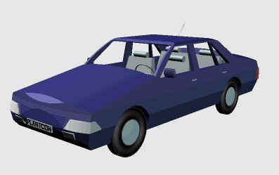

Abstraction
Abstraction Example
Driver’s View Engineer’s View
48

Slide 49
Abstraction
Abstraction Advantage
Abstraction has following advantages
Simplifies the model by hiding irrelevant details
Abstraction provides the freedom to defer implementation decisions by avoiding commitment to details.
49

Slide 50
Inheritance
What is Inheritance?
In Object Oriented Programming, Inheritance enables new objects to take on properties of existing objects
Inheritance is a process by which objects of one class acquire the properties of another class.
In Inheritance concepts are arranged in a hierarchy
Concepts at the higher level are more general
Concepts at lower level are more specific (inherit properties of concepts at higher level)
50

Slide 51
Inheritance
What is Inheritance?
Higher Level (General Concepts)
Lower Level (Specific Concepts)
Vehicle
Wheeled vehicle
Boat
Car
Bicycle
2-door
4-door
51

Slide 52
Inheritance
More Definitions of Inheritance
A Parent – Child Relationship between classes is called inheritance.
Allows sharing of the behavior of the parent class to child class
Child class can add new behavior or override existing behavior of class.
Real world Example of Inheritance
A most recent form of Mobile Phone inherited from least recent models of mobile phone
Least recent mobile inherited from Ordinary dial up phone
Automatic Car inherited from Manual Car
Laptop Inherited from Desktop Computers
52

Slide 53
Inheritance
What is Inheritance?
In Object Oriented Programming, Inheritance enables new objects to take on properties of existing objects
Inheritance is a process by which objects of one class acquire the properties of another class.
In Inheritance concepts are arranged in a hierarchy
Concepts at the higher level are more general
Concepts at lower level are more specific (inherit properties of concepts at higher level)
53

Slide 54
Inheritance
What is Inheritance?
Higher Level (General Concepts)
Lower Level (Specific Concepts)
Vehicle
Wheeled vehicle
Boat
Car
Bicycle
2-door
4-door
54

Slide 55
Inheritance
More Definitions of Inheritance
A Parent – Child Relationship between classes is called inheritance.
Allows sharing of the behavior of the parent class to child class
Child class can add new behavior or override existing behavior of class.
Real world Example of Inheritance
A most recent form of Mobile Phone inherited from least recent models of mobile phone
Least recent mobile inherited from Ordinary dial up phone
Automatic Car inherited from Manual Car
Laptop Inherited from Desktop Computers
55

Slide 56
Advantages of Inheritance
Three main advantages
Reuse
Less Redundancy
Increased Maintainability
56

Slide 57
Polymorphism
What is Polymorphism?
Polymorphism is the ability of an object to take on many forms.
Manipulate objects of various classes, and invoke different methods on an object without knowing the type of object
Any Java object that can pass more than one IS-A test is considered to be polymorphic.
In Java, all Java objects are polymorphic since any object will pass the IS-A test for their own type and for the class Object.
In general, polymorphism refers to existence of different forms of a single entity
For example, both Diamond and Coal are different forms of Carbon
57

Slide 58
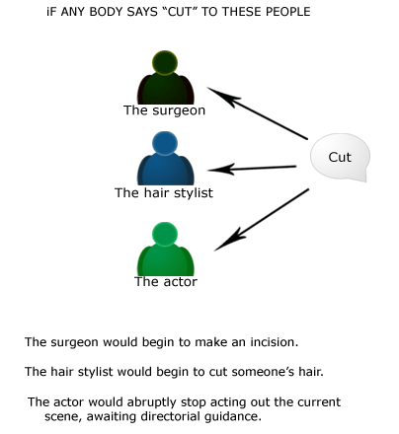
Polymorphism
What is Polymorphism?
58

Slide 59
Polymorphism
Polymorphism Example
Look at example
A Deer IS-A Animal
A Deer IS-A Vegetarian
A Deer IS-A Deer
A Deer IS-A Object
Since Deer inherits from Vegetarian, and Vegetarian inherits from Animal, then an object (say mydeer) of Deer is at all times Deer, a Vegetarian, and an Animal.
Animal
Vegetarian
Omnivorous
Deer
59

Slide 60
Polymorphism
Polymorphism in OO Model
In Object Oriented Model, Polymorphism means that different objects can behave in different ways for the same message
Consequently the sender of the message does not need to know exact class of the receiver
60

