Slide 2
Lecture 2
Introduction to Java Language
Statically-typed programming language
Data Types in Java
Class in Java
Method in Java
Ways to initialize and object
Constructor

Slide 3
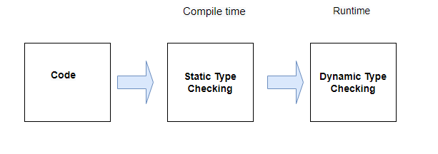
Statically Typed Programming Language
In statically typed programming languages, type checking occurs at compile time. At compile time, source code in a specific programming language is converted to a machine-readable format. This means that before source code is compiled, the type associated with each and every single variable must be known.
Java is a statically-typed programming language. It means, all variables must be declared before its use. That is why we need to declare variable's type and name.

Slide 4
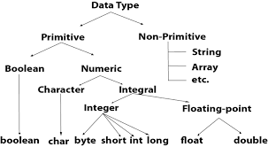
Data Types in Java

Slide 5
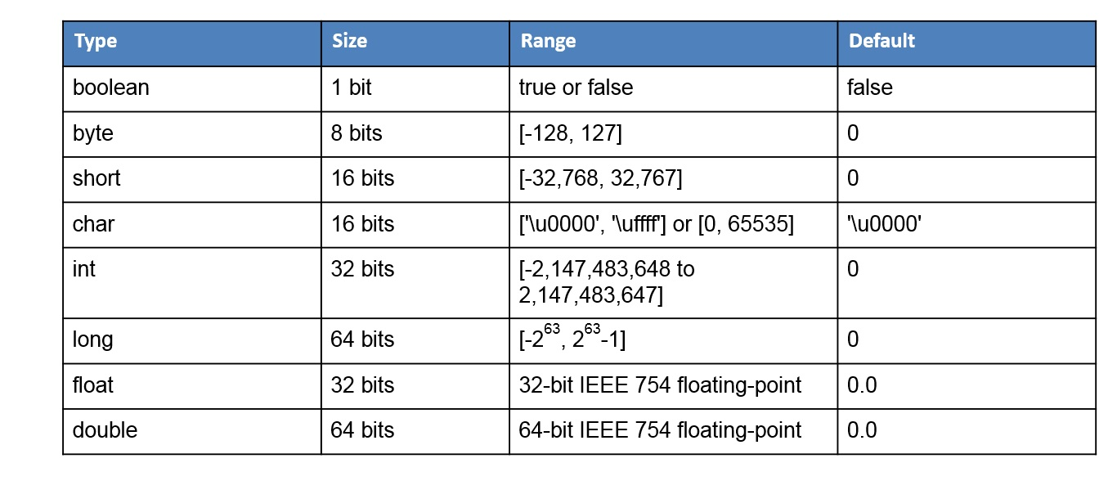
Primitive Data Type
In Java, primitive data types are the most basic types of data. They are predefined by the language and serve as the building blocks for data manipulation. Java has eight primitive data types, each of which represents a single piece of information with specific size and value limits. These data types are not objects and do not have methods associated with them.

Slide 6
Primitive Data Type
Key Characteristics:
Efficient: Since primitive types are not objects, they are more memory-efficient and faster to access.
Immutable: Primitive values cannot be changed once assigned.
Default values: Each primitive type has a default value (e.g., int defaults to 0, boolean to false, char to \u0000, etc.).
Primitive types are crucial for low-level operations, but Java also provides wrapper classes (like Integer, Boolean, etc.) that provide object-oriented features for these types when needed.

Slide 7
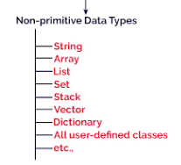
Non-Primitive Data Types
In Java, non-primitive data types (also called reference types) are more complex types created by the programmer or provided by Java as part of its libraries. These types are used to store references (or addresses) to the actual data in memory, rather than storing the data directly like primitive types. Non-primitive types include objects, arrays, strings, and classes.

Slide 8
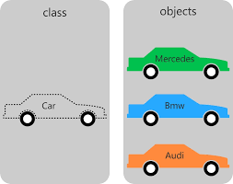
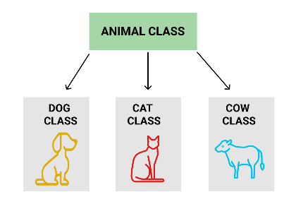
Class in Java
In Java, a class is a fundamental concept in object-oriented programming. It serves as a blueprint or template that defines the structure and behavior of objects. A class is a logical entity that doesn't exist physically, but it describes how objects of that class will be structured and how they will behave when created.

Slide 9
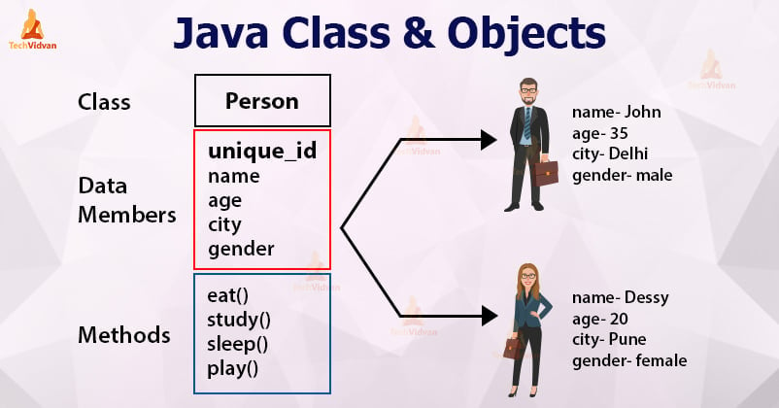
Syntax to declare a class
class <class_name>{
field; //data members;
method;
}

Slide 10
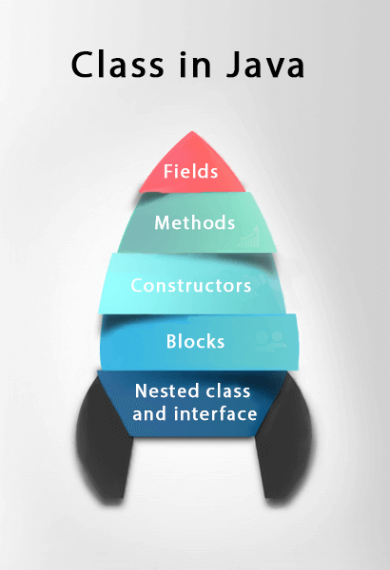
Key Components of a Java Class:
A class in Java can contain:
Fields
Methods
Constructors
Blocks
Nested class and interface
Fields (Attributes or Variables): Fields are the data members or variables that hold the state of an object. They represent the properties or characteristics of the class.

Slide 11
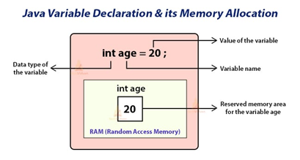
Variable in Java
Class Student
{ String name;
int age =20;
}

Slide 12
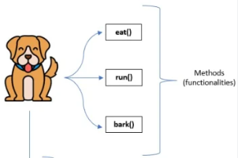
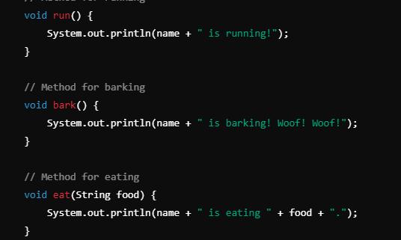
Method in Java
In Java, a method is like a function which is used to expose the behavior of an object.
Advantage of Method
Code Reusability
Code Optimization

Slide 13
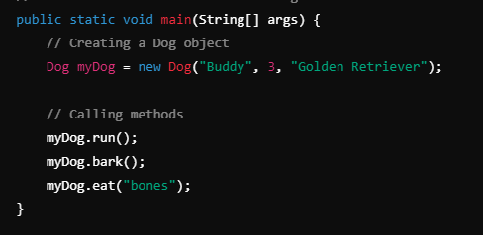


Slide 14
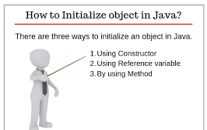
Ways to initialize object

Slide 15
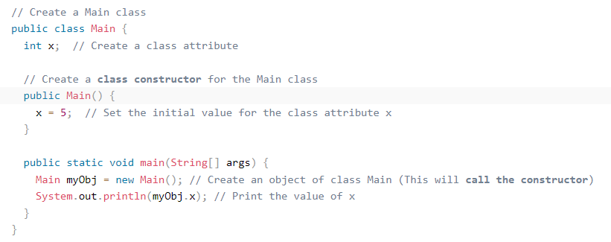
Ways to initialize object
1) Object and Class Example: Initialization through Constructor

Slide 16
2) Object and Class Example: Initialization through Reference variable
Understanding Reference variable
1. Reference variable is used to point object/values.
2. Classes, interfaces, arrays, enumerations, and, annotations are reference types in Java. Reference variables hold the objects/values of reference types in Java.
3. Reference variable can also store null value. By default, if no object is passed to a reference variable then it will store a null value.
4. You can access object members using a reference variable using dot syntax.
<reference variable name >.<instance variable_name / method_name>

Slide 17
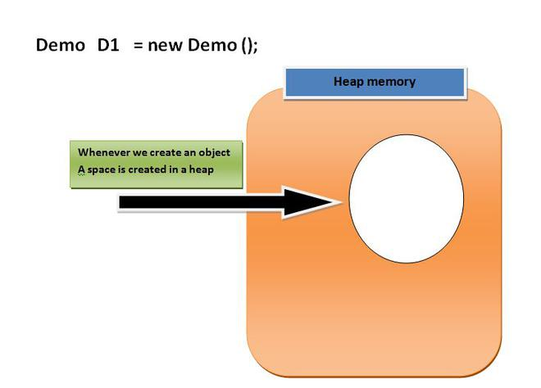
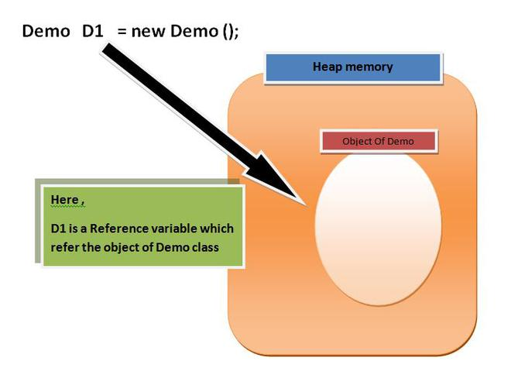

Slide 18
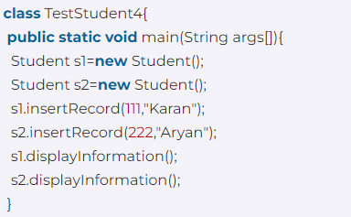
3) Object and Class Example: Initialization through method
In this example, we are creating the two objects of Student class and initializing the value to these objects by invoking the insertRecord method. Here, we are displaying the state (data) of the objects by invoking the displayInformation() method.

Slide 19
Constructors in Java
In Java, a constructor is a block of codes similar to the method. It is called when an instance of the class is created. At the time of calling constructor, memory for the object is allocated in the memory.
It is a special type of method which is used to initialize the object.
Every time an object is created using the new() keyword, at least one constructor is called.
It calls a default constructor if there is no constructor available in the class. In such case, Java compiler provides a default constructor by default.
Note: It is called constructor because it constructs the values at the time of object creation. It is not necessary to write a constructor for a class. It is because java compiler creates a default constructor if your class doesn't have any.

Slide 20
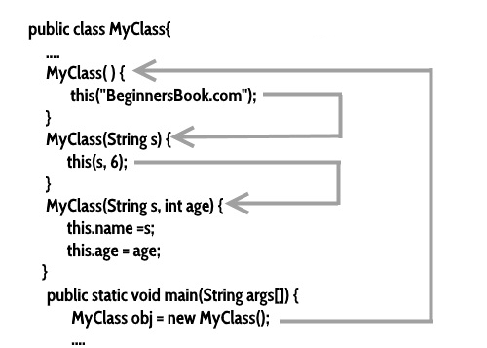
Rules for creating Java Constructor
There are two rules defined for the constructor.
Constructor name must be the same as its class name
A Constructor must have no explicit return type
A Java constructor cannot be abstract, static, final, and synchronized

Slide 21
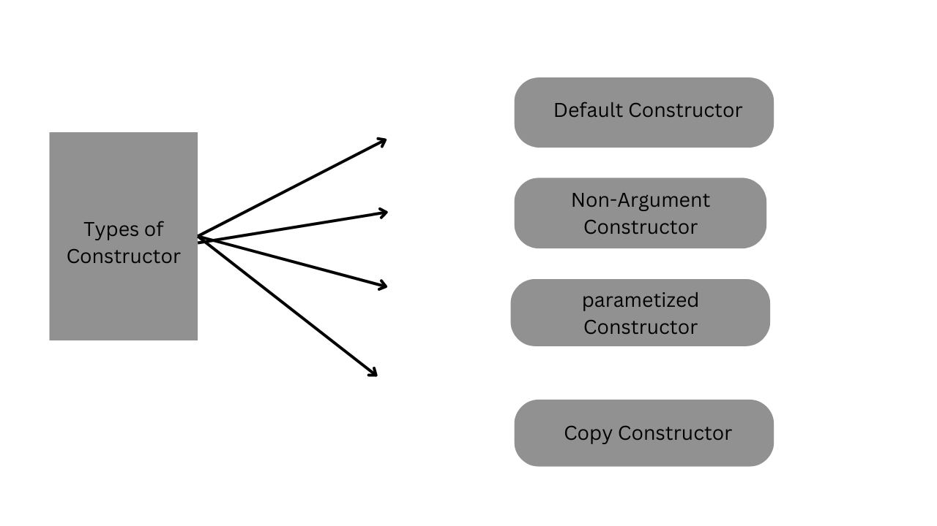
Types of Java constructors

Slide 22
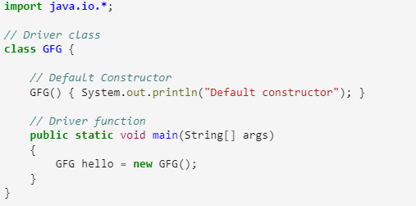
Default Constructor
A constructor that has no parameters is known as default the constructor. A default constructor is invisible. And if we write a constructor with no arguments, the compiler does not create a default constructor. It is taken out. It is being overloaded and called a parameterized constructor. The default constructor changed into the parameterized constructor. But Parameterized constructor can’t change the default constructor. The default constructor can be implicit or explicit. If we don’t define explicitly, we get an implicit default constructor. If we manually write a constructor, the implicit one is overridded.

Slide 23
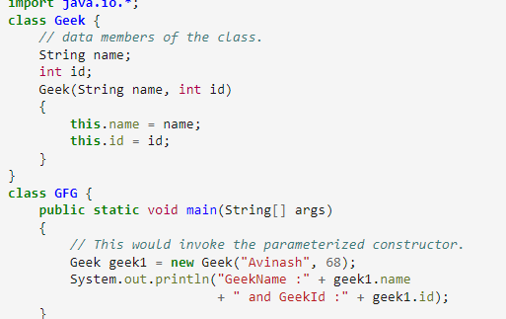
Non – Argument Constructor
A constructor that has parameters is known as parameterized constructor. If we want to initialize fields of the class with our own values, then use a parameterized constructor.

Slide 24
Parameterized Constructor
A constructor which has a specific number of parameters is called a parameterized constructor.
Why use the parameterized constructor?
The parameterized constructor is used to provide different values to distinct objects. However, you can provide the same values also.
//Java Program to demonstrate the use of the parameterized constructor.
class Student4{
int id;
String name;
//creating a parameterized constructor
Student4(int i,String n){
id = i;
name = n;
}

Slide 25
//method to display the values
void display(){System.out.println(id+" "+name);}
public static void main(String args[]){
//creating objects and passing values
Student4 s1 = new Student4(111,"Karan");
Student4 s2 = new Student4(222,"Aryan");
//calling method to display the values of object
s1.display();
s2.display();
}
}

Slide 26
Copy Constructor in Java
Like C++, Java also supports a copy constructor. But, unlike C++, Java doesn’t create a default copy constructor if you don’t write your own. A prerequisite prior to learning copy constructors is to learn about constructors in java to deeper roots. Below is an example Java program that shows a simple use of a copy constructor.
class Person {
private String name;
private int age;
public Person(String name, int age) {
this.name = name;
this.age = age;
}
public Person(Person another) {
this(another.name, another.age);
}
// Getters and setters for the instance variables
}

