Slide 1
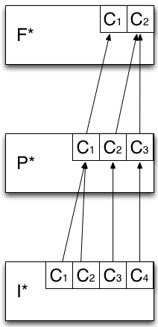
F* - Analytical Model of Resource Federation
Models how the capabilities offered by the infrastructure layer are aggregated and then exposed to the application layer.
Heterogeneous capabilities of I* are aggregated by means of overlays so to offer a unified abstraction to the application layer.
P* is used as the overlay layer, a way to organize the capabilities exposed by I* into logical containers.

