Slide 1
Next Generation Middleware for Distributed Exascale Computing The Role of Modeling and Simulation
Research in Advanced DIstributed Cyberinfrastructure and Applications Laboratory (RADICAL)
http://radical.rutgers.edu
Talk based primarily upon the effort of the RADICAL group, but different parts have benefitted from collaborations with the AIMES Project Partners (Katz, Weissman) and LMU-Munich (Straube, Kranzmuller)

Slide 2
Outline
Why Distributed Exascale Computing (DEC)?
Foundational requirements for DEC
Distributed Computing 2013
NGMW as a way to address DEC requirements
Functional Aims, Design Objectives
Proposed architecture for a model-based, capability-driven NGMW
Models at multiple levels and their integration: Applications (A*, W*), Dynamic Resources (P*), Infrastructure (I*), Federation (F*)
Putting it all together: Conceptual and Implementation
Modeling and Simulation in NGMW
Active role for simulation and not just offline/passive simulation
ModSim Challenges
Notes:
Will try to end in a non-traditional way, by using the Organizers Qs as a way to summarize the talk

Slide 3
Why Distributed Exascale Computing?
Support new science and new usage modes
Different modes of exascale computing
E.g. Coupling exaflops of computing with exabytes of data
Existing and future DoE Applications and facilities
Complex, multi-component, distributed data and workflow based
Efficient utilization of “traditional” exascale resources
Synergistic and complementary; not competitive
Workloads from leadership machines to other less powerful machines
Support the “long tail of science” and existing application requirements
Many concurrent applications can scale

Slide 4
Extreme Scale Distributed Computing in 2013
First generation of DC characterized by “glueing it” together
Many local solutions, lack of end-to-solutions
We are still learning how to architect large-scale systems
Scaling remains difficult for individual scientists
O(10⁻²) can do O(100) tasks of O(10GB) over O(10) nodes
Macroscopic vs microscopic theory of distributed systems!
Missing principles and practice of “systems in the large”
Absence of analytical models of applications, infrastructure
Given a general workload there is an inability to estimate how long a workload will take? And where to execute?
And we do not know how wrong we are!

Slide 5
DEC Foundational Requirements
Support novel and broad range of application requirements
Large-scale simulations integrated with big-data analysis (ATLAS, HEP)
Real-time computing coupled with distributed data from scientific experiments at global scale (LSST, SKA)
Move away from static formulation to adaptive applications
Federate diversified set of resources
Manage complexity and heterogeneity of infrastructure
Co-Design and Execution: Multi-level and Integrated
“Balanced” infrastructure that supports scaling along all dimensions
Scaling-up, Scaling-out, Scaling-across
When and how to distribute? What and where to distribute?

Slide 6
DEC vs Traditional EC
There are many application types as opposed to a set of kernels that need to optimized
Metrics of performance varied
Application structure simple, but infrastructural requirements difficult
Task-level composition and coordination is important and varied
External data infrastructure, repositories
Design point is to support exascale collectively for many scalable applications on “production” infrastructure
Community (HEP) applications, essentially similar
Explains why DC software environment is complex, points to an important role for middleware
Integrate services: heterogeneous software & system access layers

Slide 7
NGMW Functional Aims and Requirements
Functional Aims
What to distribute? Where/how to distribute? When to distribute?
Need to integrate information about applications and resources (compute, data and networks)
Support reasoning and predictable behavior
Functional Requirement
Support adaptive applications in conjunction with dynamic resources
Need to federate systems to provide well-defined capabilities
Abstracted application communication and dataflow representation that captures application logic yet is not application-specific and allows for reasoning on distribution, scheduling, placement
Notes:
Sub problem X is better running on a non-leadership class machine?

Slide 8
NGMW Design Objectives
Not just “glues” different layers together but:
Supports multi-level reasoning and predictable performance
Reasoning about performance
Exposes well-defined capabilities rather than technology
Capability: Well-defined and aggregated functionality, without regard to how, or the specific approach used
E.g., Num. of tasks, throughput, probabilistic bounds on time-to-completion, performance of resources, data (volumes/transfer/storage ability)
Well-defined capability over heterogeneous, dynamic resources requires flexible federation of resources and services
Notes:
Can design for randomness but not for unpredictable behaviour

Slide 9
NGMW: Capability Challenges
• How to provide well-defined capabilities?
Well-defined capability amidst heterogeneous, dynamic resources requires flexible federation of resources and services
What functional (property) units, and how to compose functionality?
Relationship between models and reasoning
Two levels of conceptual abstractions to enable reasoning:
Models that enable reasoning at multiple, integrated levels to provide performance estimation and predictability
When and how to distribute? What and where?
A Linpack for distributed systems/applications?
In turn need models of semantics – static and dynamic, and performance
Models that enable functional comparison for individual components, e.g., P* for Pilot-systems 10.1109/eScience.2012.6404423
Notes:
This slide needs MAJOR attention

Slide 10
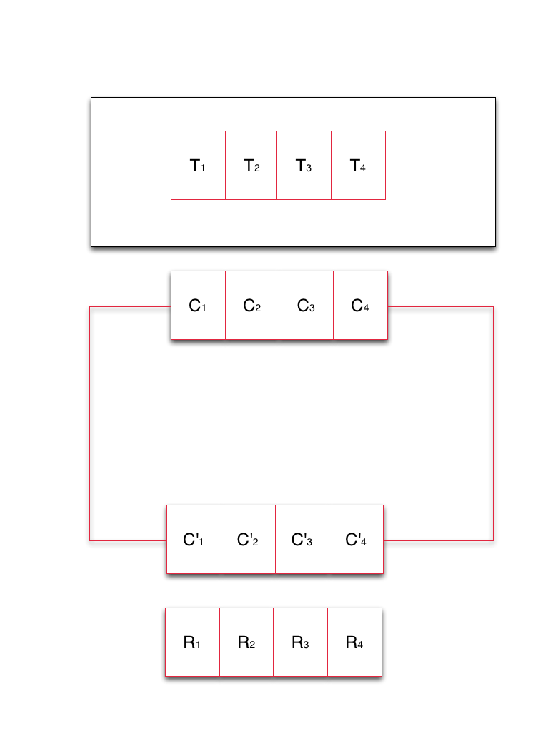
NGMW Schematic
Notes:
Middleware capabilities as an abstraction to resources
Middleware’s responsibility to support the set of capabilities that an application asks for and determine the collection of resources that can/must be used to provide capability

Slide 11
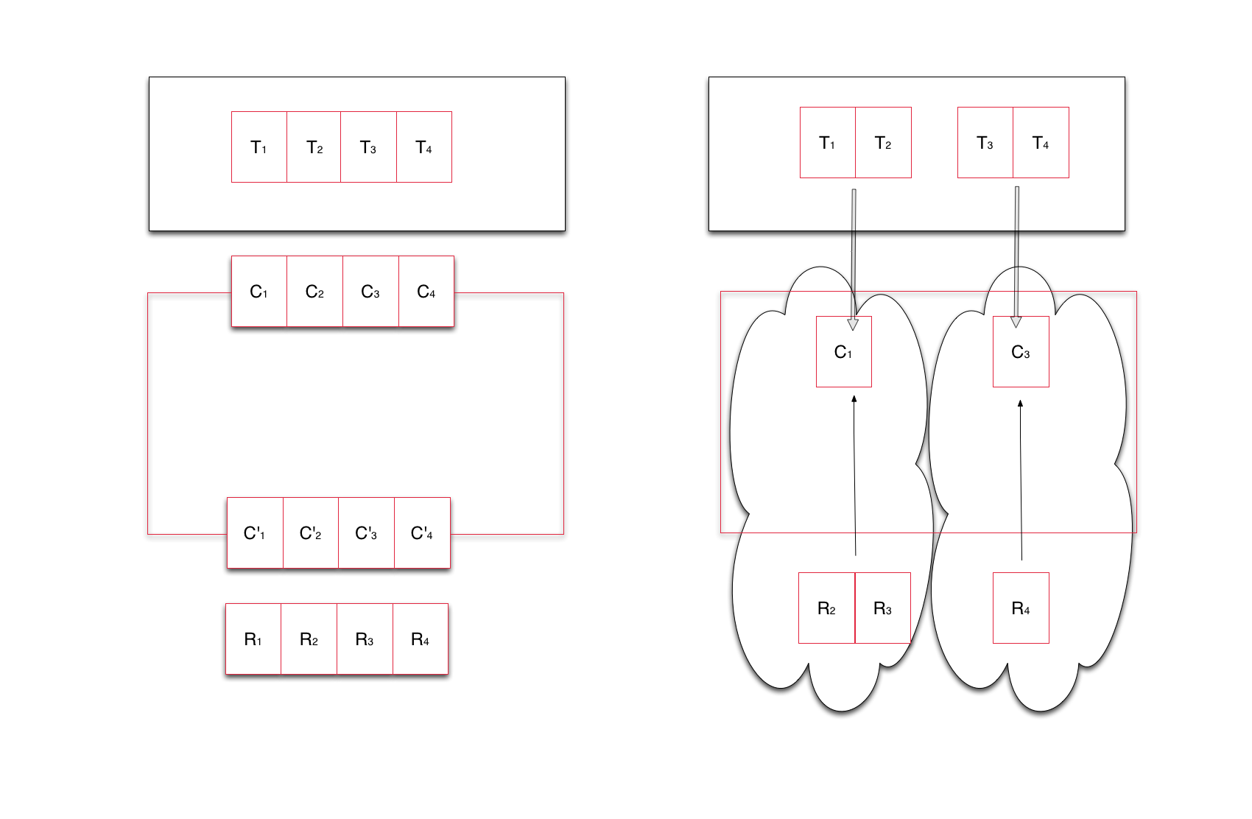
NGMW Schematic
Notes:
Middleware capabilities as an abstraction to resources
Middleware’s responsibility to support the set of capabilities that an application asks for and determine the collection of resources that can/must be used to provide capability

Slide 12
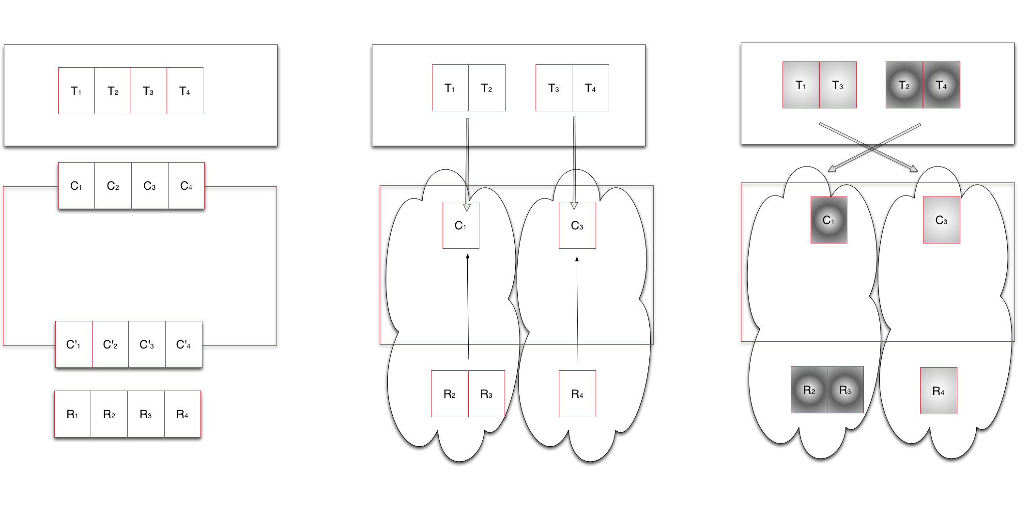
NGMW Schematic
Notes:
Middleware capabilities as an abstraction to resources
Middleware’s responsibility to support the set of capabilities that an application asks for and determine the collection of resources that can/must be used to provide capability

Slide 13
A*/W*
A* models the structure of some distributed application classes
Accompanying communication and coordination properties
Decomposition of application's problem and data space
Implications for application components and their distribution
Supports the derivation of a workload representation
W* analytical model of application workload
Constituents are small units of workload which can have causal and temporal relationships (Concurrent, Sequential, Starts-After, ...)
Constituents can be transformed directly either as system workload
Workloads are considered static; no changes based on (non-predictable) application
representations of W* will be used for simulations (WL description) and experiments (WL implementation)
Dynamic applications result in workloads with a range of properties
Notes:
Decomposition of application's problem and data space

Slide 14
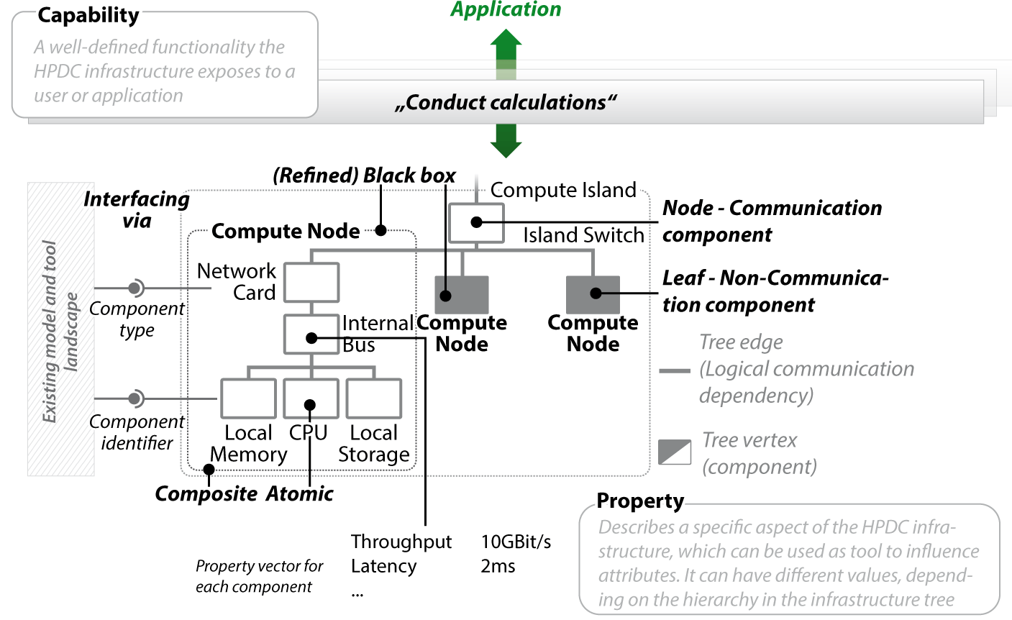
I* - Analytical HPDC Infrastructure Model
Slide courtesy: Straube, Kranzlmuller (LMU, Munich)
Notes:
Fast modeling
Easy data integration
Multiple levels of granularity
Redundancy handling

Slide 15
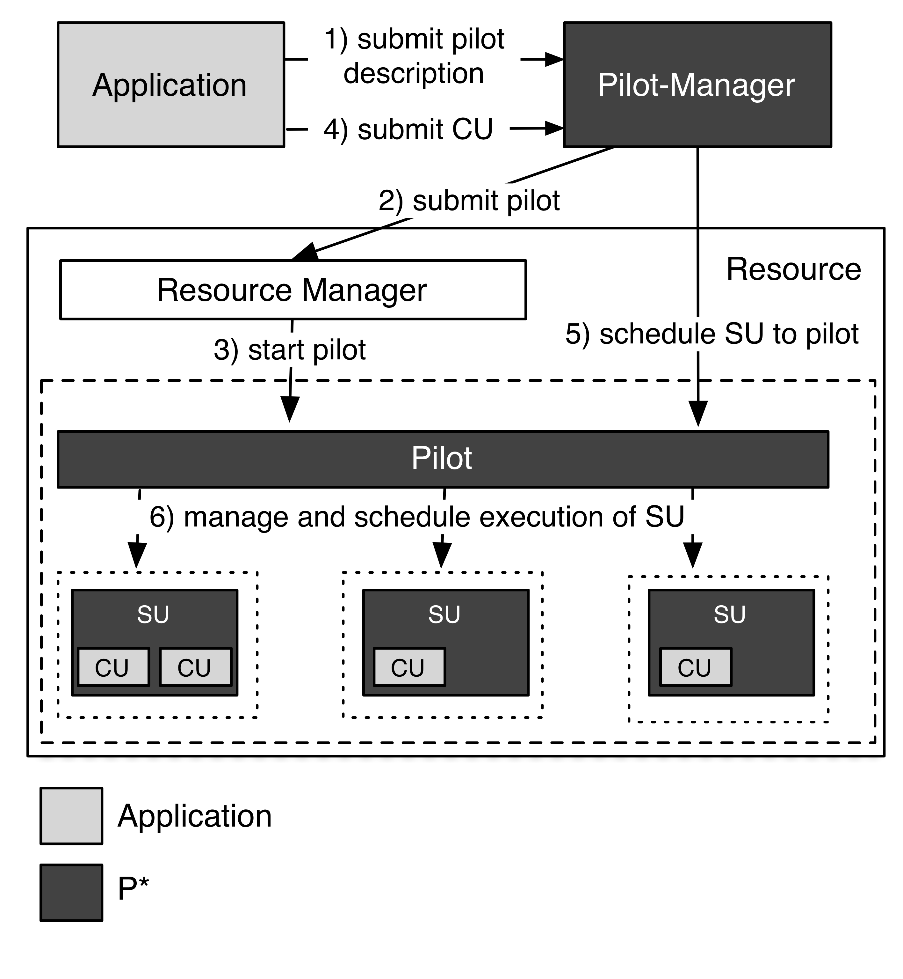
P*: Model for Dynamic Resources
Elements:
Pilot-Compute (PC).
Pilot-Data (PD).
Compute Unit (CU).
Data Unit (DU).
Scheduling Unit (SU).
Pilot-Manager (PM).
Characteristics:
Coordination.
Communication.
Scheduling.
Pilot-API
Will extend to Compute, Data and Network
“P*: A Model of Pilot-Abstractions”, 8th IEEE International Conference on e-Science 2012, 2012

Slide 16
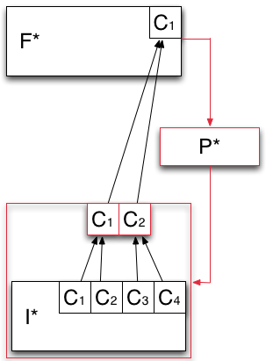
F* - Analytical Model of Resource Federation
Models how the capabilities offered by the infrastructure layer are aggregated and then exposed to the application layer.
Heterogeneous capabilities of I* are aggregated by means of overlays (red box).
P* is used to aggregate the capabilities exposed by I* into logical containers of resources (red box).

Slide 17
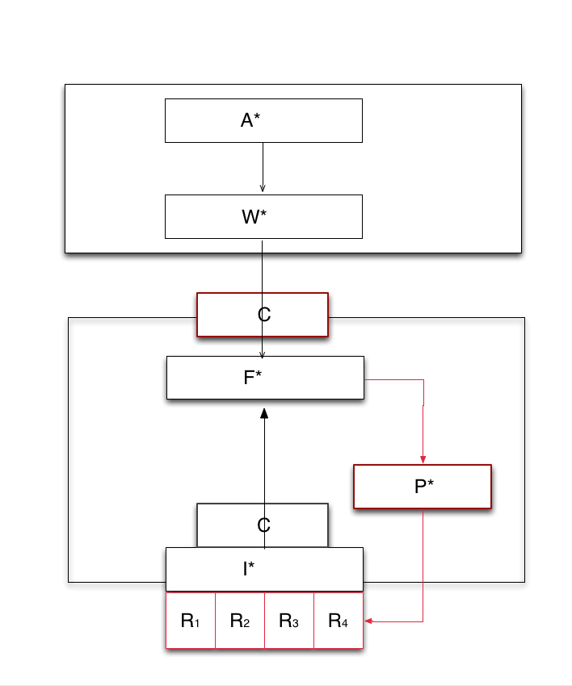
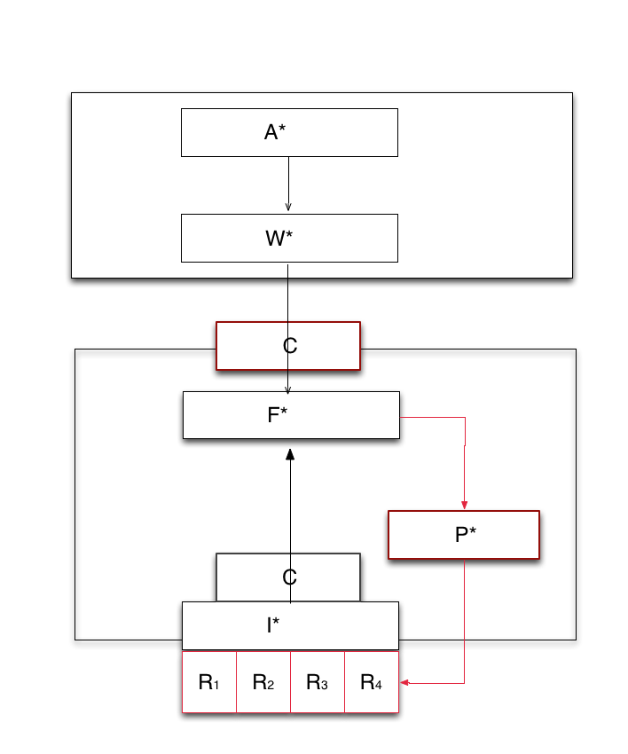
*.* : Putting it together
P*: Decouples dynamic resource management from job and task management
F*: Resource aggregation and provisioning decoupled from job and resource management
Furthers the separation of concerns
C* provides, F* decides, P* executes
Federate at the capability level
P* creates the overlay at the resource level
Notes:
We take the schematic of NGMW and show how the different levels at which the Models work, (ii) how different models interact, especially (a) Andre and Christian’s work/interface, (ii) I* and F*.

Slide 18
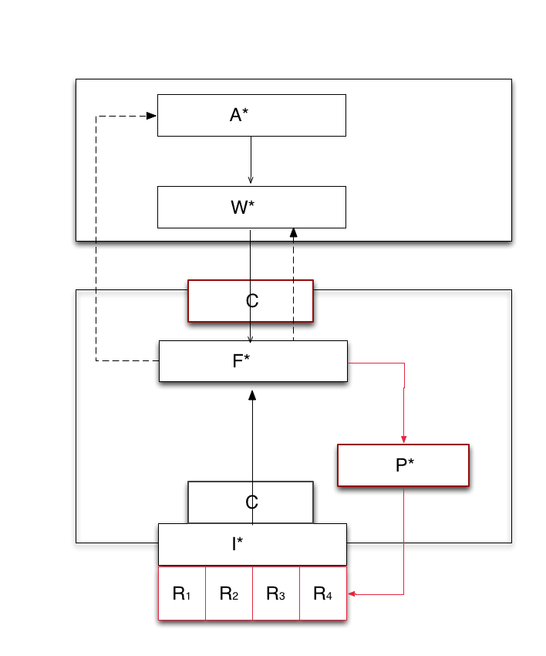
Design Obj: Multi-level and Integrated Reasoning
Transformation of application workload via system workload to infrastructure capability
Application requests R(100, T,10), say 100 tasks, of type T, complete within 10 units of time
Federation Layer/Manager responds with collective capability of C(50, T, 10) or C(100, T, 20)
Adaptive Application
Adaptivity can be either at A, W level
Application may self-throttle number of tasks, or type of task generated
Or workload description can be changed to meet the capability
Notes:
We show how *.* meets the first of the design objectives of NGMW

Slide 19
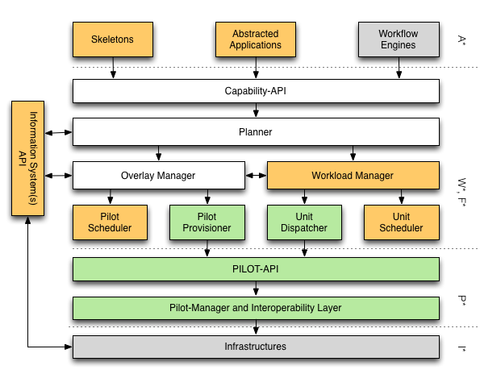
*.* : Putting it together
Notes:
We take the schematic of NGMW and show how the different levels at which the Models work, (ii) how different models interact, especially (a) Andre and Christian’s work/interface, (ii) I* and F*.

Slide 20
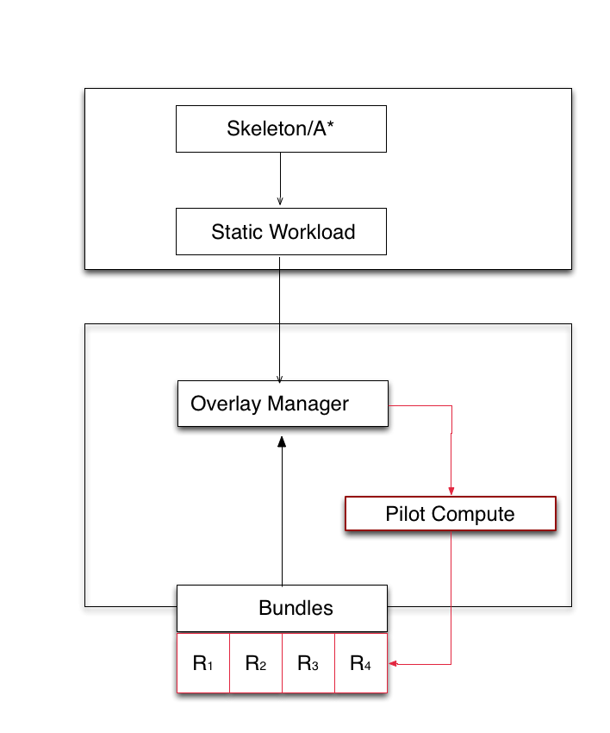
AIMES: Demonstration of Flexible Federation (SC’13)
Application say Bag-of-Tasks
Say BoT(100, H, 10)
Generate similar workload description from different application representations
Bundles currently support federation
Info on resource availability
Eventually resource properties
Ultimately bundles (and I*) should be consistent with C*
Formalize the advantages of dynamic and flexible federation
Performance improvements
Notes:
We take the schematic of NGMW and show how the different levels at which the Models work, (ii) how different models interact, especially (a) Andre and Christian’s work/interface, (ii) I* and F*.

Slide 21
NGMW: Interaction of Models and Simulation
Interaction between Models:
[A*, W* ] and [P*, F*]
Here A* is a conceptual model, and W* is an analytical model
A specific instance of A*, is subject to a transformation W which converts into executable units (per W*) that have performance requirements
Infrastructure modeled as I*, capability is exposed and federated per F*
I* subject to a transformation F (aggregation of resources per F*) to provide a federated capability
Role of Simulation
If we federate a given set of infrastructure {I} what is the performance we expect?
If we want a capability [C], what is the set of infrastructure {I} we need to federate to get this [C] with well-defined probability distribution?
Given an instance of an application (model), what is the workload independent of the underlying resources?

Slide 22
Organizer’s Questions
What is the major contribution of your research?
Model-based, Capability-driven Middleware for DEC
DEC not a fringe effort but show one possible approach to synergize and couple modeling DEC with traditional exascale modeling efforts
What are the gaps you identify in the research coverage in your area?
ModSim is necessary for DEC, but is it sufficient to capture requirements?
Focus on resource federation, relying upon advances in identity management to address policy/AAA issues of dynamic resource
What is the bigger picture for your research area? (i.e., identify synergistic projects, complementary projects in technical sense, etc)
Projects that focus on other aspects of the problem; unclear which parts are going to be most critical, rewarding?
Optimal workload characterization
Optimal mapping (given a workload to resource)
Static versus dynamic mapping
Notes:
“Perfection is achieved, not when there is nothing more to add, but when
there is nothing left to take away”. Have we moved beyond perfection?

Slide 23
Organizer’s Questions
How do you see cross-pollination across projects funded by different funding agencies?
Integrated Modeling and Simulation
Need to use models of infrastructure provided by HPC community
Abstractions that we develop – capability, Pilots for dynamic resources etc. may have a role
What is the one thing that would make it easier/possible to leverage/use the results of other projects to further your own research?
Well defined interfaces and semantics
What would you like to most see solved/addressed other than what they are working on?
Theoretical work on integrating models of varying specificity, granularity and scale

Slide 24
Acknowledgements
Richard Carlson
Douglas Thain (Notre Dame)
Sergey Panitkin (ATLAS/PANDA)
AIMES: Integrated Middleware Framework for Extreme Collaborative Science, Office of Advanced Scientific Computing and Research, Department of Energy ER26115/DE- SC0008591

Slide 25
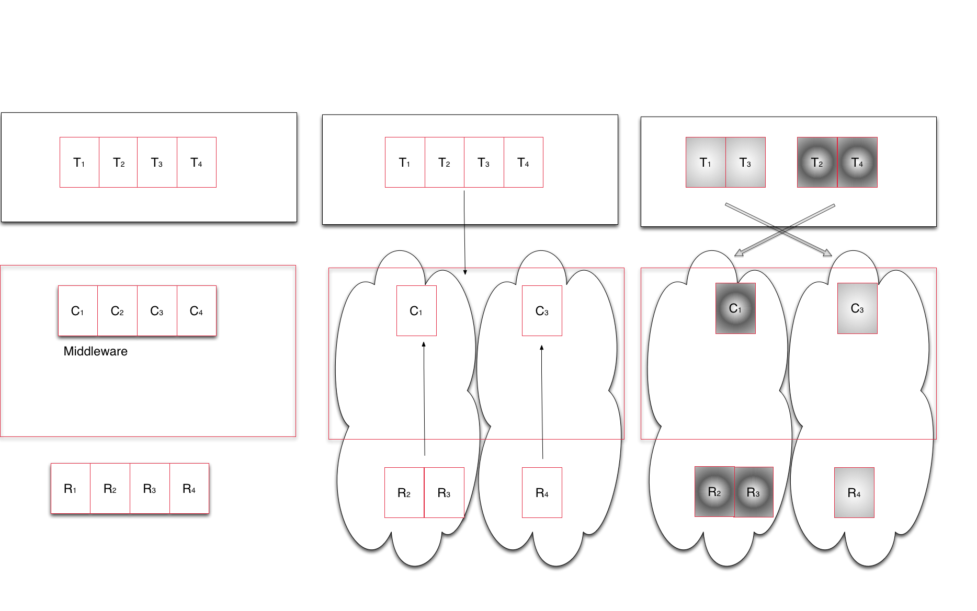
NGMW Schematic
Notes:
Middleware capabilities as an abstraction to resources
Middleware’s responsibility to support the set of capabilities that an application asks for and determine the collection of resources that can/must be used to provide capability

Slide 26
P*
Pilot-Jobs provide an abstraction for dynamic resource management. Currently abstraction is job based, but can be extended to include network and storage as other resource elements
P* is a conceptual model for Pilot-based resource

Slide 27
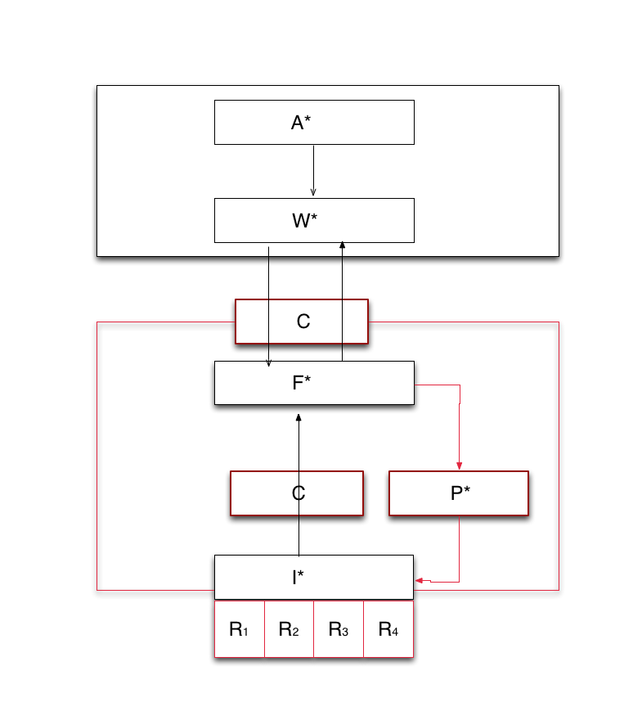
*.* : Putting it together
P*: Decouples dynamic resource management from job and task management
F*: Resource aggregation and provisioning decoupled from job and resource management
Furthers the separation of concerns
C* provides, F* decides, P* executes
Federate at the capability level
P* creates the overlay at the resource level
Notes:
We take the schematic of NGMW and show how the different levels at which the Models work, (ii) how different models interact, especially (a) Andre and Christian’s work/interface, (ii) I* and F*.

Slide 28
Mapping Tasks to Resources
Different aspects of mapping tasks to resources
Optimal Characterization: Finding the optimal workload characterization (of an application)
Generality versus specificity. Class of Applications versus Many application classes/types
Different applications have different metrics
Optimal Federation: Finding the optimal infrastructure configurations for a given workload
Irrespective of whether it is best representation of an application
Resources availability at extreme scale is variable
Optimal Mapping: Workload to Resource Mapping
Static versus Dynamic Mapping

Slide 29
ModSim Challenges
Overarching Consideration: How does modeling DEC couple to and synergize with HPC exascale modeling efforts?
Operational Challenges:
Granularity
Different models of varying specificity
Some are analytical, some are conceptual
Multi-scale
Macroscopic versus microscopic consequences
Many possible parameters, which should be used?
Linking models that reason using different parameters, e.g., energy considerations may not play a role at large-scale distribution
Heterogeneity
Federating heterogeneous distributed infrastructure
Notes:
Data generation doubles every << 12 months, i.e. faster than the doubling rate of data storage (roughly 18 months)

