Slide 1
Next Generation Middleware for Distributed Exascale Computing The Role of Modeling and Simulation
Research in Advanced DIstributed Cyberinfrastructure and Applications Laboratory (RADICAL)
http://radical.rutgers.edu
Talk based primarily upon the effort of the RADICAL group, but different parts have benefitted from collaborations with the AIMES Project Partners (Katz, Weissman) and LMU-Munich (Straube, Kranzmuller)

Slide 2
Outline
Introducing Distributed Exascale Computing (DEC)
Why DEC?
Distributed Computing 2013
Foundational requirements for DEC
Next Generation Middleware (NGMW) to address DEC requirements
Functional Aims, Design Objectives
Proposed architecture for a capability-based NGMW
Models at multiple levels and their integration: Applications (A*, W*), Dynamic Resources (P*), Infrastructure (I*), Federation (F*)
Putting it all together: Conceptual and Implementation
Modeling and Simulation in NGMW
Active role for simulation and not just offline/passive simulation
ModSim Challenges
Notes:
Will try to end in a non-traditional way, by using the Organizers Qs as a way to summarize the talk
Proposed Architecture is not to burden you with a solution, but to show you possible “shape of a solution”. Careful design and digging in is still required.
DEC reaffirms many of the traditional EC ModSim challenges, even if the scale, granularity and specific model roles are different!!!!

Slide 3
Why Distributed Exascale Computing?
Support new science and new usage modes
Different modes of exascale computing
“Ensemble based” versus “single hero based”
Coupling exaflops of computing with exabytes of data
Existing and future DoE Applications and facilities
Complex, multi-component, distributed data and workflow based
Efficient and effective utilization of collective set of resources
Offload workloads from leadership to less powerful machines
Onload workloads from distributed systems onto leadership
Strategically and synergistically, not competitively
Support the “long tail of science” and existing application requirements
Scale as many scalable concurrent applications
Notes:
Onload: time-critical, critical components which can’t be fully estimated…

Slide 4
Extreme Scale Distributed Computing in 2013
First generation of DC characterized by “gluing it” together
Many local solutions, lack of end-to-end solutions
Inability to reason about spatio-temporal execution properties
Given a general workload there is an inability to estimate how long a workload will take? And where (and why) it will execute?
Complete absence of analytical models of applications, infrastructure
And we do not know how wrong our estimates would be!
We are still learning how to architect large-scale systems
Scaling remains difficult for individual scientists
< 1% can do O(100) tasks of O(10GB) over O(10) nodes
Macroscopic vs microscopic theory of distributed systems!
Missing principles and practice of “systems in the large”

Slide 5
DEC Foundational Requirements
Support novel and broad range of application requirements
Large-scale simulations integrated with distributed big-data analysis (ATLAS, HEP)
Real-time computing coupled with distributed data from scientific experiments (LSST, SKA)
Federate diversified set of resources
Manage complexity, heterogeneity and dynamism of infrastructure
Resultant “balanced” infrastructure that supports scaling along several dimensions (scaling up, out, across..)
Support for adaptive applications and dynamic resources
Move away from static execution to co-execution
Starting point for flexible execution involving multi-level and integrated information
Notes:
Bear with me if this seems incremental progress or repetitive, but I think its important to ensure that we’re on the same page --- about the granularity and the challenges

Slide 6
DEC in Relation to “Traditional” EC
There are many application types as opposed to a set of kernels that need to optimized
Metrics of performance varied, i.e. not just peak performance
Builds upon energy, resilience and performance
Application structure simple, but infrastructural requirements difficult
Task-level composition and coordination is important and varied
External data infrastructure, repositories
Design to support exascale collectively for many scalable applications on “production” infrastructure
Community (HEP) applications, essentially similar
Explains why DC software environment is complex, points to an important role for middleware
Middleware: Platform to build common and integrated services, whilst hiding heterogeneous software & system access layers

Slide 7
NGMW Functional Aims and Requirements
Functional Aims
Support spatio-temporal execution reasoning
What to distribute? Where/how to distribute? When to distribute?
Estimate time to completion?
Beyond glue: Need to integrate information about applications and heterogeneous resources (compute, data and networks)
Estimate performance
Functional Requirement
Support adaptive applications in conjunction with dynamic resources
Federate heterogeneous infrastructure to provide well-defined capabilities
Notes:
Integration of Information: Applications/Services/Tools about resources – Critical role for middleware

Slide 8
NGMW Design Objectives
Does not just “glue” different layers together but:
Supports multi-level reasoning and predictable performance
Reasoning about performance
Exposes well-defined capabilities rather than technology
Capability: Well-defined and aggregated functionality, without regard to how, or the specific approach used
E.g., Num. of tasks, throughput, probabilistic bounds on time-to-completion, performance of resources, data (volumes/transfer/storage ability)
How to provide well-defined capabilities?
Single model of capability that integrates across multiple-levels and across flexible federation of resources
What are the functional property units for resources, and how to compose functionality across infrastructure?
Notes:
Can design for randomness but not for unpredictable behaviour

Slide 9
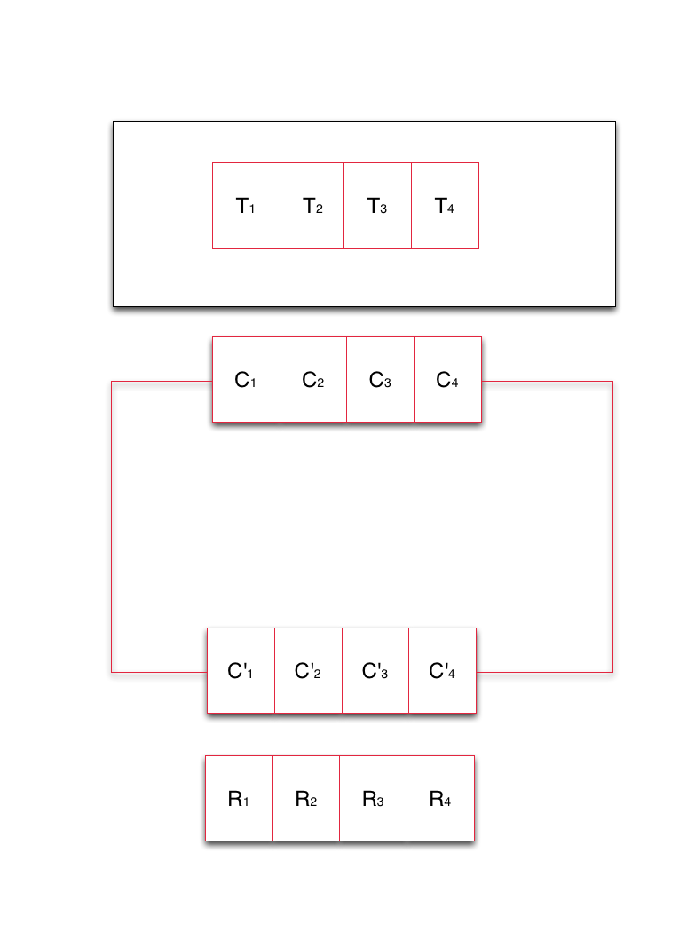
NGMW Schematic
Notes:
Middleware capabilities as an abstraction to resources
Middleware’s responsibility to support the set of capabilities that an application asks for and determine the collection of resources that can/must be used to provide capability

Slide 10
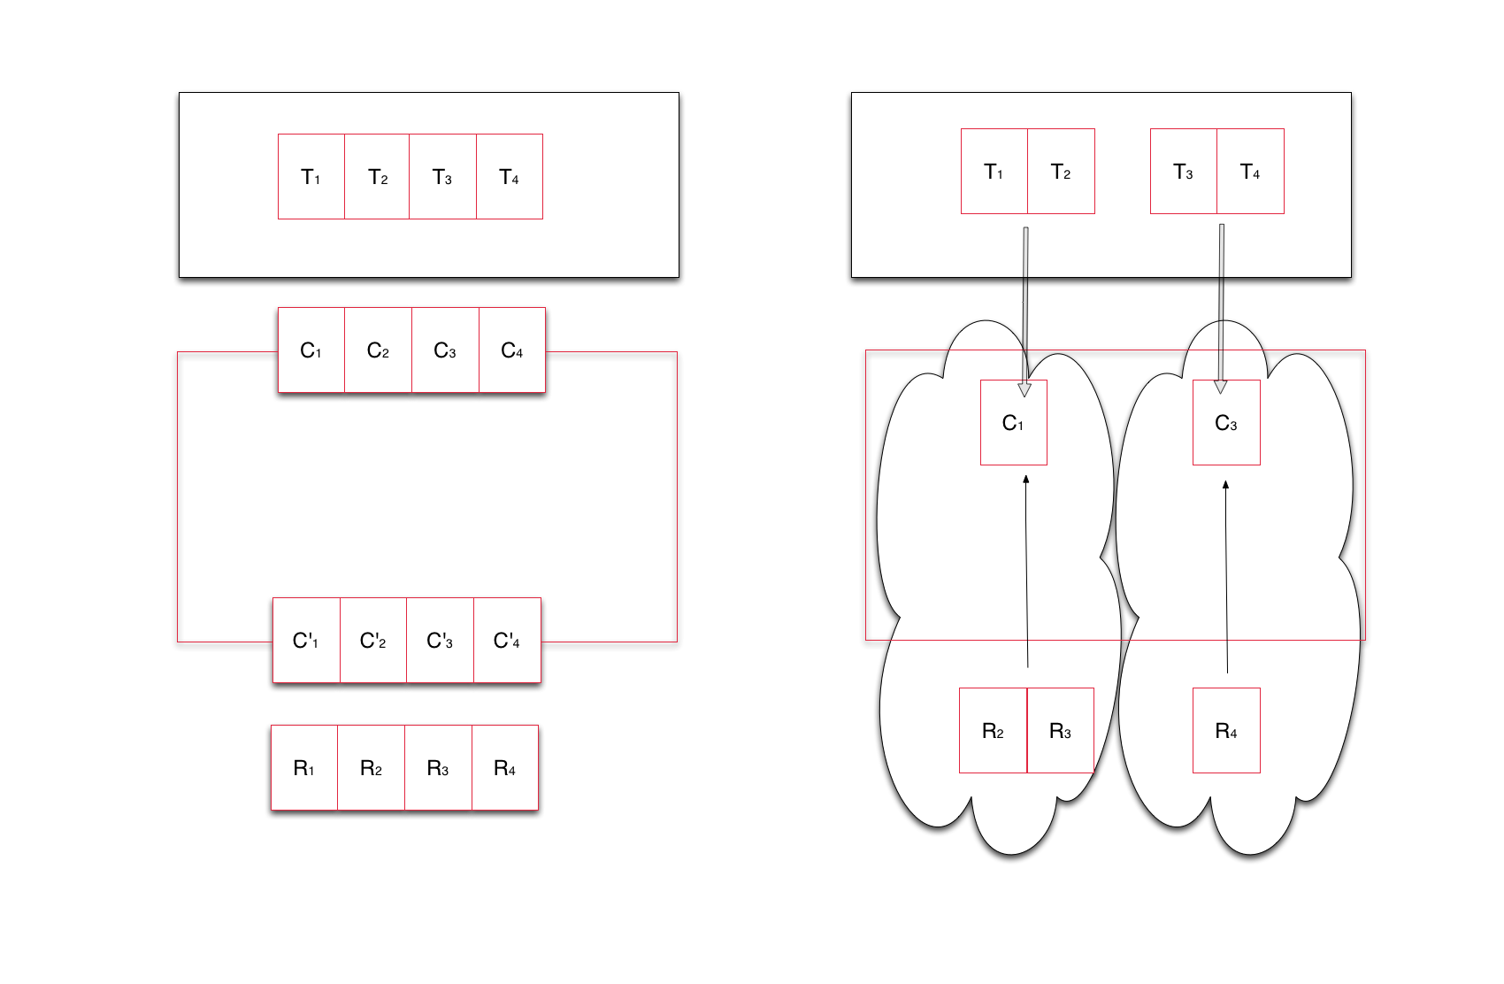
NGMW Schematic
Notes:
Middleware capabilities as an abstraction to resources
Middleware’s responsibility to support the set of capabilities that an application asks for and determine the collection of resources that can/must be used to provide capability

Slide 11
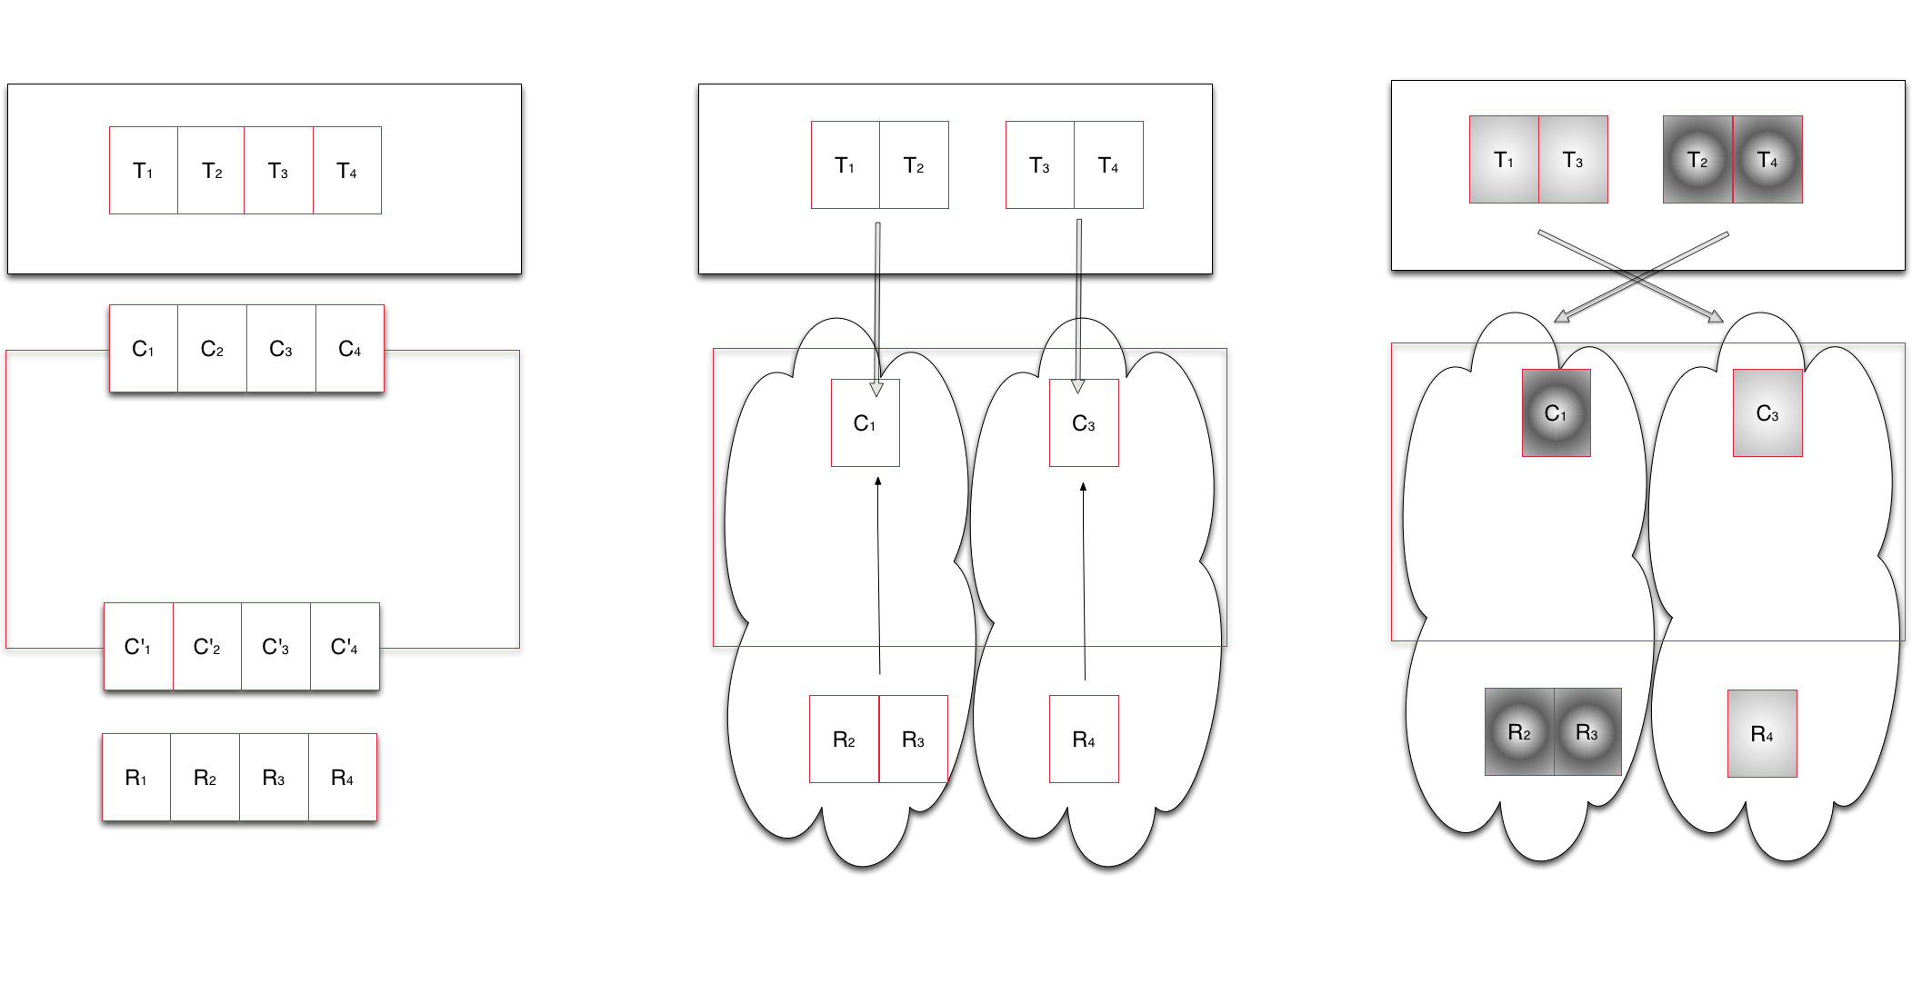
NGMW Schematic
Notes:
Middleware capabilities as an abstraction to resources
Middleware’s responsibility to support the set of capabilities that an application asks for and determine the collection of resources that can/must be used to provide capability

Slide 12
A*/W*
Analysis suggests that there are many application types
Multiple application models (Skeleton, A* = [A1, A2, A3,..])
Two-tier (A*/W*) approach supports specificity yet supports commonality
A*: Conceptual models of distributed application classes
Accompanying communication and coordination properties
Implications for application components and their distribution
A* supports the derivation of a workload representation
W* analytical model of application workload
Constituents are units of application workload which can have causal and temporal relationships (Concurrent, Sequential, Starts-After, ...)
Constituents can be transformed directly into system workload
Multiple application models can use W*
Workloads are considered static
Adaptive applications result in different workloads units
Notes:
Mostly Applications that are composed of multiple tasks – different degrees of coupling… homogenous or heterogeneous tasks
Essential Vectors of an Application: Communication, Coordination, Execution Units, Environment
Modeling Goal: Task level composition, Concurrency, Support Integrated Modeling

Slide 13
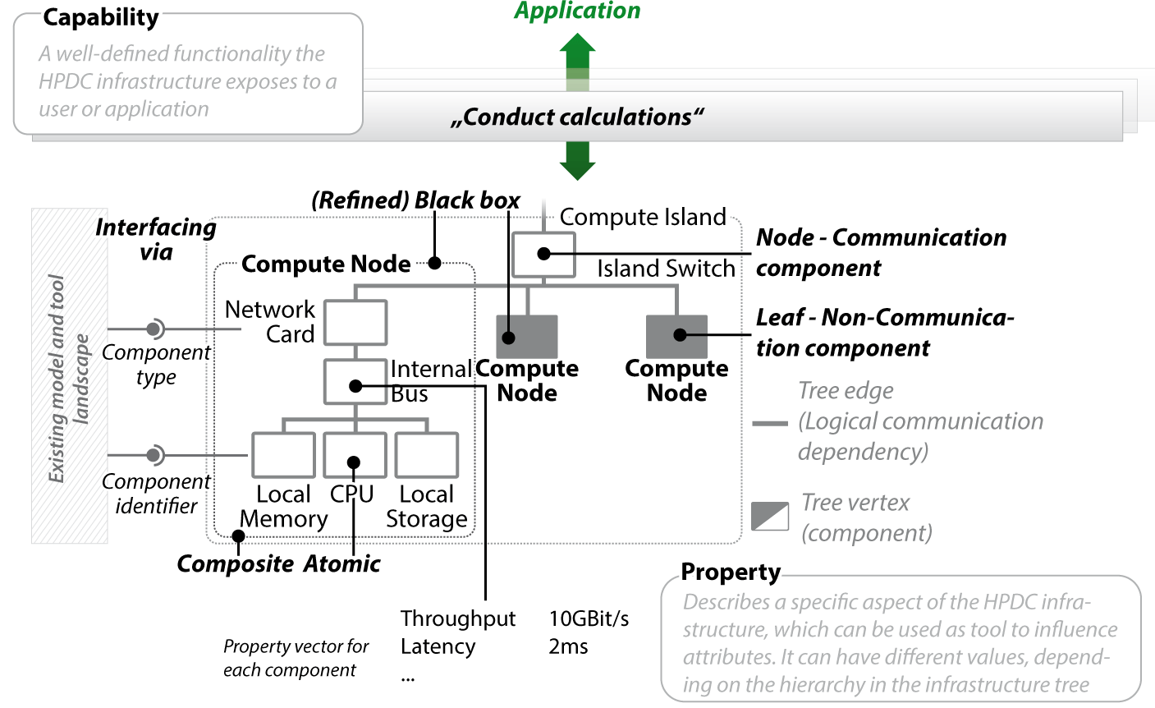
I* - An Analytical Infrastructure Model
Slide courtesy: Straube, Kranzlmuller (LMU, Munich)
Notes:
Fast modeling
Easy data integration
Multiple levels of granularity
Redundancy handling

Slide 14
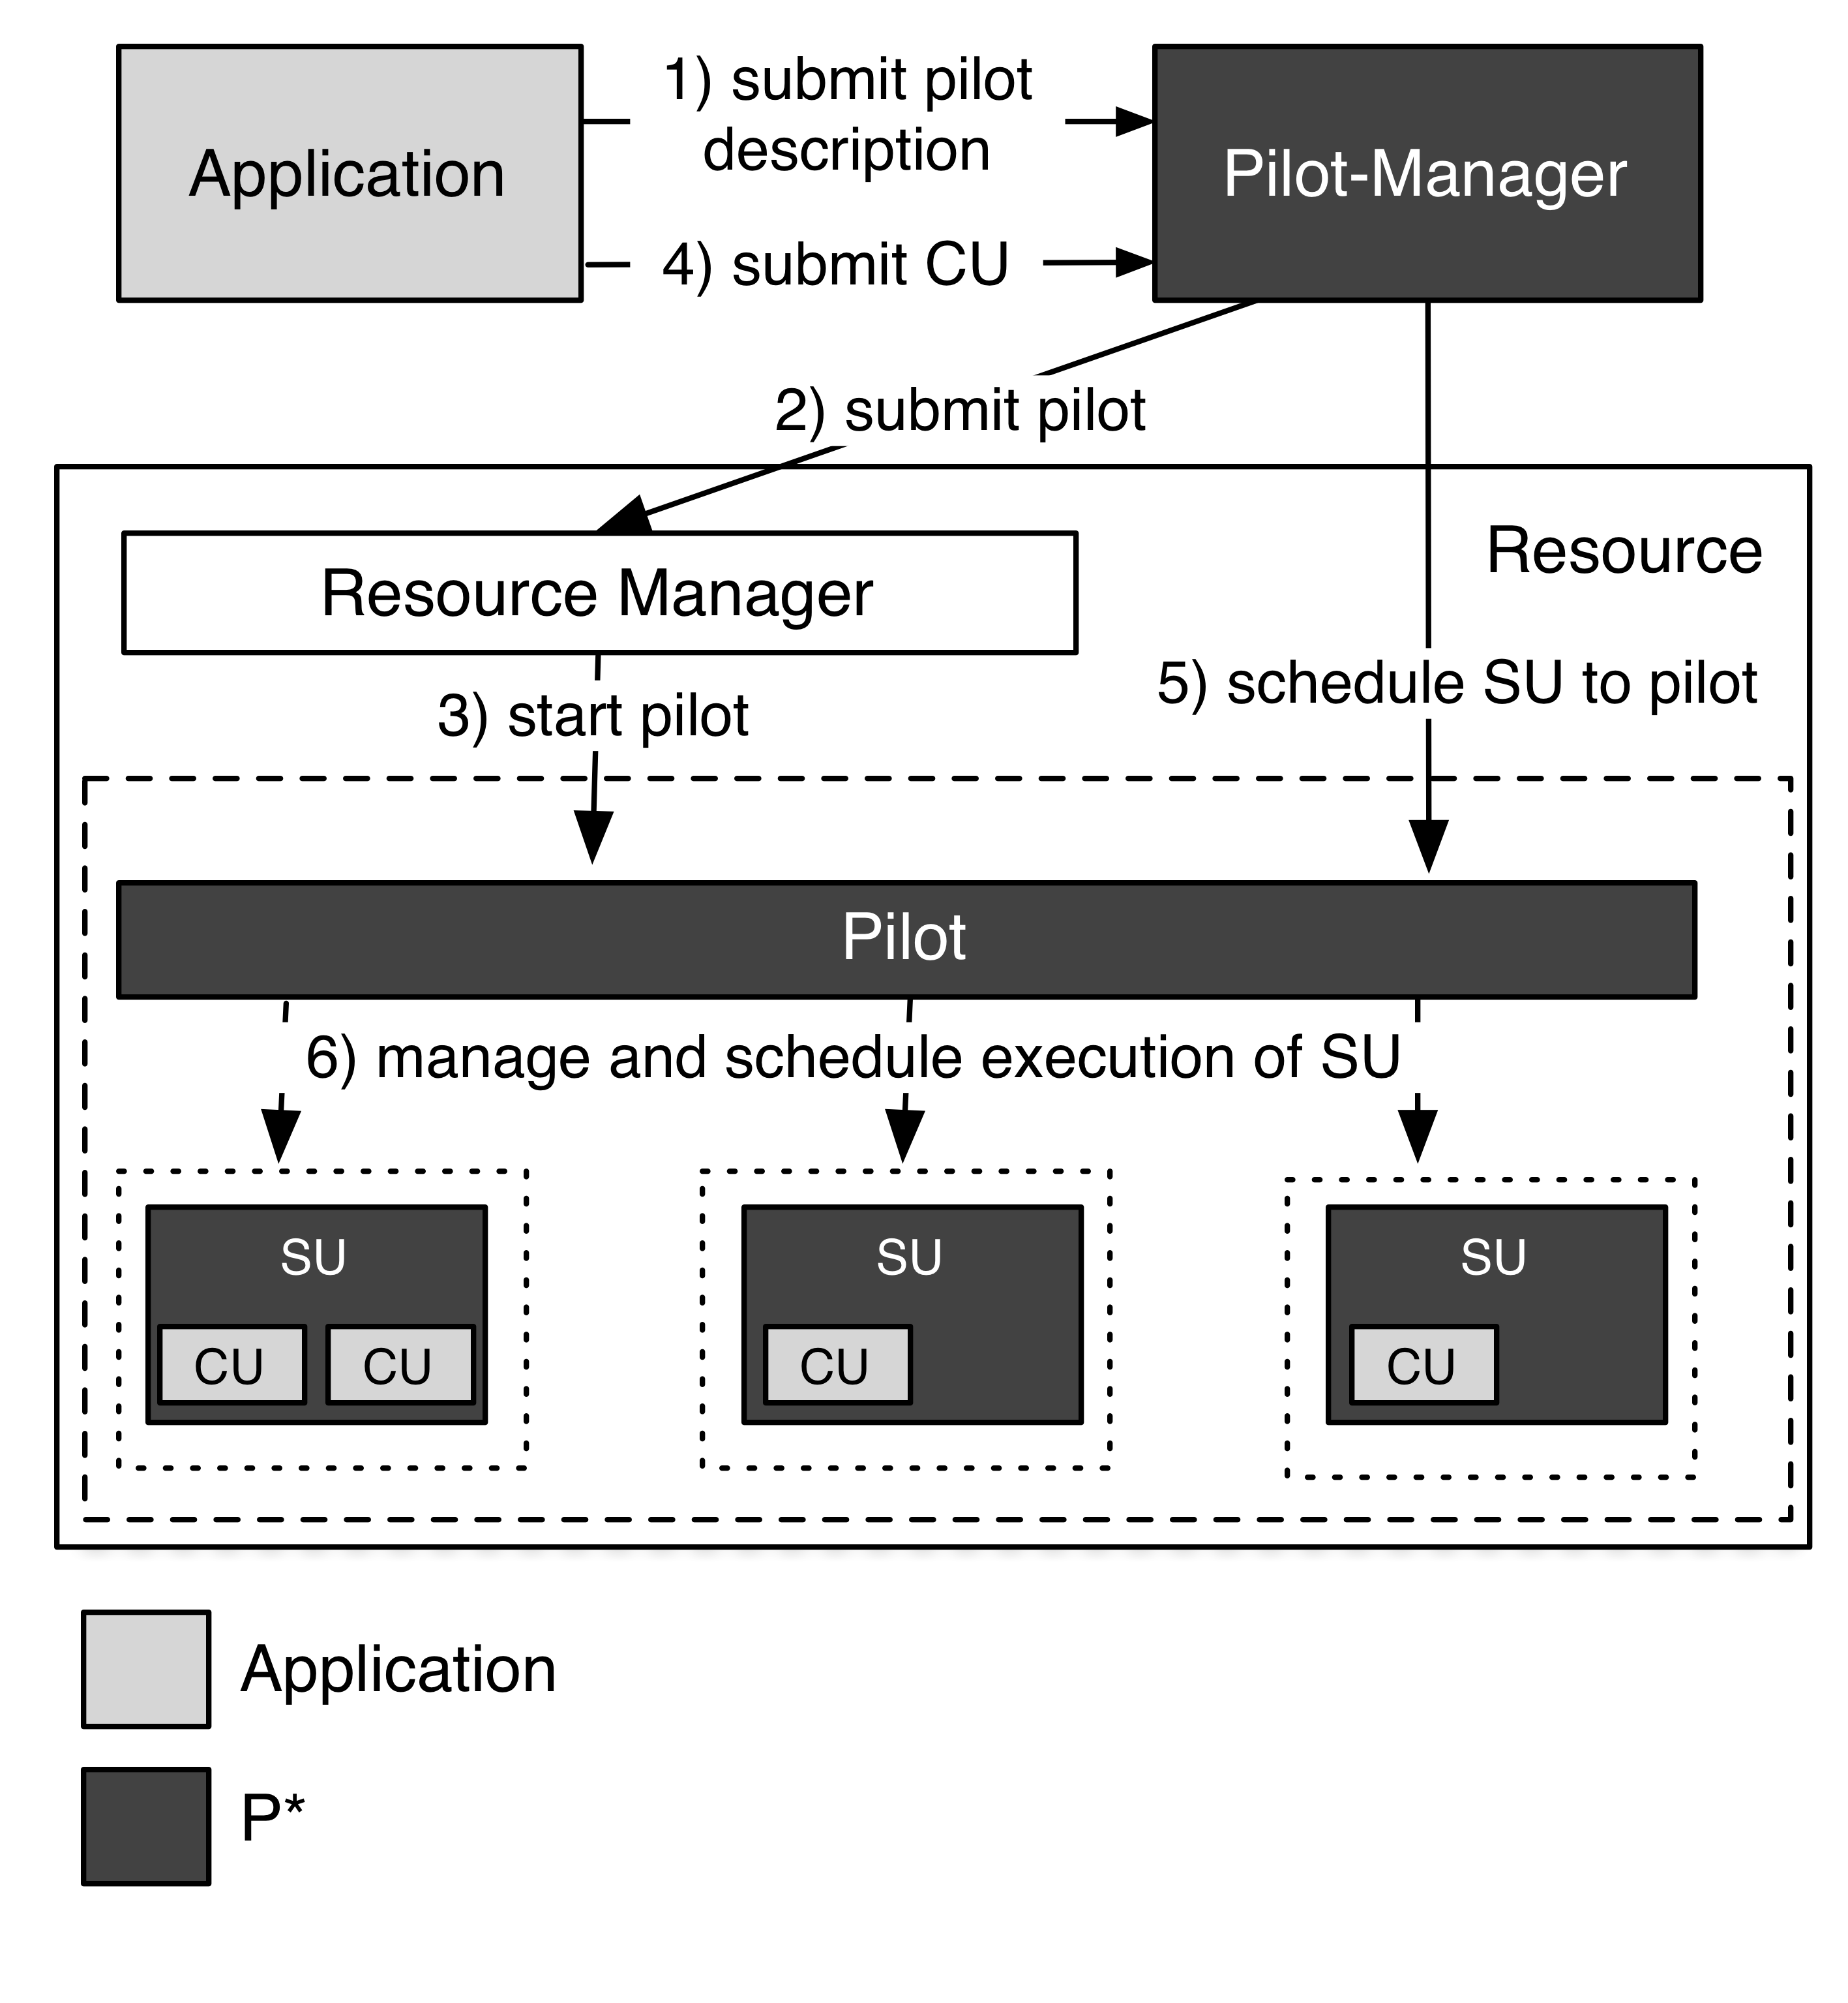
P*: Model for Dynamic Resources
Elements:
Pilot-Compute (PC).
Pilot-Data (PD).
Compute Unit (CU).
Data Unit (DU).
Scheduling Unit (SU).
Pilot-Manager (PM).
Characteristics:
Coordination.
Communication.
Scheduling.
Pilot-API
Effort underway to include other resource elements: Data, Network
“P*: A Model of Pilot-Abstractions”, 8th IEEE International Conference on e-Science 2012, 2012

Slide 15
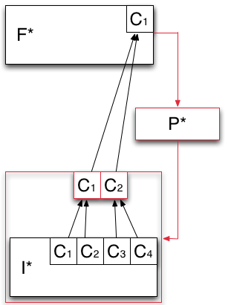
F* - Analytical Model of Resource Federation
Models how the capabilities offered by the infrastructure layer are aggregated and then exposed to the application layer.
Heterogeneous capabilities of I* are aggregated by means of overlays (red box).
P* is used to aggregate the capabilities exposed by I* into logical containers of resources (red box).

Slide 16
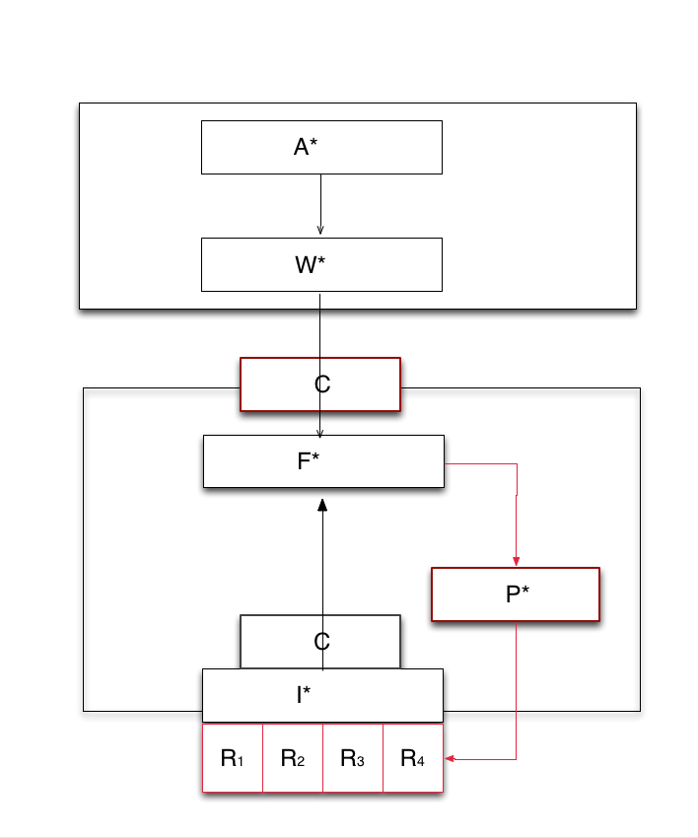
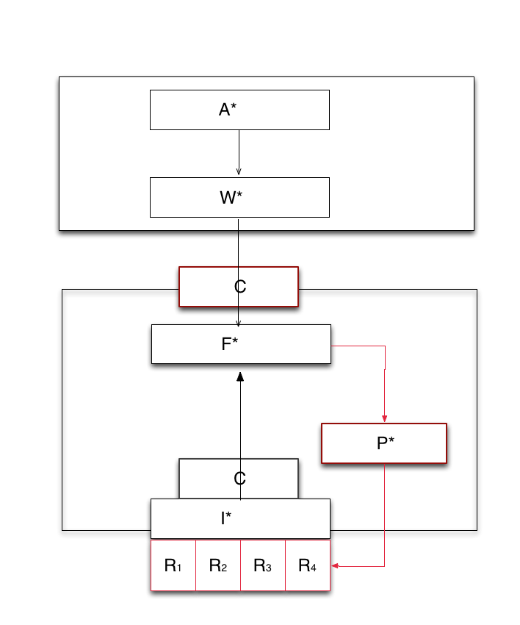
*.* : Putting it together
P*: Decouples dynamic resource management from job and task management
F*: Resource aggregation and provisioning decoupled from job and resource management
Furthers separation of concerns
C* provides, F* decides, P* executes
Federate at capability level
P* creates overlay at the resource level
Notes:
We take the schematic of NGMW and show how the different levels at which the Models work, (ii) how different models interact, especially (a) Andre and Christian’s work/interface, (ii) I* and F*.

Slide 17
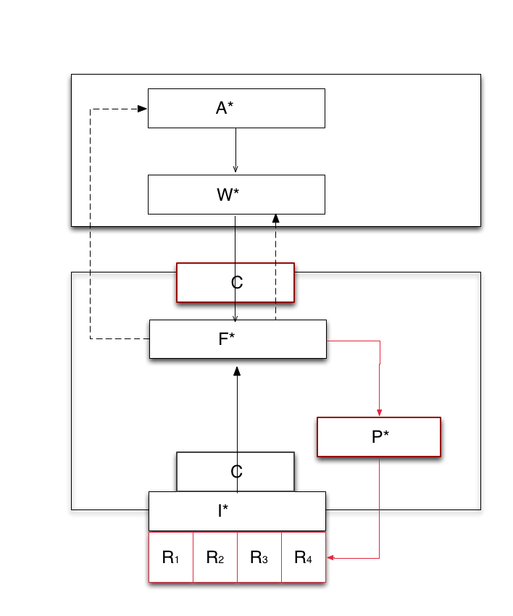
Design Objective: Multi-level Integrated Reasoning
Transformation of application workload via system workload to infrastructure capability
Application requests R(100, T,10), say 100 tasks, of type T, complete within 10 units of time
Federation Layer/Manager responds with collective capability of C(50, T, 10) or C(100, T, 20)
Adaptive Application
Adaptivity can be either at A, W level
Application may self-throttle number of tasks, or type of task generated
Or workload description can be changed to meet the capability
Notes:
We show how *.* meets the first of the design objectives of NGMW at a CONCEPTUAL LEVEL!!

Slide 18
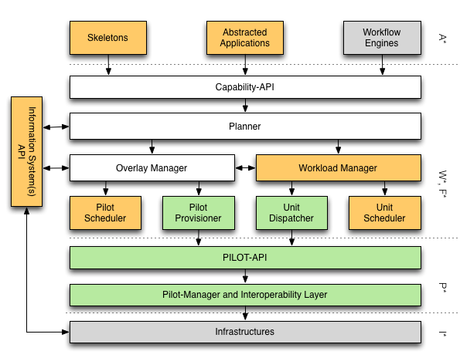
*.* : Putting it together
Notes:
We take the schematic of NGMW and show how the different levels at which the Models work, (ii) how different models interact, especially (a) Andre and Christian’s work/interface, (ii) I* and F*.

Slide 19
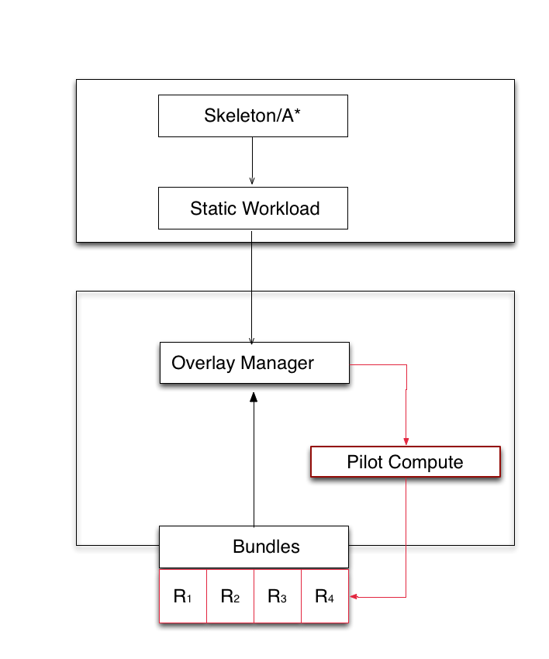
AIMES: Demonstration of Flexible Federation (SC’13)
Application say Bag-of-Tasks
Say BoT(100, H, 10)
Generate similar workload description from different application representations
Bundles currently support federation
Info on resource availability
Eventually resource properties
Ultimately bundles (and I*) should be consistent with C*
Formalize the advantages of dynamic and flexible federation
Performance improvements
Notes:
We take the schematic of NGMW and show how the different levels at which the Models work, (ii) how different models interact, especially (a) Andre and Christian’s work/interface, (ii) I* and F*.

Slide 20
NGMW: Interaction of Models and Simulation
Interaction between Models:
[A*, W* ] and [P*, I*, F*]
A* is a conceptual model; W* is an analytical model
A specific instance of A*, is subject to a transformation W which converts into units (per W*) that have performance requirements
Infrastructure modeled as I*, capability is exposed and federated per F*
I* subject to a transformation F (aggregation of resources per F*) to provide a federated collective capability
P* aggregates resource overlays along C, D and N
Role of Simulation
If we federate a given set of infrastructure {I} what is the performance we expect?
If we want a capability [C], what is the set of infrastructure {I} we need to federate to get this [C] with well-defined probability distribution?

Slide 21
Organizer’s Questions
What is the major contribution of your research?
Capability-based Middleware for DEC
DEC not a fringe effort but show one possible approach to synergize and couple modeling DEC with traditional exascale modeling efforts
What are the gaps you identify in the research coverage in your area?
ModSim is necessary for DEC, but is it sufficient to capture requirements?
Focus on resource federation, relying upon advances in identity management to address policy/AAA issues of dynamic resource
What is the bigger picture for your research area? (i.e., identify synergistic projects, complementary projects in technical sense, etc)
Projects that focus on other aspects of the problem; unclear which parts are going to be most critical, rewarding?
Optimal workload characterization
Optimal mapping (given a workload to resource)
Static versus dynamic mapping
Notes:
“Perfection is achieved, not when there is nothing more to add, but when
there is nothing left to take away”. Have we moved beyond perfection?

Slide 22
Organizer’s Questions
How do you see cross-pollination across projects funded by different funding agencies?
Integrating multi-scale Models
Need to use models of infrastructure provided by HPC community
Abstractions that we develop – capability, Pilots for dynamic resources etc. may have a role
What is the one thing that would make it easier/possible to leverage/use the results of other projects to further your own research?
Well-defined interfaces and semantics, i.e. Model interoperability
What would you like to most see solved/addressed other than what they are working on?
Theoretical work on integrating models of varying specificity, granularity and scale

Slide 23
Acknowledgements
Richard Carlson
Douglas Thain (Notre Dame)
Sergey Panitkin (ATLAS/PANDA)
AIMES: Integrated Middleware Framework for Extreme Collaborative Science, Office of Advanced Scientific Computing and Research, Department of Energy ER26115/DE- SC0008591
NSF CAREER Award, Division of Advanced Cyberinfrastructure (ACI), OCI-1253644

