Slide 1
Next Generation Middleware for Distributed Exascale Computing Infrastructure The Role of Modeling and Simulation
Research in Advanced DIstributed Cyberinfrastructure and Applications Laboratory (RADICAL)
http://radical.rutgers.edu

Slide 2
Outline
Why Distributed Exascale Computing (DEC)?
Explain it is complementary to traditional EC
The case for NGMW: Why current approaches to DEC wont work!?
Design considerations for NGMW
Capability Based
Abstracted data logic (representation, distribution, scheduling, placement) that captures application-semantics yet is not application-specific
Integrated for Adaptive Applications and Dynamic Resource Management
Schematic/Outline for NGMW
Adaptive Application: A*, W*
Dynamic Resources/Infrastructure: P*, I*
Federation of Infrastructure F*
Research Agenda
Challenges in ModSim
Other Challenges in NGMW

Slide 3
Distributed Computing in 2013
Distributed Computing Infrastructure (DCI)
First Generation of DC characterized by “glueing it” together
Many local solutions, lack of end-to-solutions
Scaling remains difficult for individual scientists
O(10⁻²) can do O(100) tasks each of O(10GB) over O(10) nodes
We are still learning how to architect large-scale systems
Macroscopic vs microscopic theory of distributed systems!
Notes:
Any intellectual honest assessment of 2025 must begin by an attempt to understand 2013 and how we got here
Something about the current status of DC-2013
Few (with hand holding), community applications on infrastructure

Slide 4
Distributed Computing in 2013
The space of possible DCA is large (and rich), but developing DCA remains a hard undertaking
More than just submitting jobs; coordination of different components
Inconsistent and incomplete tools for deployment and execution
Distributed Computing Applications (DCA)
Many new types of applications have emerged
More than first-generation, i.e., distributed HPC and BoT HTC
DCI software environment is complex and fragile
Middleware functionality and semantics
Heterogeneous software and system access layers
Difficult to integrate services and extend tools
Distributed Computing practice for Large-scale Science doi 10.1002/cpe.2897
Notes:
Effective engineering is coda for managing complexity – intrinsic and extrinsic of DCI and DCA
Something about the current status of DC-2013

Slide 5
Why Distributed Exascale Computing?

Slide 6
“Many Simulations” Pathway to Exascale
Different aspects of mapping tasks to resources
I. Optimal Characterization: Finding the optimal workload characterisation (of an application)
Generality versus specificity. Class of Applications versus Many application classes/types
Different applications have different metrics
II. Optimal Federation: Finding the optimal resource configurations for a given workload
Irrespective of whether it is best representation of an application
Resources availability at extreme scale is variable
III. Optimal Mapping: Workload to Resource Mapping
Static versus Dynamic Mapping
If traditional HPC where workloads are characterized by finite set of kernels then static is acceptable; where workload is dynamic and capture many different applications then

Slide 7
Extreme Scale DC: ATLAS/HEP
Observation:
“.. Distributed computing will persist ” for integrated HPC + HTC
Richard Mount (SLAC), c.f. http://goo.gl/pJzIjH
Requirement:
ATLAS in >2018 needs:
Non-monolithic extreme-scale and integrated HPC + HTC
Challenges:
Mostly economic, but also how to manage workload decomposition
Development and deployment of future supercomputing applications
Role for flexible execution strategies
Question:
“.. Are systems of the complexity of ATLAS Distributed Computing sustainable long-term?”

Slide 8
DEC vs Traditional EC
Application structure simple, infrastructural requirements difficult
Explains why DCI software environment is complex and fragile
Middleware functionality and semantics
Heterogeneous software and system access layers
Difficult to integrate services and extend tools
Therefore a distinct role for middleware

Slide 9
DC-2025: Foundational Requirements
Support a broad range of DCA requirements
e.g. Large-scale simulations, big-data repositories, real-time computing, scientific experiments at global scale
Novel application classes: Adaptive Applications
Balanced DCI and support for scaling along all dimensions
Scaling-up, Scaling-out, Scaling-across
Separate capability from technology used to provide functionality
Capability: Well-defined and aggregated functionality, without regard to how, or the specific technology/approached used
e.g., Num. of tasks, throughput, probabilistic bounds on time-to-completion, performance of resources, data (volumes/transfer/storage ability)

Slide 10
DC-2025: Foundational Challenges
Distributed Computing Infrastructure:
Federate diversified set of resources at multiple levels
E.g. how/when to federate leadership machines with other less powerful machines?
Providing capabilities
What functional units, and how to compose functionality?
Designing a federated system that scales along 1 dimension is relatively easy compared to scaling along >1 dimensions
Distributed Computing Applications:
When and how to distribute? What and where to distribute?
Manage transition from static to adaptive applications
Notes:
Data generation doubles every << 12 months, i.e. faster than the doubling rate of data storage (roughly 18 months)

Slide 11
DEC Foundational Challenges
Implementation Challenge
Manage complexity and heterogeneity of infrastructure
Providing capabilities
What functional units, and how to compose functionality?
Federate diversified set of resources at multiple levels
Designing a federated system that scales along 1 dimension is relatively easy compared to scaling along >1 dimensions
How/when to federate leadership machines with other less powerful machines?
Distributed Computing Applications:
When and how to distribute? What and where to distribute?
Manage transition from static to adaptive applications
Notes:
Data generation doubles every << 12 months, i.e. faster than the doubling rate of data storage (roughly 18 months)

Slide 12
NGMW
• Need to federate systems to provide well-defined capabilities from heterogeneous dynamic components with varying levels of control
• How to provide well-defined capabilities?
Well-defined capability amidst heterogeneous, dynamic resources requires flexible federation of resources and services
Reasoning about performance
Can design for randomness but not for unpredictable behaviour
Combination of reasoning (across possible configurations) and flexible federation points to a role for next-generation middleware
• How will applications utilize systems?
For given capability appropriate execution strategy is determined
Interoperability: DCI level? DCA level Interoperability?
Notes:
factor in uniformity in resources

Slide 13
NGMW
Design Objective and Role of Next Generation Middleware
Provide well-defined capabilities
Next Generation Middleware will be defined to be that which we can add to existing middleware layer(s) to provide systems based upon well-defined capability rather than a technology, or a specific execution strategy (say HTC or HPC), or a specific usage mode!
Federation via middleware:
Test Case: How would we federate XSEDE and OSG?
New complementary and non-destructive models of federation required
Adaptive execution strategy and flexible federation
Can’t remove complexity, can only manage it, belief that it is best done with such middleware that supports interoperablity

Slide 14
NGMW…. (3)
What is the primary issue(s) of current DCI?
How to deliver “well-defined” capabilities that go beyond underlying technologies, tools or infrastructure to implement/provide them?
Fundamental conceptual gap in providing well-defined capabilities
Lack of reasoning and ability to estimate/calibrate performance
Two levels of conceptual abstractions to enable reasoning:
Models that enable functional comparison for individual components, e.g., P* for Pilot-systems 10.1109/eScience.2012.6404423
Models that enable reasoning at multiple, integrated levels to provide performance estimation and predictability
When and how to distribute? What and where?
A Linpack for distributed systems/applications?
Notes:
Capabilitiy: Well-defined and aggregated functionality, without regard to how, or the specific technology/approached used
e.g., Num. of tasks, throughput, probabilistic bounds on time-to-completion, performance of resources, data (volumes/transfer/storage ability)
Much has been said about Implementation abstractions. There are implementation challenges galore in delivering such capabilities. We will focus on the Conceptual Gaps!

Slide 15
NGMW Important Questions
When to distribute?
Sub problem X is better running on a non-leadership class machine?
What to distribute?
Where/how to distribute?
Need information about resources, networks
What is a capability?

Slide 16
NGMW Design Objectives
• Need to federate systems to provide well-defined capabilities from heterogeneous dynamic components for adaptive applications
• How to provide well-defined capabilities?
Combination of reasoning (across possible configurations) and flexible federation points
Well-defined capability amidst heterogeneous, dynamic resources requires flexible federation of resources and services
Reasoning about performance
Can design for randomness but not for unpredictable behaviour
• How will applications utilize systems?
For given capability appropriate execution strategy is determined
Interoperability: DCI level? DCA level Interoperability?
Notes:
This should expand each of the points in DEC foundational challenges

Slide 17
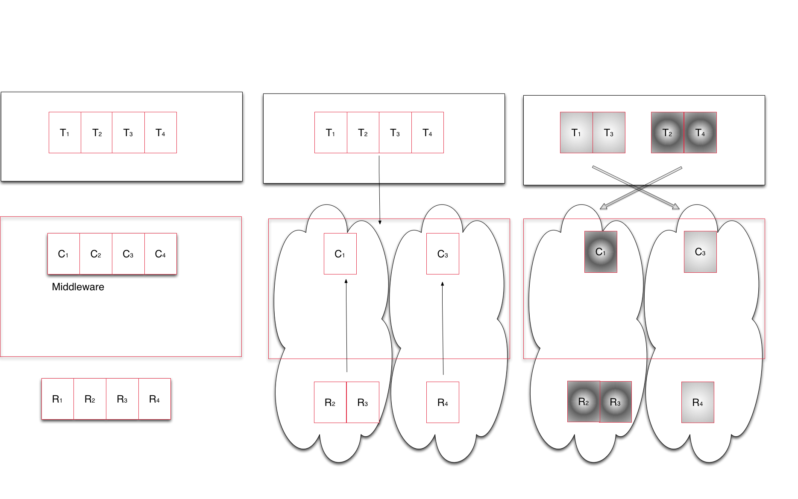
NGMW Schematic
Notes:
Middleware capabilities as an abstraction to resources
Middleware’s responsibility to support the set of capabilities that an application asks for and determine the collection of resources that can/must be used to provide capability

Slide 18
NGMW: Outline
Understanding the Different Models:
A* : Conceptual Model for Distributed Application
One of many different analytical models of an application
W*: Analytical model of workload
Outputs concrete executable units, thus provides a measure of performance and prediction but independent of resources
P*: Conceptual Model for Dynamic Resources
I* : Analytical Model for Infrastructure [Munich]
F*: Analytical Model of resource federation/overlay
Determines how different resources might be federated
In turn builds upon a model/models of infrastructure (I*)
Notes:
A* and W* need fixing

Slide 19
NGMW: Outline
Interaction between Models:
[A*, W* ] and [P*, F*]
Here A* is a conceptual model, and W* is an analytical model
A specific instance of A*, is subject to a transformation W which converts into executable units (per W*) that have performance requirements
Infrastructure modeled as I*, capability is exposed and federated per F*
I* subject to a transformation F (aggregation of resources per F*) to provide a federated capability
Role of Simulation
If we federate a given set of resources {I} what is the performance we expect?
If we want a capability [C], what is the set of resources {I} we need to federate to get this [C] with well-defined probability distribution?
Given an instance of an application (model), what is the workload independent of the underlying resources?

Slide 20
A* [Andre]
Andre: is this really a model of your emulator?

Slide 21
W* [Andre]
Andre: is this really a model of your emulator?

Slide 22
P*
Pilot-Jobs provide an abstraction for dynamic resource management. Currently abstraction is job based, but can be extended to include network and storage as other resource elements
P* is a conceptual model for Pilot-based resource

Slide 23
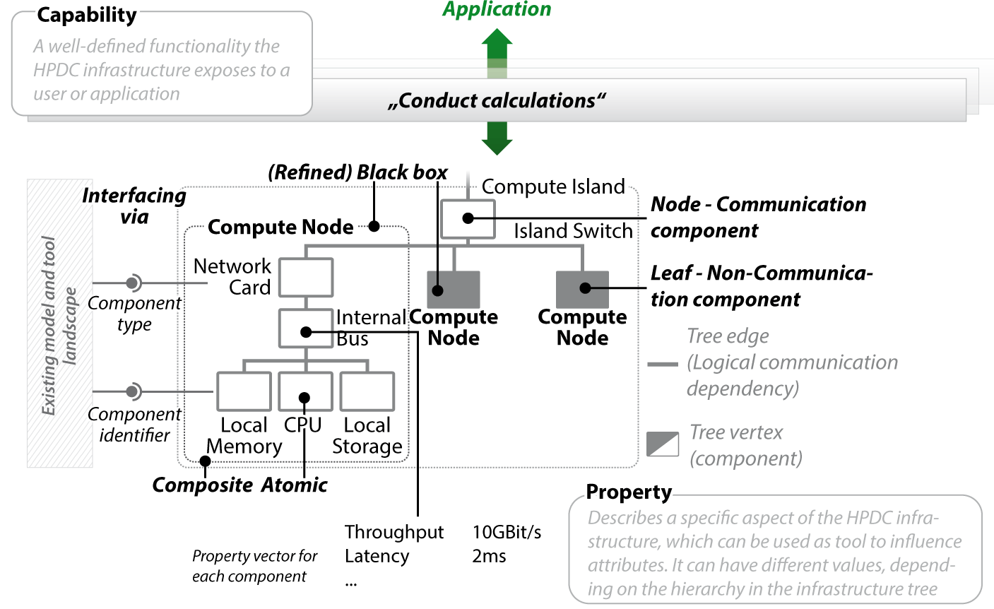
I* ]
Fast modeling
Easy data integration
Multiple levels of granularity
Redundancy handling

Slide 24
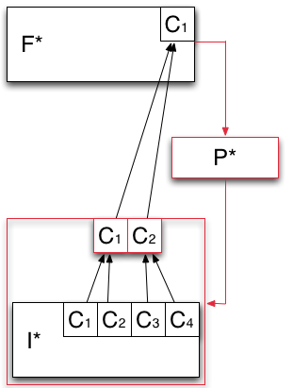
F* - Analytical Model of Resource Federation
Models how the capabilities offered by the infrastructure layer are aggregated and then exposed to the application layer.
Heterogeneous capabilities of I* are aggregated by means of overlays (red box).
P* is used to aggregate the capabilities exposed by I* into logical containers of resources (red box).

Slide 25
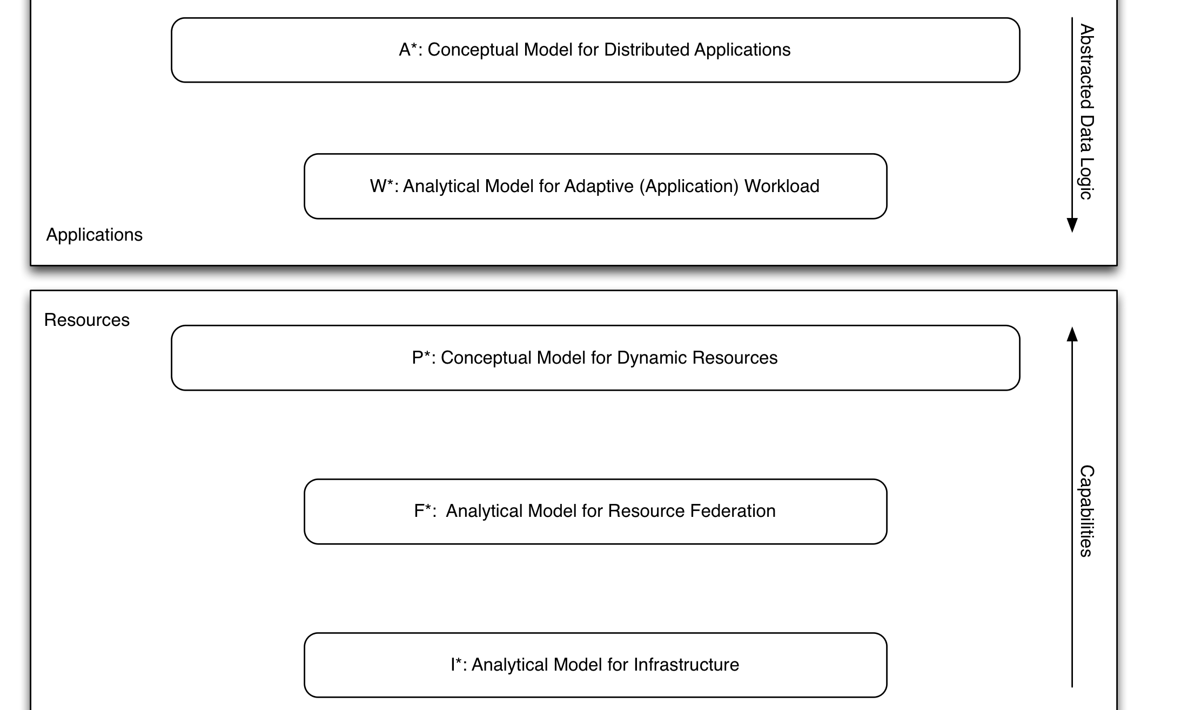
*.* : Putting it together
Notes:
We take the schematic of NGMW and show how the different levels at which the Models work, (ii) how different models interact, especially (a) Andre and Christian’s work/interface, (ii) I* and F*.

Slide 26
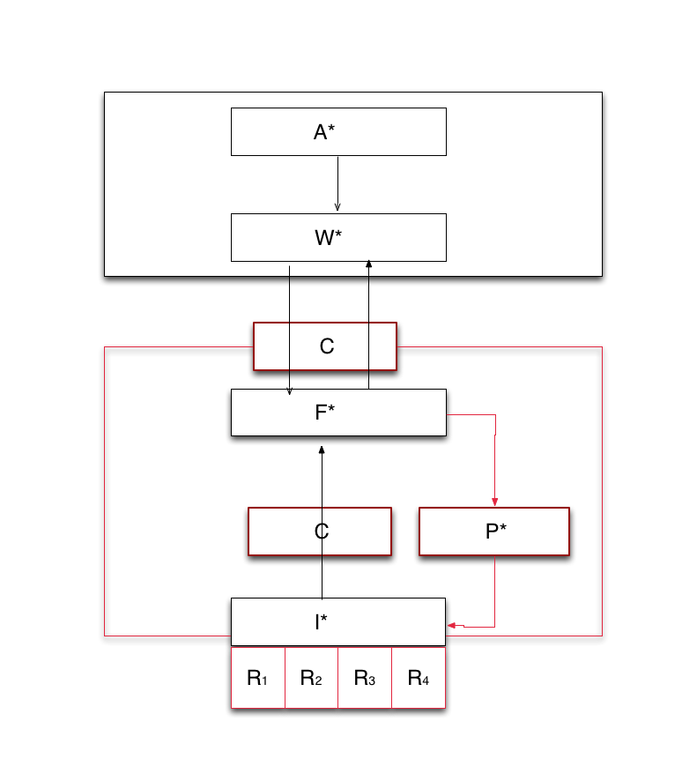
*.* : Putting it together
Notes:
We take the schematic of NGMW and show how the different levels at which the Models work, (ii) how different models interact, especially (a) Andre and Christian’s work/interface, (ii) I* and F*.

Slide 27
Modeling Challenges
Overarching Challenge: How does modeling DEC couple to and synergize with HPC exascale modeling efforts?
Operational Challenges:
Granularity
Different model of varying specificity
Some are analytical, some are conceptual
Multi-scale
Macroscopic versus microscopic consequences
Many possible parameters, which should be used?
Linking models that reason using different parameters, e.g., energy considerations may not play a role at large-scale distribution
Heterogeneity
Federating heterogeneous distributed infrastructure
Notes:
Data generation doubles every << 12 months, i.e. faster than the doubling rate of data storage (roughly 18 months)

Slide 28
Organizer’s Questions [SJ]
What is the major contribution of your research?
What are the gaps you identify in the research coverage in your area?
What is the bigger picture for your research area? (i.e., identify synergistic projects, complementary projects in technical sense, etc)
How do you see cross-pollination across projects funded by different funding agencies?
What is the one thing that would make it easier/possible to leverage/use the results of other projects to further your own research?
What would you like to most see solved/addressed other than what they are working on?

