Slide 1
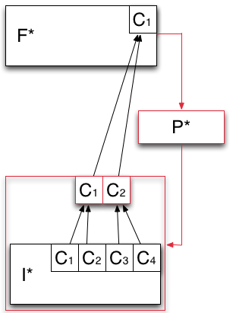
F* - Analytical Model of Resource Federation
Models how the capabilities offered by the infrastructure layer are aggregated and then exposed to the application layer.
Heterogeneous capabilities of I* are aggregated by means of overlays (red box).
P* is used to aggregate the capabilities exposed by I* into logical containers of resources (red box).

