Slide 1
Next Generation Middleware for Distributed Exascale Computing Infrastructure The Role of Modeling and Simulation
Research in Advanced DIstributed Cyberinfrastructure and Applications Laboratory (RADICAL)
http://radical.rutgers.edu
This talk is primarily the effort of the RADICAL group, but different parts of this work have benefitted from collaborations with the AIMES Project (Katz, Weissman) and LMU-Munich (Straube, Kranzmuller)

Slide 2
Outline
Why Distributed Exascale Computing (DEC)?
Foundational requirements for DEC
The State of Extreme Scale Distributed Computing
NGMW as a way to address DEC requirements
Design considerations for NGMW
Proposed Architecture for NGMW
Adaptive Application: A*, W*
Dynamic Resources/Infrastructure: P*, I*
Federation of Infrastructure F*
Putting it altogether: conceptual and implementation
Role of Modeling and Simulation
Challenges in ModSim

Slide 3
Why Distributed Exascale Computing?
Efficient utilization of “traditional” exascale resources
Synergistic: Not competitive but complementary
How/when to send workloads from leadership machines to other less powerful machines?
How to federate them?
Long tail of science?
Different modes of exascale computing
Coupling exaflops of computing with exabytes of data
DoE Applications and facilities

Slide 4
DEC vs Traditional EC
Application structure simple, infrastructural requirements difficult
Explains why DCI software environment is complex and fragile
Middleware functionality and semantics
Heterogeneous software and system access layers
Difficult to integrate services and extend tools
Therefore a distinct role for middleware

Slide 5
DEC Foundational Requirements
Applications
Support a broad range of DCA requirements
e.g. Large-scale simulations, big-data repositories, real-time computing, scientific experiments at global scale
Novel application classes: Adaptive Applications
Manage transition from static to adaptive applications
When and how to distribute? What and where to distribute?
Infrastructure
Federate diversified set of resources at multiple levels
Implementation Challenge
Manage complexity and heterogeneity of infrastructure
Multi-level: Balanced DCI and support for scaling along all dimensions
Scaling-up, Scaling-out, Scaling-across

Slide 6
Distributed Computing in 2013
First Generation of DC characterized by “glueing it” together
Many local solutions, lack of end-to-solutions
Scaling remains difficult for individual scientists
O(10⁻²) can do O(100) tasks each of O(10GB) over O(10) nodes
We are still learning how to architect large-scale systems
Macroscopic vs microscopic theory of distributed systems!
Absence of analytical models of applications, infrastructure
Given a general workload there is an inability to estimate how long a workload will take? And where to execute?
And we do not know how wrong we are!

Slide 7
NGMW Design Aims and Objectives
Design Aims
When to distribute?
Sub problem X is better running on a non-leadership class machine?
What to distribute?
Where/how to distribute?
Need information about resources, networks
What is a capability? [this might go.. Depending upon order of slides]
Design Objectives
Need to federate systems to provide well-defined capabilities
Abstracted data logic (representation, distribution, scheduling, placement) that captures application-semantics yet is not application-specific
Needs fixing…
Integrated for Adaptive Applications and Dynamic Resource Management
Federation of heterogeneous dynamic components
Support adaptive applications

Slide 8
NGMW [Work in Progress, will compact 8-11 into 2 slides]
Design Objective and Role of Next Generation Middleware
Not just glues together different layers but:
Exposes well-defined capabilities rather than technology
Supports reasoning and predictable performance
Reasoning of how, when to distribute?
Separate capability from technology used to provide functionality
Capability: Well-defined and aggregated functionality, without regard to how, or the specific technology/approached used
e.g., Num. of tasks, throughput, probabilistic bounds on time-to-completion, performance of resources, data (volumes/transfer/storage ability)
Providing capabilities
What functional units, and how to compose functionality?
Designing a federated system that scales along 1 dimension is relatively easy compared to scaling along >1 dimensions

Slide 9
NGMW: Capabiltiy Challenges
• How to provide well-defined capabilities?
Well-defined capability amidst heterogeneous, dynamic resources requires flexible federation of resources and services
Need to federate systems to provide well-defined capabilities from heterogeneous dynamic components with varying levels of control
Reasoning.. Can design for randomness but not for unpredictable
What functional units, and how to compose functionality?
New complementary and non-destructive models of federation
Adaptive execution strategy and flexible federation
Can’t remove complexity, can only manage it, belief that it is best done with such middleware that supports interoperablity
How will applications utilize systems?
For given capability appropriate execution strategy is determined
Interoperability: DCI level? DCA level Interoperability?
Notes:
factor in uniformity in resources

Slide 10
NGMW: Challenges
Fundamental conceptual gap in providing well-defined capabilities
Lack of reasoning and ability to estimate/calibrate performance
Two levels of conceptual abstractions to enable reasoning:
Models that enable functional comparison for individual components, e.g., P* for Pilot-systems 10.1109/eScience.2012.6404423
Models that enable reasoning at multiple, integrated levels to provide performance estimation and predictability
When and how to distribute? What and where?
A Linpack for distributed systems/applications?
Notes:
Capabilitiy: Well-defined and aggregated functionality, without regard to how, or the specific technology/approached used
e.g., Num. of tasks, throughput, probabilistic bounds on time-to-completion, performance of resources, data (volumes/transfer/storage ability)
Much has been said about Implementation abstractions. There are implementation challenges galore in delivering such capabilities. We will focus on the Conceptual Gaps!

Slide 11
NGMW: Challenges
• How to provide well-defined capabilities?
Combination of reasoning (across possible configurations) and flexible federation points
Well-defined capability amidst heterogeneous, dynamic resources requires flexible federation of resources and services
Reasoning about performance
Can design for randomness but not for unpredictable behaviour
• How will applications utilize systems?
For given capability appropriate execution strategy is determined
Interoperability: DCI level? DCA level Interoperability?
Notes:
This should expand each of the points in DEC foundational challenges

Slide 12
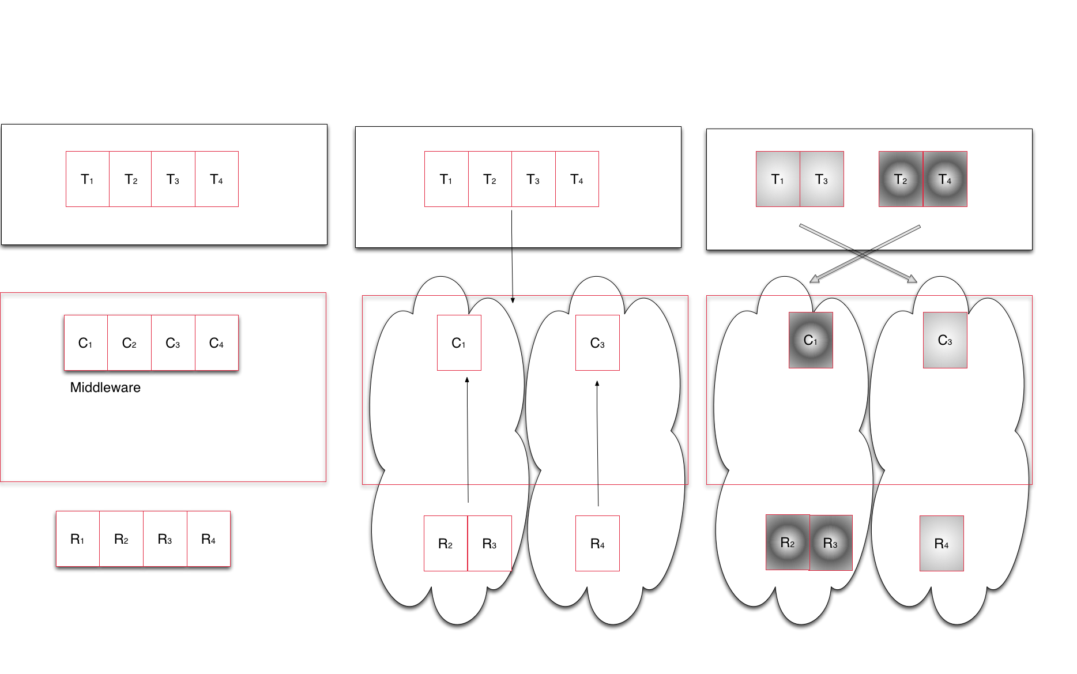
NGMW Schematic
Notes:
Middleware capabilities as an abstraction to resources
Middleware’s responsibility to support the set of capabilities that an application asks for and determine the collection of resources that can/must be used to provide capability

Slide 13
A*/W*
A* models the structure of some distributed application classes
Accompanying communication and coordination properties
Decomposition of application's problem and data space
Implications for application components and their distribution
Supports the derivation of a workload representation
W* analytical model of application workload
Constituents are small units of workload which can have causal and temporal relationships (Concurrent, Sequential, Starts-After, ...)
Constituents can be transformed directly either as system workload
Workloads are considered static; no changes based on (non-predictable) application
representations of W* will be used for simulations (WL description) and experiments (WL implementation)
Dynamic applications result in workloads with a range of properties
Notes:
Decomposition of application's problem and data space

Slide 14
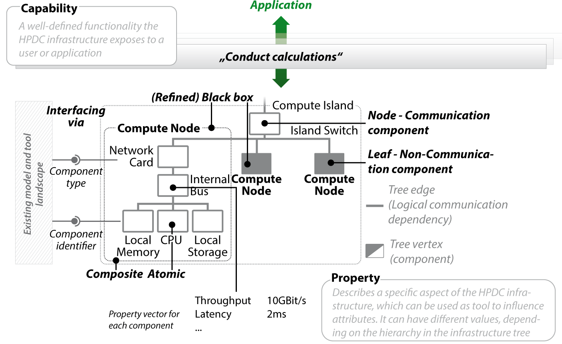
I* ]
Fast modeling
Easy data integration
Multiple levels of granularity
Redundancy handling

Slide 15
P*
Pilot-Jobs provide an abstraction for dynamic resource management. Currently abstraction is job based, but can be extended to include network and storage as other resource elements
P* is a conceptual model for Pilot-based resource

Slide 16
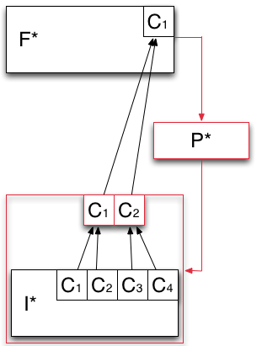
F* - Analytical Model of Resource Federation
Models how the capabilities offered by the infrastructure layer are aggregated and then exposed to the application layer.
Heterogeneous capabilities of I* are aggregated by means of overlays (red box).
P* is used to aggregate the capabilities exposed by I* into logical containers of resources (red box).

Slide 17
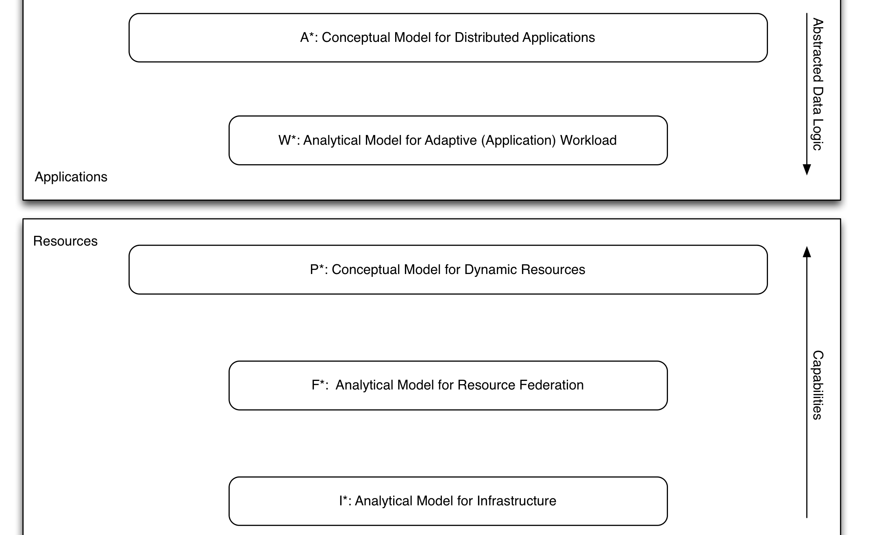
*.* : Putting it together
Notes:
We take the schematic of NGMW and show how the different levels at which the Models work, (ii) how different models interact, especially (a) Andre and Christian’s work/interface, (ii) I* and F*.

Slide 18
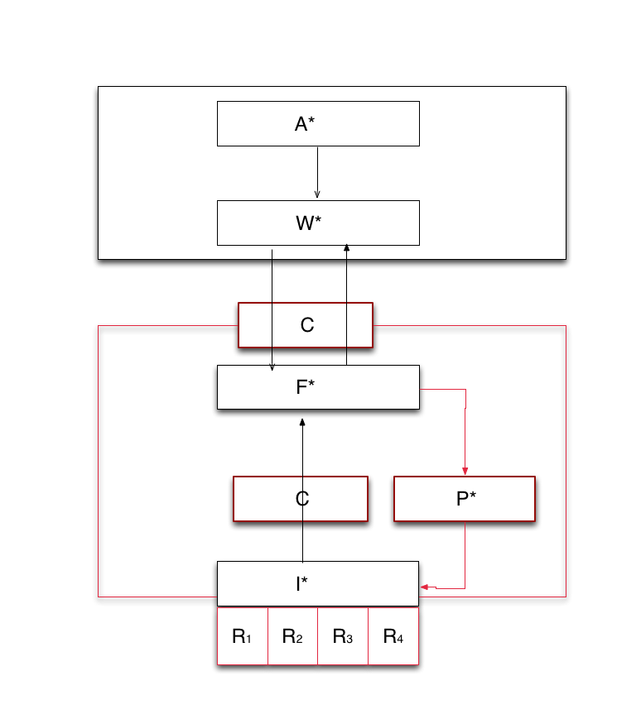
*.* : Putting it together
Notes:
We take the schematic of NGMW and show how the different levels at which the Models work, (ii) how different models interact, especially (a) Andre and Christian’s work/interface, (ii) I* and F*.

Slide 19
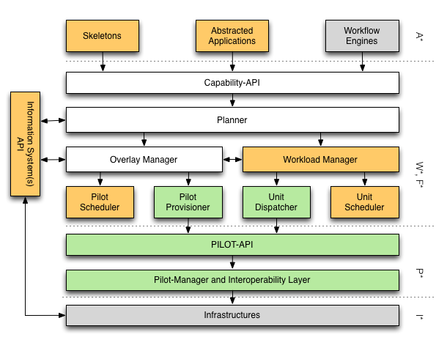
*.* : Putting it together
Notes:
We take the schematic of NGMW and show how the different levels at which the Models work, (ii) how different models interact, especially (a) Andre and Christian’s work/interface, (ii) I* and F*.

Slide 20
This will be eliminated..
Understanding the Different Models:
A* : Conceptual Model for Distributed Application
One of many different analytical models of an application
W*: Analytical model of workload
Outputs concrete executable units, thus provides a measure of performance and prediction but independent of resources
P*: Conceptual Model for Dynamic Resources
I* : Analytical Model for Infrastructure [Munich]
F*: Analytical Model of resource federation/overlay
Determines how different resources might be federated
In turn builds upon a model/models of infrastructure (I*)
Notes:
A* and W* need fixing

Slide 21
NGMW: Interaction of Models and Simulation
Interaction between Models:
[A*, W* ] and [P*, F*]
Here A* is a conceptual model, and W* is an analytical model
A specific instance of A*, is subject to a transformation W which converts into executable units (per W*) that have performance requirements
Infrastructure modeled as I*, capability is exposed and federated per F*
I* subject to a transformation F (aggregation of resources per F*) to provide a federated capability
Role of Simulation
If we federate a given set of resources {I} what is the performance we expect?
If we want a capability [C], what is the set of resources {I} we need to federate to get this [C] with well-defined probability distribution?
Given an instance of an application (model), what is the workload independent of the underlying resources?

Slide 22
Mapping Tasks to Resources
Different aspects of mapping tasks to resources
I. Optimal Characterization: Finding the optimal workload characterisation (of an application)
Generality versus specificity. Class of Applications versus Many application classes/types
Different applications have different metrics
II. Optimal Federation: Finding the optimal resource configurations for a given workload
Irrespective of whether it is best representation of an application
Resources availability at extreme scale is variable
III. Optimal Mapping: Workload to Resource Mapping
Static versus Dynamic Mapping
If traditional HPC where workloads are characterized by finite set of kernels then static is acceptable; where workload is dynamic and capture many different applications then

Slide 23
Organizer’s Questions [SJ]
What is the major contribution of your research?
What are the gaps you identify in the research coverage in your area?
What is the bigger picture for your research area? (i.e., identify synergistic projects, complementary projects in technical sense, etc)
How do you see cross-pollination across projects funded by different funding agencies?
What is the one thing that would make it easier/possible to leverage/use the results of other projects to further your own research?
What would you like to most see solved/addressed other than what they are working on?

Slide 24
Modeling Challenges
Overarching Challenge: How does modeling DEC couple to and synergize with HPC exascale modeling efforts?
Operational Challenges:
Granularity
Different model of varying specificity
Some are analytical, some are conceptual
Multi-scale
Macroscopic versus microscopic consequences
Many possible parameters, which should be used?
Linking models that reason using different parameters, e.g., energy considerations may not play a role at large-scale distribution
Heterogeneity
Federating heterogeneous distributed infrastructure
Notes:
Data generation doubles every << 12 months, i.e. faster than the doubling rate of data storage (roughly 18 months)

Slide 25
Distributed Computing in 2013
The space of possible DCA is large (and rich), but developing DCA remains a hard undertaking
More than just submitting jobs; coordination of different components
Inconsistent and incomplete tools for deployment and execution
Distributed Computing Applications (DCA)
Many new types of applications have emerged
More than first-generation, i.e., distributed HPC and BoT HTC
DCI software environment is complex and fragile
Middleware functionality and semantics
Heterogeneous software and system access layers
Difficult to integrate services and extend tools
Distributed Computing practice for Large-scale Science doi 10.1002/cpe.2897
Notes:
Effective engineering is coda for managing complexity – intrinsic and extrinsic of DCI and DCA
Something about the current status of DC-2013

Slide 26
Extreme Scale DC: ATLAS/HEP
Observation:
“.. Distributed computing will persist ” for integrated HPC + HTC
Richard Mount (SLAC), c.f. http://goo.gl/pJzIjH
Requirement:
ATLAS in >2018 needs:
Non-monolithic extreme-scale and integrated HPC + HTC
Challenges:
Mostly economic, but also how to manage workload decomposition
Development and deployment of future supercomputing applications
Role for flexible execution strategies
Question:
“.. Are systems of the complexity of ATLAS Distributed Computing sustainable long-term?”

Slide 27
DEC Foundational Challenges: Infrastructure
Federate diversified set of resources at multiple levels
Designing a federated system that scales along 1 dimension is relatively easy compared to scaling along >1 dimensions
How/when to federate leadership machines with other less powerful machines?
Implementation Challenge
Manage complexity and heterogeneity of infrastructure
Multi-level: Balanced DCI and support for scaling along all dimensions
Scaling-up, Scaling-out, Scaling-across
Notes:
Data generation doubles every << 12 months, i.e. faster than the doubling rate of data storage (roughly 18 months)

