Slide 1
Next Generation Middleware for Distributed Exascale Computing Infrastructure The Role of Modeling and Simulation
Research in Advanced DIstributed Cyberinfrastructure and Applications Laboratory (RADICAL)
http://radical.rutgers.edu

Slide 2
Outline
Why Distributed Exascale Computing (DEC)?
Explain it is complementary to traditional EC
The case for NGMW: Why current approaches to DEC wont work!?
Design considerations for NGMW
Capability Based
Abstracted data logic (representation, distribution, scheduling, placement) that captures application-semantics yet is not application-specific
Integrated for Adaptive Applications and Dynamic Resource Management
Schematic/Outline for NGMW
Adaptive Application: A*, W*
Dynamic Resources/Infrastructure: P*, I*
Federation of Infrastructure F*
Research Agenda
Challenges in ModSim
Other Challenges in NGMW

Slide 3
DC in circa 2013

Slide 4
NGMW Important Questions
When to distribute?
Sub problem X is better running on a non-leadership class machine?
What to distribute?
Where/how to distribute?
Need information about resources, networks
What is a capability?

Slide 5
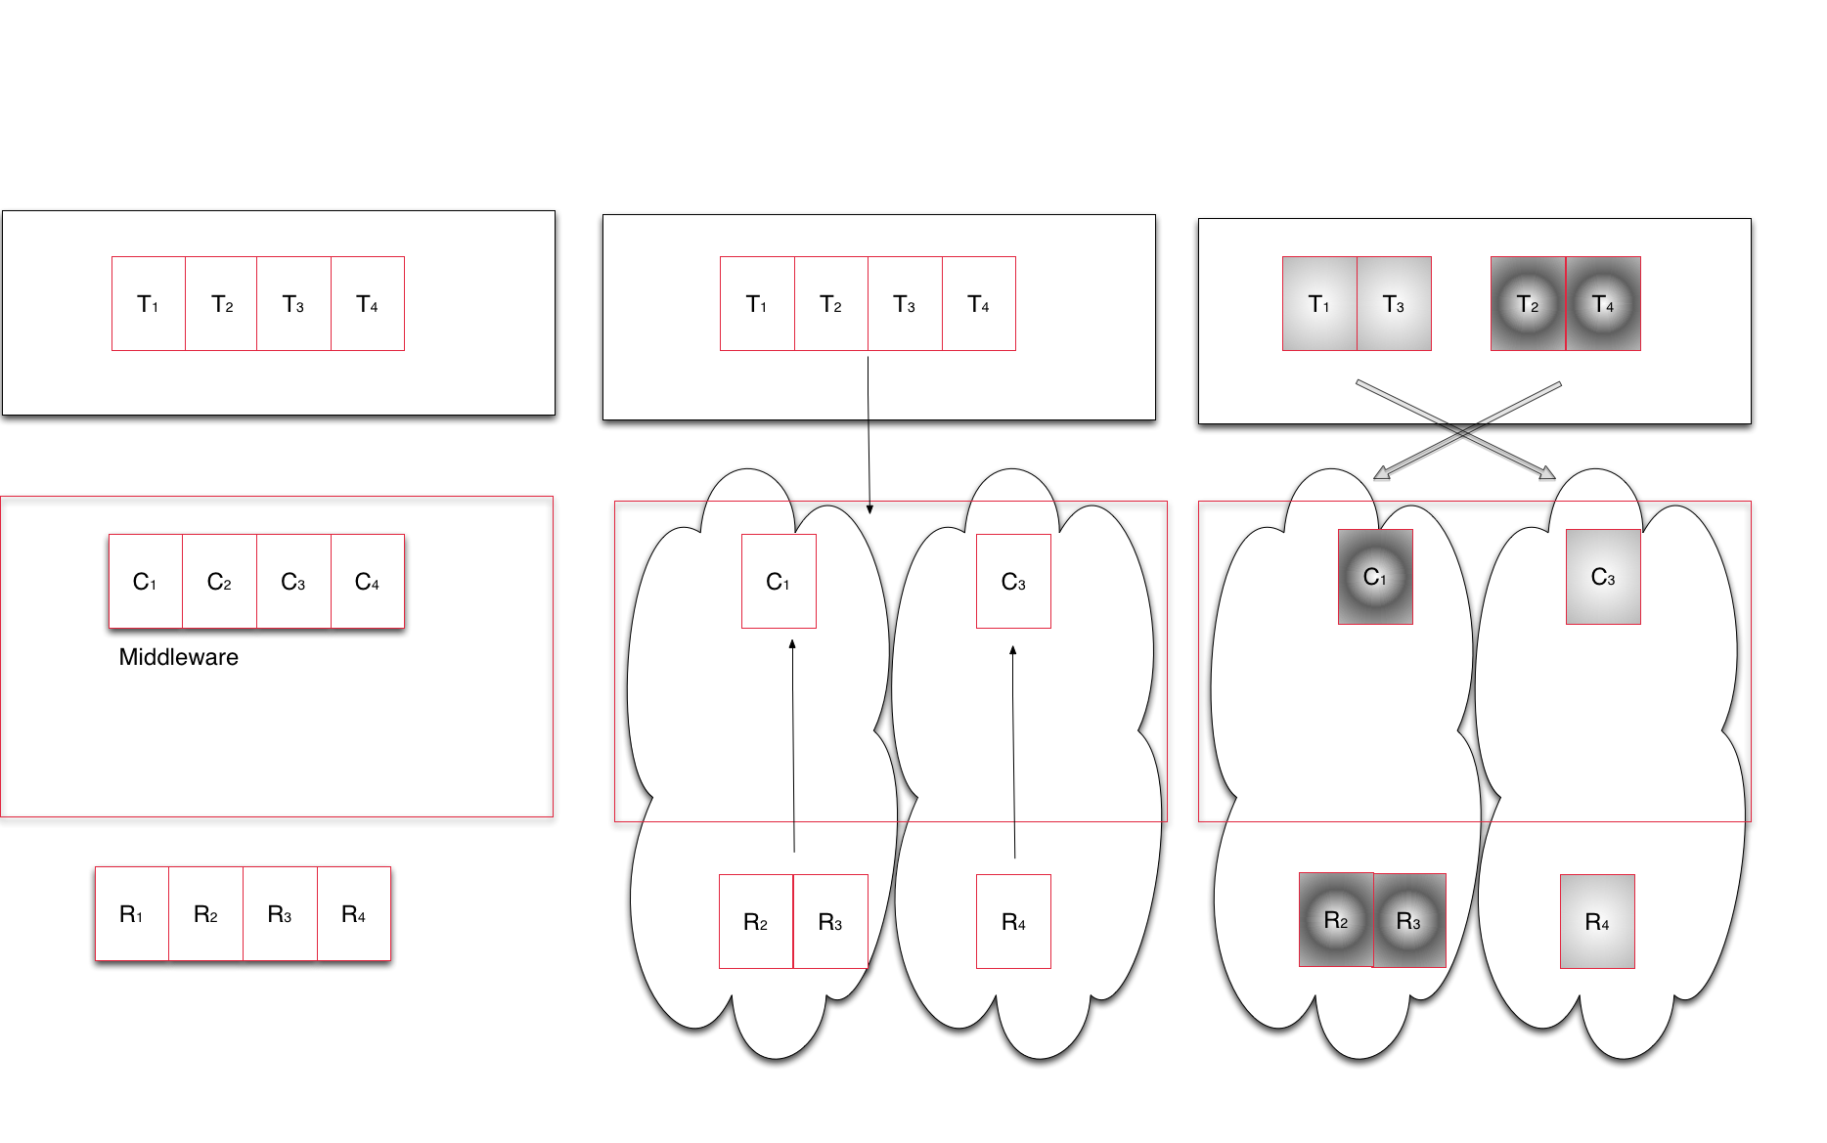
NGMW Schematic
Notes:
Middleware capabilities as an abstraction to resources
Middleware’s responsibility to support the set of capabilities that an application asks for and determine the collection of resources that can/must be used to provide capability

Slide 6
DEC Foundational Challenges
Implementation Challenge
Manage complexity and heterogeneity of infrastructure
Providing capabilities
What functional units, and how to compose functionality?
Federate diversified set of resources at multiple levels
Designing a federated system that scales along 1 dimension is relatively easy compared to scaling along >1 dimensions
How/when to federate leadership machines with other less powerful machines?
Distributed Computing Applications:
When and how to distribute? What and where to distribute?
Manage transition from static to adaptive applications
Notes:
Data generation doubles every << 12 months, i.e. faster than the doubling rate of data storage (roughly 18 months)

Slide 7
Outline
Understanding the Different Models:
A* : Conceptual Model for Distributed Application
One of many different analytical models of an application
W*: Analytical model of workload
Outputs concrete executable units, thus provides a measure of performance and prediction but independent of resources
P*: Conceptual Model for Dynamic Resources
I* : Analytical Model for Infrastructure [Munich]
F*: Analytical Model of resource federation/overlay
Determines how different resources might be federated
In turn builds upon a model/models of infrastructure (I*)
Notes:
A* and W* need fixing

Slide 8
Outline
Interaction between Models:
[A*, W* ] and [P*, F*]
Here A* is a conceptual model, and W* is an analytical model
A specific instance of A*, is subject to a transformation W which converts into executable units (per W*) that have performance requirements
Infrastructure modeled as I*, capability is exposed and federated per F*
I* subject to a transformation F (aggregation of resources per F*) to provide a federated capability
Role of Simulation
If we federate a given set of resources {I} what is the performance we expect?
If we want a capability [C], what is the set of resources {I} we need to federate to get this [C] with well-defined probability distribution?
Given an instance of an application (model), what is the workload independent of the underlying resources?

Slide 9
A* [Andre]
Andre: is this really a model of your emulator?

Slide 10
W* [Andre]
Andre: is this really a model of your emulator?

Slide 11
P*
Pilot-Jobs provide an abstraction for dynamic resource management. Currently abstraction is job based, but can be extended to include network and storage as other resource elements
P* is a conceptual model for Pilot-based resource

Slide 12
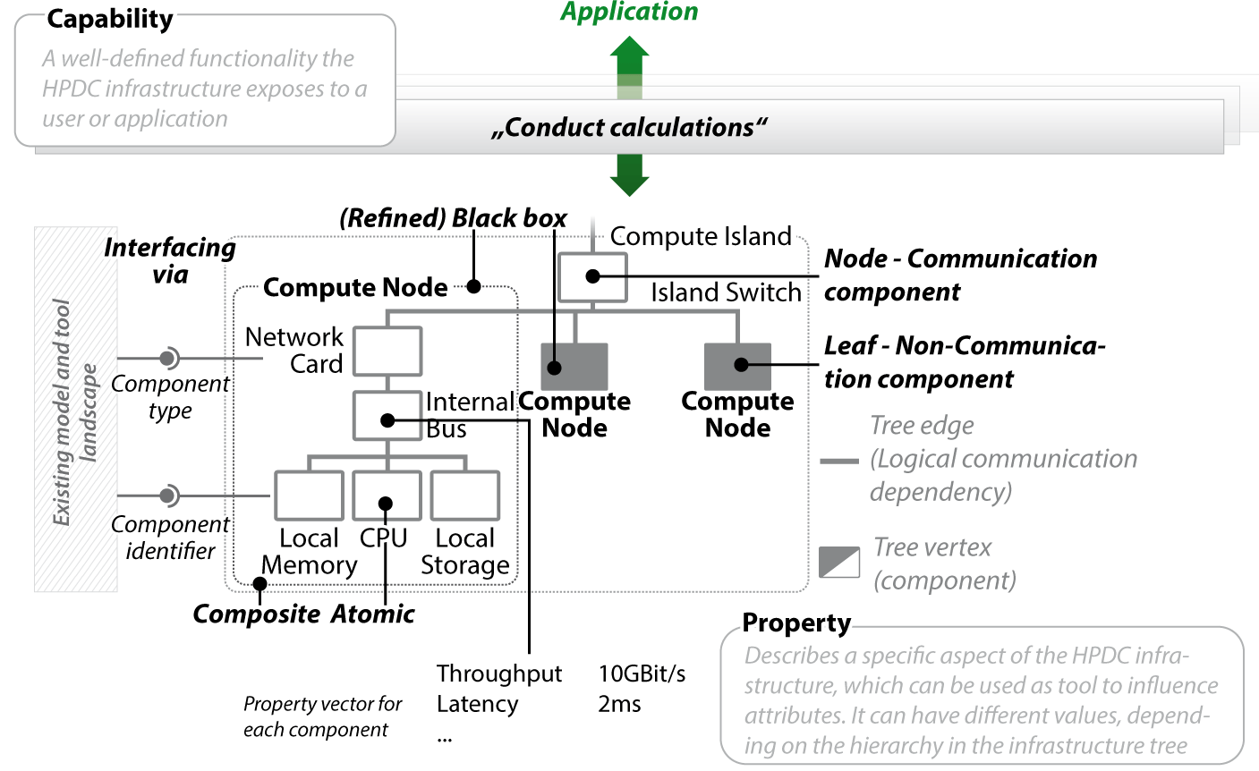
I* ]
Fast modeling
Easy data integration
Multiple levels of granularity
Redundancy handling

Slide 13
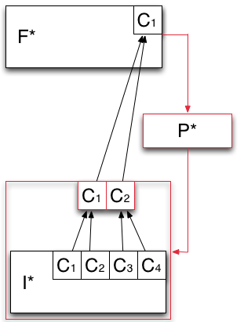
F* - Analytical Model of Resource Federation
Models how the capabilities offered by the infrastructure layer are aggregated and then exposed to the application layer.
Heterogeneous capabilities of I* are aggregated by means of overlays (red box).
P* is used to aggregate the capabilities exposed by I* into logical containers of resources (red box).

Slide 14
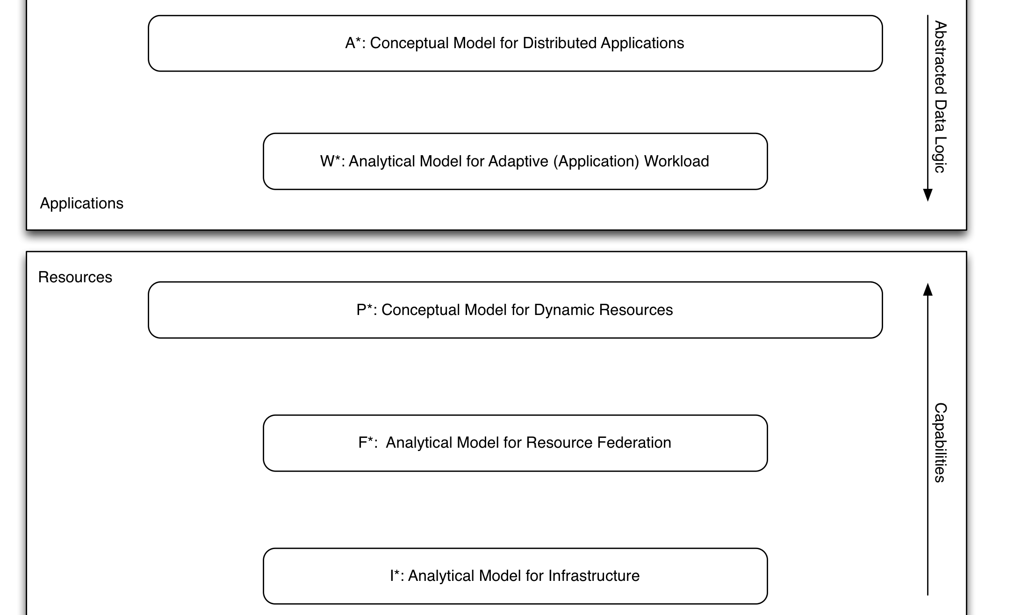
*.* : Putting it together
Notes:
We take the schematic of NGMW and show how the different levels at which the Models work, (ii) how different models interact, especially (a) Andre and Christian’s work/interface, (ii) I* and F*.

Slide 15
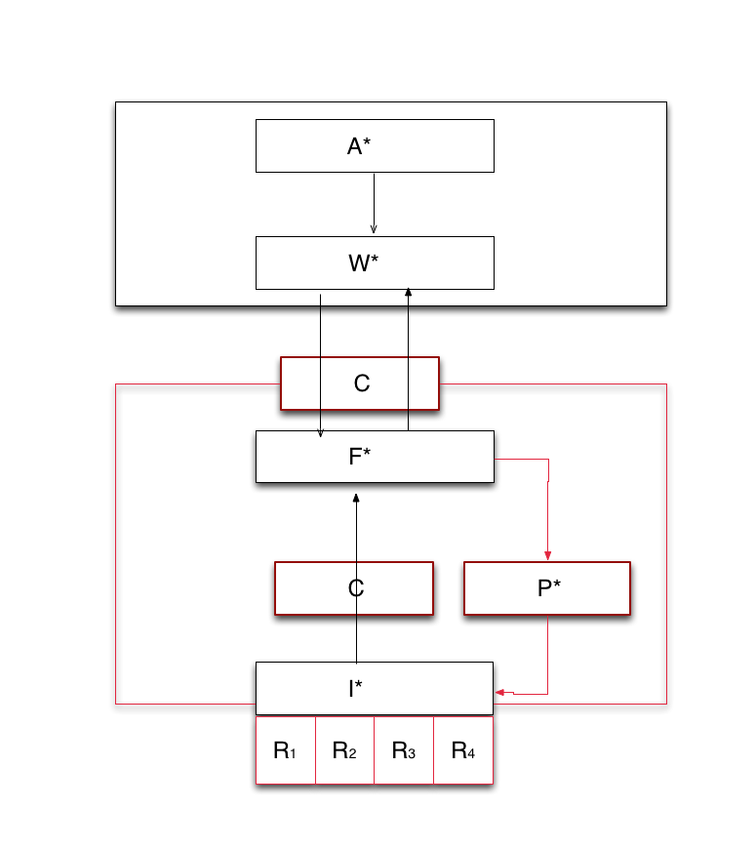
*.* : Putting it together
Notes:
We take the schematic of NGMW and show how the different levels at which the Models work, (ii) how different models interact, especially (a) Andre and Christian’s work/interface, (ii) I* and F*.

Slide 16
Modeling Challenges
Overarching Challenge: How does modeling DEC couple to and synergize with HPC exascale modeling efforts?
Operational Challenges:
Granularity
Different model of varying specificity
Some are analytical, some are conceptual
Multi-scale
Macroscopic versus microscopic consequences
Many possible parameters, which should be used?
Linking models that reason using different parameters, e.g., energy considerations may not play a role at large-scale distribution
Heterogeneity
Federating heterogeneous distributed infrastructure
Notes:
Data generation doubles every << 12 months, i.e. faster than the doubling rate of data storage (roughly 18 months)

Slide 17
NGMW Research Agenda
• Need to federate systems to provide well-defined capabilities from heterogeneous dynamic components for adaptive applications
• How to provide well-defined capabilities?
Combination of reasoning (across possible configurations) and flexible federation points
Well-defined capability amidst heterogeneous, dynamic resources requires flexible federation of resources and services
Reasoning about performance
Can design for randomness but not for unpredictable behaviour
• How will applications utilize systems?
For given capability appropriate execution strategy is determined
Interoperability: DCI level? DCA level Interoperability?
Notes:
This should expand each of the points in DEC foundational challenges

Slide 18
Organizer’s Questions [SJ]
What is the major contribution of your research?
What are the gaps you identify in the research coverage in your area?
What is the bigger picture for your research area? (i.e., identify synergistic projects, complementary projects in technical sense, etc)
How do you see cross-pollination across projects funded by different funding agencies?
What is the one thing that would make it easier/possible to leverage/use the results of other projects to further your own research?
What would you like to most see solved/addressed other than what they are working on?

