Slide 1
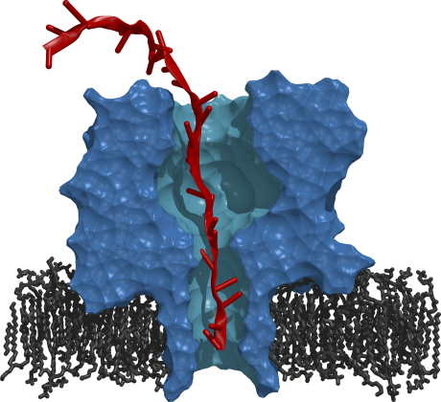
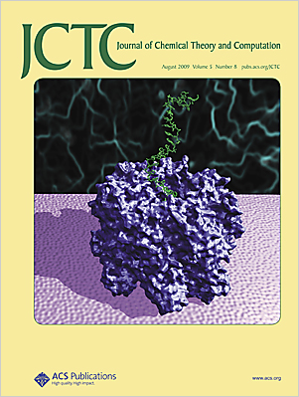
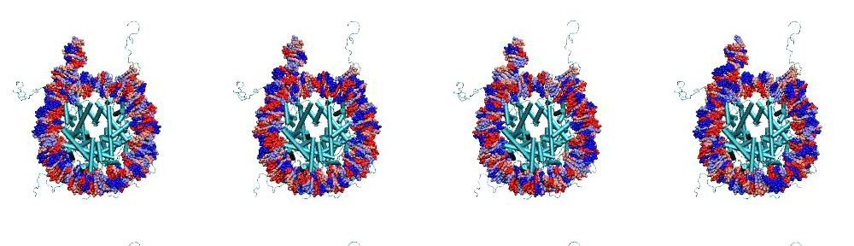
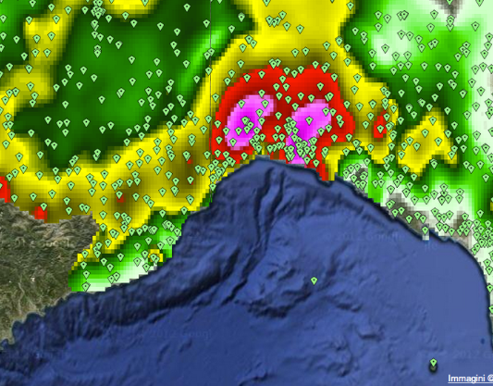
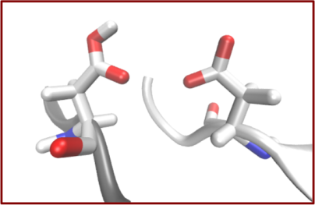
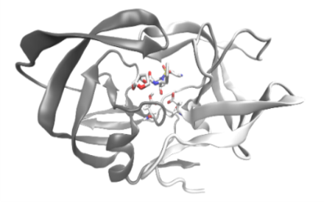
Will there be Innovation in Middleware?
Shantenu Jha, Andre Merzky, Matteo Turilli
http://radical.rutgers.edu
MeDIA, Rome
22nd April , 2013

Slide 2
The Role for Middleware on Production DCI
The Problem
Production DCI need to support:
Multiple Science & Engineering applications
Range of application usage modes
The current generation of Middleware has not supported novel usage nor scalable usage of DCI
Not just big/prestige projects, think long-tail of science
Higgs-like particle was discovered in spite of, not because…
The Hypothesis
Unique and Important Role for middleware
Must provide “basis” for higher-level service and capabilities
Plethora of partial and incomplete middleware solutions
The Solution
A systems-engineering approach to middleware and DCI is required
Standards support Interoperability and enable innovation at higher-levels
Notes:
Innovation in Middleware has not kept pace with DCI

Slide 3
SAGA: Resource Interoperability and Standards-based Access Layer
http://saga-project.org

Slide 4
SAGA: Background
What?
Standards based Application Level Interoperabilty
Provides stable syntax and semantics on application side
Portability of programming abstractions and constructs
How is SAGA Used?
Uniform access and scripting layer to infrastructure
Build applications, tools and services that use distributed infrastructure
E.g. Gateways, BigJob (Implementation P* Model of Pilots)
Benefits
Standards facilitate interoperability and extensibility, and thus permit innovation at higher and other levels
Multiple implementations and adaptors available

Slide 5
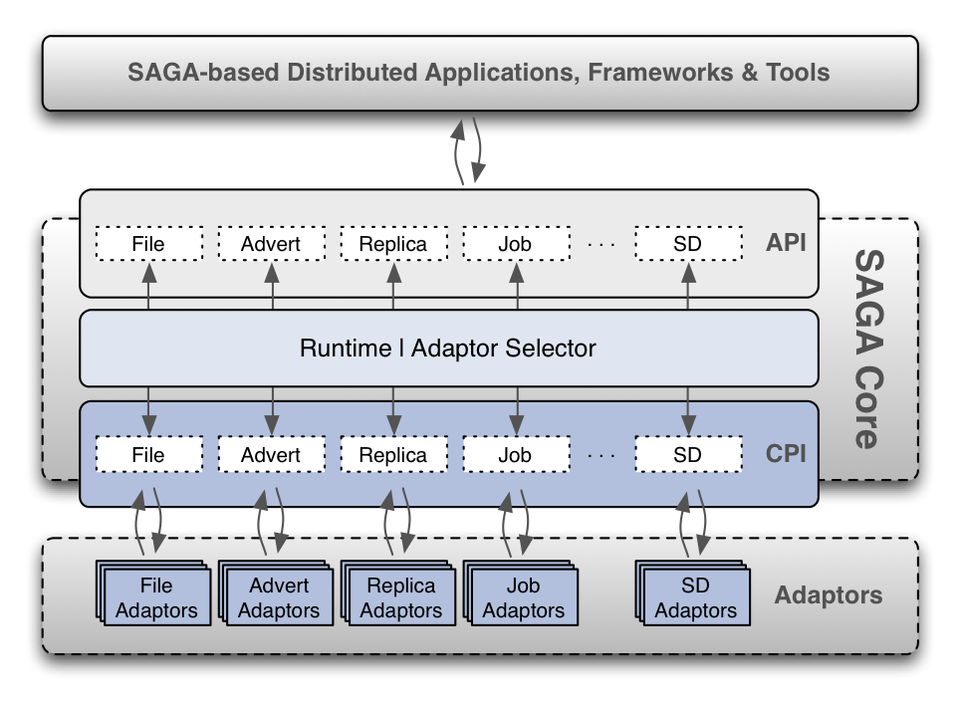
Background
SAGA: Community Standard for Distributed Applications
http://saga-project.org
Notes:
Distributed Applications generally defined.. Tools ⬅➔ Applciations

Slide 6
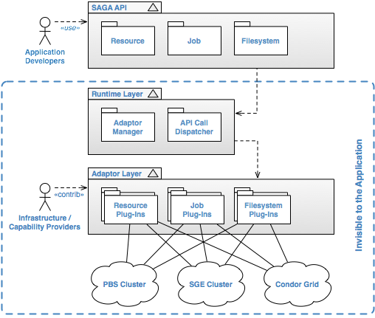
SAGA-Python
Re-architected implementation of saga (BlisS) that provides
support for bulk optimization
support for callbacks
support for asynchronous operations
Implements ‘official’ OGF python language bindings
Implements the job, file, replica and resource APIs
Supports multiple backends:
PBS, TORQUE, SGE, SLURM, Condor, SFTP, iRODS, (GSI-)SSH
local schedulers (PBS, SGE, ...) can be accessed remotely via SSH tunnels
Website:
http://saga-project.org
http://saga-project.github.com/saga-python/
https://github.com/saga-project/saga-python

Slide 7
Questions from RADICAL
Yes there are many issues of process/governance but before that….
How will MeDIA ensure that the whole is greater than the sum of the parts?
N different ways of doing the similar yet incompatible job submission but 0 ways of supporting "native" bulk job submission
Establish design objectives for next-generation middleware, can and will MeDIA enable innovation in middleware? How?
“Minimally Complete” and support for higher-level services
Social-welfare or talking-shop for a middleware distributions?
Having established the moral and technical case for standards-based approach, how will MeDIA facilitate a standards-based approach?
What/Is there a role for SAGA in MeDIA?

