Slide 1
A Framework for Flexible and Scalable Replica-Exchange on Production Distributed CI
Brian K. Radak, Melissa Romanus, Emilio Gallicchio, Tai-Sung Lee, Ole Weidner, Nan-Jie Deng, Peng He, Wei Dai, Darrin York, Ronald Levy, Shantenu Jha

Slide 2
Overview
Introduction
Replica-Exchange Algorithms
Synchronous
Asynchronous
Making REMD Accessible for DCI
Async RE Software Package
Use of XSEDE resources via SAGA/BigJob
Experiments
Systems Investigated
Systems in PJ Terms
Results
System 1
System 2
System 3
System 4
Future Work
Conclusion

Slide 3
Introduction
Replica-exchange molecular dynamics (REMD) is a method for effectively sampling high-dimensional rough energy landscapes
Enhanced sampling relative to regular MD simulations
Systems with similar potential energies can sample conformations at different temperatures
Potential to overcome energy barriers on the potential energy surface
Can be used for a range of physical systems from protein-folding to binding energy affinity calculations
Traditional REMD previously limited to smaller scales
Enhanced sampling comes at the cost of coordination overhead
Goals of this Paper: Release Async RE package to public – show current performance statistics to scientific community
Note: This paper does not aim to provide a computational chemistry analysis of the results.

Slide 4
“Replica” Exchange
Multiple importance sampling simulations (i.e. MD trajectories) executed in parallel, using intermittently exchange information
Information exchanged corresponds to thermodynamic state definitions
Microscopic reversibility requirements ensure simulation maintains the correct importance sampling weights in each state
Thus, sims can be viewed as identical “replicas” in both target configurational and state spaces
Advantage of such uniform sampling: Diagnose locally insufficient sampling, assess the accuracy of global properties

Slide 5
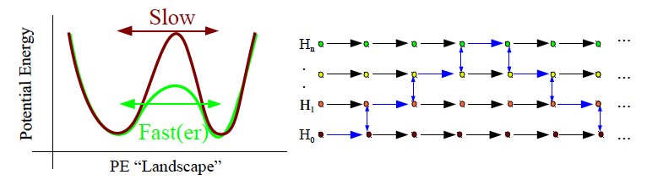
Why Replica Exchange?
• Based upon the Hamiltonian-hopping idea
- Can move in PE space more effectively, “faster”
- Consqueunce: Thermodynamic equilibrium between Hamiltonian states must be maintained
• Serial Implementations (serial tempering, etc.):
– free energy weights are adjusted to regulate time spent at each state
Parallel Implementations (replica exchange):
– runs as many MD replicas as states; Hamiltonian swaps between replicas
– overall each state is equally sampled automatically
– suitable for parallel environments

Slide 6
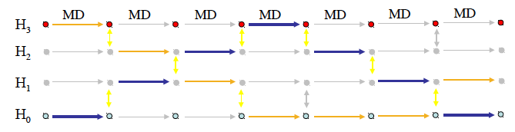
Synchronous Replica Exchange
PROBLEM: NOT scalable to 1000’s of replicas/states
After a fixed number of MD steps all replicas stop computing and exchanges occur simultaneously.
All replicas need to run at the same time
Termination of one replica causes termination of the whole RE simulation.
Not suitable for large RE calculations on limited resources
Not suitable for pools of delocalized, heterogeneous, dynamic, unreliable, possibly at times isolated processors.
Multi-dimensional RE schemes are difficult to implement within existing MD engines codebases.
Overall speed is the speed of the slowest processor. CPU resources – often divided among a minority

Slide 7
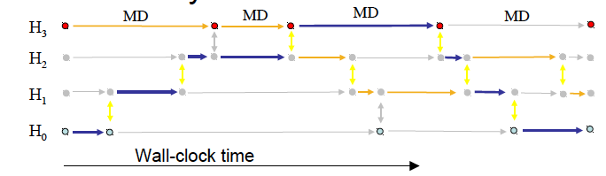
Asynchronous Replica Exchange
Exchanges are performed at random times between random pairs of available replicas.
Replicas run independently in between exchanges.
Termination of one replica does not affect the others.
Not all replicas need to be running at the same time.
The number of running replicas can vary depending on available resources.
Satisfies microscopic reversibility.
Does not rely on centralized master gather/scatter mechanism.
Each replica can complete a different number of MD steps in between swaps.
Suitable for large RE applications on dynamic and heterogeneous computational resources.
Fast and slow processors automatically operate at near 100% utilization. Overall speed scales as global processing capacity.

Slide 8

RE in Computational Terms
Molecular Dynamics Simulations
Multiple molecular dynamics threads (replicas) are each assigned to a different thermodynamic or potential energy state of the system
Executed in parallel
Replicas travel in configurationally space as well as in state space by communication and exchange of parameters (state assignments)
RE Computationally
Scaling many loosely-coupled MPI-style MD simulations
Use of pre-existing MD simulators such as IMPACT, AMBER, etc.
Each replica represents an individual execution model with different input parameters (many jobs submitted to batch queue)
CDI Project Goal: Understand important aspects of the physics of protein-ligand recognition by multidimensional replica exchange (RE) computer simulations

Slide 9
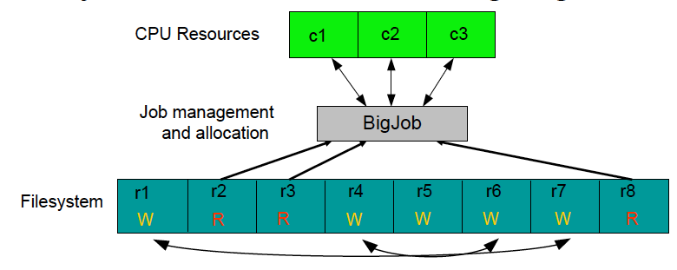
Async Replica-Exchange Package
Python package built to perform file-based asynchronous parallel replica exchange
Exchanges are performed for pairs of replicas currently not running
Plus: Does not require changes to MD code
Minus: Exchanges only possible when replicas in “Waiting” state = low exchange frequency

Slide 10
Job and Data Management using Pilots
Job launching and monitoring occurs through the use of BigJob (http://saga-project.github.io/BigJob/)
Flexible, extensible Pilot-Job system
Pilot-Jobs allow you to submit a “container” job to a batch queue; i.e. 100 tasks does not require 100 separate jobs to the queue – submit 1 job with space for 100 tasks and allow BigJob to manage
BigJob is built upon SAGA (Simple API for Grid Applications) – an “access layer” for Distributed Computing Infrastructure
SAGA is an OGF standard
Particular implementation of SAGA by RADICAL group: saga-python (http://saga-project.github.io/saga-python/)
Write code in a well-defined API and be able to access different middleware and operating systems
Use same job description to submit to PBS or SLURM or Clouds
BigJob is an open-source python module
Can be used as an underlying “framework” to develop more advanced applications

Slide 11
AsyncRE: Python Utility for File-Based Asynchronous RE
Main architecture:
Replicas are prepared in individual directories (r1, …, rM)) starting from template input files, or similar.
A subset of replicas is launched via BigJob. They enter running “R” state.
When a replica completes a run it enters a "W" (wait) state.
Exchanges of thermodynamic parameters are conducted by Gibbs sampling among waiting replicas
Cycle is repeated.
Detection of failed replicas: automatically resubmitted.
Checkpointing and restart.
Resilient execution (i.e. file system errors).
Run and “forget”

Slide 12
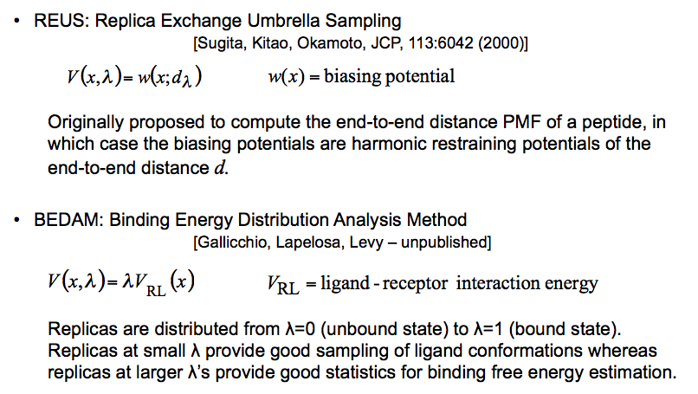
Async RE Package Current Analysis Methods

Slide 13
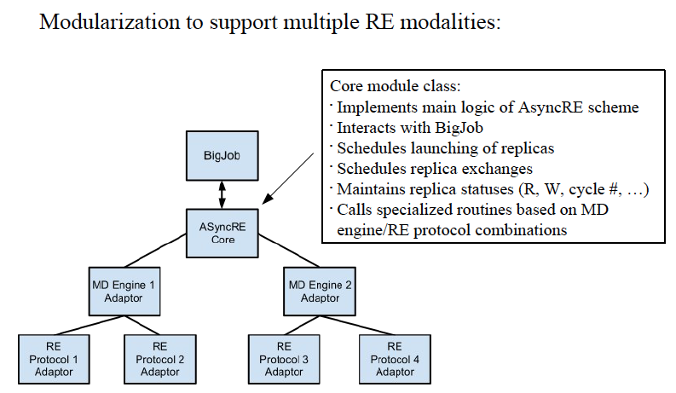
AsyncRE Software Implementation
https://github.com/saga-project/asyncre-bigjob

Slide 14
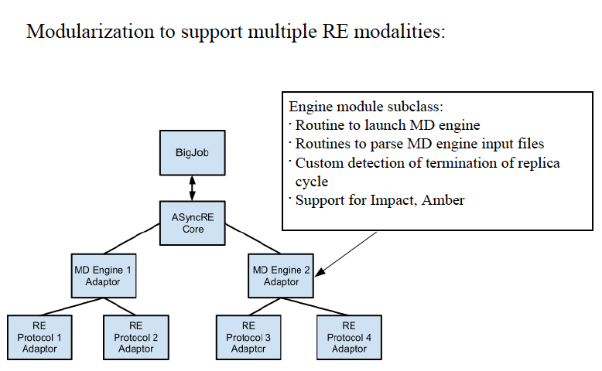
AsyncRE Software Implementation
https://github.com/saga-project/asyncre-bigjob

Slide 15
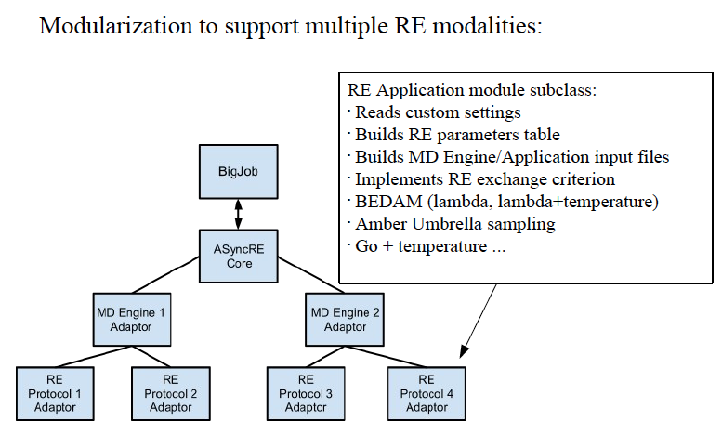
AsyncRE Software Implementation
https://github.com/saga-project/asyncre-bigjob

Slide 16
AsyncRE Installation
The AsyncRE package is installed via pip (successor to easy_install). The package is available on PyPi (Python Package Index). A typical installation of the software includes only the following commands:
pip install numpy
pip install configobj
pip install async_re-0.1.0.t a r.gz
https://github.com/saga-project/asyncre-bigjob

Slide 17
Experiments
Performance Evaluation
Software Package has three modes of potential bottlenecks:
SAGA/BigJob
AsyncRE Python Package
AMBER/IMPACT/MD simulation slow down
Can introduce application overhead: the fraction of the application runtime that is spent on application management logic, communication, and coordination
How do we measure ‘quality’ or ‘performance’ in the MD world?
In the computational chemistry community, typically the number of nanoseconds of simulation times output per day
Must remember “not all simulation time is created equal”
Multiple short simulations do not usually contain as much statistical information as a single long simulation of the same length

Slide 18
Systems Investigated (aka SCIENCE!)
MD engines
IMPACT (implicit solvent)
System 1: Host/guest binding of cyclooctanol/β-cyclodextrin. The exchange parameters are all permutations of the system temperatures and an alchemical parameter coupling the host/guest interactions.
System 2: Folding of the TrpCage mini-protein. The exchange parameters are all permutations of the system temperature and the coupling weight of a Go-type biasing potential.
AMBER (explicit solvent)
System 3: Umbrella sampling of the backbone conformational space of alanine dipeptide. The exchange parameters are all permutations of harmonic biasing potentials of each torsion. (i.e. CLASSICAL AMBER RUN)
System 4: Hybrid quantum mechanical/molecular mechanical umbrella sampling of phosphoryl transfer in 2-hydroxy ethyl ethyl phosphate, a model reaction for base catalyzed RNA cleavage. The exchange parameters are all permutations of harmonic biasing potentials on the breaking and forming bonds (i.e. QM/MM AMBER RUN)

Slide 19
Let’s Talk Pilots
IMPACT (Systems 1 and 2): Fixed Pilot Size, fixed Pilot runtime, and varying number of replicas in proportion to the number of cores per replica
AMBER (System 3): Fixed Pilot Size, approx. fixed cycle length (in CPU time) while varying the number of concurrent jobs (i.e. the number of cores per job) and the simulation time of each cycle
AMBER (System 4): Fixed replica count (192) while varying Pilot size

Slide 20
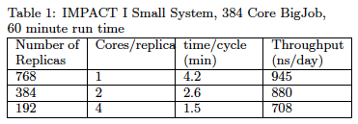
Results – System 1
Nominal maximal throughput: 1300 ns/day (uninterrupted MD at the measured MD CPU speed [4.2 minutes for 10ps per replica])
Observed throughput / maximum = 73%
This corresponds to the overhead imposed by replica exchange coordination (i.e. T^{O}_{BJ} + T^{O}_{RE} )
Parallel efficiency (more cores introduces parallel overhead)
76% for 2 cores
67% for 4 cores
Replica exchange coordination overhead remains approx constant
Indicates ASyncRE+BigJob capable of handling ~4000 subjob launches per hour for this particular system

Slide 21
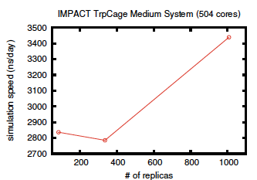
Results – System 2
Nominal maximal throughput: 4.7 μs/day
Observed throughput / maximum = 75%
This corresponds to the overhead imposed by replica exchange coordination (i.e. T^{O}_{BJ} + T^{O}_{RE} )
With 12-cores we obtain 2.8 μs/day
6-fold speed up in terms of single-replica MD throughput

Slide 22
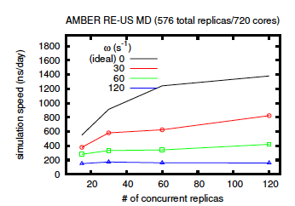
Results – System 3
Umbrella sampling of the backbone conformational space of alanine
dipeptide. The exchange parameters are all permutations of harmonic
biasing potentials on each torsion.
Length of each simulation cycle (i.e. the frequency with which simulations are coordinated) was fixed in real time by varying the simulation time per cycle
Ideal performance considered to be zero coupling in this case
Diminished results due to coordination overheads
Launch frequency seems to be fairly uniform at higher freq. (see blue line)
Conclusion: Generally, the number of replicas can be increased with only a minor performance hit

Slide 23
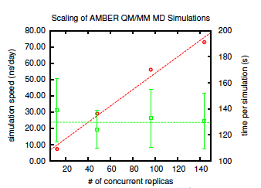
Results – System 4
QM/MM is not generally considered parallelizable
RE provides efficient sampling irrespective
Repex FW: BigJob-based Repex
Framework to handle O(100)---O(1000) concurrent simulations
Amongst the earliest QM/MM
Framework similar to classical QM/MM
Performance increases linearly with core count – no apparent coordination cost for additional simulations
QM/MM simulations are serial

Slide 24
Conclusion
Basic aim of REMD is to increase the statistical power of multiple simulations by facilitating the exchange of information between them in a concerted fashion
New AsyncRE python package proves to be able to handle more large-scale replica exchange than was previously possible
Modular code design allows for the development of new adaptors or RE methods (development on NAMD adaptor being investigated)
SAGA/BigJob allow the AsyncRE framework to submit to various platforms and XSEDE machines
The framework is applied in a consistent manner across simulation engines and execution modes
Performance of the simulation engines are inline with expected behavior in the absence of coordination from ASyncRE/BigJob

Slide 25
Future Work
Develop new MD engine adaptors
NAMD
Stress-test components more individually
Clear separation to identify bottlenecks and how to mitigate them
Utilize BigJob’s data-movement capabilities in order to run across multiple XSEDE machines
Test the capabilities of running order 10³ replicas
Data deluge, transfer, analysis
Adaptive RE: add/remove replicas during run
Load on front-end host (exchanges can be somewhat expensive)
Grow user base and user documentation

Slide 26
Acknowledgements
“The Rutgers Chemists”
Brian Radak, Darrin York, Ronald Levy, Emilio Gallicchio, Tai-Sung Lee, Nan-Jie Deng, Peng He, Wei Dai
Rutgers RADICAL Team
http://radical.rutgers.edu
Especially: Shantenu Jha, Pradeep Kumar Mantha (graduated), Ole Weidner, Andre Luckow, Andre Merzky, Ashley Zebrowski
TACC ECSS Assistance: Yaakoub El-Khamra
National Science Foundation

Slide 27
References
Rutgers BioMaps: http://biomaps.rutgers.edu
Rutgers RADICAL: http://radical.rutgers.edu
AsyncRE Software Package: https://github.com/saga-project/asyncre-bigjob/
AsyncRE Mailing List: async-replica-exchange@googlegroups.com
saga-python: http://saga-project.github.io/saga-python/
BigJob: http://saga-project.github.io/BigJob/

Slide 28


