Slide 1
A Fresh Perspective on Large-Scale Distributed Cyberinfrastracture
October 15th , 2013

Slide 2
Overview
The Problem
  Current state of distributed applications and infrastructure is problematic
    Heterogeneous middleware, point solutions, usability, …
    Occupied by plumbing; insufficient reasoning about when/how to distribute
  Distributed computing at scale needs performance, flexibility, and extensibility
    Resource Management: Flexibility vs Performance
      Inflexible: Optimized/pinned to a specific platform, e.g., MPI, Hadoop-based applications
      Flexible: Run anywhere but performance is unpredictable, e.g.,_x0005_BWA/NGS applications
The Hypothesis
  “Managing complexity is not the same as extracting simplicity”
    Extracting simplicity whilst managing complexity requires abstractions
    Abstractions and models are key to “reason about distribution”
The Solution
  Pilot-abstractions to facilitate reasoning across application and resource level (compute, data and network)
Notes:
Distributed computing is one pathway to extreme-scale
Problem statement was valid 10 years ago. What has changed in 10 years? Need/want to reason
Current State: M-to-M A-I, but we can think of it as a challenge to map 1-to-many, many-to-1
“managing complexity is not the same as extracting simplicity” ---- requires abstractions!

Slide 3
Introduction to Pilot Jobs
Working definition: a system that generalizes a placeholder job to provide multi-level scheduling to allow application-level control over the system scheduler via a scheduling overlay
User Space
User Application
Pilot-Job System
Policies
Pilot-Job
Pilot-Job
System Space
Resource A
Resource B
Resource C
Resource D
Notes:
Get slides of Pilot Jobs from Ole
Pilot-jobs as a (A)RM because of limitations of the middleware and infrastructure. Different middleware; differenent limitations. Therefore different pilot jobs semantically and functionally.

Slide 4
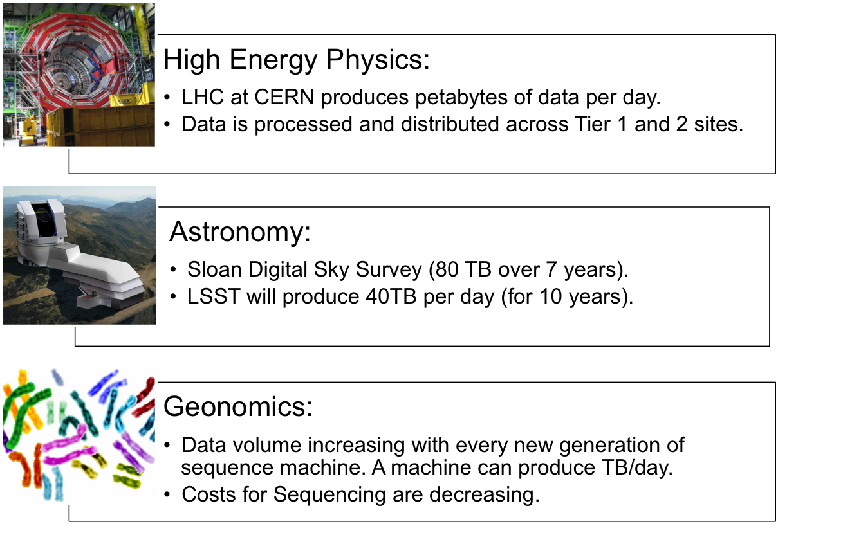
Data-intensive Sciences

Slide 5
Pilot-Data: Design Objectives
Reduce barrier of entry to extreme-scale distributed, dynamic data
Enable reasoning about distributed and dynamic compute, data and resources
Remove lower-level details:
  Access to heterogeneous backend infrastructures
  file I/O and networking
  synchronization between compute and data
Enable data-aware decision making:
  Exploit data locality whenever possibly.
  Enable applications to control typical trade-offs: data movement e.g. makes sense if data is process multiple times
Notes:
allow applications to construct their own “data-pipelines” on application-level and connect data sources with compute
Similar levels of heterogeneity in the data infrastructure
File systems, storage, transport protocols, …
Support application level capabilities to specify dependencies at a logical level rather than specific file level
First class support for Affinities (D-C, D-D)
Typically placement and scheduling of data is decoupled from the compute-tasks
Integrated approach to compute and data ?
Dynamic decision for data
Analogous to late-binding of data
Fluctuating resources as a fundamental property of DCI
Abstraction for other factors and not application specific way:
Varying data sources, fluctuating data rates, etc

Slide 6
What is Pilot-Data?
Manage (dynamic) storage resources in conjunction with Pilot-Jobs
Unified access layer to different heterogeneous storage backend and access layers: SRM, iRODS, Globus Online, S3
Higher-level abstraction to manage distributed and dynamic data/compute in (geographically) distributed systems:
  Data Unit: Grouping of files that are accessed together
  Manage complex data flows consisting of multiple steps of compute across (geographically) distributed resources
Co-Location and co-scheduling of compute and data

Slide 7
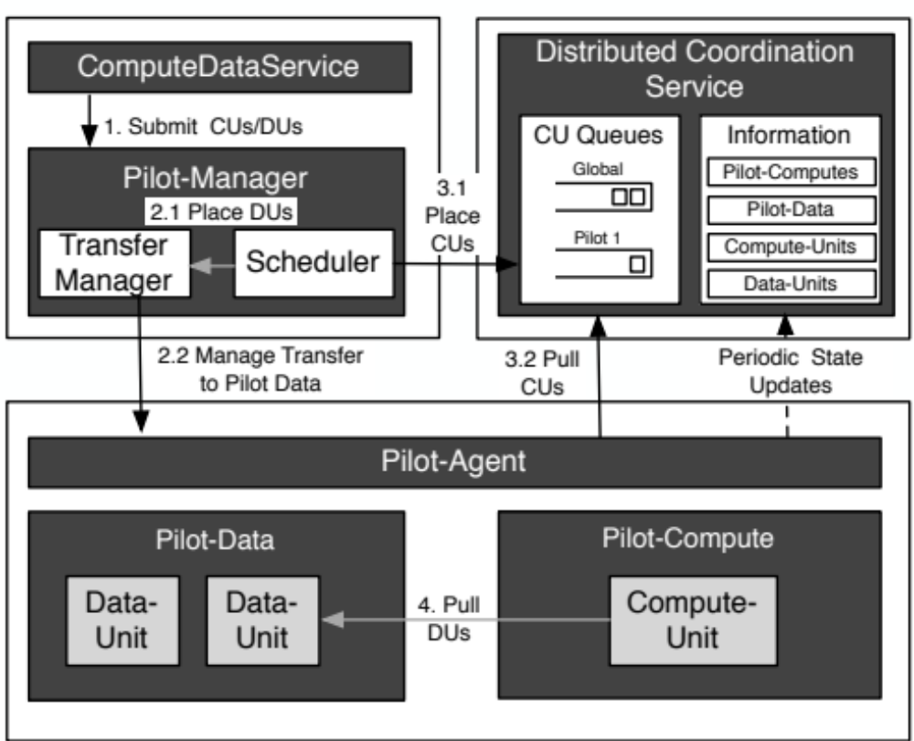
Pilot-Data Architecture

Slide 8
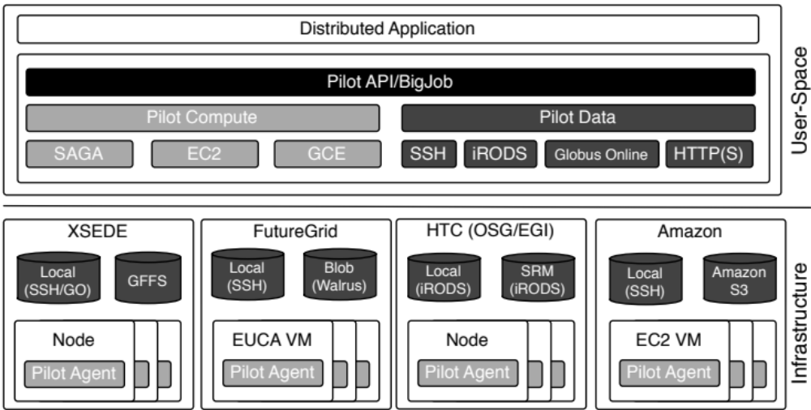
Supported Infrastructures

Slide 9
Pilot-Data on OSG
OSG proposes three usage modes for data-intensive applications:
  Condor-based file staging
  SRM
  iRODS
Complex Decision Matrix:
 | Condor Filestaging | SRM | iRODS
Data Volume | Low | High | High
Complexity | Low | High | Medium
Data Distribution | Local | Local | Local, Geographic
Data Replication | No | No | Yes
Flexibility (Multi-stage applications, data reuse, multiple infrastructure) | Low | Low | Low
Pilot-Data
Backend-specific
Backend-specific
Local, Geographic
PD and System-specific replication
High
Pilot-Data enables the user/application to tradeoff the different characteristics of data cyberinfrastructures

Slide 10
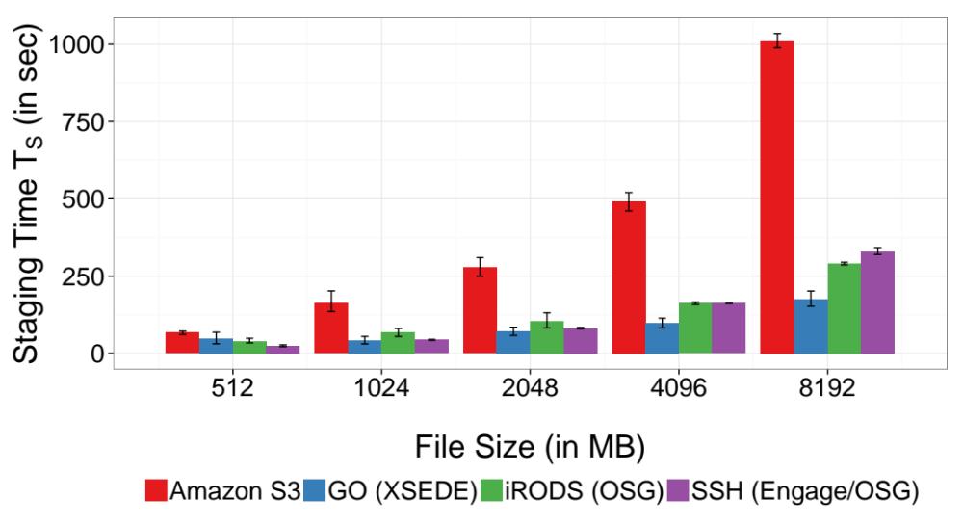
Pilot-Data Performance
Pilot-Data support different transfer protocols and storage backends

Slide 11
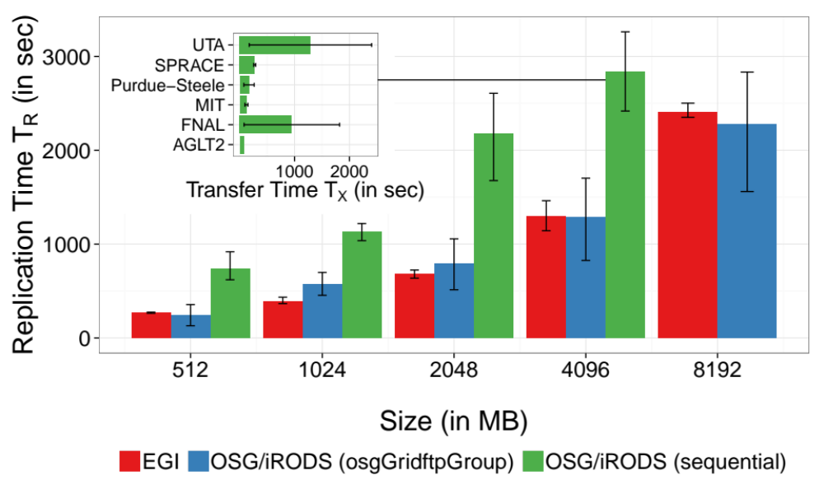
Pilot-Data: Support Infrastructure-Level Replication

Slide 12
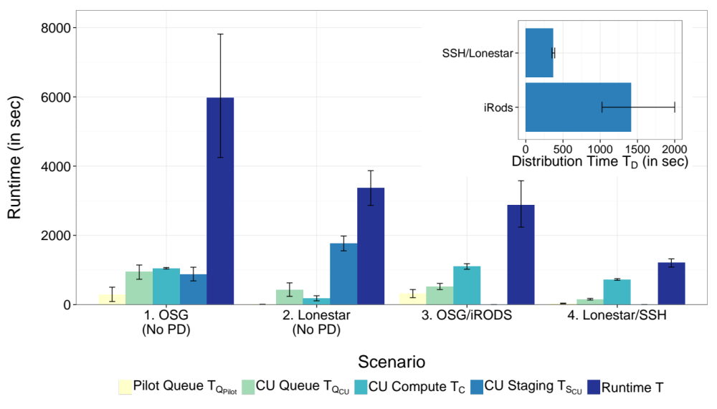
Supporting Infrastructure Interoperability
Once a Compute Unit requires a
significant amount of data (~8.3 GB) data staging becomes the bottleneck
Notes:
PJ Framework Interoperability: Average runtime of 128 BFAST CUs on different infrastructures. CUs are equally distributed across the two in- frastructures. The performance heavily depends on the available bandwidths to the resources, which determines the time required for file transfers.

Slide 13
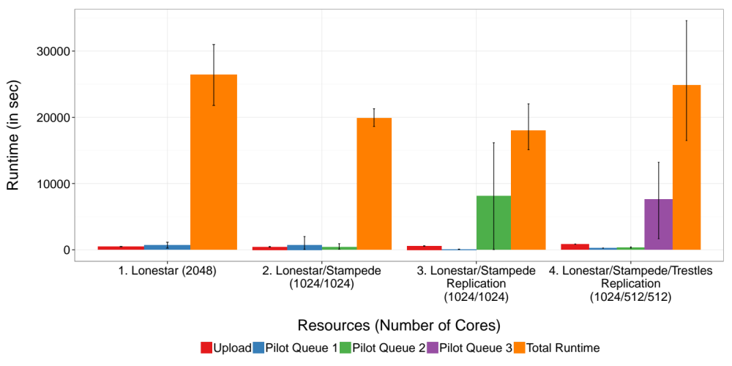
Genome Sequencing: Supporting Large-Scale Distributed Data and Compute using Pilot-Data
Notes:
PJ Framework Interoperability: Average runtime of 128 BFAST CUs on different infrastructures. CUs are equally distributed across the two in- frastructures. The performance heavily depends on the available bandwidths to the resources, which determines the time required for file transfers.

Slide 14

Backup

Slide 15
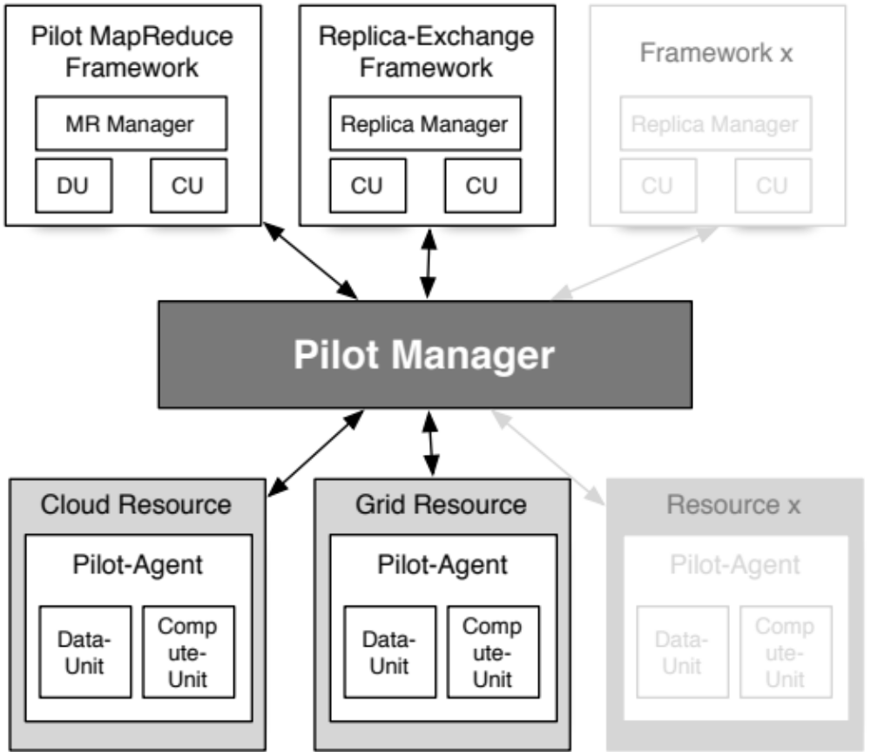
Pilot-Abstraction: Supporting Heterogeneous Application Workloads

Slide 16
Conclusion
Simplicity: Pilot-Compute/Pilot-Data enables the effective management of compute/data in heterogeneous, distributed environments:
    “Embrace distribution” - do not hide it
Interoperability: BigJob allows the interoperable use of different infrastructures
Performance: Enables the flexible placement of compute/data and the exploration of performance trade-offs
Notes:
Affinity provides a higher-level abstraction that support reasoning about data localities

Slide 17
Publications
Andre Luckow, Mark Santcroos, Ole Weidner, Andre Merzky, Pradeep Mantha, Shantenu Jha, P*: A Model of Pilot-Abstractions, IEEE e-Science, 2012
Andre Luckow, Mark Santcroos, Ole Weidner, Ashley Zebrowski, Shantenu Jha, Pilot-Data: An Abstraction for Distributed Data, submitted to Supercomputing 2013.
Pradeep Mantha, Andre Luckow, Shantenu Jha: Pilot-MapReduce: An extensible and flexible MapReduce implementation for distributed data, MapReduce Workshop at HPDC 2012.
Mark Santcroos, Barbera DC van Schaik, Shayan Shahand, Silvia Delgado Olabarriaga, Andre Luckow, Shantenu Jha: Exploring Flexible and Dynamic Enactment of Scientific Workflows using Pilot Abstractions, CCGrid 2013.

Slide 18
Next Steps
Explore system-level and application-level data management capabilities:
  System-level and application-level replication
Modelling infratructures and applications:
  Support reasoning about resources (compute and data) and applications
  Enable execution planning
Evolve and validate abstractions
  Pilots as a way to reason about infrastructures
Next Publications:
  Pilot Survey Paper: A Fresh Perspective on Pilot-Jobs
  BigJob: A Pilot-Job for Compute and Data

Slide 19
Limitations of existing Pilot-Jobs
Many Pilot-Job offerings, often semantically distinct
  DIANE DIRAC CONDOR Glide-In SWIFT ToPoS Falkon, PanDA Nimrod/G, ……, BigJob
Conceptual and practical barriers to interoperability
  P* towards a unified view of Pilot-Jobs, Pilot-Abstractions
Data remains a dependent variable, not a primary variable
  P* introduces the concept of Pilot-Data
We know “what” Pilot-Jobs do, but the “how” remains primitive
  How to map tasks to pilot-jobs?
  When to map tasks to pilot-jobs? Pilot-jobs to resources?
  How to “slice and dice” resources? How to map to infrastructure?
    Role for underlying resource abstraction (Bundles)?
Notes:
Pilot-jobs as a (A)RM because of limitations of the middleware and infrastructure. Different middleware; differenent limitations. Therefore different pilot jobs semantically and functionally.
Pilots tell you what to do (N x M) but not why or how?

Slide 20
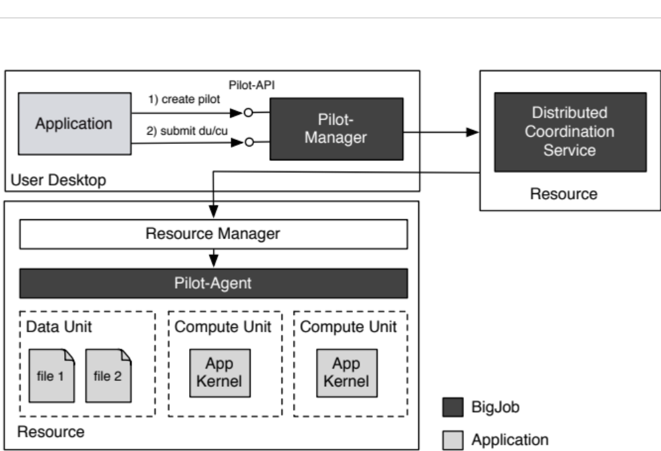
BigJob: Implementation of the P* Model

Slide 21
Overview
Distributed computing is one pathway to extreme-scale
The Problem
  Current state of distributed applications and infrastructure is problematic
    Middleware, Point solutions, Usability, Heterogeneity..
  Distributed computing at scale: need performance, flexibility, and extensibility
    Applications are inflexible: optimized and pinned to a specific platform
      MPI, Hadoop-based applications
    Applications are flexible: run anywhere but performance is unpredictable
      _x0005_BWA/NGS applications
    Busy with plumbing, less on reasoning about when/how to distributed
The Hypothesis
  Abstractions and Models are key to “reason about distribution”
  Extracting Simplicity whilst managing Complexity requires abstractions
The Solution
  Fresh approach to resource management – compute, data, and network
  Pilot-abstractions to facilitate reasoning across application and resource level
Notes:
Problem statement was valid 10 years ago. What has changed in 10 years? Need/want to reason
Current State: M-to-M A-I, but we can think of it as a challenge to map 1-to-many, many-to-1
“managing complexity is not the same as extracting simplicity” ---- requires abstractions!

Slide 22
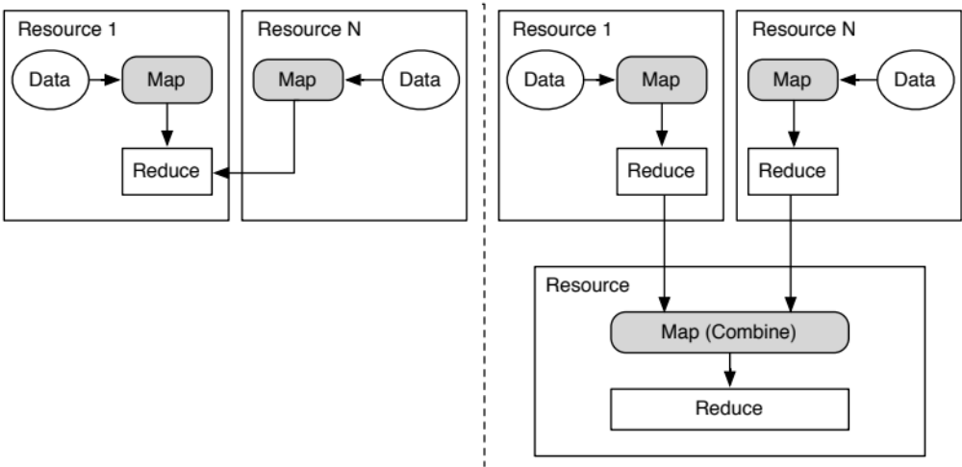
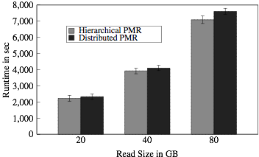
Pilot-MapReduce
Pilot-Abstractions enable
the flexible use of distributed resources
Distributed MapReduce
Hierarchical MapReduce
Genome Sequencing MapReduce application on different resource configurations

Slide 23
Acknowledgements/Funding Sources
Active:
  NSF CAREER Award 2012 (OCI-1253644)
  CDI NSF-CDI (NSF CHE 1125332)
  ExTENCI (NSF OCI)
  SCIHM NSF-OCI (OCI-1235085)
  AIMES DoE-ASCR (DE-FG02-12ER26115)
Compute Time:
  NSF TeraGrid TRAC award TG-MCB090174
  NSF FutureGrid Award (No. 42)
Recent Past:
  NSF/LEQSF (2007-10)-CyberRII-01
  NSF HPCOPS NSF- OCI 0710874 award
  UK EPSRC (GR/D0766171/1; OMII) and e-Science Institute, UK
  NSF OCI 1059635
  NIH Grant Number P20RR016456

Slide 24
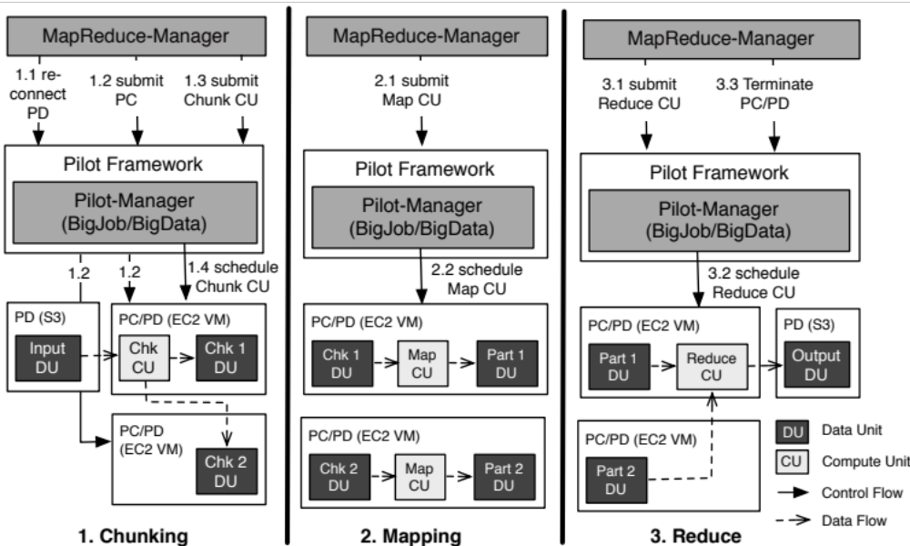
Application Examples: Pilot-MapReduce

Slide 25
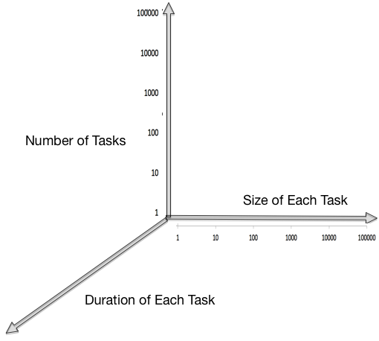

Slide 26
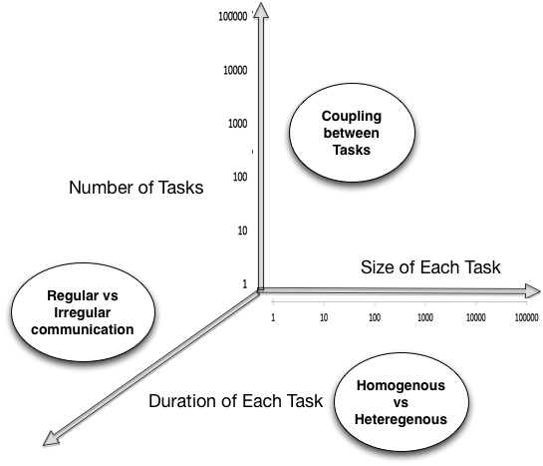

Slide 27
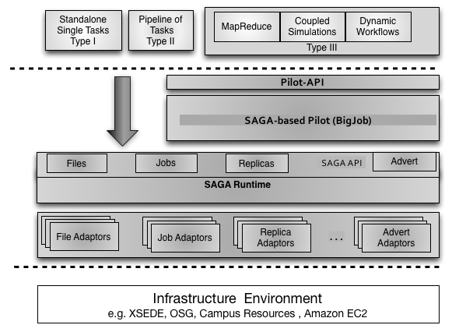

Slide 28
Related Work: Data Management in Pilot-Jobs
Many Pilot-Jobs do not support sophisticated data management:
  Simple support for file movement in and out
  Infrastructure-dependent handling of input/output data
  Often very inefficient with respect to the exploitation of data locality
PanDA Dynamic Data Placement
  On-going refinement of data management capabilities
    File movement
    Integration of different data backends (e.g. XROOTD)
  Static processing and replication model of Atlas experiment did not proof flexible enough
    PD2P: on-demand replication of data to tier 2 sites, e.g. popularity, locality, usage patterns of the data, etc.
    However, constrained to specific “official” Atlas datasets. No application-level control.

