Slide 1
Distributed and Loosely Coupled Parallel Molecular Simulations using the SAGA API
PI: Ronald Levy, coPI: Emilio Gallicchio, Darrein York, Shantenu Jha
Consultants: Yaakoub El Khamra, Matt McKenzie

Slide 2
Objective
Prepare the software infrastructure to conduct large scale distributed uncoupled (ensemble-based) and coupled replica exchange molecular dynamics simulations using SAGA with the IMPACT and AMBER molecular simulation programs.
SAGA

Slide 3
Difficulties
Launch and monitor/manage 1k-10K loosely coupled replicas
Long job duration: days to weeks (will have to checkpoint & restart replicas)
Pairwise asynchronous data exchange (no global synchronization)

Slide 4
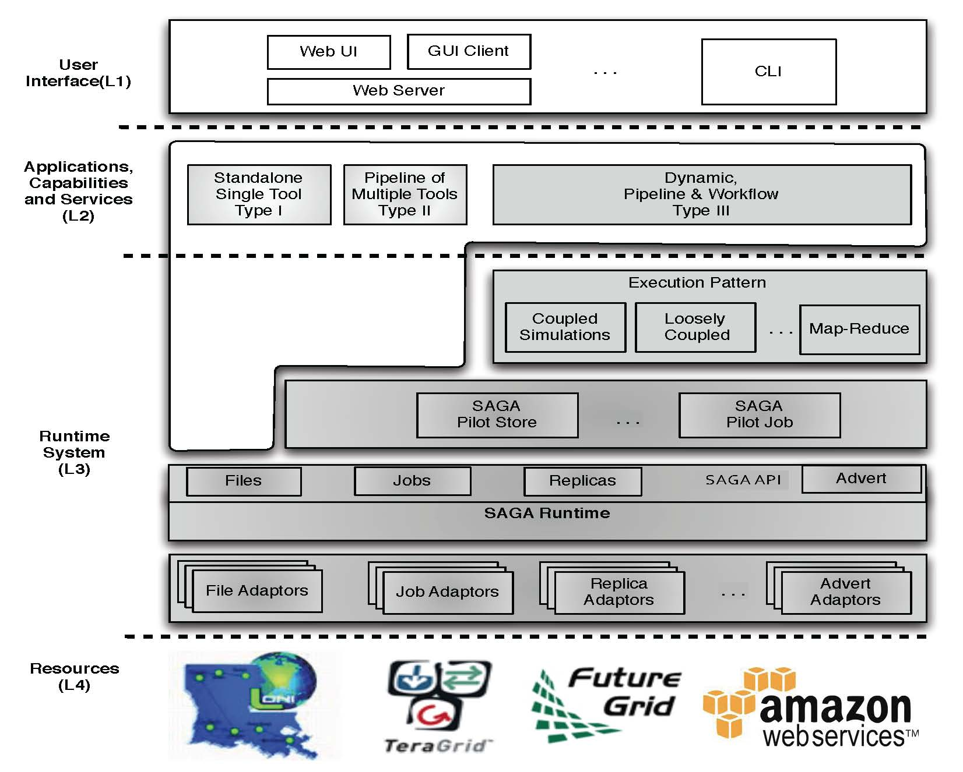
Simple Solution: SAGA
Three levels:
Access/Application Layer
Services & middleware Layer
Resource Layer
Application/Access Layer
Extensible and flexible
Standard-based middleware and services
OGF Standard and official access layer of NSF XSEDE: Globus+Unicore
Resource Level
Extensible + Interoperable
Direct Immediate support from the development team

Slide 5
SAGA Supporting Infrastructure
Advert Service: a central DB that acts as a central data exchange repo (anything from allocation project names to file locations and job info)
BigJob: a pilot job framework that acts as a container job for many smaller jobs (supports parallel and distributed jobs)
DARE: science gateway framework that supports BigJob jobs

Slide 6
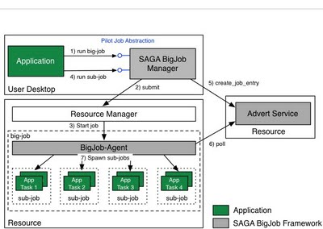
Aside: BigJob
SAGA BigJob comprises of three components
BigJob Manager that provides the pilot job abstraction and manages the orchestration and scheduling of BigJobs (which in turn allows the management of both bigjob objects and subjobs)
BigJob Agent that represents the pilot job and thus, the application-level resource manager running on the respective resource, and
Advert Service that is used for communication between the BigJob Manager and Agent.
BigJob supports MPI and distributed (multiple-machine) workflows

Slide 7
This is NOT new software
Most (if not all) of the infrastructure is tried and true, but not at extremely large scale
Sanity checks, perpetual demos and performance checks are run continuously to find problems
Focusing on hardening and resolving issues when running at scale

Slide 8
SAGA on TeraGrid
SAGA deployed as a CSA on Ranger, Kraken and Lonestar
Advert service hosted by SAGA team
Replica exchange workflows, EnKF workflows and coupled simulation workflows using BigJob on TeraGrid (many papers)
Basic science gateway

Slide 9
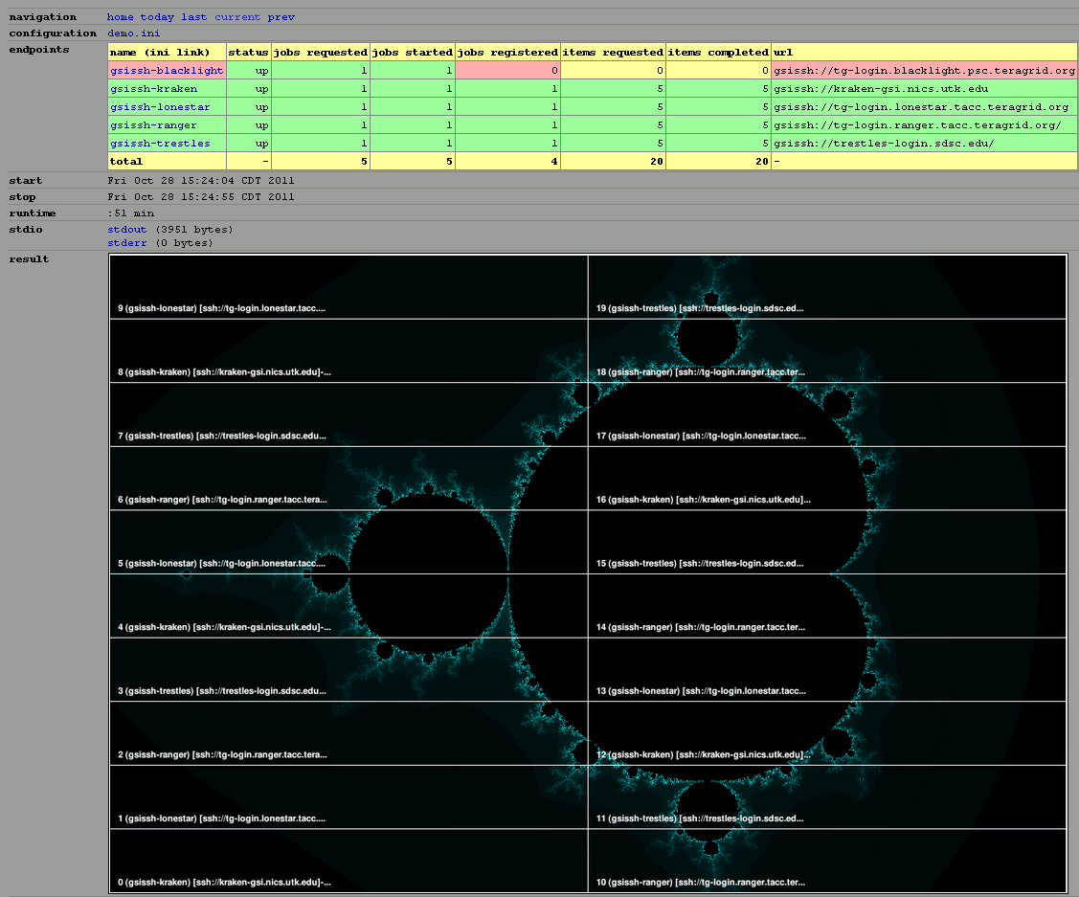
Perpetual SAGA Demo on XSEDE

Slide 10
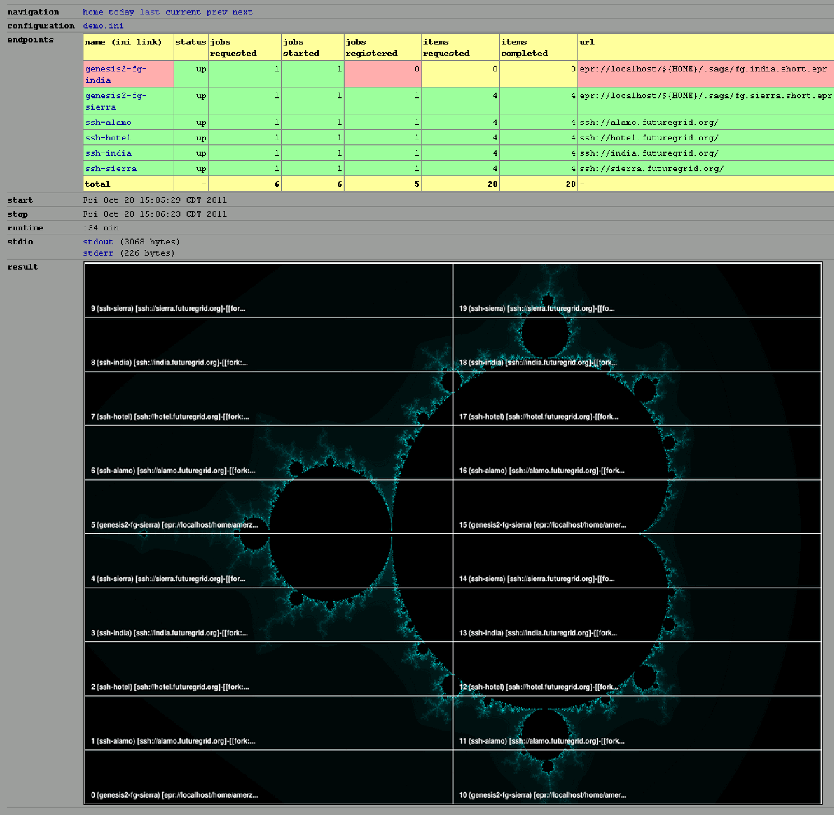
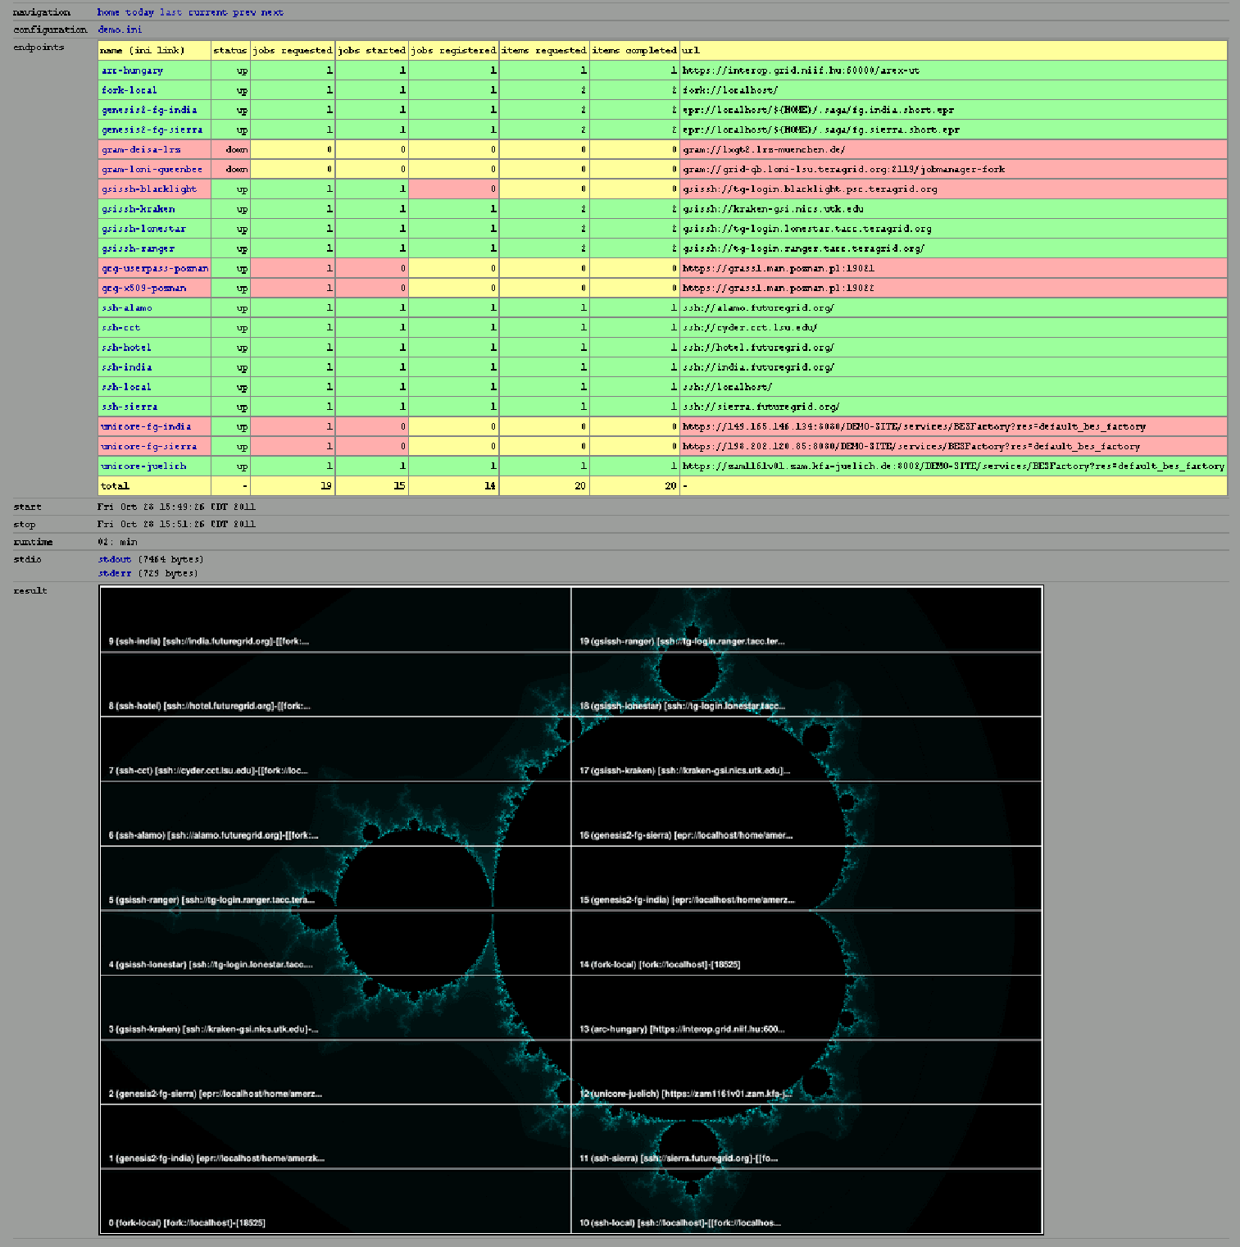
FutureGrid & OGF-GIN

Slide 11
SAGA on XSEDE
Latest version (1.6.1) is available on Ranger, Kraken and Lonestar, will be deployed on Blacklight and Trestles as CSA
Automatic deployment and bootstrapping scripts available
Working on virtual images for advert service and gateway framework (hosted at Data Quarry)
Effort is to make the infrastructure: “system friendly, production ready and user accessible”

Slide 12
Tom Bishop’s Stuff Goes here

Slide 13
Workplan
Deploy SAGA infrastructure on XSEDE resources (done)
Deploy a central DB for SAGA on XSEDE resources (almost done)
Deploy the BigJob pilot job framework on XSEDE resources (almost done)
Deploy the science gateway framework
Run and test scale-out

Slide 14
References
SAGA website: http://www.saga-project.org/
BigJob website: http://faust.cct.lsu.edu/trac/bigjob/
DARE Gateway: http://dare.cct.lsu.edu/

