Slide 1
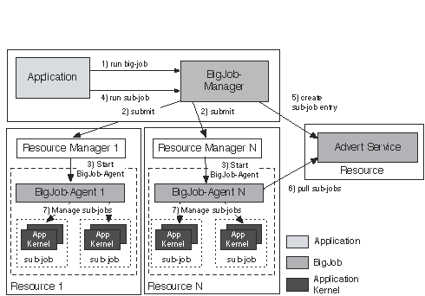
Abstractions for Dynamic Execution: SAGA Pilot-Job (BigJob)

Slide 2
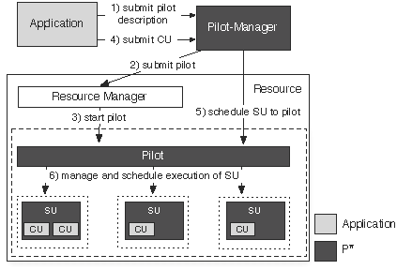
P* Model of Pilot-Abstractions

Slide 3
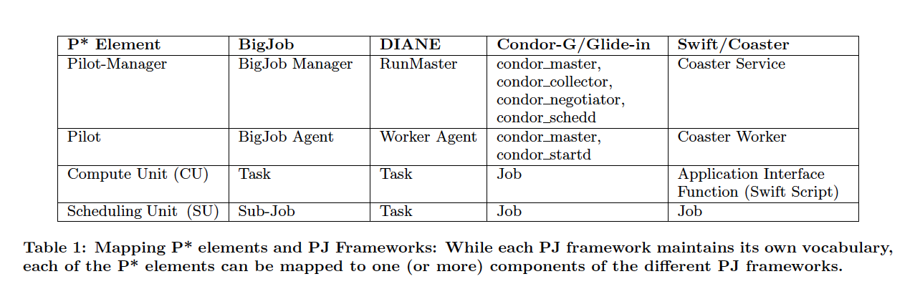
Mapping P* Elements to PJ-Frameworks

Slide 4
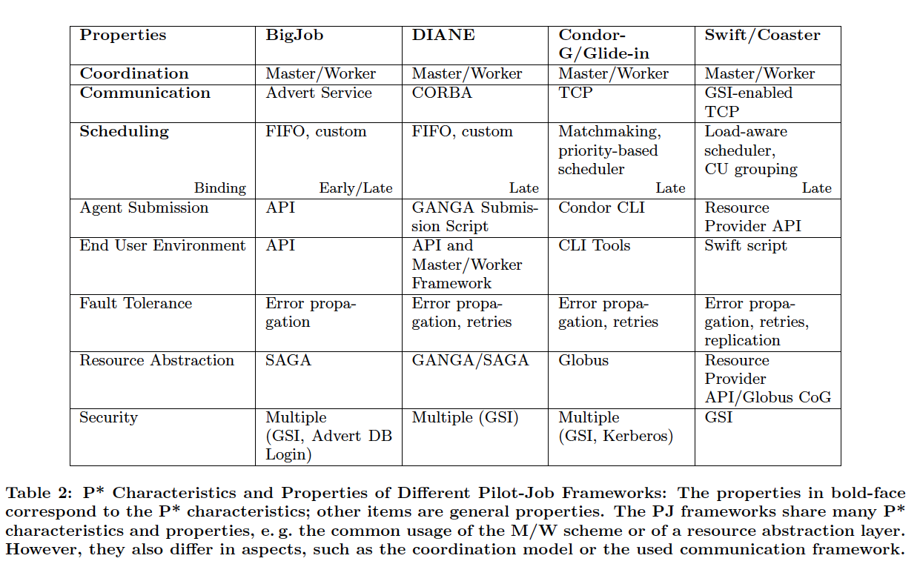
Mapping P* Characteristics to PJ-Frameworks

Slide 5
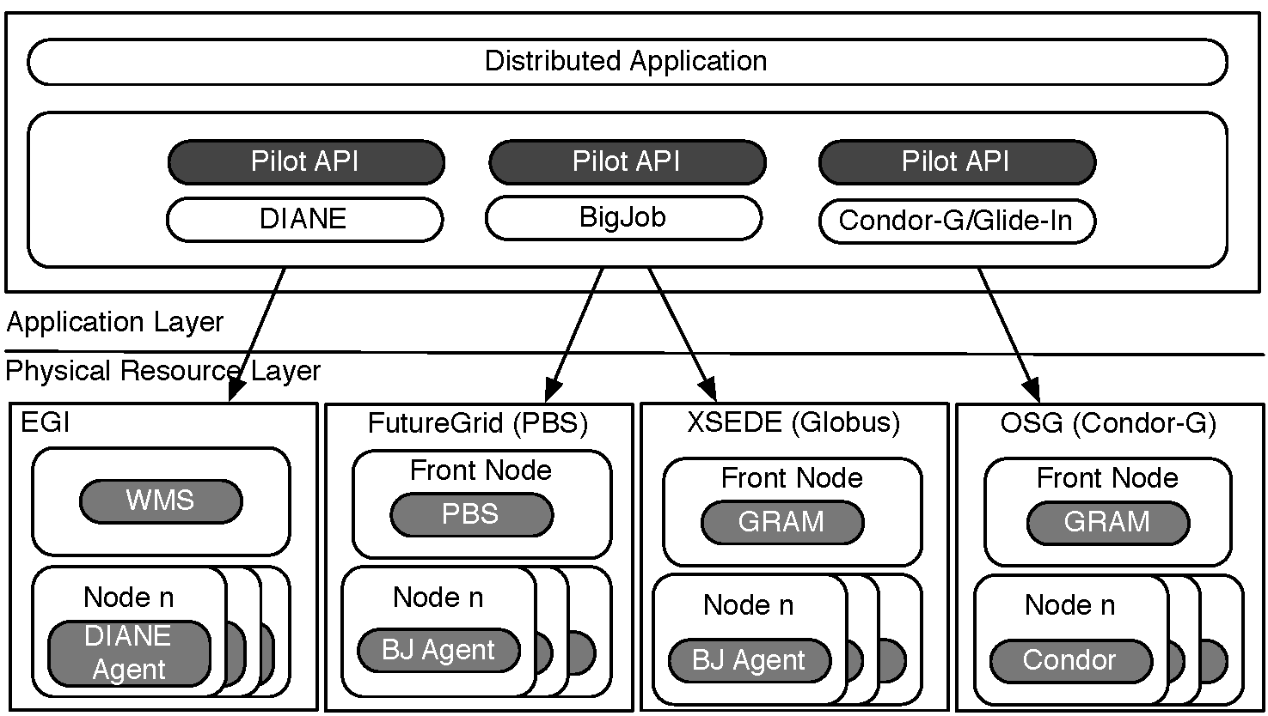
Exposing the P* Model: The Pilot-API

Slide 6
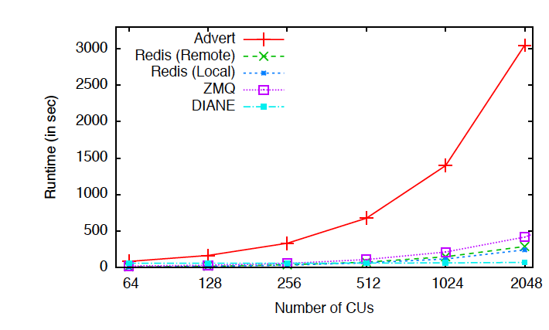
Efficient Coordination of “ensembles”

Slide 7
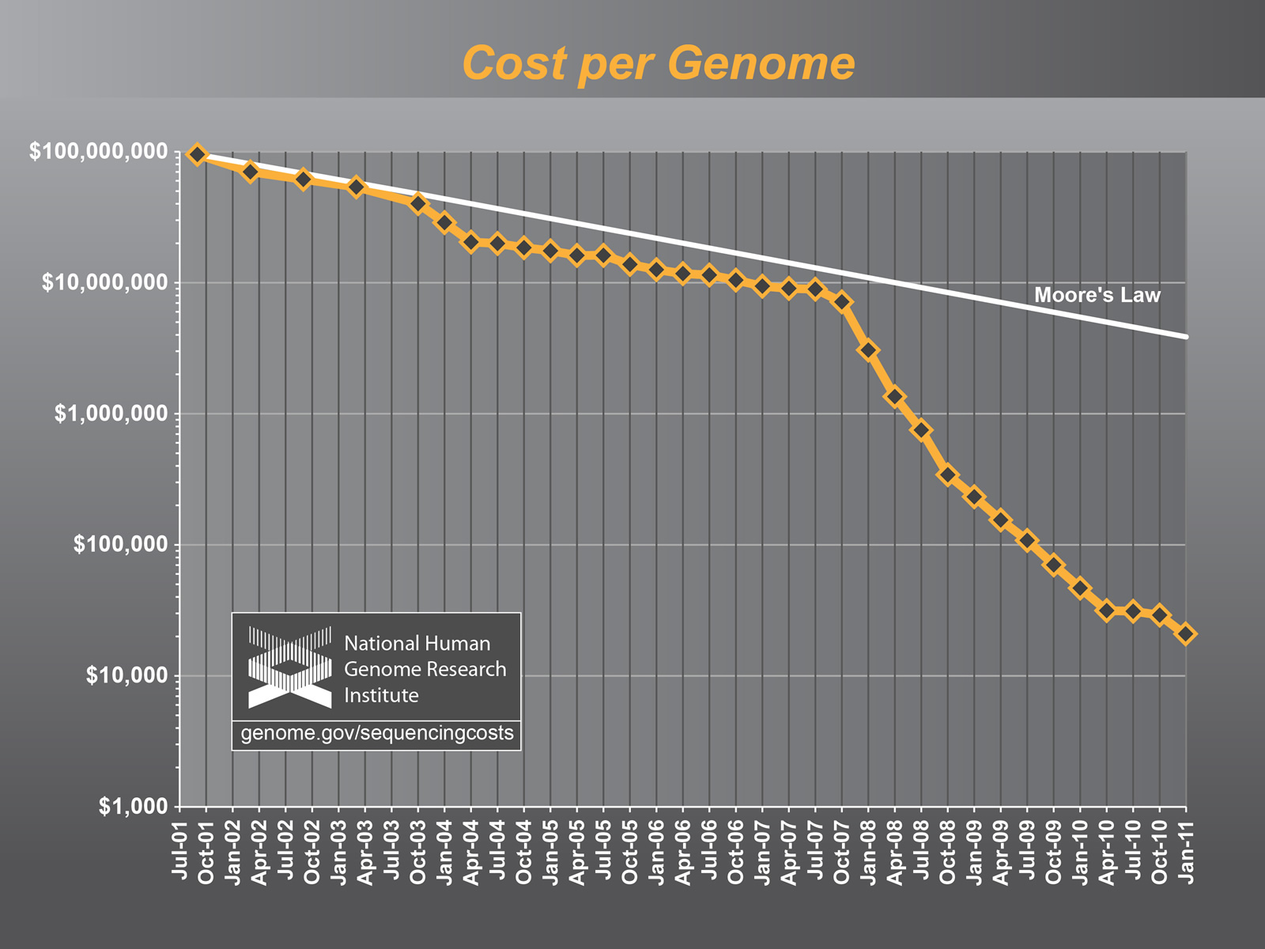
The Challenge of Integrating Compute and Data CI

Slide 8
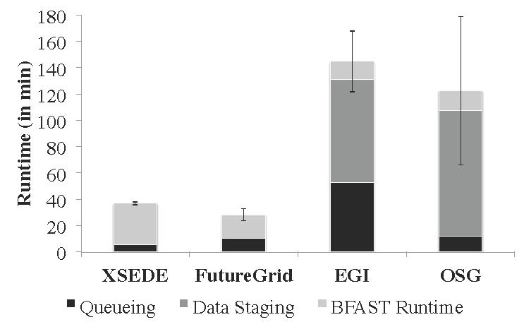
Performance of Pilot-Jobs: Multiple DCI

Slide 9
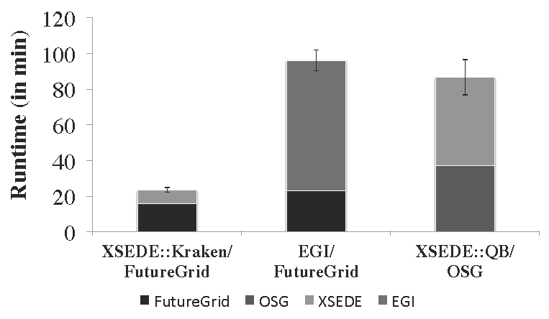
Pilot-Job Interoperability via Pilot-API

Slide 10
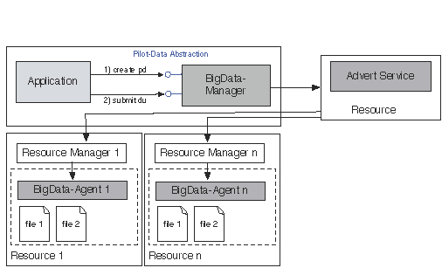
Pilot-Data
In analogy with BigJob - BigData (before Big Data was BigData!)

Slide 11
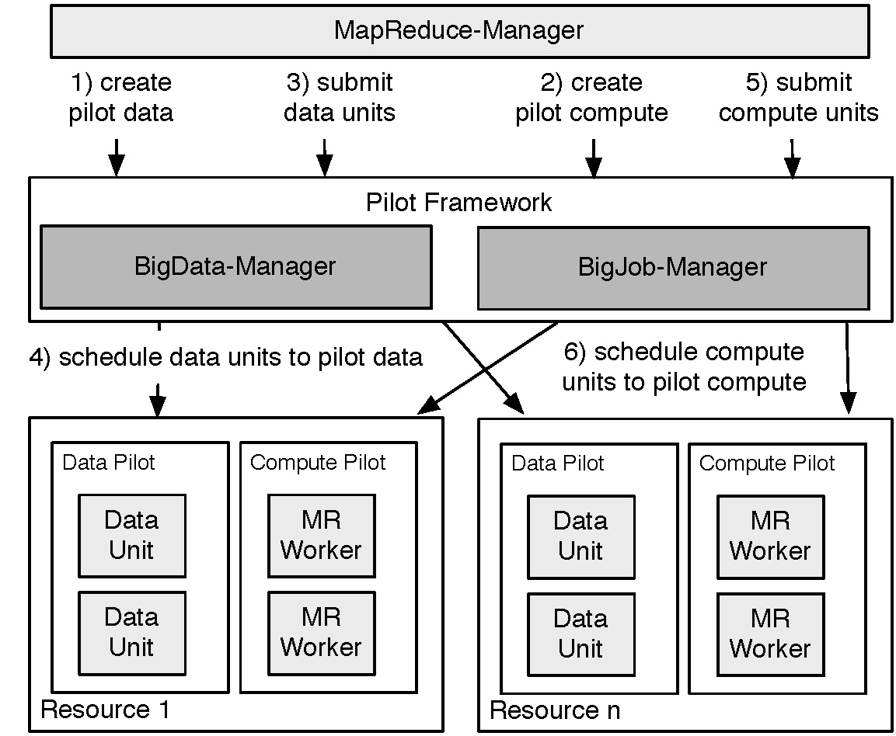
Pilot-MapReduce for NGS

Slide 12
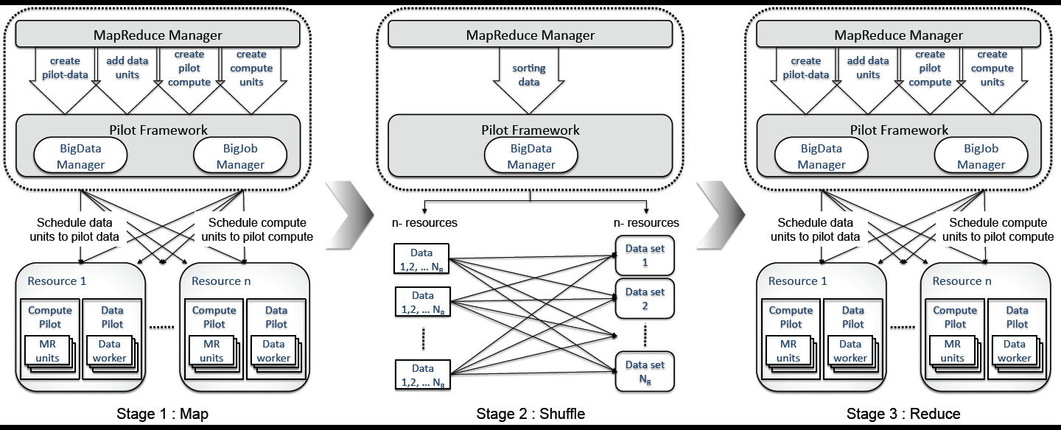
Pilot-MapReduce

Slide 13
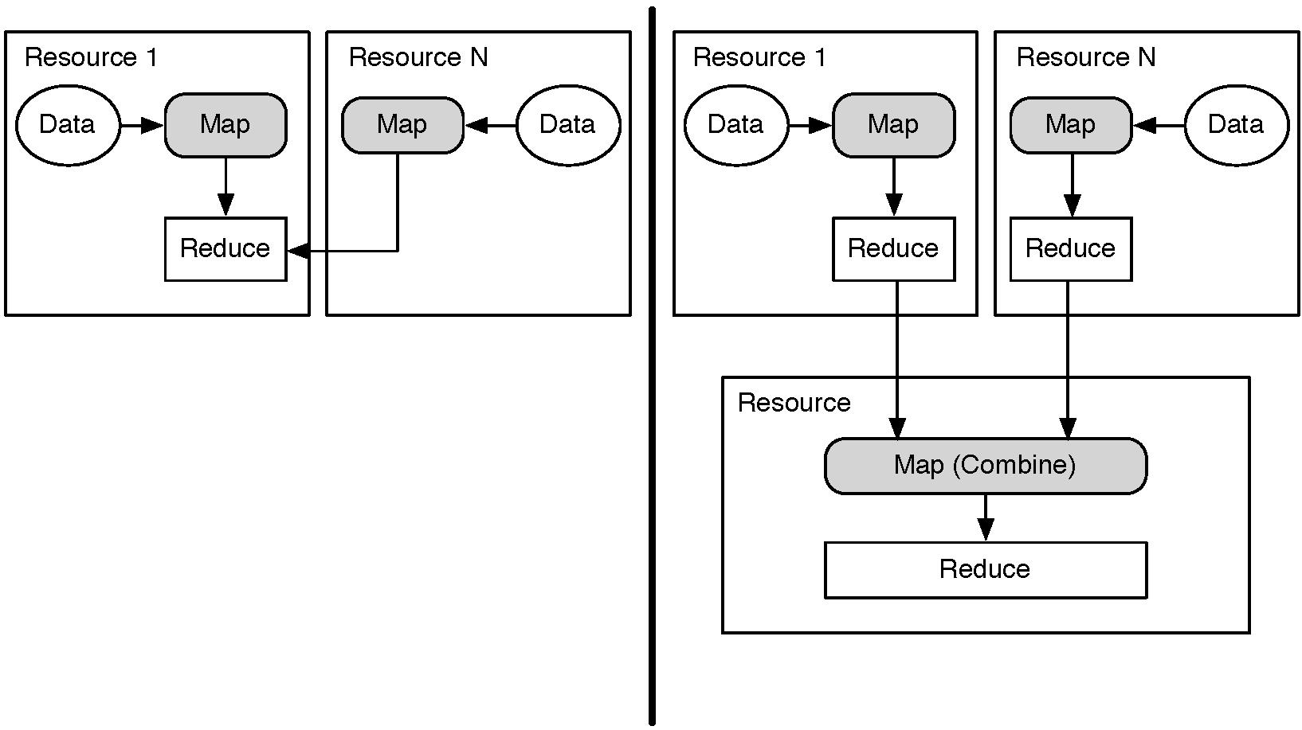
Distributed (DMR) versus Hierarchical (HMR)

Slide 14
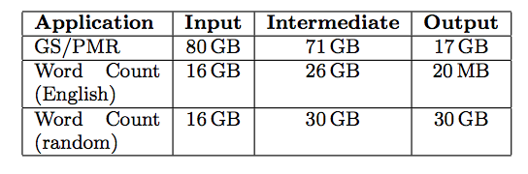
Hadoop vs PMR (for distributed data scenarios)

Slide 15
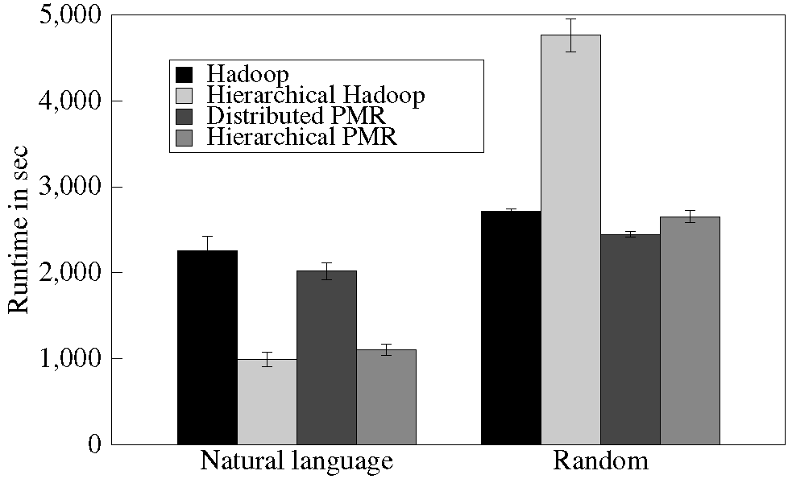
Hadoop vs PMR (for distributed data scenarios)

Slide 16
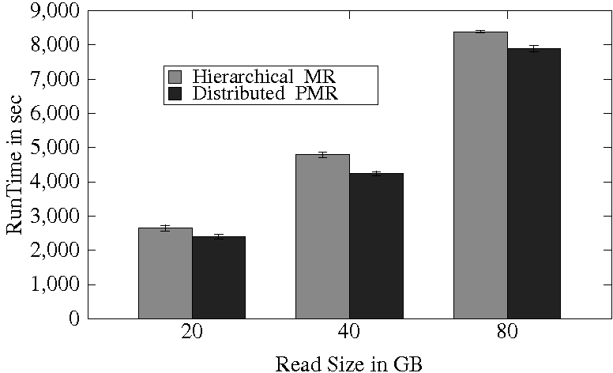
Hadoop vs PMR (for distributed data scenarios)

Slide 17
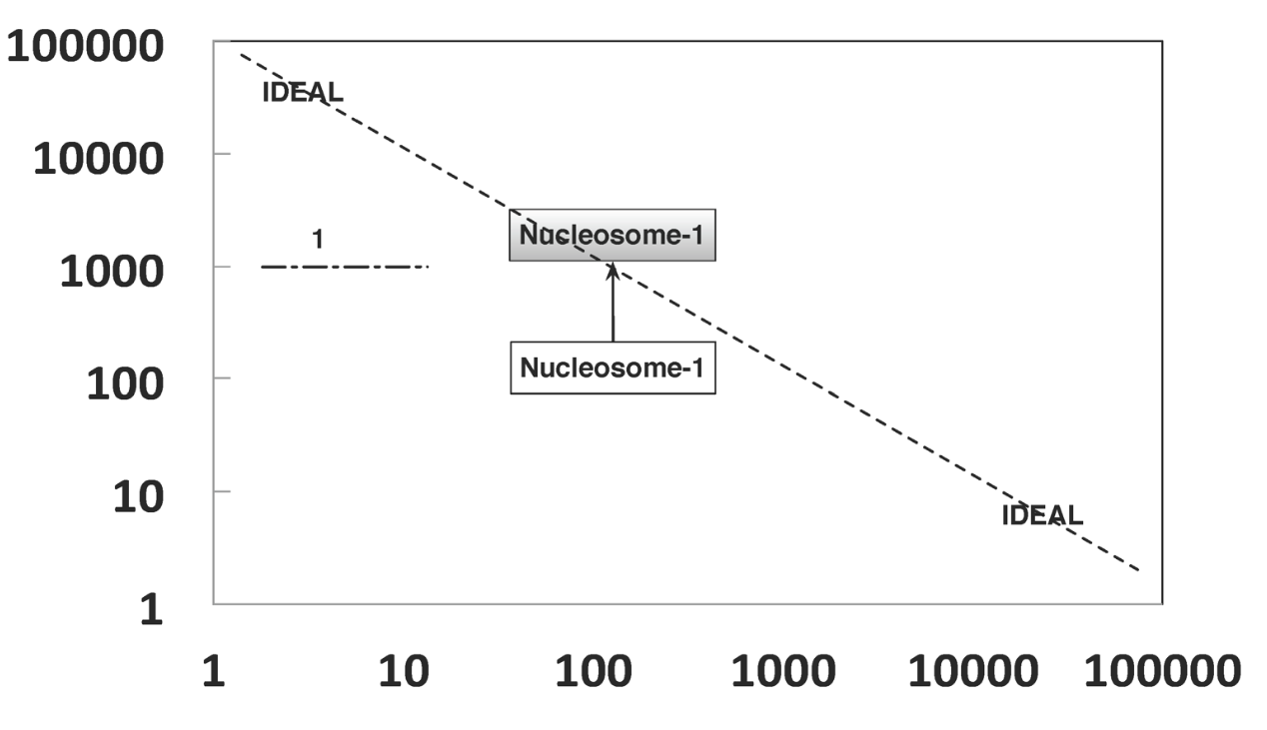
SAGA-based PJ: HT-HPC
# of Ensemble Members
Number of cores per Ensemble Member

Slide 18
Abstractions for Dynamic Execution
SAGA Pilot-Job (BigJob)

Slide 19
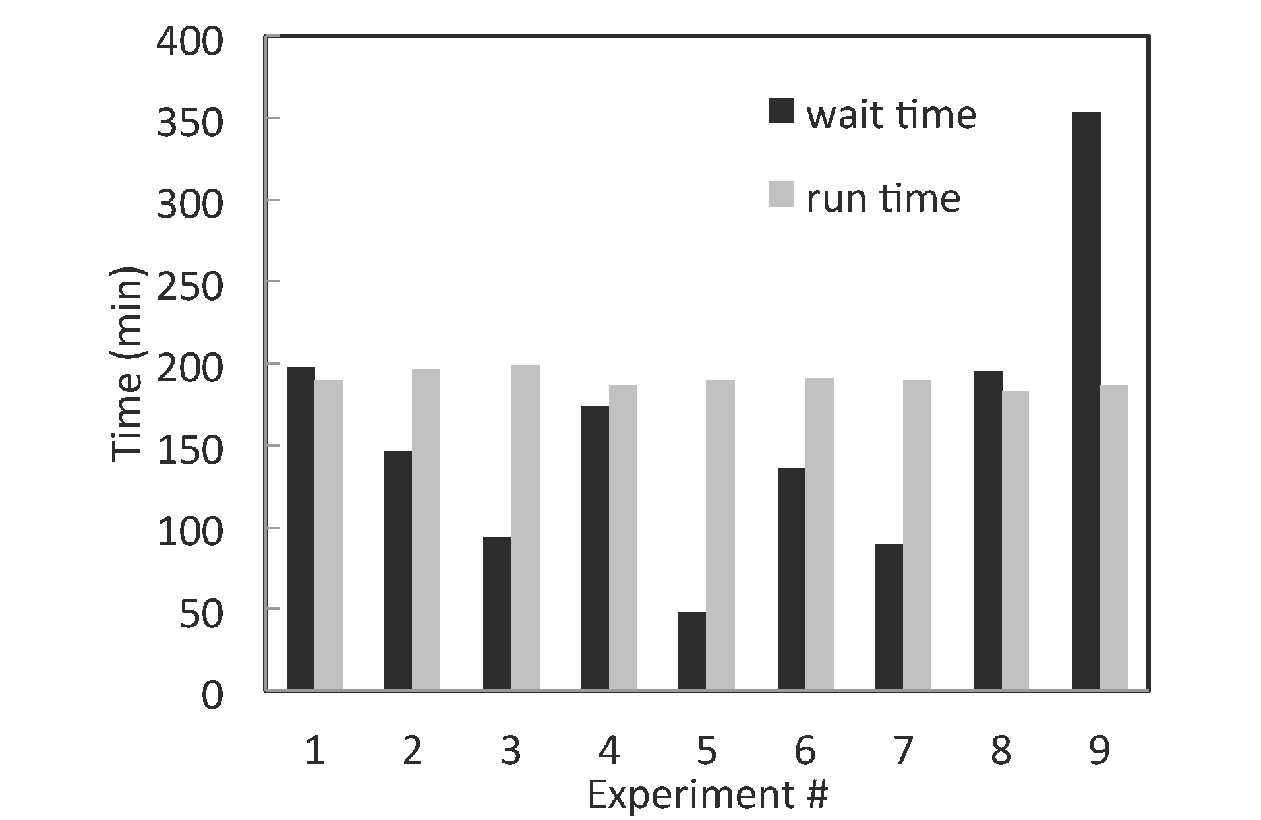
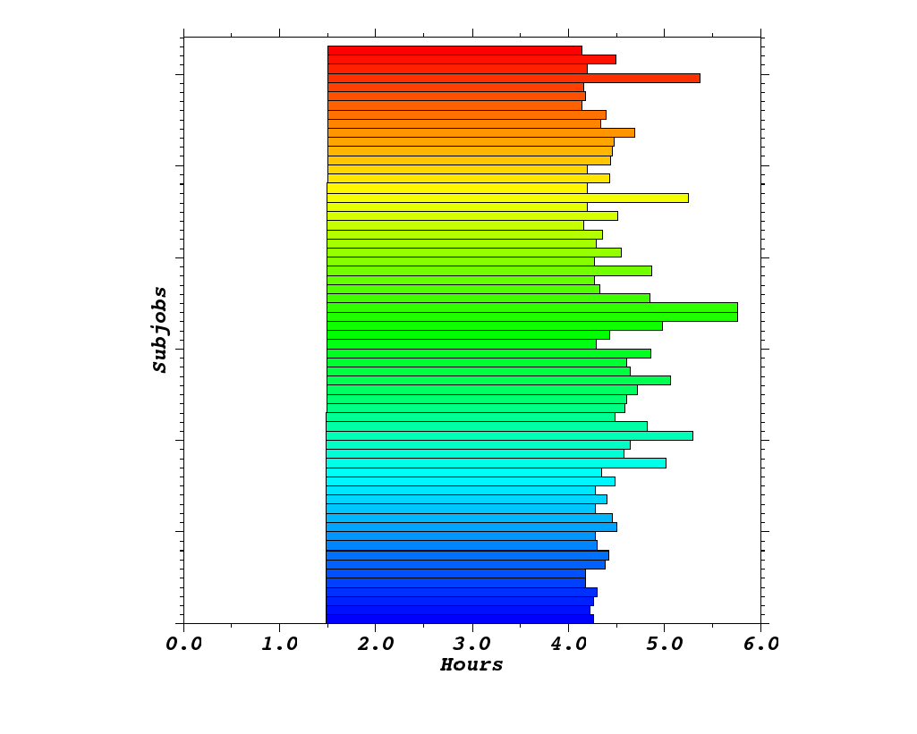
HT-HPC (Kraken)
126 ensembles, each of 192 cores = 24192 cores

Slide 20
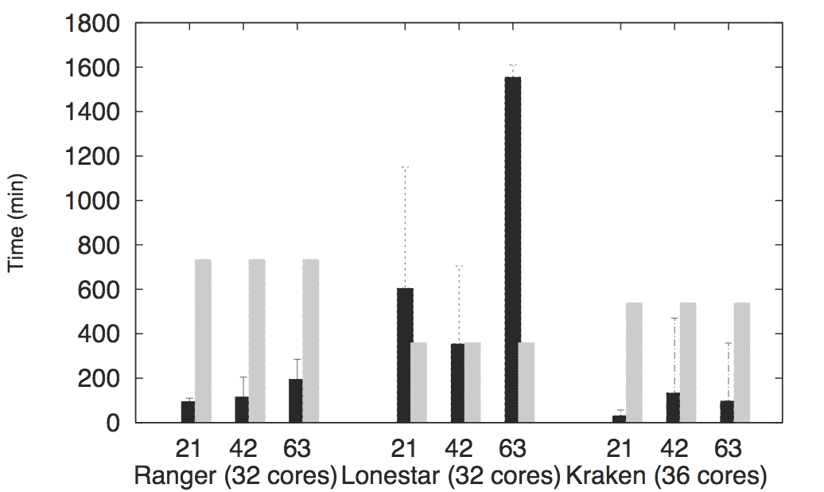
Scale-Out

Slide 21
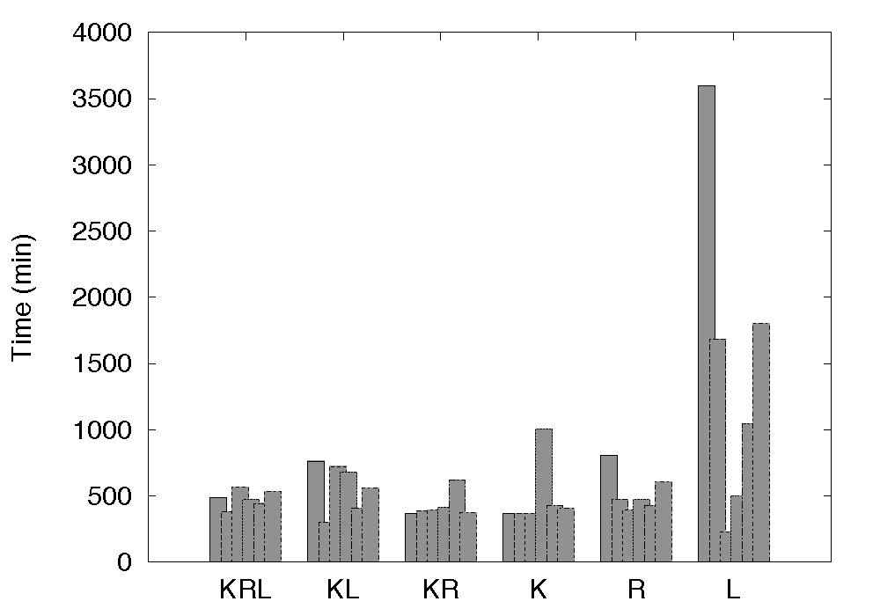
Performance Advantage of Scale-Across

Slide 22
What is “unique” about Pilot-Jobs built using the right abstractions?
Pilot-Jobs: Decouple resource assignment & resource-workload binding
Pilot-Jobs are/have been typically used for:
  Enhancing resource utilization; Facilitate high-throughput simulation
  Lowering wait time for multiple jobs (better predictability)
Several unique aspects about the SAGA-based Pilot-Job
  Infrastructure Independent and “standard” PJ API to access other PJs
    SAGA PJ API (Pilot API) basis for inter-operable PJ
  Extensible (and programmable) Pilot-Jobs
    Have not been used for Science Driven Objectives:
SAGA-based Pilot-Job form the basis for
  Advanced run-time frameworks for load-balancing and FT
  For autonomic scheduling and application-level scheduling
  Extension of Pilot-abstraction to other “dimensions”

Slide 23
What is “unique” about P* Implementation using SAGA?
Pilot-Jobs: Decouple resource assignment & workload binding
  Enhancing resource utilization
  Facilitate high-throughput simulation
  Lowering wait time for multiple jobs (better predictability)
Several unique aspects about the SAGA-based Pilot-Abstraction
  Infrastructure Independent and “standard” Pilot API
    Pilot API basis for inter-operable and Pilots
  Extensible (and programmable) Pilots
    Have not been used for Science Driven Objectives
  Extension of Pilot-abstraction to other “dimensions”
SAGA-based Pilot-Job form the basis for:
  Advanced run-time frameworks for load-balancing and FT (TROY)
  For autonomic scheduling and application-level scheduling (MLaDS)
P* : Many Research Challenges and Opportunities

Slide 24
P*-based Pilot-Jobs : Research Challenges
SAGA-based Pilot-Job form the basis for
  Advanced run-time frameworks for load-balancing and FT
  For autonomic scheduling and application-level scheduling
  Extension of Pilot-abstraction to other “dimensions”

Slide 25
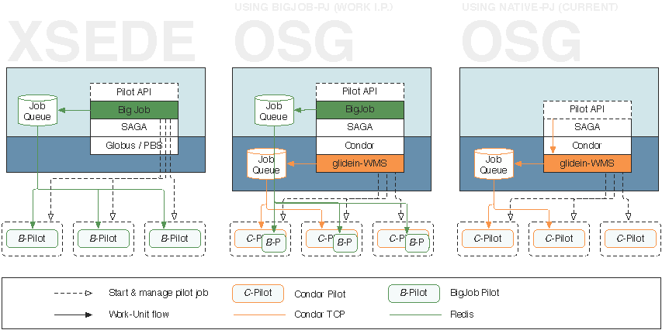
Limitations of Application-level Abstractions

Slide 26
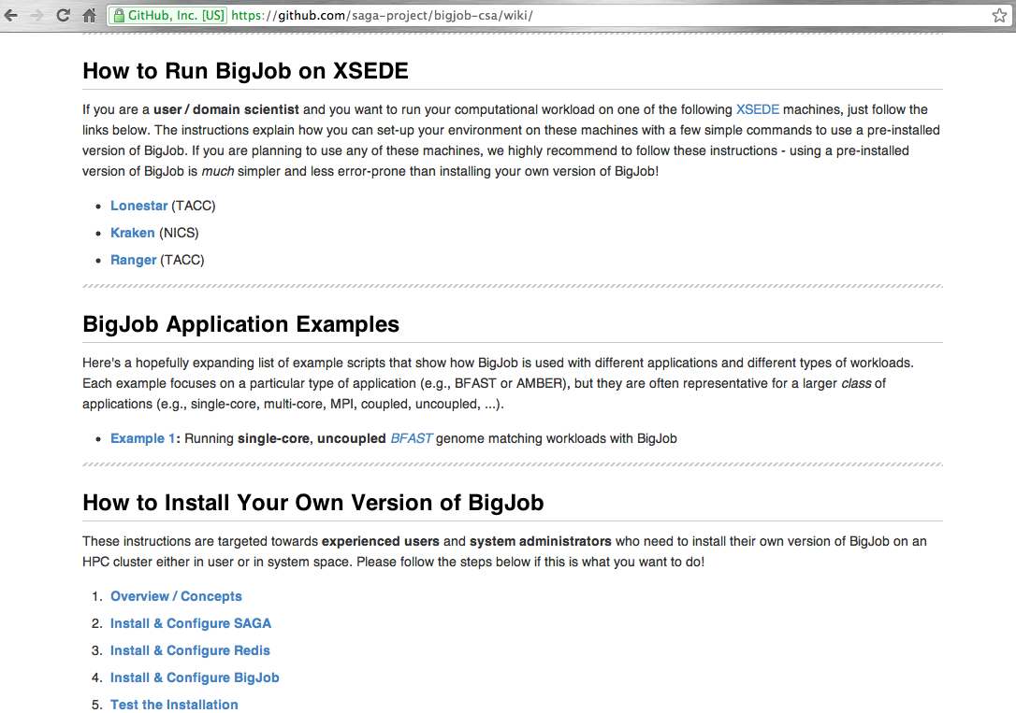
https://github.com/saga-project/BigJob/wiki/

