Slide 1
Introduction to SAGA and BigJob
The RADICAL Group
http://radical.rutgers.edu
http://saga-project.org

Slide 2
SAGA: In a nutshell
There exists a lack of DC capabilities that:
  Provide basic & most common grid functionality for applications and thus hide underlying complexity, varying semantics..
  The building blocks upon which to construct “consistent” higher-levels of functionality and abstractions
  Meets the need for a broad spectrum of Application and Infrastructures
Simple, integrated, stable, uniform and community-standard
  Simple and Stable
  Integrated: Similar semantics & style across primary functional areas
  Uniform: Same interface for different distributed systems
  The building blocks upon which to construct “consistent” higher-levels of functionality and abstractions
  OGF-standard, “official” Access Layer/API of EGI, NSF-XD

Slide 3
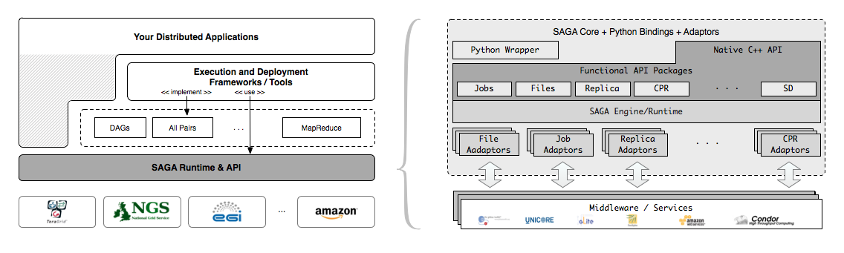
SAGA – An Overview
SAGA provides the base layer upon which other abstractions and capabilities are provided
http://www.saga-project.org

Slide 4
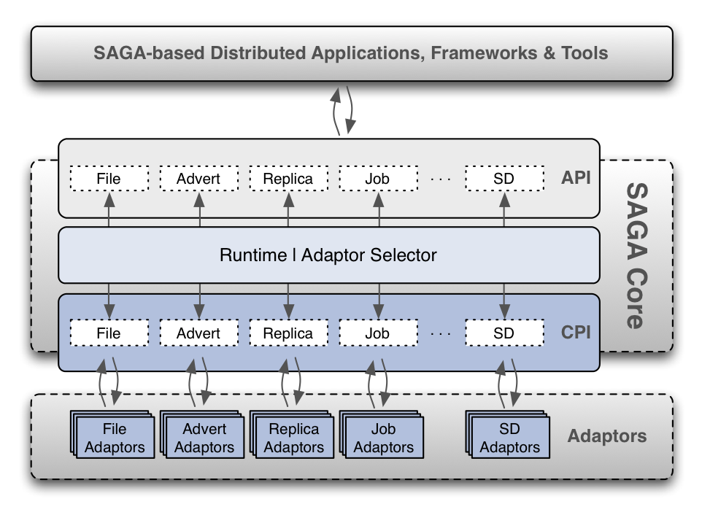
SAGA: OGF Standard for Distributed Applications

Slide 5
SAGA: Abstraction upon which other abstractions are built
HOW SAGA is Used?
  Uniform Access-layer to DCI
    EGI, XSEDE, DATAONE, UK NGS and NAREGI/RENEKI and Clouds
  Application “Scripting Layer” to DCI
    Improved and enhanced HTHP ensembles
  Build tools, middleware services and capabilities that use DCI
    e.g. Gateways, Pilot-Jobs
WHAT is SAGA Used for?
  Support production-grade science and engineering
    Aircraft design (Airbus) to the search for Higgs and neutrinos!
  Research tool to design, implement reason about distributed programming models, systems and applications

Slide 6
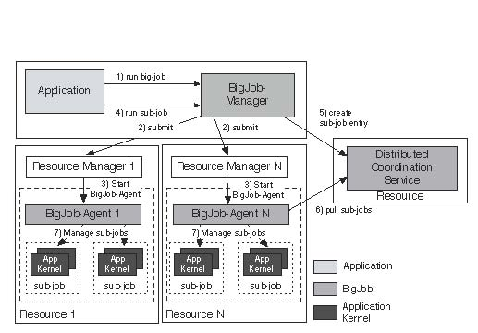
Understanding Pilot-Jobs: Abstractions for Dynamic Execution
SAGA Pilot-Job (BigJob)

Slide 7
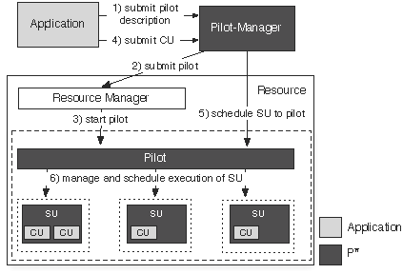
P* Model of Pilot-Abstractions

Slide 8
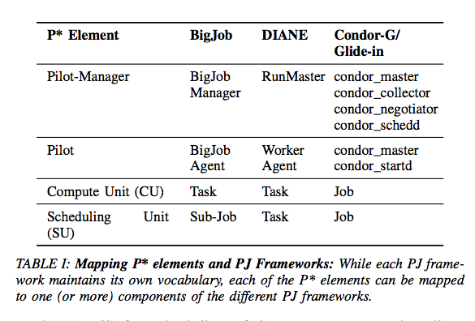
Towards a common model for Pilot-jobs, Luckow, Santcroos, Merzky, Weidner and Jha, to appear in proceedings of HPDC’12

Slide 9
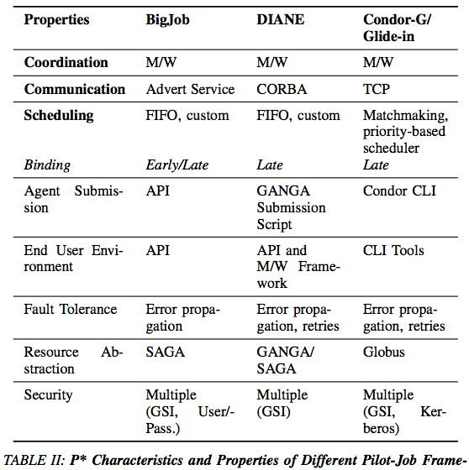

Slide 10
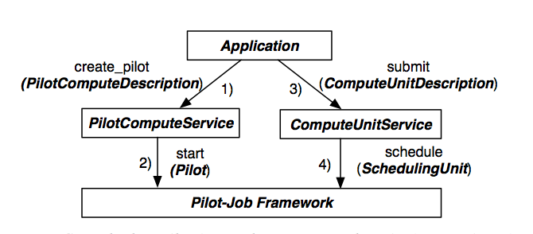
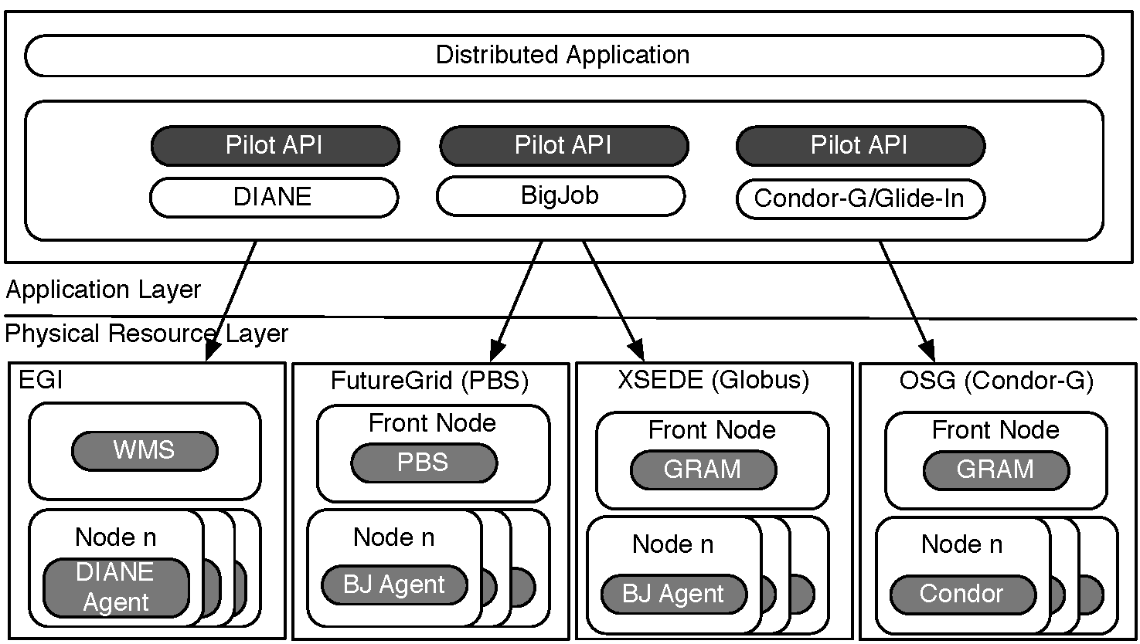
Exposing the P* Model: The Pilot-API

Slide 11
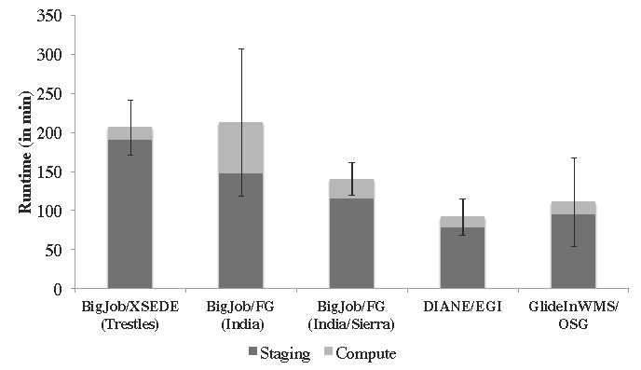
Accessing Multiple DCI & Pilot-Jobs via Pilot-API
128 BFAST tasks, O(10) GB

Slide 12
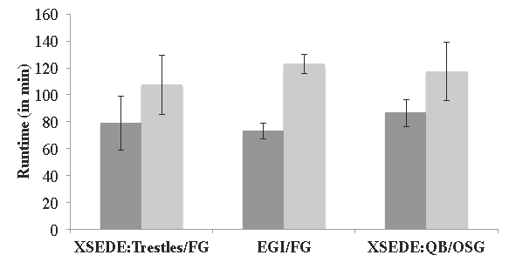
Pilot-Job Interoperability via Pilot-API

Slide 13
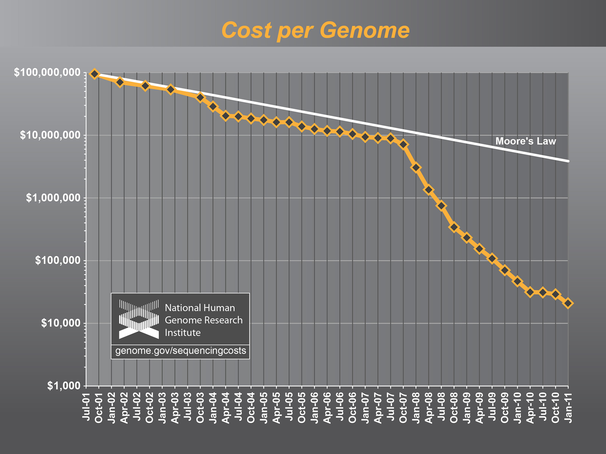
The Challenge of Integrating Compute and Data at Scale

Slide 14
Pilot-Abstraction for Dynamic Distributed Data?
Similar levels of heterogeneity in the data infrastructure
  File systems, storage, transport protocols, …
Support application level capabilities to specify dependencies at a logical level rather than specific file level
  First class support for Affinities (D-C, D-D)
Typically placement and scheduling of data is decoupled from the compute-tasks
  Integrated approach to compute and data ?
Dynamic decision for data
  Analogous to late-binding of data
  Fluctuating resources as a fundamental property of DCI
Abstraction for other factors and not application specific way:
  Varying data sources, fluctuating data rates, etc

Slide 15
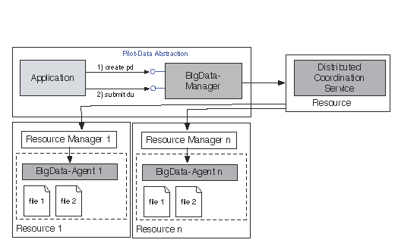
Pilot-Data: Abstraction for Dynamic Distributed Data
In analogy with BigJob - BigData (before Big Data was BigData!)

Slide 16
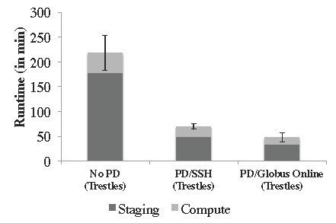
Pilot-Data: Coupled Data Management and Efficient Transfer

Slide 17
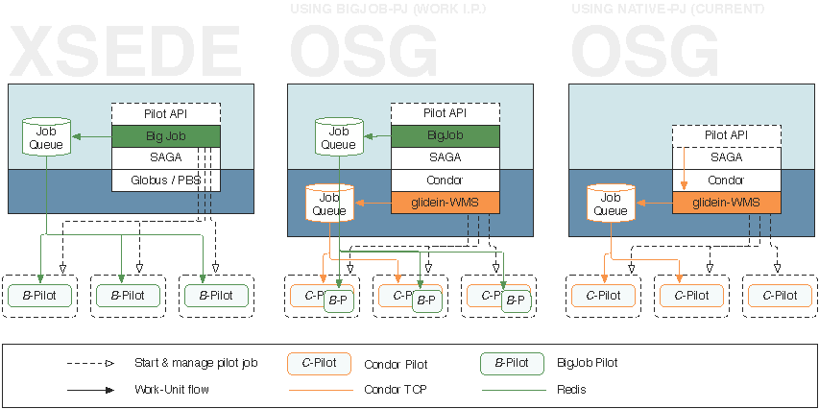
Deployment Context: Limitations of Abstractions

Slide 18
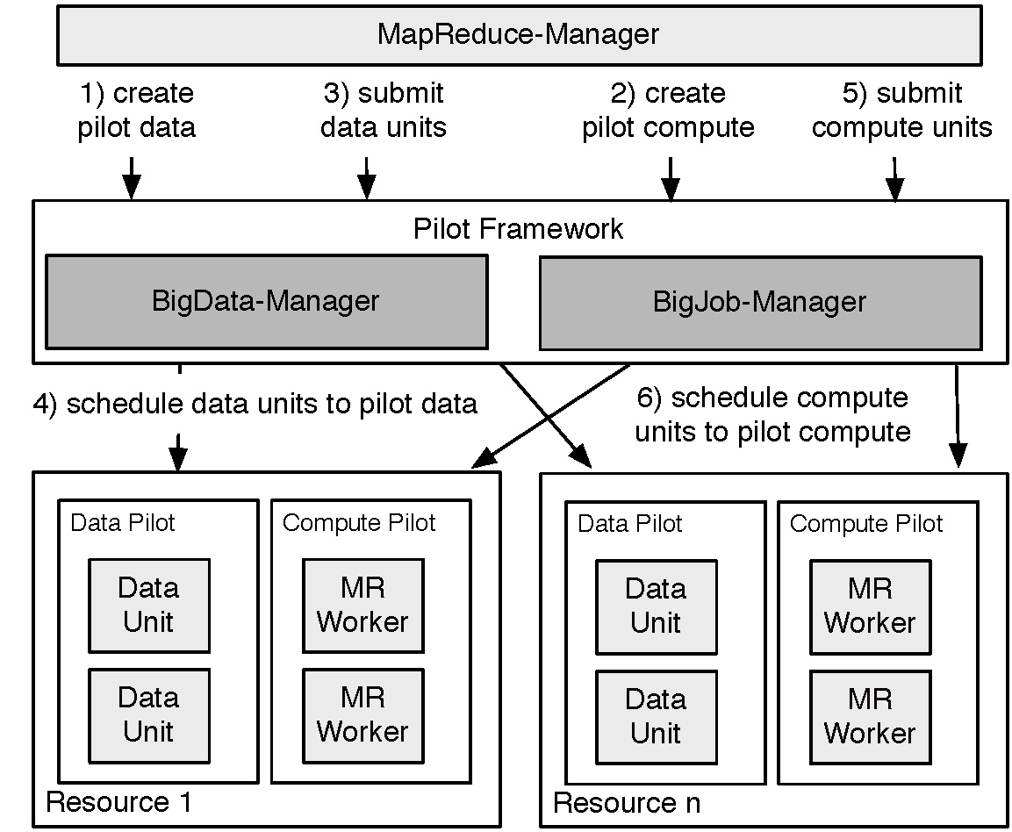
Pilot-MapReduce (for NGS)

Slide 19
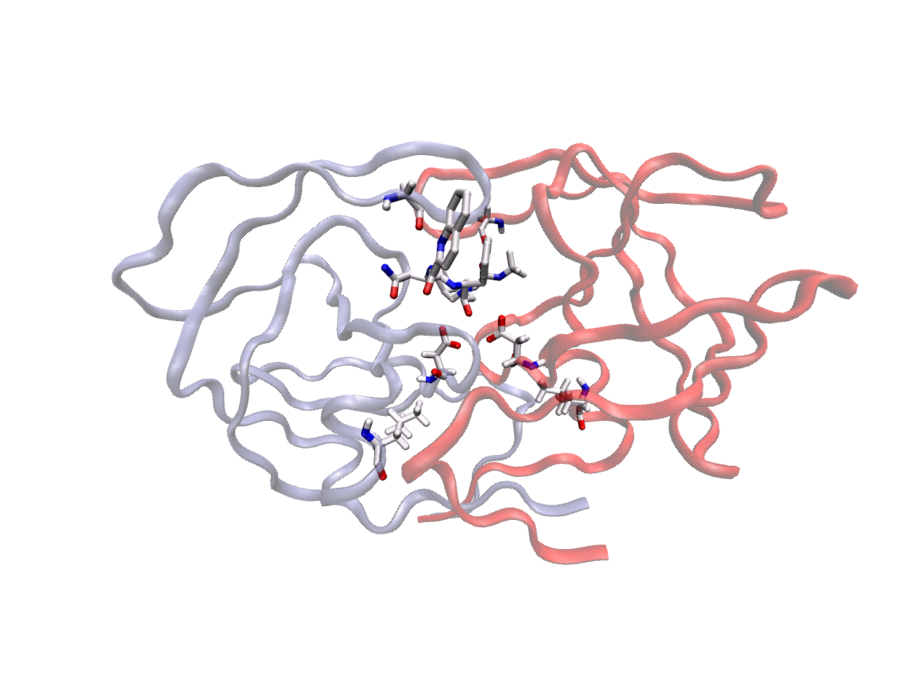

HIV Protease
HIV-1 Protease is a common target for HIV drug therapy
Enzyme of HIV responsible for protein maturation
Target for Anti-retroviral Inhibitors
Example of Structure Assisted Drug Design
9 FDA inhibitors of HIV-1 protease
So what’s the problem?
Emergence of drug resistant mutations in protease
Render drug ineffective
Drug resistant mutants have emerged for all FDA inhibitors
Monomer B
101 - 199
Monomer A
1 - 99
Glycine - 48, 148
Flaps
Saquinavir
P2 Subsite
Catalytic Aspartic Acids - 25, 125
Leucine - 90, 190
C-terminal
N-terminal
Collaboration with Peter Coveney (UCL)

Slide 20
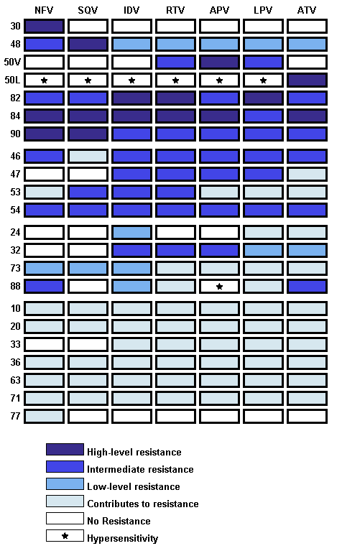
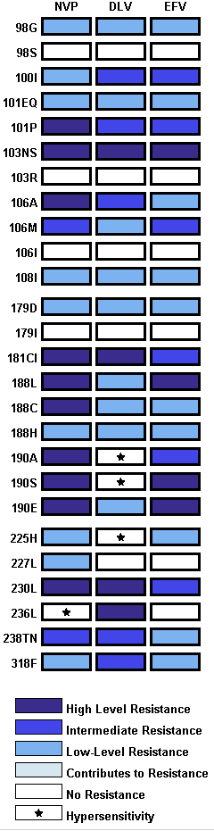
Resistance Causing Mutations
Protease inhibitors
RT inhibitors
Mutations at many positions affect resistance
The HIV genome can accommodate many mutations
Mutations interact to produce resistance
Too many mutations for clinicians to interpret
Support software is used to interpret genotypic assays from patients

Slide 21

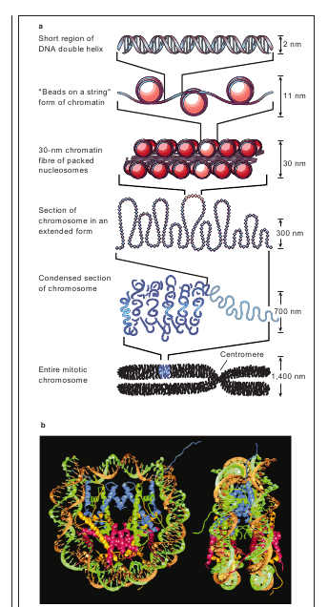
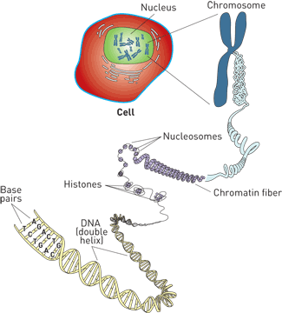
Slide Courtesy: Tom Bishop (LaTECH) Under Wraps C&E News July 17, 2006
http://pubs.acs.org/cen/coverstory/84/8429chromatin1.html
Collaboration with Tom Bishop (La Tech)
Felsenfeld&Groudine, Nature Jan 2003

Slide 22
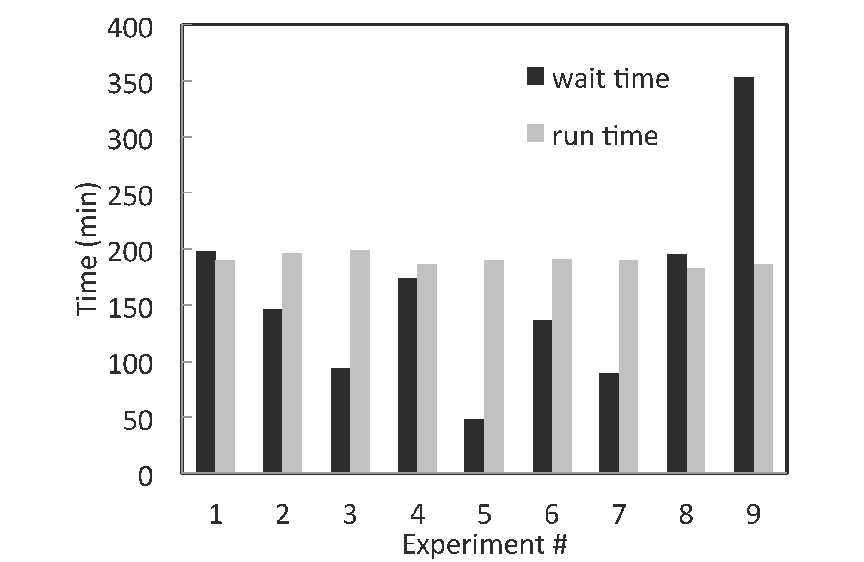
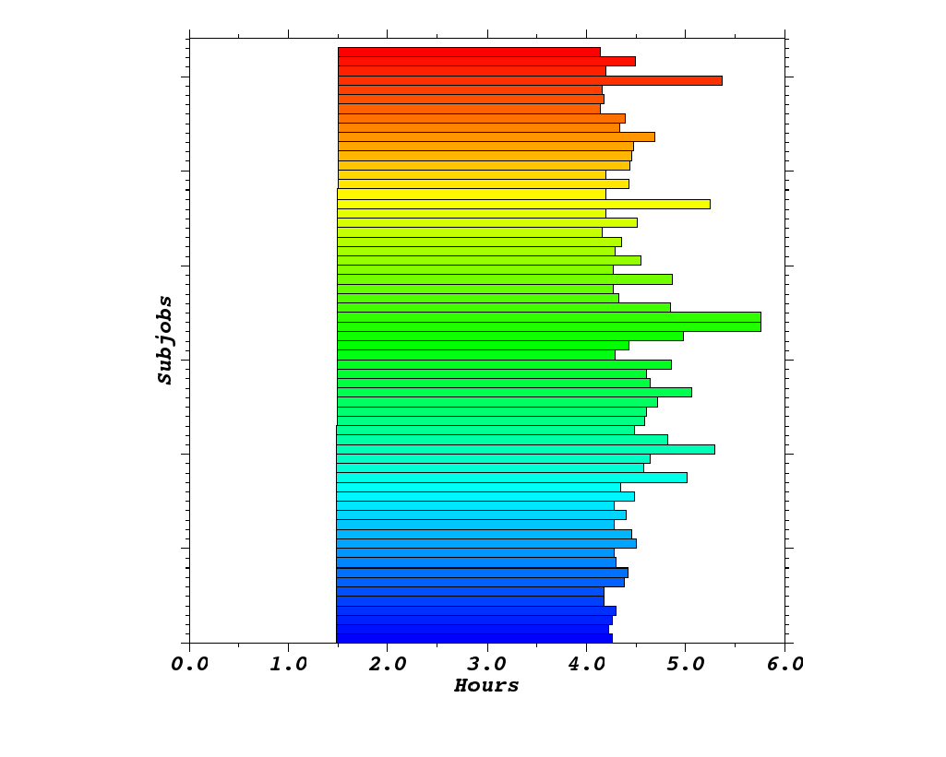
HT-HPC (Kraken)
126 ensembles, each of 192 cores = 24192 cores

Slide 23
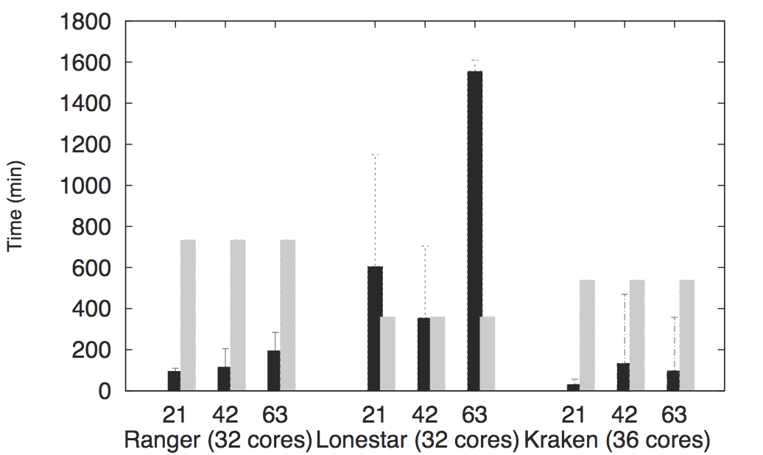
Scale-Out/Across

Slide 24
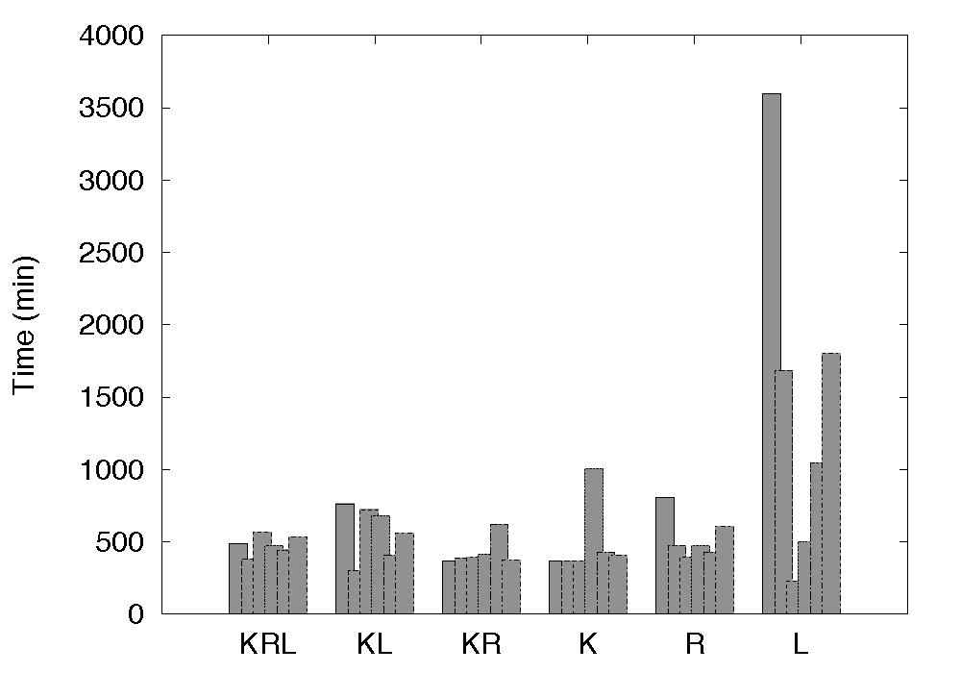
Statistical Performance Improvement via Scale-Across

Slide 25
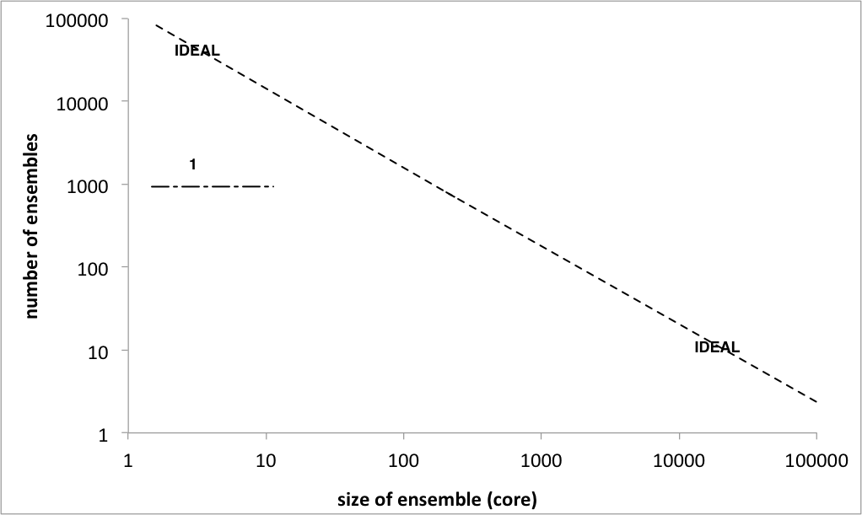
SAGA-based PJ: HT-HPC
# of Ensemble Members
Number of cores per Ensemble Member

Slide 26
Generalized Ensemble and Advanced Sampling Methods
Simulations and Methodology have been tied to specific implementations and infrastructure
  Break the coupling between the development and the underlying infrastructure:
    Interoperable: Usage across multiple infrastructure
    Extensible -- to new methods of communication and coordination
    Scalable
  Whither New Distributed Algorithms?
    Infrastructure doesn’t support implementation/testing, hence no attempts at algorithmic innovation; hence no pressure on infrastructure!
    Replica-Exchange: Synchronous versus Asynchronous
Challenges at Multiple-Levels
  Heterogeneity of environments – coordination and execution
  Distributed Coordination Problem over heterogeneous resources

Slide 27
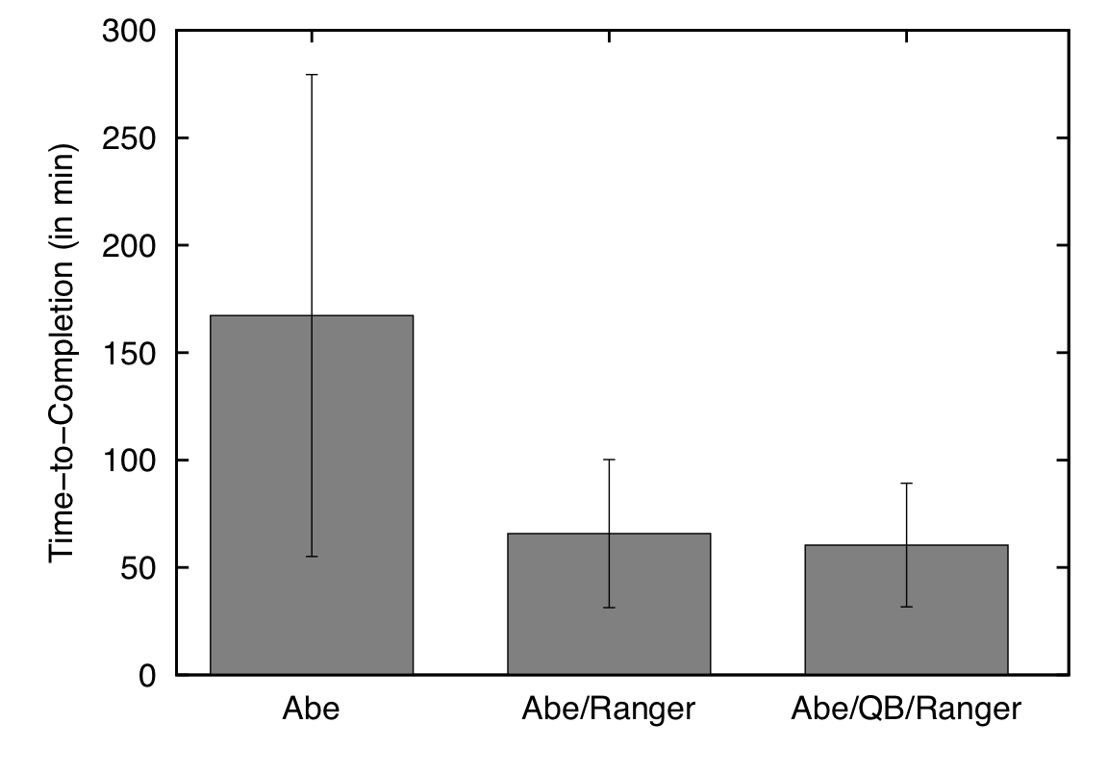
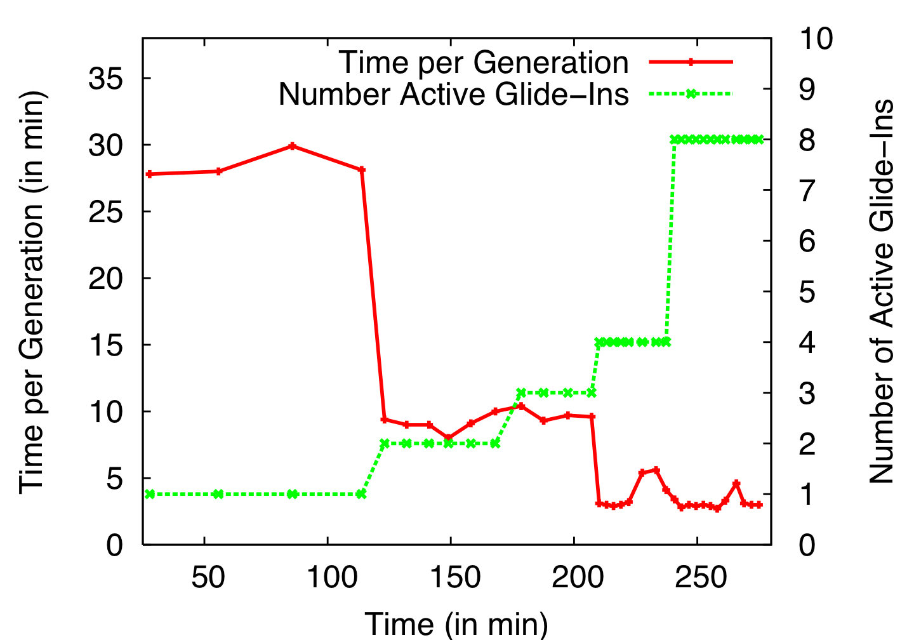
Distributed Adaptive Replica Exchange (DARE)
Multiple Pilot-Jobs on the “Distributed” TeraGrid
Ability to dynamically add HPC resources. On TG:
  Each Pilot-Job 64px
  Each NAMD 16px
Time-to-completion improves
  No loss of efficiency
Time-per-generation is measure of sampling
Adaptive Replica-Exchange,
Phil. Trans of Royal Society A (2009)

Slide 28
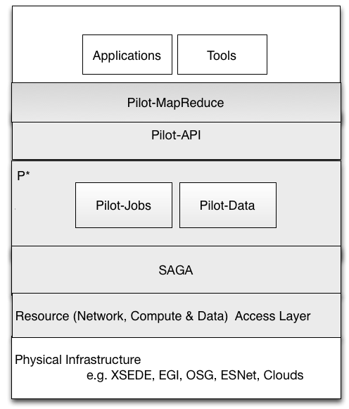
P* Model of Pilot-Abstractions Redux

Slide 29
Acknowledgments
SAGA and RADICAL Group Members
  http://saga-project.org
NSF/LEQSF (2007-10)-CyberRII-01
NSF HPCOPS NSF- OCI 0710874 award
NSF CHE 1125332
NSF-ExTENCI (OCI-1007115)
UK EPSRC (GR/D0766171/1) and e-Science Institute, UK
NSF OCI 1059635
NIH Grant Number P20RR016456
NSF TeraGrid TRAC award TG-MCB090174
NSF FutureGrid Award (No. 42)

Slide 30
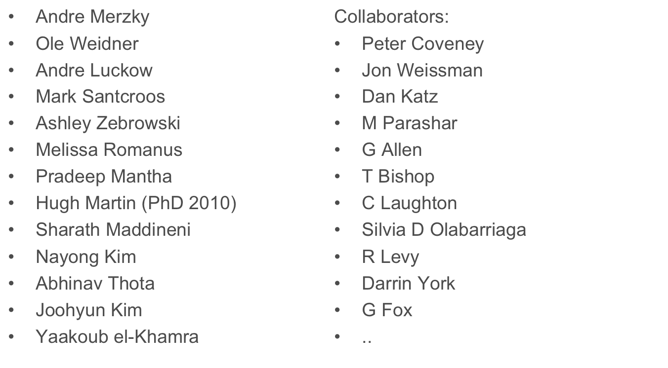
Some of the People Who Make it Happen

