Slide 1
AIMES: Abstractions and Integrated Middleware for Extreme-Scales
Shantenu Jha, Matteo Turilli - Rutgers U
Jon Weissman - U Minnesota
Daniel S. Katz, Zhao Zhang - U Chicago
DOE NGNS PI Meeting – Mar 18-20 2013, Emeryville, CA
http://aimes-project.org
DOE ASCR under grant numbers: DE-FG02-12ER26115,
DE-SC0008617 & DE-SC0008651

Slide 2
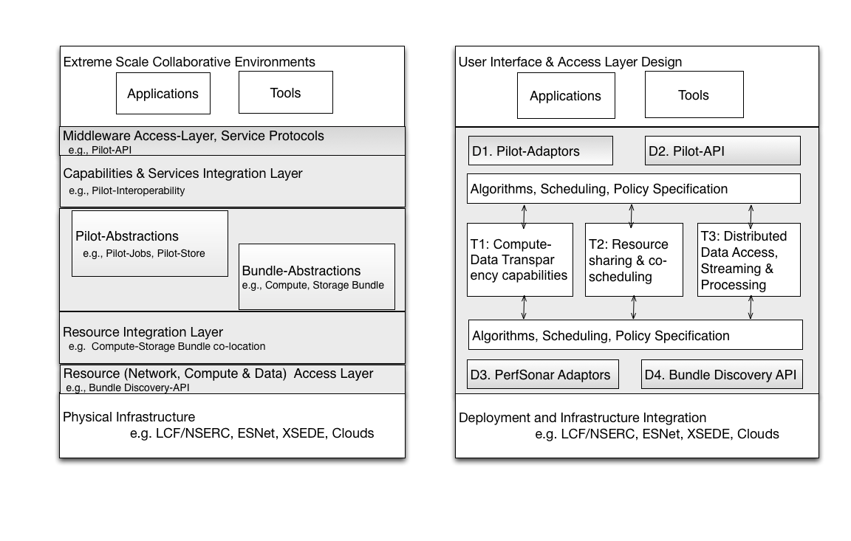
Objectives
Distributed computing is an important component in extreme-scale collaboration
Extreme-Scale Challenges: predictable, flexible, reliable, federation
“Beyond Glue” => reason about the application and infrastructure
Develop new abstractions for resources at all levels
Impact
Model for next-generation distributed applications and infrastructures
Predictable performance across diverse infrastructures (flexible execution) for small- and large-scale collaborations
New integrated resource management paradigms
Progress and Accomplishments
DoE application analysis to produce initial skeleton drivers for research
Defined primary abstractions: pilot and bundle interactions, and use cases
Identified key research elements: signatures
Identified initial short, medium & long term research & development goals
Notes:
Extreme scale: new challenges whether they be resource mgmt or identity mgmt!!
How can we do it better?
Beyond Glue” distinction b/w 1st gen to next-gen. Necessary Cond: Less brittle, fragile?
Obj->Impact: N tasks: how to distributed? Spatiotemporal.

Slide 3
Overview
Distributed computing is one pathway to extreme-scale and a necessity for collaboration
The Problem
Current state of distributed applications and infrastructure is problematic
Two situations predominate:
Applications are inflexible: optimized and pinned to a specific platform
Applications are flexible: run anywhere but performance is unpredictable
The Hypothesis
Flexibility and performance are compatible!
Extracting Simplicity whilst managing Complexity requires abstractions
Abstractions and Models are key to “reason about distribution”
The Solution
We advance middleware abstractions that will facilitate reasoning integrated across application and resource level
AIMES: Integrated approaches to Resource Management
Notes:
Problem statement was valid 10 years ago. What has changed in 10 years? Need/want to reason
Current State: M-to-M A-I, but we can think of it as a challenge to map 1-to-many, many-to-1
“managing complexity is not the same as extracting simplicity” ---- requires abstractions!

Slide 4
The Application Perspective
AIMES has identified DoE applications in consultation with developers and users and their “patterns”
LHC histogramming: Distributed MapReduce
MG-RAST and KBASE: Bag of Tasks and Distributed MapReduce
PDSF applications: Bag of Tasks
TIP: Bag of Tasks
Fusion: Concurrent communicating processes
Other distributed applications for our research:
Montage: multi-stage workflow
Clustering: iterative MapReduce
Kalman filtering Reservoir Modeling: campaign
Notes:
This is a summary of Dan’s discussion with Application groups
Building upon our understanding of collaborative environments and applications before the project
Set the stage for skeletons!

Slide 5
Role and Use of Application Skeletons
Describe application
choose type of skeleton
specify skeleton parameters
Build application
create executables & data files
and description (abstract DAG/DAX)
Program workflow
build Swift script
run Pegasus
Etc.
Simulate application in system
Run
application in system
Red = not written yet
Blue = not tested yet
Notes:
Skeletons abstract out the key details of an application, act as a form of signature/characterization
Skeleton en route to modeling distributed applications
Top Down: Skeleton + Flesh: Application – Flesh::Many to one: one to many one

Slide 6
Introduction to Pilot Jobs
Working definition: a system that generalizes a placeholder job to provide multi-level scheduling to allow application-level control over the system scheduler via a scheduling overlay
User Application
Pilot-Job System
Policies
User Space
Pilot-Job
Pilot-Job
Resource Manager
System Space
Resource A
Resource B
Resource C
Resource D
Notes:
Get slides of Pilot Jobs from Ole
Pilot-jobs as a (A)RM because of limitations of the middleware and infrastructure. Different middleware; differenent limitations. Therefore different pilot jobs semantically and functionally.

Slide 7
Introduction to Pilot Jobs
Working definition: a system that generalizes a placeholder job to provide multi-level scheduling to allow application-level control over the system scheduler via a scheduling overlay
Advantages of Pilot Job systems:
Abstraction between application and resource layer
Avoid bottlenecks of system-level only scheduling
Move control upwards and provides flexibility upwards
Enable the “slicing and dicing” of resources for applications
Limitations of current Pilot-Jobs implementations:
Many Pilot-Job offerings, often semantically distinct
Conceptual: P* towards a unified view of pilot-jobs, pilot-abstractions
How to “slice and dice” resources? How to map to infrastructure?
Role for underlying abstraction (Bundles)?
Notes:
Pilot-jobs as a (A)RM because of limitations of the middleware and infrastructure. Different middleware; differenent limitations. Therefore different pilot jobs semantically and functionally.
Pilots tell you what to do (N x M) but not why or how?

Slide 8
Introduction to Resource Bundles
Resource-facing abstraction “below” Pilots
Aggregated resources: compute, storage, network
Objective: model of infrastructure resources
predictive, flexible, adaptive, active
Bundle profile
resource histograms: using probes and workload measurements
Bundle signature
compact representation
Bundle allocation
late binding of bundle to pilots
Notes:
Research is in red
Predictive => estimate resource availability, capacity
Flexible => can add or remove resources
Adaptive+active => can program events to propagate up to P* level

Slide 9
AIMES
Shape of the solution
Resource abstractions at application- and resource-facing levels
Awareness of application + Awareness of physical resources
Co-design approach
Integrative resource management
Across compute (C), storage (S), networking (N)
Across resource types/scales/federation
Vertical: abstractions at application and resource level are aware of each other
Horizontal: C, S and N aware
Notes:
At a later stage we’ll take the FOA picture and speak to it, e.g., Location transparency – pilot-data, bundle and an interoperation layer…

Slide 10
AIMES
High-level architecture
Functional view
Notes:
This is where we talk about unifying pilot abstractions.. Speak to the cronological viewpoint of data distribution.. The third class of moving where the computing is..
Talk about programmability of the network.. Strong emerging trend.. Distributed reasoning must include models of network performance – predictive and responsive
Research Q: how resource transparency at different levels “ties” together?

Slide 11
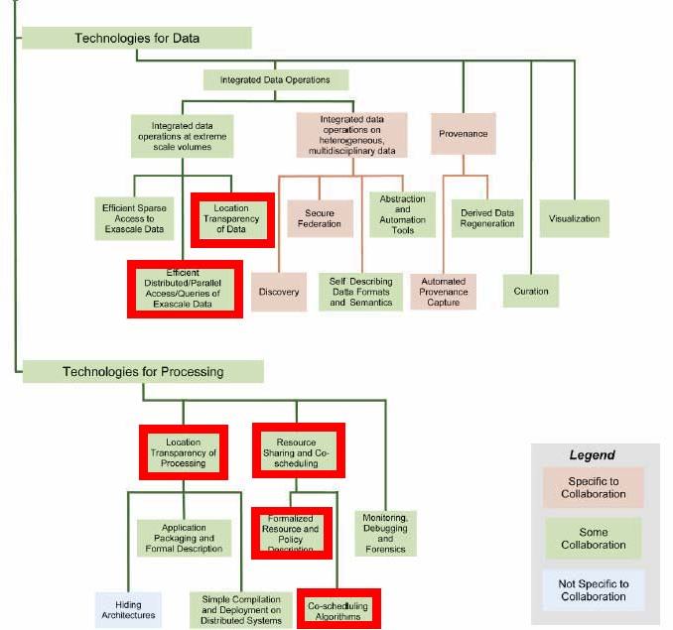
AIMES – FOA alignment
Notes:
At a later stage we’ll take the FOA picture and speak to it, e.g., Location transparency – pilot-data, bundle and an interoperation layer…

Slide 12
Short-term
Create skeleton that represents Montage
Define capabilities of bundles
Define the Separation of Concerns and API between Pilots and Bundles
Prototype demonstration:
Focus on compute resources: Pilots and Bundles
Integrate Skeleton + Pilot-Abstractions
Integrate Pilot-Abstractions with Bundles
Identify Experimental Infrastructure
Instantiate montage-skeleton for different parameter range and execute over heterogeneous infrastructure

Slide 13
Middle-term
Middle Term: Develop storage-based Pilot/Bundles; Integrate Pilot/Bundle abstractions with network monitoring tools - e.g. perfsonar
Understand the role of dynamic network capabilities as an element of resource management in conjunction with pilot/bundle abstractions
Obtain skeletons for network and storage-based applications
Investigate integrating network scheduling capabilities
Explore specific technologies such as NSI, SDN
Inform and integrate with groups at OGF

Slide 14
AIMES: Abstractions and Integrated Middleware for Extreme-Scales
Shantenu Jha, Matteo Turilli - Rutgers U
Jon Weissman - U Minnesota
Daniel S. Katz, Zhao Zhang - U Chicago
Thank you

Slide 15
Middle and Long-term
Middle Term: Develop storage-based Pilot/Bundles; Integrate Pilot/Bundle abstractions with network monitoring tools - e.g. perfsonar
Understand the role of dynamic network capabilities as an element of resource management in conjunction with pilot/bundle abstractions
Obtain skeletons for network and storage-based applications
Investigate integrating network scheduling capabilities
Explore specific technologies such as NSI, SDN
Inform and integrate with groups at OGF
Long Term: Provide prototype and deployment of network aware pilot/bundle based resource management
Reason about performance, trade-offs, configurations and composability
What are possible models for distributed applications and (next-generation) DCIs?
What properties/requirements/constraints does this impose on middleware?

Slide 16
Long-term
Provide prototype and deployment of network aware pilot/bundle based resource management
Reason about performance, trade-offs, configurations and composability
What are possible models for distributed applications and (next-generation) DCIs?
What properties/requirements/constraints does this impose on middleware?
Notes:
Can we replace pilot/bundle with pilot-abstractions, given that bundle may end up being a specialized pilot?
For point 2: we need a more nuanced view of infrastructure .. Not use it or leave it

