Slide 1
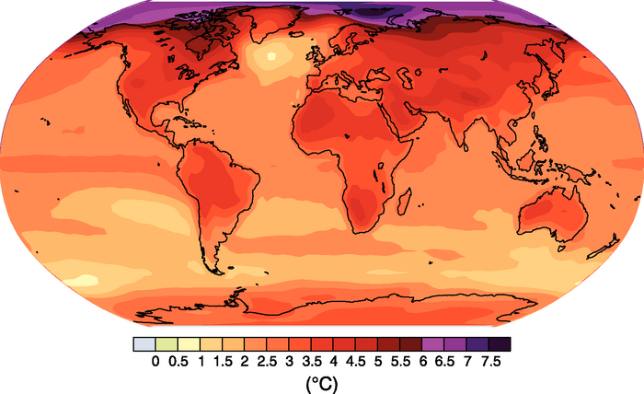
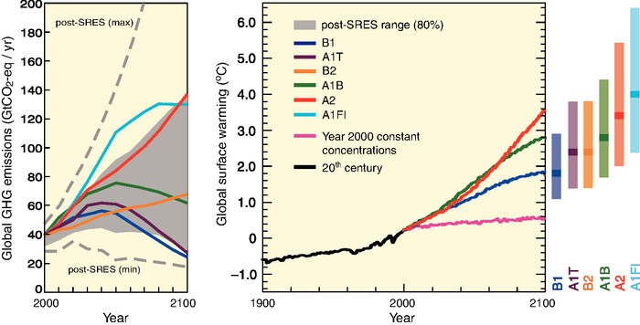
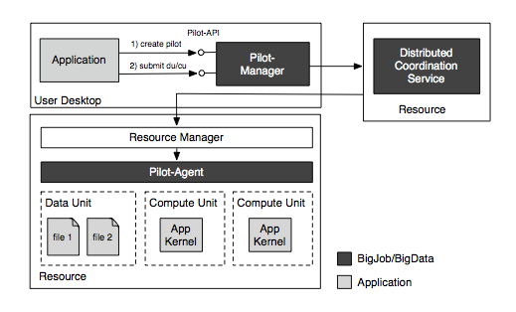
Abstractions for Distributed Dynamic Data-intensive (D3) Science on NSF Distributed Cyberinfrastructure
Shantenu Jha, Rutgers University http://radical.rutgers.edu
Abstract: This CAREER Award project (2013-2018) will develop middleware to support Distributed Dynamic Data-intensive science on Distributed Cyberinfrastructure (DCI) such as the Extreme Science and Engineering Discovery Environment (XSEDE) [1] and the Open Science Grid [2]. DCI substantially increase the computational power available to research scientists; however, such distributed systems face limitations in their ability to handle the large data-volumes being generated by today’s scientific instruments and simulations. To address this challenge, we will develop conceptual models and their extensible implementations that will facilitate the integration of high-performance computing and large-scale data sets. Building on previous work on pilot-jobs, this project will design, develop and implement the concept of “pilot-data” and the linking abstraction of “affinity”. The result will be a unified model and framework for improving the matching of storage and computing resources, as well as dynamic data and compute tasks, and thus facilitate dynamic workflow placement and scheduling. This research has the potential to significantly advance multiple areas of science and engineering, by generating innovative production-grade middleware for accomplishing scalable big-data science on a range of DCI systems.
The Role of Two Abstractions: Pilot-Data and Affinity
Pilot-Data: As formulated by the P* Model, pilot-data is an extension of the pilot-job abstraction to support dynamic data, and thereby provide a common conceptual framework for modeling data in conjunction with compute tasks. This will enable the treatment of data and computation as equal first-class entities within the extended pilot-abstraction; consequently data can be provisioned either where computation is scheduled to take place, or compute tasks can be provisioned where data resides. This leads to a richer set of possible correlations between compute and data entities involved; correlations can be either spatial and/or temporal, and could arise either as a consequence of constraints of localization (e.g., data is fixed, compute must move, or vice-versa), or as temporal ordering imposed on the different entities.
Affinities: The concept of affinity is used to describe the dynamic correlations and relationship between the different entities of pilot-system. They provide an useful approach for modeling different resource topologies, application characteristics and allow for effective application-driven reasoning. Affinities are suitable as an accompaniment to pilot-abstractions as they allow dynamic, heterogeneous and multi-level decisions, and thus support efficient data-compute-resource placements.
Motivation: D3 Science and Applications Gene Sequencing, next-generation astronomy and current climate applications from the Earth System Grid Federation (ESGF) are representative of D3 Science. As an example, for ESGF, the overall data generated and stored is 2-10 PB. The data are generated by a distributed set of climate centers, stored in a distributed set of federated archives, and used by distributed set of users, who run analysis on a data center, or gather data from the ESGF to a local system. The scheduling of data analysis jobs needs to be responsive to spatio-temporal changes that characterizes the input data.
_x0005_ Education and Outreach: The CAREER project will develop new curricula, teaching and outreach materials for introducing secondary and college students, and the general public to the emerging field of distributed data-intensive science. In partnership with FutureGrid [6], we will design simple and effective vehicles for sharing these resources with Historically Black Colleges and Universities (HBCUs) and other institutions where faculty might otherwise have relatively limited opportunity to develop advanced course materials. We will also partner with Rutgers’ Douglass Program for Women in Science, and The Academy at Rutgers for Girls in Engineering and Technology (TARGET), to increase engagement of, and support for, female students in the DCI research community.
P* Model: In contrast to static resource utilization of traditional single high-performance computing systems, DCI are by definition comprised of a set of resources that are fluctuating – growing, shrinking, changing in load. Pilot-Jobs provide a means to map specific tasks onto explicit heterogeneous and dynamic resource pools. The P* Model provides the first common and minimal conceptual model for describing and analyzing Pilot-Job systems.
SAGA-Pilot [3-6] is a pilot-system that implements the P* Model. An architectural diagram is provided below.
References
(1) XSEDE, http://www.xsede.org
(2) Open Science Grid: http://opensciencegrid.org
(3) P*: A Model of Pilot-Abstractions 8th IEEE Int. Conference on e-Science 2012: http://dx.doi.org/10.1109/eScience.2012.6404423
(4) SAGA Python: http://saga-project.github.com/saga-python/
(5) SAGA-Pilot/BigJob: http://saga-project.github.io/BigJob/
(6) The SAGA Project http://saga-project.org
(7) FutureGrid http://www.futuregrid.org
(8) Pilot-Data: An Abstraction for Distributed Data, arXiv:1301.6228
Acknowledgements
This work is supported by NSF Award OCI-1253644

