Slide 1
A Fresh Perspective on Pilot-Abstractions
http://radical.rutgers.edu
Workshop on HPC and Super-computing for Future Science Applications
Brookhaven National Lab
05 June 2013

Slide 2
Pilot-Jobs (PJ): Five Myths
  PJs do not have well defined architecture, model and semantics
    PJs are such a simple concept, it doesn't need more “attention”
    Everyone should write their own PJ just because they can
  PJs are about circumventing queuing delays on only HTC
    Meta-scheduling over HTC PJs unfairly game HPC queuing
  PJ have to be tied to specific infrastructure and infrastructures have to be tied to specific PJ
    Extensibility and Interoperability have been difficult to establish
  PJs are stand-alone passive (system) tools, as opposed to
  user-space, active and extensible components of a CI
  PJ cannot help with data intensive applications

Slide 3
Limitations of existing Pilot-Jobs?
The landscape of PJ reflects the broader eco-system of distributed middleware & infrastructure, in addition to PJ specifics
Many Pilot-Job offerings, often semantically distinct
  DIANE, DIRAC, CONDOR Glide-In, SWIFT, ToPoS Falkon PanDA Nimrod/G, BigJob …
  Varying levels of control. User || system space?
We know “what” pilot-jobs do, but the “how” remains less clear
  How to map tasks to pilot-jobs?
  How to “slice and dice” resources?
  How to map to infrastructure?
Conceptual & practical barriers to extensibility (& interoperability)
  Software Engineering, customization
Data remains a dependent variable, not a primary variable
  Introduce the concept of Pilot-data
Notes:
Pilot-jobs as a (A)RM because of limitations of the middleware and infrastructure. Different middleware; differenent limitations. Therefore different pilot jobs semantically and functionally.
Pilots tell you what to do (N x M) but not why or how?

Slide 4
Introduction to Pilot Jobs
Working definition: a system that generalizes a placeholder job to provide multi-level scheduling to allow application-level control over the system scheduler via a scheduling overlay
User Space
User Application
Pilot-Job System
Policies
Pilot-Job
Pilot-Job
Resource Manager
System Space
Resource A
Resource B
Resource C
Resource D
Notes:
Get slides of Pilot Jobs from Ole
Pilot-jobs as a (A)RM because of limitations of the middleware and infrastructure. Different middleware; differenent limitations. Therefore different pilot jobs semantically and functionally.

Slide 5
Introduction to Pilot-Jobs
Working definitions:
  A system that generalizes a placeholder job to provide multi-level scheduling to allow application-level control over the system scheduler via a scheduling overlay
  “.. defined as an abstraction that generalizes the reoccurring concept of utilizing a placeholder job as a container for a set of compute tasks; an instance of that placeholder job is referred to as Pilot-Job or pilot.”
Advantages of Pilot-Job systems:
  Abstraction between application and resource layer
    Flexible resource management
  Multi-level Scheduling
  Avoid bottlenecks of system-level only scheduling
    Support for late-binding
  Move control and flexibility “upwards”
  Enable the “slicing and dicing” of resources for applications
Notes:
Pilot-jobs as a (A)RM because of limitations of the middleware and infrastructure. Different middleware; differenent limitations. Therefore different pilot jobs semantically and functionally.
Pilots tell you what to do (N x M) but not why or how?

Slide 6
PilotJob Paradigm
Based upon analysis of many Pilot-Job implementations,
Architecture – two distinct logical elements:
  Workload manager. Responsible for making available the tasks to the executor alongside the needed data and retrieving results
  Task executor. Responsible for executing the tasks while managing their data.
  Communication and Coordination (C-C) patterns allow for and regulate the interaction between these two components.
Execution model – based on multi-level scheduling and late-binding:
  Multi-level scheduling. Tasks of a workload are scheduled on one or more pilots and the pilots are then scheduled on a given resource.
  Late binding. Pilots are bound to a set of resources and tasks are executed by the pilot on these resources. Pilots are not directly (early) bound to a resource.

Slide 7
Task: A set of operations that are part of a workload and are encoded into one or more programs.
Placeholder: A proxy for a bounded set of resources of a given infrastructure.
Pilot: A placeholder running on multiple types of infrastructure and capable of executing tasks while managing the data related to these taks.
Job: One or more program executed on a specific type of infrastructure.
  jobs and tasks are functionally analogous but qualitatively different. Tasks are not bound to an infrastructure but are necessarily part of a workload.
  Pilots are jobs only when they are scheduled on an infrastructure utilising that abstraction. On a cloud a pilot is a program executed within a virtual machine.
Multi-level scheduling: A type of scheduling that separates the scheduling of tasks on a pilot and the scheduling of that pilot on an infrastructure.
Late-binding: A capability that allows for tasks not to be bound directly to resources. Tasks are bound to pilots and not to a specific resource, either before or after pilots are bound to a resource.

Slide 8
P*: Theory and Practice of Pilot-Jobs

Slide 9
P*: A Conceptual Model for Pilot Abstractions
A Minimal but complete model
  Minimum: Towards a common understanding of pilot-jobs
    Provides vocabulary and model for analysis and insight across different PJs
    Does not try to provide closed form answers to all issues
  Complete: Can be used to design a priori an effective Pilot-Job
Establish basic terminology, functionality and inter-relationship
  What is the pilot? What is the agent? Push or pull?
Provide a framework for comparison across Pilot implementations
  Many existing pilot implementations can be understood using P*
  Not all pilot implementations must adhere strictly to P*
    It is descriptive, not prescriptive
Unified view of Pilot-Abstractions:
  Provides symmetrical treatment for compute and data

Slide 10
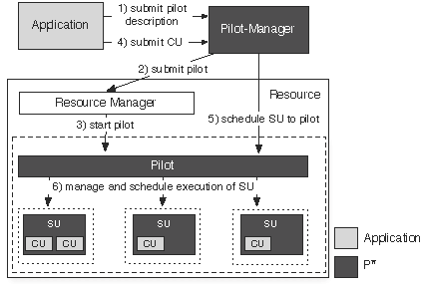
P* Model: Elements, Characteristics and API
Elements:
  Pilot-Compute (PC)
  Pilot-Data (PD)
  Compute Unit (CU)
  Data Unit (DU)
  Scheduling Unit (SU)
  Pilot-Manager (PM)
Characteristics:
  Coordination
  Communication
  Scheduling
Pilot-API

Slide 11
P* Elements
Pilot-Compute
The placeholder entity that gets submitted to a resource
Often has the role of an agent:
  collects information
  manages the resources allocated
  exchanges data
Executes application code
Pilot-Data
The placeholder entity that represents a storage resource (reservation)
Can have the role of an agent:
  collects information
  manages the resources allocated
Physically stores the data

Slide 12
P* Elements
Compute Unit (CU)
Is defined by the application
Encapsulates a self-contained piece of work that is submitted to the PJ framework
E.g.:
  task, job, rpc, web service call, etc.
Data Unit (DU)
Is defined by the application
Encapsulates a self-contained piece of logical data that is submitted to the PJ framework
E.g.:
  file, chunk, database, etc.

Slide 13
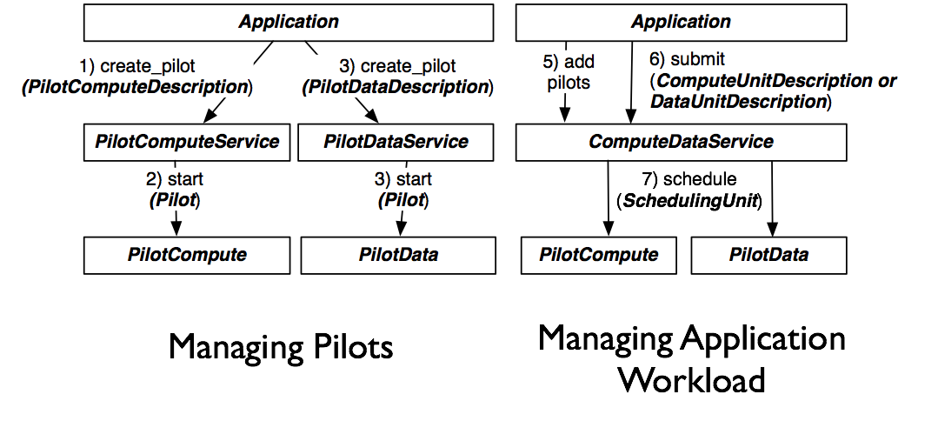
Pilot-API: Unified API to Pilot-Compute and Pilot-Data

Slide 14
BigJob: A Reference Implementation of the P* Model

Slide 15
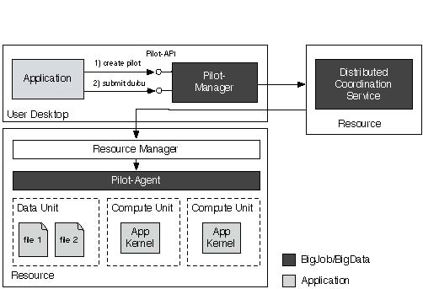
BigJob: Implementation of the P* Model

Slide 16
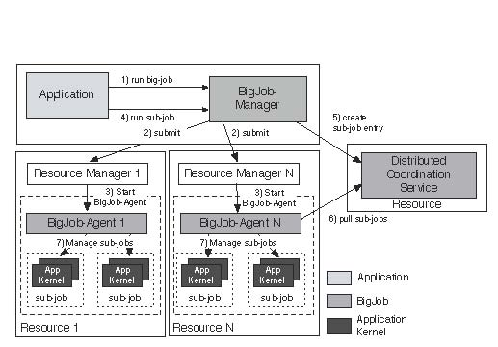
BigJob: Implementation of the P* Model
SAGA Pilot-Job (BigJob)

Slide 17
SAGA: Interoperability Layer for BigJob
  http://saga-project.org

Slide 18
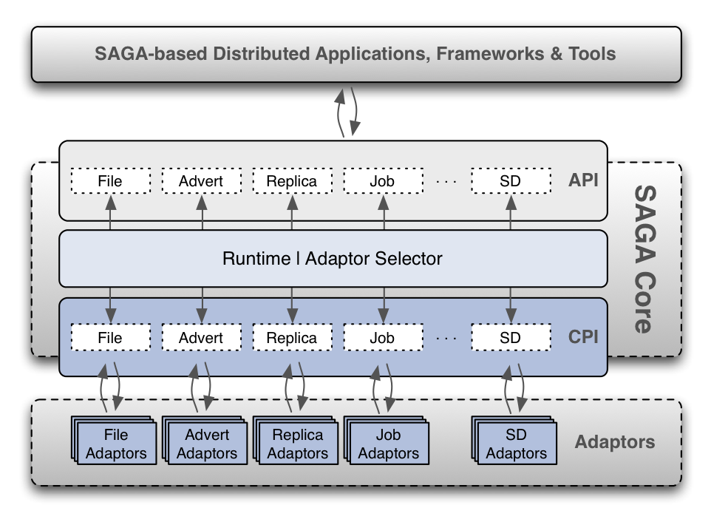
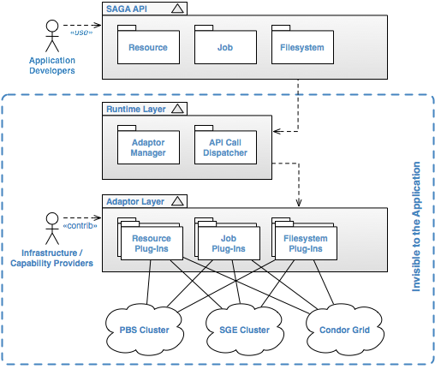
SAGA: Standard for Distributed Applications

Slide 19
SAGA: Interoperability layer upon which other tools and applications are built
HOW SAGA is Used?
  Uniform Access-layer to DCI
    EGI, XSEDE, DATAONE, UK NGS and NAREGI/RENEKI and Clouds
  Application “Scripting Layer” to DCI
    Improved and enhanced HTHP ensembles
  Build tools, middleware services and capabilities that use DCI
    e.g. Gateways, Pilot-Jobs
WHAT is SAGA Used for?
  Support production-grade science and engineering
  Research tool to design, implement reason about distributed programming models, systems and applications

Slide 20
BigJob: An Extensible, Interoperable Pilot-Job for HPC and HTC Workloads

Slide 21
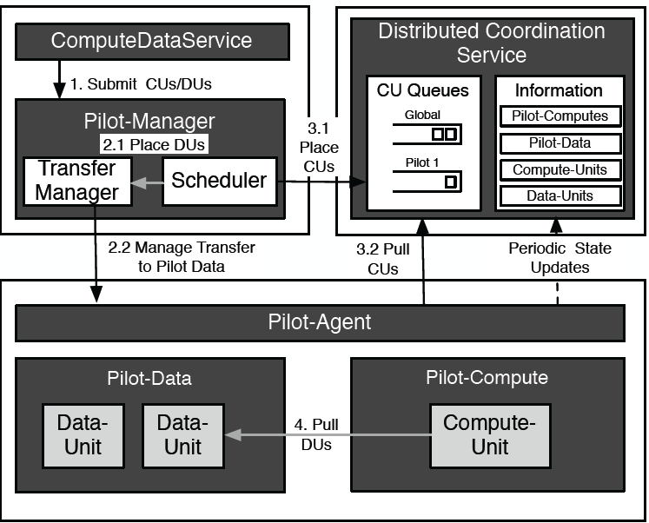
BigJob Workload Management

Slide 22
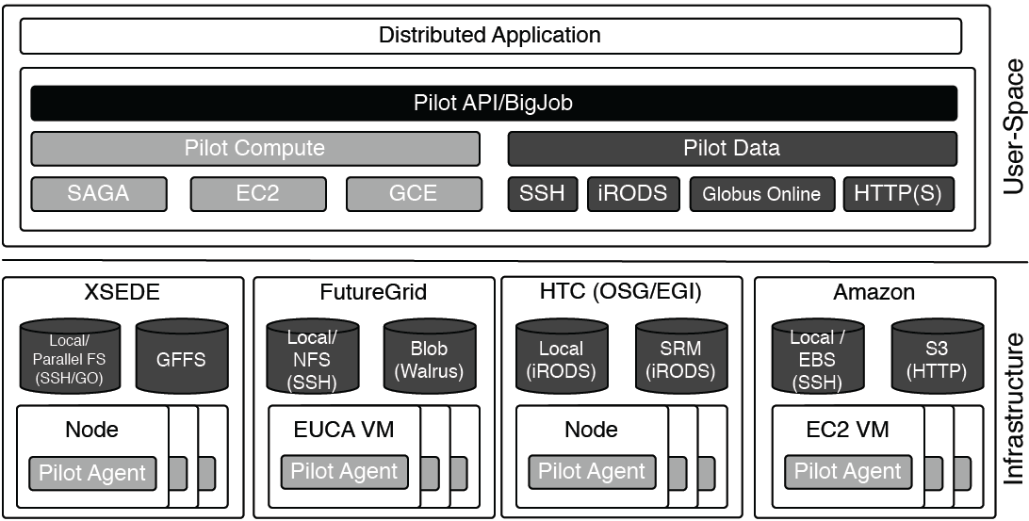
BigJob: Resource Interoperability

Slide 23
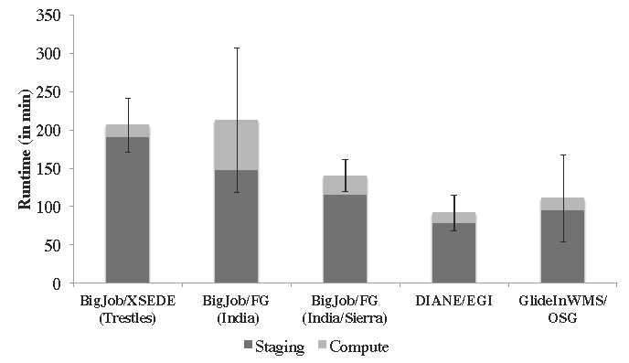
Accessing Multiple DCI & Pilot-Jobs via Pilot-API
128 BFAST tasks, O(10) GB

Slide 24
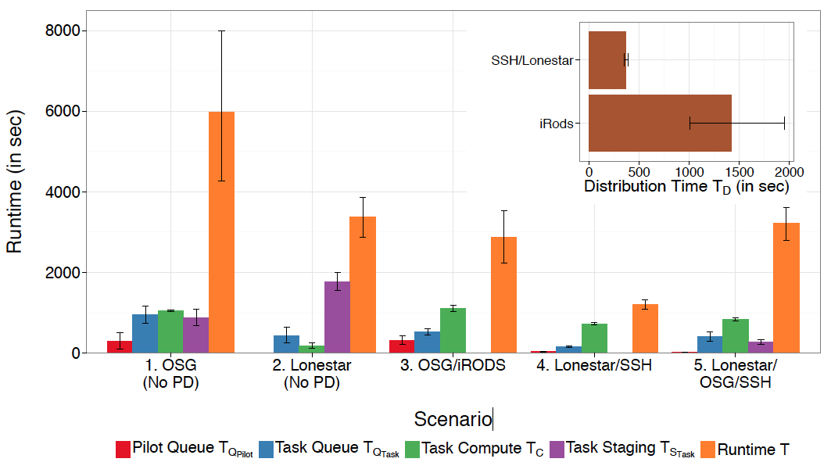
Notes:
Pilot-based Runtimes for running BWA on 2 GB of sequence read files using 8 tasks for five dif- ferent infrastructure configurations on XSEDE and OSG. The inset shows the distribution time (TD) for the 8.3 GB dataset. TD for iRODS includes the replication time. The usage of PD (scenarios 3-5) leads to an performance improvement compared to a naive data management (scenario 1-2).

Slide 25
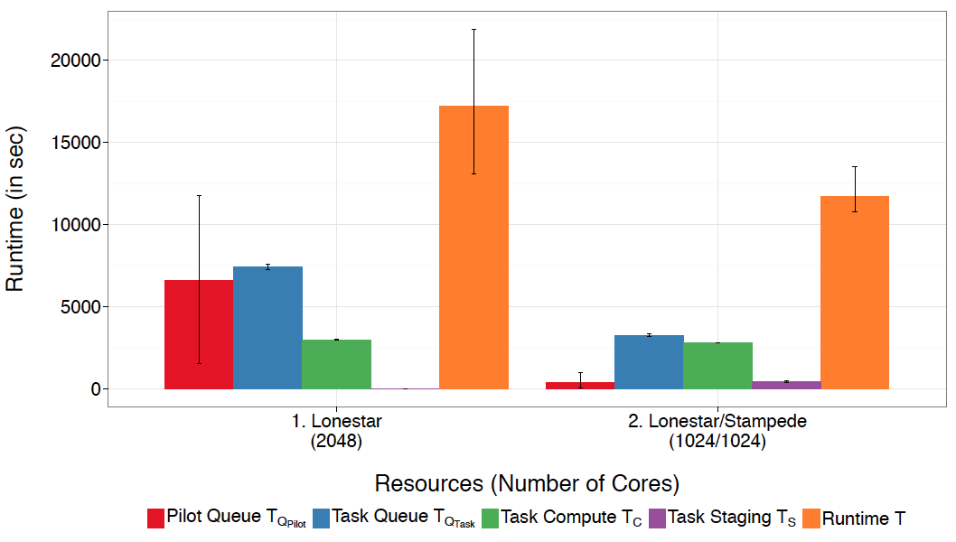
Insert figure 10
Notes:
Running 1024 tasks each consuming 9 GB data on multiple XSEDE machines: The BJ-internal overhead observable in TQT askincreased significantly compared to previous experiments with fewer tasks. Using multiple resources improved T despite the overhead introduced for data movements, in partic- ular due to shorter queuing times.

Slide 26
BigJob Performance
Number of tasks that BJ can dispatch per second:
  Locally:
  Distributed:
Number of tasks concurrently managed:
  Min size of task (sub-job):
  Max size of tasks:
Number of Pilots (Pilot-Agents) that can be marshaled
  Locally:
  Distributed:
Typical number of sub-jobs per Pilot-Agent
Obviously the above depend upon data per task
Range of data: O(1) Byte to O(10⁹) Bytes
Duration of each task: O(1) second to O(10⁵) seconds

Slide 27
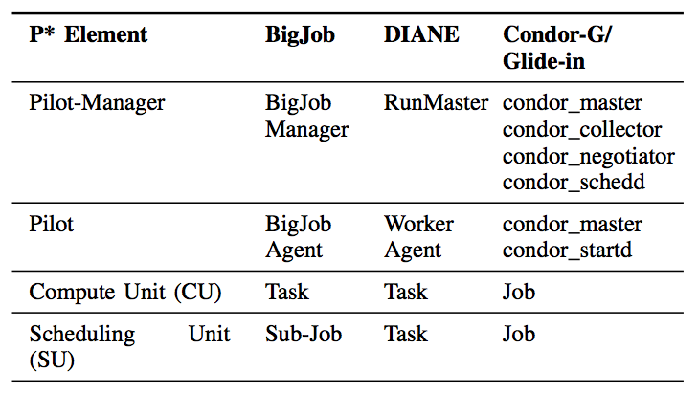
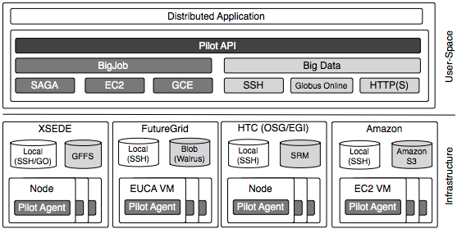
P*: Mapping and Interoperability

Slide 28
BigJob Exemplar: Varying the “coupling” between many MD Simulations on Many Supercomputers

Slide 29
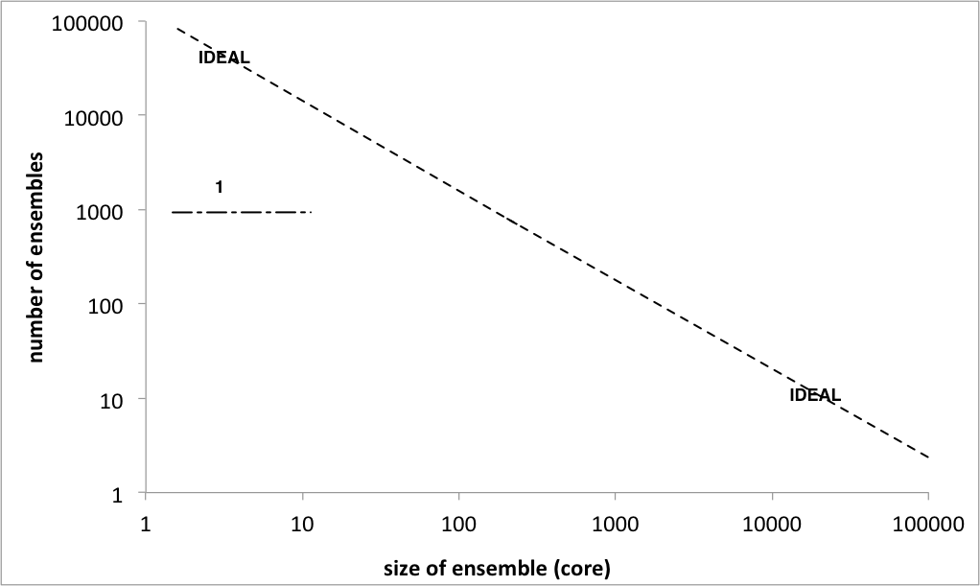
HP-HTC or HT-HPC?
# of Ensemble Members
Number of cores per Ensemble Member

Slide 30
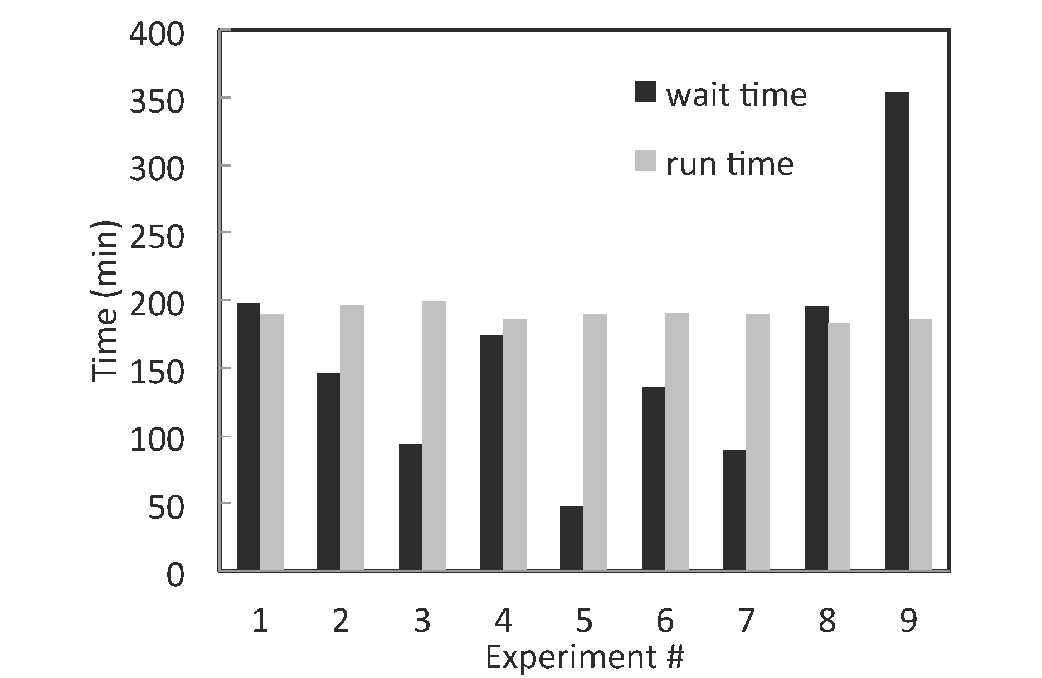
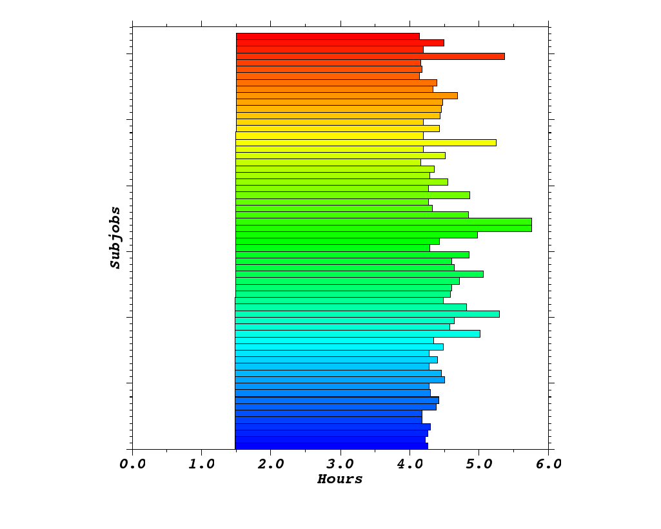
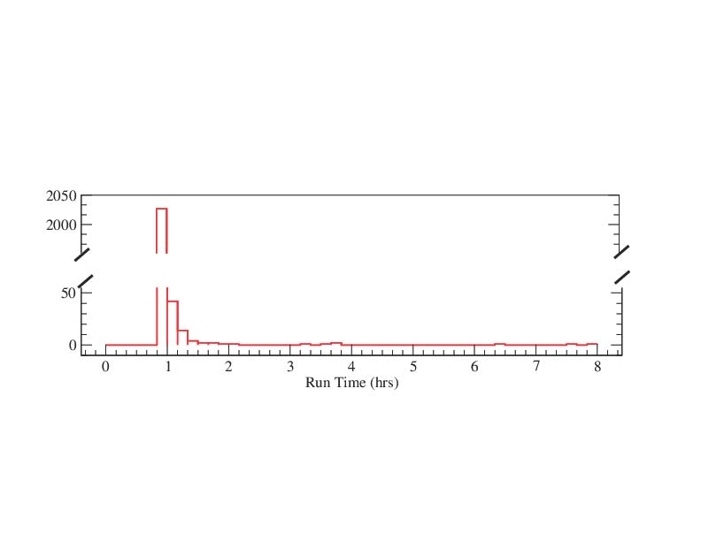
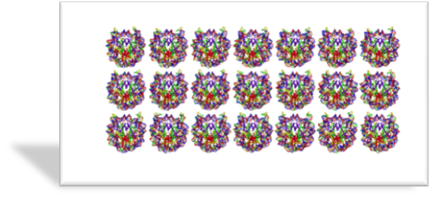
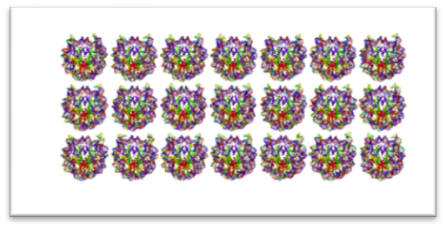
HT-HPC on Kraken
126 ensembles, each of 192 cores = 24192 cores

Slide 31
Distributed and Loosely Coupled Parallel Molecular Simulations
Understand the physics of protein-ligand recognition via multidimensional replica-exchange computer simulations
Asynchronous RE – replicas run until they are done and then are eligible to exchange with other replicas that have completed.
  In contrast, synchronous replica exchange waits until all replicas have reached a “done” state before it can attempt exchanges
Challenges
  Launch and monitor/manage (order 10³-10⁴) loosely coupled replicas
  Long job duration: days to weeks (will have to checkpoint & restart replicas)
  Pairwise asynchronous data exchange (no global synchronization)

Slide 32
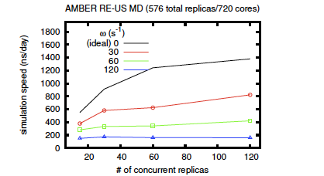
Replica-Exchange Performance in AMBER
Umbrella sampling of the backbone conformational space of alanine dipeptide. The exchange parameters are all permutations of harmonic
biasing potentials on each torsion.

Slide 33
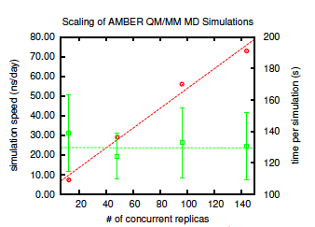
QM/MM Replica-Exchange
QM/MM is not generally considered parallelizable
  RE provides efficient sampling irrespective
Repex FW: BigJob-based Repex
  Framework to handle O(100)--- O(1000) concurrent simulations
  Amongst the earliest QM/MM
  Framework similar to classical QM/MM
Performance increases linearly with core count and number of QM/MM simulations
  No apparent coordination cost for additional simulations
Notes:
"Green lines represent the time per simulation, essentially showing that
greater number of replicas does not cause slow down due to coordination as
the number of replicas increases. Red lines represent “number of
nanoseconds simulated in a 24 wall-clock period”, i.e., amount simulated.
This is the basis for claims about linear performance gains (weak scalingin a way)."

Slide 34
DoE AIMES: Abstractions and Integrated Middlewarre for Extreme Scale
http://aimes-project.org
DoE-ASCR (DE-FG02-12ER26115)
Collaboration between Rutgers (lead), Chicago and UM

Slide 35
Overview
Distributed computing is one pathway to extreme-scale and a necessity for collaboration
The Problem
  Current state of distributed applications and infrastructure is problematic
  Two situations predominate:
    Applications are inflexible: optimized and pinned to a specific platform
    Applications are flexible: run anywhere but performance is unpredictable
The Hypothesis
  Flexibility and performance are compatible!
  Extracting Simplicity whilst managing Complexity requires abstractions
    Abstractions and Models are key to “reason about distribution”
The Solution
  We advance middleware abstractions that will facilitate reasoning integrated across application and resource level
AIMES: Integrated approaches to Resource Management
Notes:
Problem statement was valid 10 years ago. What has changed in 10 years? Need/want to reason
Current State: M-to-M A-I, but we can think of it as a challenge to map 1-to-many, many-to-1
“managing complexity is not the same as extracting simplicity” ---- requires abstractions!

Slide 36
References
``P*: A Model of Pilot-Abstractions”, 8th IEEE International Conference on e-Science 2012 (DOI: 10.1109/eScience.2012.6404423)
“Distributed Computing Practice for Large-Scale Science & Engineering Applications” Shantenu Jha, Daniel S. Katz, Jon Weissman et al, Computing and Concurrency: Practice and Experience, 2012 (DOI: 10.1002/cpe.2897)
“Pilot-Data: An Abstraction for Distributed Data”, arXiv:1301.6228
“A Fresh Perspective on Pilot-Jobs”, Review/Survey Article on Pilot-Jobs, to be submitted (2013)

Slide 37
References
RADICAL:
  http://radical.rutgers.edu
Publications:
  http://radical.rutgers/edu/publications
SAGA-Python:
  http://saga-project.github.io/saga-python/
BigJob: An implementation of P*
  BigJob: https://github.com/saga-project/BigJob/wiki

Slide 38
Acknowledgements/Funding Sources
Active:
  NSF CAREER Award 2012 (OCI-1253644)
  CDI NSF-CDI (NSF CHE 1125332)
  ExTENCI (NSF OCI)
  SCIHM NSF-OCI (OCI-1235085)
  AIMES DoE-ASCR (DE-FG02-12ER26115)
Compute Time:
  NSF TeraGrid TRAC award TG-MCB090174
  NSF FutureGrid Award (No. 42)
Recent Past:
  NSF/LEQSF (2007-10)-CyberRII-01
  NSF HPCOPS NSF- OCI 0710874 award
  UK EPSRC (GR/D0766171/1) and e-Science Institute, UK
  NSF OCI 1059635
  NIH Grant Number P20RR016456

Slide 39
Acknowledgements
Graduate Students:
Ashley Zebrowski
Melissa Romanus
Mark Santcroos
Anton Trekalis
Undergraduate Students:
Vishal Shah
Research Scientist/Programmer:
Andre Luckow
Andre Merzky
Matteo Turilli
Ole Weidner

Slide 40
Future Directions

Slide 41
Pilot-Abstraction for Dynamic Distributed Data?
Similar levels of heterogeneity in the data infrastructure
  File systems, storage, transport protocols, …
Support application level capabilities to specify dependencies at a logical level rather than specific file level
  First class support for Affinities (D-C, D-D)
Typically placement and scheduling of data is decoupled from the compute-tasks
  Integrated approach to compute and data ?
Dynamic decision for data
  Analogous to late-binding of data
  Fluctuating resources as a fundamental property of DCI
Abstraction for other factors and not application specific way:
  Varying data sources, fluctuating data rates, etc

