Slide 1
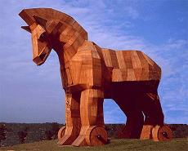


P*: A Model of Pilot-Abstractions
Andre Luckow, Mark Santcroos, Ole Weidner, Andre Merzky, Pradeep Mantha, Shantenu Jha
IEEE eScience 2012
Chicago, 11 October 2012

Slide 2
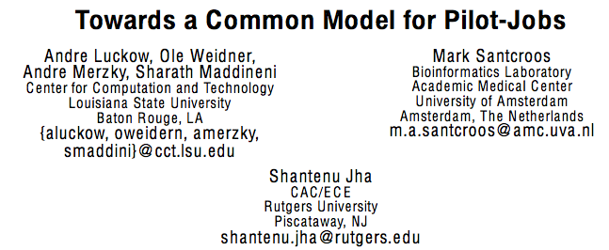
ACM HPDC 2012

Slide 3
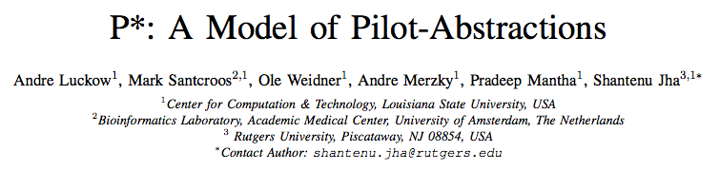
IEEE eScience 2012

Slide 4
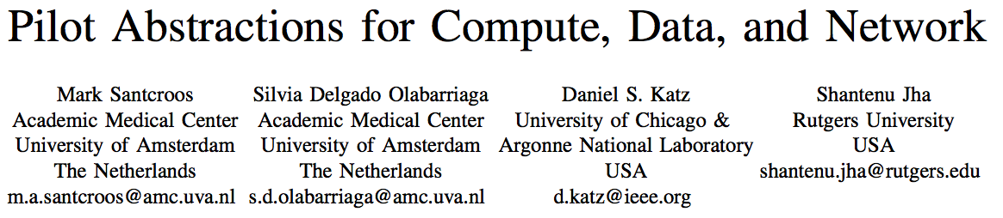
NECS12 Workshop

Slide 5
Landscape of DCI and Applications: Empirical Assertions
DCI is complex: Heterogeneous software, access-layers, policy..
The space of possible Distributed Applications (DA) is large (and rich), but the number of effective and extensible DA small
There are missing abstractions and poor implementations
  Many local solutions, lack of end-to-solutions, especially tools
  Missing conceptual frameworks and systems approach to tools
Accept, if not embrace “distributedness”
  Manage it, but also exploit it
  The ability to reason: distributed performance, decomposition or aggregation!
Notes:
Whereas the choice of tools will
always be in influenced by soft factors, we are focussing on the absence
of tools, services and capabilities that enable the developer to
reason about the above hard factors

Slide 6
DCI Challenges: Infrastructure Perspective
DCI is complex: Heterogeneous software, access-layers, policy..
  Middleware: Heterogeneity and semantic incompatibility
  Slow/lack of agreement towards a standards-based solution
  Difficult to integrate services & software (service-level Interop)
  This is not Google (i.e., uniform, single top-down solution), as much of a socio-cultural challenge as a technical one
Distributed Computing Practice for Large-Scale Science & Engineering Applications, Jha, Cole, Katz, Parashar, Rana and Weissman, CCPE (in press)
Notes:
Development is definitely a challenging
aspect of these application, our analysis demonstrates that deployment
and execution concerns are important too (and in many/some cases the
dominant barrier!).

Slide 7
DCI Challenges: Application Perspective
End-to-end application support missing
  Many moving and changing parts, insufficient / partial coverage
Well defined interfaces
  Standard-layers handle hard parts, allowing innovation elsewhere
  Effective dynamic resource utilization and execution models
    Beyond simple static single batch-mode…
“Complex” coordination requirements
  How to manage coordination?
Abstractions to support: Where, when, how to distribute?
  Both Development and System/Infrastructure level abstractions
Notes:
Whereas we agree that the choice of tools is a result of
non-quantitative factors, we also believe, a
distributed application has some unique challenges: a distributed
application/developer has to reason about the environment that the
application will execute in, has to make assumptions about the runtime
availability, and has to assume a failure model that transcends
complete knowledge of the application or even predicates it upon
knowledge of a system/resource.

Slide 8
Context
Scientific computing applications demand (computer) resources to execute

Slide 9
Application
Can be a simple script calling multiple instances of a program
Can be a complex workflow management system that dynamically executes tasks based on a workflow description
Resource requirements may vary over time
  Internal dynamics of an application
  Different solvers
  Adaptive algorithms

Slide 10
Compute Resources
Heterogeneous
  Local clusters
  High Throughput Computing Grids
  High Performance Computing Clusters
  Desktop Grids
  IaaS (clouds)
Capacity is fluctuating
  Growing, shrinking
  Changing in load and capabilities

Slide 11
Storage / Data Resources
Local storage systems / data sources
Different protocols / access mechanisms
Distributed experiment data
Data may be replicated
Persistent / volatile
Dynamic

Slide 12
Decoupling
Applications that are capable of using tools, abstractions and services that decouple payload management and resource assignment have been more successful at efficiently utilizing distributed resources.

Slide 13
Pilot Jobs
A Pilot-Job is an abstraction that uses a placeholder job as a container for a set of compute tasks
An instance of that placeholder job is commonly referred to as Pilot-Job or pilot

Slide 14
Pick your flavor …
DIANE
DIRAC
CONDOR Glide-In
Swift Coasters
ToPoS
Falkon
PanDA
Nimrod/G
BigJob
…

Slide 15
P*: a model
A model for Pilot Abstraction
Minimal but Complete
Establish terminology
Provide a framework for comparison

Slide 16
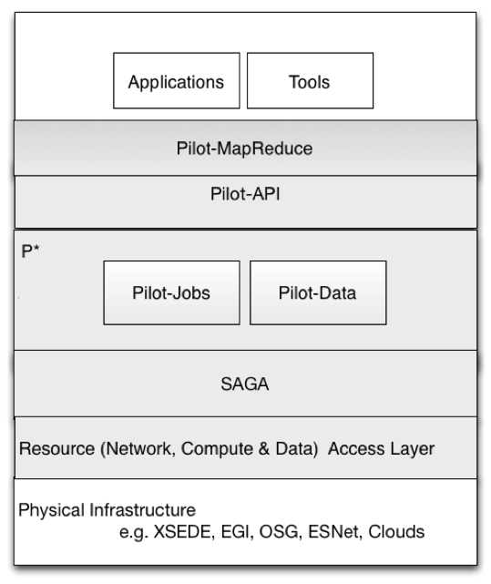
Positioning of P*

Slide 17
Pilot-Abstraction for Dynamic Distributed Data
Similar heterogeneity for data infrastructure
Application level capabilities on logical level and not on file level
Fundamentally task placement is independent of data placement
Dynamic decision for data
Other considerations (varying data sources, data rates, etc)

Slide 18
Elements of the P* model
Pilot-Compute (PC)
Pilot-Data (PD)
Compute Unit (CU)
Data Unit (DU)
Scheduling Unit (SU)
Pilot-Manager (PM)

Slide 19
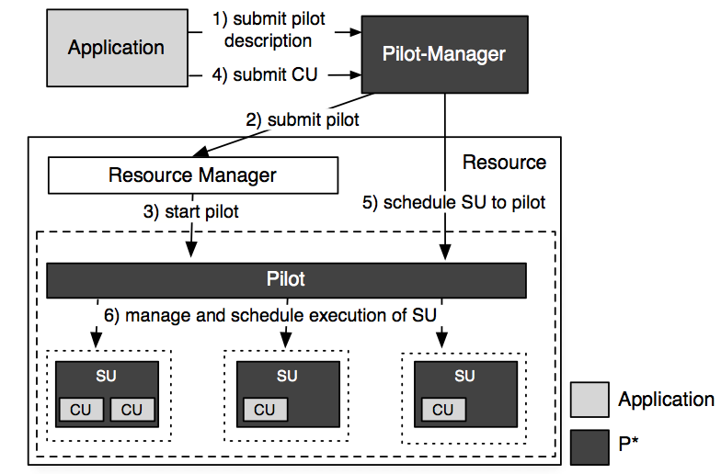
P* Model of Pilot Abstractions

Slide 20
Pilot-API
Python implementation of P* model
Exhibits the decoupling of Workload and Resources

Slide 21
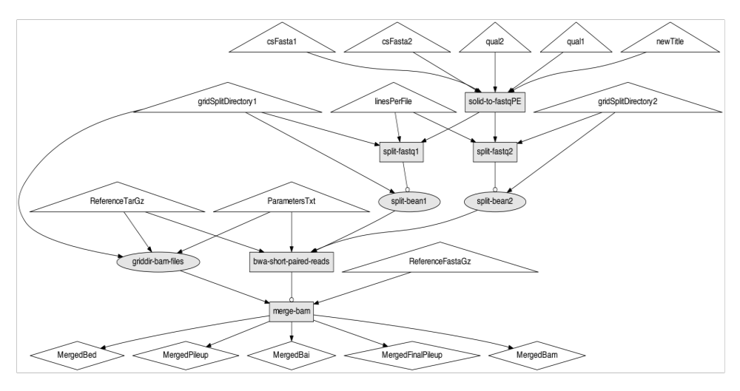
NGS Workflow

Slide 22
Element: Pilot Compute(PC)
The placeholder entity that gets submitted to a resource
Often has the role of an agent:
  collects information
  manages the resources allocated
  exchanges data
Executes application code

Slide 23
PilotCompute Creation
# Instantiate a PilotComputeService running on localhost
pilot_compute_service = PilotComputeService(‘localhost’)
# Define a PilotComputeDescription
pilot_compute_desc = {
‘service_url’: ‘cream://gb-ce-amc.amc.nl/
cream-pbs-medium’
}
# Create a PilotCompute through the PilotComputeService
pilot_compute_service.create_pilot(pilot_compute_desc)

Slide 24
Element: Pilot Data(PD)
The placeholder entity that represents a storage resource (reservation)
Can have the role of an agent:
  collects information
  manages the resources allocated
Physically stores the data

Slide 25
PilotData Creation
# Instantiate a PilotDataService
pilot_data_service = PilotDataService()
# Define a PilotDataDescription
pilot_data_description = {
’service_url’: ’srm://tbn18.nikhef.nl/ home/mark/pilotdata/’
}
# Create a PilotData
pilot_data_service.create_pilot(pilot_data_description)

Slide 26
Element: Compute Unit (CU)
Is defined by the application
Encapsulates a self-contained piece of work that is submitted to the PJ framework
E.g.:
  task, job, rpc, web service call, etc.

Slide 27
ComputeUnit
# Define ComputeUnitDescription for solid-to-fastqPE
compute_unit_description = {
’executable’: ’solid-to-fastqPE’,
’arguments’: [<...APPLICATION_ARGUMENTS...>],
’input_data’: [solid_du],
’output_data’: [fwd_fastq_du, rev_fastq_du],
}
# Submitting solid-to-fastqPE ComputeUnit
cd_service.submit_compute_unit
(compute_unit_description)

Slide 28
Element: Data Unit (DU)
Is defined by the application
Encapsulates a self-contained piece of logical data that is submitted to the PJ framework
E.g.:
  file, chunk, database, etc.

Slide 29
Input DataUnit
# Define DataUnitDescription for short read files
solid_dud = {’file_urls’: [
’file:///Test42/Test42_F3.csfasta.bz2’),
’file:///Test42/Test42_F3_QV.qual.bz2’),
’file:///Test42/Test42_R3.csfasta.bz2’),
’file:///Test42/Test42_R3_QV.qual.bz2’)]
}
# Submit the DataUnit, this will initiate a transfer.
solid_du = cd_service.submit_data_unit(solid_dud)

Slide 30
Output DataUnit
# DataUnit for forward fastq output file
data_unit_description = {
’file_urls’: [’Test42_fwd_read.fastq.gz’]
}
fwd_fastq_du = DataUnit(data_unit_description)

Slide 31
Element: Scheduling Unit (SU)
Represents a DataUnit / ComputeUnit internal to the runtime system
Allows for aggregation and division of application level payload

Slide 32
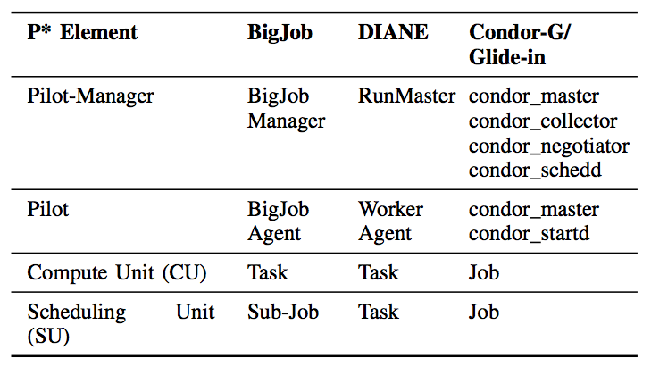
Mapping

Slide 33
Three services
PilotComputeService
  Manages a pool of compute resources
PilotDataService
  Manages a pool of storage resources
ComputeDataService
  Manages the application’s workload

Slide 34
PilotComputeService
PilotComputeService is responsible for creating and managing the PilotComputes
It is the application's interface to the Pilot-Manager in the P* Model
Created from PilotComputeDescription
Creates a PilotCompute

Slide 35
PilotDataService
PilotDataService is responsible for creating and managing the PilotDatas
It is the application's interface to the Pilot-Manager in the P* Model
Created from PilotDataDescription
Creates a PilotData

Slide 36
ComputeDataService
The ComputeUnitDescription is a task description based on SAGA Job Description
It offers the application to describe a ComputeUnit in an abstract way that is dealt with by the Pilot-Manager

Slide 37
ComputeDataService
# Instantiate a ComputeDataService
cd_service = ComputeDataService()
# Connect PilotComputeService to ComputeDataService
cd_service.add_pilot_compute_service
(pilot_compute_service)
# Connect PilotDataService to ComputeDataService
cd_service.add_pilot_data_service(pilot_data_service)
# Submitting solid-to-fastqPE ComputeUnit
cd_service.submit_compute_unit
(compute_unit_description)

Slide 38
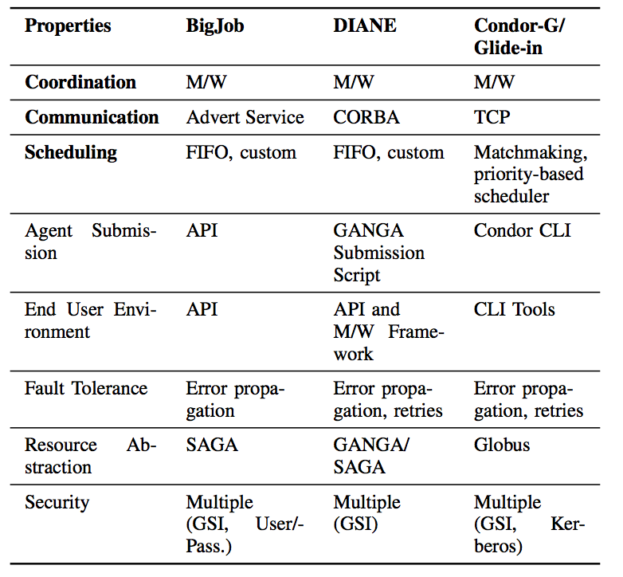
Characteristics and other properties

Slide 39
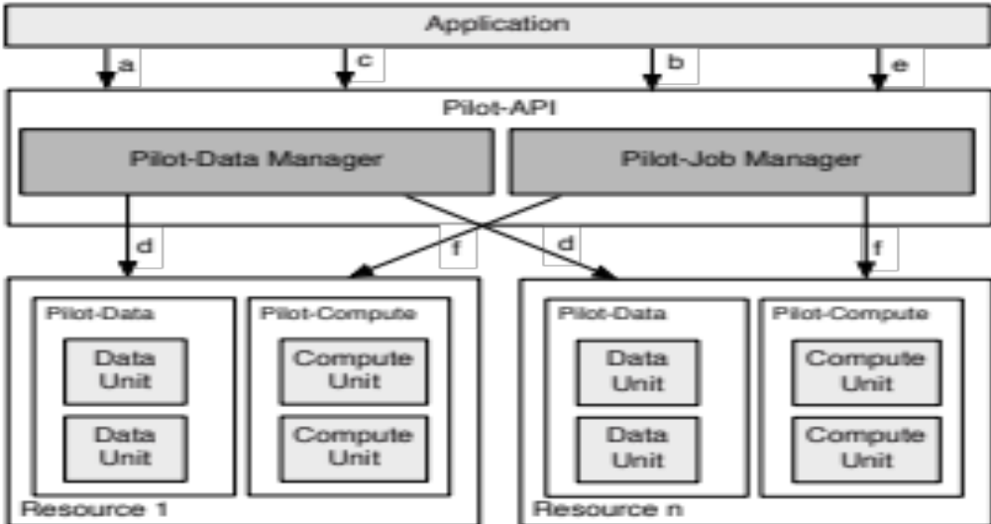
> 1000 words

Slide 40
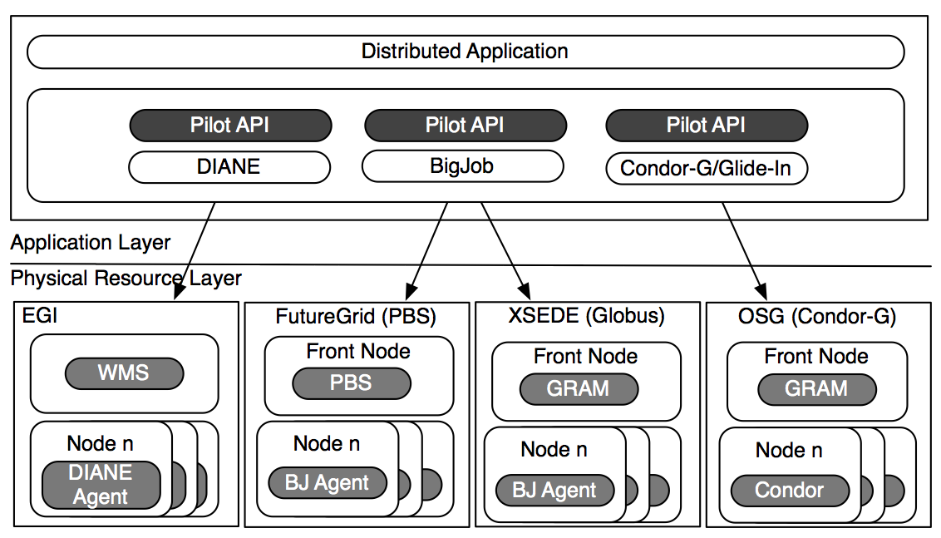
Pilot-API and PJ frameworks

Slide 41
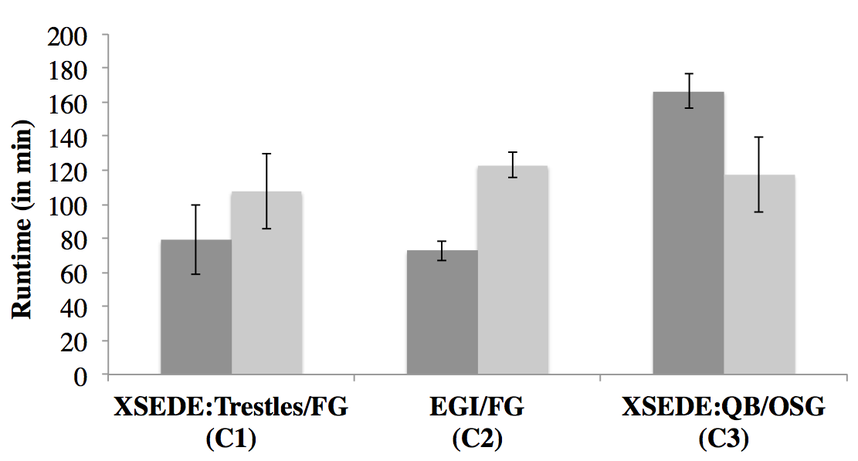
PJ Framework Interoperability

Slide 42
Conclusions
Established P* as an abstraction for supporting dynamic execution
Common framework for comparisons
Well defined Pilot-API for application developers

Slide 43
Discussion
Applicability to workflow paradigm
Extension with networking
Clouds are an important and useful development but not a panacea

Slide 44
Acknowledgements
This work is funded by NSF CHE-1125332 (Cyber-enabled Discovery and Innovation), HPCOPS NSF-OCI 0710874 award, NSF-ExTENCI (OCI- 1007115) and NIH Grant Number P20RR016456 from the NIH National Center For Research Resources
SJ acknowledges the e-Science Institute, Edinburgh for supporting the research theme. “Distributed Programming Abstractions” & 3DPAS
MS is sponsored by the program of BiG Grid, the Dutch e-Science Grid, which is financially supported by the Netherlands Organisation for Scientific Research, NWO
This work has also been made possible thanks to computer resources provided by TeraGrid TRAC award TG-MCB090174 (Jha) and BiG Grid
This document was developed with support from the US NSF under Grant No. 0910812 to Indiana University for “FutureGrid: An Experimental, High-Performance Grid Test-bed”

