Slide 1
Hands-On with BigJob
Presented by: Melissa Romanus
The RADICAL Group
http://radical.rutgers.edu
http://saga-project.org

Slide 2

Agenda
Introduction and Overview [1hour]
Hands-On Session [2 hours]
Installing BigJob
Writing your First BigJob Script
Running BigJob on XSEDE resources
Working with Data Staging
Advanced Workflows using BigJob

Slide 3

Using BigJob for Computational Chemistry
BigJob is utilized to submit many tasks to simulate a molecular dynamics system
The plot to the left shows each individual simulation task, which is a 1 ns simulation of a system containing approximately 158,000 atoms, mostly water
BigJob supports this loosely-coupled workflow

Slide 4
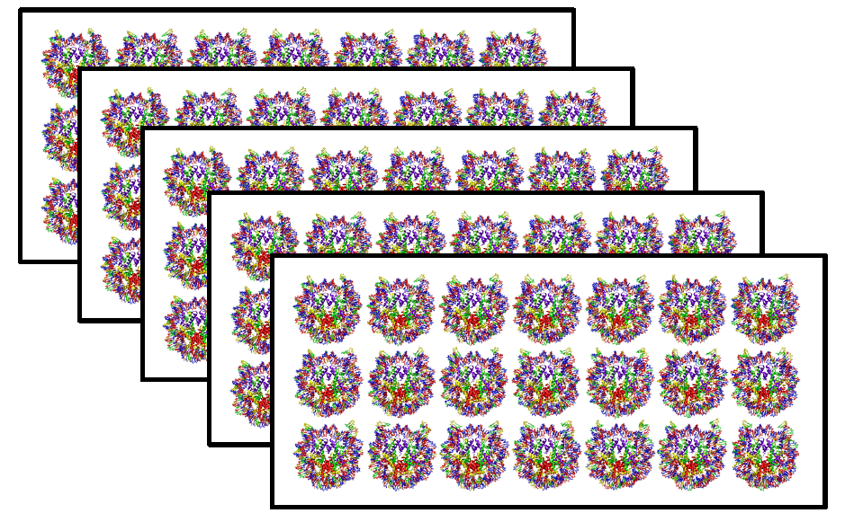
Using BigJob for Computational Chemistry
The entire simulation ensemble includes 5 sets of 21 systems, as pictured.
Don’t want to worry about resource management
BigJob is used to decouple the task execution from the resource management
Supports large-scale ensemble runs and size

Slide 5
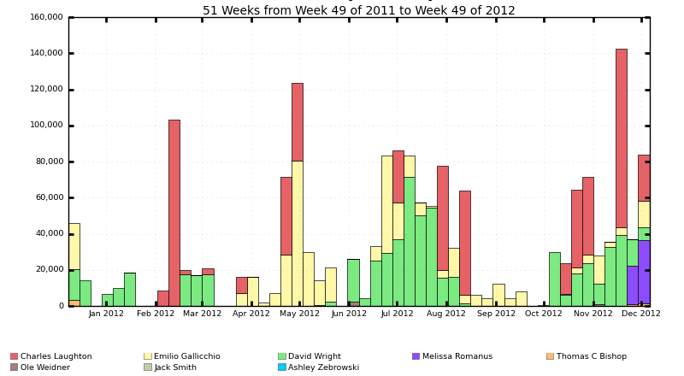
BigJob Community Uptake on XSEDE
BigJob is used across heterogeneous XSEDE resources for a variety of simulations

Slide 6
Introduction
What is BigJob?
A SAGA-based Pilot-Job Framework
Lightweight Python scripts utilizing SAGA capabilities
BigJob allows for the execution of multiple jobs without the necessity to queue each job.
BigJob allows user-level, programmable control of the execution environment and construction of complex workflows
Decouples the task coordination from the task execution
Provides the logic of the execution without having to schedule the tasks individually
Notes:
Change Bliss to SAGA-Python

Slide 7
Please Point Your Browser…
Follow along with this tutorial by visiting….
XSEDE Tutorial Part 3: BigJob
http://saga-project.github.com/BigJob/sphinxdoc/patterns/simple.html

Slide 8
Environment Set-Up
Open a terminal (Linux/Mac: Terminal, Windows: PuTTy)
ssh <your username>@lonestar.tacc.utexas.edu
Bootstrap your Local Python Environment
module load python
Create your virtual environment
curl --insecure -s https://raw.github.com/pypa/virtualenv/master/virtualenv.py | python - $HOME/.bigjob

Slide 9
Environment Set-Up cont’d
Activate your newly installed Python environment to update your PYTHONPATH
source $HOME/.bigjob/python/bin/activate
Ensure batch jobs have the same Python environment by adding the following lines to $HOME/.profile
Open $HOME/.profile in your favorite text editor (e.g. vim, emacs, etc)
module load python
source $HOME/.bigjob/python/bin/activate

Slide 10
BigJob Components
There are two main components of concern when writing BigJob scripts.
Pilot Description: Defines the resource specification for managing jobs on each resource
Compute Unit Description: Defines the actual job description and data for movement
cd $HOME

Slide 11
Pilot Description
Resource specification requirements
service_url: Specifies the SAGA Bliss job adaptor and resource hostname on which jobs can be executed. For remote hosts, password-less login must be enabled.
number_of_processes: specifies the total number of processes that need to be allocated to run the jobs
queue: Specifies the name of the job queue to be used
project: Specifies the allocation for your project to charge
working_directory: specifies the directory in which the Pilot-Job agent executes
walltime: Specifies the number of minutes that the resources are requested
file_transfers: specifies the files that need to be transferred in order to execute the jobs successfully. Generally files common to all jobs are listed here.
Notes:
Will provide examples as presenter is going through it and then the code will show it coming together

Slide 12
Pilot Description Code
What does it all look like in Python?
pilot_compute_description.append({ "service_url": "sge+ssh://localhost",
"number_of_processes": 12,
”project": "XSEDE12-SAGA",
"queue" : "development",
"working_directory": os.getenv( "HOME")+ "/agent",
"walltime":10 })

Slide 13
Compute Unit Description
CU Requirements (job description, etc):
executable: The code or software that you are trying to run/execute
arguments: The list of arguments that will be passed to the executable (i.e. command line arguments)
environment: specifies the list of environment variables to be set for successful job execution
working_directory: The directory in which the job has to execute. If left unspecified, the Pilot-Job creates a default directory
number_of_processes: specifies the number of processes to be assigned for the job execution
spmd_variation: specifies the type of job. By default, it is single job.
output: The file in which the standard output of the job execution will be stored
error: The file in which the standard error of the job execution will be stored (will be a blank file if no errors)
file_transfers: The files that need to be transferred in order to execute the job successfully.
Notes:
note: presenter should explain examples along with this – i.e. note that environment is relevant for batch queue jobs etc

Slide 14
Compute Unit Description Code
What does it all look like in Python?
compute_unit_description = { "executable": "/bin/echo",
"arguments": ["Hello","$ENV1","$ENV2"],
"environment": ['ENV1=env_arg1','ENV2=env_arg2'],
"number_of_processes": 4,
"spmd_variation":"mpi",
"output": "stdout.txt",
"error": "stderr.txt" }

Slide 15
Install BigJob
BigJob is available via PyPi and can be installed via pip.
pip install bigjob
Verify that your installation was successful
python –c “import bigjob; print bigjob.version”
Create BigJob agent directory. BigJob uses this agent directory as it’s ‘working directory’ in our examples.
mkdir $HOME/agent

Slide 16
Please Point Your Browser…
Follow along with this tutorial by visiting….
Chained Example: BigJob
http://saga-project.github.com/BigJob/sphinxdoc/patterns/chained.html

Slide 17
Please Point Your Browser…
Follow along with this tutorial by visiting….
Coupled Example: BigJob
http://saga-project.github.com/BigJob/sphinxdoc/patterns/coupled.html

Slide 18
Sample: Running on Stampede
Follow along with this tutorial by visiting….
Coupled Example: BigJob
http://saga-project.github.com/BigJob/sphinxdoc/patterns/coupled.html

Slide 19
Please Point Your Browser…
Follow along with this tutorial by visiting….
Running on Stampede
http://saga-project.github.com/BigJob/sphinxdoc/patterns/exsede.html

Slide 20
Introduction to Pilot Data
Follow along with this tutorial by visiting….
Introduction to Pilot Data
http://saga-project.github.com/BigJob/sphinxdoc/usage/pilotdata.html

Slide 21
Using Remote Pilot Data
Follow along with this tutorial by visiting….
Using Remote Pilot Data
http://saga-project.github.com/BigJob/sphinxdoc/patterns/pdata.html

Slide 22
Questions?
Notes:
Yes, I realize this text is small but they can read the website

