Slide 1

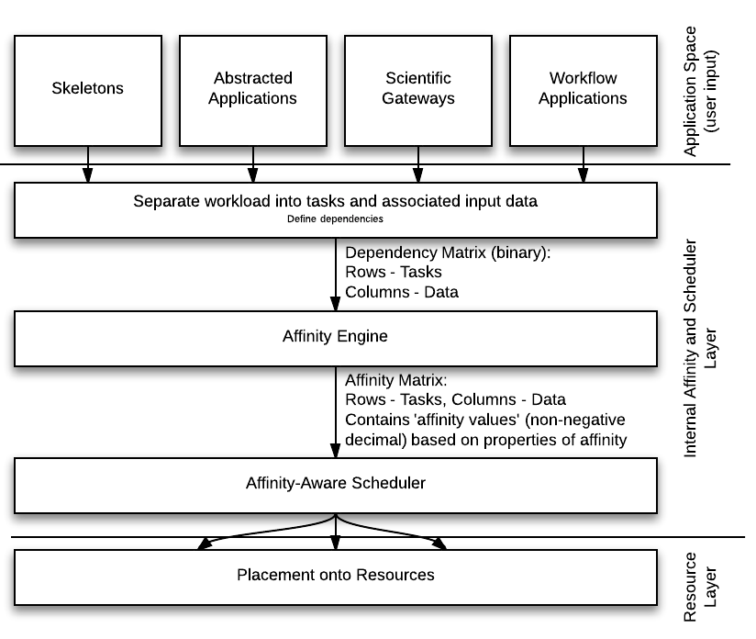
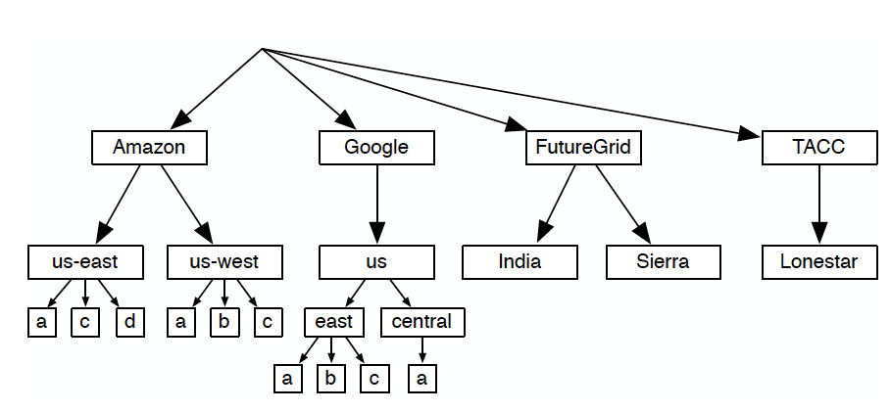
Modeling Affinity in High-Performance Distributed Computing
Melissa Romanus
melissa.romanus@rutgers.edu
Electrical & Computer Engineering Department
Rutgers, The State University of New Jersey
Shantenu Jha
shantenu.jha@rutgers.edu
Electrical & Computer Engineering Department
Rutgers, The State University of New Jersey
RADICAL
Research in Advanced Distributed Cyberinfrastructure and Applications Laboratory
Motivation:
Heterogeneous environments across clusters, grids, clouds, and other forms of distributed cyber-infrastructure
Distribution of data across multiple resources may result in situations where reactively co-locating data for compute operations may be expensive in terms of network bandwidth, latencies, etc.
Hardware provides potential to perform computing at extreme-scales but many scientists are still limited by software or other efficiency factors (such as data movement or scheduling)
Goal: Provide a semantically-rich abstraction for expressing the relationships between data, computation, and network, which can be used to reason about compute-data co-placement and scheduling
Benefits of Affinity
Affinity aids in the decision making by taking into account factors that may not be available at the ‘scheduler’ level
As an abstraction, the application of affinity is not limited to compute-data relationships only (could use for data dispersion)
By predicting efficient placement at a high-level, there is less optimization delay at the scheduler level
Benefits of Scheduling + Affinity
Minimize data movement across networks or machines
Move computation to large datasets when possible
Maximize throughput, performance, or both
Preserve privacy and security of data when necessary
Affinity Concept
Relationships can be either spatial or temporal
Based on a number of factors, including file transfer time between locations, geography of data centers, etc.
Finer-grained than a dependency
Provide the computed affinity to a scheduler to aid in the placement decision
Three-pronged Developmental Approach
Provide formal mathematical and assignment models to describe the relationships
Create an emulator to analyze ideas and test proposed solutions
Incorporate these solutions into an existing software to measure its benefits
Figure 2: Example flow from user-defined application data to placement on resource utilizing affinity. A user first defines his or her application, including executable, environment variables, input data, etc. This application description is used to generate a dependency matrix between all tasks and their input data. The affinity engine takes this matrix, along with data from information services (file transfer times, geographic location, etc.) to generate affinity values between tasks and data. A larger affinity value indicates to the scheduler that it is advantageous to schedule these tasks/data together. An affinity-aware scheduler is then able to accept this affinity matrix and utilize it to aid in the placement decision-making process. Note that affinity is just one of what could be many inputs that the scheduler may utilize for optimizing placement.
Figure 1: Rudimentary affinity model based only on geographic location. This tree-based approach assumes user-defined location labels granted to both compute and data operations. Each resource is assigned an affinity based on this model. The smaller the distance between the two resources, the larger the affinity.
Related Work
Google File System (GFS): Uses locality hints and tries to assign tasks to machines with local copies of data to be operated on
Microsoft Azure: Offers an affinity group for geographic locality of cloud deployments and storage
DataCutter: Middleware that operates on large scientific datasets; processes distributed data through a series of individualized processes
iRODS: Allows for processing distributed data at a localized level via micro-services; allows for localized computation of distributed data on clients by replication via multiple distributed datasets
Filecule: Group data into units, and aggregate files together based on their usage; static assignment of data-data affinity
Future Work
Expand emulator complexity
Account for different types of affinities, i.e. relationships beyond compute-data such as compute-compute, data-data, compute/data-resource
Implement affinity algorithm into software with advanced scheduling capabilities
Measure the overhead of affinity calculations
Test at different scales; increase the size of the data, does affinity outperform random placement at small or large scales
Demonstrate how the affinity abstraction can be implemented in existing cyberinfrastructure to provide an important tool for effective compute-data placement and scheduling.

