Slide 1
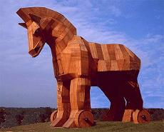


Pilot Abstractions
Mark Santcroos, et al
BioAssist Programmers Meeting
14 September 2012

Slide 2
eBioscience @ BioLab
BiG Grid (2010-2012)
  Data Management, Infrastructure, Support
SHIWA (2010-2012)
  Workflow Interoperability
SCI-BUS (2011-2014)
  Scientific Gateways
COMMIT (2010-2014)
  Frontends for Neuro Imaging
ER-FLOW (2012-2014)
  Workflow Interoperability
ADICT Innovation Fund (2009-2012)
  Provenance
http://www.ebioscience.amc.nl/
http://www.bioinformaticslaboratory.nl/

Slide 3
RADICAL @ Rutgers
Research in Advanced Distributed Cyberinfrastructure and Applications Laboratory
  Cyberinfrastructure Research & Development
  Computation & Data-enabled Science & Engineering
  Fundamental aspects of Computing
  RADICAL members lead the SAGA project
http://radical.rutgers.edu/
http://saga-project.org/

Slide 4
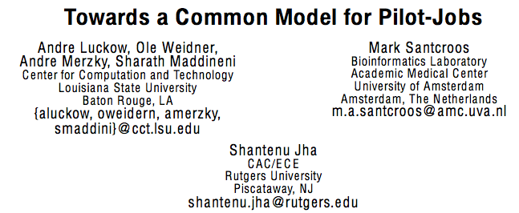
ACM HPDC 2012

Slide 5
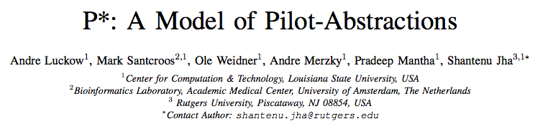
IEEE eScience 2012

Slide 6
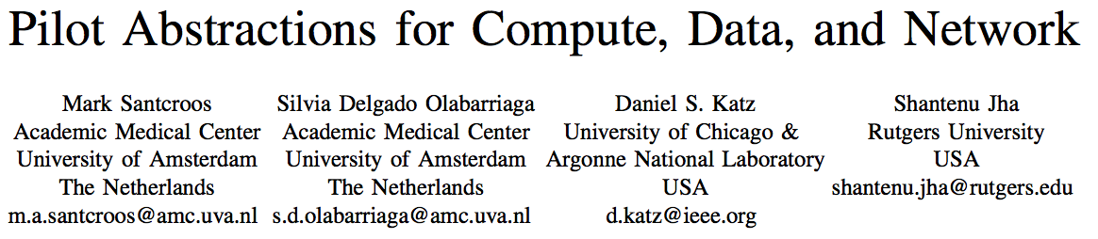
NESC12 Workshop

Slide 7
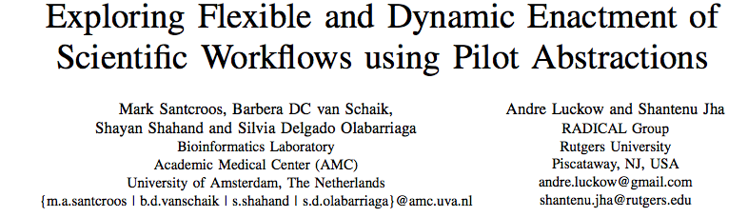
In progress …

Slide 8
Context
Scientific computing applications demand (computer) resources to execute

Slide 9
Application
Can be a script calling multiple instances of a program
Can be a complex workflow management system that dynamically executes tasks based on a workflow description

Slide 10
Resources
Local clusters
High Throughput Computing Grids
High Performance Computing Clusters
Desktop Grids
IaaS (clouds)

Slide 11
Dynamicity (1)
Compute capacity is fluctuating
  Growing, shrinking
  Changing in load and capabilities

Slide 12
Dynamicity (2)
Application resource requirements may vary over time
  Internal dynamics of an application
  Different solvers
  Adaptive algorithms

Slide 13
Decoupling
Applications that are capable of using tools, abstractions and services that decouple workload management and resource assignment and scheduling have been more successful at efficiently utilizing distributed resources.

Slide 14
Pilot Jobs
“A Pilot-Job can be defined as an abstraction that generalizes the reoccurring concept of utilizing a placeholder job as a container for a set of compute tasks; an instance of that placeholder job is commonly referred to as Pilot-Job or pilot.”

Slide 15
Pick your flavor …
DIANE
DIRAC
CONDOR Glide-In
SWIFT
ToPoS
Falkon
PanDA
Nimrod/G
BigJob
…

Slide 16
P*: a model
A model for Pilot Abstraction
Minimal but Complete
Establish terminology
Provide a framework for comparison

Slide 17
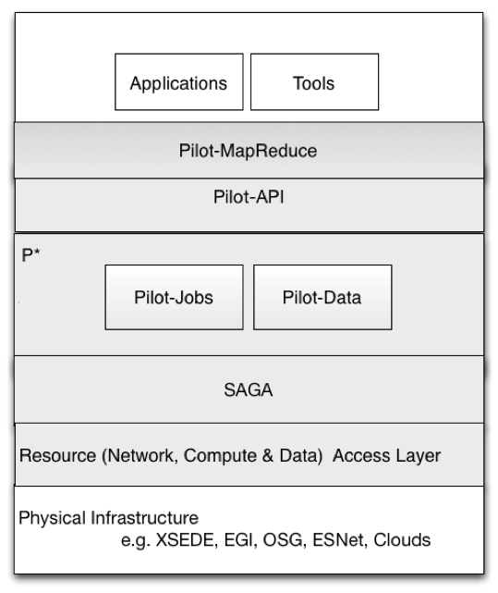
P* Model of Pilot Abstractions

Slide 18
Pilot-Abstraction for Dynamic Distributed Data
Similar heterogeneity for data infrastructure
Application level capabilities on logical level and not on file level
Fundamentally task placement is independent of data placement
Dynamic decision for data
Other considerations (varying data sources, data rates, etc)

Slide 19
Elements of the P* model
Pilot-Compute (PC)
Pilot-Data (PD)
Compute Unit (CU)
Data Unit (DU)
Scheduling Unit (SU)
Pilot-Manager (PM)

Slide 20
Element: Pilot Compute(PC)
The placeholder entity that gets submitted to a resource
Often has the role of an agent:
  collects information
  manages the resources allocated
  exchanges data
Executes application code

Slide 21
Element: Pilot Data(PD)
The placeholder entity that represents a storage resource (reservation)
Can have the role of an agent:
  collects information
  manages the resources allocated
Physically stores the data

Slide 22
Element: Compute Unit (CU)
Is defined by the application
Encapsulates a self-contained piece of work that is submitted to the PJ framework
E.g.:
  task, job, rpc, web service call, etc.

Slide 23
Element: Data Unit (DU)
Is defined by the application
Encapsulates a self-contained piece of logical data that is submitted to the PJ framework
E.g.:
  file, chunk, database, etc.

Slide 24
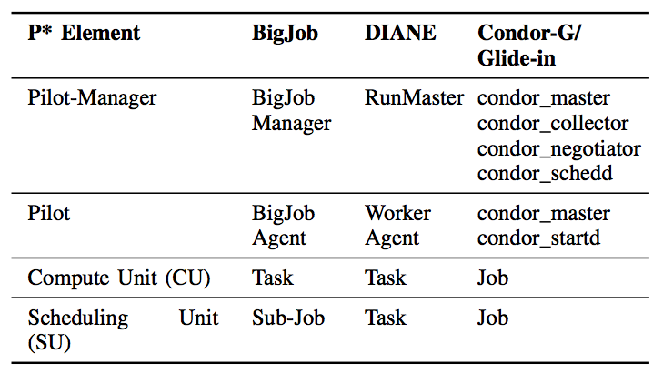
Mapping

Slide 25
Characteristics of the P* model
Coordination
Communication
Scheduling

Slide 26
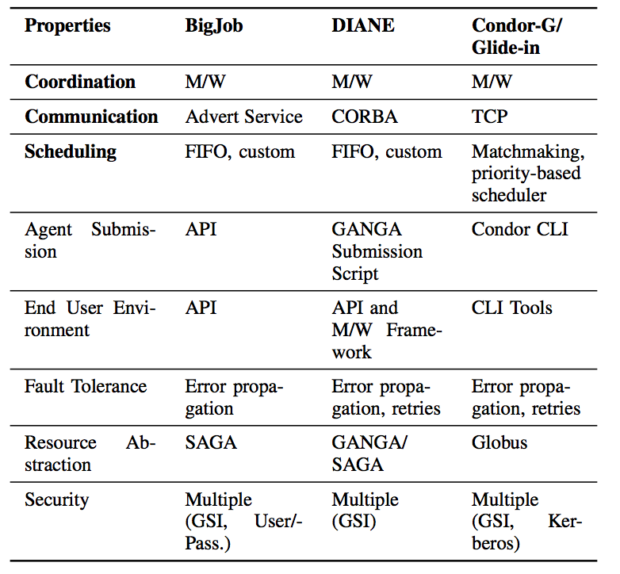
Characteristics and Properties

Slide 27
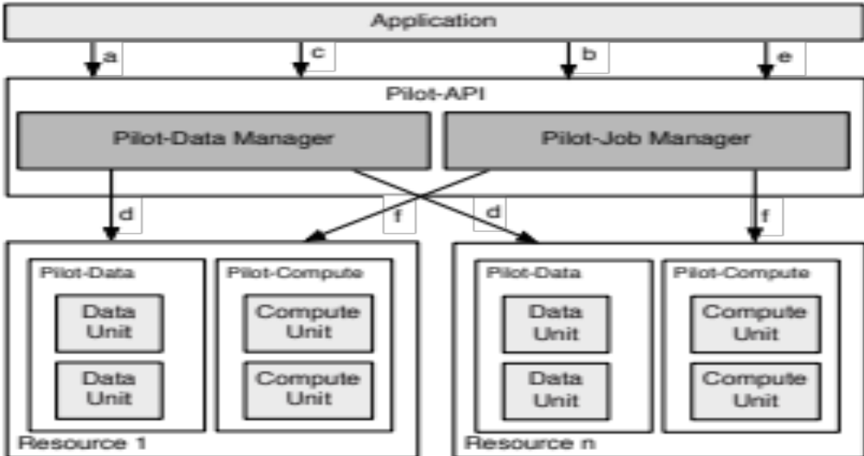
> 1000 words

Slide 28
Pilot-API
Python implementation of P* model
Exhibits the decoupling of Workload and Resources

Slide 29
Three services
PilotComputeService
  Manages a pool of compute resources
PilotDataService
  Manages a pool of storage resources
ComputeDataService
  Manages the application’s workload

Slide 30
PilotComputeService
PilotComputeService is responsible for creating and managing the PilotComputes
It is the application's interface to the Pilot-Manager in the P* Model
Created from PilotComputeDescription
Creates a PilotCompute

Slide 31
PilotDataService
PilotDataService is responsible for creating and managing the PilotDatas
It is the application's interface to the Pilot-Manager in the P* Model
Created from PilotDataDescription
Creates a PilotData

Slide 32
ComputeDataService
The ComputeUnitDescription is a task description based on SAGA Job Description
It offers the application to describe a ComputeUnit in an abstract way that is dealt with by the Pilot-Manager

Slide 33
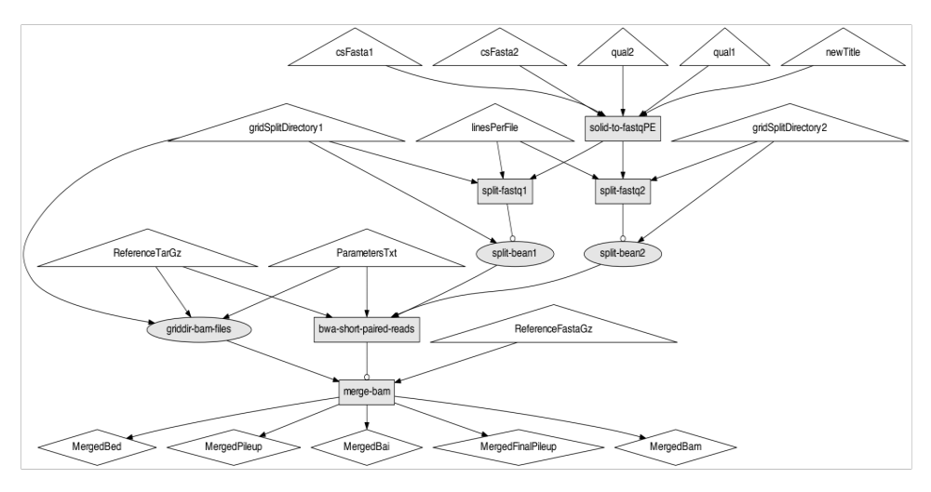
MOTEUR Workflow

Slide 34
Code

Slide 35
In summary …

Slide 36
Conclusions
Established PJ as an abstraction for supporting dynamic execution
Common framework for comparisons
Well defined Pilot-API for application developers

Slide 37
Next steps
Further explore workflow waradigm
Role of networking
Pilot-API implementations of other systems

Slide 38


