Slide 1
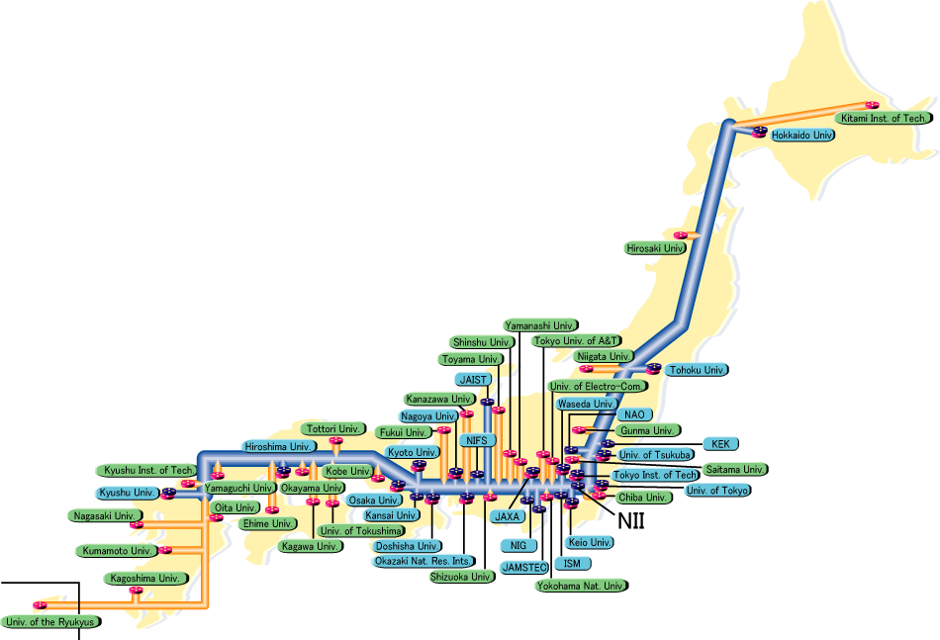
Introduction
SINET3: Production R&E network
10-40 Gbps national backbone
10 Gbps for NYC and LA
KEK is the central laboratory for HEP in Japan
Major HEP projects:
Belle, J-PARC and ATLAS ongoing projects
ILC and Super-Belle future projects
Also covering
Material science, bio-chemistry and so on using synchrotron light and neutron source
Radio therapy using accelerator
University group support in these field
Grid deployment
Reliable operation
Univ. of Tokyo
Tohoku Univ.
Nagoya Univ.
NAO
Kobe Univ.
KEK
Hiroshima Univ.
Univ. of Tsukuba
Hiroshima IT (HIT)
HEP intensive
Computer Science
Coordination and implementation of infrastructures for particularly Japanese HEP institutes are KEK’s responsibility.
Notes:
SINET3 is one of production R&E network and is operated by National Institute of Informatics (NII).
Several VOs have been federated among universities over the different middleware, e.g. gLite and NAREGI.
KEK takes responsibility for coordination and implementation of infrastructure, e.g. central network service, software services and so on.
NAO, which stands for National Astronomical Observatory of Japan, is national institute for astronomy.

Slide 2
Grid Deployment at KEK
NAREGI middleware is being deployed as the general purpose e-science infrastructure in Japan
Seamless user environment between the local resource and multiple grid environment should be provided.
Otherwise user have to create as many applications as middleware.
Matrix between experiment and middleware
 | gLite | NAREGI | Gfarm | SRB | iRODS
Belle | Using | Planning | Using | Using
Atlas | Using
Radio therapy | Using | Developing | Planning
ILC | Using | Planning | Planning
J-PARC | Planning | Planning | Planning |  | Testing
Super-Belle | To be decided by 2010
Notes:
In order to deploy NAREGI middleware as the general purpose e-science infrastructure in Japan, we need compatibility between middlewares
At least between NAREGI and gLite, which is the biggest (and maybe very attractive for many people) resource scale even in Japan.

Slide 3
RENKEI Project Aims
Osaka Univ.
Tsukuba Univ.
KEK
SAGA
Middleware-independent service & application
Service & Applications
Svc
Apps
Apps
HEP
Library
RNS
Yet Another FC service based on OGF standard
Python Binding
C++ Interface
SAGA framework
SAGA-Engine
Adpt
Adpt
Adpt
SAGA adaptors
SRB
iRODS
NAREGI
gLite
Cloud
LRMS
LSF/PBS/SGE/…
This activity is funded by MEXT as a part of RENKEI project which develops seamless linkage of resources in the Grids and the local one for e-Science.
Notes:
The project “RENKEI - REsources liNKage for E-scIence” has been funded by MEXT for 3.5 years (2008-2011) and consists of 5 kinds of work groups.
KEK is developing the SAGA adaptors to bridge the NAREGI and applications
In order to demonstrate an application in multi grid infrastructure, we are developing a web application for radiotherapy simulation as practical example upon HEP library, RNS and SAGA.
RNS is being developed by another work group that consists of Osaka university and Tsukuba university
Simply, our goal is to provide middleware-independent applications and services.
A few items shown in red-line boxes are (or will be) developed by KEK members.

Slide 4
Development Time-line
2008 | 2009 |  |  |  | 2010 |  |  |  | 2011
Q4 | Q1 | Q2 | Q3 | Q4 | Q1 | Q2 | Q3 | Q4 | Q1 | Q2 | Q3 | Q4
System Design
SAGA-NAREGI adaptors
Universal Grid API v1.0
Proto-apps in testbed
App & Service Examples
Universal Grid API v2.0
Notes:
In past few months, use-cases are well analyzed and job adaptors for NAREGI and PBS has been developed.
Universal Grid API that focuses on assist to develop mainly for end user’s applications is going to be developed in 2009 till Q3 of 2010.
Also a few application examples are going to be demonstrated in 2009.

Slide 5
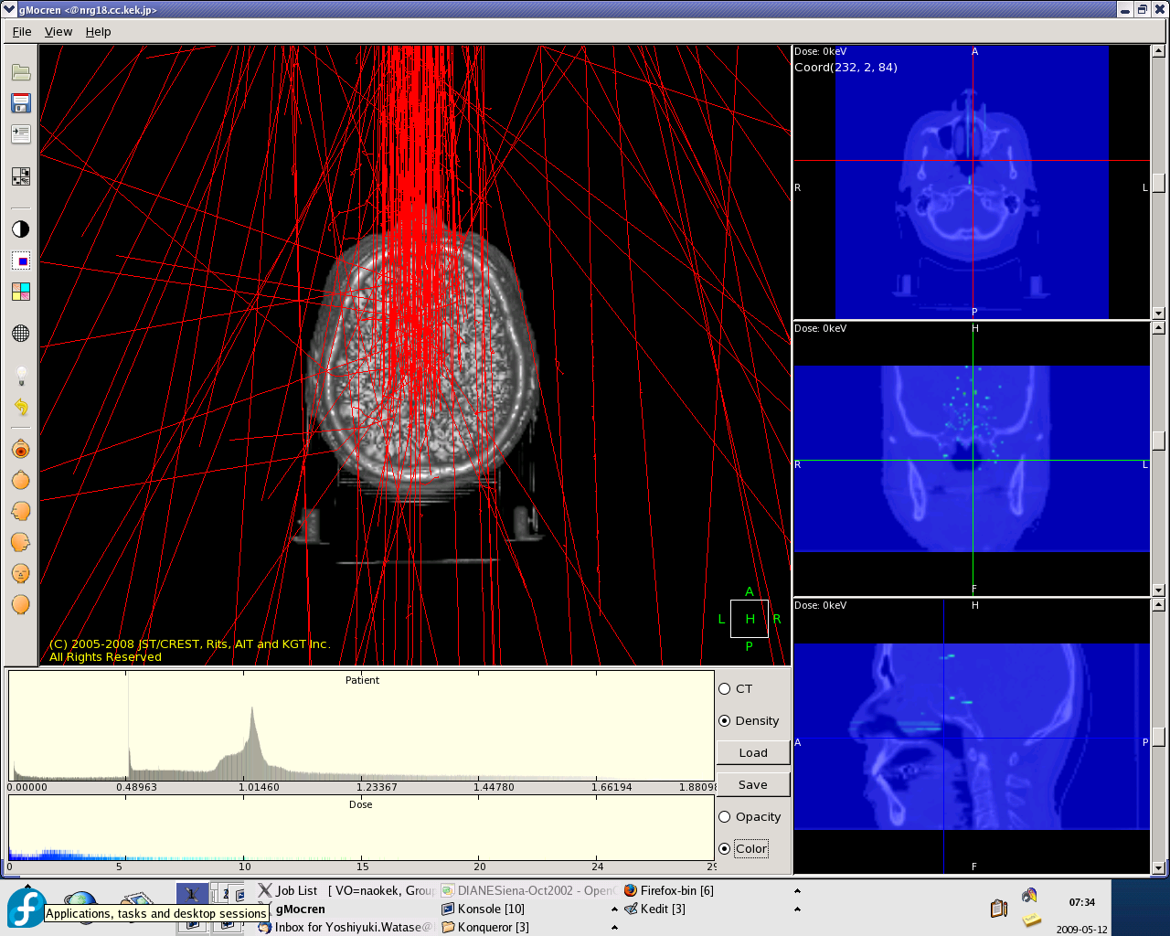
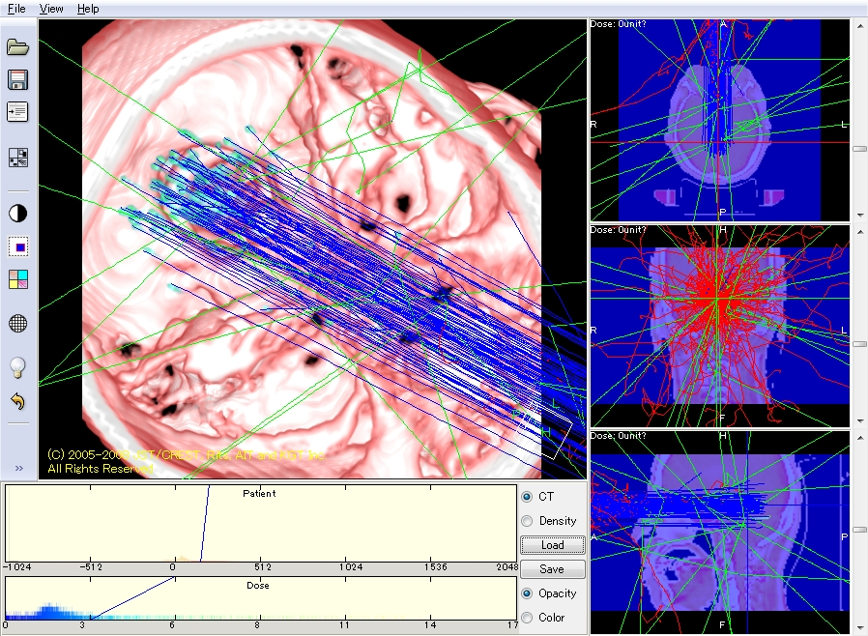
Practical Examples in Testbed
Grid environment
MW: NAREGI v1.1 released in October 2008
VO scale: KEK, NAO, HIT, and NII
SAGA adaptors:
NAREGI adaptor for job completed in April 2009
Torque adaptor completed in June 2009
Demonstration in testbed
Particle therapy simulation based on Geant4 as the 1st practical example
Resource scale
3 sites: KEK, NAO, HIT
CPU: 10 cores
OS: CentOS 5.2 x86_64
Memory: 2 GB each
Well done!
More application-wise development in 2009
Notes:
As the first practical example, particle therapy simulation is demonstrated in testbed (NAREGI only)
We would pay efforts for more application-wise development in 2009
Geant4 is a toolkit for the simulation of the passage of particles through matter. Its areas of application include high energy, nuclear and accelerator physics, as well as studies in medical and space science.

Slide 6

Other Materials
Members in KEK (sorted by alphabetic order)
Go Iwai
Yutaka Kawai
Takashi Sasaki
Yoshiyuki Watase
List of institutes getting involved in RENKEI project
Advanced Industrial Science and Technology
Fujitsu Limited
KEK
National Institute of Informatics
Osaka University
Tamagawa University
Tokyo Institute of Technology
Tsukuba University
Logo (see bottom-right corner in this slide)
Please let me know if you need anything else.

