Slide 1
SAGA: Simple Examples, Programming Manual, SAGA-Shell, Example Applications
NeSC 2009, September 3rd/4th
Hartmut Kaiser, Shantenu Jha, Ole Weidner, Andre Merzky, Andre Luckow

Slide 2
Agenda
Overview, resources, accounts, etc.
SAGA command line tools
Examples

Slide 3
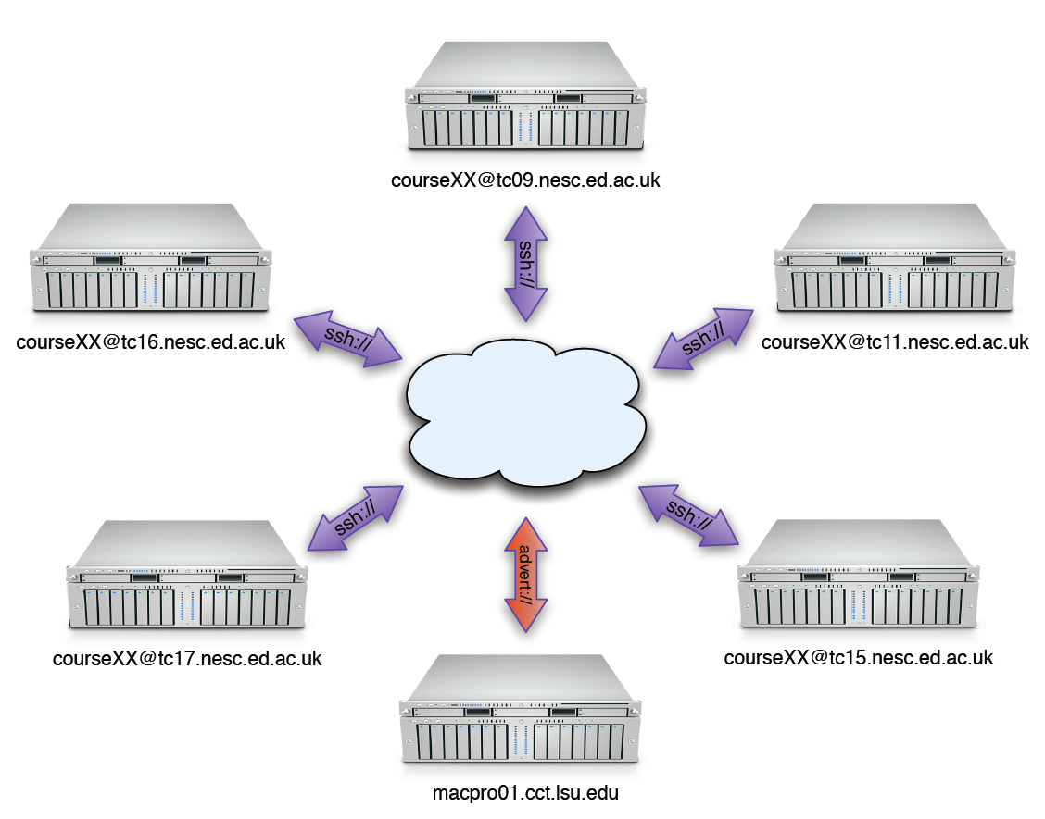
Infrastructure

Slide 4
Login
Login (ssh) to one of the following machines:
tc09.nesc.ed.ac.uk
tc11.nesc.ed.ac.uk
tc15.nesc.ed.ac.uk
tc16.nesc.ed.ac.uk
tc17.nesc.ed.ac.uk
Credentials:
course01, course02,…, course12

Slide 5
Enter the SAGA world
source /usr/local/saga/share/saga/saga-env.sh
Make sure everything works:
saga-job run ssh://user@tcXX.nesc.ed.ac.uk /bin/hostname
saga-advert list_directory advert://FIXME/FIXME

Slide 6
Enter the SAGA world
If something goes wrong:
Will print logging information about adaptors, settings, API calls, etc.
setenv SAGA_VERBOSE = 0…6

Slide 7
Documentation
General information
http://faust.cct.lsu.edu/trac/saga/wiki/NeSC2009
API documentation
http://saga.cct.lsu.edu/cpp/apidoc/
Programming manual
http://tinyurl.com/saga-manual

Slide 8
Command line tools
SAGA comes with simple command line tools that allow to access basic package functionality.
The source code is very simple and a great starting point to explore the SAGA package APIs:
saga-file $SAGA_ROOT/saga/tools/clutils/file/
saga-job $SAGA_ROOT/saga/tools/clutils/job/
saga-advert $SAGA_ROOT/saga/tools/clutils/advert/
saga-replica $SAGA_ROOT/saga/tools/clutils/replica/
saga-shell $SAGA_ROOT/saga/tools/shell/

Slide 9
Command line tools
‘Shell bindings’
Package specific (file, job, advert, replica)
SAGA shell
All in one solution
Filesystem navigation (filesystem, advert, replica)
Job launching
Scripting

Slide 10
Command line tool: saga-file
Supported protocols
Depends on SAGA adaptors
We will use ssh and local adaptors
Also available: Globus GridFTP, Curl (subset), KFS, Amazon EC2, Opencloud (Sector/Sphere), Hadoop (HDFS)
Supported commands:
Command | Arguments
copy | <url from> <url to>
move | <url from> <url to>
remove | <url>
cat | <url>
list_dir | <url>

Slide 11
Command line tool: saga-job
Supported protocols
Depends on SAGA adaptors
We will use ssh and local adaptors
Also available: Globus Gram, Condor, OMII-GridSAM, LSF, Amazon EC2, Opencloud (Sector/Sphere)
Supported commands:
Command | Arguments
run | <rm url> <command> <arguments>
submit | <rm url> <command> <arguments>
state | <rm url> <jobid>
suspend | <rm url> <jobid>
resume | <rm url> <jobid>
cancel | <rm url> <jobid>

Slide 12
Command line tool: saga-advert
What is it?
Central data store with
Hierachical keys
Attributes
Filesystem like structure
Supported protocols
Depends on SAGA adaptors
We will use local adaptor
Local backend: SQLite3
Remote backend: PostgreSQL
Also available: Hadoop H-Base, Hypertable

Slide 13
Command line tool: saga-advert
Supported commands:
Command | Arguments
list_directory | <advert-url> <pattern>
add_directory remove_directory | <advert-url>
add_entry remove_entry | <advert-url>
store_string | <advert-url> <string>
retrieve_string | <advert-url>
list_attributes | <advert-url>
set_attribute | <advert-url> <key> <value>
remove_attribute | <advert-url> <key>

Slide 14
Command line tool: saga-replica
What is it?
Central data store allowing to amp logical file names to a set of physical files (i.e. different instances of same file on different machines)
Hierachical keys
Attributes
Filesystem like structure
Supported protocols
Depends on SAGA adaptors
We will use local adaptor
Local backend: SQLite3
Remote backend: PostgreSQL
Also available: Globus RLS (subset)

Slide 15
Command line tool: saga-replica
Supported commands:
Command | Arguments
list_directory | <lfn> <pattern>
add_directory remove_directory | <lfn>
add_lfn remove_lfn list_pfns | <lfn>
add_pfn | <lfn> <pfn>
remove_pfn | <lfn> <pfn>
list_attributes | <lfn>
set_attribute | <lfn> <key> <value>
remove_attribute | <lfn> <key>

Slide 16
Command line tool: saga-shell
All in one of all command line tools as mentioned earlier
Keeps context in between commands
Navigate (remote) filesystems (advert, replica too!)
Launch (remote) jobs, uses io redirection to access in/out
All commands are implemented using SAGA

Slide 17
Command line tool: saga-shell
Some of the supported commands
Type | Commands
File system navigation | pwd, ls, mv, cp, cd, mkdir, rmdir, touch, cat
Job package | run, suspend, resume, kill, status, ps
replica | rep_find, rep_list, rep_add, rep_remove, rep_update, rep_replicate
environment | setenv, getenv, env
permissions | add_proxy, remove_proxy

Slide 18
Hands on
Try and run command line tools
Copy a file, move it, delete it
Run a job (/bin/sleep 10), monitor its status
Play with advert service, create, directories, entries, store date, attributes

Slide 19
General Guidelines
Pimpl paradigm, shared_ptr
Sync/async API’s
Task container
Error handling

Slide 20
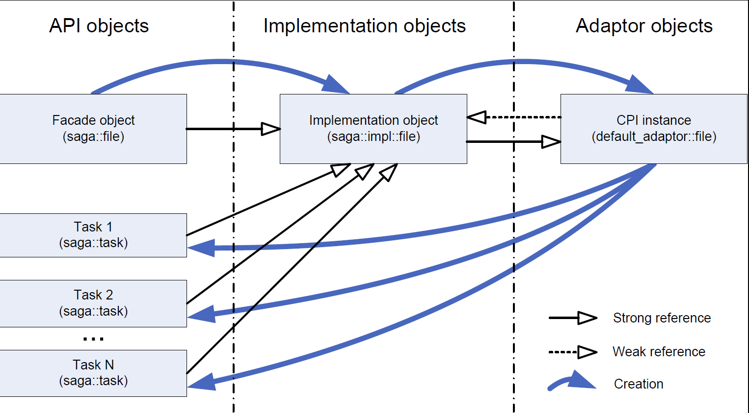
Pimpl paradigm, shared_ptr

Slide 21
Pimpl paradigm, shared_ptr
All SAGA API objects are very lightweight (except saga::url)
Cheap to copy, passed as arguments, or stored in containers
#include <saga/saga.hpp>
void copy(saga::filesystem::file f, saga::url const& target)
{
f.copy(target);
}
int main(int argc, char* argv[])
{
saga::url source("ssh://tc17/etc/passwd");
saga::url target(".");
saga::filesystem::file f(source, saga::filesystem::Read);
copy(f, target);
return 0;
}

Slide 22
Sync/Async API’s
Almost all API objects expose 4 different sets of API functions:
Synchronous
Returns result synchronously
saga::off_t file::get_size();
Task based
Returns handle to deferred result (using a task object)
Asynchronous
saga::task not running yet
saga::task file::get_size<saga::task::Async>();
Task
saga::task already running
saga::task file::get_size<saga::task::Task>();
Synchronous
saga::task guaranteed to be finished
saga::task file::get_size<saga::task::Sync>();

Slide 23
Sync/Async API’s
Synchronous
Asynchronous
saga::url source("ssh://tc17/etc/passwd");
saga::filesystem::file f(source, saga::filesystem::Read);
saga::off_t size = f.get_size();
saga::url source("ssh://tc17/etc/passwd");
saga::filesystem::file f(source, saga::filesystem::Read);
saga::task t = f.get_size<saga::task::ASync>();
t.run();
saga::off_t size = t.get_result<saga::off_t>();

Slide 24
Sync/Async API’s
Asynchronous creation of objects
Factory functions
// create task
saga::task t =
saga::filesystem::file::create<saga::task::ASync>("fileurl");
// ...
saga::filesystem::file f =
t.get_result<saga::filesystem::file>();

Slide 25
Task container
Special container allowing to handle many tasks as one
// create a list of tasks to run jobs
saga::job::service js("somehost");
saga::task_container tc;
for (int i = 0; i < num; ++i)
{
tc.add_task(js.run_job<Task>(execs[i], hosts[i]));
}
// execute tasks
tc.run();
// wait for any of the tasks to finish
std::vector<saga::task> finished =
tc.wait(saga::task_container::Any));

Slide 26
Error Handling
Error handling is currently purely exception based
Also:
try {
saga::filesystem:file f("non-existing file");
// …
}
catch (saga::exception const& e) {
std::cerr << e.what() << std::endl;
}
e.get_error(); // error code
e.get_message(); // top level message
e.get_object(); // get failing API object
e.get_all_exceptions(); // get list of exceptions
e.get_all_messages(); // get list of messages

Slide 27
A Simple SAGA Application
Simple file copy example: copy.cpp
#include <saga/saga.hpp>
int main(int argc, char* argv[])
{
saga::url source("ssh://tc17/etc/passwd");
saga::url target(".");
saga::filesystem::file f(source, saga::filesystem::Read);
f.copy(target);
return 0;
}

Slide 28
Compiling and Linking a SAGA Application
Simple file copy example: Makefile
Use saga-config
Or do it the hard way:
SAGA_SRC = $(wildcard *.cpp)
SAGA_ADD_BIN_OBJ = $(SAGA_SRC:%.cpp=%.o)
SAGA_BIN = copy
include $(SAGA_LOCATION)/share/saga/make/saga.application.mk
g++ -Wall `saga-config --cxxflags` `saga-config --lflags` copy.cpp
g++ -Wall –I$SAGA_LOCATION/include –pthread \
-L$SAGA_LOCATION/lib \
-lsaga_engine –lsaga_package_file copy.cpp

Slide 29
Running a SAGA Application
Make sure that the SAGA libraries can be found by the loader.
Use: /usr/local/saga/share/saga/saga-env.sh
If something goes wrong - use SAGA_VERBOSE:
SAGA_VERBOSE=6 ./copy

Slide 30
Programmers Guide
Set of very small and easy examples, one for each package/paradigm
file_copy, file_copy (async)
Error handling
Attributes
Stream (server/client)

Slide 31
Hands on
Try compiling and running other examples
Urls
Packages: file, job, replica
Modify stream server/client (see next slide)

Slide 32
Hands on
Modify stream_server and stream_client to establish connection using advert service
Server:
Client:
saga::stream::server s("tcp://tc17:<port>");
saga::advert::entry e
("advert://macpro01.cct.lsu.edu/NeSC2009/exercise_3/<uid>“,
saga::advert::CreateParents);
e.store_object(s);
...
saga::advert::entry e
("advert://macpro01.cct.lsu.edu/NeSC2009/exercise_3/<uid>");
saga::stream::server s (e.retrieve_object());
saga::stream::stream c (s.get_url());
...

Slide 33
Example 1: hello_world
Hello world
Launch 3 jobs on different machines
Execute “/bin/echo”
No job dependency
Each job returns its passed input argument
"Hello"
"distributed"
"world!"
Jobs are launched in parallel (in separate threads)
As soon as result is collected it's printed on local console

Slide 34
Example 1: hello_world
Hello world
Arbitrary sequence of results
Optimally: "Hello distributed world!"
Demonstrates
How to launch a remote job using SAGA job_service
Pass arguments using the command line
Collect result by output redirection
The source code can be found here (see ‘Example1’):
http://faust.cct.lsu.edu/trac/saga/wiki/NeSC2009
The example uses localhost to spawn childs
For remote execution change HOST1, HOST2, HOST3 from "localhost" to "[tc11, tc15, tc16, or tc17].nesc.ed.ac.uk"

Slide 35
Hands on
Compile and run example locally
Modify the code to run it remotely
Compile and run example remotely
Run other remote executables
Modify hello_world to produce consistent results
“Hello distributed world!”
…

Slide 36
Example 2: chaining_jobs
Launch 3 jobs on 3 different machines
Output of previous job is needed to launch next job
Simple sequential execution, but SAGA style
Demonstrates
How to launch a job using SAGA job_service
How to feed input to launched job
How to collect output
Launched job: /usr/bin/bc
Increment the number passed as the argument
Pass returned incremented number to next job

Slide 37
Example 2: chaining_jobs
Pass input
Command line (same as before)
Stage in of input files
Using job package API
Using file package API
Input redirection
Using Stream API
Using Advert service
Collect output
Output redirection
Stage out of output files
Using job package API
Using file package API
Using Stream API
Using Advert service

Slide 38
Hands on
Coordinate execution sequence of multiple jobs
3 jobs are running, but wait for a flag in advert service to be set by previous job to continue

Slide 39
Example 3: depending_jobs
Coordinating information from advert service
Launch a single job sequentially on a set of remote resources
Simulating checkpointing/relaunching on different resource (migration)
Maintain a single result value in advert service
Gets written by one job, and read by the next
Demonstrates
How to launch remote job using SAGA job, while maintaining environment
Assembling argument lists
Result is left in advert service, but accessed afterwards

Slide 40
Thanks! Questions?
http://saga.cct.lsu.edu

